Slide 1


UM02 :
Final project
3 Visualizations on GDP expenditures
By Marion JOANNES
2020 - 01 - 10

Slide 2
CONTENTS:
Map of the educational expenditures across the world
Interactive bar chart on the EU governments expenditures
Static visualization of french government expenditures in 2017

Slide 3
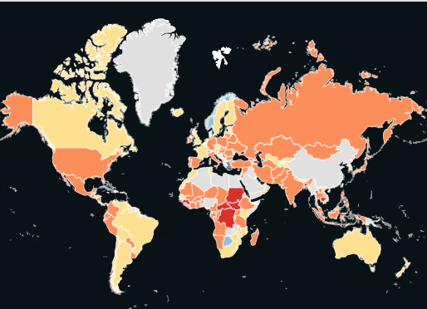
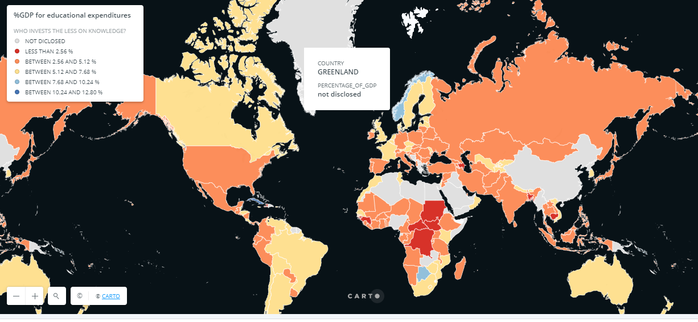
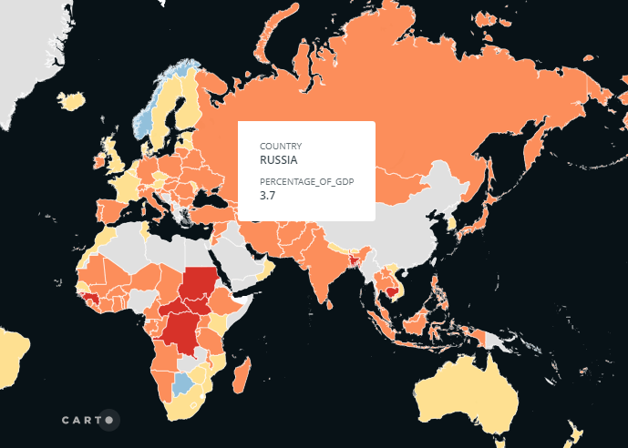
Who spends the less on knowledge?
Percentage of GDP invested in education across the world (2017)
Source: Central Intelligence Agency, CIA (2020). The World FactBook. Consulté sur https://www.cia.gov/library/publications/the-world-factbook/, le 04/01/2020.
Link to the actual visualization: https://mjoannes.carto.com/builder/bc494b0f-f68a-4b75-a057-ee20f169a774/embed

Slide 4
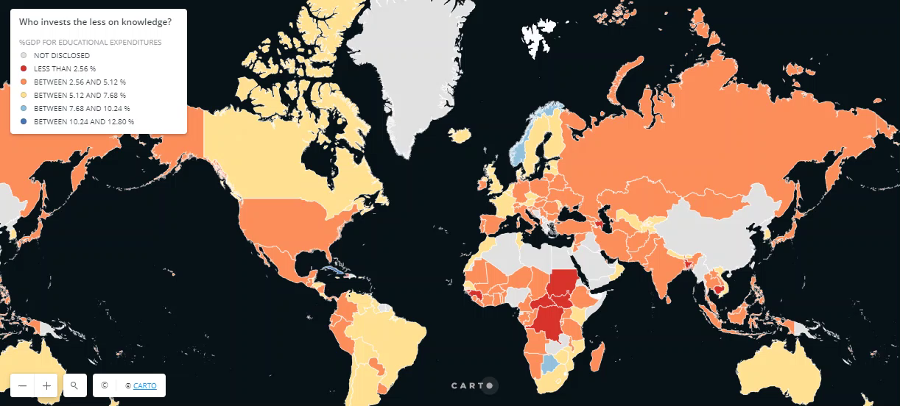

Slide 5
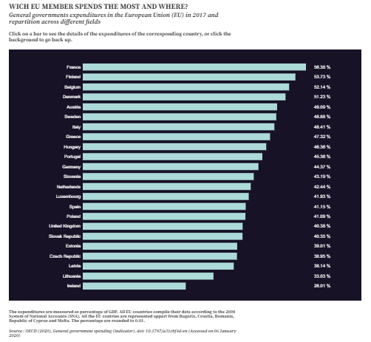
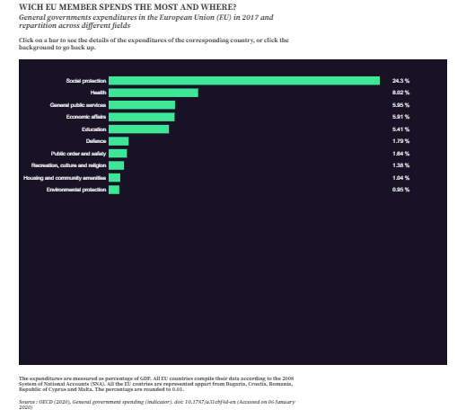
Which EU member spends the most and where?
General governments expenditures in the European Union (EU) in 2017 and repartition across different fields
Source: OECD (2020), General government spending (indicator). doi: 10.1787/a31cbf4d-en (Accessed on 06 January 2020)
Link to the actual visualization: https://observablehq.com/@marionjoannes/untitled

Slide 6
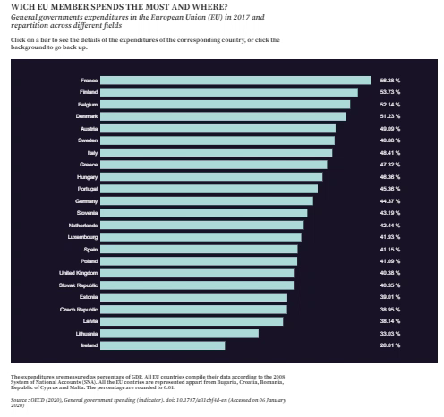

Slide 7


