Slide 1

How to think in Map-Reduce Paradigm
Ayon Sinha
ayonsinha@yahoo.com

Slide 2
Overview
Think Distributed, think super large data
Convert single flow algorithms to MapReduce
Q&A

Slide 3
Think Keys and values
Think about the output first in terms of Key-Value. e.g.
  Dimensions:Metrics (date, webpage, locale: #users, #visits, #abandonment)
  Membership:List of members (cluster centroid representing HackerDojo students: [member1, member2, ….])
  Property:Value (userId: name, location, #transactions, purchase Categories with frequencies )

Slide 4
Thinking in MapReduce contd..
How can the Mapper collect this information for the reducers
How is the value distribution for keys
  Be very careful of the power-law distribution and the “curse of the last reducer”
  Know the appx. maximum number of values for the reducer key
Input data independence

Slide 5
Example of Join in MapReduce
Input
  User-id purchase-info data files
  User-id user-details data files
Output
  User-id : {user details, category purchase with frequencies}

Slide 6
Example contd.
Reducer for one userID
Input to Reducer:
<userdId456>:{D_John Doe, 123 main st,
Home Town, CA
P_Amazon Kindle 3 $139 03/25/2011
P_Cowboy boots, $145, 04/01/2011
P_Aviator Sunglasses $69, 03/31/2011
..
…}
Aggregate and emit from Reducer
<userId123: “D_”+details>
User details Mappers
<userId456: “D_”+details>
<userId459: “D_”+details>
<userId234: “D_”+details>
<userId678: “D_”+details>
<userId991: “D_”+details>
User purchase mappers
<userId991: “P_”+purch-details>
<userId123: “P_”+purch-details>
<userId678: “P_”+purch-details>
<userId234: “P_”+purch-details>
<userId456: “P_”+purch-details>

Slide 7
Ricky's Blog
kmeans(data) {
initial_centroids = pick(k, data)
upload(data)
writeToS3(initial_centroids)
old_centroids = initial_centroids
while (true){
map_reduce()
new_centroids = readFromS3()
if change(new_centroids, old_centroids) < delta {
break
} else {
old_centroids = new_centroids
}
}
result = readFromS3()
return result
}

Slide 8
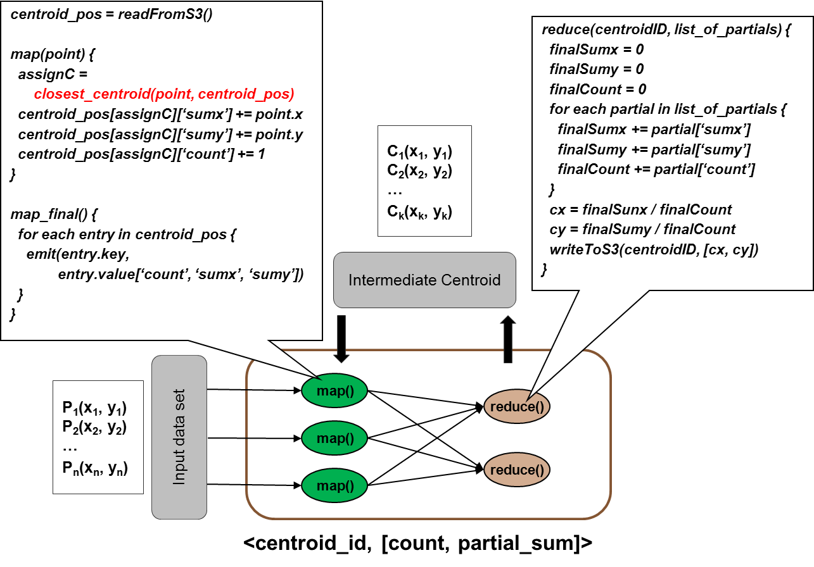
Mapper and Reducer

Slide 9
Distance measures
Euclidean distance
Manhattan distance
Jaccard Similarity
Cosine similarity
Or any other metric that suits your use-case (faster the better)
  Remember there is no such thing as “absolute similarity” in real world. Even identical twins may be dissimilar in some trait that can mark them hugely dissimilar from that perspective. e.g. 2 shirts of the same brand, color and pattern is considered dissimilar by buyer if the size is different, but they are similar for the manufacturer.

Slide 10
K-Means Time complexity
Non-parallel Algorithm
  K* n * O(distance function) * num iterations
Map Reduce version
  K* n * O(distance function) * num iterations * O(M-R)/ s
  O(M-R) = O(K log K * s * (1/p)) where:
  K is the number of clusters
  s is the number of nodes
  p is the ping time between nodes (assuming equal ping times between all nodes in the network)

Slide 11
Recommendations
Do not limit your thinking to one phase of Map-Reduce. There are very few problems in the real world that can be solved by a single MapReduce phase. Think Map-Map-Reduce, Map-Reduce-Reduce, Map-Reduce-Map-Reduce and so on.
Partition and filter your data as early as possible in the flow. “What is the other reason match-making sites ask for preferences before running their massively parallel match algorithms?”
Apply simple algorithms first to large data and slowly increase complexity as needed. Is the added complexity and maintenance costs worth it in a business setting? It has been shown by Brill, Banko in Scaling to Very Very Large Corpora for Natural Language Disambiguation, 2001, that vast amounts of data can help less complex algorthims to perform equal or better than more comlex one with less data.
Remember “The curse of the last reducer”. One cluster will invariably(with real data) have way more points to process than most others.

Slide 12
References
Ricky Ho's blog Pragmatic Programming Techniques
Collective Intelligence by Satnam Alag
Programming Collective Intelligence by Toby Segaran
Algorithms of the Intelligent Web by Marmanis, Babenko
Brill, Banko.( 2001) Scaling to Very Very Large Corpora for Natural Language Disambiguation

