Slide 1


Shape perception via high-channel-count neuroprosthesis in monkey visual cortex
Xing Chen, Feng Wang, Eduardo Fernandez, Pieter R. Roelfsema
Published in Science in 2020
Anaïs Halimi
Marion Pavaux
Notes:
Welcome to our presentation of the paper

Slide 2
INTRODUCTION
Notes:
Introduce the context

Slide 3




Introduction – Team
Pieter R. Roelfsema Team
Alpha and gamma oscillations
2014 - Characterize feedback and feedforward processing in monkey visual cortex
Vision in monkey
1998 - Object-based attention in the primary visual cortex of the macaque monkey
Notes:
Main team in Netherlands that works on the project on the computational part

Slide 4

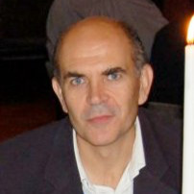
Introduction – Team
Pieter R. Roelfsema Team
Alpha and gamma oscillations
2014 - Characterize feedback and feedforward processing in monkey visual cortex
Vision in monkey
1998 - Object-based attention in the primary visual cortex of the macaque monkey
Eduardo Fernandez Team
Visual prosthesis
2019 - Toward the development of a cortically based visual neuroprosthesis
Notes:
Also in collaboration with researcher in spain, to add a technical contribution

Slide 5
Introduction – Problematic
Are electrical stimulation able to restore functional, life-enhancing vision in the blind (monkey) ?

Slide 6
Overview
Introduction
Method
Experiments
Training
Test
Results
Discussion
Perspectives

Slide 7
Introduction – Objectives
Proof of concept
Create a form of artificial vision with electrical microstimulation
Phosphenes
= perceived dots of light in receptive field of the stimulated neuron
Notes:
Team Pieter R. Roelfsema:
several studies on vision in monkey
Object-based attention in the primary visual cortex of the macaque monkey - 1998

Slide 8
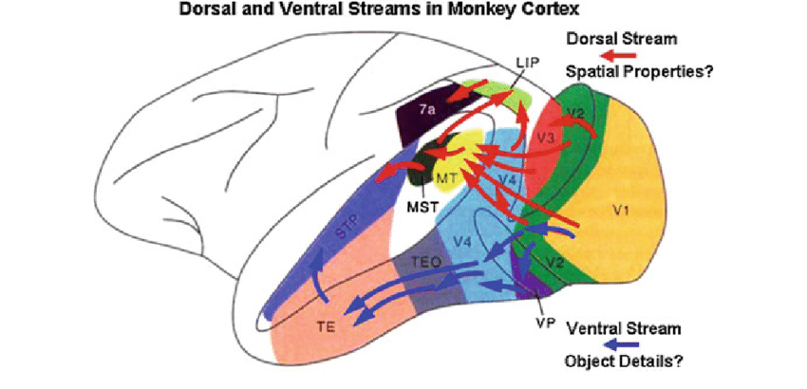

Introduction – Animal model
From Selection of Stimulus Parameters for Visual MEG Studies of Sensation and Cognition - 2012
Monkey L
Monkey A
Notes:
Team Pieter R. Roelfsema:
several studies on vision in monkey
Object-based attention in the primary visual cortex of the macaque monkey - 1998

Slide 9
METHOD

Slide 10
Method – Innovation
1024 channel neuroprosthesis !
Notes:
Use 1024 electrodes to answer this question
Lot compared to other studies

Slide 11
Method – Innovation
1024 channel neuroprosthesis !
Why ?
Notes:
Why ?
Because the more electrodes you have the more accurate is the stimulation and the recording.

Slide 12
Method – Innovation
1024 channel neuroprosthesis !
Allows better resolution…
Invasive electrical stimulation !
Notes:
Invasive electrical stimulation

Slide 13
Method – Innovation
1024 channel neuroprosthesis !
Allows better resolution…
Invasive electrical stimulation !
Why ?
Notes:
Why ?
If injection of the same current per electrode as before, you end up with a surfacic current that is uncomfortable and may be dangerous. Surface mA range
So if you go deeper in the brain you get less isolation layers and you can stimulate with lower currents.
Invasive electrical stimulation is one solution to implement more électrodes in fact.
+ more precise because tinier phosphenes
+ less inference

Slide 14
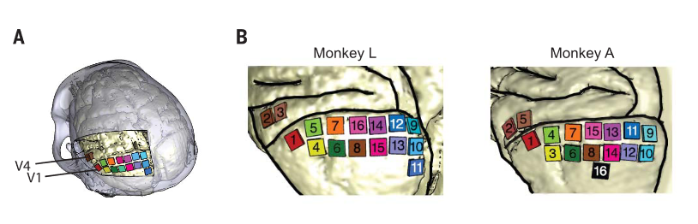
Method – Electrodes implementation
1024 channel neuroprosthesis !
Allows better resolution…
Invasive electrical stimulation !
Lower currents…
V1 : 14 arrays of 64 electrodes
V4 : 2 arrays of 64 electrodes
Fig. 1 : Locations of arrays in areas V1 and V4 in left hemisphere of monkey L. Higher-magnification view of array locations.
Notes:
Here you see where the électrodes have been implented in the visual cortex of both monkeys.

Slide 15
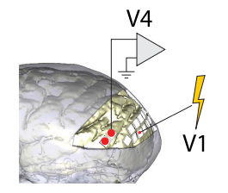
Method – Electrodes implementation
1024 channel neuroprosthesis !
Allows better resolution…
Invasive electrical stimulation !
Lower currents…
Fig. 1: Locations of arrays in areas V1 and V4 in left hemisphere of monkey L. Higher-magnification view of array locations.
Fig. 2: Schematic showing recording from V4 during V1 microstimulation
Notes:
Microstimulation delivered in V1
To know the effect of stimulation in V4, which is meaningful as said anaïs, recording was made through those two electrodes. You will see the results of this recording in the results section.

Slide 16
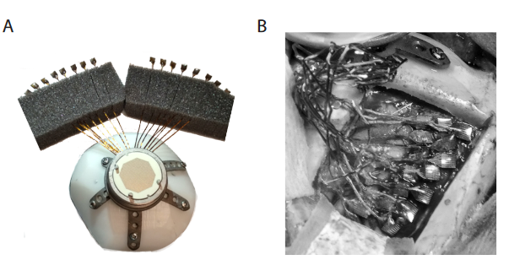
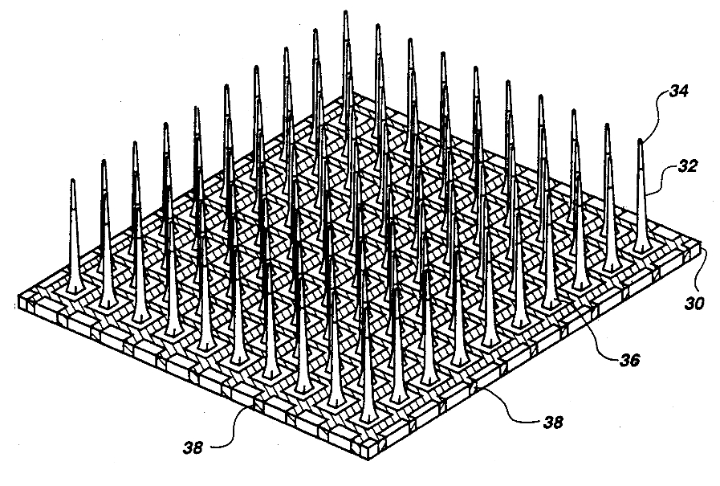
Method – Electrodes Implementation
x 16
Fig. 3: Customized 1024-channel cranial pedestal with 16 Utah arrays and surgery.
Utah Array
Intracortical
Left V1
Notes:
Left Famous Utah array was the one used, 14 V1 and 2 in V2 for a total of 1024 électrodes.
On the right you see pedestrial and électrodes implemented in real brain.

Slide 17
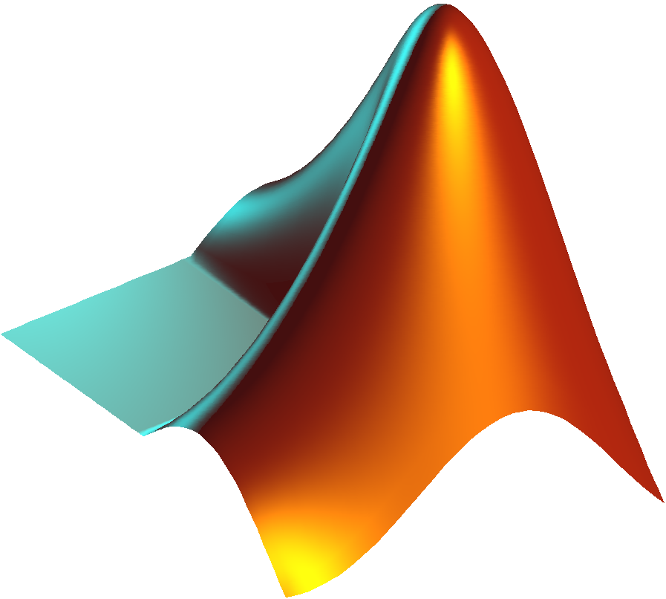
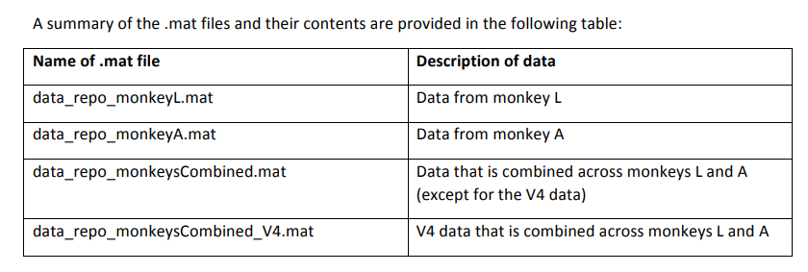
Method – Computation
Fig. 4: Matlab files of the article
Notes:
To process data they used matlab. The data and the code have open access.

Slide 18
EXPERIMENT TRAINING
Notes:
The experiment was composed of three to four tasks
The monkey have been trained for the task before the implementation and tested after the implementation.
So let’s describe the training first.

Slide 19


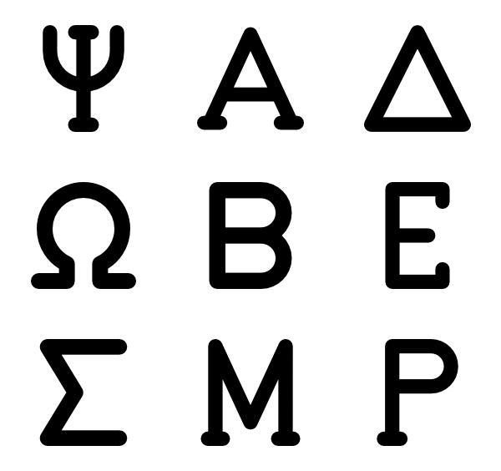

Experiment – Training
Notes:
Monkey A and B were trained at recognizing shapes, direction and movment in front of a screen. They indicated their answer with an eye movement to one corner of the screen and were rewarded for correct answers.
Let me describe the different recognition tasks in more details.

Slide 20
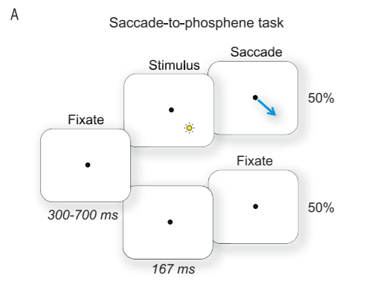
Experiment – Training
Task : To make eye movements to visually presented dots on a computer monitor.
Fig. 5 : The yellow circle represents a phosphene; the arrow represents an eye movement to the artificially induced perception.
Notes:
Each task was composed this way :
The monkey fixated a point during 300 to 700 ms, then the stimuli appears and then they perform an eye movement.
In this task, if the monkey sees something it makes the eye movement toward the phosphene, otherwise stay focus.
So called saccade to phosphene task

Slide 21
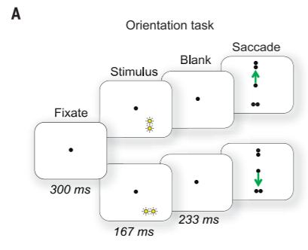
Experiment – Training
Fig. 6 : Two-phosphene orientation discrimination task. The monkey reported with an eye movement whether two phosphenes (or visually presented dots) were oriented horizontally or vertically
Fig. 5 : The yellow circle represents a phosphene; the arrow represents an eye movement to the artificially induced perception.
Task : Report the spatial alignment of two phosphenes.
Notes:
In the orientation task, the monkey has to look up if the stimulus presented a vertical orientation and down for a horizontal stimulus.

Slide 22
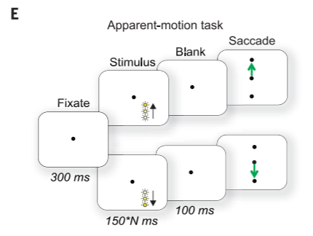
Experiment – Training
Fig. 5: The yellow circle represents a phosphene; the arrow represents an eye movement to the artificially induced perception.
Fig. 6 : Two-phosphene orientation discrimination task. The monkey reported with an eye movement whether two phosphenes (or visually presented dots) were oriented horizontally or vertically
Task : Report the apparent motion direction of a sequence of visually presented dots.
Fig. 7 : Direction of-motion task
Notes:
In apparent-motion task, phosphenes appears sequentially from top to bottom or from bottom to top. The monkey look toward the same direction of the stimulus.

Slide 23
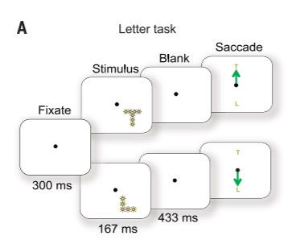
Experiment – Training
Fig. 5: The yellow circle represents a phosphene; the arrow represents an eye movement to the artificially induced perception.
Fig. 6 : Two-phosphene orientation discrimination task. The monkey reported with an eye movement whether two phosphenes (or visually presented dots) were oriented horizontally or vertically
Task : Report the identity of 16 visually presented letters on a screen by making an eye movement to a target.
Fig. 7: Direction of-motion task
Fig. 8: The monkey reported letter identity with an eye movement.
Notes:
The final task, that could be useful to study for implementation in human is the letter task in which this time, the monkey has to indicate which letter it has seen.
Also training after implementation as weel both visual and microstimulation

Slide 24
EXPERIMENT TEST

Slide 25
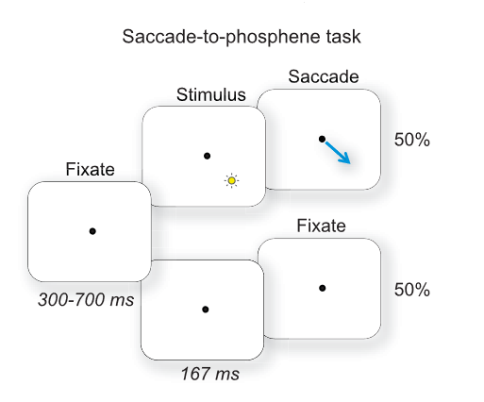
Experiment – Test – Generation of composite visual percepts
Electrical microstimulation on individual V1 electrodes
Fig. 5: The yellow circle represents a phosphene; the arrow represents an eye movement to the artificially induced perception.

Slide 26
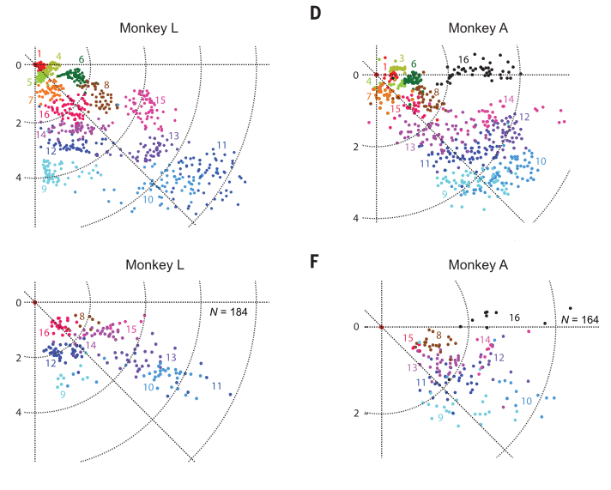
Experiment – Test – Generation of composite visual percepts
Fig. 5: The yellow circle represents a phosphene; the arrow represents an eye movement to the artificially induced perception.
Fig. 9: Receptive fields centers

Slide 27
Experiment – Test – Direction of motion task
Simultaneous stimulation of unfamiliar pairs of electrodes
Fig. 6 : Two-phosphene orientation discrimination task. The monkey reported with an eye movement whether two phosphenes (or visually presented dots) were oriented horizontally or vertically

Slide 28
Experiment – Test – Direction of motion task
Sequential stimulation of three electrodes with a vertical or horizontal offset
Fig. 7: Direction of-motion task
Notes:
For this task they replaced the visual stimulation by the stimulation of three électrodes

Slide 29
Experiment – Test – Letter task
Simultaneous stimulation on 8, 10, or 15 electrodes in V1
Alternance between visual and microstimulation blocks
Fig. 8: The monkey reported letter identity with an eye movement.
Notes:
They used the same number of électrodes at each trial.
Presented unknown letters and known letters from the training

Slide 30
RESULTS

Slide 31
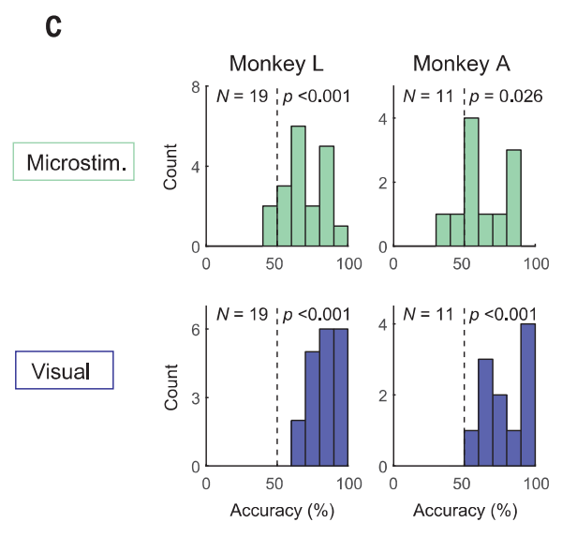
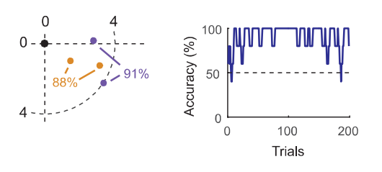

Results – Orientation task
Fig. 10: (Left) RF centers for an example set of four electrodes in monkey A. Black circle, fixation point; orange dots, horizontal condition; purple dots, vertical condition. (Right) Accuracy (averaged across five trials) for this example set.
Fig. 11 : Distribution of accuracies across electrode sets during microstimulation (green) and visual (blue) versions of the task.

Slide 32
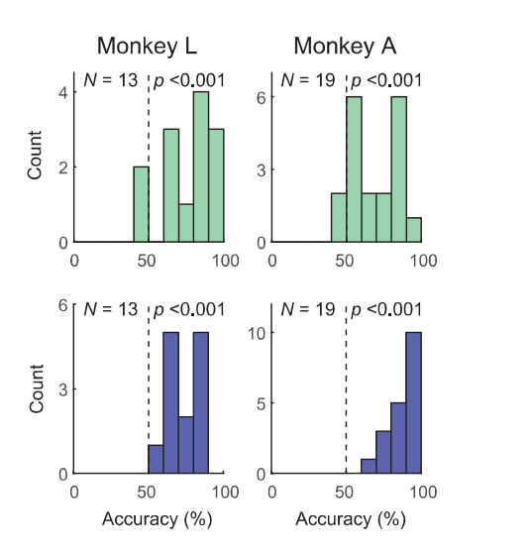
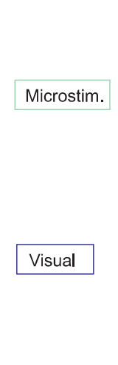
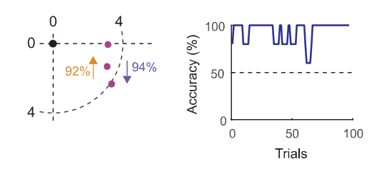
Results – Apparent motion task
Fig. 12 : (Left) RF centers for an example set of three electrodes, stimulated in sequence (indicated by arrows). (Right) Accuracy for this example set.
Fig. 13: Distribution of accuracies across electrode sets during microstimulation (green) and visual (blue) versions of the task.
Notes:
For an example set of three électrodes.

Slide 33
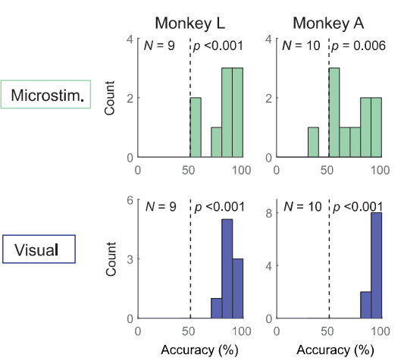
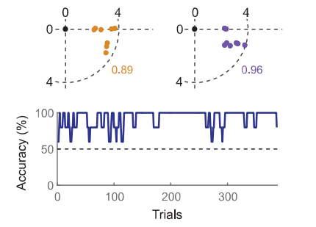
Results – Letter task
Fig. 14: (Top) RF centers of eight stimulated V1 electrodes whose RF centers formed a T or an L (orange and purple circles). (Bottom) Accuracy (smoothed across five trials) for this example set.
Fig. 15 : Accuracy for sessions on microstimulation (green) and visual (blue) versions of the task.

Slide 34
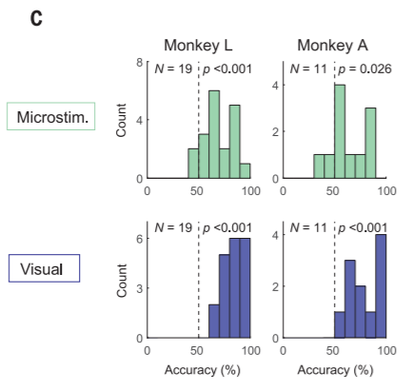
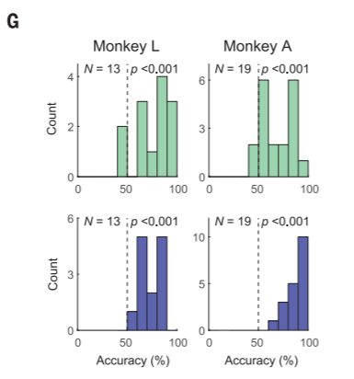
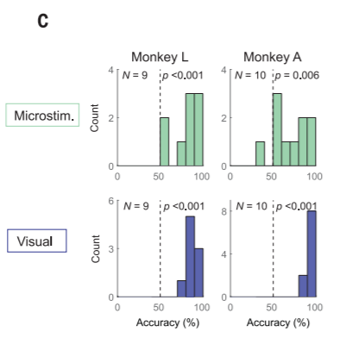
Results – Conclusion
Accuracy is significatively above 50%
Proof of concept validated
Accuracy variance is however higher during microstimulation than during visual stimulation
Fig. 11 : Distribution of accuracies across electrode sets during microstimulation (green) and visual (blue) versions of the task.
Fig. 13: Distribution of accuracies across electrode sets during microstimulation (green) and visual (blue) versions of the task.
Fig. 15: Accuracy for sessions on microstimulation (green) and visual (blue) versions of the task.
Notes:
In avarage accuracy is on the right side of the graph which means the monkeys were not going with chance.
Validate the fact intra visual stimulation allows recognition of direction, motion and complex forms by the user.
Now saying that the variance is higher for microstimulation which says, what we could have guess, that there is higher probability for the monkey to reach a lower accuracy for the task.
Another results I mentioned is they succeed in showing we can use V4 to callibrate current thresholds in V1, which saves lot of time

Slide 35
DISCUSSION

Slide 36
What about accuracy ?
Could the monkey get used to the task ?
What about associating electrical percepts with right answers ?

Slide 37
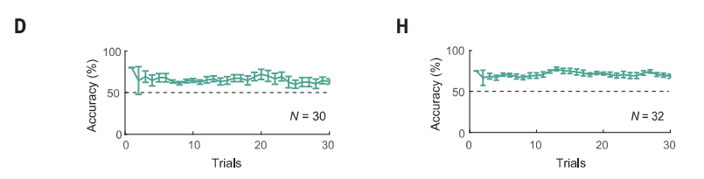
What about accuracy ?
Fig. 16: Distribution of accuracies across electrode sets during microstimulation (green) and visual (blue) versions of the task.

Slide 38
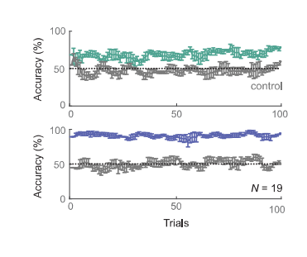
What about accuracy ?
Fig. 16: Distribution of accuracies across electrode sets during microstimulation (green) and visual (blue) versions of the task.
Fig. 17 : Mean accuracy across electrode sets and monkeys, as a function of trial number (average and SEM across five trials) in the microstimulation (green) and visual (blue) versions of the task. In a control task with novel electrical stimulation and visually presented dot patterns, the accuracy was close to chance (gray).

Slide 39

To be continued...
A
L
Strong difference ask for more individuals to improve the analysis
Notes:
You may have noticed that results are very different between monkeys.
It could be due to the implementation of the électrodes, not exactly in the same place. Also one monkey may learn faster the task or be more motivated to get reward.
Or simply the neuronal circuits, biology is different for both animals.
It would be very welcome to conduct experiments on much more monkeys.

Slide 40
To be continued...
A
L
Strong difference ask for more individuals to improve the analysis
Use of machine Learning to calibrate the currents in V1 and V4
Notes:
V1 callibration used to predict V4 callibration is really good. But maybe with more data and individuals we could make use of ML techniques to predict directly a good callibration of the électrodes.

Slide 41
To be continued...
A
L
Strong difference ask for more individuals to improve the analysis
Use of machine Learning to calibrate the currents in V1 and V4
Implementation in human brain
Notes:
Then when we get to this point it would be nice to see it implemented in humans !

Slide 42

To be continued...
A
L
Strong difference ask for more individuals to improve the analysis
Use of machine Learning to calibrate the currents in V1 and V4
Implementation in human brain
Biocompatible
Surface area
Wireless
Notes:
With requirements that the device stays discrete so wireless, biocompatabible, and that the device fits the brain surface area of humans.

Slide 43
Thank you for your attention !
Notes:
Any questions :
Why both visual and micro stimulation for letter task ?
Why is it a BMI ?
Will you say it is a closed loop experiment ? Brain machine interface ?

Slide 44
Bibliography
Fernández, E., Pelayo, F., Romero, S., Bongard, M., Marin, C., Alfaro, A., and Merabet, L. (2005). Development of a cortical visual neuroprosthesis for the blind: the relevance of neuroplasticity. J Neural Eng 2, R1-12.
Aine, C.J., Supek, S., Sanfratello, L., and Stephen, J.M. (2019). Selection of Stimulus Parameters for Visual MEG Studies of Sensation and Cognition. In Magnetoencephalography : From Signals to Dynamic Cortical Networks, S. Supek, and C.J. Aine, eds. (Cham: Springer International Publishing), pp. 997–1031.- 2012
Piedade, M., Gerald, J., Sousa, L., Tavares, G., and Tomás, P. (2006). Visual neuroprosthesis: A non invasive system for stimulating the cortex. Circuits and Systems I: Regular Papers, IEEE Transactions On 52, 2648–2662.

Slide 45
Overview
Introduction
Methods
Experiments
Training
Test
Results
Conclusion
Perspectives

Slide 46
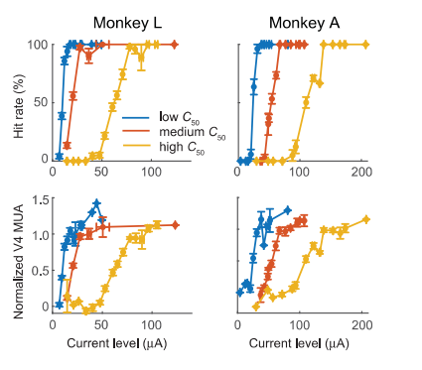
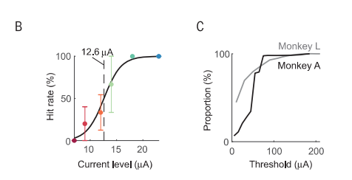
Appendices
Fig. 8: . (B) Probability of eliciting a saccade, as a function of current amplitude, during stimulation on an example V1 electrode in monkey L. The dashed line indicates the current threshold; error bars represent SEM. (C) Cumulative distribution of current thresholds.
Fig. 8: Mean performance (top) and mean V4 response (bottom) as a function of current amplitude for V1 electrodes with low (blue), intermediate (red), and high thresholds (yellow; tertiles). Vertical error bars represent SEM of performance levels (upper) or V4 responses (lower); horizontal error bars represent SEM of current levels.

Slide 47
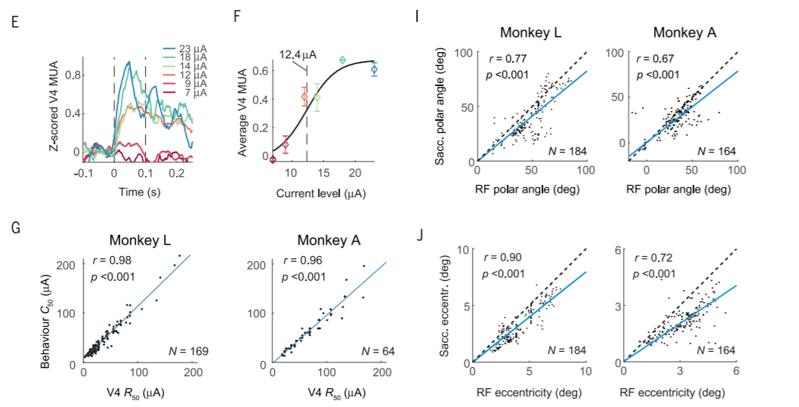
Appendices
Fig. 8: (E) Time course of activity (relative to stimulation onset), averaged across V4 channels during V1 microstimulation [same session as in (B)]. The dashed lines indicate the time window during which V4 activity was measured. (F) V4 activity as a function of stimulation current [same session as in (B) and (E)]. The dashed line indicates the current threshold; error bars represent SEM. (G) Correlation between current thresholds derived from neurometric (R50) and psychometric functions (C50). (I and J) Comparison of polar angle (I) and eccentricity (J) between RFs and saccadic end points. The blue line shows a linear regression, which was constrained to pass through the origin.

