Slide 1
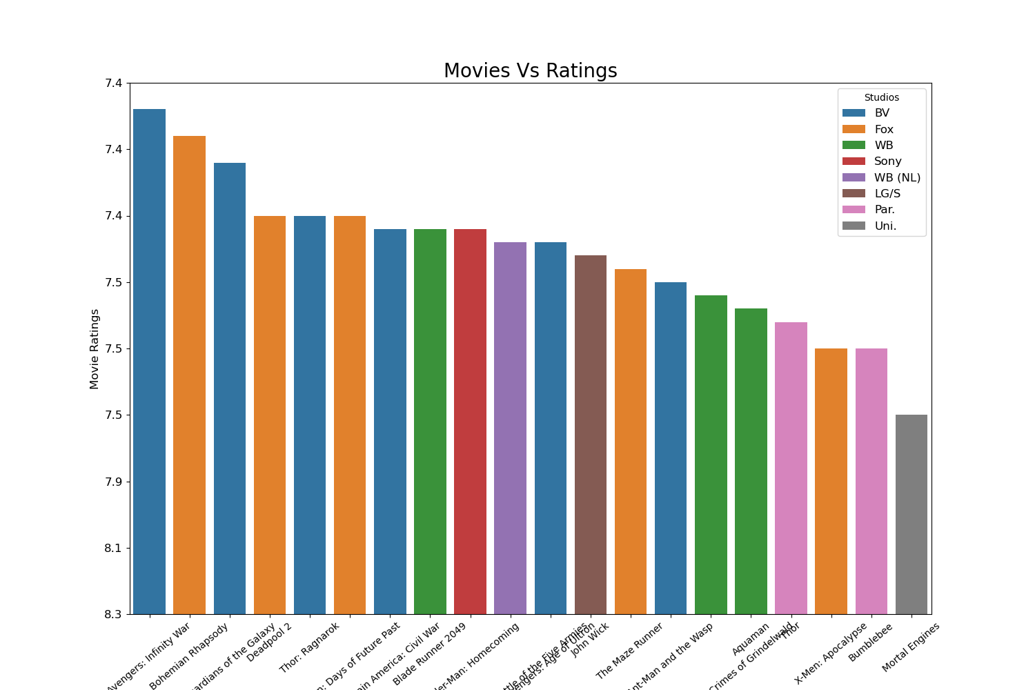
Report
The bar plot in the graph shows the performance of films from various studios.
the graph lets viewers evaluate the caliber of films released by various studios by giving a visual depiction of how movie ratings fluctuate throughout studios.
Moreover, the graph indicates that “Avengers: Infinity Wars” has the greatest scores, indicating that its caliber is exceptional.

Slide 2
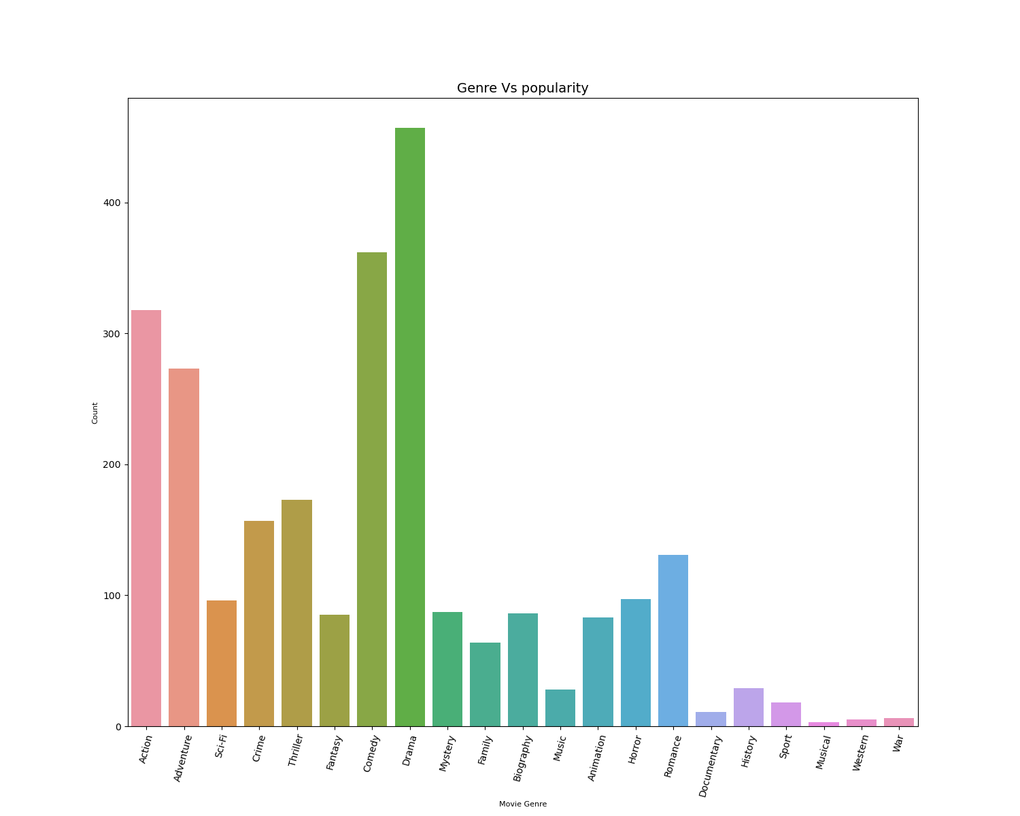
Genre vs popularity
Explanations
The bar plot in the graph above illustrates the relative popularity of several film genres.
All things considered, this graph offers a visual depiction of the popularity distribution across various film genres, with drama clearly emerging as the most popular genre.

Slide 3
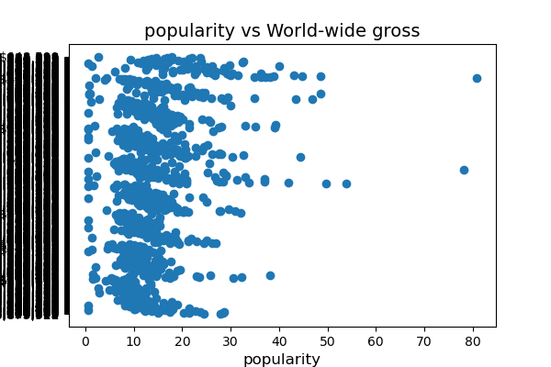
Popularity vs worldwide gross
Graph
Explanation
The tight cluster formed by the data points suggests that the majority of the films in the dataset have comparable levels of popularity and revenue. This suggests that some elements—genre, release window, or promotional tactics, for example—have a recurring effect on the box office and public perception of various films.
A few of our films are outliers, meaning that their popularity is abnormally high or low in relation to their earnings.
In general, scatter plot with focused data points indicates a strong correlation between the global gross revenue of a film and its popularity, suggesting that successful films typically have a higher global profile.

Slide 4
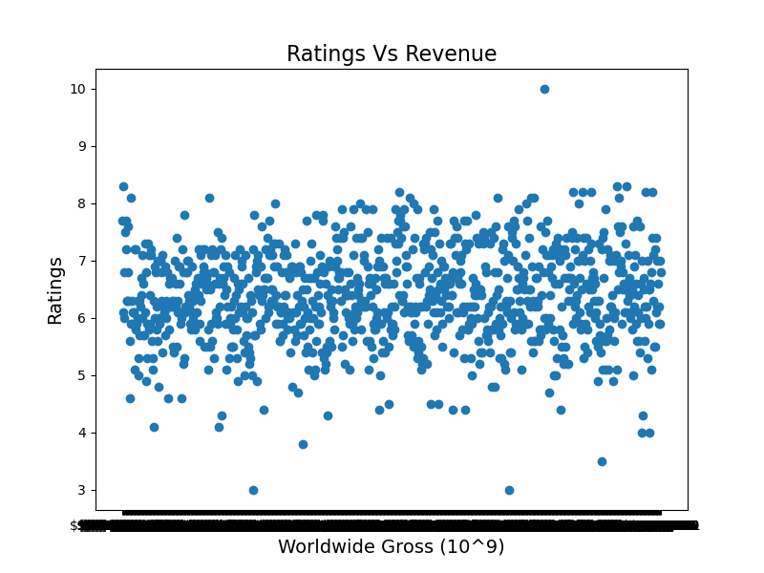
Ratings Vs Revenue
Graph
Explanation
In this instance, the scatter plot shows how movie revenue and ratings relate to one another. The ratings for each film are shown on this axis, and they usually indicate how well-received the film was by critics and viewers.
Higher scores signify a more positive opinion of the film's calibre. The income each movie brought in is displayed on the vertical axis. The movie's revenue, which is usually expressed in terms of ticket sales or box office receipts, indicates its financial success. The scatter plot's wide distribution indicates that there may be variation in the dataset's revenue and movie ratings. Included are films with a broad spectrum of reviews and box office performance.
The intricacy of the scatter plot indicates a complex relationship between revenue and ratings. larger-rated films may generally be associated with larger box office receipts, although this relationship is probably influenced by other factors as well. These variables may include audience demographics, release schedule, genre, and marketing tactics. Overall, the widely dispersed but highly concentrated scatter plot suggests that there are more elements at play than just critical acclaim when it comes to a film's financial success, pointing to a complex relationship between movie ratings and income.

Slide 5
Recommendation
With the most ratings, "Avengers" stood out in this instance, demonstrating Microsoft's commitment on high-quality content. This indicates that it was of extraordinary quality. In order to emulate this, they should focus on creating content of the same caliber as the Avengers. They should also tell gripping stories that captivate their audience and use excellent production values to make films that stand out from the crowd and win praise from critics and audiences.
Capitalize on Popular Genres - Drama is shown on the graph as the most popular genre, indicating a significant audience preference. Use this knowledge to your advantage by creating content that fits well-liked categories like drama. Thus, they ought to devote money to producing engrossing plays that pique viewers' interest and boost ticket sales. They can increase their chances of becoming financially successful and attracting an audience by appealing to popular genres.
Strategic Investment in Popularity - A scatter plot including concentrated data points shows that there is a direct correlation between the global gross revenue of a movie and its popularity. Investing in ventures with a high potential for popularity can maximize your financial success. To find new trends, audience inclinations, and possible blockbuster ideas, conduct market research. Strategic resource allocation to projects with the highest potential for success can help you achieve large financial returns and international recognition.

