Slide 1

Dynamic loading of plugins in Rust in the absence of a stable Application Binary Interface
TODO: some text is too small, or should just be removed
Author: Mario Ortiz Manero
Supervisor: Javier Fabra Caro

Slide 2




What’s Tremor?
“An early-stage event processing system for unstructured data with rich support for structural pattern-matching, filtering and transformation.”

Slide 3
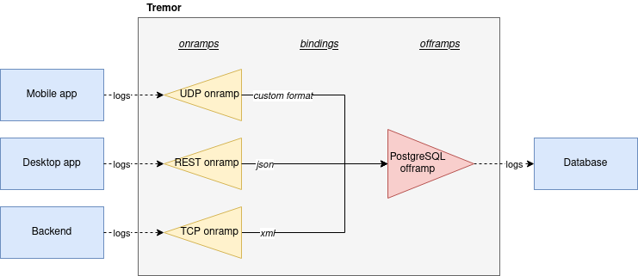
What’s Tremor?
Typical example:
Collecting and transforming logs from different applications into a single database

Slide 4
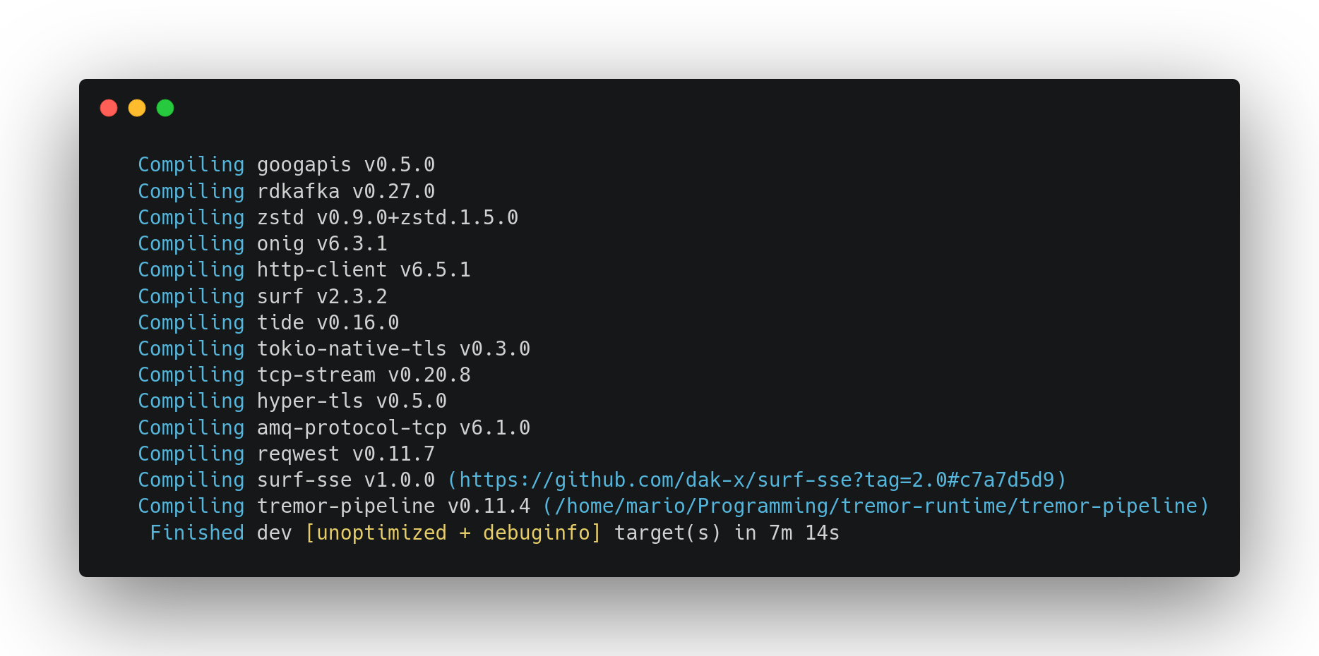
Why a Plugin System?
61% of Rust users suffer from similar issues

Slide 5

Why a Plugin System?
Discord connector
Spotify connector
YAML codec
base64 postprocessor

Slide 6


Why a Plugin System?

Slide 7



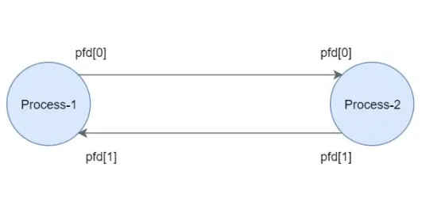
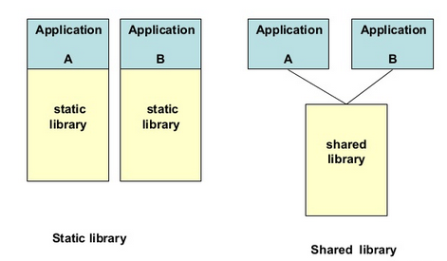

How to implement a Plugin System?
Many approaches:
Scripting languages
WebAssembly
Inter-Process Communication
Dynamic loading
The only one performant enough for Tremor is “dynamic loading”

Slide 8
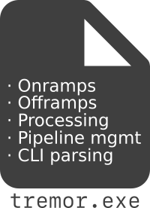
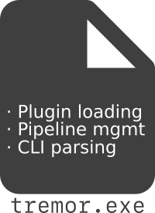


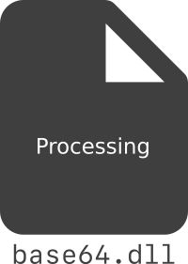
How to implement a Plugin System?
Dynamic loading works at the binary level: the executable is split up into a runtime and loadable libraries with the functionality
The runtime can load these libraries into its memory, and call the functions that they export

Slide 9

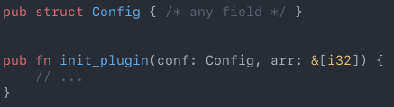
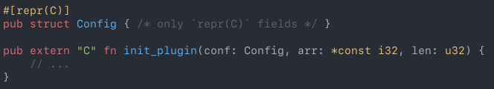
How to implement a Plugin System?
…but dynamic loading isn’t even possible with plain Rust
Basically, we need to write C with Rust for the interface
A plugin in an ideal world
A plugin in the real, dream-shattering world

Slide 10
Questions?

