Slide 1
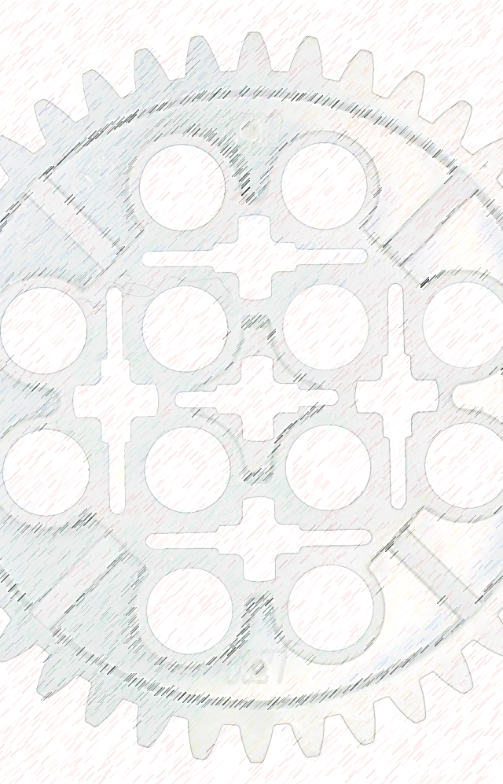
Building Tomorrow’s Robots Today
The STEAMpunks
Team 476
Est. 2014

Slide 2
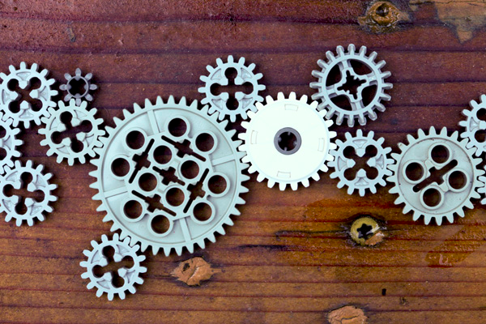
The STEAMpunks
The STEAMpunks

