Slide 1
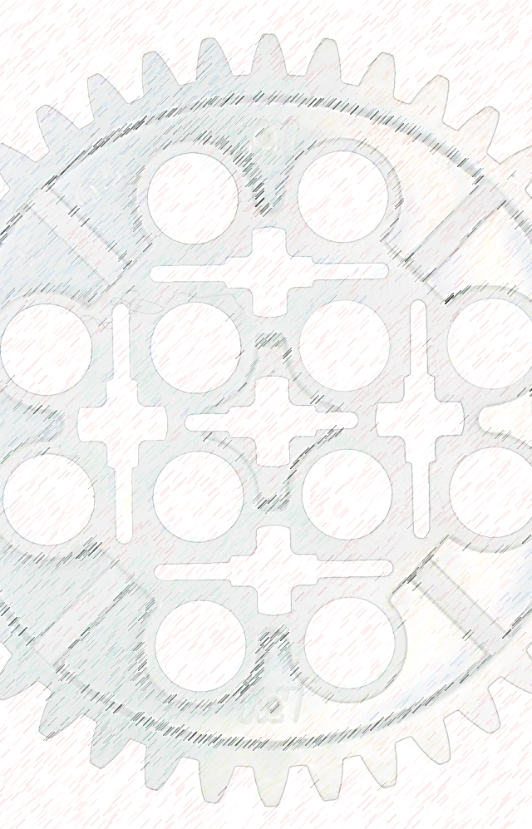
Building Tomorrow’s Robots Since 2014
The STEAMpunks

Slide 2
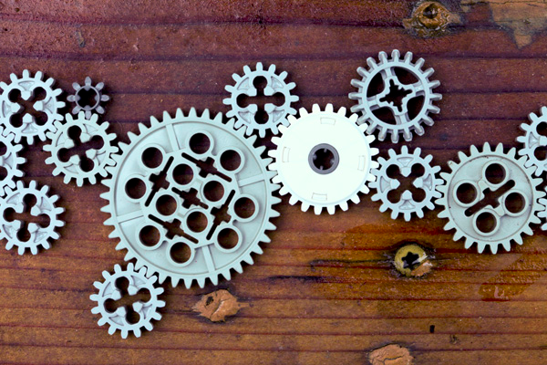
The STEAMpunks
The STEAMpunks

