Slide 1
Benchmark Dotnet
Introduction to Benchmarking

Slide 2
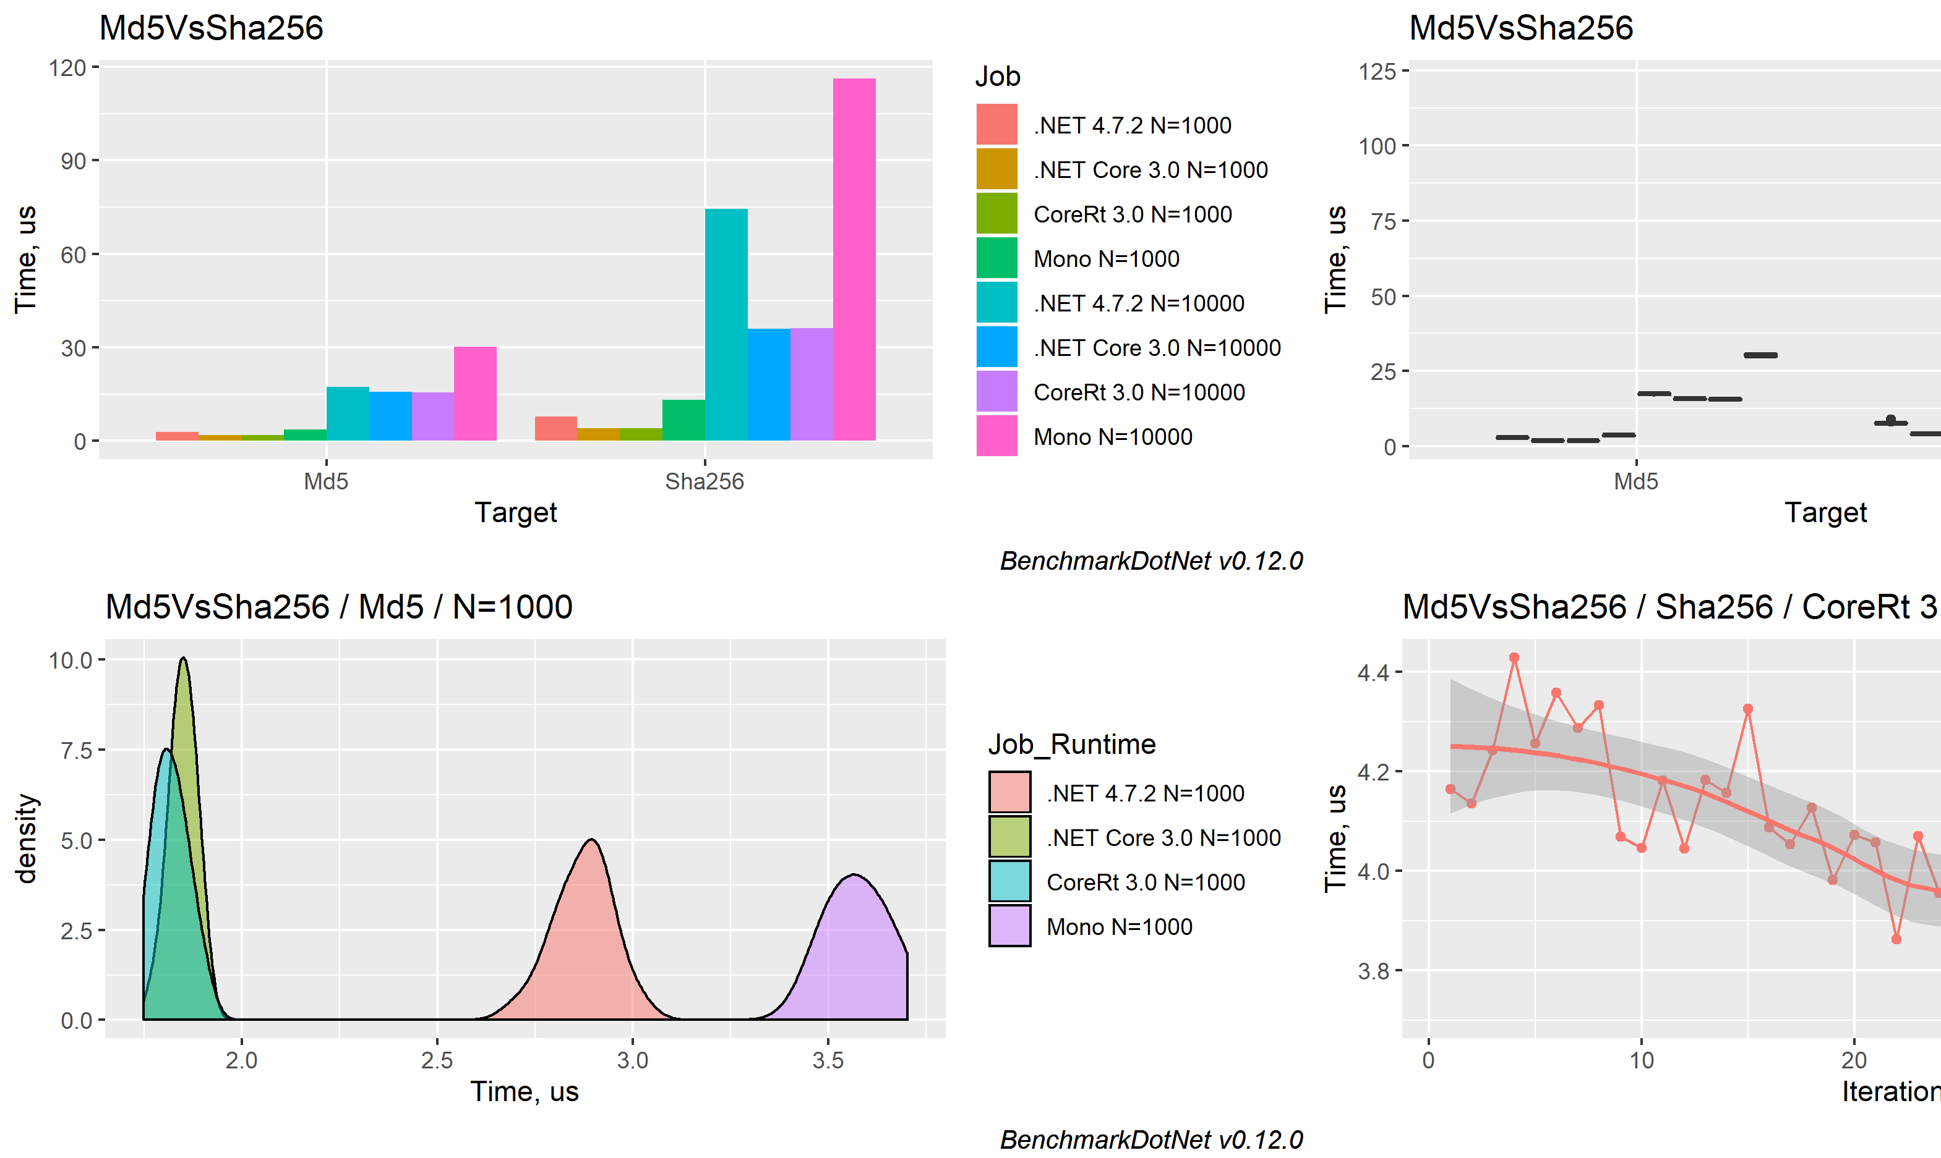
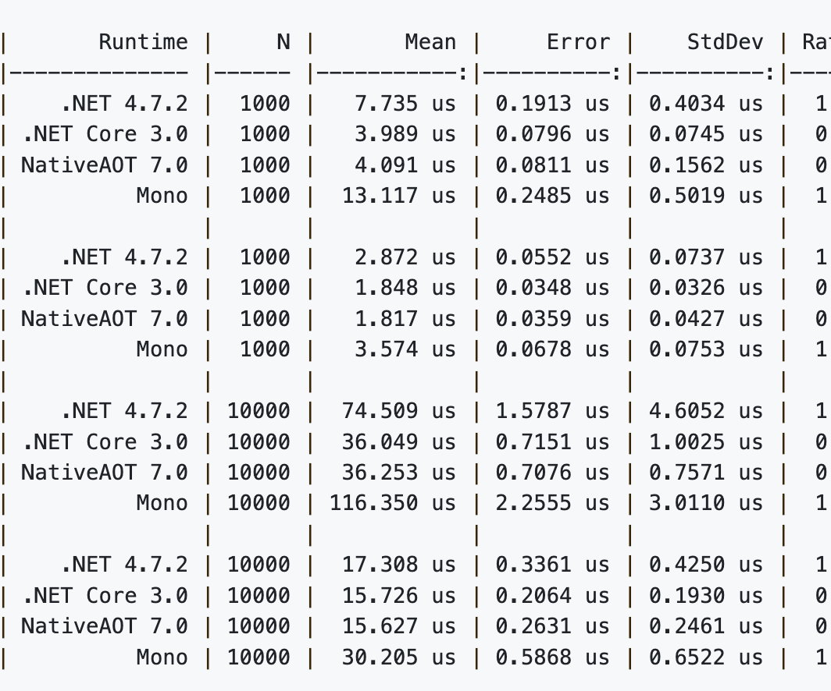
BenchmarkDotNet Intro
Repo: https://github.com/dotnet/BenchmarkDotNet
What is it
BenchmarkDotNet helps you to transform methods into benchmarks, track their performance, and share reproducible measurement experiments.
It’s just as simple as writing unit tests!
Produces user friendly results that can also be exported as charts.

Slide 3
Why should we write benchmarks?
Code refactoring. Is the code I am editing improving or degrading?
Identifying Performance bottlenecks and areas the need reworking.

Slide 4
Getting Started
What do we need? 1. The project we would like to check the performance. 2. Create a Benchmark DotNet console app.

Slide 5
Getting Started
Installing the BenchmarkDotNet template:
dotnet new -i BenchmarkDotNet.Templates
Creating a new benchmark project In our directory, type:
dotnet new benchmark --console-app

Slide 6
Demo
Empty Solution

Slide 7
Accuracy
It is incredibly accurate It’s giving us results with a precision of about a tenth of a nanosecond, measuring to the level of individual CPU cycles! (it runs the benchmark billions of times when necessary, and has lots of clever tricks to remove the benchmark framework overhead)
In fact, it gives warnings if we are doing something wrong

Slide 8

What a benchmark is not?
Benchmark is not telling us how fast a method is. That depends on the machine it runs
So how are benchmarks useful? (answer later)

Slide 9
Demo
Variables in loops

Slide 10

Results Explanation
Memory diagnose will add more to the results !
Mean: The average time it takes (microseconds)
GC0 GC1: Variables that survived the first GC. How many times garbage collector run for 1k operations

Slide 11
Results Explanation
GC Gen 0
GC Gen 1
GC algorithm will run on Gen 0; Everything that is not needed is going to be purged;
Everything that is needed is going to survive another Generation (Gen 1)
GC is expensive! We should not force it to run, we should let it do it’s thing.

Slide 12
Back to the question: How are benchmarks useful?
I have a first run
I have an alternative solution
I can see an improvement
On another machine probably I won’t see the same numbers, BUT I will see a similar improvement ratio.

Slide 13
Demo
Other tests. String Concatenation Populated result folder.

