Slide 1
Waste Management – Citizens Engagement
Fragiskos Fourlas (1059336)
Marios Stamatopoulos (1059383)
Nikos Panagiotopoulos (1053552)

Slide 2
Intended Implementations
Monitor bin status
Optimal path for truck
Predict bin fullness
Generate analytics
Points-rewards system

Slide 3
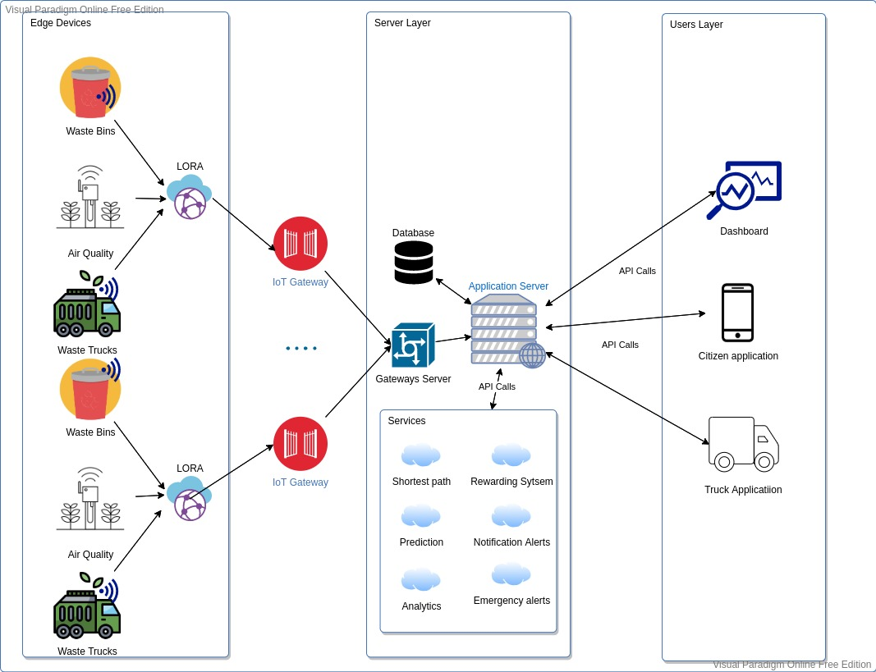

Slide 6
Workload Allocation
Prediction, Reward System, Gateways/Devices
Optimal Route, Server Structure, Alerts, Database
Frontend Design and Structure, Data Analysis

Slide 7
THANK YOU

