Slide 1

SafeSchool
A multi-agent AI system for detecting safety violations and child abuse in schools
Medet Akhmetov · Artificial Intelligence and Machine Learning · project defence
github.com/marioscordia/multi-agent
Notes:
SafeSchool takes school surveillance footage and decides, with a stated reason, whether it shows a safety violation. It then blurs every face and alerts the right person. It is the practical part of my master's thesis on computer vision for detecting violence and child abuse in schools.

Slide 2
Schools record everything and watch almost nothing
A literature review of 50 papers (2022–2026) found three gaps this system is built to close.
2 / 50
Adults
Accuracy
papers mention privacy
in almost every benchmark
reported, false alarms not
Our answer: One agent owns face redaction and is the only one that touches images
Our answer: A depth-aware body-size check for the adult-on-child case
Our answer: An independent verifier states a false-alarm risk on every decision
Notes:
The review of 50 recent papers found that privacy is almost never discussed, that benchmarks use adults in non-school settings, and that papers report accuracy but not false-alarm behaviour. Each gap maps to a design decision.

Slide 3


Why a team of agents, not one
Independent verification
One privacy boundary
An agent that reviews its own conclusion inherits the assumption that produced the error. The Verifier sees only the evidence, has no stake in the verdict, and is the only agent that can send a case back.
Exactly one agent opens images and exactly one sends anything out. The privacy guarantee can be audited in one place.
The other splits follow failure modes: a missed person (perception) must be told apart from a wrong interpretation (reasoning), and decoding must stay reproducible.
Notes:
These two properties are structural: they disappear the moment the agents are merged. They are the core argument for a multi-agent design here, not efficiency.

Slide 4
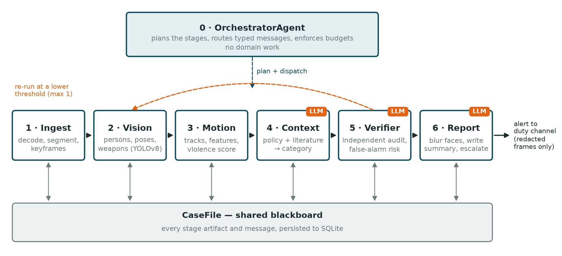
Pipeline + orchestrator + shared blackboard
Pipeline — real data dependency. Orchestrator — owns budgets and the one re-run. Blackboard — the Verifier audits the whole chain.
Notes:
Stages depend on each other, so a pipeline. One agent must own budgets and the single control decision, so an orchestrator. The Verifier needs every earlier artifact, so a shared CaseFile stored in SQLite. Hierarchy is not used: six linear stages gain nothing from a tree. The re-run loop goes back to vision at most once.

Slide 5
Seven agents, one role each, at most five tools
0
1
2
3
Orchestrator
Ingest
VisionDetector
MotionAnalyst
Plans, routes, enforces budgets. No domain work.
Decodes video, cuts clips, extracts keyframes.
Persons, poses, weapons with local YOLOv8.
Tracks people, computes features and a score.
4
LLM
5
LLM
6
LLM
3 of 7 use Claude
where judgement or language is needed. The rest do exact, reproducible work.
Context
Verifier
PrivacyReport
Interprets motion against policy and literature.
Audits the chain: accept, reject or re-run.
Blurs faces, writes the staff summary, alerts.
Notes:
Each agent declares its role, input and output types, tools and completion criterion in code; safeschool agents prints the table. The five-tool limit is enforced when the class is defined. Three agents call Claude: Context classifies, Verifier audits, PrivacyReport writes the staff summary. The orchestrator makes no tool or LLM calls at all.

Slide 6




Typed messages, one shared state
Typed and strict
Pydantic models with extra="forbid": a wrong field fails at the hand-off, not three stages later.
Control apart from data
A re-run threshold travels on the envelope, never inside the incident payload.
Explicit state
A CaseFile blackboard, saved to SQLite after every stage.
One loop, bounded
The Verifier may send a case back once; then it must decide.
Notes:
Detections are twenty times larger than anything else because they carry every box and keypoint. The motion agent collapses 10 KB of geometry into a 0.7 KB assessment, so the language-model agents only ever see small summaries and never images. An early bug put the re-run threshold inside the payload; the strict schema rejected it, which is why control data now rides on the envelope.

Slide 7







Reliability and safety built into the runtime
Step and time budget
Loop guard
Bounded re-run
Retries
40 steps and 300 s per case
same input 3 times aborts
at most one, then decide
3 attempts with backoff
Strict model output
Refusal fallback
Full call log
Secrets and privacy
JSON schema; categories limited
fallback model, then policy rule
every agent, tool, LLM call
key in .env; faces blurred first
Notes:
All of this lives in the shared runtime, so no agent can forget it. Logging is done by the runtime rather than the agents, which is what makes the load numbers trustworthy. Each mechanism has unit tests: 50 in total.

Slide 8
10 of 10 scenarios pass with the real model
10/10
Scenario | Expected | Result
Corridor walking (real) | no alert | no violation · log
Crowded aisle (real) | no alert | no violation · log
Single person (real) | no interaction | no violation · log
Empty scene | no alert | no violation · log
Corrupt / missing file | clean failure | stated reason
One-sided fight | violence alert | physical violence · admin
Knife held in a hand | emergency | weapon threat · emergency
Adult dragging a child | safeguarding | adult-on-child · emergency
Mutual rough play | no violence alert | low concern · log
scenarios, Claude
10/10
scenarios, offline mock
50
unit tests pass
Notes:
Ten scenarios with stated expectations; corrupt and missing file are shown in one row. The four real-footage cases matter most: the right answer is silence, and a system that cannot stay quiet is not deployable in a school. The violent cases use synthetic detections because the benchmarks cannot be redistributed; every such run is labelled as test data.

Slide 9
No agent carries more than a quarter of the work
23.3%
busiest agent (MotionAnalyst)
40%
limit in the specification
0%
orchestrator: plans, routes, nothing else
Notes:
Measured from the logs of the real-model run with tools/load_report.py. The 40% limit would sit at 105 calls. It was not automatic: an early version ran YOLO per frame and put the vision agent at 77%. Batching per clip and moving tracking to the motion agent fixed it, so the role boundary and the load balance were the same decision.

Slide 10
The real model caught what the mock missed
10/10
7/10
10/10
mock model
real Claude
after the fix
fixed rules agreed with weak test data
called the synthetic fight 'play': it moved slower than walking
data calibrated to real footage, evidence summary added
Limits: heuristic scorer, synthetic violent cases, 11–18 s per case.
Next: a temporal classifier trained on child-specific data, licensed real footage, parallel reasoning agents.
Code: github.com/marioscordia/multi-agent
Notes:
The most instructive result: in mock mode everything passed, but the real model rejected the violent test cases, and its reasoning showed why: the fake fight moved slower than people walking. The model was right; the data was wrong. Lesson: a deterministic mock checks the plumbing, not the judgement. Thank you, I am happy to take questions.

