Slide 1
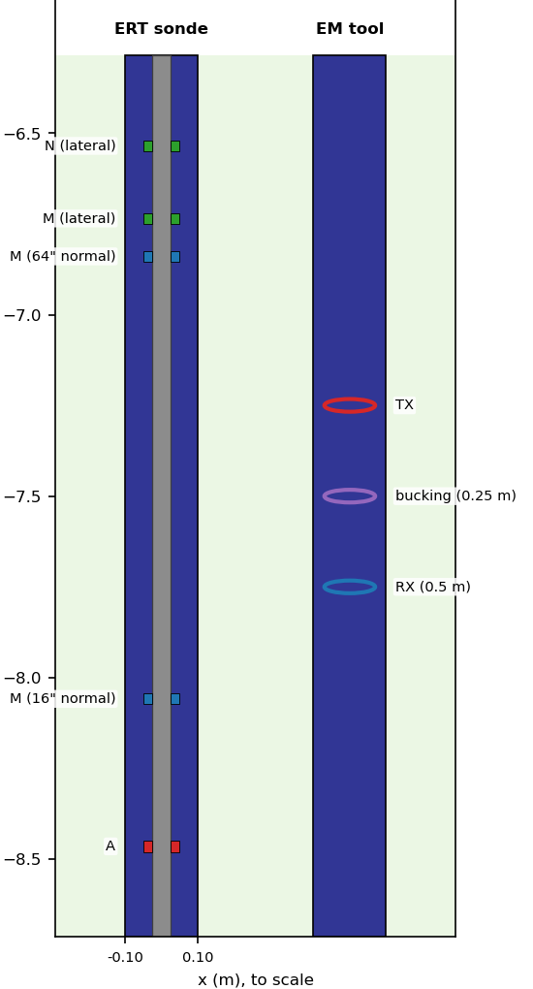



How much of a borehole log is the backfill?
PyBorehole: 3D simulation of resistivity (ERT), induction (EM) and natural gamma-ray tools in backfilled boreholes
A joint effort of
Aristotle University
of Thessaloniki
github.com/mariosgeo/PyBorehole · pip install pyborehole
Notes:
WHAT TO SAY
This talk is about one practical question: when we log a backfilled borehole, how much of what the tool reads comes from the backfill around it, and how much from the formation we actually want to measure?
PyBorehole is a joint effort of Metinco, Deltares and the Aristotle University of Thessaloniki. It simulates three logging methods in 3D: DC resistivity (ERT), electromagnetic induction (EM) and natural gamma ray. Each tool is simulated twice, with the real borehole and with the hole filled with formation; the ratio of the two is the borehole effect.
THE PICTURE
The panel on the right is drawn to scale: a 0.2 m backfilled hole with, on the left, an ERT sonde (grey 50 mm insulating body, ring electrodes A, M and the lateral M and N), and on the right an EM tool (transmitter, bucking coil and receiver). It shows how little room there is between tool and formation, and why the backfill matters.
PRACTICAL
The code is open source (github.com/mariosgeo/PyBorehole) and installs with pip install pyborehole.
LIKELY QUESTION
"Is this inversion or forward modelling?" Forward modelling: we predict what a tool reads for a known model. That is exactly what is needed to design surveys and to correct logs for the borehole.

Slide 2

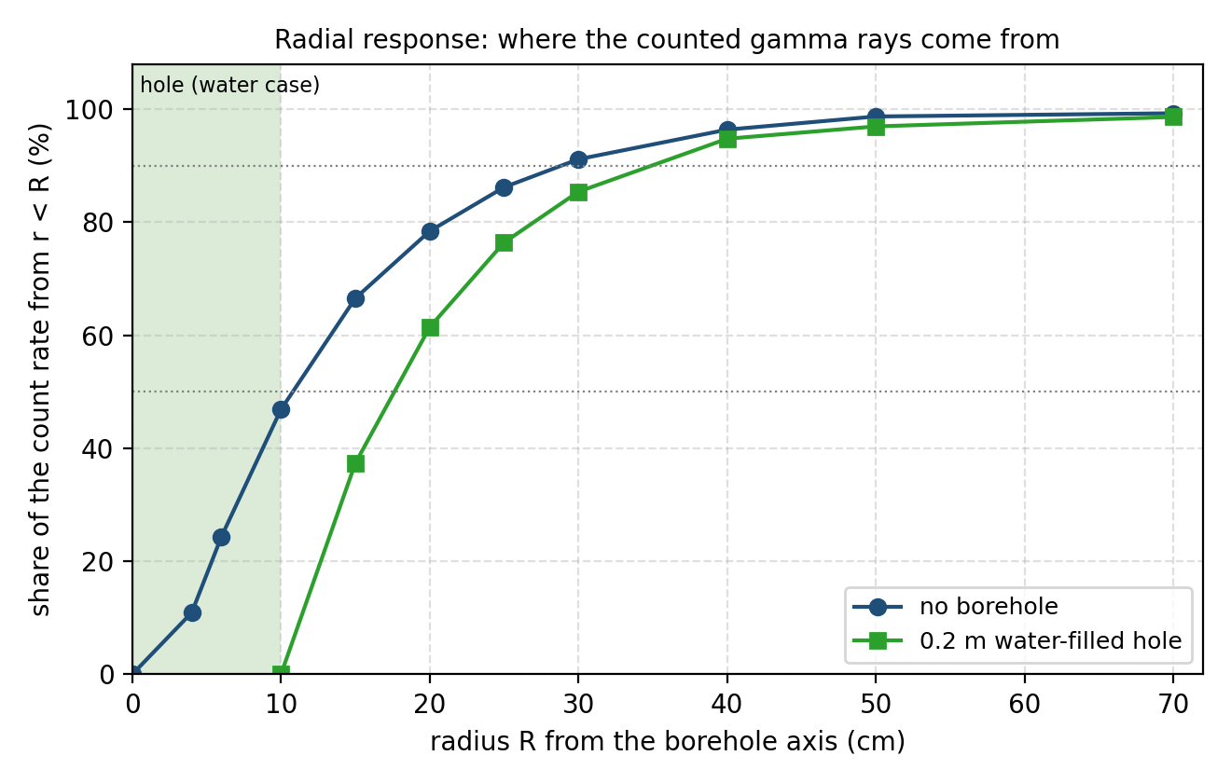


Every borehole log mixes the hole and the formation
The backfill sits where the tool is most sensitive
Monitoring wells are backfilled with sand, bentonite, cement or water. All of it lies within a few centimetres of the sensor.
The size of the effect depends on many choices
Borehole diameter, backfill resistivity and radioactivity, tool design, electrode or coil spacing, frequency.
Simulate with and without the hole
PyBorehole runs each tool twice. The ratio of the two logs is the borehole effect; 1 means no effect.
Gamma-ray tool (Geant4): without a borehole, almost half of the counts come from the first 10 cm around the axis, exactly where the backfill is.
Notes:
WHAT TO SAY
Three ideas carry the whole project.
1. The backfill sits where the tool is most sensitive. Monitoring wells and geotechnical boreholes are backfilled with filter sand, bentonite, cement grout or simply water, and all of it lies within a few centimetres of the sensor.
2. How much it matters depends on many choices: hole diameter, the resistivity and radioactivity of the backfill, the tool design, the electrode or coil spacing and the frequency.
3. The clean way to isolate the hole is to simulate the tool twice, with and without the borehole. The ratio of the two logs is the borehole effect: 1 means no effect, below 1 the hole makes the tool read low, above 1 high.
THE FIGURE
Radial response of the gamma-ray tool, computed with Geant4: the share of the count rate that comes from within radius R of the axis. Without a borehole almost half of the counts come from the first 10 cm, which is exactly the space a 0.2 m hole occupies. In a water-filled hole the tool has to look further (50 % within 18 cm instead of 11 cm). The same logic applies to ERT and EM: short spacings are dominated by the hole.
LIKELY QUESTION
"Why not just use the service company's correction charts?" Those charts exist for standard oilfield tools in mud-filled holes. They do not cover slim tools in sand, bentonite or cement backfill, focused versus unfocused coils, or arbitrary diameters. The simulation gives the correction for the actual setup.

Slide 3
Why 3D modelling: the geometry decides the reading
Layered (1D) model
3D model (PyBorehole)
No borehole at all
Tool is a point in an infinite layer
Cannot show backfill, casing or tool body
Cannot move the tool off-centre
Round hole with concentric backfill zones and casing
Insulating tool body, ring electrodes, coil sets
Layer boundaries that cut across the tool
Off-centre tool (EM octree)
3D octree simulation: two-coil EM tool, s = 0.5 m, 400 Hz; 1 Ohm.m backfill in a 0.2 m hole; formation 100 Ohm.m
Notes:
WHAT TO SAY
Why 3D and not a simpler layered model? A layered (1D) model has no borehole at all: the tool is a point inside an infinite layer, so it cannot represent backfill, casing or a tool body, and it cannot move the tool off-centre.
PyBorehole builds the real geometry: a round hole with concentric zones (backfill, casing, gravel pack, seal), an insulating tool body with ring electrodes or coil sets, layer boundaries that cross the tool as it moves, and, for EM, a tool that is not centred in the hole.
THE CHART
3D octree simulation of a two-coil EM tool (coil spacing 0.5 m, 400 Hz) in a 0.2 m hole with 1 Ohm.m backfill in a 100 Ohm.m formation. Centred, the tool reads 19 Ohm.m. Moved 3, 6 and 8 cm off the axis it reads 21, 29 and 46 Ohm.m. The same tool in the same hole changes its reading by a factor of 2.4 just by touching the wall.
WHY IT HAPPENS
Off-centre, the eddy-current loops around the tool cross the borehole wall between the 1 Ohm.m backfill and the 100 Ohm.m formation. Charge builds up on the wall and blocks part of the current in the backfill. Simple geometric-factor theory has no such charges and predicts almost no change; for a weak contrast (50 vs 100 Ohm.m) the simulation indeed shows almost none (95.5 to 96.2 Ohm.m).
CHECKS
The off-centre result was verified: homogeneous ground reads its true value with the tool off-centre (99.6 / 100.2 Ohm.m), and refining the octree mesh 2x changes the result by 0.2 %.

Slide 4
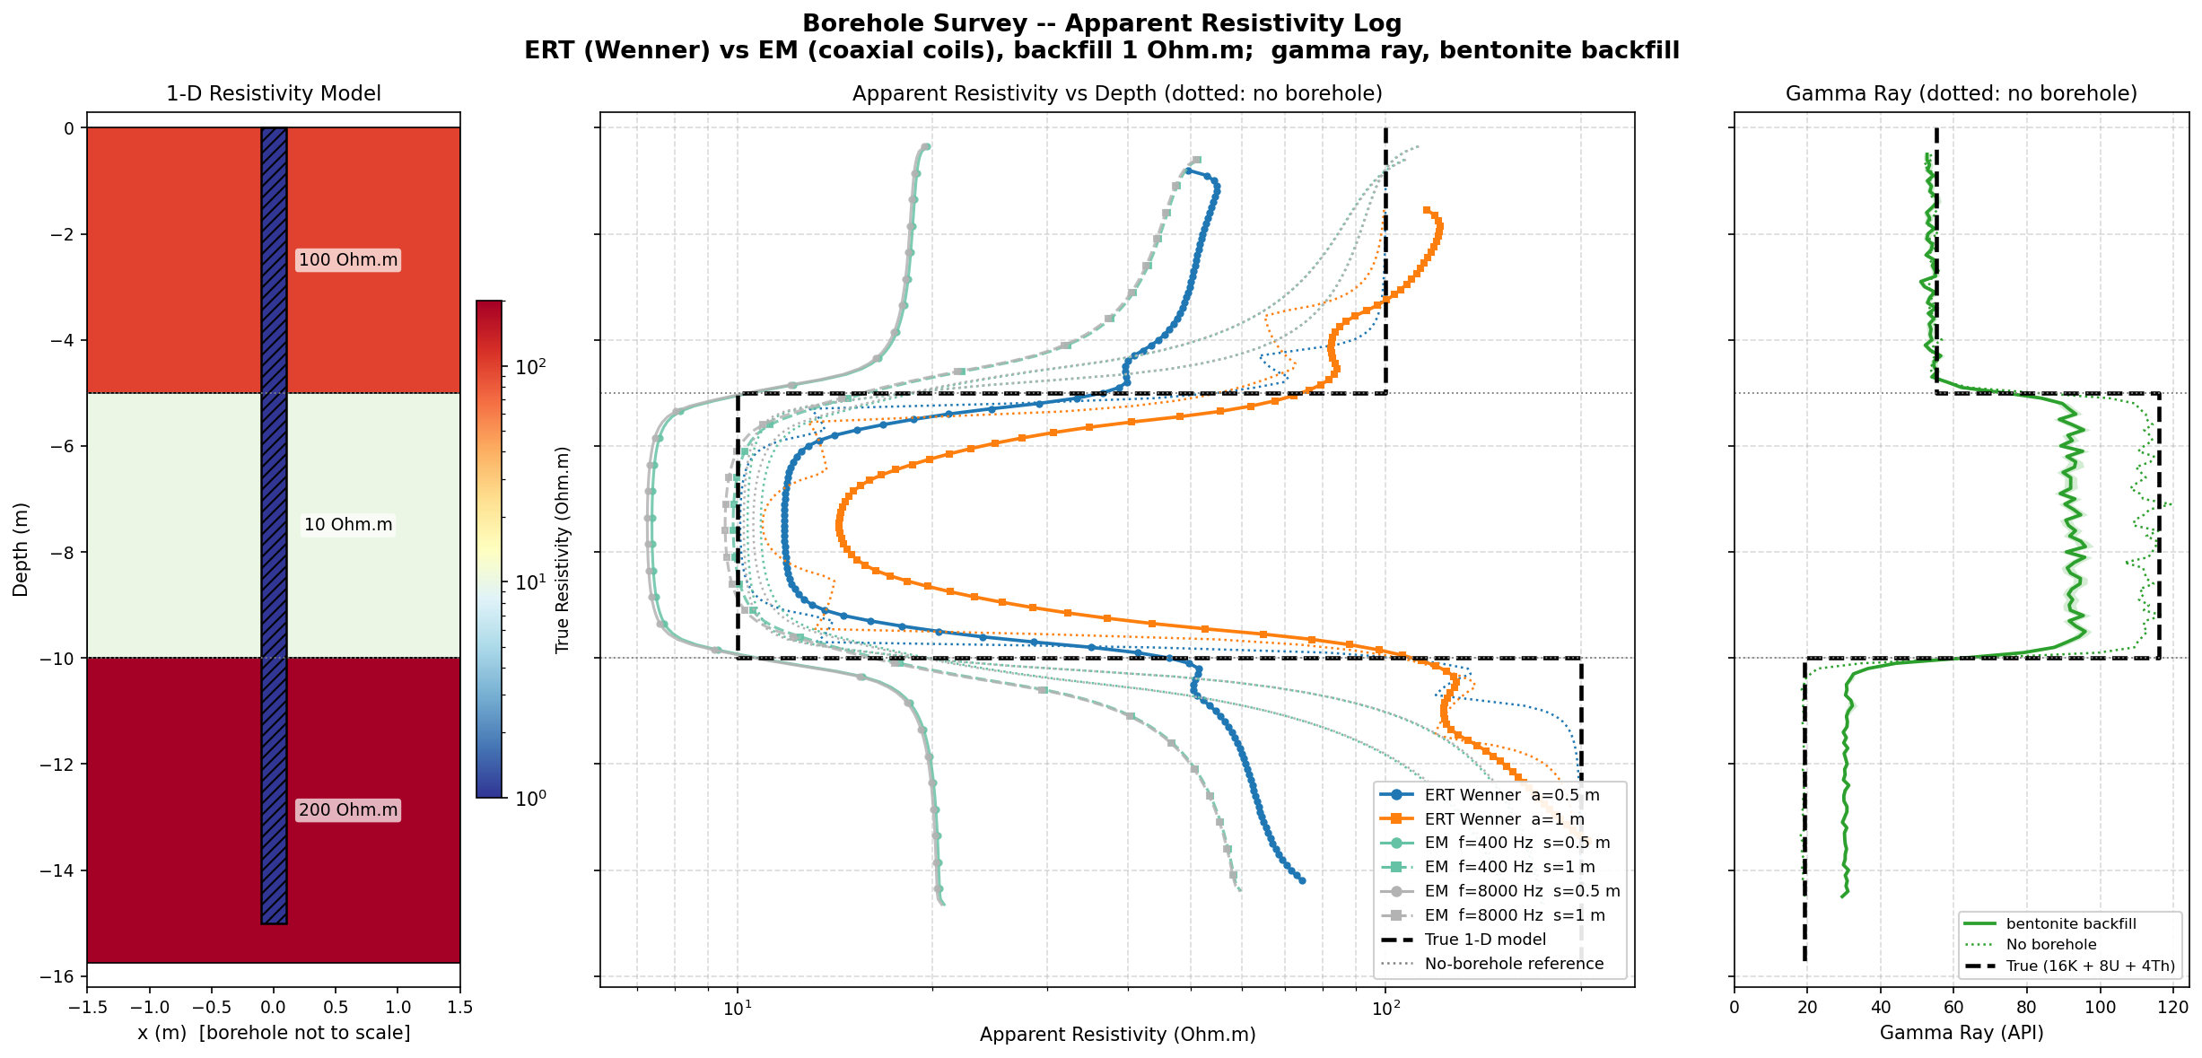
The backfill can dominate the log
0.19×
EM two-coil tool (s = 0.5 m) in 1 Ohm.m backfill: reads a fifth of the true 100 Ohm.m
1.6×
ERT 64" normal in the same hole: reads 60 % too high (current channelling)
+61 %
Gamma ray in clean gravel with bentonite grout; water instead gives −24 %
ERT (Wenner) and EM logs through a 100 / 10 / 200 Ohm.m model, 0.2 m hole, 1 Ohm.m backfill; dotted = no borehole
Notes:
WHAT TO SAY
Three headline numbers show that the backfill can dominate a log. All are for a 0.2 m hole in a 100 Ohm.m formation unless stated otherwise.
0.19x - A two-coil induction tool with 0.5 m spacing in 1 Ohm.m (saline or conductive) backfill reads about a fifth of the formation resistivity. Induction tools are very sensitive to conductive material close to the coils.
1.6x - The same backfill makes a 64-inch normal resistivity log read 60 % too high. The current from the electrode is channelled along the conductive hole between the insulating tool body and the wall, which raises the measured potential.
+61 % - For the gamma ray it is the material, not the resistivity, that matters: bentonite grout contains K, U and Th, so in a clean gravel (19 API) it raises the reading by 61 %. A water-filled hole lowers the reading by about 24 % in every layer, because water only absorbs.
THE FIGURE
ERT (Wenner) and EM logs through the three-layer model (100 / 10 / 200 Ohm.m, 15 m), 0.2 m hole, 1 Ohm.m backfill. Solid = with the hole, dotted = no borehole, dashed = true model. The difference between solid and dotted is the borehole effect, varying with depth and layer.
SOURCES OF THE NUMBERS
EM: SimPEG simulation (slide 14). ERT: Fourier-Bessel solution for ring electrodes on a 50 mm tool, matched by the 3D code within 0.3 % (slide 9). Gamma ray: Geant4 simulation (slide 19).

Slide 5




One model, three methods, one app
ERT
EM
Gamma ray
App
DC resistivity
Induction
Natural radioactivity
Streamlit
PyGIMLi · 3D finite elements · Wenner, normal, lateral · tool body and ring electrodes
SimPEG · axisymmetric and 3D octree meshes · two-coil and focused tools
Geant4 · Monte Carlo photon transport · NaI(Tl) probe · K, U, Th
Geometry, properties, tools and run in the browser · logs and borehole effect
Shared input: layers, borehole diameter and depth, backfill (or concentric zones: casing, gravel pack, seal).
Every result is checked against an exact solution: ERT and EM within 0.1–1.7 %, gamma ray against service-company correction charts and OpenMC.
Notes:
WHAT TO SAY
PyBorehole is three simulators and an app that share one earth model.
ERT - DC resistivity with PyGIMLi: 3D finite elements, Wenner, normal and lateral arrays, an insulating tool body and ring electrodes.
EM - induction with SimPEG: an exact axisymmetric mesh for full logs in seconds, and a 3D octree mesh for an off-centre tool; two-coil and focused (bucked) coil arrays.
Gamma ray - Geant4 Monte Carlo photon transport with a NaI(Tl) probe and K, U, Th sources in every layer and in the backfill.
App - a Streamlit interface: geometry, properties, tools and run in the browser, without writing code.
SHARED INPUT
The layers (depth, resistivity, material, K/U/Th), the borehole (depth, diameter) and the backfill, either a single fill or concentric zones such as a PVC casing in a gravel pack with a bentonite seal.
VALIDATION
Every simulator was checked against an exact or independent solution: ERT and EM within 0.1-1.7 % of Fourier-Bessel solutions for an infinite borehole; the gamma ray against the service-company correction for a water-filled 8-inch hole (0.76 vs 0.77) and against the independent OpenMC code.
LIKELY QUESTION
"Can I use my own logging tool?" Yes: electrode spacings, coil spacings, frequencies, bucking coils, tool body diameter and the gamma-ray crystal size are all settings.

Slide 6

1 · ERT — DC resistivity
PyGIMLi · 3D finite elements · realistic resistivity sonde
Notes:
TRANSITION
First method: DC resistivity, or ERT in the logging sense - an electrode injects a current and others measure the potential it creates. The simulator is built on PyGIMLi, the open-source Geophysical Inversion and Modelling Library, which solves the problem with 3D finite elements. We will look at the physics, the 3D mesh, the effect of diameter and backfill resistivity, and the realistic sonde.

Slide 7
ERT: inject a current, measure a potential
ERT
∇·(σ ∇u) = −I δ(r − r_{A}) ρ_{a} = k · ΔV / I
Potential u of a point current I in a conductivity σ(x, y, z); apparent resistivity from the measured voltage
Boundaries: no current through the ground surface; mixed (Robin) condition on the far sides and bottom
Arrays: Wenner (A, M, N, B downhole), normal (A–M, B and N remote), lateral (A–M–N, B remote)
Geometric factor k: analytic half-space value, or calibrated in a homogeneous earth for a real sonde
What PyGIMLi does for us
Assembles and solves the 3D finite-element system (quadratic P2 elements)
Singularity removal: the field near each electrode is analytic, the rest numerical
Mixed boundary conditions and geometric factors for any electrode layout
Meshing through TetGen, from the geometry we build
Notes:
WHAT TO SAY
ERT solves the DC potential equation: the divergence of conductivity times the potential gradient equals the injected point current. For a measured voltage difference dV and current I, the apparent resistivity is rho_a = k * dV / I, where k is the geometric factor of the electrode layout.
BOUNDARY CONDITIONS
No current flows through the ground surface (homogeneous Neumann). On the far sides and the bottom of the model, 100 m away, a mixed (Robin) condition assumes the field decays like a point source, which lets the model stay small.
ARRAYS
Wenner: A, M, N, B all downhole with equal spacing. Normal: A and M on the sonde, B and N remote ("at infinity"); measures the potential at M. Lateral: A on the sonde, M and N close together at distance AO, B remote; measures roughly the potential gradient.
GEOMETRIC FACTOR
For idealised electrodes on the axis the analytic half-space value is used (it includes the image above the surface, so a homogeneous earth reads its true value at any depth). With a tool body the factor is calibrated numerically, exactly as for a real sonde.
WHAT PYGIMLI DOES
Assembles and solves the finite-element system with quadratic (P2) elements; singularity removal (the field near each electrode is analytic, only the smooth remainder is numerical), which is what makes small spacings accurate; mixed boundary conditions; meshing through TetGen from the geometry PyBorehole builds.
LIKELY QUESTION
"Why quadratic elements?" Linear elements left a bias of a few percent for strong borehole contrasts; with P2 the error against the exact solution drops to 0.1 %.

Slide 8
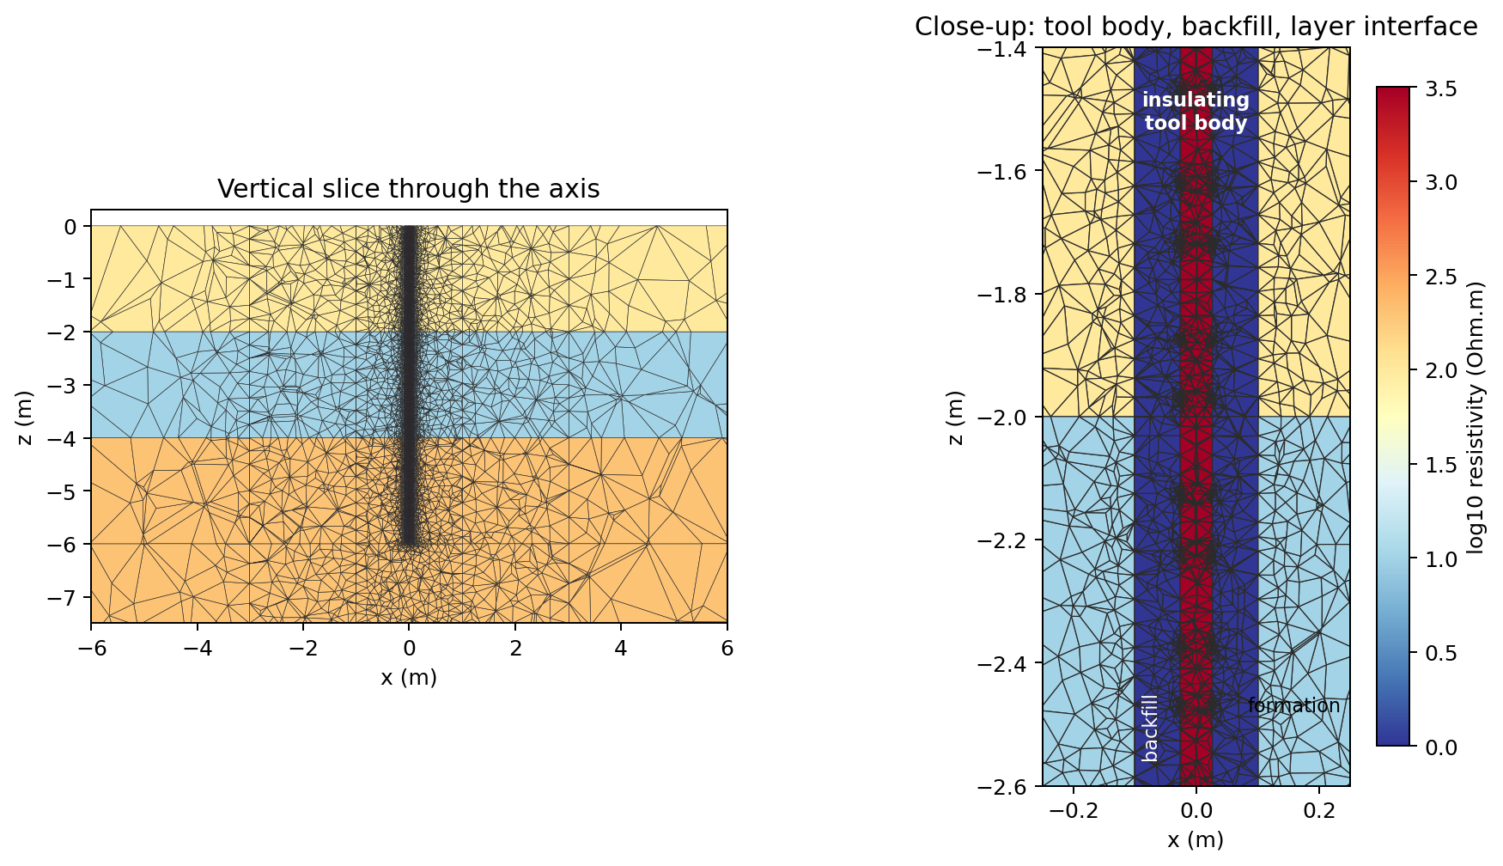
A 3D mesh built around the borehole
ERT
1
Concentric rings
Backfill, casing and tool body are 24-sided polygons with the area of the true circle
2
Exact interfaces
Layer boundaries and zone limits are mesh faces, not staircases
3
Graded refinement
Fine cells in the hole, coarser outward to the 100 m boundary (~375 000 cells)
4
Validated
Matches the exact infinite-borehole solution within 0.1 %
Slice through the 3D tetrahedral mesh along the borehole axis: 1 Ohm.m backfill, 50 mm tool body, 100 / 10 / 200 Ohm.m layers
Notes:
WHAT TO SAY
The mesh is built around the borehole. The figure is a vertical slice through the 3D tetrahedral mesh along the axis; colours are log10 resistivity. Left: the full view, with fine cells along the hole and coarser cells outward. Right: a close-up of the tool body (red, insulating), the 1 Ohm.m backfill (dark blue) and a layer interface at 2 m depth.
FOUR DESIGN CHOICES
1. Concentric rings: backfill zones, casing and tool body are regular polygons whose area equals that of the true circle. (An inscribed polygon has too little area and biases the reading: with 8 sides the old code had 10 % less borehole.)
2. Exact interfaces: every layer boundary and zone limit is a face of the mesh, so cells never straddle a resistivity jump.
3. Graded refinement: borehole cells about R/1.6, a near zone to 10 borehole radii, a medium zone, and an unconstrained far field to 100 m. About 375 000 cells for a 15 m log; borehole rings stop at the hole bottom, which keeps the mesh small.
4. Validation: an on-axis Wenner array in a 0.2 m hole with 1 and 1000 Ohm.m backfill matches the exact infinite-borehole solution within 0.1 %. The first version of the code was 17 % off, mainly because of mesh quality and linear elements.
DETAIL
Electrodes are mesh nodes. If an electrode would fall exactly on a layer interface, the electrode grid is shifted by half a step, because a point electrode on a resistivity jump converges poorly (5 % error before the fix, 0.04 % after).

Slide 9
Diameter and backfill resistivity set the effect
ERT
Ring electrodes on a 50 mm insulating tool, formation 100 Ohm.m. Fourier–Bessel solution, which the 3D code matches within 0.3 %. 1.00 = no effect.
Notes:
WHAT TO SAY
These two charts are the core ERT result: the borehole effect of the 16-inch and 64-inch normals as a function of backfill resistivity, for hole diameters of 0.1, 0.2 and 0.3 m. Ring electrodes on a 50 mm insulating tool body, formation 100 Ohm.m. 1.00 means no effect.
READING THE CHARTS
16-inch normal (left): with conductive backfill the effect depends strongly on diameter. In a wide 0.3 m hole the tool reads low (0.62 at 1 Ohm.m) because much of the current stays in the conductive hole. In a narrow 0.1 m hole it reads high (1.34) because the current is squeezed into the thin annulus between tool and wall.
64-inch normal (right): the longer spacing reads high in conductive backfill for every diameter, up to 1.6 at 1 Ohm.m in a 0.2 m hole; this is current channelling along the hole.
Resistive backfill (300-1000 Ohm.m) changes both tools by less than about 5 %.
HOW THE CURVES WERE COMPUTED
Not with the 3D code directly but with a three-region Fourier-Bessel solution (insulating mandrel, backfill, formation) for ring electrodes, with the same calibration as the tool. The 3D code reproduces this solution within 0.3 %, so the solution is a validated shortcut: the whole chart takes seconds instead of many hours of 3D runs. The 3D code is still needed for layers, finite holes, zones and non-ideal geometry.
LIKELY QUESTION
"Why can a conductive backfill make a resistivity tool read too high?" Because the measured potential depends on how current spreads. A conductive channel guides the current along the hole, past the measuring electrode, which raises the potential there compared with a homogeneous earth.

Slide 10
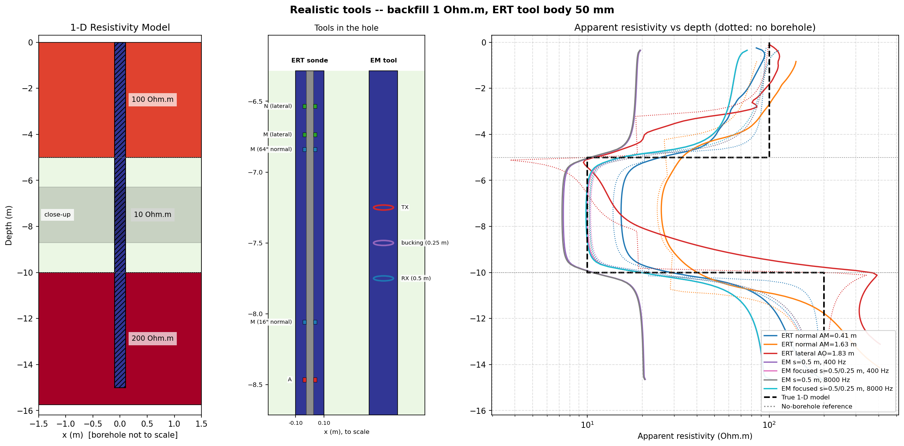
We also simulate the real resistivity sonde
ERT
Insulating tool body (50 mm) in the middle of the hole
Ring electrodes on its surface; single points were up to 21 % wrong in resistive backfill
Normal 16" / 64" and lateral arrays with remote B and N electrodes
Tool constant calibrated in a homogeneous earth, as for a real sonde
Validated against an exact solution for rings on a mandrel: within 0.3 %
run_realistic.py: model, tools in the hole to scale, and logs of all tools for 1 Ohm.m backfill (dotted = no borehole)
Notes:
WHAT TO SAY
Beyond idealised point electrodes on the axis, PyBorehole simulates the actual resistivity sonde (run_realistic.py).
WHAT IS MODELLED
- An insulating tool body (default 50 mm) in the middle of the hole; it is part of the tool, so it is kept in the no-borehole reference.
- Ring electrodes on its surface. A single point electrode was not good enough: with 1000 Ohm.m backfill the potential on the far side of the tool, 0.2 m from the current electrode, was 21 % lower than on the near side, because current hardly spreads around the tool in a thin resistive annulus. Since the centred tool is axisymmetric, the ring-to-ring resistance equals the average over points around the ring; four points are exact here.
- Normal (16" and 64") and lateral arrays with remote B and N electrodes.
- A tool constant calibrated in a homogeneous earth with the same tool, as service companies calibrate real sondes.
- Validation against an exact Fourier-Bessel solution for ring electrodes on an insulating mandrel: within 0.3 % for 1 and 1000 Ohm.m backfill.
THE FIGURE
Left: the model. Middle: the tools to scale at mid-depth (ERT sonde with ring electrodes, EM tool with coils). Right: logs of all realistic tools for 1 Ohm.m backfill, dotted = no borehole.
PERFORMANCE
Solving only for current electrodes and reading the potentials directly made these runs practical: about 30 minutes and up to 17 GB of RAM for the full sweep at 0.1 m steps; a 0.2 m step roughly halves both.

Slide 11
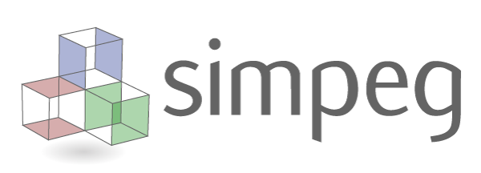
2 · EM — electromagnetic induction
SimPEG · axisymmetric and full 3D meshes · two-coil and focused tools
Notes:
TRANSITION
Second method: electromagnetic induction. Induction tools need no electrical contact with the formation, so they also work in PVC-cased wells, which makes them popular in groundwater monitoring. The simulator is built on SimPEG, the open-source Simulation and Parameter Estimation in Geophysics framework. We will cover the physics, the two meshes, the effect of diameter and backfill for two-coil and focused tools, and the frequency and spacing settings.

Slide 12

EM: induced currents, heard by a receiver
EM
1 Transmitter coil
2 Eddy currents
3 Receiver coil
An alternating current (400 Hz – 40 kHz) creates a primary magnetic field
The changing field induces current loops in the ground, proportional to its conductivity σ
The loops create a secondary field; its quadrature part gives the apparent conductivity
What SimPEG does for us
Solves Maxwell's equations in the frequency domain (E-field formulation)
Magnetic-dipole sources and point receivers for the coils
Cylindrical and OcTree meshes from discretize
One factorisation per frequency for the whole log
∇×E = −iωμH ∇×H = σE + J_source
Skin depth δ ≈ 503 √(ρ / f) m: 18–250 m here, much longer than the coil spacing
Apparent resistivity: the full space that gives the same quadrature field (exact at any frequency)
Boundary at ≥ 3 skin depths; resistive air above the surface
Notes:
WHAT TO SAY
An induction tool works much like a metal detector, in three steps.
1. The transmitter coil carries an alternating current (here 400 Hz to 40 kHz) and creates a primary magnetic field.
2. The changing field induces eddy-current loops in the ground around the tool; their strength is proportional to the conductivity.
3. These currents create a secondary field at the receiver coil. Its quadrature (90 degrees out of phase) part is proportional to the conductivity and gives the apparent conductivity.
THE EQUATIONS
Maxwell's equations in the frequency domain: curl E = -i omega mu H and curl H = sigma E + source current. SimPEG uses the e^(+i omega t) time convention.
KEY NUMBERS
The skin depth, about 503 * sqrt(rho / f) metres, is 18-250 m for these frequencies and formations, much longer than the coil spacing; this is the low-induction-number regime. We convert the quadrature into an apparent resistivity by finding the homogeneous full space that gives the same quadrature field, which is exact at any frequency. The simpler low-induction-number formula is up to 13 % off in 1 Ohm.m ground at 8 kHz with 1 m spacing.
The model boundary is placed at least three skin depths away, with resistive air above the surface.
WHAT SIMPEG DOES
Solves the E-field formulation; provides magnetic-dipole sources and point receivers for the coils; the cylindrical and octree meshes come from its companion library discretize; one matrix factorisation per frequency serves the whole log.
LIKELY QUESTION
"What about the in-phase component?" At these induction numbers the in-phase secondary field is about 1e-8 of the primary, below the accuracy of any mesh, so it is not interpreted.

Slide 13
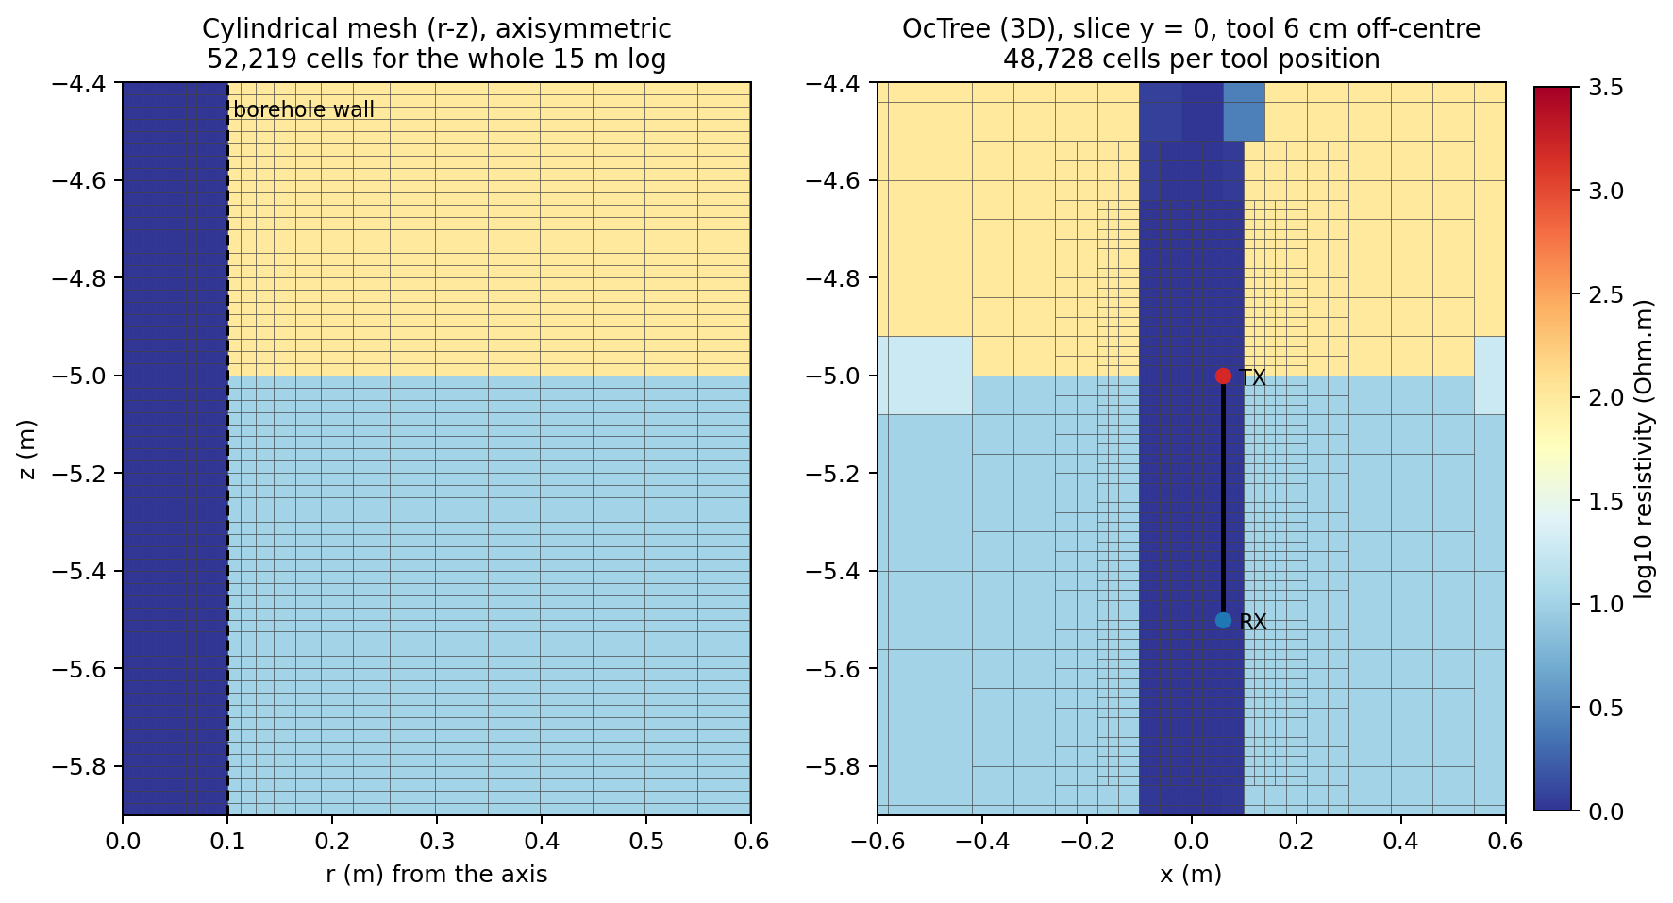
Two meshes: exact axisymmetric and full 3D
EM
Cylindrical mesh: exact for a centred coaxial tool; cell faces on every zone radius; a whole log in seconds
OcTree mesh: true 3D for an off-centre tool or transverse coils; ~10 s per tool position
Volume-averaged cells where cubes cut the round wall
Validated: within 0.1–1.7 % of the exact borehole solution, both meshes
Notes:
WHAT TO SAY
Two meshes, chosen by the geometry.
CYLINDRICAL MESH (left)
For a centred coaxial tool in horizontal layers the problem is axisymmetric, so a cylindrical r-z mesh with a single angular cell is exact, not an approximation. Cell faces lie on every borehole-zone radius (about 1 cm cells inside a 0.2 m hole) and on every layer depth. About 52 000 cells for a whole 15 m log, which runs in seconds.
OCTREE MESH (right)
For an off-centre tool or coils across the hole the problem is truly 3D. A Cartesian octree is built around each tool position: 2 cm cubes around the hole and the coils, doubling in size every few cells out to the model edge; about 50 000-75 000 cells and about 10 s per tool position and frequency. Because cubes cut the round wall, each cell gets its volume-averaged conductivity (4 x 4 x 4 samples); without that, shifting the grid by half a cell changed the result by up to 4 %. The slice shows a tool 6 cm off-centre.
VALIDATION
Both meshes were compared with an exact Fourier-Bessel solution for coaxial coils on the axis of an infinite borehole: within 0.1-1.7 % for 1 to 1000 Ohm.m backfill at 400 and 8000 Hz (cylindrical) and 0.1-1.5 % (octree). Coplanar coils in a full space: within 0.7 %.
LIKELY QUESTION
"When should I use the octree?" Only for non-axisymmetric cases at selected depths; a full 151-position log in 3D would take about an hour.

Slide 14
Two-coil vs focused tool
EM
SimPEG simulations, 400 Hz, formation 100 Ohm.m. A bucking receiver cancels the direct field and, to first order, the borehole signal.
Notes:
WHAT TO SAY
The borehole effect for EM, as a function of backfill resistivity, for 0.1, 0.2 and 0.3 m holes. SimPEG simulations at 400 Hz, formation 100 Ohm.m, ratio of the log with the hole to the log without it.
TWO-COIL TOOL (left, s = 0.5 m)
Induction is very sensitive to conductive backfill: with 1 Ohm.m the tool reads 49 % of the true value in a 0.1 m hole, 19 % in a 0.2 m hole and 10 % in a 0.3 m hole. Even 10 Ohm.m backfill costs 9-46 %. Resistive backfill makes the tool read slightly high (up to 9 % in a wide hole), because the hole removes conductive formation.
FOCUSED TOOL (right, bucking coil at 0.25 m)
A bucking receiver, wound against the main receiver with weight -(s_b/s)^3, cancels the direct field. The contribution of a conductive borehole near the axis scales the same way (area / s^3), so it cancels to first order too. In a 0.1 m hole the effect almost disappears; in a 0.2 m hole with 10 Ohm.m backfill it drops from 28 % to 4 %. In wide holes with very conductive fill, focusing helps but cannot remove the effect.
CAVEAT
The bucking coil is a generic design; commercial slim induction tools use their own, often proprietary, coil sets. The focused tool was validated against the exact solution within 0.2-1.3 %.
LIKELY QUESTION
"So should we always use a focused tool?" For conductive backfill, yes: it is the single most effective way to reduce the borehole effect for induction.

Slide 15

Spacing matters, frequency barely does
EM
EM settings
Coil spacings (any number)
Frequencies (any number)
Bucking receiver per coil pair
Measuring step along the hole
Tool offset and coil orientation (3D)
Longer spacings see past the backfill: s = 0.25 m reads 6 % of the true value, s = 2 m reads 79 %. From 400 Hz to 40 kHz the result changes by less than 3 %.
Notes:
WHAT TO SAY
The coil spacing and the frequency are settings of the simulation, like they are design parameters of a tool. This chart isolates their effect: a two-coil tool in a 0.2 m hole with 1 Ohm.m backfill, ratio with hole / no hole versus coil spacing, at 400 Hz, 8 kHz and 40 kHz.
READING THE CHART
Spacing matters enormously: at 0.25 m the tool reads only 6 % of the true value, at 1 m 48 %, at 2 m 79 %. A longer spacing sees further into the formation and weights the backfill less.
Frequency barely matters: the three curves overlap, differing by less than 3 % from 400 Hz to 40 kHz. In the low-induction-number regime the quadrature response is proportional to conductivity times frequency, so the apparent conductivity, and hence the borehole effect, hardly depends on frequency.
ALL EM SETTINGS
Coil spacings and frequencies (any number of each), a bucking receiver per coil pair, the measuring step along the hole, and, with the 3D octree, the tool offset and coil orientation (coaxial or coplanar).
PRACTICAL TAKEAWAY
To reduce the backfill effect with induction, change the geometry (longer spacing, focusing), not the frequency. Frequency starts to matter only in very conductive formations or at much higher frequencies, where the skin depth approaches the coil spacing.

Slide 16
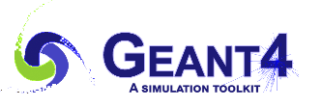
3 · Natural gamma ray
Geant4 · Monte Carlo photon transport · NaI(Tl) probe
Notes:
TRANSITION
Third method: the natural gamma ray. Unlike ERT and EM there is no field equation to solve: the tool counts photons emitted by natural radioactivity, and the physics is the transport of those photons through rock, backfill and the tool. We simulate it with Geant4, the Monte Carlo toolkit developed at CERN for particle and radiation physics. We will cover the physics, how Geant4 is used, and the effect of the backfill.

Slide 17
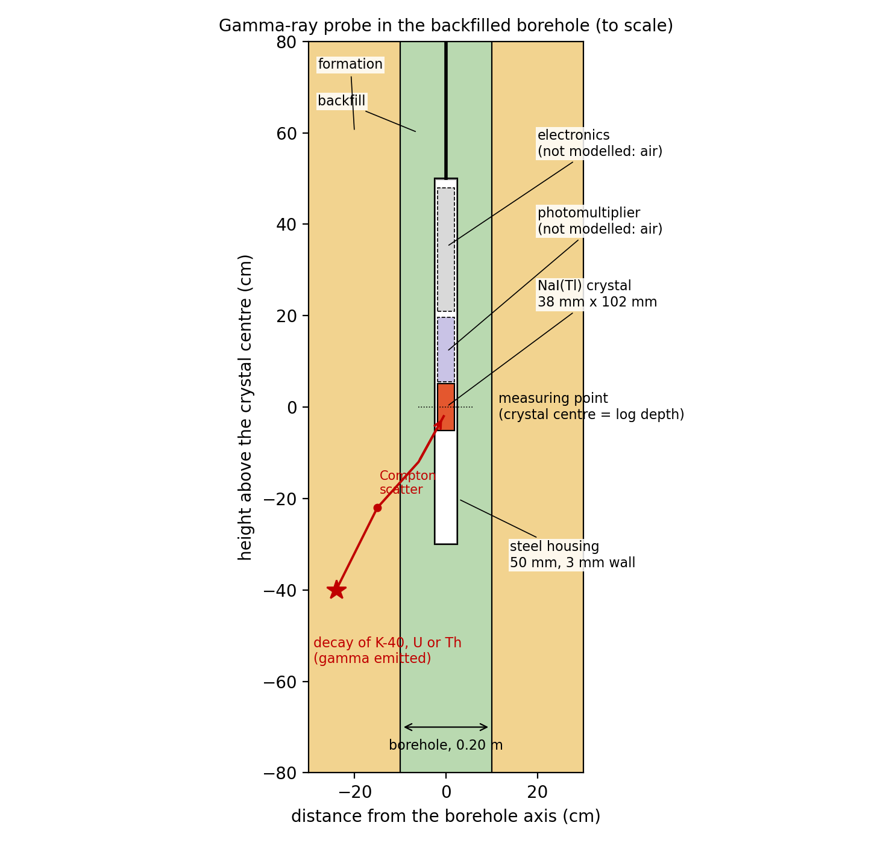
Gamma ray: counting photons from K, U and Th
GR
Sources: decays of K-40 (1.46 MeV) and of the U and Th series (Bi-214, Tl-208) in rock and backfill
Transport: photons Compton-scatter and are absorbed in rock, backfill and the steel housing
Detector: NaI(Tl) crystal 38 × 102 mm counts every pulse above 0.1 MeV
Gamma ray (API) ≈ 16 K + 8 U + 4 Th (K in %, U and Th in ppm)
Geant4 follows every photon in 3D: each scatter changes its direction and energy, until it is absorbed or leaves the model.
Notes:
WHAT TO SAY
The gamma-ray tool counts photons from natural radioactivity.
SOURCES
Potassium-40 (one line at 1.46 MeV) and the decay series of uranium-238 (for example Bi-214 at 0.61, 1.12 and 1.76 MeV) and thorium-232 (for example Tl-208 at 2.61 MeV), assumed in secular equilibrium. Every layer and the backfill have their own K (%), U (ppm) and Th (ppm). Activities: 1 % K = 313 Bq/kg of K-40, 1 ppm U = 12.35 Bq/kg, 1 ppm Th = 4.06 Bq/kg (IAEA-TECDOC-1363).
TRANSPORT
On the way to the detector the photons Compton-scatter (losing energy and changing direction) and are eventually absorbed photoelectrically, in the rock, the backfill and the 3 mm steel housing. A gamma ray travels about 10 cm in rock before its first interaction, which is why the tool sees only a few tens of centimetres.
DETECTOR
A NaI(Tl) scintillation crystal of 38 x 102 mm (1.5 x 4 inch), typical of slim water-well probes, in a 50 mm steel housing. Every pulse above 0.1 MeV counts in the gross count; energy windows around the K, U and Th lines give the spectral logs. Resolution about 7 % at 662 keV.
API UNITS
The log is calibrated to API units as for the API test pit; for standard rocks GR (API) is about 16 K + 8 U + 4 Th.
THE FIGURE
The probe in the backfilled hole, to scale, with one simulated photon history: emitted by a decay, Compton-scattered, absorbed in the crystal. The photomultiplier and electronics are not modelled (air).

Slide 18
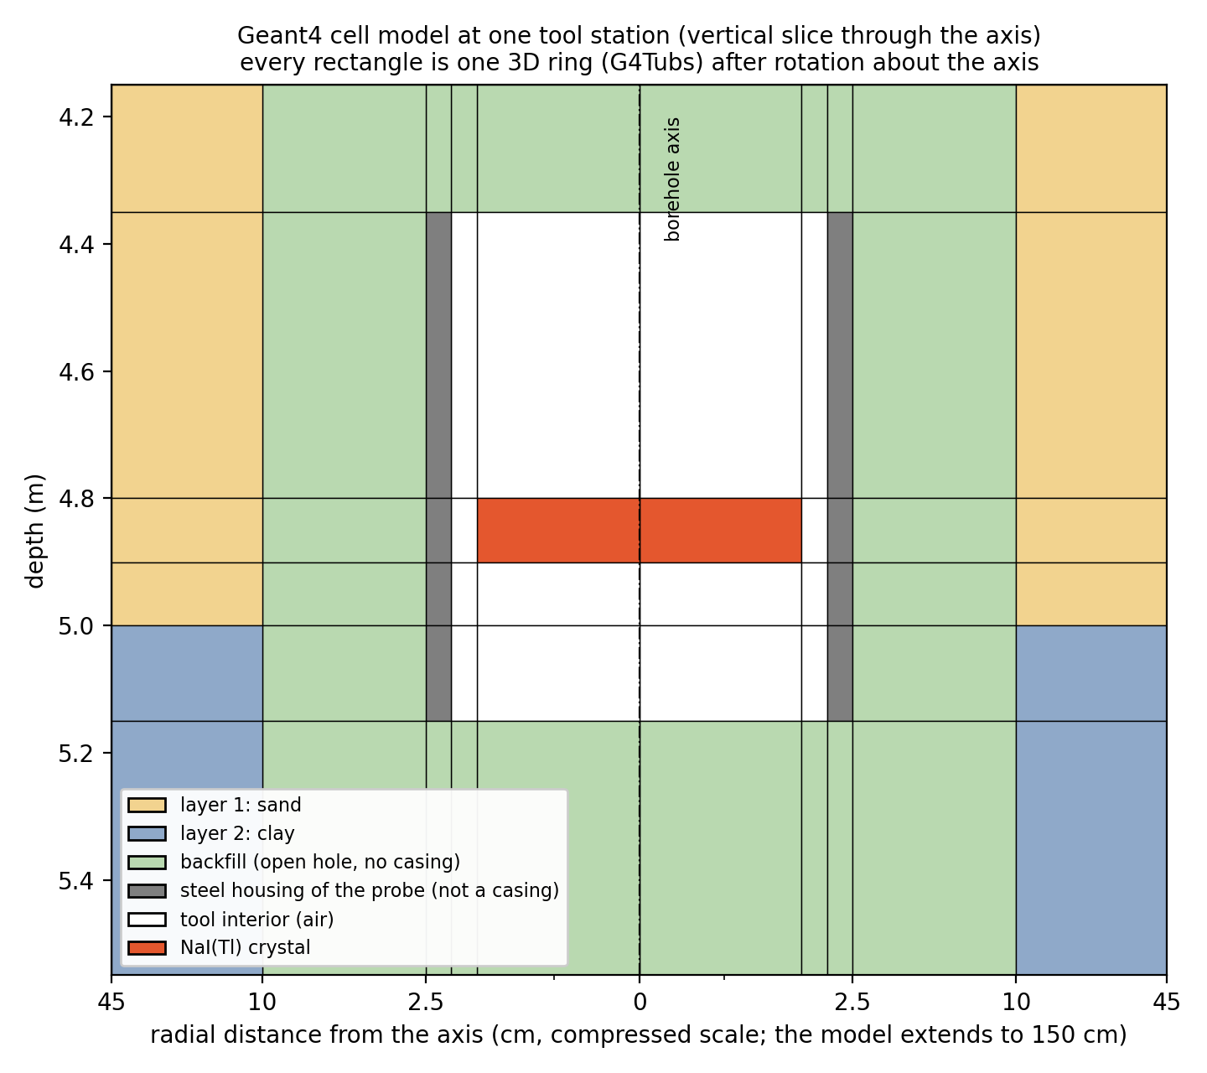
How we use Geant4
GR
Python settings
Input file
gammalog (Geant4)
Results
Layers with material and K, U, Th; borehole; backfill
Material compositions, activities, gamma lines, rings of the geometry
Monte Carlo on all CPU cores, with variance reduction
Count rate, gamma ray (API), apparent K, U, Th, with errors
Validation
0.76
water-filled 0.2 m hole / no hole; service-company charts give 0.77
≤ 1 %
count rate independent of density in an infinite medium, as theory requires
43 / 45
K count rate (counts/s), Geant4 / independent OpenMC code: equal within OpenMC's ±3.6 %
Notes:
WHAT TO SAY
How the gamma-ray simulation runs, in four steps.
1. Python settings: the layers with material and K, U, Th; the borehole; the backfill material and its radioactivity.
2. Input file: Python turns these into material compositions (minerals mixed with pore water at a given porosity, giving bulk density and element fractions), activities per cubic metre, the gamma lines and the geometry of rings.
3. gammalog: a small Geant4 program (gammalog.cc, standard electromagnetic physics with the G4EMLOW data). At each tool station it rebuilds the model as 50-100 concentric 3D rings (G4Tubs) around the crystal and transports the photons; copies run on all CPU cores. Variance reduction (importance sampling of emission points, splitting and Russian roulette) makes it much faster without changing the expected result.
4. Results: absolute count rate (counts/s), gamma ray in API, apparent K, U, Th, each with its Monte Carlo error (about 2 % per station by default).
THE FIGURE
One station: every rectangle is one 3D ring after rotation about the axis; the grey ring is the steel housing; the radial axis is compressed to show the thin housing.
VALIDATION
- A water-filled 0.2 m (8 inch) hole with a centred 50 mm tool reduces the count rate to 0.76 of the no-hole value; service-company correction charts give about 0.77.
- In an infinite medium the count rate per unit mass concentration must not depend on density; the simulation reproduces this within 1 % from 1.6 to 2.7 g/cm3.
- The independent OpenMC code, run on the same problem without variance reduction, gives the same count rates within its statistics (K: 43.0 vs 45.3 counts/s, OpenMC +/- 3.6 %).

Slide 19
The backfill moves the gamma ray both ways
GR
Water: −24 % in every layer; it only absorbs
Bentonite and cement grout are radioactive themselves: they raise a clean gravel (+61 %, +39 %) and lower a clay
Where the tool looks: 90 % of the counts come from within 29 cm of the axis (35 cm in a water-filled hole)
Diameter: a wider hole puts more backfill in that zone (setting BOREHOLE_DIAM)
Notes:
WHAT TO SAY
The borehole effect of the gamma ray depends on the backfill material, and it can go either way. The chart shows the count rate with the hole divided by the count rate without it, in the middle of each layer, for a 0.2 m hole.
WATER (teal)
About 0.76 in every layer: water only absorbs, so it lowers the reading by roughly a quarter regardless of the formation.
FILTER SAND (yellow)
Quartz sand is denser than water and only weakly radioactive; it lowers the reading in the radioactive layers (0.61 in the clay) and less in the gravel (0.90).
BENTONITE AND CEMENT GROUT (red, grey)
They contain K, U and Th themselves (typical values for bentonite grout: 0.3 % K, 2 ppm U, 8 ppm Th, about 53 API). In the clean gravel (19 API) they therefore raise the reading: +61 % for bentonite, +39 % for cement. In the clay (116 API) they are less radioactive than the formation and lower it (0.82, 0.70).
WHERE THE TOOL LOOKS
90 % of the counts come from within 29 cm of the axis without a hole, 35 cm in a water-filled hole. The backfill replaces exactly the part of the formation the tool weights most.
DIAMETER
A wider hole puts more backfill in that zone. This sweep was run for 0.2 m; the diameter is a setting (BOREHOLE_DIAM).
CAVEAT
The backfill radioactivities are typical published values, not measurements; replace them with assays of your own grout or sand.

Slide 20
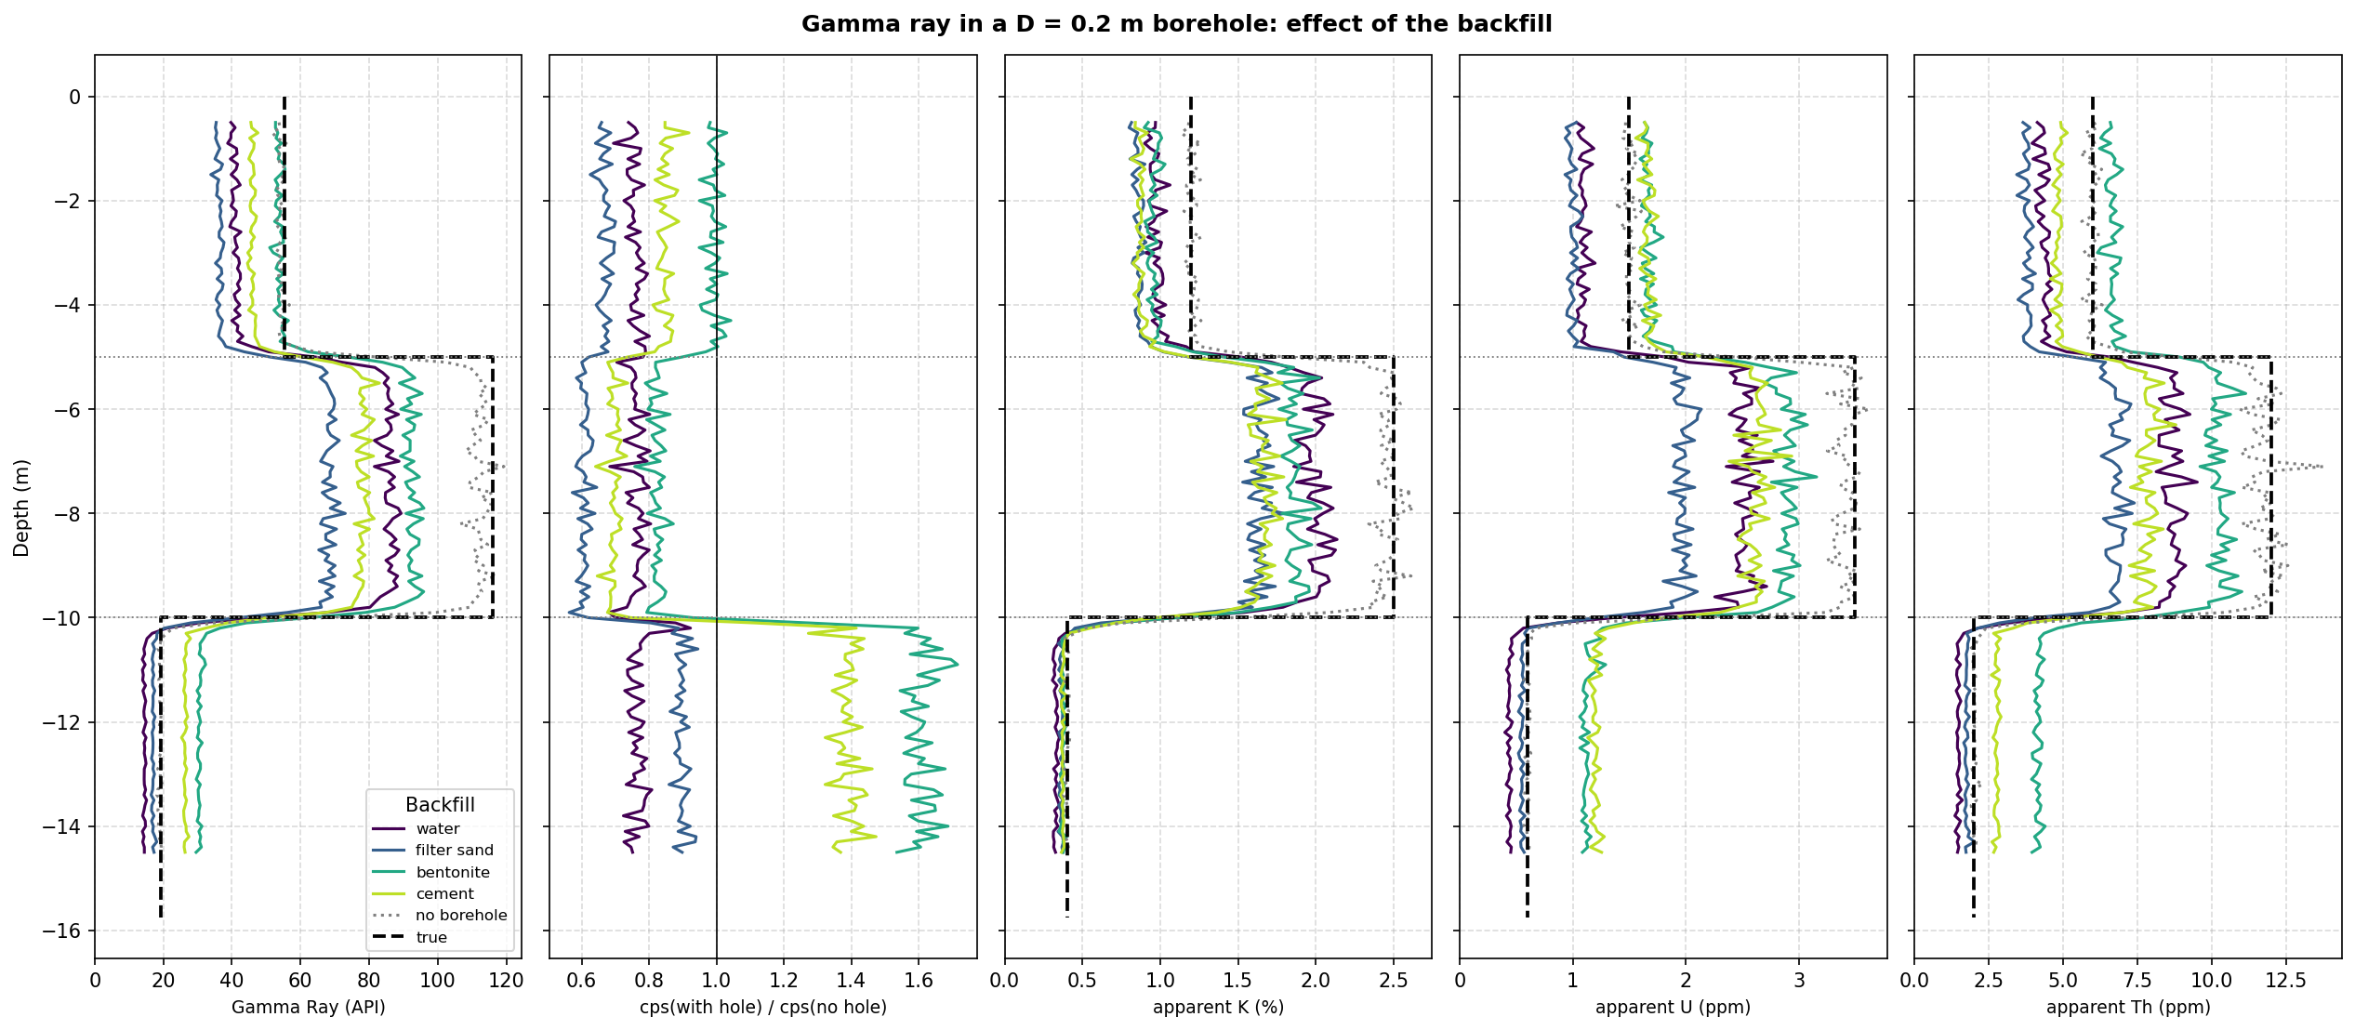
Gamma-ray logs for four backfills
GR
Geant4 simulations, 0.2 m hole, sand / clay / gravel (55 / 116 / 19 API). Panels: gamma ray (API); count rate with hole / no hole; apparent K, U, Th. Dotted = no borehole, dashed = true value.
Notes:
WHAT TO SAY
These are the full logs behind the previous chart: Geant4 simulations through the three-layer model (silty sand 55 API, clay 116 API, gravel 19 API) in a 0.2 m hole, for four backfills.
THE FIVE PANELS
1. Gamma ray in API: each backfill colour against the no-borehole log (dotted) and the true layer value (dashed).
2. The count rate with the hole divided by the count rate without it: the borehole effect. Below 1 for water and filter sand everywhere; above 1 for bentonite and cement in the low-radioactivity gravel.
3-5. Apparent K (%), U (ppm) and Th (ppm) from the spectral windows around 1.46, 1.76 and 2.61 MeV. They show which element causes the change: bentonite adds mainly thorium and uranium.
THINGS TO POINT OUT
- Bed boundaries are not sharp steps: the tool averages over a few decimetres (10-90 % width 26 cm without a hole, 36-39 cm with a bentonite- or water-filled hole). The half-way point marks the boundary.
- The curves are noisy because Monte Carlo statistics are finite: about 2 % per station at the default setting; more statistics give smoother logs at longer run time.
- The 5 m beds are thick enough to read their true value in the middle; beds thinner than about 0.75 m are underestimated, and the borehole makes that worse.

Slide 21
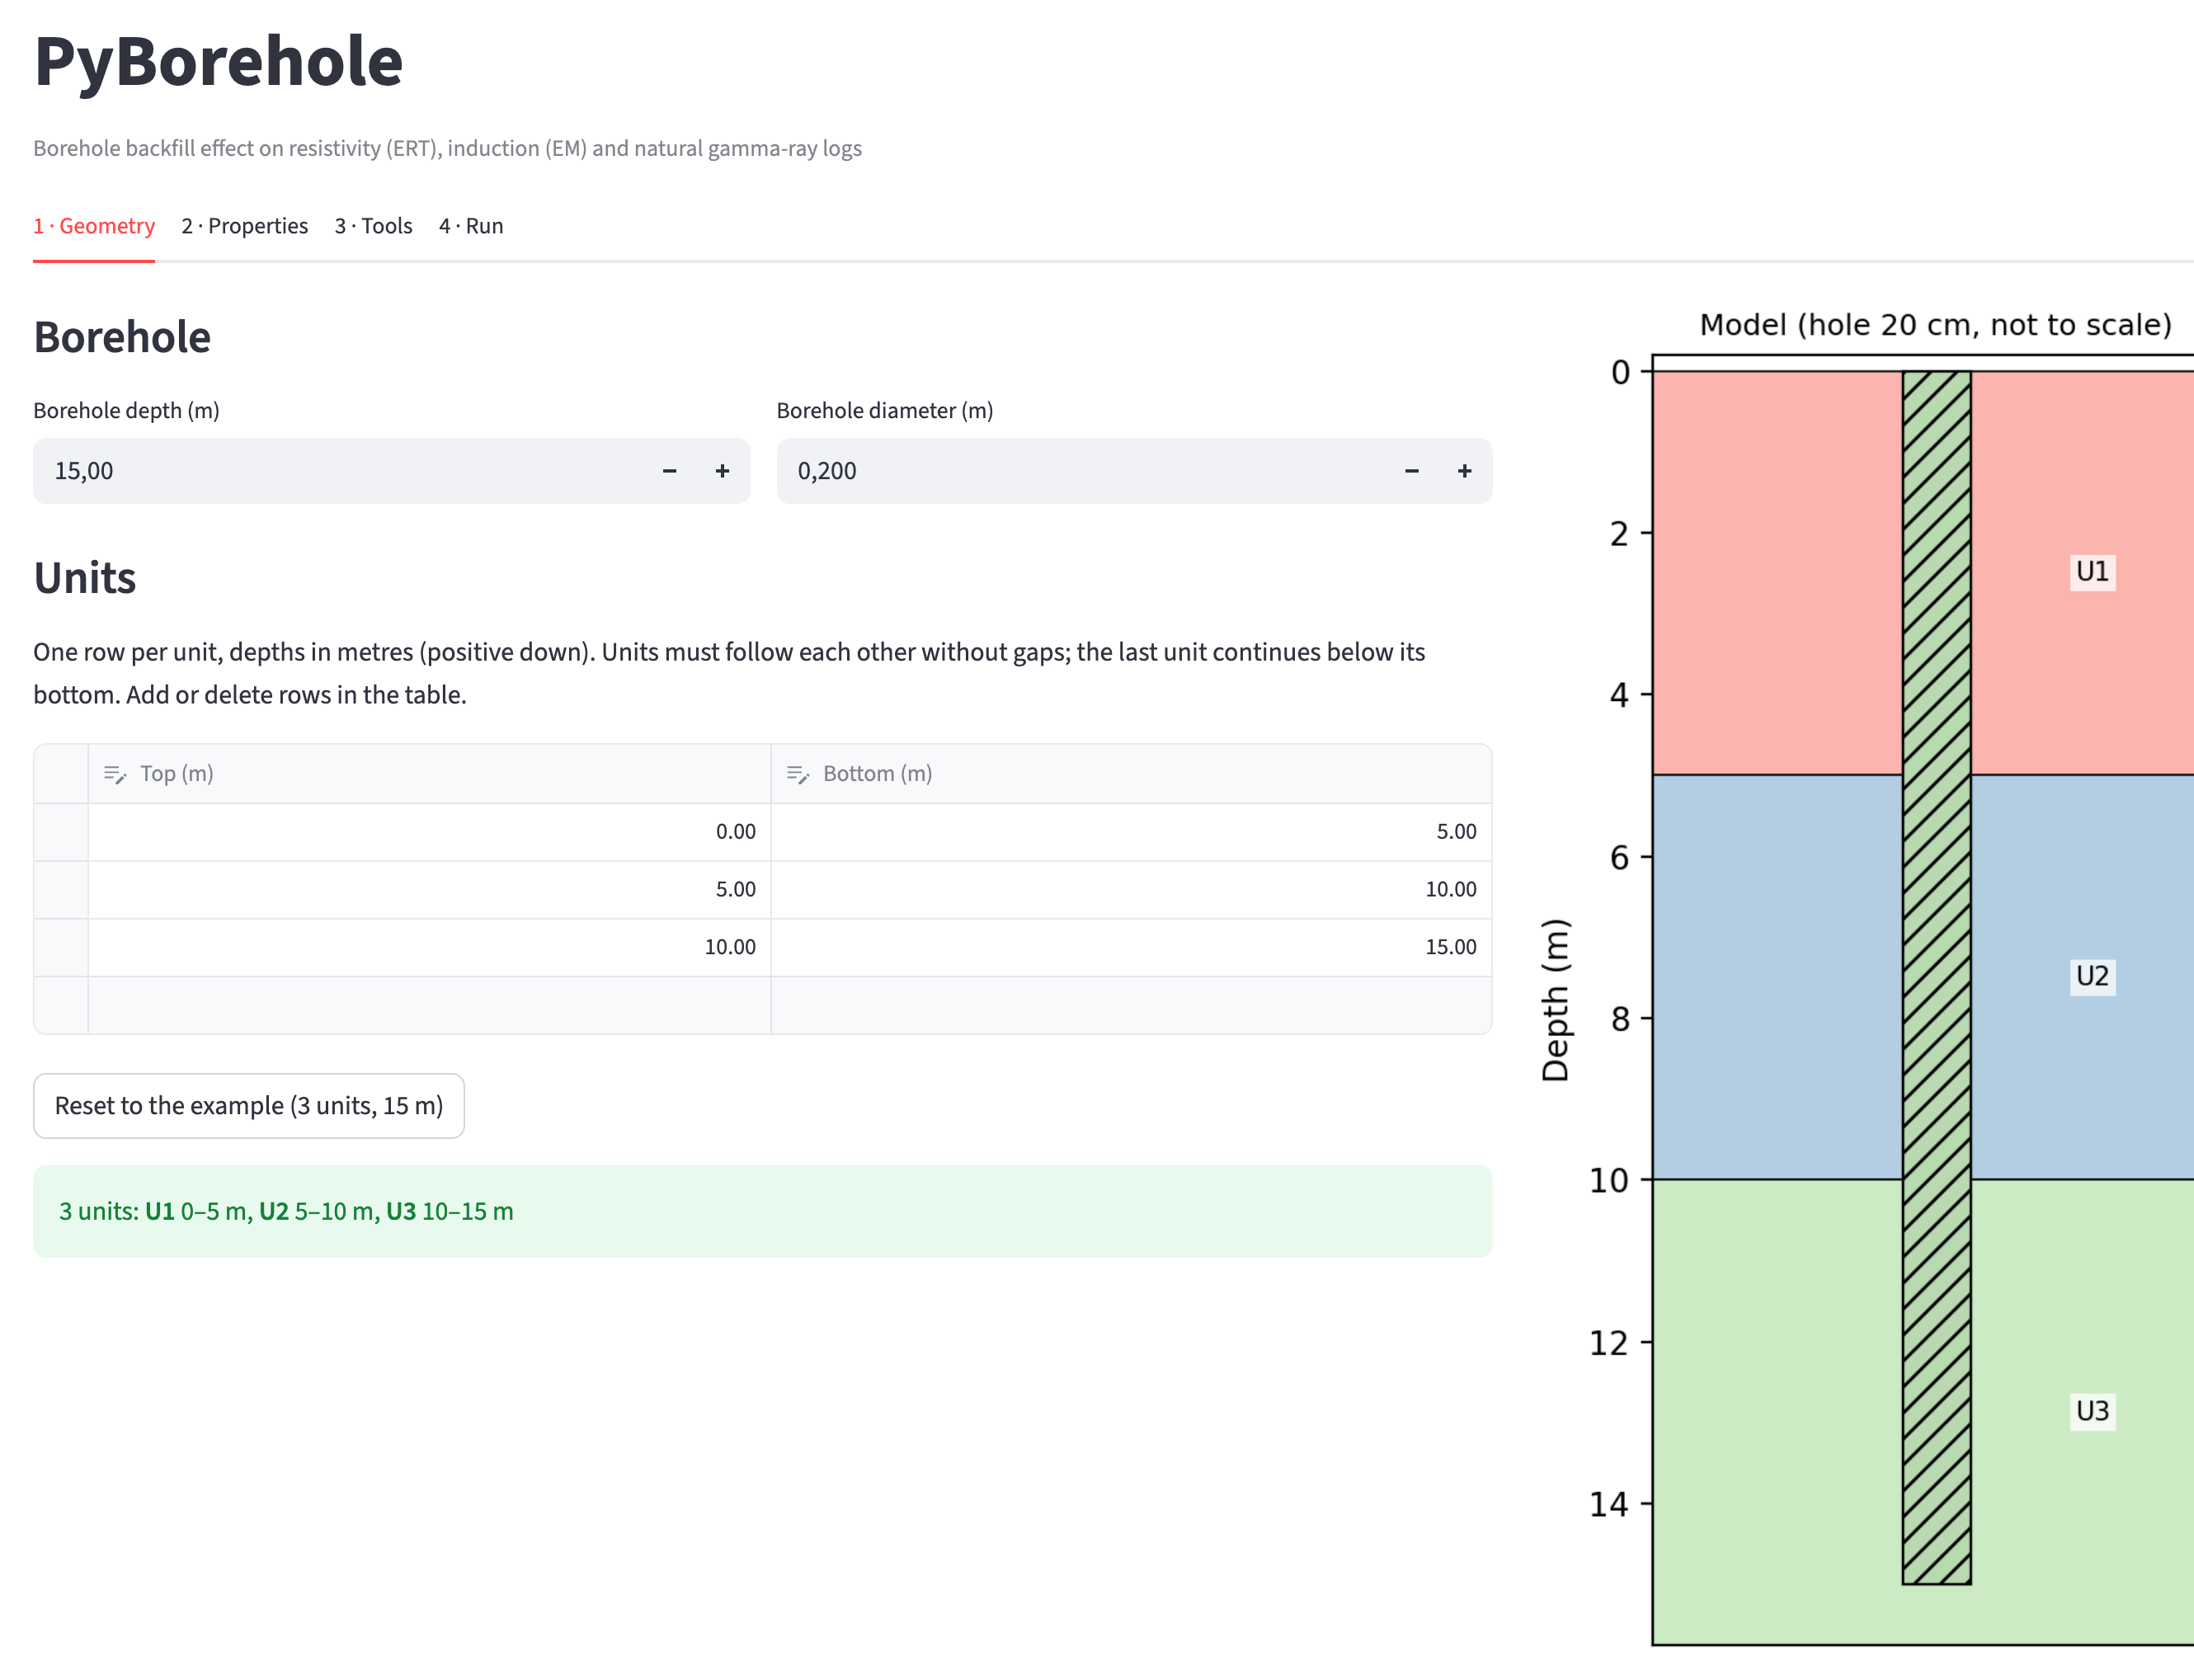
4 · The PyBorehole app
Streamlit · all three methods in the browser · no code needed
Notes:
TRANSITION
All of this is also available without programming. We built a Streamlit app that runs in the browser: you describe the borehole and the layers, choose the tools, and run ERT, EM and the gamma ray with one click. The next slides show the four tabs.

Slide 22



Set up a model and run it in four tabs
App
1 · Geometry
2 · Properties
3 · Tools
4 · Run
Borehole depth and diameter; units as a table of top and bottom depths
Lithology and pore water per unit from a database; Archie's law gives the resistivity
ERT array and spacings, EM coils and frequencies, gamma-ray probe and statistics
Tick ERT, EM and/or gamma ray; logs, borehole effect and CSV download
pip install "pyborehole[all]"
pyborehole-app
Unavailable simulators are greyed out with the reason. Typical run times for the 3-unit example: EM about 35 s, gamma ray 10 s to a few minutes, ERT about 5 minutes.
Notes:
WHAT TO SAY
The app follows the modelling workflow in four tabs.
1. Geometry: borehole depth and diameter, and the units as an editable table of top and bottom depths.
2. Properties: for each unit a lithology and a pore water from a built-in database; Archie's law turns them into a bulk resistivity; K, U, Th for the gamma ray; the borehole fill.
3. Tools: the ERT array and spacings, the EM coil spacings and frequencies, the gamma-ray probe and the counting statistics.
4. Run: choose which methods to simulate, run, and get the logs, the borehole effect and a CSV download.
INSTALLATION
pip install "pyborehole[all]" installs the Python parts; pyborehole-app starts the app. Geant4 (and optionally OpenMC) are installed separately, as described in docs/INSTALL.md; a simulator that is not installed is greyed out in the Run tab, with the reason.
RUN TIMES (3-unit example)
EM about 35 s; gamma ray 10 s to a few minutes depending on the statistics; ERT about 5 minutes and several GB of RAM (two 3D solves).

Slide 23
Tab 1 · Geometry
App
Borehole depth and diameter
Units as an editable table of top and bottom depths; rows can be added or deleted
Checks: units get identifiers U1, U2, … in depth order; gaps and overlaps are reported
Live sketch of the model next to the table
Notes:
WHAT TO SAY
Tab 1, Geometry.
- Borehole depth and diameter at the top.
- The units as a table of top and bottom depths in metres, positive downward. Rows can be added or deleted directly in the table; the last unit continues below its bottom.
- The app checks the table: units get identifiers U1, U2, ... in depth order, and gaps or overlaps between units are reported.
- On the right, a live sketch of the model with the borehole (not to scale) updates as you edit.
LIKELY QUESTION
"Can the borehole be deeper than the layers?" Yes; the last unit extends downward to the bottom of the model.

Slide 24
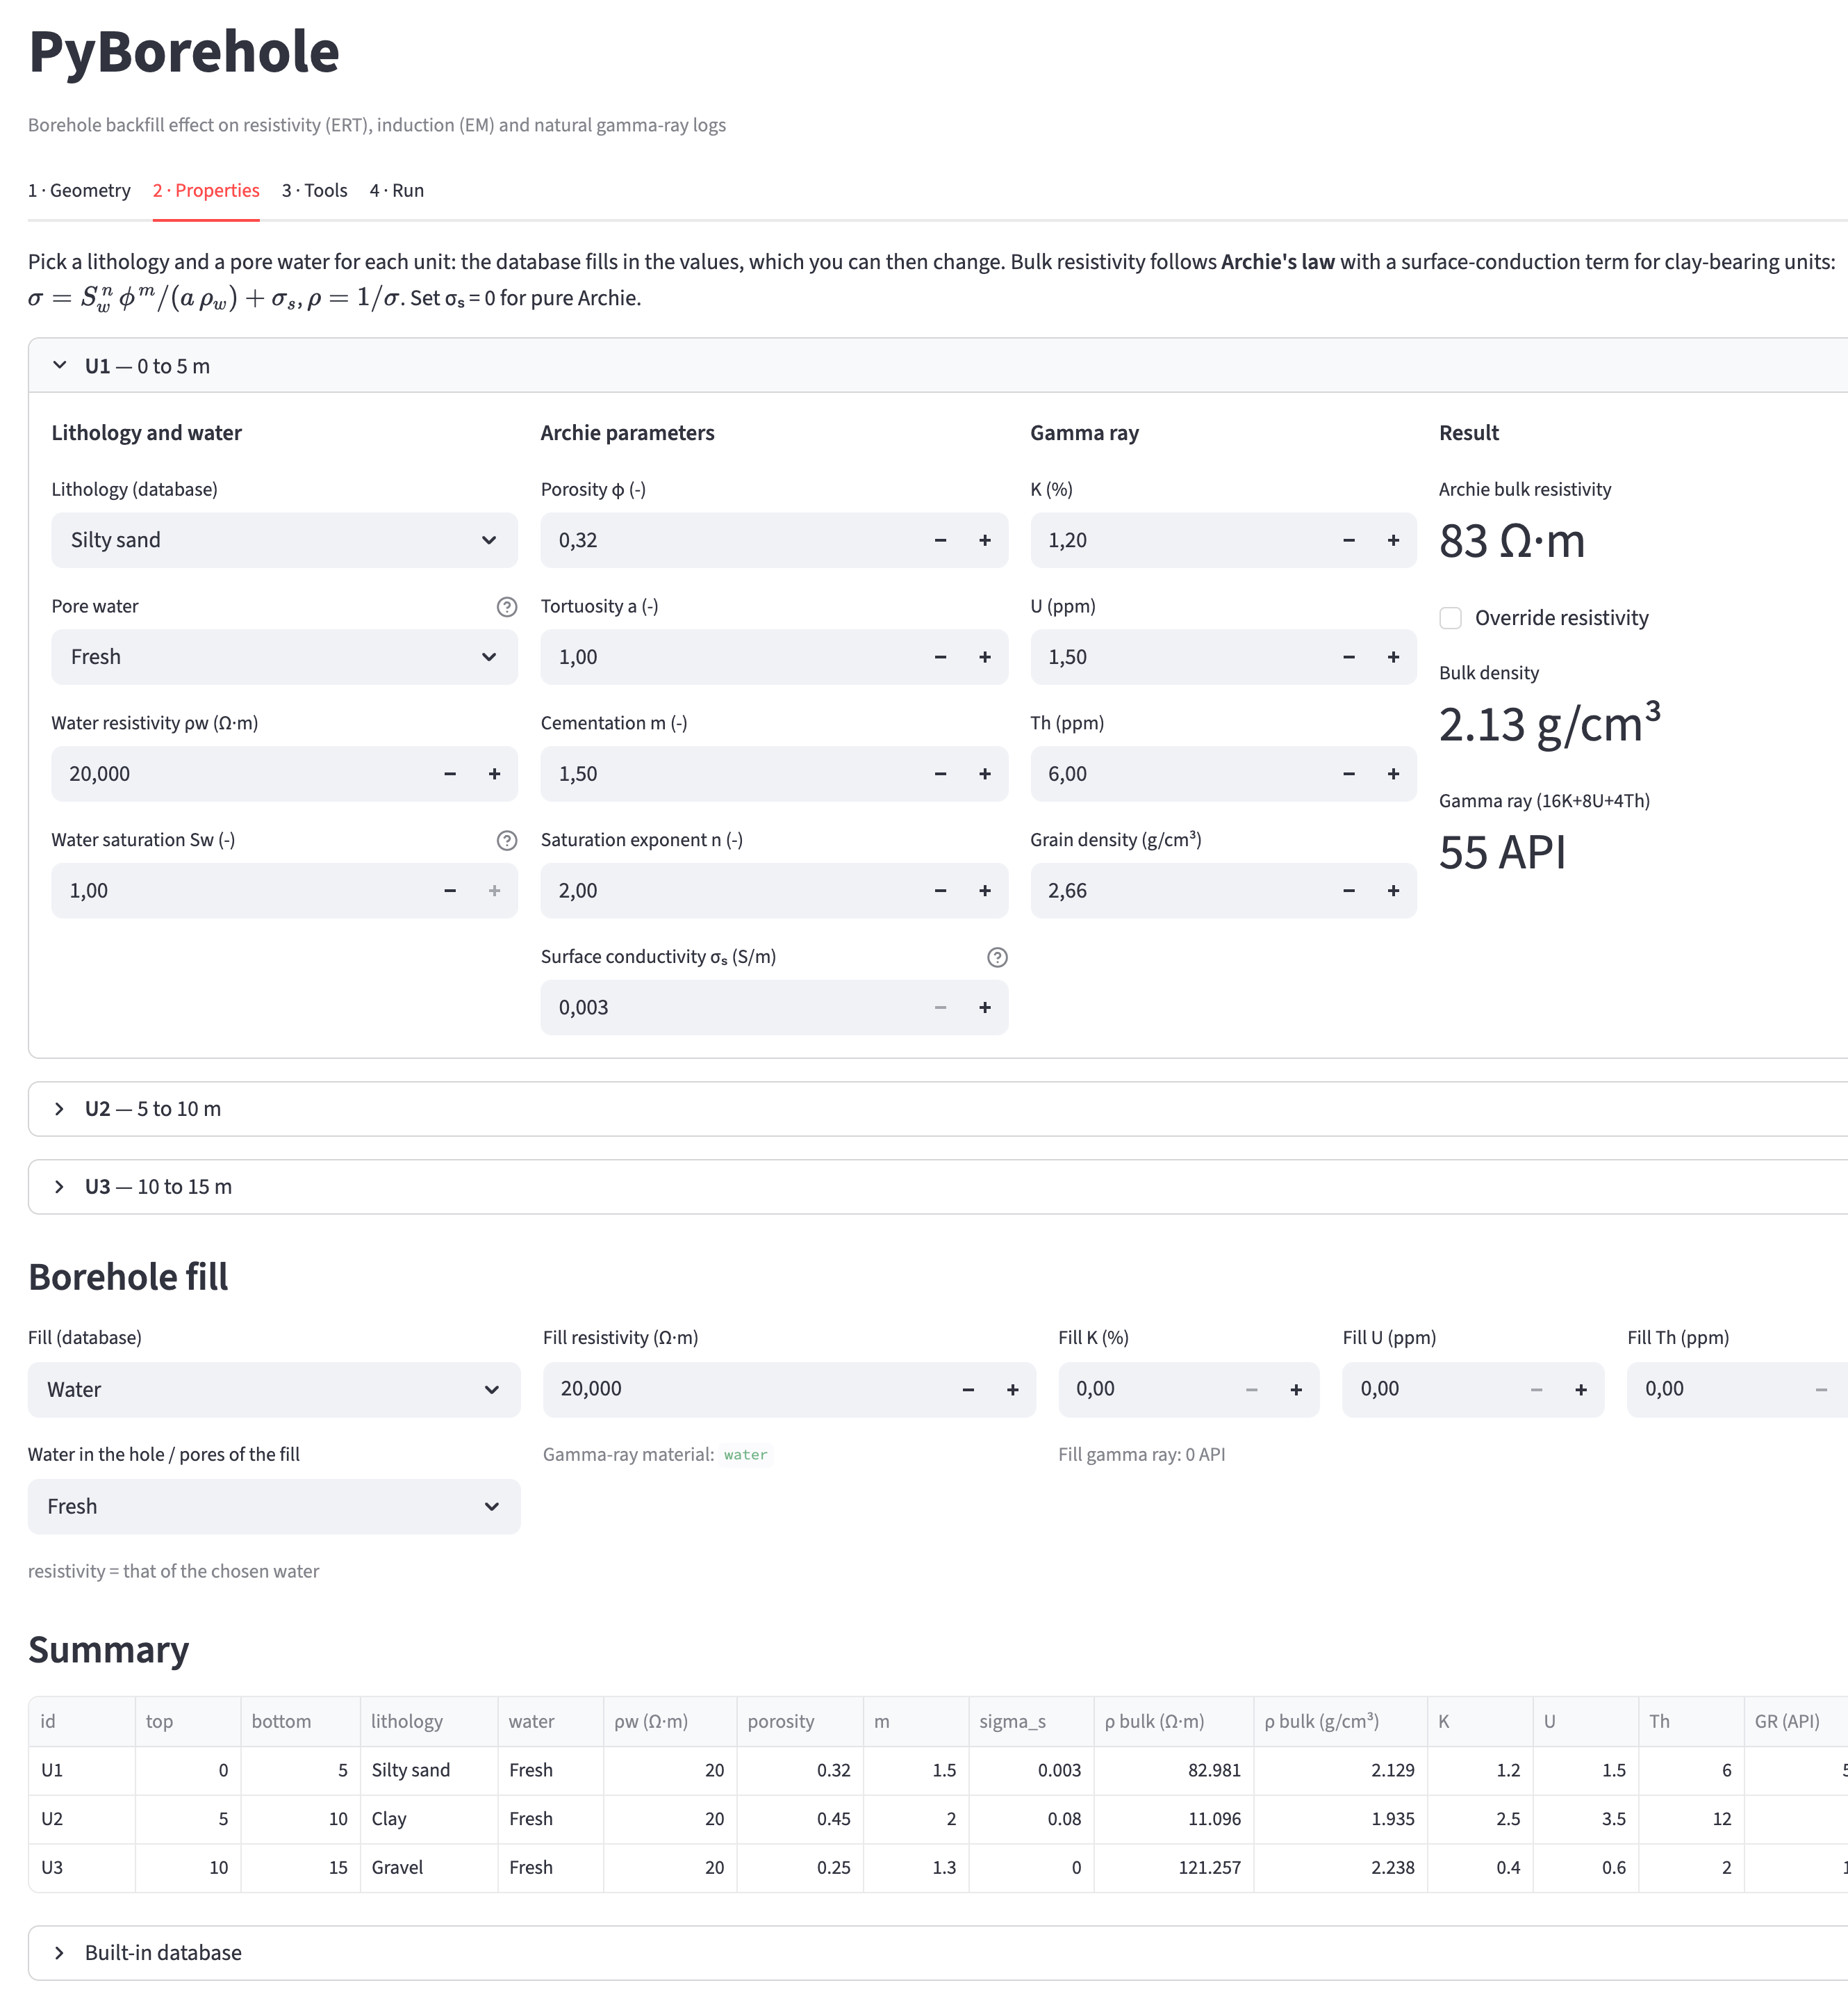
Tab 2 · Properties
App
Lithology and pore water per unit from the built-in database (gravel to limestone; fresh, brackish, salt)
Archie's law σ = Swⁿ φᵐ / (a ρw) + σs gives the bulk resistivity; it can be overridden
K, U, Th and density for the gamma ray
Borehole fill: water, filter sand, bentonite or cement grout
Notes:
WHAT TO SAY
Tab 2, Properties. Each unit (U1 is expanded here) gets:
- a lithology from the built-in database (gravel, sand, silty sand, silt, clay, glacial till, sandstone, limestone) and a pore water (fresh, brackish, salt);
- the corresponding porosity, Archie parameters (a, m, n) and K, U, Th, which can all be edited;
- the bulk resistivity from Archie's law, sigma = Sw^n * phi^m / (a * rho_w) + sigma_s. The surface-conduction term sigma_s accounts for clay; plain Archie overestimates the resistivity of clays several-fold in fresh water. The value can also be overridden.
- the bulk density and the gamma ray (16 K + 8 U + 4 Th) as a check.
BOREHOLE FILL
Water, filter sand, bentonite or cement grout, with their resistivity and K, U, Th; the water in the hole or in the pores of the fill can be chosen too.
SUMMARY
A table at the bottom lists every unit with its properties, so the model can be checked at a glance.

Slide 25
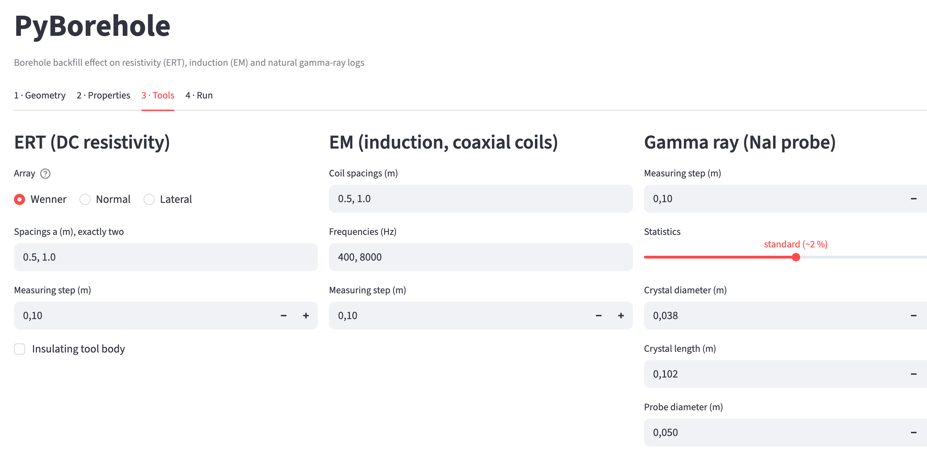
Tab 3 · Tools
App
ERT: Wenner, normal or lateral; spacings; measuring step; insulating tool body
EM: coil spacings and frequencies (comma-separated lists); measuring step
Gamma ray: measuring step, statistics (precision vs run time), crystal and probe size
Notes:
WHAT TO SAY
Tab 3, Tools: the three logging tools side by side.
ERT: array type (Wenner, normal or lateral), the two spacings, the measuring step, and an optional insulating tool body (which switches on the ring electrodes and the calibrated tool constant).
EM: coil spacings and frequencies as comma-separated lists, so several coil pairs and frequencies are simulated at once; the measuring step.
Gamma ray: measuring step; a statistics slider that trades precision against run time (standard is about 2 % per station); crystal diameter and length and the probe diameter.
LIKELY QUESTION
"Where are the bucking coil and tool offset?" They are available in the Python interface (run_realistic.py and EMGeometry) and can be added to the app.

Slide 26
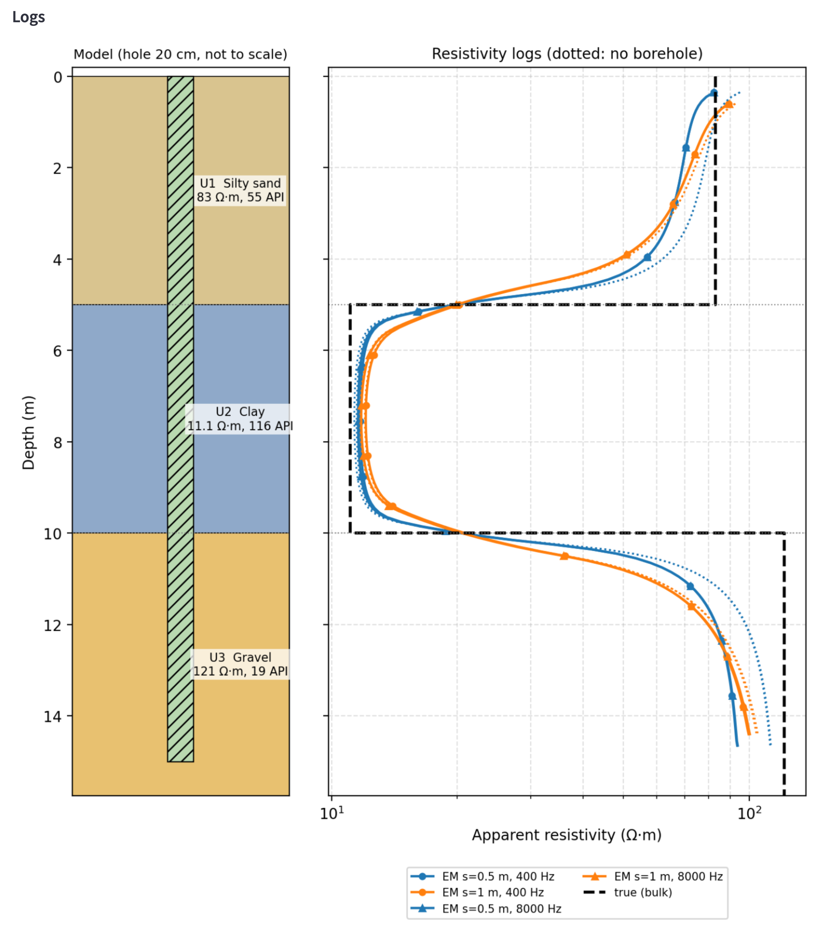
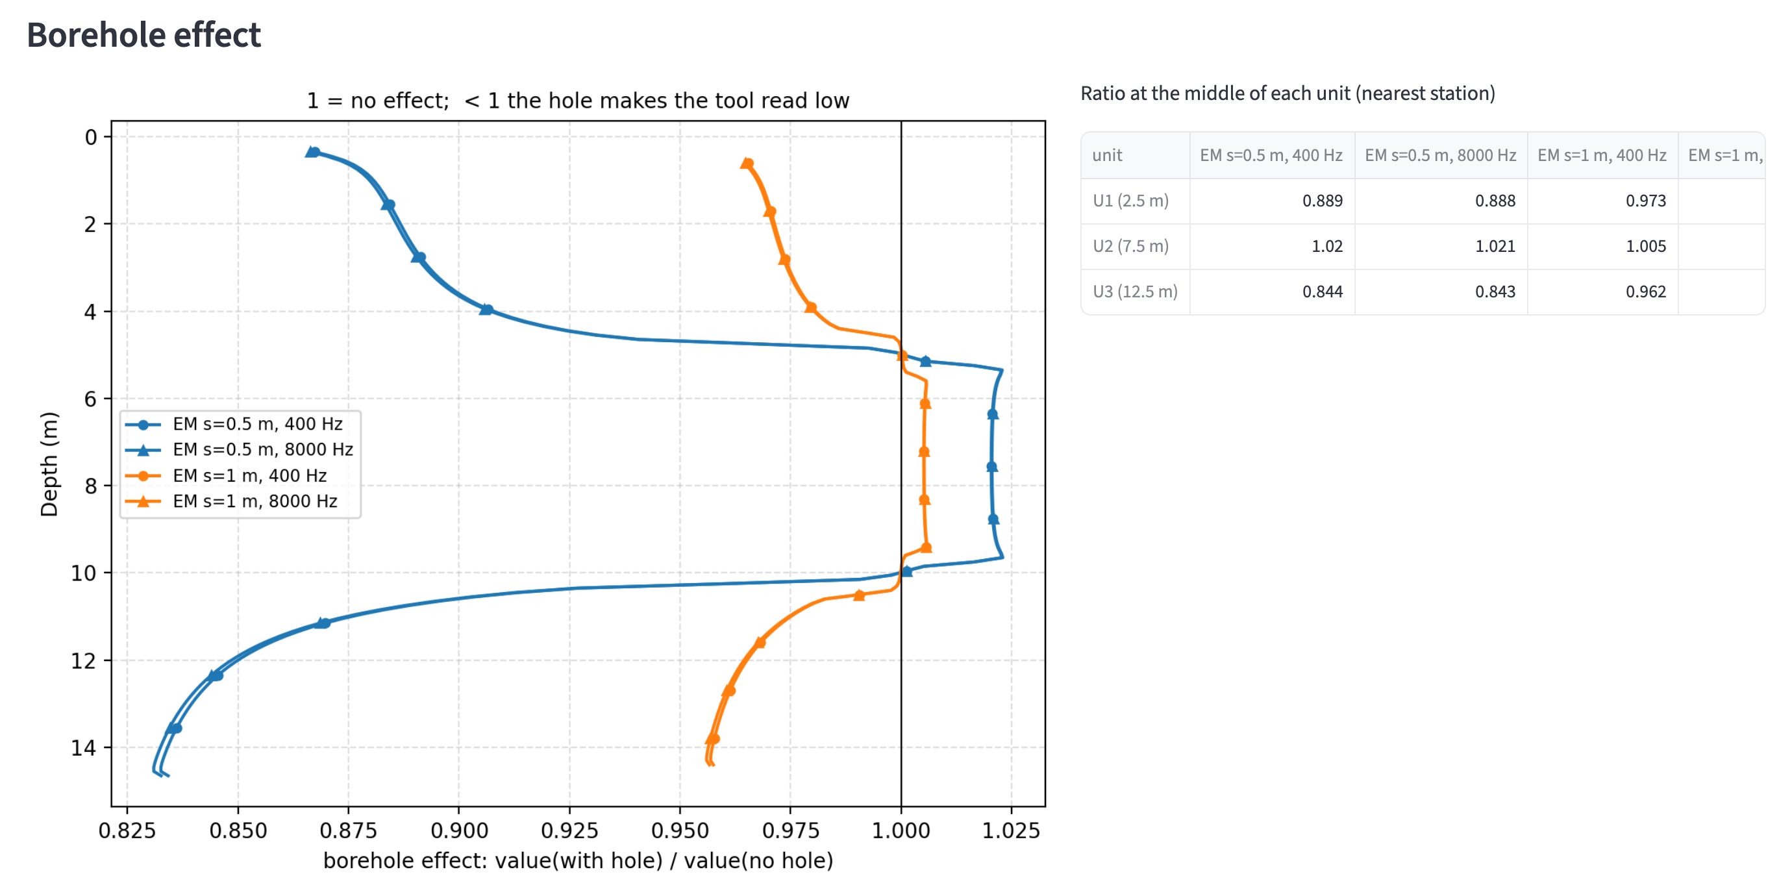
Tab 4 · Run
App
Tick the methods to run; missing simulators are greyed out with the reason
Results: model next to the logs with and without the hole, borehole effect per tool, table per unit
Download the logs as CSV
Notes:
WHAT TO SAY
Tab 4, Run. Tick the methods to simulate; the app checks what is installed and greys out a missing simulator with the reason (in this screenshot only EM was run).
RESULTS
- Left: the model next to the resistivity logs, with the borehole (solid) and without it (dotted), and the true bulk resistivity (dashed). Here: EM coil spacings 0.5 and 1 m at 400 Hz and 8 kHz.
- Right: the borehole effect of each tool versus depth (1 = no effect, below 1 the hole makes the tool read low), and a table of the effect in the middle of each unit.
- The logs can be downloaded as CSV for further processing.
READING THIS EXAMPLE
Fresh-water fill (20 Ohm.m) in a 0.2 m hole: the 0.5 m coils read 11 % low in the silty sand and 16 % low in the gravel; the 1 m coils only 3-4 %. In the clay (11 Ohm.m) the less conductive water makes the tools read slightly high (2 %).

Slide 27
What PyBorehole gives you
3D
the hole, backfill, tool body and an off-centre tool are modelled, not assumed away
3
The borehole effect of ERT, EM and gamma-ray tools, for your hole, your backfill and your tool, before you log. Developed jointly by Metinco, Deltares and the Aristotle University of Thessaloniki.
methods on one shared model: PyGIMLi, SimPEG and Geant4
0.1–1.7 %
github.com/mariosgeo/PyBorehole · pip install pyborehole · pyborehole-app
ERT and EM against exact solutions; gamma ray matches industry correction charts
Notes:
WHAT TO SAY
To summarise: PyBorehole quantifies the borehole effect of resistivity, induction and gamma-ray tools for a given hole, backfill and tool, before logging, and provides the corrections afterwards.
THREE POINTS
3D - the borehole, the backfill zones, the tool body with ring electrodes and coils, and even an off-centre tool are modelled, not assumed away.
3 methods - ERT with PyGIMLi, EM with SimPEG and the gamma ray with Geant4, all on one shared earth model.
Validated - ERT and EM agree with exact Fourier-Bessel solutions within 0.1-1.7 %; the gamma ray reproduces the industry correction for a water-filled hole (0.76 vs 0.77) and agrees with the independent OpenMC code.
KEY MESSAGES FOR PRACTICE
- Conductive backfill is the main problem for induction: use longer or focused coil arrays.
- For normals and laterals, conductive backfill can make the tool read too high or too low depending on diameter and spacing.
- For the gamma ray the material matters: water lowers the log by about a quarter; bentonite and cement add their own radioactivity.
THE CONSORTIUM
Developed jointly by Metinco, Deltares and the Aristotle University of Thessaloniki. Open source at github.com/mariosgeo/PyBorehole; pip install pyborehole; pyborehole-app starts the interface.
POSSIBLE NEXT STEPS
Measured backfill properties, a diameter sweep for the gamma ray, casing and screen sections, comparison with field logs.

