Slide 1
Big Data Graduation Project
Submitted by:
Andrew Rafaat Adeeb 16P8011 Mario Sherif Rasmy 16P3021

Slide 2
OUTLINES
INGESTION
STORAGE
PROCESSING
OOZIE WORKFLOW
VISUALIZATION

Slide 3
Ingestion
Big Data ingestion is the transportation of data from assorted sources to a storage medium where it can be accessed, used, and analyzed by an organization.
Since there is only one source of data and it is provided for us “covid-19.csv”, so we can consider uploading this data to the virtual machine cloudera as the ingestion process, it is illustrated in the following steps.

Slide 4
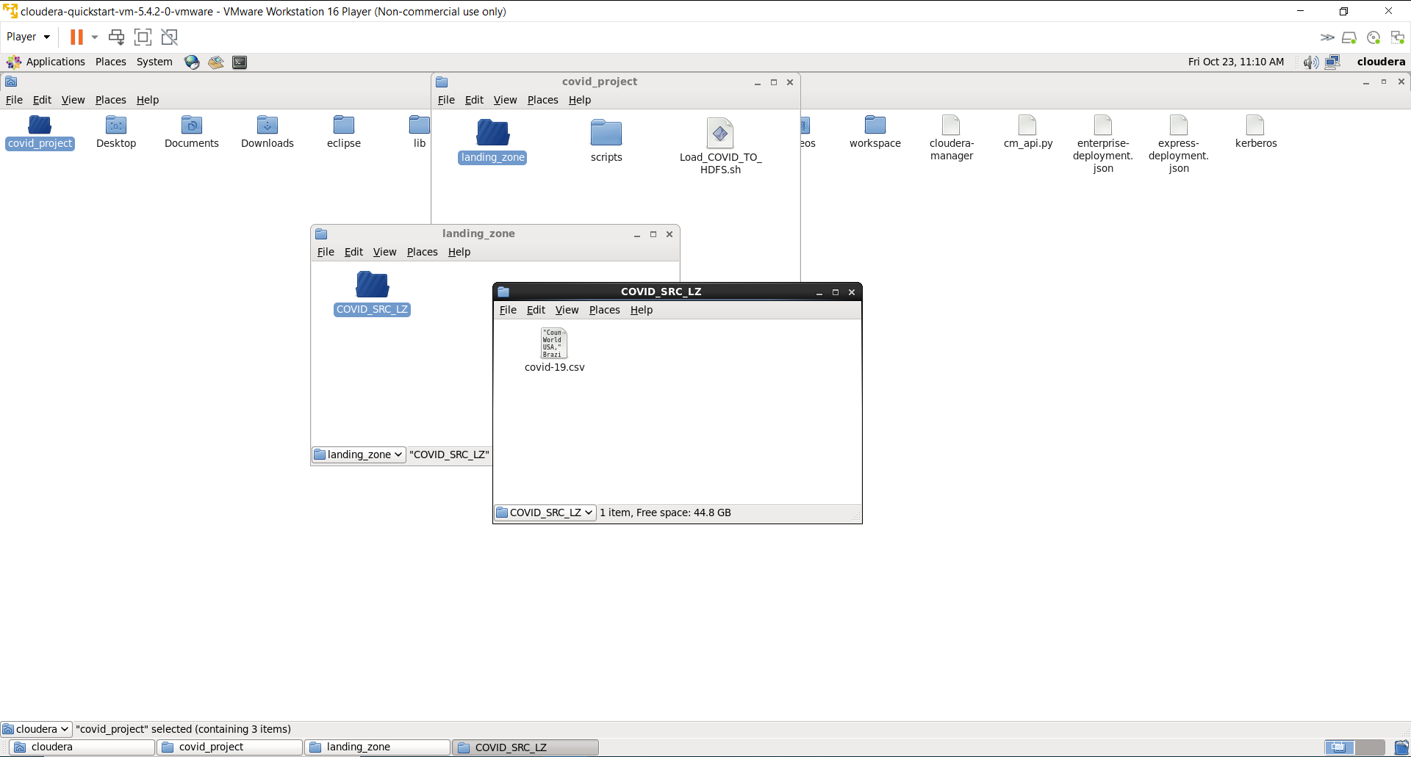

Slide 5
Storage
Storage for big data is designed to collect voluminous data produced at variable speeds by multiple sources and in varied formats.
Hadoop Distributed File System is used in this project to store data, the steps for copying data to HDFS is illustrated in the next step.

Slide 6
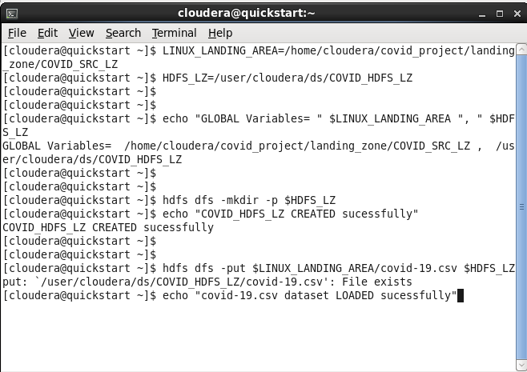

Slide 7
Processing
big data usually stored in thousands of commodity servers so traditional programming models such as message passing interface (MPI) cannot handle them effectively. Therefore, new parallel programming models are utilized to improve the performance of NoSQL databases in datacenters.
Hive is used in this project which is a MapReduce wrapper that provide a better environment and querying and analyzing easier, this is illustrated in the next steps.

Slide 8
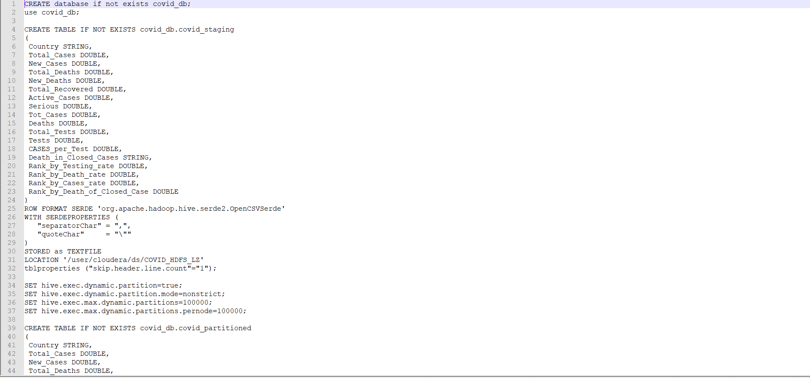

Slide 9
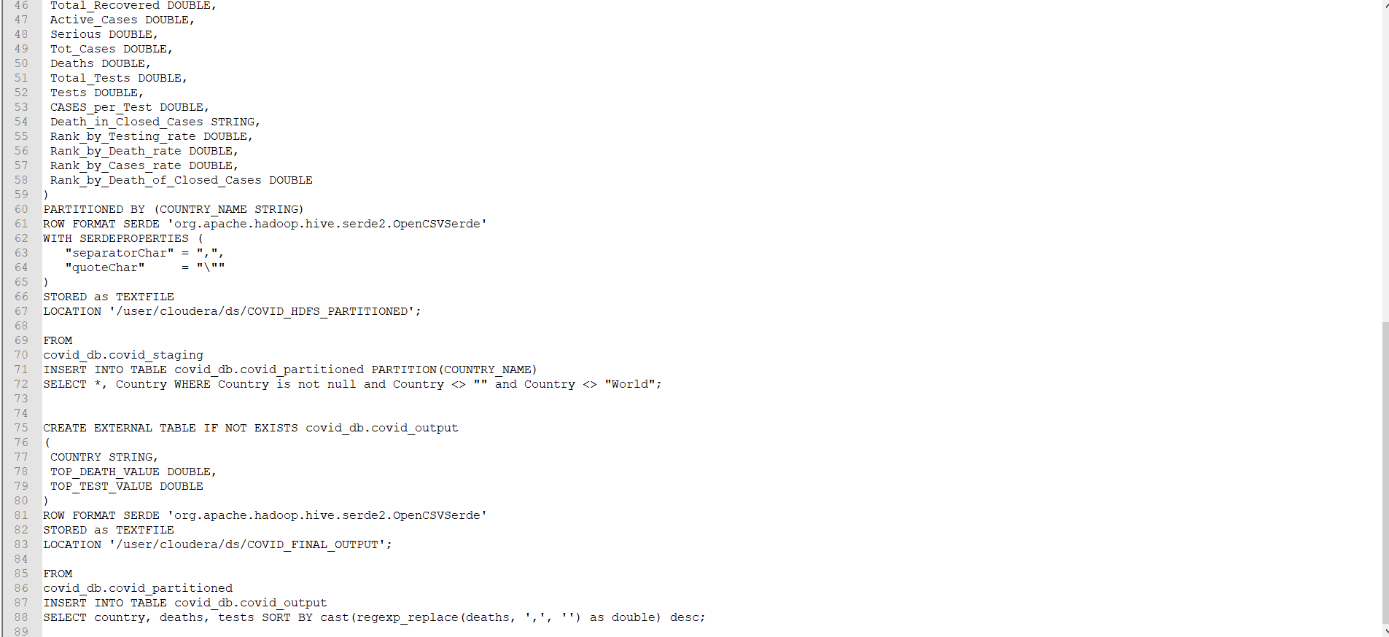

Slide 10
Oozie workflow
Apache Oozie is a server-based workflow scheduling system to manage Hadoop jobs.
An Oozie Workflow is a collection of actions arranged in a Directed Acyclic Graph (DAG). Control nodes define job chronology, setting rules for beginning and ending a workflow. In this way, Oozie controls the workflow execution path with decision, fork and join nodes. Action nodes trigger the execution of tasks.
Oozie workflow setup is illustrated in the next steps.

Slide 11
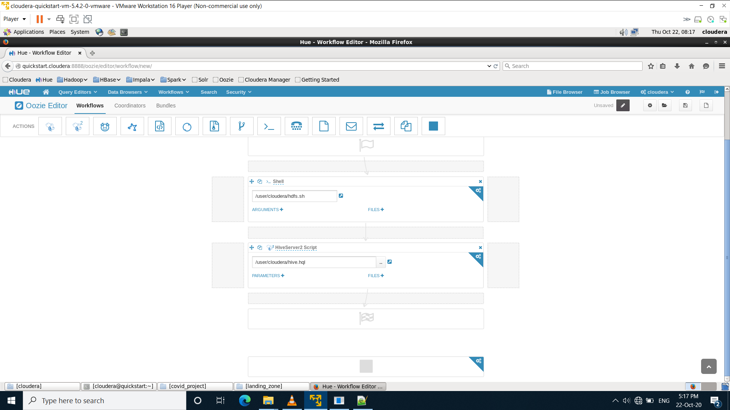

Slide 12
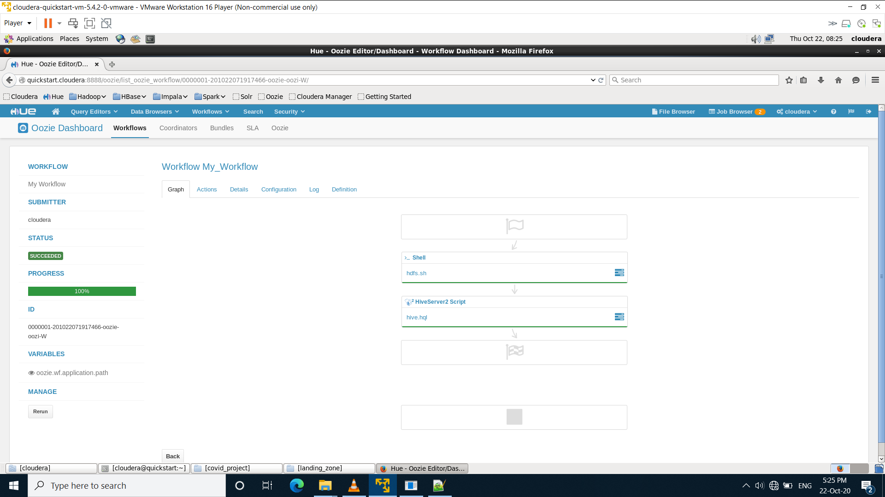

Slide 13
Visualization
Big data visualization refers to the implementation of more contemporary visualization techniques to illustrate the relationships within data. Visualization tactics include applications that can display real-time changes and more illustrative graphics, thus going beyond pie, bar and other charts. These illustrations veer away from the use of hundreds of rows, columns and attributes toward a more artistic visual representation of the data.
We used Power BI to visualize the relationships within data, these visualizations is shown in the next slide.

Slide 14
