Slide 1
AI & Big Data Coursework – 21COP511
F133746

Slide 2
Task 2: Question: Which Region has the most maternal deaths and what is the most possible factor that can cause maternal mortalities?
Objectives:
Find the Region who has the most deaths
Analyse the correlation between Health Expenditure and Maternal Mortality
Analyse if Caesareans affect Maternal maternity
Analyse the effect in Adolescent birth rate and Maternal Mortality
Analyse if Births that attended by skilled personnel are a factor of Maternal Mortality
Analyse if Anaemia had an impact in Maternal Maternity
Find the Region with the most deaths and conclude overall which factors above are related to Maternal deaths

Slide 3
Data Compilation
First, I used Maternal Mortality ratio and Region to find the continent with the most deaths. For the rest objectives I used again Region and the Value of Health Expenditure as a percentage of the Gross Domestic Product to analyze the relation that has with the maternal mortality. Moreover, I choose to use the number of Births attended by skilled health personnel and the Antenatal care coverage to see if the have any impact on maternal mortality. I also use Caesareans, Pregnant women with Anaemia and Adolescent birth rate (per 1000 women) to check again for any relation or impact on maternal deaths.

Slide 4
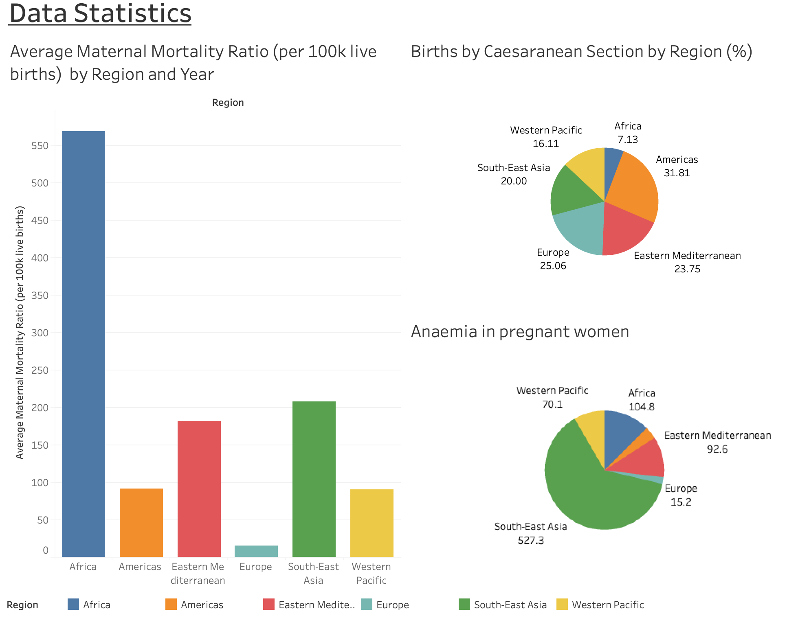

Slide 5
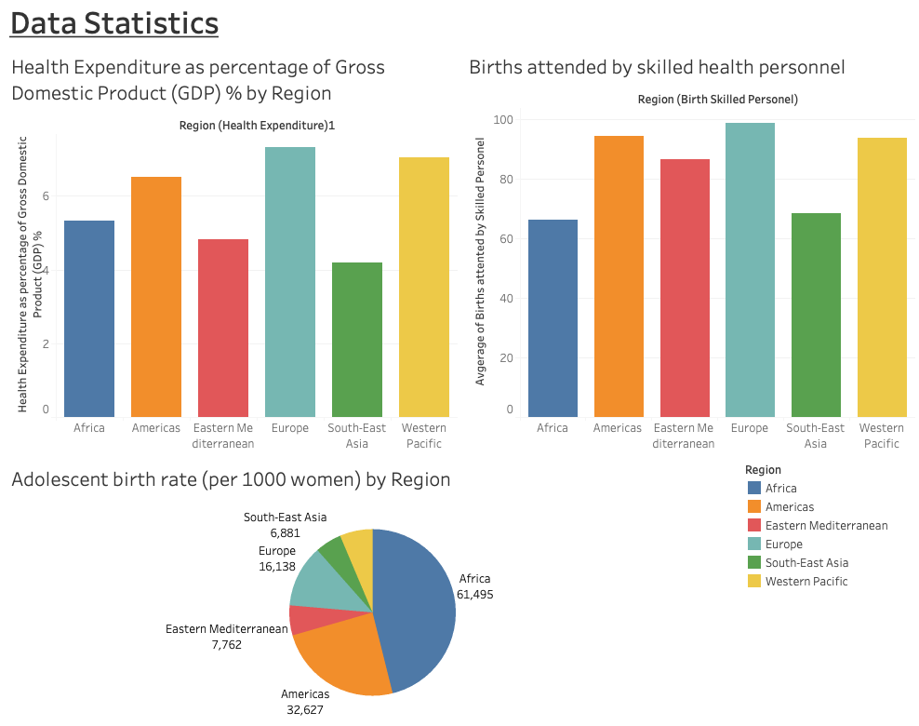

Slide 6
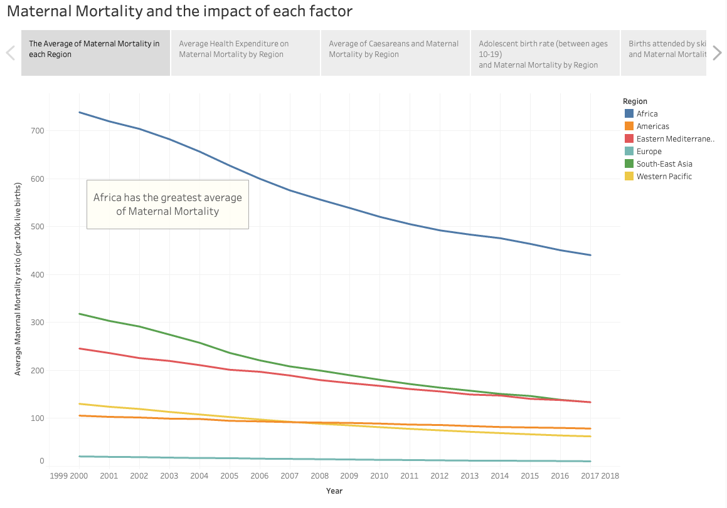

Slide 7
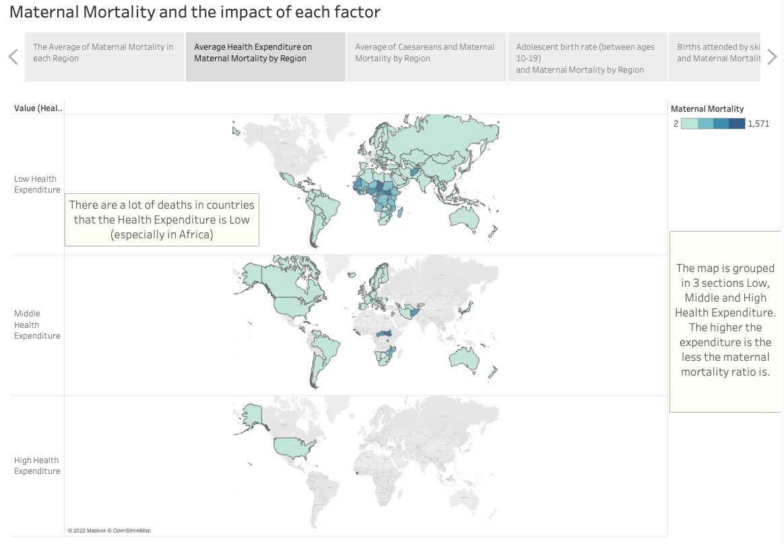

Slide 8
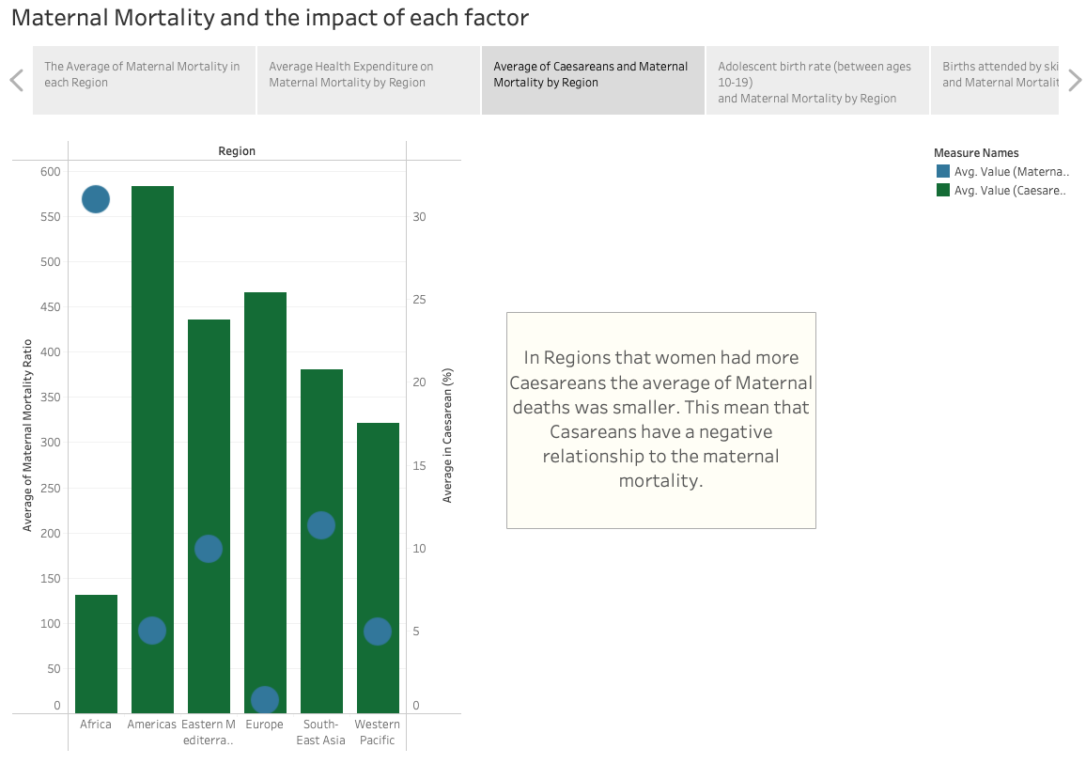

Slide 9
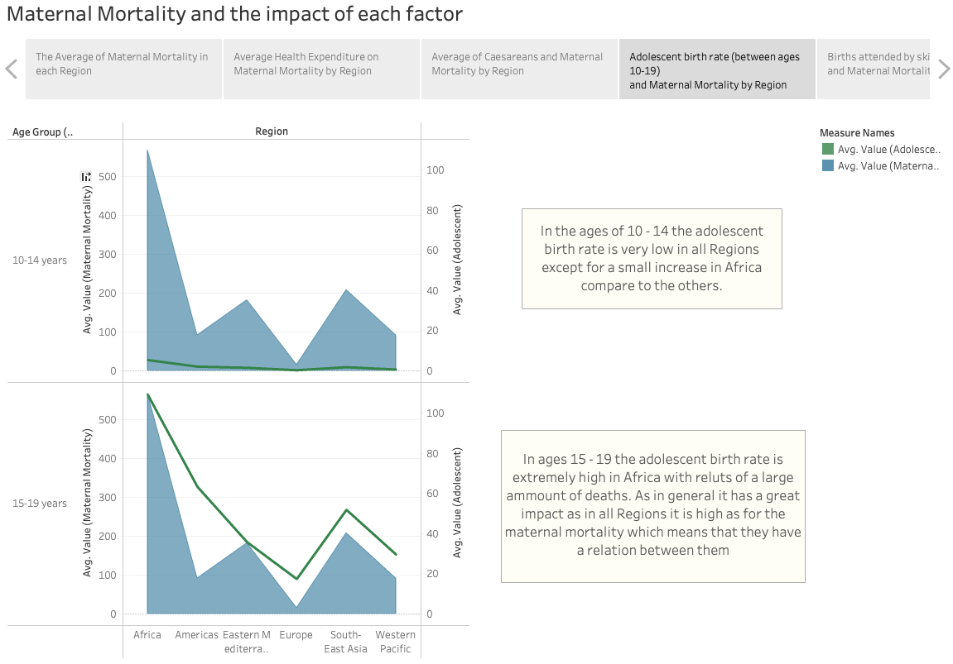

Slide 10
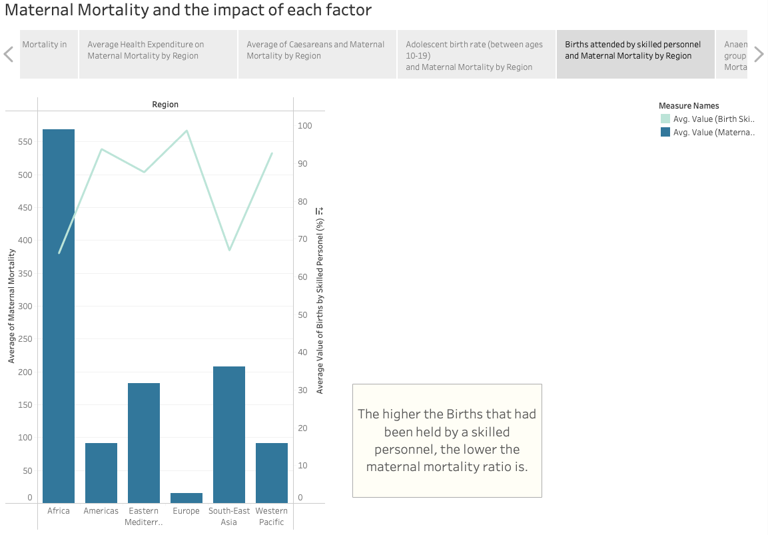

Slide 11
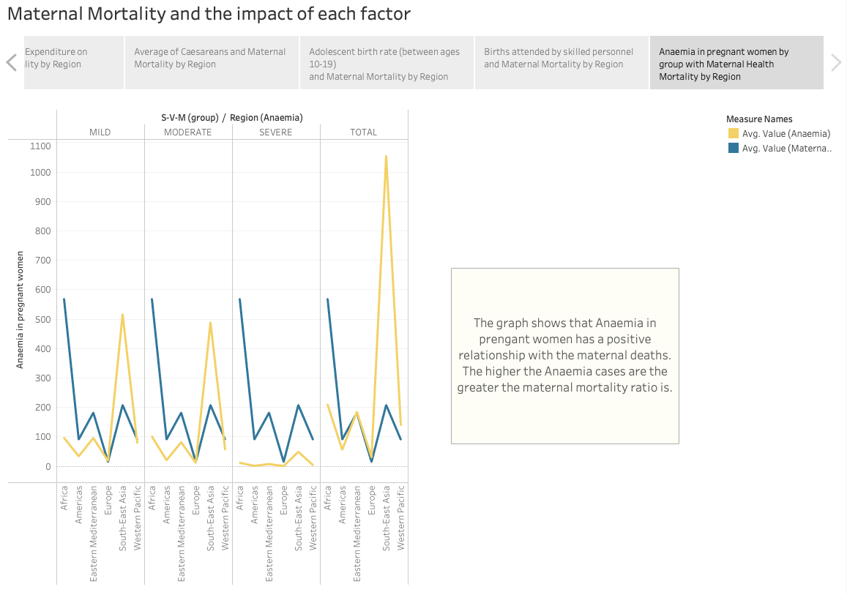

Slide 12
Relevant Findings:
The findings on a paper was that Anaemia in pregnant women associate with maternal deaths. For the research they used survey methods all around 29 different countries. Moreover, the possibilities of maternal death was higher in mother with severe anaemia, although that leads to a more biological plausibility because severe anaemia reduces the oxygen as well as the iron and alters enzyme so maybe that is the reason of the correlation of the deaths (Daru J. et al, 2018). In the analysis that have been made in the previous slides I came with the same results that an increased number of pregnant women with anaemia has increased number of maternal mortality.
As it concerns the health expenditure, in a recent paper they found that there is indeed a negative effect between the health expenditure and the maternal mortality (Goli S., 2021). Furthermore, another observation was that in a country in a region in Africa although the health expenditures are high the maternal mortalities are still being high too. As for my analysis I found the same results that in regions with more health expenditure the maternal mortality was lower.

Slide 13
On another paper (Nour M. N., 2008) the research showed that births attended by skilled personnel had a direct impact on the decrease of the maternal mortality. In addition, some more factors of those results would be the delay of women to seek care in time, decide to seek care and delay or postpone to take a treatment. The same results have been found in the analysis I have made.
One more finding was that a statistic showed that girls younger than the age of 15 are more likely to die from maternal causes as it is double likely at the ages 15-19 (Nove A. et al, 2014). The risk for maternal mortality in younger ages is also based on education and socioeconomic factors. On my findings I found equally that in the ages of 15-19 the maternal mortality was very high although that didn’t seem to be the case as it comes for the ages younger than 15.

Slide 14
Conclusion:
1) To start with the first part of the question was what Region had the more deaths and that is Africa with a significant difference compared to the others as it can be seen on the first line graph.
Going now to the second part of the question, there are multiple factors that can increase or decrease the maternal deaths.
2) On the the map we can see three groups, the low, middle and high government expenditure. On the Low health expenditure, the maternal mortalities are extremely high. Going to the Middle and High health expenditure it is obvious that the deaths are decreasing. This is because countries that spend their money in the health care like doctors and treatments the maternal deaths are in less risk.
3) On the third graph we can see the average of Caesareans with the maternal mortality ration. As the number of caesareans is high the maternal deaths are low. Some women may suffer for a decease that it is very serious so with caesareans they avoid the danger of death. Caesareans then have a positive impact as they can decrease the deaths.

Slide 15
On the fourth graph we can see the adolescent births in two groups of ages. In the fist one 10-14 the deaths are very low compared to the group of 15-19 which there are significantly high. This is clear that the there is a really bad affection in the maternal mortality ration.
On the fifth graph it is shown the births attended by skilled health personnel which seems that as long as they help women to give the birth the maternal mortality is lower.
On the sixth graph we can see the analysis of the Anaemia in the maternal mortality which has a great impact as well because especially in the total section the higher the Anaemia is seen in the pregnant women, the higher the danger of death.
As a conclusion, the factors the have a bad impact on maternal mortalities is mainly the adolescent and the Anaemia. As for the rest they can have a negative impact if the relation is not right.
One more thing that has to be mentioned is that as from the data they were not enough to give a clear view as if they have indeed a bad influence on the maternal mortalities. Moreover, in some of the data WHO misclassified some countries in the wrong region which provided not so clear results.

Slide 16
References
Daru J. et al (2018). Risk of maternal mortality in women with severe anaemia during pregnancy and post partum: a multilevel analysis. [Online]. Available at: https://reader.elsevier.com/reader/sd/pii/S2214109X18300780?token=A19FA44CED973B6E28C24DE7C3CB3398B0840C308ED8778091C990A6A021A8AAD8D76FF317A5E179AD96B3AFE373D70C&originRegion=eu-west-1&originCreation=20220527091128 [Accessed: 26/05/2022]
Goli S. (2021). Relationship between mortality and health care expenditure: Sustainable assessment of health care system. [Online]. Available at: https://www.ncbi.nlm.nih.gov/pmc/articles/PMC7904168/ [Accessed: 26/05/2022]
Nour M. N. (2008). An Introduction to Maternal Mortality. [Online]. Available at: https://www.ncbi.nlm.nih.gov/pmc/articles/PMC2505173/ [Accessed: 26/05/2022
Nove A. et al (2014). Maternal mortality in adolescents compared with women of other ages: evidence from 144 countries. . [Online]. Available at: https://www.sciencedirect.com/science/article/pii/S2214109X13701797 [Accessed: 26/05/2022]
(2022) WHO. [Online]. Available at: https://www.who.int/data/gho/data/themes/maternal-and-reproductive-health

Slide 17
Task 1:
The first talk was an introduction to AI, ML and cognitive computing by Richart Hopkings Freng from IBM. The talk was about the history of AI/ML, how it evolved throw-out the years and some amazing inventions such as Deep Blue, Stanley, Watson and Alphago which by the time they invented were ahead of their time. The thing I found more interesting to the talk was the computer called Watson. It is amazing how they are setting a task. This task is around two weeks, and they have to complete it. Moremanage to build a machine who was able to understand a question and then deciding which algorithms to run to get the right answer. This machine was able to compete a quiz game called Jeopardy. Furthermore, one more thing that impress me was the Neurosynaptic chip which can analyse multiple video signals and try to identify people, bikes, or automobiles.
The second talk was about the Data Science Life Cycle by Ayodeji Akiwowo, a PhD student at Loughborough University. The topic was mainly to describe the role of a Data Scientist, the cycle that use to do his job and more specific the CRISP-DM. It was very interesting that this cycle has 6 steps, and a lot of organisations over, he said that in the cycle you can go back and forward from stage to stage. This gives you the opportunity to fix something you have done in the past. Also, he mentions that in all parts of the cycle, documentation is very important as model monitoring which you need to constantly monitor the model performance.

Slide 18
The third talk I am going to describe is about AI in Food Manufacturing by Dr Mohammad Saada. The talk was about Millitec and what they do. He explained that MIllitec is building machines that require a certain level of hygienic standards. In this talk I was impressed about their trial to build a new machine and the collaboration with our university. More specific, Millitec had a lack at the expertise of the computers so they seeked help from the department of computer science of Loughborough University. In the end it was interesting that they turn to the use of Machine Learning in order to make the machine detect the different objects that travelling underneath the cameras. In the end they made the HDR hygienic delta robot which adopted the past 2 years, and it is impressive.
The fourth talk was talking about Big Data and Cyber Security by Jensen Deutrom and John Alcock. In general, the talk was about the big data, they worries and the solutions as well as the Risks of the data and the opportunities. One thing that draw my attention was that in Fujitsu they carry out cyber and treat detection. They do that by using intelligence driven security information and provide a predictive contect which helps the organisations understand the treats they are facing. Furthermore, one more interesting thing they told us was that human risk is overlooked. Humans are usually the weakest link in the chain, so we need to have a solution to address the risk as for example the past 2 years we are all using zoom and this reduced ours ability to security behaviour.
The title of the fifth talk was “Human – Centred Innovation” by Many Wallace. This talk was about what businesses are for, what is innovation and what products can create. The interesting part of the talk was about Metaverse and the elements they are going to power it. More specific, she said that metaverse isn’t owned by any company or a group. Impressive was the fact that a lot of people invented their money in Crypto currencies and NFT’s although now there is a crash and that is not good. Virtual Economies are getting famous more and more as we can buy Cryptocurrencies even from PayPal. One last thing that was interesting is that a monetisation is here. People can now create, sell or resell virtual goods as well.

