Slide 1

Servo Radar Detection System using Arduino & LABVIEW

Slide 2
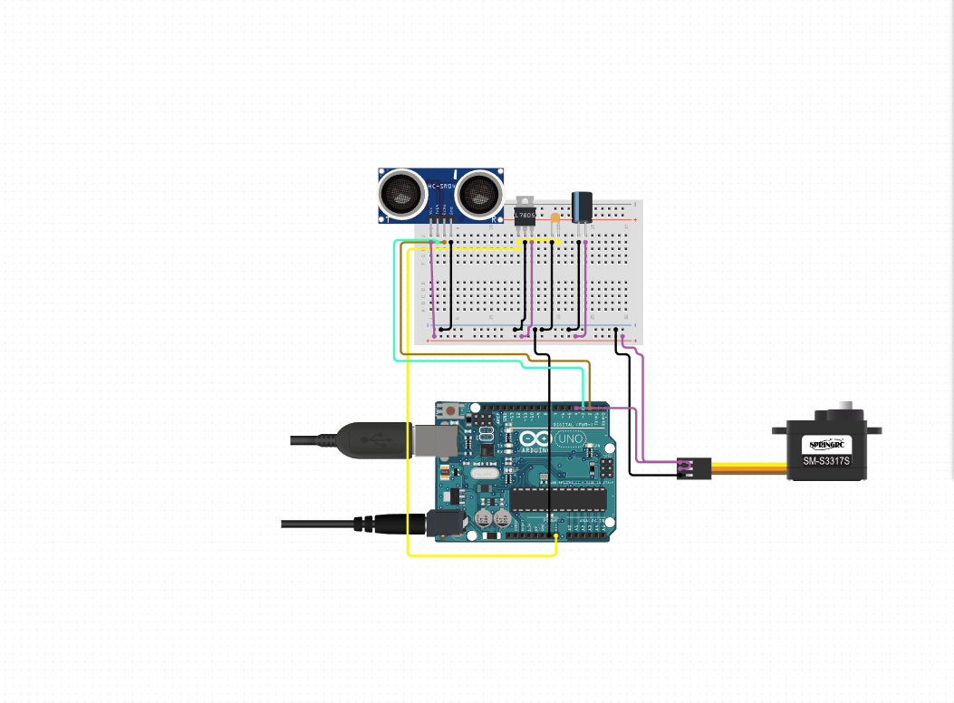
Schematic, Hardware & Connection Between Components
1)Arduino Uno
2) Ultrasonic Sensor: HC-SR04
3)Servo Motor
4)Breadboard
5)MIKROE-512 breadboard Jumper wires
6)RS Pro Make USB A to Male USB B Cable, USB 2.0, 500mm

Slide 3
Software Requirements
1) NI Labview ( v18 & above
2) Arduino IDE 1.8.19
3) NI-VISA Extension package

Slide 4
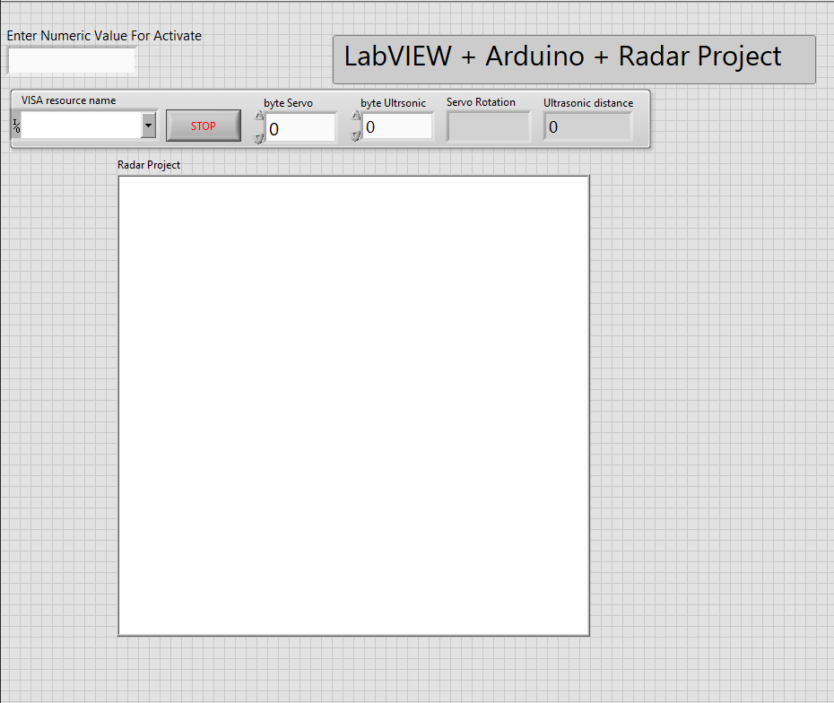
Basic Overview and User Interface

Slide 5
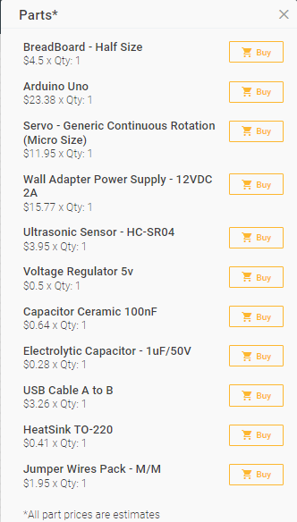
General Cost of Project Shown

