Slide 1
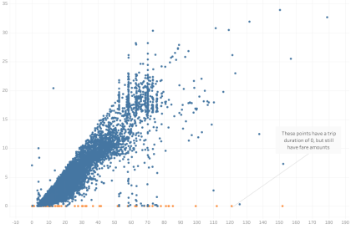
Exploratory Data Analysis of New York City TLC Data
Executive summary report
Commission Prepared by Automatidata
Project Overview
The NYC Taxi & Limousine Commission has contracted with Automatidata to build a regression model that predicts taxi cab ride fares. In this part of the project, the data needs to be analyzed, explored, cleaned and structured prior to any modeling.
As a result of the conducted exploratory data analysis, the Automatidata data team considered trip distance and total amount as key variables to depict a taxi cab ride. The provided scatter plot shows the relationship between the two variables. This scatter plot was created in Tableau to enhance the provided visualization.
The Problem: After running initial exploratory data analysis (EDA) on a sample of the data provided by New York City TLC, it is clear that some of the data will prove an obstacle for accurate ride fare prediction. Namely, trips that have a total cost entered, but a total distance of “0.” At this point, our analysis indicates these to be anomalies or outliers that need to be factored into the algorithm or removed completely.
Trip Distance
Total Amount
Proposed solution: After analysis, we recommend removing outliers with a total distanced recorded of 0.
Alt Text: Graph displaying New York City TLC data plotting variables for total distance and total amount.
Determine any unusual data points that could pose a problem for future analysis in predicting trip fares.
  For example, locations that have longer durations.
Determine the variables that have the largest impact on trip fares.
Filter down to consider the most relevant variables for running regression, statistical analysis, and parameter tuning.
Keys to success
Ensuring with New York City TLC that the sample provided is an accurate reflection of their data as a whole.
Plan for handling other outliers, such as low trip distance paired with high costs.

