Slide 1
Oracle Communications ATS

Slide 2
Agenda
What is ATS?
Requirements
Deployment Mechanism
Architecture Overview
Installation of ATS
How ATS functions?
Jenkins Overview
Files in ATS
How to login in ATS Pod?
Behave Framework

Slide 3
What is ATS?
ATS (Automated Test Suite) - ATS is use for testing the 5G NFs/4G/DSRs.
It will provide a GUI interface for the user to test a single NF independently or test different 5G NFs independently in the same environment.
All the developed test scenario for any NF can be bundled with the Docker images of the micro-services involved and delivered as a fully automated suite to perform Lab deployment and testing.

Slide 4
Requirements
There is a need to provide an End-to-End solution to the customers for deploying and testing the OC 5G-NFs.
As per oracle solution to 5G which is completely CNE enabled. Customers are required to provide CNE to support deployment of OC 5G-NFs
Eventually all the 5G NFs will have ATS as an integral part of the package/image.

Slide 5
5G-ATS Deployment Mechanism
The ATS for OC 5G-NF will be delivered as a Docker image to the customers.
The framework and simulator are common across the NFs, but the test scripts are designed as per the NF functionality.
We'll be deploying the ATS using helm charts and these charts will be delivered to customers as a tar file along with the Docker images. Along with 5G NF package ATS will also be delivered; which will contain following micro-services
    ATS
    Stubs
    DNS

Slide 6
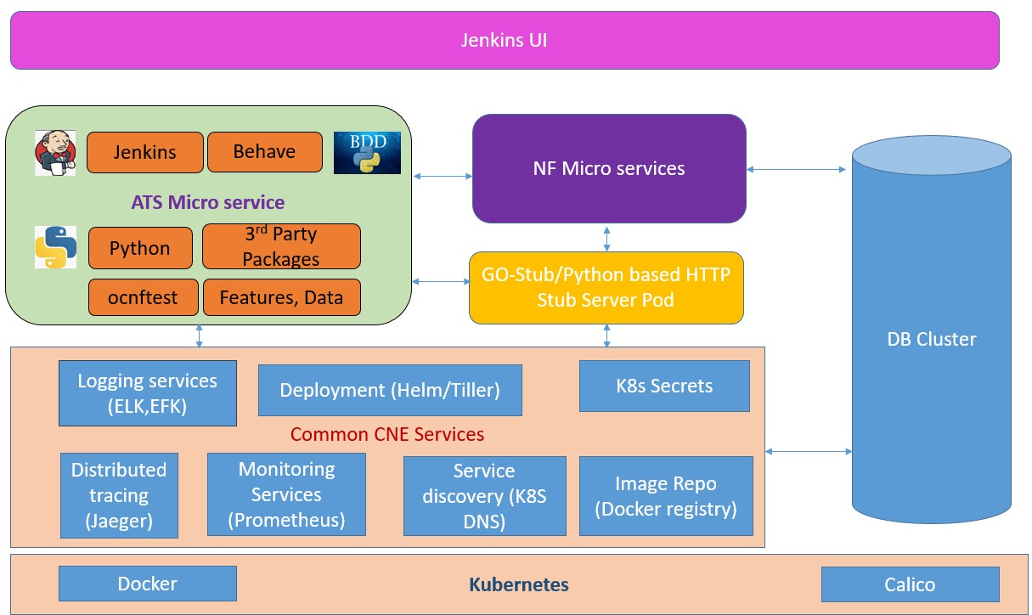
Architecture Overview

Slide 7
Supported Functions
Any package can be upgraded on need basis.
It uses egress API Gateway from other NF
It runs on Kubernetes/ OCCNE as a micro service
It connects with any NF like PCF, SLF, NRF, SCP, BSF and can be used for New feature, Regression, Performance test cases execution in automated way
It connects with GO-Stub which uses to simulate any NF
It uses Jenkins UI for selecting and executing the features
Uses Docker registry as Image Repo
Uses Helm2 and Helm3 version to deploy the ATS image
We have In-cluster deployment in which ATS can co-exist in the same cluster where the NFs are deployed and Out-cluster deployment where ATS can co-exist in different cluster from cluster where NFs are deployed.

Slide 8
Installation of ATS package
Download current version package ocats-policy-tools-1.12.0.0.0.tgz from support portal in Oracle(http://support.oracle.com/) and place it Jumpserver.
Contents of the ocats-policy-tools-1.12.0.0.0.tgz zip file:
      |_ _ _ocats-policy-pkg-1.12.0.0.0.tgz
      | |_ _ _ _ _ _ ocats-policy-1.12.0.tgz (Helm Charts)
      | |_ _ _ _ _ _ ocats-policy-images-1.12.0.tar (Docker Images)
      | |_ _ _ _ _ _ ats_data.tar (Policy ATS and Jenkins job Data)
      |_ _ _ocstub-pkg-1.1.0.0.0.tgz
      | |_ _ _ _ _ _ ocstub-go-1.1.0.tgz(Helm Charts)
      | |_ _ _ _ _ _ ocstub-go-image-1.1.0.tar (Docker Images)
      |_ _ _ocdns-pkg-1.1.2.0.0.tgz
      | |_ _ _ _ _ _ ocdns-bind-1.1.2.tgz (Helm Charts)
      | |_ _ _ _ _ _ ocdns-bind-image-1.1.2.tar (Docker Images)
      |_ _ _ocamf-pkg-1.1.0.0.0.tgz
      |_ _ _ _ _ _ ocamf-stub-1.1.0.tgz (Helm Charts)
      |_ _ _ _ _ _ ocamf-stub-image-1.1.0.tar (Docker Images)

Slide 9
Installation of ATS
Bellow steps need to follow to install ATS
Untar ocats package
tar -zxvf ocats-policy-pkg-1.12.0.0.0.tgz
Delete existing PVC with nf-namespace:
kubectl delete pvc policy-pvc -n <nf-namespace>
Create PVC with nf-namespace:
kubectl apply -f PersistentVolumeClaim.yaml -n <nf-namespace>
Verify created pvc is bound to the PV and is available with nf-namespace
kubectl get pvc -n <nf-namespace>
Load the nf ATS Image into docker:
docker load --input ocats-policy-images-1.12.0.tar

Slide 10
Tag ats image to registry name:
docker tag ocats-policy:1.12.0 <REPO NAME>:<Port#>/<path>/ocats-policy:1.12.0
Push ats image to registry:
docker push <REPO NAME>:<Port#>/<path>/ocats-policy:1.12.0
Modify values-yaml-file
Modify values-yaml-file as PVEnabled: true, PVClaimName: "policy-pvc" and repository:<local-repo-name>
Install the NF-ATS Image using helm
helm install -name ocats ocats-policy-1.12.0.tgz --namespace <nf-namespace> -f ocats-policy/<values-yaml-file>
Verify helm status of ocats:
List the helm status and confirm <ocats> image with CHART (ocats-policy-1.12.0) STATUS shown as DEPLOYED in namespace of NF
helm ls | grep ocats-policy

Slide 11
Check the newly Installed NF-ATS POD status
kubectl get pods -n <nf-namespace> | grep ocats
Copying ATS data to ATS pod:
Extract the tar file
tar -xvf ats_data.tar
Copy directory “ocpcf_tests” to ATS pod
kubectl cp ats_data/ocpcf_tests <pcf-namespace>/<ats pod name>:/var/lib/jenkins/
Copy directory “jobs” to ATS pod:
kubectl cp ats_data/jobs <nf-namespace>/<ats pod name>:/var/lib/jenkins/.jenkins/
Restart ATS pod
kubectl delete pod <ats-pod name> -n <nf-namespace>
Login to ats pod and verify copied job
kubectl -it exec <ats-pod-name> -n <nf-namespace> /bin/bash

Slide 12
Installation of ocstub
Bellow steps need to follow to install ocstub
Untar ocstub package
tar -zxvf ocstub-pkg-1.1.0.0.0.tgz
Load the ocstub Image into docker:
docker load --input ocstub-go-image-1.1.0.tar
Tag ocstub image to registry name:
docker tag ocstub-go:1.1.0 <REPO-NAME>:<Port#>/<path>/ocstub-go:1.1.0
Push ocstub image to registry:
docker push <REPO-NAME>:<Port#>/<path>/ocstub-go:1.1.0
Modify values-yaml-file
Modify stub-custom.yaml as repository:<local-repo-name>
Install the ocstub Image using helm
helm install ocstub-go --set service.name=<stub-service-name> --name <stub-service-name> --namespace <pcf-namespace> -f ocstub-go/values.yaml

Slide 13
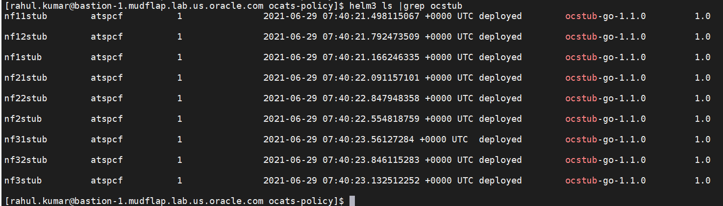
Verify helm status of nf1stub:
helm ls | grep ocstub
Check the newly Installed ocstub POD status
kubectl get pods -n <nf-namespace> | grep ocstub

Slide 14
Installation of ocdns-bind
Bellow steps need to follow to install ocdns-bind
Untar ocdns package
tar -zxvf ocdns-pkg-1.1.2.0.0.tgz
Load the ocdns-bind Image into docker:
docker load --input ocdns-bind-image-1.1.2.tar
Tag ocdns image to registry name:
docker tag ocdns-bind:1.1.2 <REPO-NAME>:<Port#>/<path>/ocdns-bind:1.1.2
Push ocdns image to registry:
docker push <REPO-NAME>:<Port#>/<path>/ocdns-bind:1.1.2
Modify values-yaml-file
Modify ocdns-custom.yaml as repository:<local-repo-name>
Install the ocdns Image using helm
helm install -f ocdns-bind/<Values.yaml file> ocdns <bind-tgz-file>
Verify helm status of ocdns:
helm ls | grep ocdns

Slide 15
Installation of ocamf
Bellow steps need to follow to install ocamf
Untar ocamf pkg
tar -zxvf ocamf-pkg-1.1.0.0.0.tgz
Load the ocamf-stub Image into docker:
docker load --input ocamf-stub-image-1.1.0.tar
Tag ocamf image to registry name:
docker tag ocamf-stub:1.1.0 <REPO-NAME>:<Port#>/<path>/ ocamf-stub:1.1.0
Push ocdns image to registry:
docker push <REPO-NAME>:<Port#>/<path>/ ocamf-stub:1.1.0
Modify values-yaml-file
Modify ocamf-custom.yaml as repository:<local-repo-name>
Install the ocamf Image using helm
helm install -f ocamf-stub/<amf-stub-values.yaml file> ocamf <amf-stub-tgz-file> --set service.name=ocamf2

Slide 16
Verify helm status of ocamf :
helm ls | grep ocamf
Check the newly Installed ocamf POD status
kubectl get pods -n <nf-namespace> | grep ocamf

Slide 17
How ATS functions?

Slide 18
Oracle Communications Automated Test Suite – OC ATS
Automation and Validation of functional features provided by 5G NFs
Without Oracle ATS
4 Weeks
Test
Validate
Deploy
With Oracle ATS
10 Hours
Automated NF validation in the customer environment
Compare the actual results with the expected or predicted results
Test and deploy 5G NFs in production environment faster
Run all test cases
Run specific test case
Run failed test cases
Scheduled run
Generate historical test report
Get report via mail

Slide 19
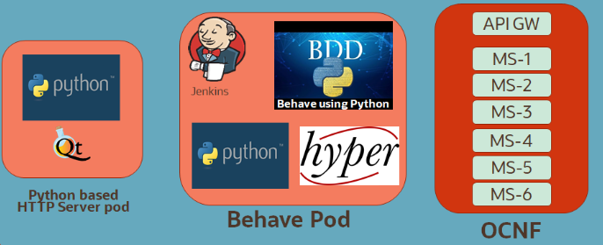
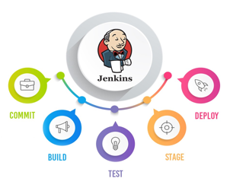
Automated Test Suite Overview
Kubernetes Cluster
Behavior Driven Development Framework for NF testing
  Automating feature test cases
Jenkins Framework
  GUI
  CI/CD
  Plugins
  Extensible
  Distributed (Master-Agent)
Cloud-Native Delivery Model
  NF under test, Simulator containers with complete framework and libraries
NF Simulators
ATS Core Modules
Oracle NF Under Test
PCF
cnPCRF
SLF
NRF
SCP
SEPP
NSSF
BSF

Slide 20
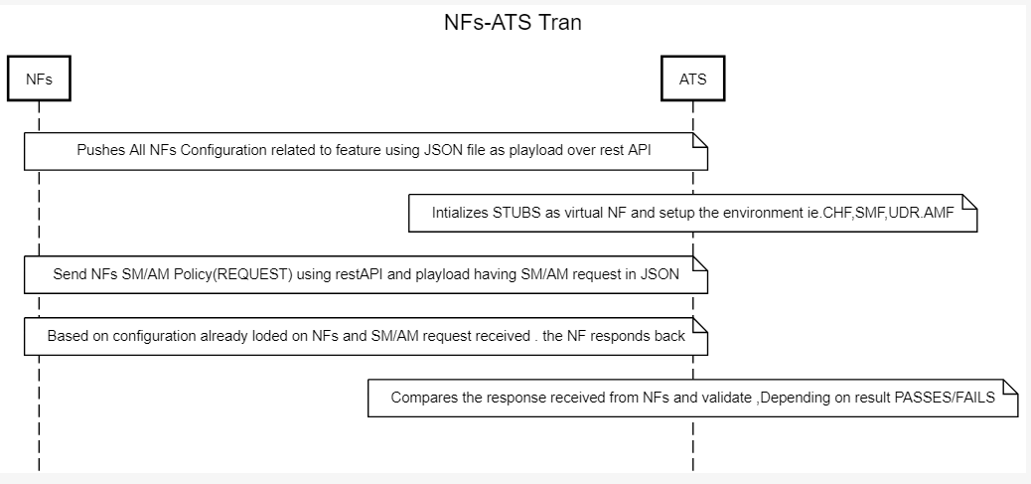
NF-ATS Transaction

Slide 21
ATS Functions
Stub1 (e.g:CHF)
Stub2 (e.g:UDR)
NF Under Test
ATS
Stub3 (e.g:NRF)
Stub4 (e.g: SMF)

Slide 22
ATS - CURL API Commands to trigger tests
To run NF-ATS with TLS Enabled support we need to first enable the Https support for Egress and Ingress gateway.
Execute the following CURL command from the ATS pod.
curl -X POST -v "https://<Ingress-gateway-service-name.namespace.svc>:<HTTPS-port>/npcf-smpolicycontrol/v1/sm-policies" --cacert caroot.cer --cert ./ocegress_client.cer --key rsa_private_key_client -H "Content-Type: application/json" -d '{ "3gppPsDataOffStatus": true, "accNetChId": { "accNetChaIdValue": "01020304", "sessionChScope": true }, "accessType": "3GPP_ACCESS", "dnn": "dnn1", "gpsi": "9192503899", "ipv4Address": "192.168.10.10", "ipv6AddressPrefix": "2001:1:22:3286::/64", "notificationUri": "http://smf-simulator:8080/smf/notify", "offline": true, "online": false, "pduSessionId": 1, "pduSessionType": "IPV4", "pei": "imei-100120210000001", "ratType": "EUTRA", "servingNetwork": { "mcc": "450", "mnc": "08" }, "sliceInfo": { "sd": "abc123", "sst": 11 }, "smPoliciesUpdateNotificationUrl": "npcf-smpolicycontrol/v1/sm-policies/{ueId}/notify", "subSessAmbr": { "downlink": "1000000 Kbps", "uplink": "10000 Kbps" }, "subscribedDefaultQosInformation": "FFS", "supi": "imsi-030003000000053", "supportedFeatures": "", "ueTimeZone": "+08:00", "userLocationInformation": { "nrLocation": { "ncgi": { "nrCellId": "512", "plmnId": { "mcc": "450", "mnc": "08" } }, "tai": { "plmnId": { "mcc": "450", "mnc": "08" }, "tac": "1801" } } } }'

Slide 23
Jenkins Overview
Jenkins is a self-contained, open-source automation server that can be used to automate all sorts of tasks related to building, testing, and delivering or deploying software. Jenkins can be installed through native system packages, Docker, or even run standalone by any machine with a Java Runtime Environment (JRE) installed.

Slide 24
1. Get the worker node IP on Bastion Host to access Jenkins GUI:
2. Get the ATS Port on Bastion Host in <pcf> namespace to access Jenkins GUI:
There are two different way to access the Jenkins GUI
  a. Worker node IP and Node Port
  b. External IP of service and Port
]$ kubectl get nodes -o wide
]$ kubectl get svc –n ocpcf
http://<Worker node IP>:<Node Port>
http://<Service External IP>:<Port of Service>

Slide 25
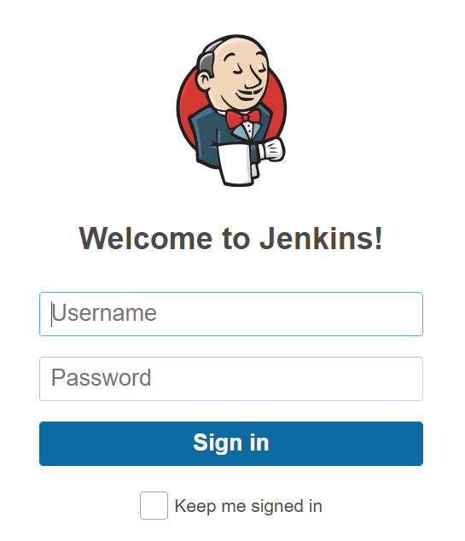
Jenkins GUI:
Enter the username and password as provided by Oracle Consulting.

Slide 26
In this ATS GUI we have two option which we highlighted in next slide
  Policy-NewFeatures: In this pipeline we have all feature which is released in current ATS version.
  Policy-Performance: In this pipeline we verify the NFs performance test including all the features.
  Policy-Regression: In this pipeline we have all feature which were released in all previous version before releasing this current GA Release.

Slide 27
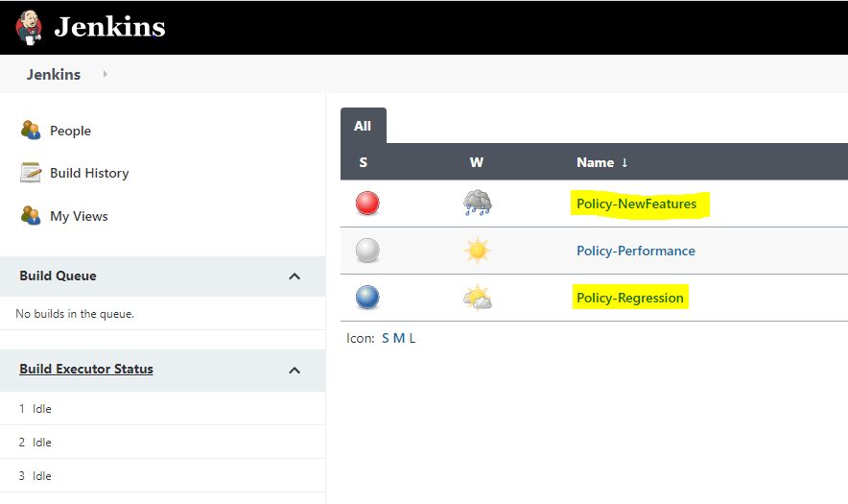
Click any one of these two option to run test Suite:

Slide 28
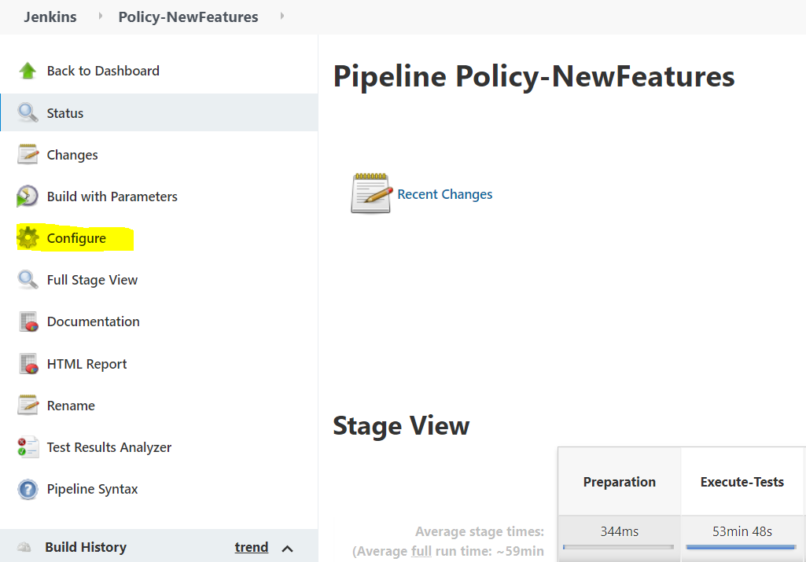
Before executing the test cases you need to check the configuration by clicking on Configure

Slide 29
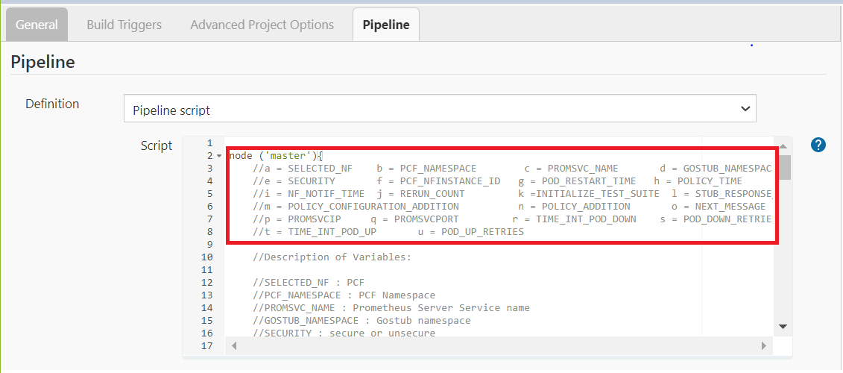
Once you click on Configure you will see this screen; Then click on Pipeline and change the pipeline parameter then save and apply the changes

Slide 30
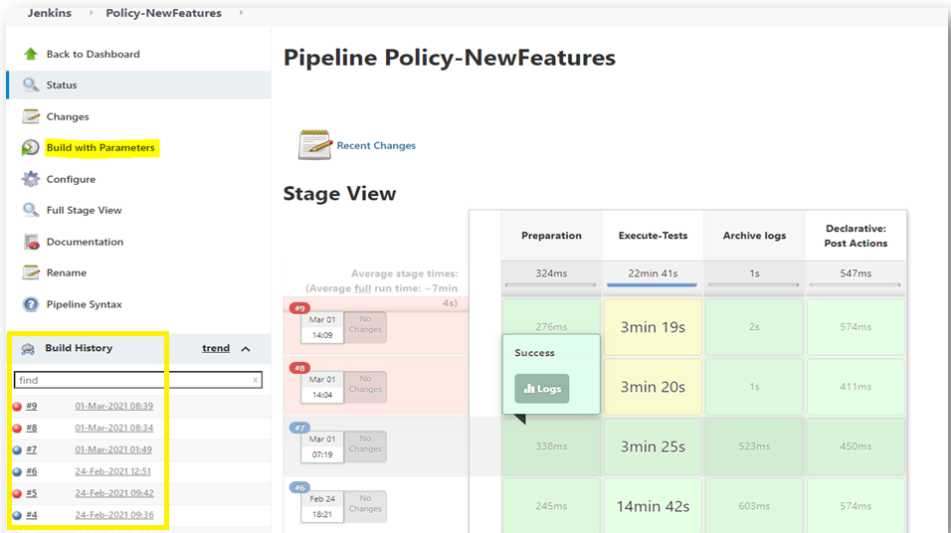
Once you click on save you will see this screen; Then click on build with parameters

Slide 31
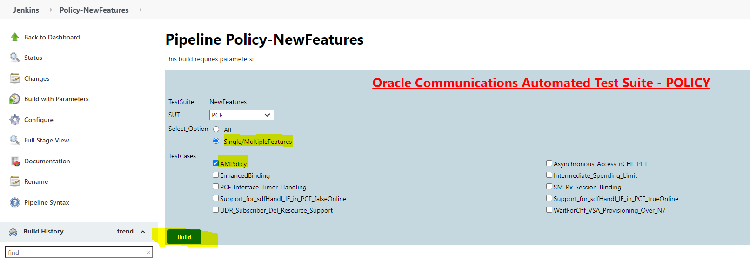
Once you click on build with parameter you will see this screen; From select_option user can either choose All or Single/Multiple Features. If user choose all then and click on build then all the test cases start running and if user choose Single/Multiple Features then user can select particular test case to run. Lets try running with particular test case

Slide 32
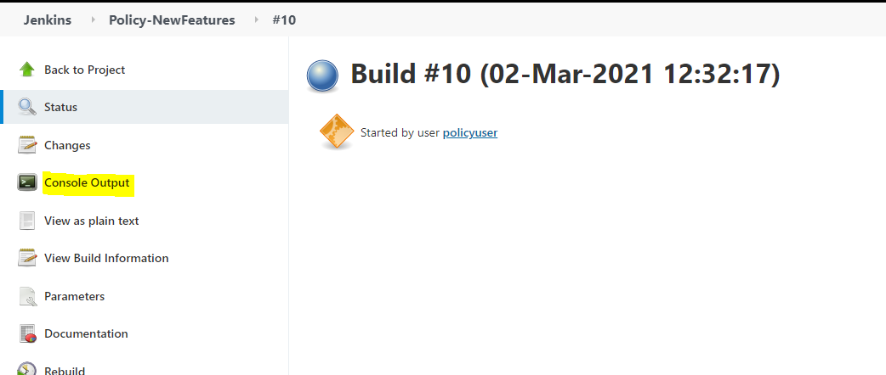
User can see running test case output by clicking on console output as shown in below screen.

Slide 33
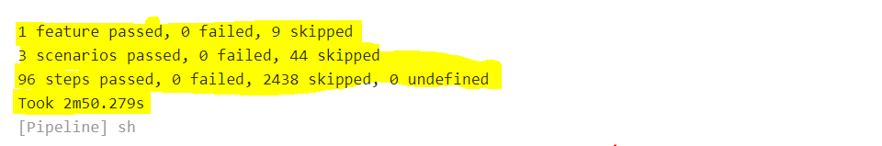
After test case are successfully run then user get the below output.

Slide 34
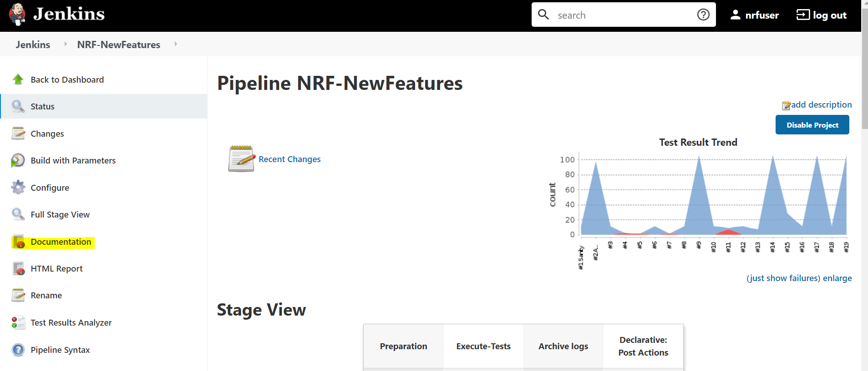
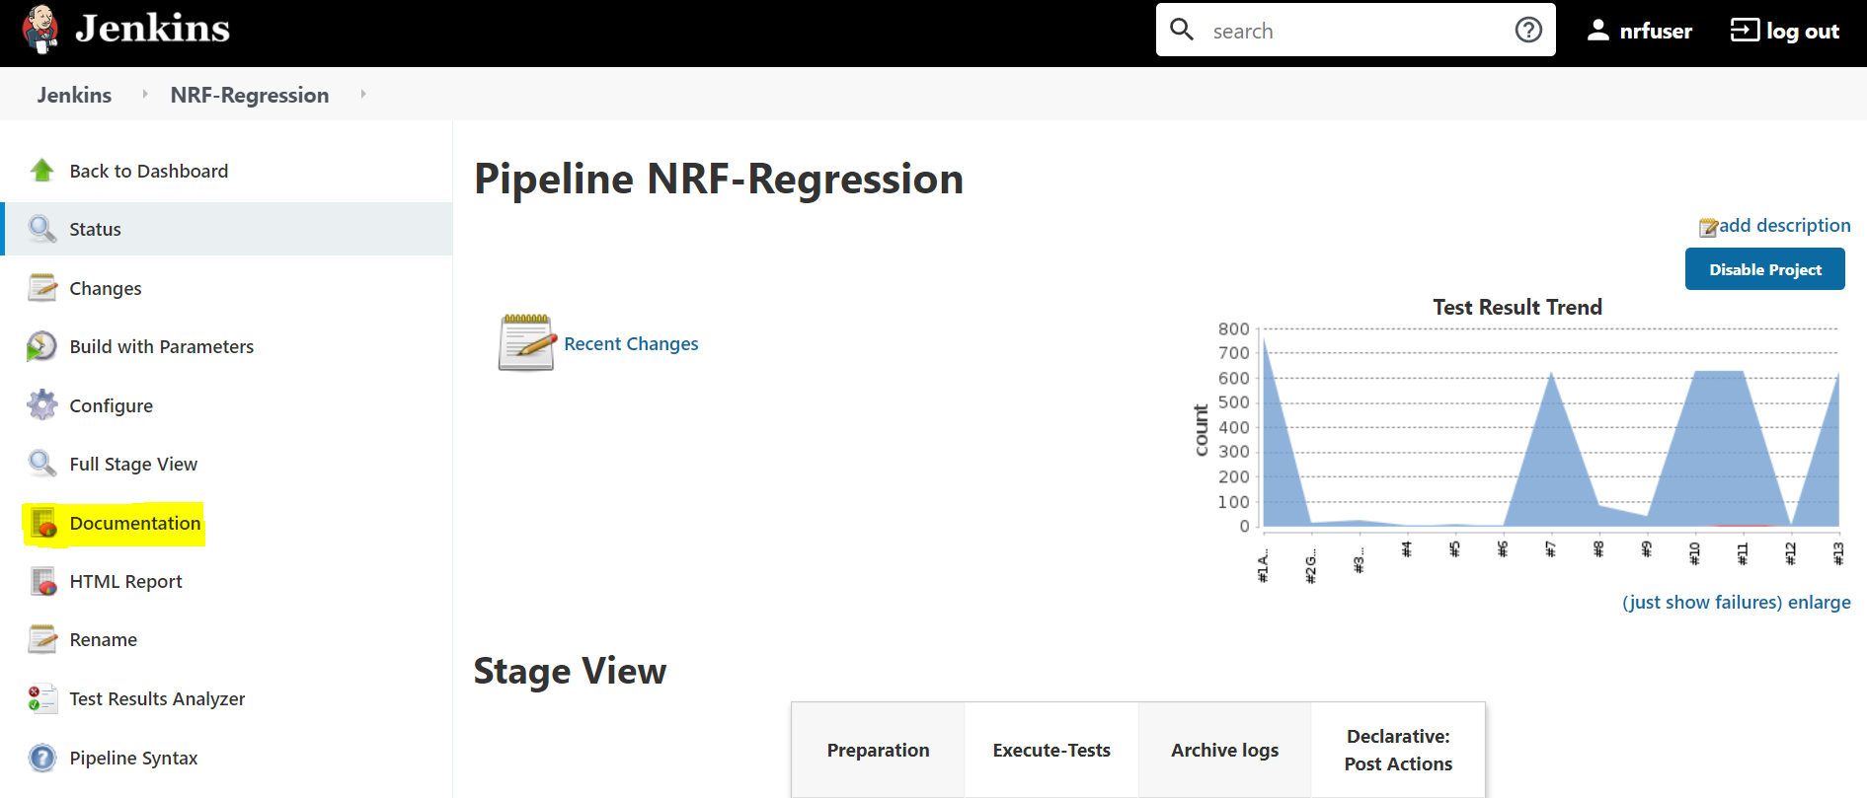
NF Pipelines
ATS Jenkins Screen :
Click NF-NewFeatures in the name column. Following screen appears
Click NF-Regression in the name column. Following screen appears

Slide 35
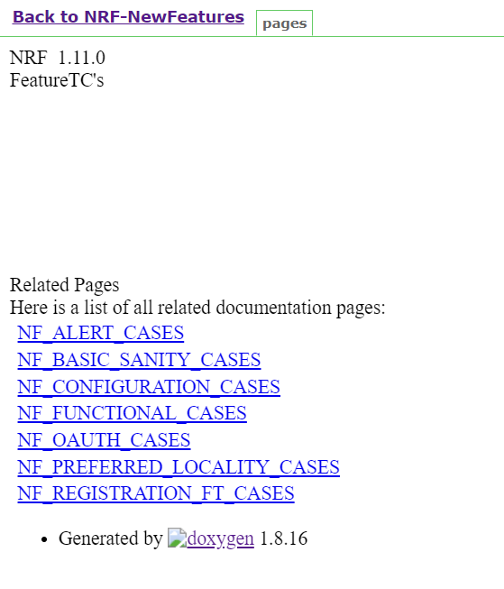
Documentation Links
ATS Jenkins Screen :
Click Documentation on the left inside NF New Features pipeline. Following screen appears which includes all the New Feature TC’s detailed explanation

Slide 36
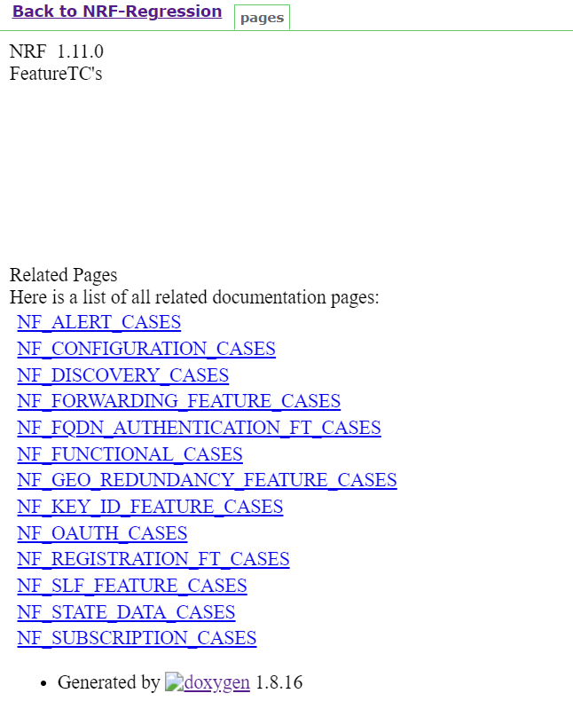
Similarly, Click Documentation on the left inside of NF Regression pipeline. Following screen appears which includes all the Regression TC’s detailed explanation

Slide 37
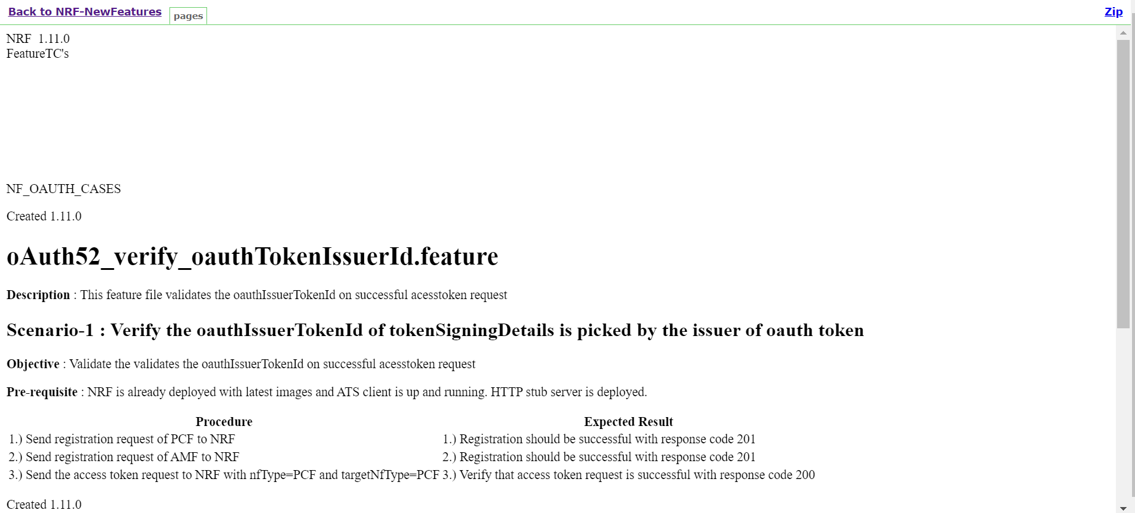
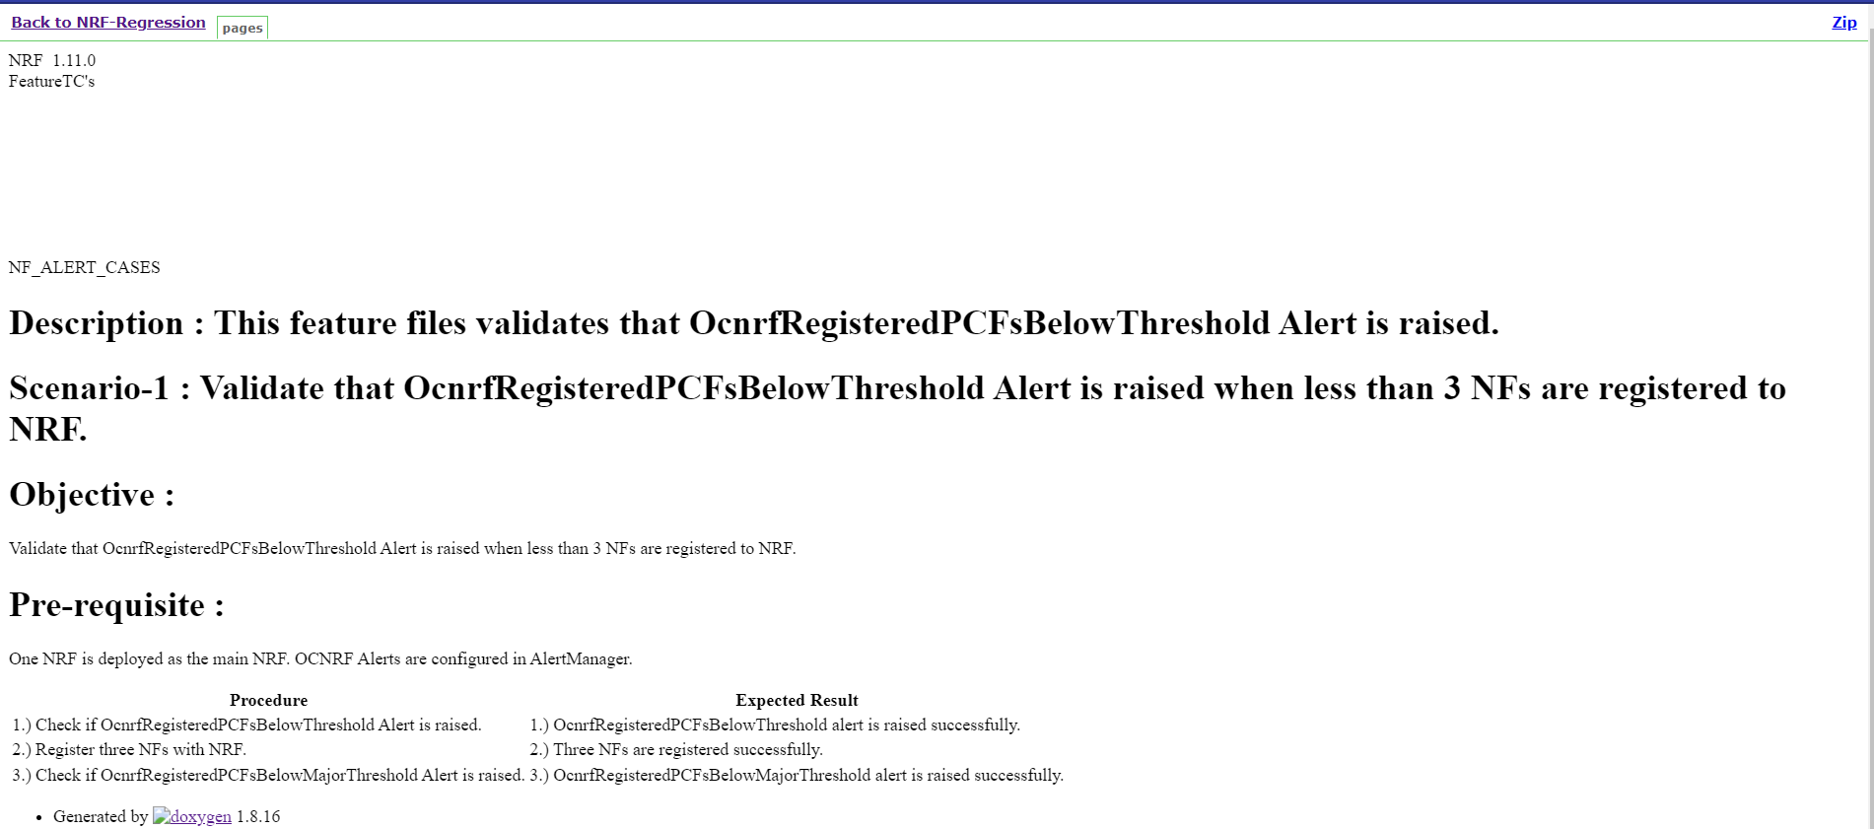
Detailed Explanation of Test Cases
ATS Jenkins Screen :
For NF New Features and NF Regression, click on any Test Cases Link and the following screen will appear which consists of detailed scenario of each case for New Features and Regression respectively

Slide 38
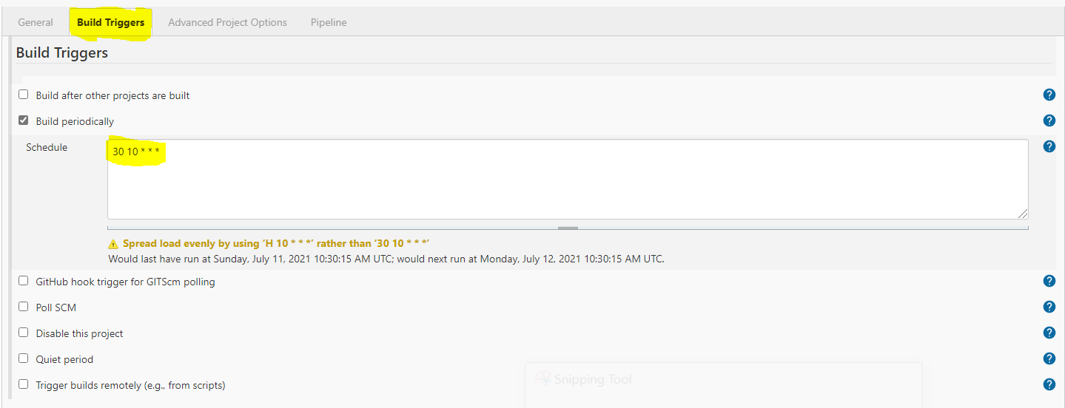
Schedule a Run

Slide 39
Files in ATS
Feature File :- A feature file is in BDD language describing a feature or part of a feature with representative examples of expected outcomes, each feature file can contain a single or Multiple scenarios within it.
Step file :- The step file is defined in python Language , its a python implementation of the scenarios defined in the feature file , All step files of NFs ATS is present
in ocnftest directory. The step file will import Library files.
Library File:- It defines all the APIs, for the NFs services, its present in ocnftest_lib folder.
Data File:- All test case configurations, Message payloads are defined in Data folder, where each file is in .json.

Slide 40
Feature File
Feature File Sections
Test Suite Initialization
Registration/Subscription
Configuration of PCF
Generating the Traffic

Slide 41
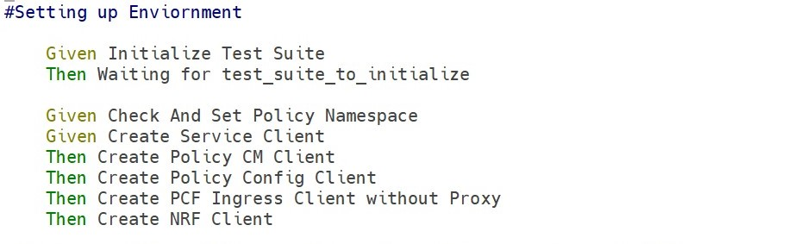
1) Test Suite Initialization
  The section contain the test suite initialization which sets up the namespace and different clients used for the call flow in this particular feature file.
  Basically, it will collect the data from the k8s cluster and pass it to the suite which lately helps to create service client, policy cm, NRF client, policy configuration and ingress client.

Slide 42
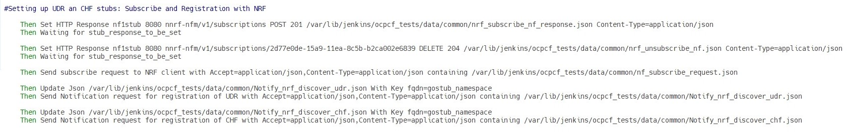
2) Registration/Subscription
  This section includes registration and subscription of stubs. There are stubs which we define as different NFs as per our need.
  As you see in our screenshot attached, we have subscribed and discovered UDR and CHF stub and registered the same with NRF

Slide 43
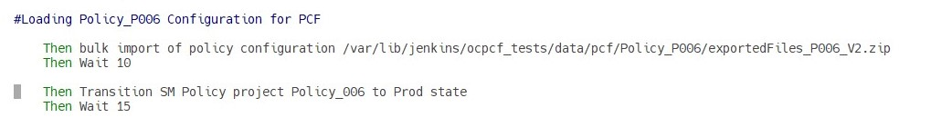
3) Configuration of PCF
  Configuration of NFs includes creation of basic configuration and policy for our feature verification. Over here we do the configuration in PCF using bulk import.
  The file which we are importing in below screenshot has all the necessary configuration to run Policy_P006 feature to execute.
  After creating configuration in PCF we make the Project into Production State.
  The steps may vary from scenario to scenario and feature file to feature file.

Slide 44
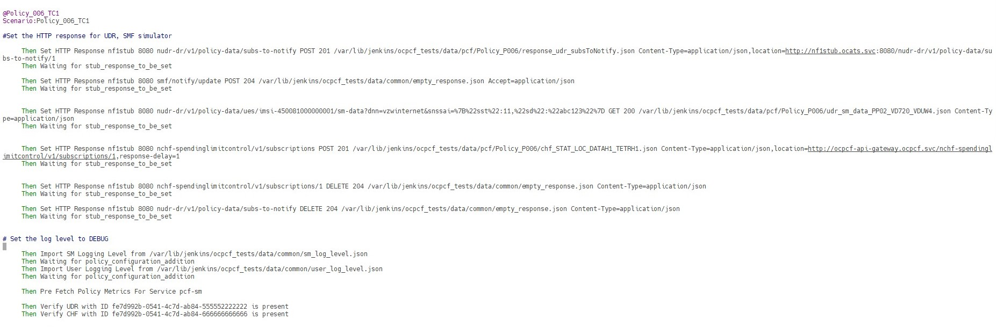
4) Generating the Traffic
  a) Preparing Stub for Response
  Stub sends the response which is provided by us, so for particular feature to work we need proper response from stub and for that we need to prepare stub with response.
  As you see below, we are preparing the stub with result code and response json with query parameter.
  In this section we also change the log level of SM and User for cross verification if any failure occurs.

Slide 45
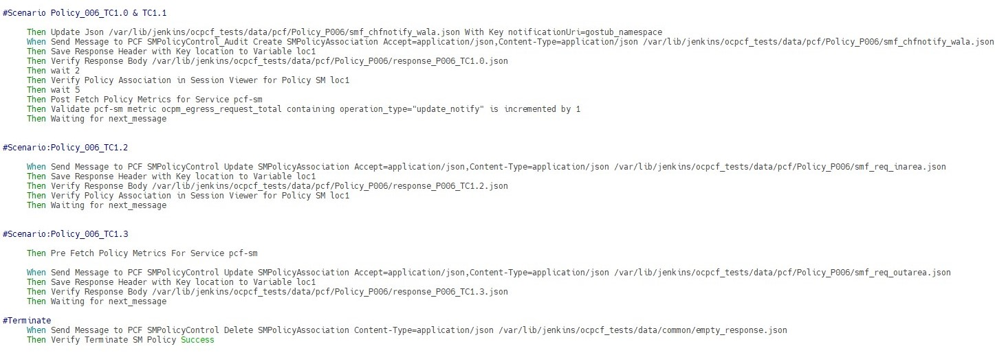
4) Generating the Traffic
  b) Feature validation and verification
  This is the section where the call flow is configured. The response is validated and verified with the expected outcome.
  As you see we have different scenarios. We send SMF request and save the response. We check the response with what we are expecting and also, we check for metrics
  After different call flow execution, we terminate the created session for the subscriber.

Slide 46
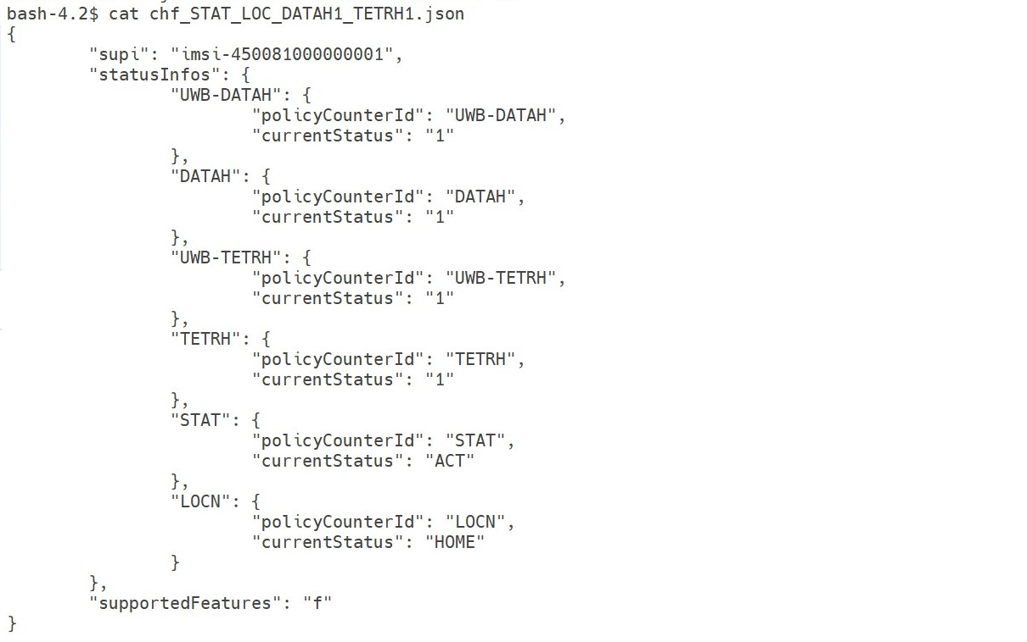
Data File
  The data files are the json files used for request/response body used for stub registration , subscribing and sending response to PCF.
  In our below screenshot of json file which we are sending request to CHF in POST method.

Slide 47
How to login in ATS Pod?
List all the pods running with PCF by using below command:
Ex: kubectl get pods –n ocpcf
Identify ocats pod name from above command output for below command.
Find the ocats pod and login into the pod using below command:
Ex: kubectl exec -it ocats-ocats-policy-6b74f596bb-lk548 -n ocpcf /bin/bash
After successful login execute below command:
Output: /var/lib/Jenkins
]$ kubectl get pods –n <pcf-namespace>
]$ kubectl exec –it <ats-pod-name> -n <pcf-namespace> /bin/bash
bash-4.2$ pwd

Slide 48
Location of feature file and data files in ATS Pod:
After login into ATS pod you can check for feature and data files at below locations:
Feature Files:
  1) newfeatures will be available at: ‘/var/lib/jenkins/ocpcf_tests/features/newfeatures/pcf’
  2) Regression will be available at: ‘/var/lib/jenkins/ocpcf_tests/features/regression/pcf’
  3) cust_newfeatures will be available at: ‘/var/lib/jenkins/ocpcf_tests/features/cust_newfeatures/pcf’
  4) cust_regression will be available at: ‘/var/lib/jenkins/ocpcf_tests/features/cust_regression/pcf’
Data Files:
  All the data files for above features will be available at: ‘/var/lib/jenkins/ocpcf_tests/data/pcf’

Slide 49
As you have seen the installation of ATS. You can find the ATS URL by following steps.
  Login to occne/Bastion Host.
  Run the command.
  Here, ocpcf is the namespace where PCF is installed.
  You will get output as shown in next slide..
$ kubectl get pods -n ocpcf

Slide 50
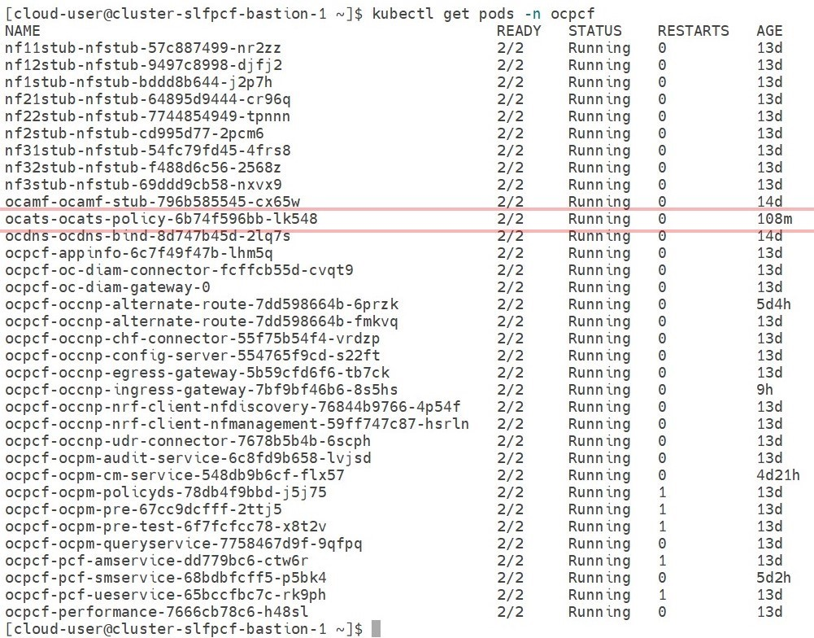
  Verify all PCF and ATS pods are READY 2/2 and status is “Running”.

Slide 51
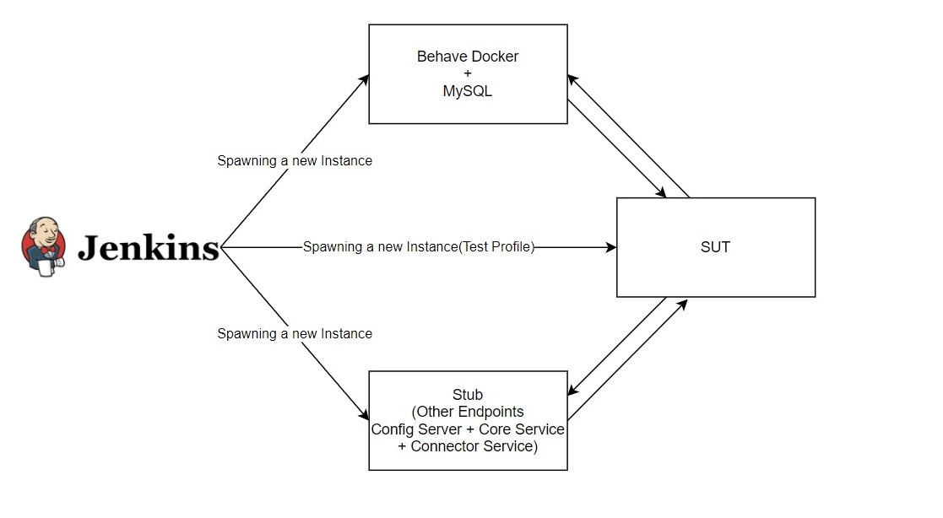
Behave Framework
Behave Framework would act as an initiator of REST request to NF to be tested. For NFs, the messages could be initiated from stubs simulated as SMF/AMF/UDR/SLF/BSF etc.

Slide 52
Any doubt or query?

