Slide 1
Algoritmul Gale Shapley
Prezentat de Rusu Marina

Slide 2
Algoritmul Gale Shapley
Acest algoritm este folosit pentru a gasi solutii la problemele stabile de potrivire.
Are ca complexitate O(n²).
Algoritmul este numit dupa David Gale(mathematician si economist) si Lloyd Shapley(mathematician si economist, a castigat premiul nobel in economie pentru: “teoria de alocatii stabile si practica proiectarii pietei”)

Slide 3
Ce ar insemna problemele stabile de potrivire?
Daca avem un numar egal de participanti(n femei si n barbati), fiecare participant trebuie sa ii ordoneze pe ceilalti dupa preferintele lui(femeia sa ordoneze barbatii dupa preferintele ei, de la barbatul pe care il prefera cel mai mult, pana la barbatul pe care il prefera cel mai putin).
O potivire nu este stabila daca:
A si B prefera mai mult pe altcineva, de ex: A ar prefera mai mult pe C, iar B al prefera mai mult pe D.
Daca A prefera pe B, iar B prefera mai mult pe D, nu este o problema, atat timp cat D prefera si el la randul sau mai mult pe altcineva decat pe B.

Slide 4
Problema casatoriilor stabile
Ni se da un numar de femei si barbati(nrFemei == nrBarbati), si fiecare femeie ordoneaza barbatii in fuctie de preferintele ei(cu care doreste sa se casatoreasca cel mai mult), si barbatii la fel, ordoneaza femeile in functie de preferinta lor.
Iar in final se cere sa gasim perechile(femeie, barbat) care se potrivesc.

Slide 5
Preferintile femeilor
Preferintele barbatilor
F1->B2,B1,B3,B4
F2->B3,B4,B1,B2
F3->B3,B1,B2,B4
F4->B3,B1,B2,B4
B1->F1,F3,F4,F2
B2->F4,F1,F3,F2
B3->F2,F1,F4,F3
B4->F2,F1,F4,F3

Slide 6
F1->B2,B1,B3,B4
F2->B3,B4,B1,B2
F3->B3,B1,B2,B4
F4->B3,B1,B2,B4
B1->F1,F3,F4,F2
B2->F4,F1,F3,F2
B3->F2,F1,F4,F3
B4->F2,F1,F4,F3

Slide 7
F1->B2,B1,B3,B4
F2->B3,B4,B1,B2
F3->B3,B1,B2,B4
F4->B3,B1,B2,B4
B1->F1,F3,F4,F2
B2->F4,F1,F3,F2
B3->F2,F1,F4,F3
B4->F2,F1,F4,F3

Slide 8
F1->B2,B1,B3,B4
F2->B3,B4,B1,B2
F3->B3,B1,B2,B4
F4->B3,B1,B2,B4
B1->F1,F3,F4,F2
B2->F4,F1,F3,F2
B3->F2,F1,F4,F3
B4->F2,F1,F4,F3

Slide 9
F1->B2,B1,B3,B4
F2->B3,B4,B1,B2
F3->B3,B1,B2,B4
F4->B3,B1,B2,B4
B1->F1,F3,F4,F2
B2->F4,F1,F3,F2
B3->F2,F1,F4,F3
B4->F2,F1,F4,F3

Slide 10
F1->B2,B1,B3,B4
F2->B3,B4,B1,B2
F3->B3,B1,B2,B4
F4->B3,B1,B2,B4
B1->F1,F3,F4,F2
B2->F4,F1,F3,F2
B3->F2,F1,F4,F3
B4->F2,F1,F4,F3

Slide 11
F1->B2,B1,B3,B4
F2->B3,B4,B1,B2
F3->B3,B1,B2,B4
F4->B3,B1,B2,B4
B1->F1,F3,F4,F2
B2->F4,F1,F3,F2
B3->F2,F1,F4,F3
B4->F2,F1,F4,F3

Slide 12
F1->B2,B1,B3,B4
F2->B3,B4,B1,B2
F3->B3,B1,B2,B4
F4->B3,B1,B2,B4
B1->F1,F3,F4,F2
B2->F4,F1,F3,F2
B3->F2,F1,F4,F3
B4->F2,F1,F4,F3

Slide 13
F1->B2,B1,B3,B4
F2->B3,B4,B1,B2
F3->B3,B1,B2,B4
F4->B3,B1,B2,B4
B1->F1,F3,F4,F2
B2->F4,F1,F3,F2
B3->F2,F1,F4,F3
B4->F2,F1,F4,F3

Slide 14
F1->B2,B1,B3,B4
F2->B3,B4,B1,B2
F3->B3,B1,B2,B4
F4->B3,B1,B2,B4
B1->F1,F3,F4,F2
B2->F4,F1,F3,F2
B3->F2,F1,F4,F3
B4->F2,F1,F4,F3

Slide 15
F1->B2,B1,B3,B4
F2->B3,B4,B1,B2
F3->B3,B1,B2,B4
F4->B3,B1,B2,B4
B1->F1,F3,F4,F2
B2->F4,F1,F3,F2
B3->F2,F1,F4,F3
B4->F2,F1,F4,F3

Slide 16
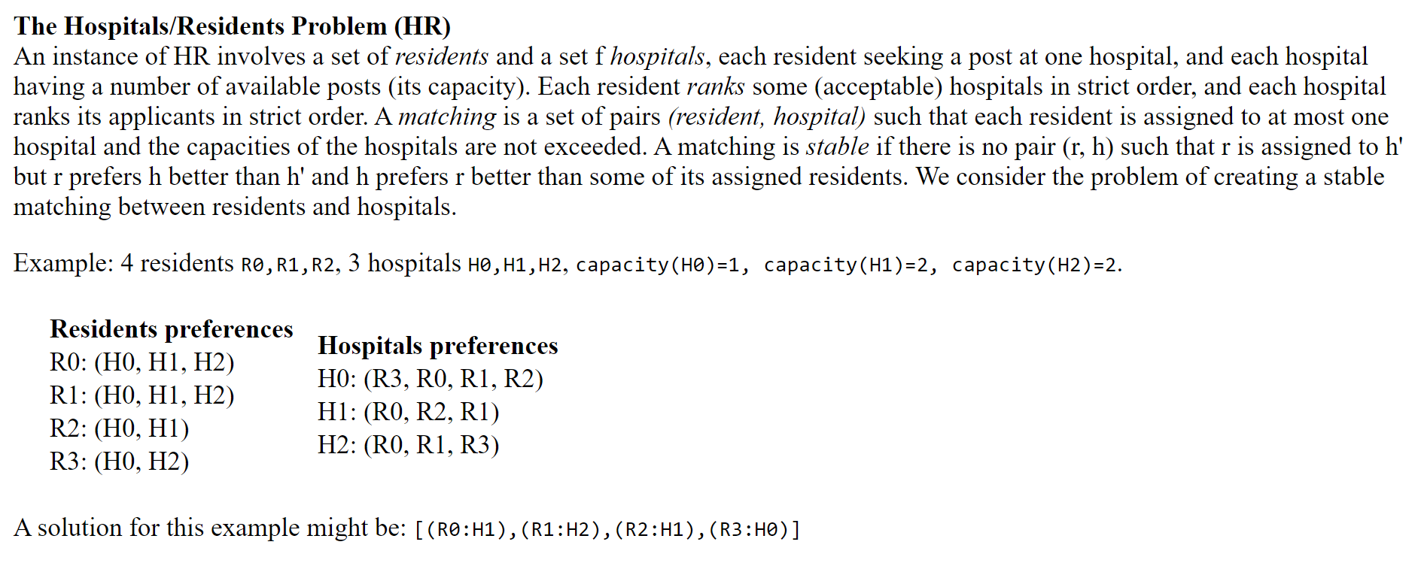

Slide 17
Referinte
https://www.youtube.com/watch?v=Qcv1IqHWAzg
https://www.geeksforgeeks.org/stable-marriage-problem/
https://en.wikipedia.org/wiki/Gale%E2%80%93Shapley_algorithm
https://en.wikipedia.org/wiki/Stable_marriage_problem

