Slide 1
Angular
Component Interactions - I

Slide 2
Angular Data Communication between Components
Angular restricts the variables defined in a component to be accessible only within that component.
Data communication between a child component and a parent component requires input and output bindings.
@Input( ) decorator facilitates input binding.
@Output( ) decorator facilitates output binding.

Slide 3
Component Interaction
Parent
Component
Data Flow
(@Output)
Data flow
(@Input)
Child
Component

Slide 4
Component Interaction
@Input( ) and @Output( ) acts as an API (Application Programming Interface), of the child component in that they allow child to communicate with the parent.
Think of @Input( ) as a doorway allowing data to flow in to child component
Think of @Output( ) as a doorway allowing data to flow out from a child component

Slide 5
Parent and Child Components
Child component is a component that is nested inside another component (parent component)
In app.component.html
<div>
<app-childcomponent></app-childcomponent>
<div>
This would mean that app.component is the parent component and child-component is the child component.
It is a good idea to also nest the folder for childcomponent inside the parent component.

Slide 6
Angular @Input( )
@Input( ) binding allows data to be passed from parent component to child component
@Input Binding
Parent
Child
Data Flow

Slide 7
Angular @Input( )
@Input( )allows the Parent component to modify the property(variable) of a child component.
This is accomplished by applying the @Input( )decorator to the property in the child component.

Slide 8
Angular @Input( )
In the example below of the child’s component class,
export class ChildComponent{
@Input() inputText: string = ‘’; ….
}
@Input( ) decorator is being applied to inputText property in the child’s component class.
This would enable inputText property to be bindable from parent component and will receive the data passed from parent.

Slide 9
Angular @Input
In order to pass the data to the property of the child component, we use the name of the property in square brackets in the parent’s template
In the Parent’s template (html),
<app-childcomponent
[inputText] = “pText”>
</app-childcomponent>
In the above example, the inputText property is being assigned the value of the variable pText which is defined in the Parent class.
export class ParentComponent {
pText: string = ‘';
}

Slide 10
Angular @Input( )
Property from parent
Source
Child Selector
<app-childcomponent [inputText] = “pText”></app-childcomponent>
target
@Input( ) property from Child

Slide 11
Angular Output Binding

Slide 12
Angular @Output( )
Output binding allows a child component to pass to the parent component.
The data communication happens as a response to events such as button clicks, form entries and other user events.
@Output Binding
Parent
Child
Data Flow

Slide 13
HTML Events with Angular Syntax
HTML Event | Angular Syntax | Description
onclick | (click) | Event that is fired when the HTML element is clicked on
onchange | (change) | Event that is fired when the HTML element is selected
onfocus | (focus) | Event that is fired when the HTML element is selected.
onsubmit | (submit) | Event that is fired when the form is submitted
onkeyup | (keyup) | Events that are fired intermittently when the keyboard keys are pressed
onkeydown | (keydown)
onkeypress | (keypress)
onmouseover | (mouseover) | Event that is fired when cursor moves over an HTML event.

Slide 14
Emitting Custom Events
Components are capable of emitting events within the component hierarchy.
Events enable you to send notifications to different levels of the application to indicate that the events have occurred.
An event can be anything you choose, such as value change, or a threshold reached.
Events allow child components to notify the parent components that a value has changed.

Slide 15
Emitting a custom event to Parent
To emit an event from a component, we use the EventEmitter class.
This class provides a emit( ) method which sends an event upward through the parent component hierarchy.
Any ancestor component that are registered for the event are notified

Slide 16
Angular @Output()
A Child Component’s property marked with @Output( ) decorator allows data to be emitted from child to parent component in response to an event.
In the child, a variable with @Output( ) decorator is set to a new EventEmitter object.
In the parent, a function (eventhandler) is created to receive the data

Slide 17
Angular @Output()
@Output() decorator allows parent component to listen to custom events emitted by child.
The parent binds to that event property and reacts to those events

Slide 18
Angular Output bindings
Output bindings are different from Input binding
Output isn’t just some data unlike Inputs, but it is also an event to trigger whatever is listening for that output.
Angular Inputs can be of any data type but, Outputs must be of the type EventEmitter.
EventEmitter emits a value which can be of any data type

Slide 19
Angular Output bindings
Suppose if we want to output a string to the parent, we create a variable of the EventEmitter type with @Output decorator. @Output( ) outputValue : EventEmitter<string> = new EventEmitter<string>();
And a parent component can subscribe to the event :
<childComponent (outputValue)=“outputHandler($event)”>
</childComponent>
And outputHandler( ) is eventhandler method implemented in parent component that will be called in response to the event.

Slide 20
Angular @Output()
A property decorated with @Output is initialized to an Angular EventEmitter with values flowing out of the component as events.
@Output() - a decorator function marks property as doorway for data to flow from child to parent
outputEvent – the name of the @Output() property
EventEmitter<string> - the @Output()’s property type
new EventEmitter<string>( ) – tells Angular to create a new event emitter and that the data it emits is of string type.
export class ChildComponent{
@Output( ) outputEvent:EventEmitter<string> = new EventEmitter<string>();
…
}

Slide 21
Angular @Output()
In the child’s template, in response to the build-in browser event like click of a button or keyup in the input textbox, a function is called.
This function is implemented in the child’s component and the implementation basically involves calling the emit( ) function on EventEmitter object and passing the value to emit as parameter to emit( ) function.
sendMessage( ){ this.outputEvent.emit(this.message); }
When a user performs an event (like click of a button)in the UI, the child lets the parent know about the event and gives the data to the parent.

Slide 22
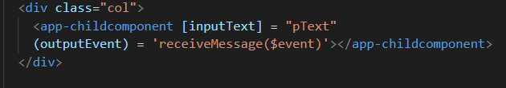
Angular @Output( )
In order to receive the custom event object emitted by the child component, use the name of the custom event in the ( ) and set it to name of the function with $event parameter that will be invoked when parent receives the emitted object.
The information about the event will be captured in the $event object
In the example above, outputEvent is the name of the custom event object that will be received by the parent’s template and receiveMessage($event) is the function in the parent that will be invoked in response.

Slide 23
Angular Output()
method from parent
Source
Child Selector
<app-childcomponent …. (outputEvent) = “receiveMessage($event)”>
</app-childcomponent>
target
@Output( ) event from Child

Slide 24
More on Component Interaction
More on @Input( ) and @Output( ) bindings:
Input and Output Properties
https://angular.io/guide/template-syntax#input-and-output-properties
Component Interaction
https://angular.io/guide/template-syntax#input-and-output-properties

Slide 25
Practice - @Input and @Output
We will use following starter project on Stackblitz to demonstrate data binding between parent and child components.
https://stackblitz.com/github/kotala-sudo/practice-InputOutput
In this project, currently we have two components,
the root component - AppComponent (app.component.ts) with it’s template (AppComponent.html) and CSS (app.component.css)
Child component – childcomponent (childcomponent.component.ts) with it’s own template (childcomponent.component.html) and CSS (childcomponent.component.css)
The purpose of the project is to pass data from parent component to the child component and then to pass data from child component (in reaction to a click of a button) to the parent component.

Slide 26
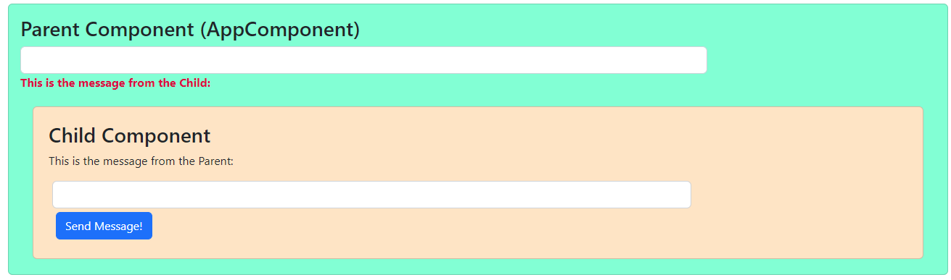
practiceInputOutput project

Slide 27
practiceInputOutput project
First define childcomponent as child of AppComponent (parent) by including the selector
<app-childcomponent></app-childcomponent>
tags in the app.component.html

Slide 28
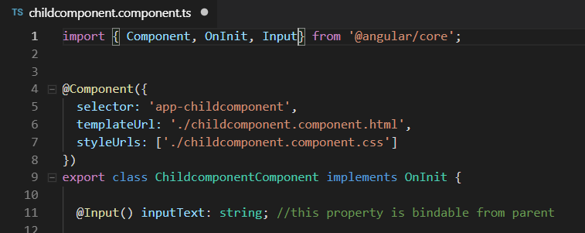
practiceInputOutput project
Next, define a property called inputText of string type in childcomponent
And as this property will be modified from parent, we will add the @Input( ) decoration to it.
Make sure to import Input from @angular/core

Slide 29
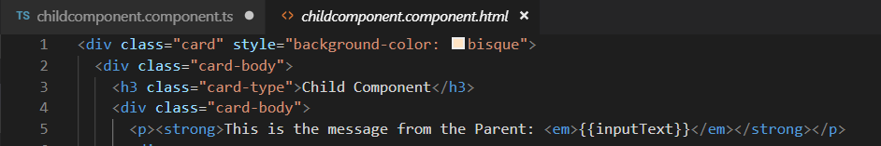
practiceInputOutput project
In the input tags inside childcomponent.component.html,
Display the value of inputText between <p> tags using string interpolation
This will display the value that would be passed by the parent for inputText

Slide 30
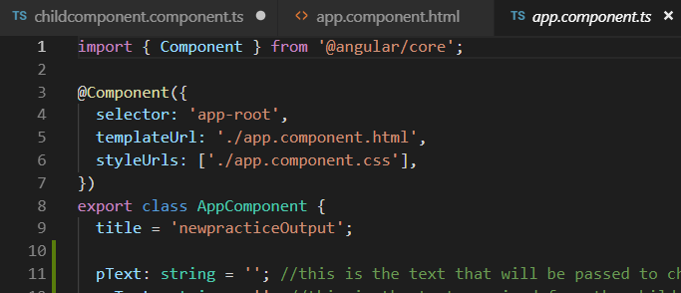
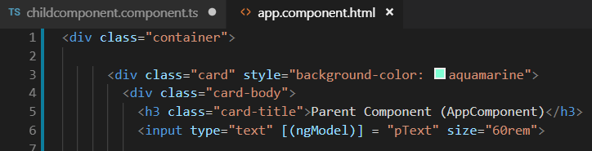
practiceInputOutput project
In the app.component.ts, define a string property pText.
The value of this property will be passed to the child component.
Next, use ngModel directive for two-way binding to set the value of pText in the <input> element in app.component.html

Slide 31
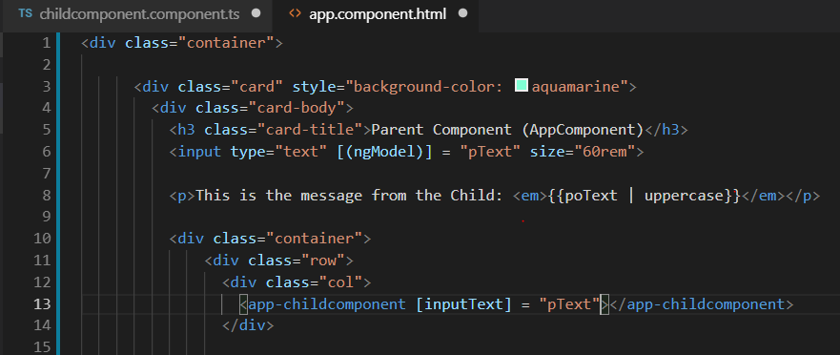
practiceInputOutput project
In the app.component.html (parent’s template), refer to the inputText property inside [ ] brackets inside the <app-childcomponent> tags and set it’s value to pText property

Slide 32
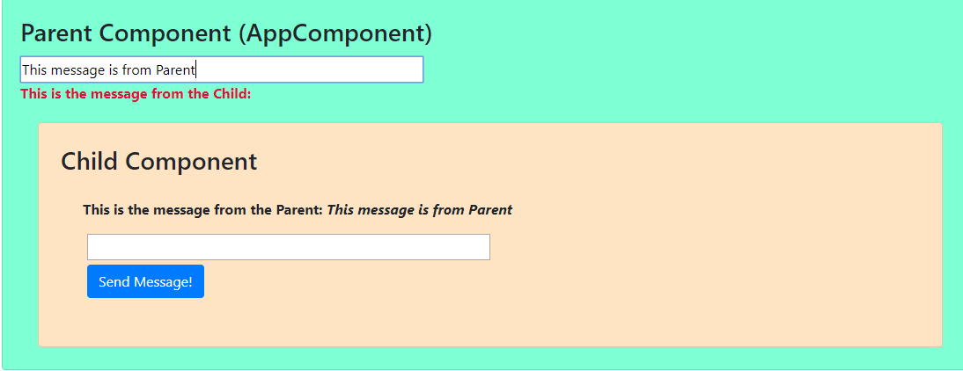
practiceInputOutput project
Save the changes and run the application.
As you type something in the textbox in parent, you will see the same text appearing in the child component.
This demonstrates data communication from parent to child using @Input( ) binding

Slide 33
practiceInputOutput project
Now we will demonstrate the data communication from child to parent in response to some event on child’s template.
In the childcomponent.component.ts, define a property outputEvent and initialize to a new EventEmitter object.
Add @Ouput( ) decorator to outputEvent property.
Make sure to import Output and EventEmitter from @angular/core
Also define a string property message whose value will be obtained from the textbox in child component and will be emitted to the parent component.
Finally, implement sendMessage( ) function which will be called in response to click of the button in the child component. This function will in turn call the emit( ) function with message as the parameter on the outputEvent EventEmitter object.
See the next slide for changes explained earlier.

Slide 34
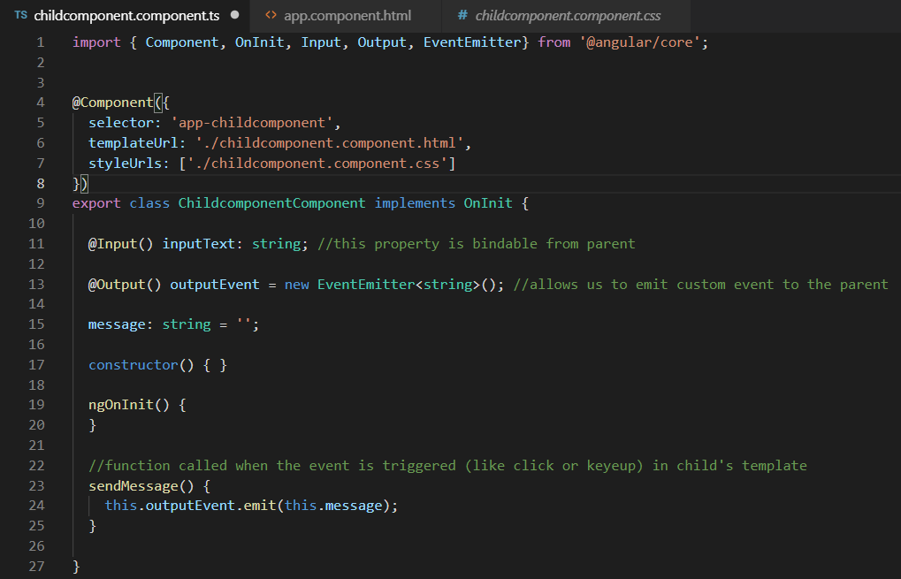
practiceInputOutput project

Slide 35
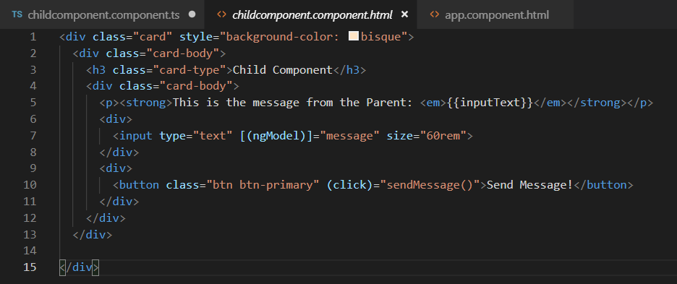
practiceInputOutput project
In the childcomponent.component.html make the following changes:
Use ngModel to set the value of message property in the <input> tags
In the button, for click event, invoke sendMessage( ) function

Slide 36
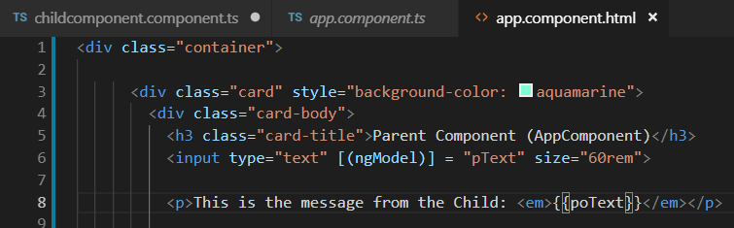
practiceInputOutput project
In app.component.ts,
Provide a string property poText that will hold the text received from the child component via the custom event object.
Implement the receiveMessage (msg: string ) method that will set the value of poText to msg string that will received via the $event object.
See the next slide for changes
In the app.component.html,
Use string interpolation to display the value of poText property in the <p> tags

Slide 37
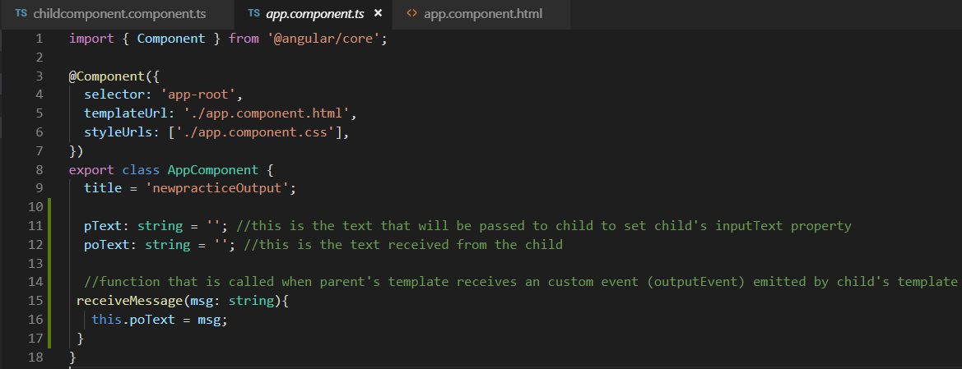
practiceInputOutput project

Slide 38
practiceInputOutput project
In the app.component.html, in order to receive the custom event emitted (outputEvent) emitted by the child component, make the following changes
In the <app-childcomponent> tags, include (outputEvent) = “receiveMessage($event)”
outputEvent is the the custom event object that will be received by the parent’s template and receiveMessage($event) is the function that will be invoked in response.

Slide 39
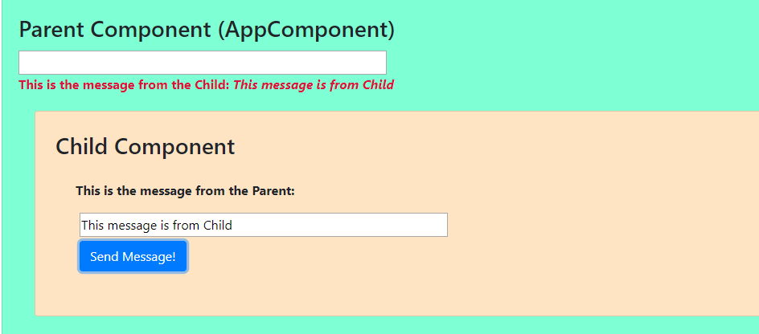
practiceInputOutput project
Save the changes and type some text in textbox in child component and click the Send Message button. In response this text is displayed now in the parent component thus demonstrating data communication from child to parent in response to an event.

Slide 40
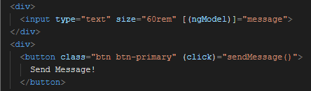
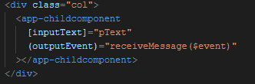
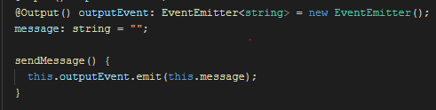
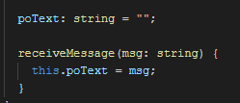
childComponent Template
Parent Template
Output binding
1. Updates message
2. sendMessage() Function called
4. receiveMessage( ) function called
3. Event object is emitted
poText updated
Parent Component class
ChildComponent class
5. Displays new value of poText in parent template
Data Communication from Child Component to Parent Component
Parent Template

