Slide 1
ACADEMIC PROJECT · SERVICENOW · 2026
Smart Student
SSC
Connect
One Platform. Every Opportunity.
Project ID: PS-005 · Platform: ServiceNow
Hackathons
Internships
Sports
Community
Powered by ServiceNow

Slide 2
Problem Statement
Students today face a major challenge — finding the right opportunities at the right time.
🏆
Hackathons
💼
Internships
No central hub to discover coding & innovation challenges suited to students.
Students miss deadlines due to poor visibility and scattered listings.
⚽
Sports & Clubs
🤝
Community Service
Sports tryouts, tournaments & extracurriculars go unnoticed without a unified feed.
Volunteering & social impact opportunities are hard to find and apply for.

Slide 3
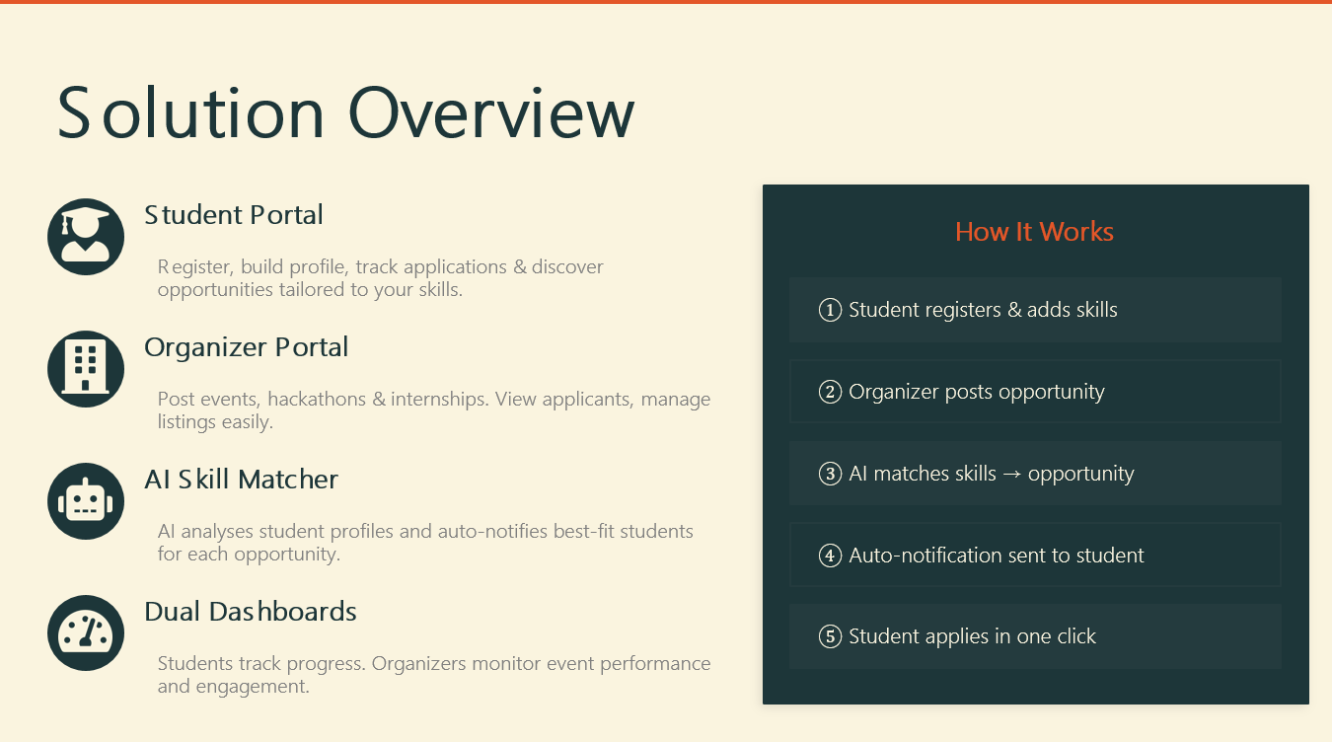

Slide 4
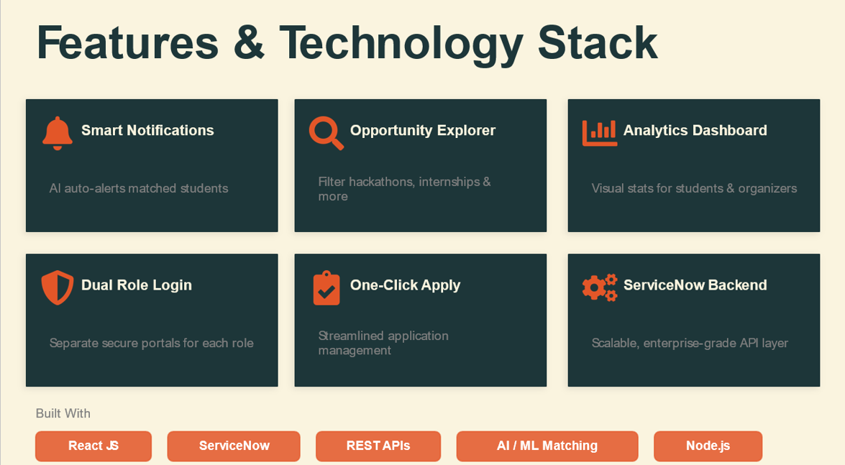

Slide 5

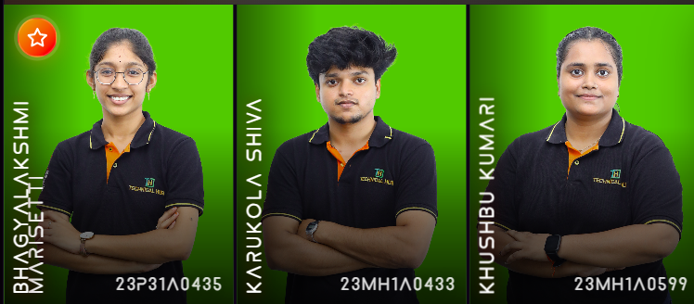
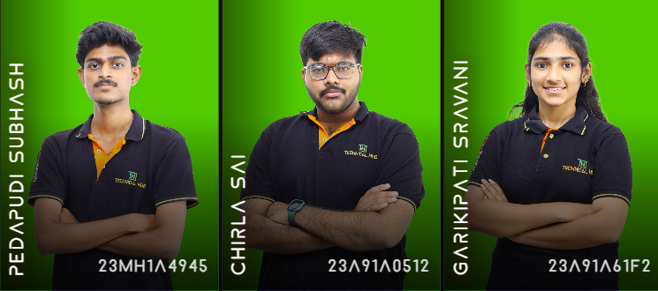
Thank You
Smart Student Connect
Any Queries??

