Slide 1
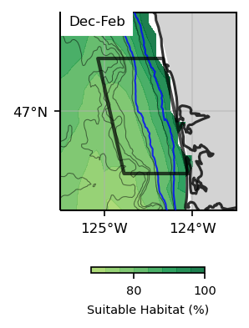
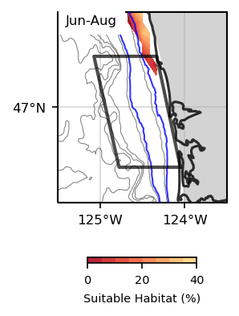
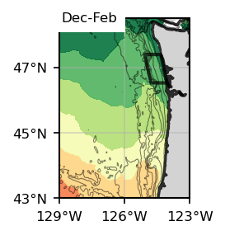
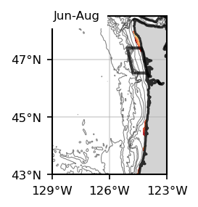
Dungeness Crab
Surface, present SSP245

Slide 2
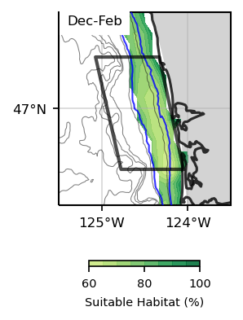
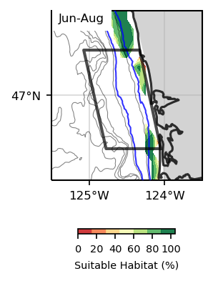
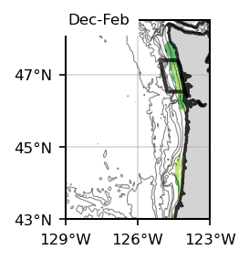
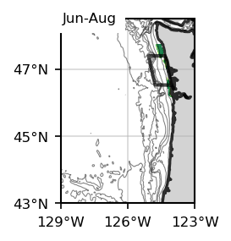
Dungeness Crab
Bottom, present SSP245

Slide 3
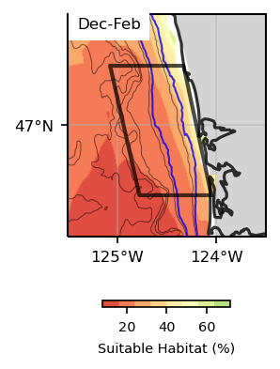
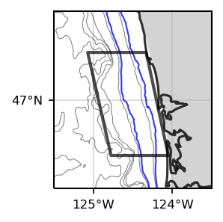
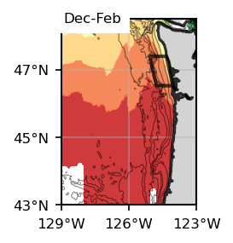
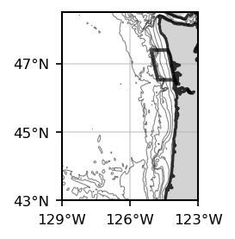
Dungeness Crab
Surface, Future, SSP 245
Jun-Aug
Jun-Aug

Slide 4
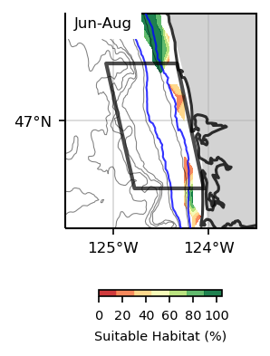
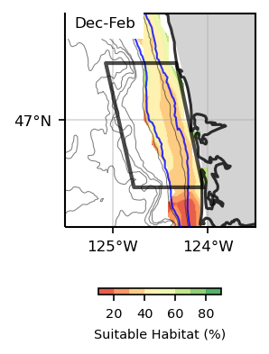
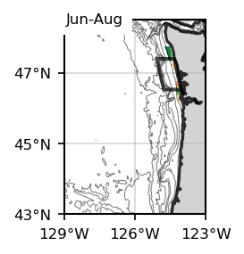
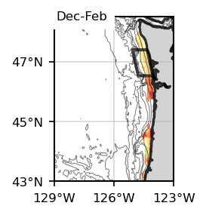
Dungeness Crab
Bottom, Future, SSP 245

Slide 5
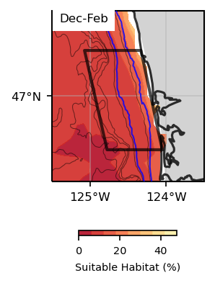
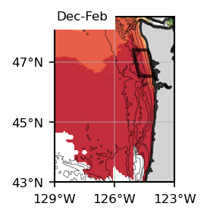
Dungeness Crab
Surface, Future, SSP 585
Jun-Aug
Jun-Aug

Slide 6
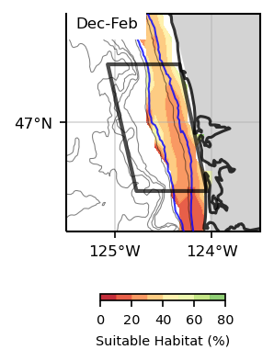
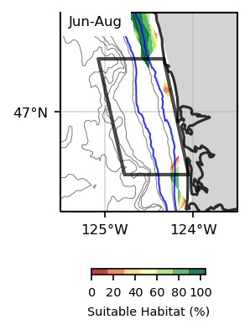
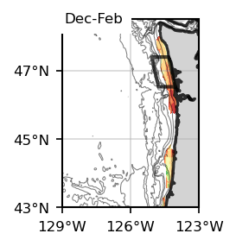
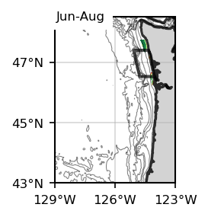
Dungeness Crab
Bottom, Future, SSP 585

Slide 7
Dungeness Crab
Metacarcinus magister;
formerly Cancer magister
Suitable Habitat
1993-2020
Surface
Surface
Juvenile and adult Dungeness crab are highly mobile and live in habitats that are dynamic for thermal, oxygen, and salinity conditions. Adult crabs prefer deeper waters where salinity and temperature are optimal but forage in estuary areas that have lower salinity and higher temperature (Curtis and McGaw 2012). These crabs remain only temporarily in stressful salinity or thermal conditions and then move to areas that are more physiologically comfortable (Curtis and McGaw 2012). When not able to vacate hypoxic areas, they will spend less time feeding and have decreased food consumption (Bernatis et al. 2007). In addition to mobility, the metabolism of juvenile crabs can change under low oxygen conditions, which facilitates their tolerance of less ideal conditions (Trigg et al. 2019).
Environmental conditions may also affect the crabbing fishery. Models testing the co-varying effects of hypoxic conditions and illegal take on Dungeness crab abundance and catch show that during hypoxic conditions, there is greater variability in catch as well as the probability of catch extremes (Froehlich et al. 2017). Abundance and catch declined with increasing illegal catch probability and these effects were greater in the presence of hypoxia (Froehlich et al. 2017). Catch is positively related to dissolved oxygen levels (Keller et al. 2009), so the fishery is more susceptible to poor catch outcomes in hypoxic conditions especially when combined with illegal take and incidental mortality (Froehlich et al. 2017).
Bottom
Bottom

Slide 8
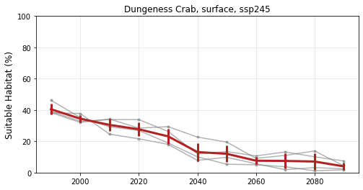
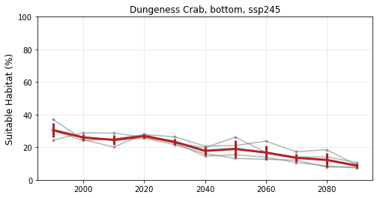
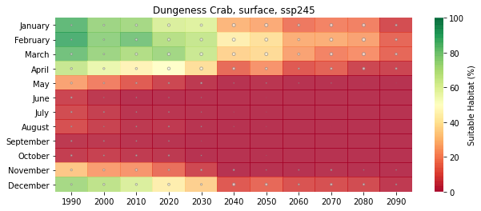
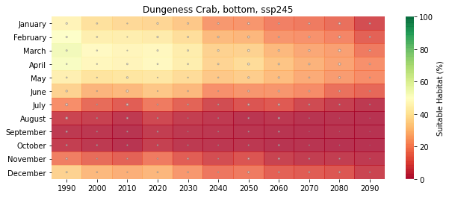
Dungeness Crab
Suitable Habitat
SSP 245
Based on Temperature & Oxygen Conditions, Dungeness Crab habitat would decrease in the future, particularly after 2040, when suitability decreases also during the winter and spring.
Surface
Surface
Bottom
Bottom

Slide 9
Surface
Surface
Jun-Aug
Dungeness Crab
Suitable Habitat
2040-2060, SSP 245
Jun-Aug
Bottom
Bottom

Slide 10
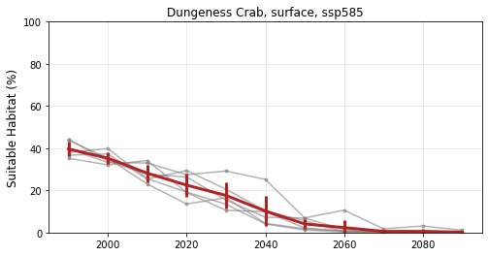
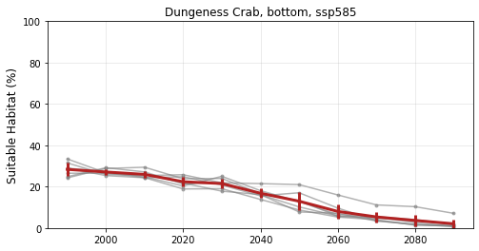
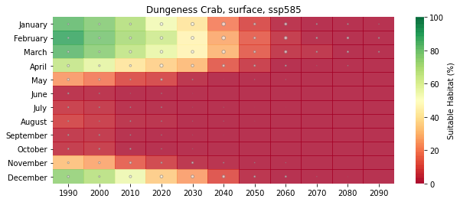
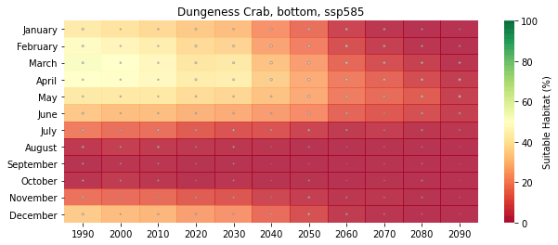
Dungeness Crab
Suitable Habitat
SSP 585
Based on Temperature & Oxygen Conditions, Dungeness Crab habitat would decrease in the future, particularly after 2040, when suitability decreases also during the winter and spring.
Surface
Bottom
Surface
Bottom

Slide 11
Dungeness Crab
Suitable Habitat
2040-2060, SSP 585
Surface
Surface
Jun-Aug
Jun-Aug
Bottom
Bottom

