Slide 1
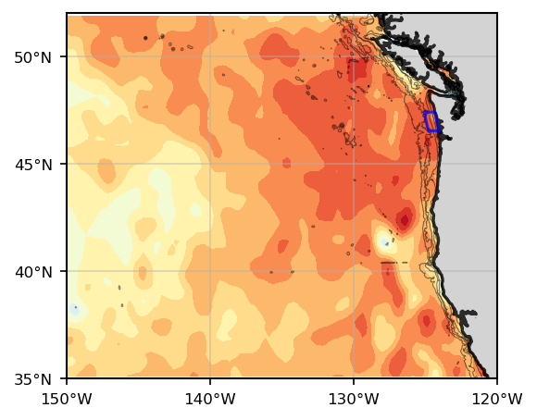
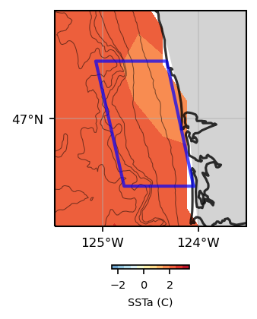
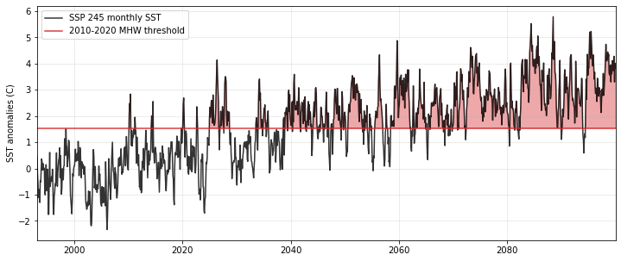
Marine Heat Waves (MHW)
Daily SST anomalies for 16 October 2014,
during the MHW dubbed ‘The Blob’.
What are they, what are the ecosystem/fisheries impacts…
With increasing mean temperature, what today is considered a MHW would become the predominant temperature….
One model SST anomalies, read line shows the MHW threshold (90th percentile)

Slide 2
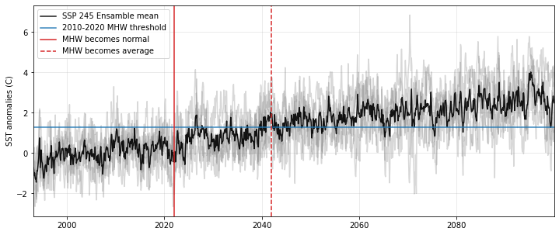
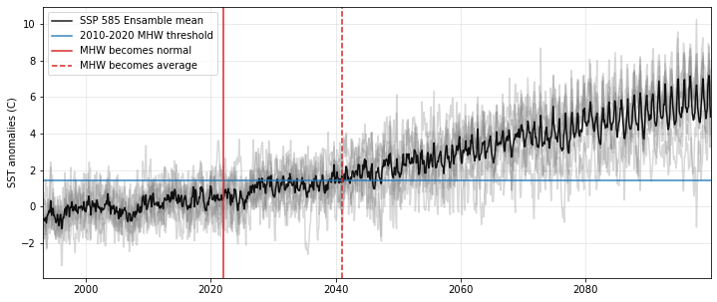
Marine Heat Waves (MHW)
Defined as periods (months) with Sea Surface Temperature anomalies above a threshold (blue line).
This threshold is usually defined as the 90th of SST anomalies monthly values over the baseline period 2010-2020.
SST anomalies calculated based on the period 1993-2019.
Red lines indicate year when the 2010-2020 MHW values become:
Normal, i.e. within decade mean + 1 standard deviation (solid line)
The decade average (dashed line)

Slide 3
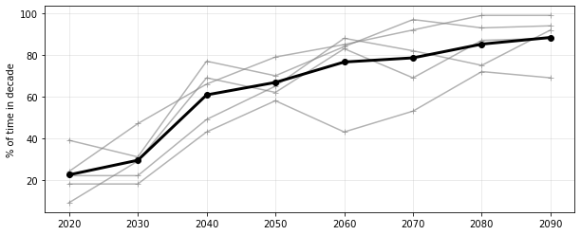
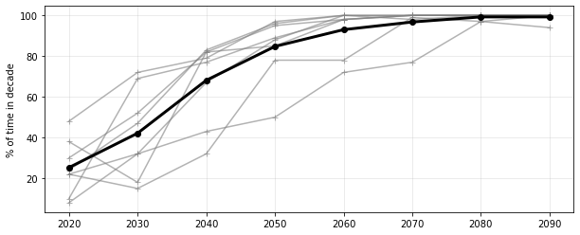
SST anomalies over the 2010-2020 MHW threshold over a decade, expressed as percentage of time
Grey lines represent each model, and black line the mean of the ensemble.
SSP245
SSP585

