Slide 1

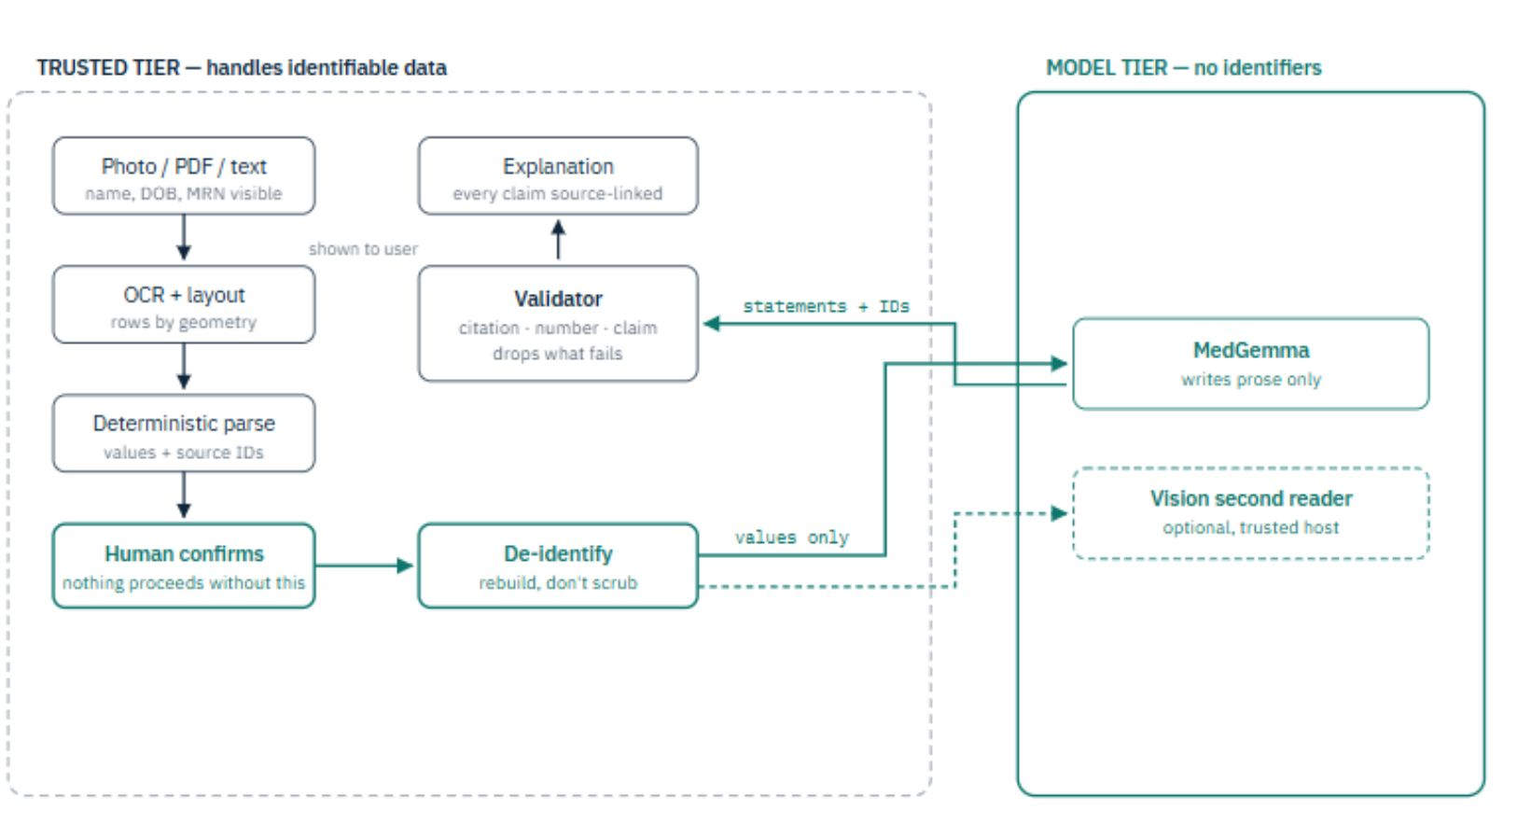
PlainMed
Clear reports. Private by design.
PlainMed explains lab reports in plain language, with every sentence linked to the report line that supports it. Numbers come from a deterministic parser, never the AI, and identifiers are removed before the model sees anything. Google MedGemma on NVIDIA GPUs. Nothing stored. Launching in India, five languages.
Google MedGemma
NVIDIA TensorRT-LLM
Launching in India

Slide 2
THE PROBLEM
A patient can read every word and understand nothing
The web makes it worse
Chatbots can't show their source
Search results strip away the context of this specific report — this value, this range, this lab. The worst-case interpretation wins the click, and patients arrive at appointments anxious about the wrong things.
Uploading to a general-purpose AI produces an answer no one can verify. You cannot check a claim you cannot trace — and the most sensitive document a person owns may leave their device, be cached, and train a model.
The one thing that matters
Neither search nor chatbot can do what a patient actually needs: show its source. So patients arrive without the questions that would actually help them.

Slide 3





WHAT IT DOES
Photograph it. Check it. Understand it.
1 · Scan
2 · Check
Photograph the paper report on any phone. No app install required for the first step.
See exactly what was read by the OCR. Correct anything before the model ever sees a value.
3 · Understand
4 · Ask
Plain language explanation — every claim source-linked to the line in the original report.
Walk away with specific, informed questions to take to your clinician — not generic fears.
Nothing is explained until a person confirms what was read. Confidence tells you the OCR was sure — it does not tell you it was right. The review step is mandatory, not conditional. It is also where a misread digit gets caught by the one person who can see the paper.

Slide 4
THE CORE IDEA
A generated 13.5 is indistinguishable from a hallucinated 13.5
So the language model is never allowed to produce one. Three strictly separated components each own exactly one job — and cannot override each other.
Parser owns the numbers
Model owns the prose
Validator owns the truth
Every value, unit, reference range, and flag is extracted deterministically. Reproducible, unit-tested, and incapable of inventing a digit.
MedGemma writes the explanation around values that were already extracted. It can improve how a sentence reads. It cannot change what it says.
Every cited line must exist in the source document. Every number must appear in it. No diagnosis, no treatment advice, no reassurance.

Slide 5
ARCHITECTURE
The GPU never learns who the patient is
Cheap GPU marketplaces will not sign healthcare data agreements. So we made the GPU not handle patient data at all — compliance burden lives entirely in the CPU tier, which costs a fraction of a cent to run.
Trusted Tier · CPU
Model Tier · GPU
Handles all identifiable data: decode → OCR → parse → de-identify. No name, no DOB, no record number ever leaves this tier. Verified in CI against 14 identifier categories.
~$0.03 / hr — the compliance-heavy tier is CPU-cheap.
Receives values only — no identifiers, no BAA needed. PaddleOCR and MedGemma share a single accelerator, so a scan needs one GPU, not two.
~$0.17 / hr — expensive to run, zero compliance burden.
De-identification by allowlist
Text is rebuilt from parsed fields, so a line containing a name never had a path through to the model tier.

Slide 6
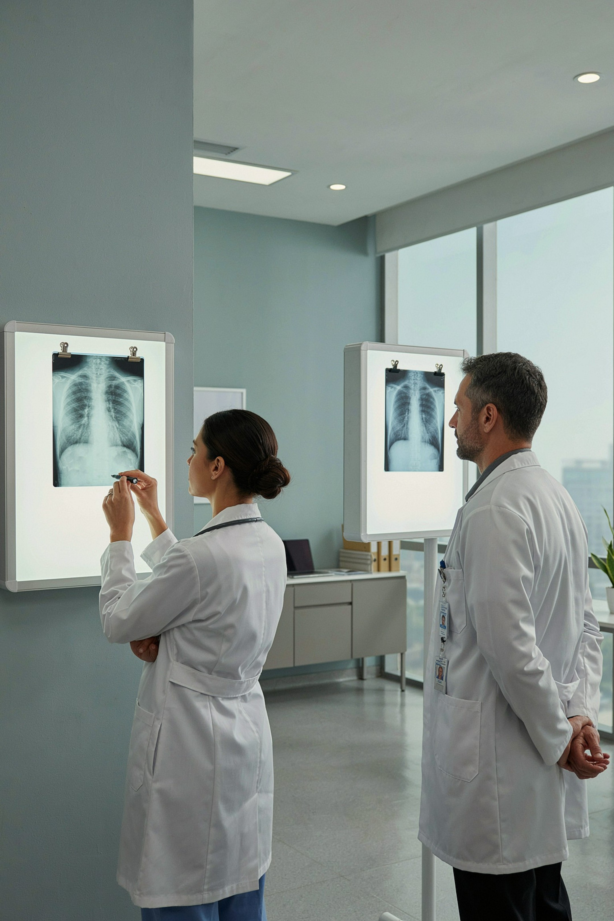
MedGemma, used as a second reader
The obvious build hands the photo to MedGemma and deletes the OCR pipeline. We deliberately did not. MedGemma reads the same photo independently — a second radiologist, not a replacement for the first.
Open weights
Runs on hardware we control — no third-party inference API required.
Medically tuned
Document understanding and a vision encoder that reads the page directly.
4B, 128K context
Fits on a commodity 16 GB GPU card — affordable at production scale.
Readers agree → confidence
Readers differ → a human is asked. The model can raise a question. It can never overwrite an answer.

Slide 7
Served on NVIDIA, priced like a rounding error
The same MedGemma model, behind a TensorRT-LLM engine — inference concerns never leak into application code. Because the GPU never sees patient data, it needs no compliance-grade host, making each report cost a fraction of a cent to serve.
NIM / TensorRT-LLM
4-bit NF4 weights
FP8, XQA and paged attention behind an OpenAI-compatible API — standard integration, state-of-the-art throughput.
A 4B model onto a 16 GB commodity card, roughly halving hourly GPU cost versus FP16.
One GPU, two jobs
Degrades, never fails
PaddleOCR and MedGemma share the same accelerator — a single scan needs one GPU, not two.
No GPU available? Validated template explanations still ship — the product never goes dark for the patient.

Slide 8
WHERE WE LAUNCH
India first, in the language the patient actually reads
$20.5B
2.5B+
India diagnostics market
Tests per year
Projected market size by 2026
Projected by 2031
56%
2→10
Pathology share
Languages
Our primary input format
English + Hindi today; 8 more shipping next
Language is a legal requirement
Built for DPDP from the start
India's DPDP Act requires the consent notice in English or an Eighth Schedule language. A patient who cannot read the notice cannot legally consent to processing.
Itemised consent notice before any processing (Rule 3)
Withdrawal as easy as giving consent
Under-18 excluded and enforced in code
Nothing stored — nothing to breach
Shipping: English, हिन्दी → Tamil, Telugu, Bengali, Marathi, Gujarati, Kannada, Malayalam, Punjabi

Slide 9
EVIDENCE
None of this is a claim. Watch it run.
132
1.3s
Tests passing
Photo to values
Parser, validation, OCR, and security — all green in CI
CPU only, before any GPU is involved
3
0
Safety proofs in CI
Bytes stored
Offline, retention, and de-identification — verified from outside the app
No file written, no report content in any log
Check | What it proves | Result | Time
offline_check | Full pipeline runs with every socket blocked | PASS | 0.55 s
retention_check | No file written, no report content in any log | PASS | 2.6 s
deident_check | 14 identifier categories never reach the model | PASS | 0.36 s

Slide 10
ARCHITECTURE DEEP DIVE
The Path a Report Takes
The pipeline is split into two strict tiers. Identifiable data — name, DOB, MRN — never crosses the dashed boundary. What reaches the model tier is a rebuilt string like Glucose 108 mg/dL (ref 70–99) [H], constructed from parsed fields, never from the original text. Statements return and are validated against the source document before any user sees them.
Why not hand the photo to MedGemma directly?
MedGemma is multimodal and its 1.5 release specifically improves medical document understanding. That path was rejected for one reason: a generated 13.5 is indistinguishable from a hallucinated 13.5. The model writes prose about values already extracted — it cannot change what the report says.
The vision encoder as second reader
MedGemma's vision encoder reads the same photo independently — like a second radiologist, not a replacement for the first. Where both readings agree, confidence is real. Where they diverge, the value is flagged for human review. The model can raise a question; it can never overwrite an answer. Because reading the image means seeing the patient's name, vision cross-check runs on trusted infrastructure only and is off by default.

Slide 11
SYSTEM COMPONENTS
The Pieces
Six focused modules compose the full pipeline. Each owns a single responsibility; none bleeds into another's concern.
Ingest
Extract
plainmed/ingest · plainmed/ocr
Photo, PDF, or pasted text. OCR returns positioned boxes; rows are grouped by vertical overlap and column gaps are preserved — naive reading order would pair one row's value with the next row's reference range.
plainmed/extract
Deterministic parsing into values with stable source IDs. Raw strings are kept verbatim. Unparsed lines are surfaced, never silently dropped.
Explain
Validate
plainmed/pipeline · plainmed/glossary
Three visually distinct card types: what the report says, what a term means (local glossary), and what the report does not answer.
plainmed/pipeline/validate · plainmed/safety
The three checks applied identically to every backend's output — template, local model, or remote tier.
Generate
Serve
plainmed/llm · plainmed/verify
Four interchangeable backends: template (no GPU), local MedGemma, a separate model tier, and NVIDIA NIM / TensorRT-LLM. Unavailability degrades to the template engine — the pipeline never fails outright.
plainmed/api · plainmed/compliance
Consent gate, anonymous signed sessions, rate limiting, audit logging, and an itemised DPDP notice in English and Hindi. Nothing is written to disk or logs.

