Slide 1
Prototyping

Slide 2
What is it?
A limited representation of a design that allows users to interact with it and to explore its suitability and explore imagined uses
Aim is to save on time and effort
Aim is to have something that can be tested with real users
‹#›

Slide 3









The Process
prototype
OK?
design
evaluate
done!
re-design

Slide 4
Goals of Prototyping
Prototyping enables evaluation, happens throughout
Exploring requirements
Test what analysis and types of interaction are best
Choosing among alternatives
Help decide critical features to determine what tech to use
Empirical usability testing
As early as possible, try out ideas with target users
Evolutionary development
May deliberately choose a malleable software platform, building project in
incremental, iterative fashion
‹#›

Slide 5
Why Prototype?
Evaluate and get feedback
Stakeholders can see, hold, interact with a prototype more easily than a document or a drawing
You can test out ideas for yourself (like a rough draft)
It encourages reflection
Prototypes answer questions (like critical features needed) and help researchers choose between alternatives
‹#›

Slide 6
How to Prototype
Start with easiest to use/most flexible tool
Palladio
Cloud-based tool out of Stanford, no account needed
Works with spreadsheets (csv, xslx, tsv)
Can explore creating maps, graphs, and network diagrams
Can explore filtering and organizing data
Can save configuration files to easily return to project for more analysis
Watch Palladio walkthrough
‹#›

Slide 7
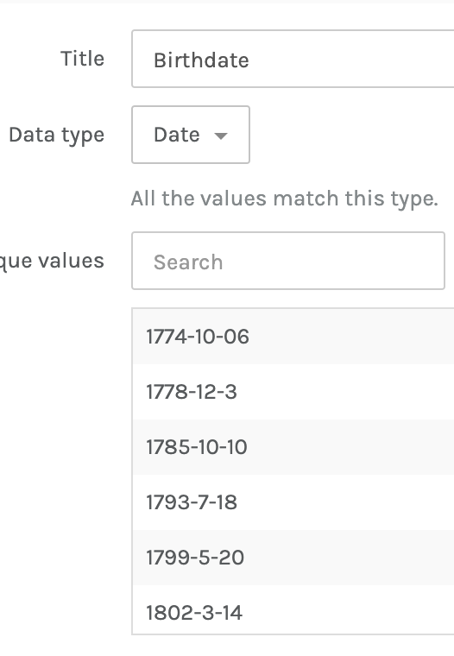
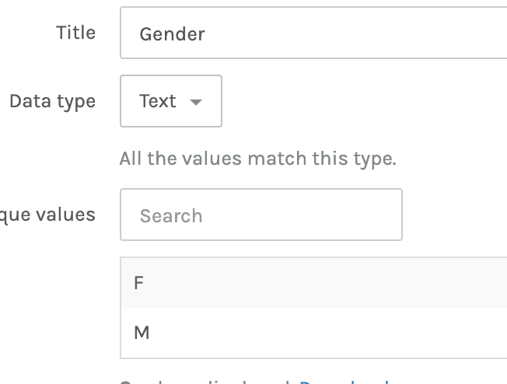
Learn to Standardize
All tools require data be standardized and formatted in certain ways.

Slide 8
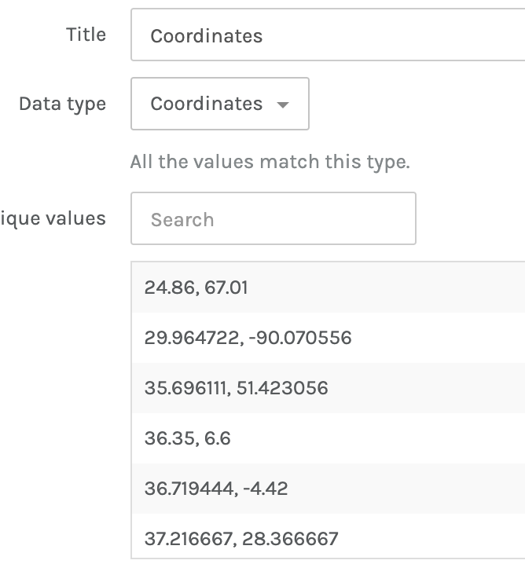
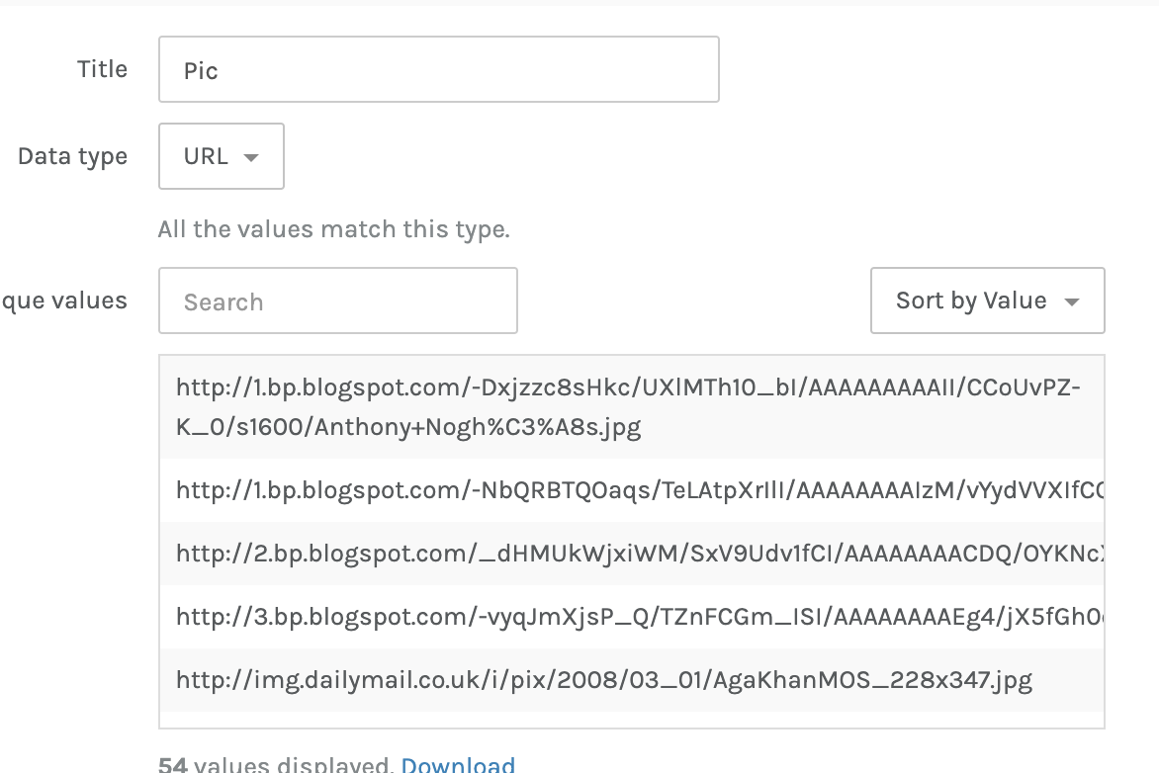
Learn Tool Idiosyncrasies
Different tools provide different features. One must structure data correctly to utilize those features.

Slide 9
Other Good Prototyping Tools
Omeka
What for?
Digital archives and exhibits
Exploratory data structuring
Exploratory maps and timelines
Google My Maps
What for?
Adding point and polygon data to layers
Voyant Tools
What for?
Exploratory corpus and text analysis
Exploratory topic modelling
‹#›

