Slide 1
Digital Humanities
Introduction

Slide 2

Course Overview
Introductions
Syllabus
How to succeed in DH

Slide 3
Definition of DH
Digital Humanities (DH) is concerned with applying computational tools to traditional fields in the humanities or liberal arts such as literature, history, and philosophy.
DH, originally known as Humanities Computing, was conceived in the late 1940s and has been practiced ever since.
Implemented by libraries, archives, museums, and other memory institutions in an effort to try to stay relevant.
When the Internet boom began in the mid-90s, all of these institutions realized it was a way for them to reach more people than ever before.

Slide 4
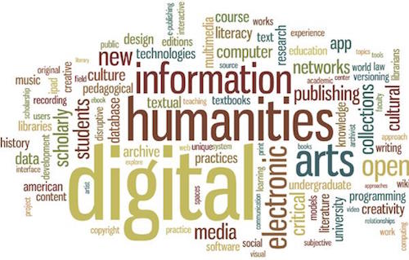
DH Discussion
Why did institutions like museums latch onto this idea so quickly?
What were the benefits and possible negative aspects to this?

