Slide 1
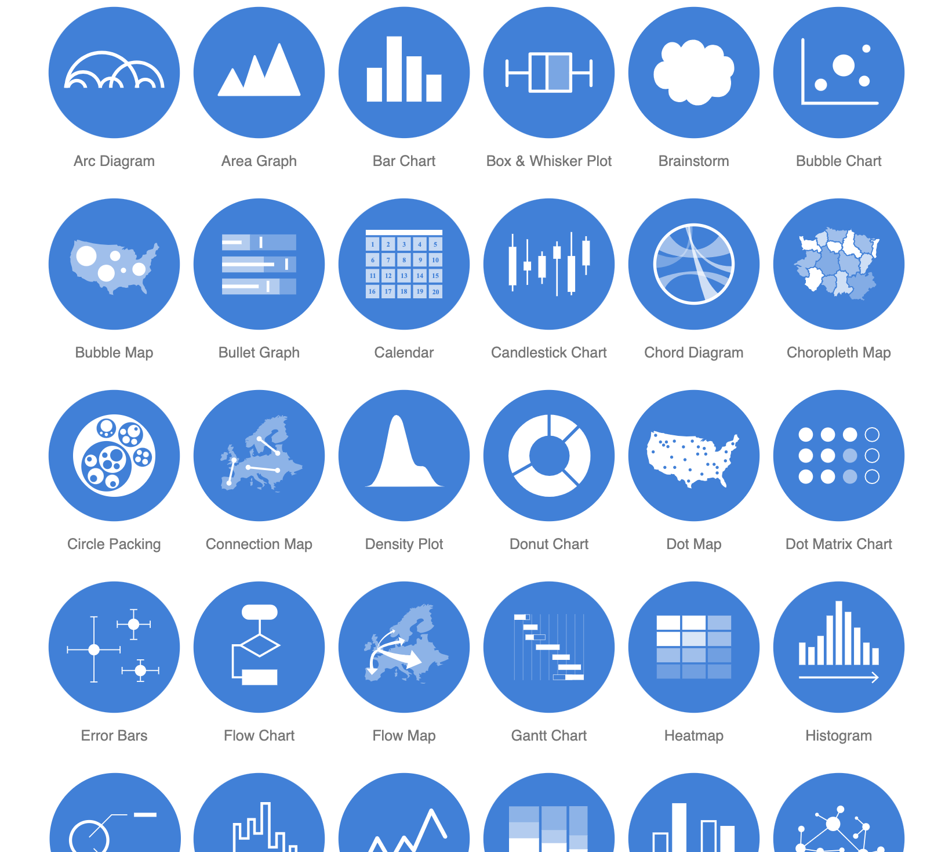
Visualization

Slide 2
Overview
What is visualization and how do DHers do it?
Talk about the Drucker visualization reading blog posts
Look at some options for visualizations using our social media coding activity
Notes:
I am only a tech person, I have no idea what Kant is talking about here; nor can I help develop a research method or point you to “transformative” digital scholarship.
Thus, the best we can do is take Kant at his word and develop a set of rule for determine when the digital thing we do is “right” or “wrong”. People often come to tech person for help without any particular details or structure information to work with. This framework is to help you develop that detail and structure.

Slide 3
What is visualization?
Representation of information into a graphic – whether a chart, image, or animation – to communicate a message
visualizations are the final product of all kinds of DH research – text analysis graphs, GIS maps, social networks, web-based stories, etc.

Slide 4
DHers Don’t Just Do Visualization
“So naturalized are the Google maps and bar charts generated from spread sheets that they pass as unquestioned representations of ‘what is’. This is the hallmark of realist models of knowledge and need to be subjected to a radical critique to return the humanistic tenets of constructed-ness and interpretation to the fore.”
Johanna Drucker from Humanities Approaches to Graphical Display

Slide 5
Visualization as “direct address”
What is direct address and what does it have to do with rhetoric?
How does Drucker make an argument that visualizations are direct address?
Notes:
The first thing that humanist want to bring to the fore about visualization is they are not objective displays of truth. Each visualization is trying to persuade the viewer of a certain view of that information, and that interpretative act needs to be identified and analyzed.

Slide 6
The Rhetoric of Direct Address
language structures power relationships--e.g. pronouns like I, you, they,
graphic displays can encode misinformation (mapping area instead of population)
“familiar formats often allows them to be consumed without hesitation – or critical consideration”
Enunciations are “forms of communication that inscribe speaking and spoken subject positions” (Drucker and Svensson, 2016).
We should pay attention to the “structuring principles of graphics as enunciative expressions that position their makers and receivers in a co-dependent relation of power.”

Slide 7
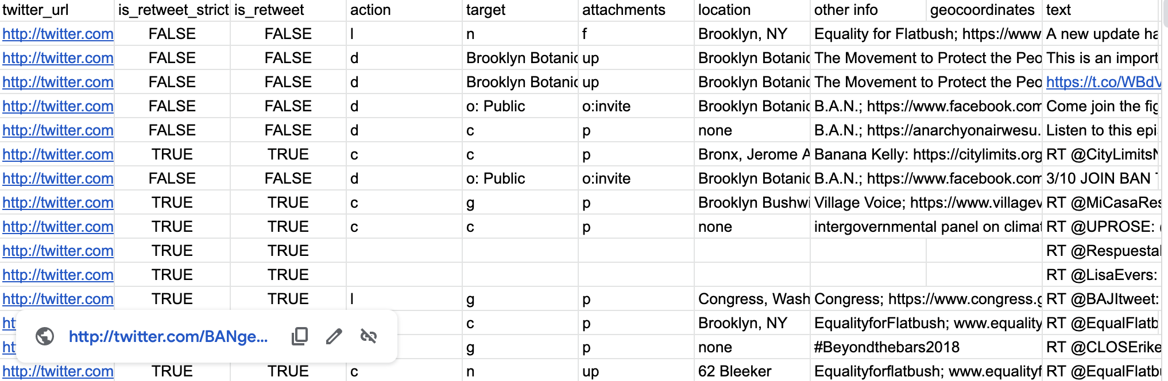
Capta
“In an Excel spreadsheet, the structuring of fields, naming of the rows and columns, semantic designations, and decisions about metric standards for quantitative entities are all authored activities that embody ideological values”
(Drucker, 2017, p. 908)
Notes:
The interpretive process of visualizations does not just start once the visualization is created. The collection and shaping of the data are affected by the bias and ideology of the preparer(s). Drucker coins the word “Capta” as a replacement term for data. Drucker suggests that the concept of data being tied to empirical science makes people think it is objective representation of natural phenomena. Capta conotates the subjective and interpretative process in information collection and organization; That is, “knowledge is constructed, taken, not simply given as a natural representation of pre-existing fact”

Slide 8
How are you enunciating using these features?
scale
labeling
visual point of view: is it totalizing?
color
The features provide a script for your message and also dictate users’ behaviors

Slide 9
Example Visualizations
https://flowingdata.com/2020/10/30/where-coronavirus-cases-are-peaking/
https://chicagosmilliondollarblocks.com/
https://www.nytimes.com/interactive/2020/11/03/us/elections/results-president.html?action=click&pgtype=Article&state=default&module=styln-elections-2020&region=TOP_BANNER&context=election_recirc
Notes:
How are these visualizations using the presentation of data - interactivity, labels, color, etc. - to get one to see that data in a certain way?

Slide 10
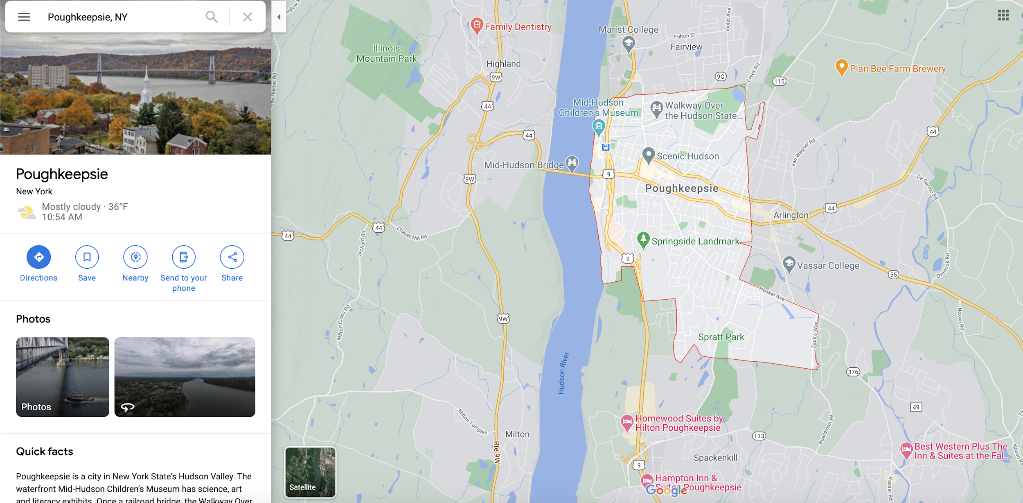
“Objective truth” of Google Maps
Notes:
When we go to Google Maps for the place where you live, what is Google suggest about that place or what one would want to do in that place?

Slide 11
Resources for Data Prep and Visualization
Check out Week 11 Resources and Tutorials
TAGS: basic visualizations in “Summary” & “Explore” sheets
Voyant for “Tweet” field in spreadsheet
Google Sheets “Explore”
count by for strings (alphabetic language)
count if numerical data
count by is_retweet

