Slide 1

Conclusion for the Contribution of an OSS Program
: JabRef
Author： RuiKang (marisuki)
Class: 1636101/1603005
@ 2018.8.13

Slide 2

Team Members
1160300514 康瑞
1160300705 谢将凤
1160300813 陈曦
1160300814 姜思琪
1160300726 李梦浩

Slide 3

Content
1. General contributions: File changes and ideas of contribution
2. Each part of contributions
3. Conclusion

Slide 4
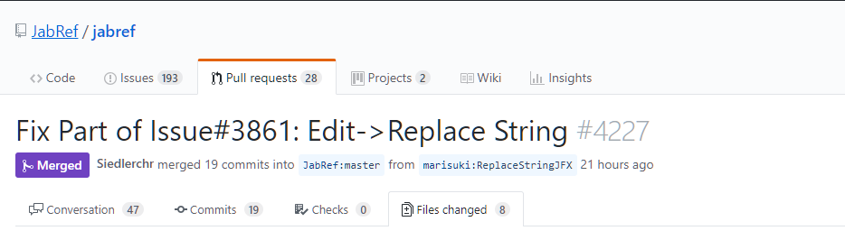
Ⅰ. General Contributions
See: https://github.com/JabRef/jabref/pull/4227
A dialog easy in design, however substantial, including every part needed in MVVM pattern
And we design this dialog with fully understand of JavaFX and related patterns,
making the codes easy to understand.

Slide 5
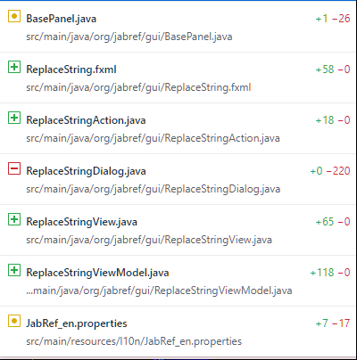
File change:
The general change is to follow the basic idea of the MVVM pattern, as shown in this slice, the FXML file is the GUI design and the other two: Action, View, ViewModel is the basic idea of MVVM pattern.

Slide 6
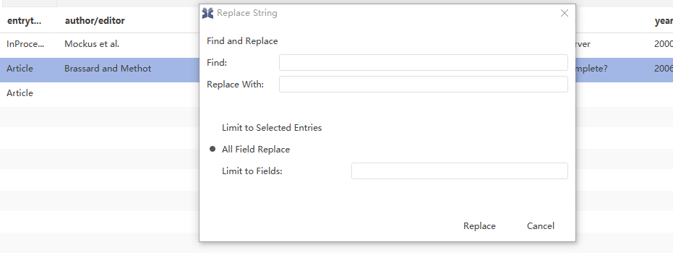
Related File Functions:
0. ReplaceString.fxml: design of the dialog (+)
1. BasePanel.java: message handler of basic panel, link dialogs (M)
2. ReplaceStringAction.java: interface for BasePanel and execute when being asked (+)
3. ReplaceStringDialog.java: old design, using Swing and integrating both logic and UI design (-)
4. ReplaceStringView.java: view part, the entrance of user input, bind with var in viewModel (+)
5. ReplaceStringViewModel.java: viewModel, logic part of the MVVM pattern. (+)
6. JabRef_en.properties: translate from keys, making outperform regulated, in UI designs. (M)

Slide 7
Ⅱ. Each Part of Contributions:
First Part: 1160300814 姜思琪
Graphics User Interface: FXML design
Details about FXML design:
This part highly relates to ReplaceString.fxml. We first place the components with its coordinate in pixels, and later, adapted the advice from maintainers of the JabRef project and finally changed it into grid design. By succeeding from old dialog, we located them and registered their action handler and fx_ids. And this part of work also includes message handler: button_replace in view, and initiate the cancel message handler.

Slide 8
Second Part: 1160300705 谢将凤
MVVM Pattern Design
Details:
This part of work includes the pattern understanding and functional description of dialog message, UI files. From the first rough design to the well-fitted design, this part of work relates to a number of changes. By packaging the view-model logic, we tested the code to ensure there being no bugs in logic part, which is the hardest part of GUI test.

Slide 9
Third Part: 1160300813 陈曦
FXML message/input handler, algorithm in viewModel
Details:
This part of work includes initialize, constructor in view and view model, which is highly related to the MVVM pattern, which binding the properties in view and view-model to synchronously handle the input. The algorithms in view-model are succeeded from the old dialog design, in the BasePanel and modified some logics to separate algorithms and view.

Slide 10
4th Part: 1160300726 李梦浩
Framework Action
Details:
This part includes the Action part in the MVVM pattern, which provides interface to BasePanel.java and execute the dialog by running the “execute”function: extended from SimpleCommand.class.

Slide 11
5th Part: 1160300514 康瑞
General design: code checking, testing, GitHub message handler
Details:
This part relates the BasePanel modifying, transferring text in FXML and registering them in properties, helping to test (be a member) the algorithm and interface in view-model, making the code look well (easily to understand) and the GitHub pushing, debugging. The general design also include Gradle build: how to build the project and generate the omitted codes.

Slide 12
Conclusion:
We work in team to complete the work: change the pattern: swing to MVVM, about the dialog: Edit->Replace String. With change on 7 files, we succeeded in participating in the whole process of OSS program contribution, the commits finally merged into master as part of v5.0 version on 11th August 2018.

Slide 13
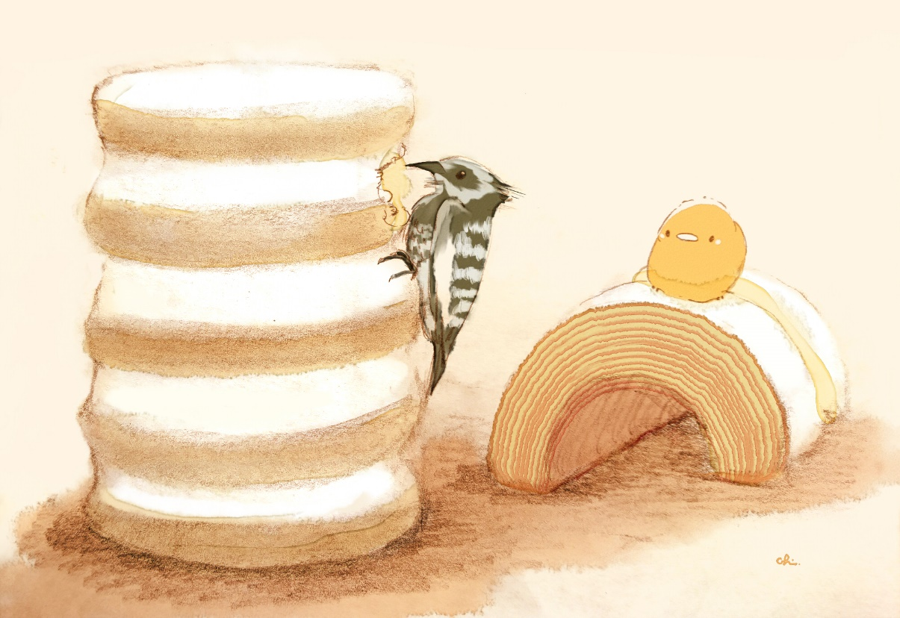
Voice Cast List: (CV)
@ 1160300705 谢将凤
@ 1160300813 陈曦
@ 1160300514 康瑞

Slide 14

Thank You!
RuiKang (marisuki)
@2018.8.13

