Slide 1
Chinese IVD Expansion in European Markets
Strategic Analysis and Market Entry Assessment

Slide 2
Executive Summary: High-Value Market with Significant Barriers
• European IVD market represents €12.9B+ opportunity with substantial government-funded healthcare spending
• Chinese suppliers face complex regulatory barriers (IVDR transition) and new procurement restrictions (IPI)
• Leading Chinese players (Mindray, Snibe, Autobio) demonstrate regulatory compliance and financial strength
• Market entry requires localization strategy, navigating country-specific reimbursement systems, and overcoming trust deficit
• Strategic acquisitions and partnerships critical for European market penetration
[1] https://drive.google.com/file/d/1zt3vNjOlugypsvPkywduyWNRPGTHrsoj/view?usp=drive_link

Slide 3
Agenda
Market Overview & Key Metrics
Regulatory Landscape Analysis
Competitive Positioning
Access & Reimbursement Framework
Strategic Opportunities & Risks
Recommendations for Market Entry

Slide 4
European IVD Market: Substantial Opportunity with Complex Structure
Market Size & Structure
• Germany: €12.9B annual IVD expenditure, 2.6% of total healthcare costs
• Per capita spending: €150 annually in Germany
• 55% growth in lab spending (2012-2022) vs 63% overall health expenditure growth
• Market dominated by large commercial laboratory networks
Key Market Trends
• Consolidation: Under 20% of clinics maintain own laboratory infrastructure
• POCT growth driven by technical personnel shortages and infrastructure decline
• Therapeutic Drug Monitoring emerging as growth area
[1] https://journals.publisso.de/en/journals/gms/volume23/000337

Slide 5
Regulatory Landscape: IVDR Compliance and Geopolitical Barriers
IVDR Transition Challenges
• Transition to IVDR extended to 2027-2028 with stricter compliance requirements
• Certification process lengthened by 6-12 months, forcing out 30%+ of SMEs
• Environmental regulations (REACH) add compliance complexity for reagents
International Procurement Instrument (IPI)
• Effective June 2025: Bans Chinese companies from public contracts >€5M
• Limits Chinese component usage to 50% maximum in successful bids
• Exceptions only where no alternative suppliers exist
[1] https://drive.google.com/file/d/1zt3vNjOlugypsvPkywduyWNRPGTHrsoj/view?usp=drive_link [2] https://ec.europa.eu/commission/presscorner/detail/en/ip_25_1569

Slide 6
Competitive Landscape: Chinese Suppliers Gaining Traction
Company | Regulatory Progress | Financial Strength | Market Strategy
Mindray | IVDR certified, HyTest acquisition | 11.58B CNY net profit (2023) | Localization via acquisitions
Snibe | 211 chemiluminescence IVDR certificates | 16.62% revenue growth (Q1 2024) | Distributor network in 18 countries
Autobio | IVDR certified, Sekisui partnership | Positive net profit growth | Strategic partnerships
Wondfo | IVDR QMS certified, 150+ countries | Global manufacturing footprint | POCT focus, acquisitions
[1] https://en.caclp.com/industry-news/3530.html [2] https://en.caclp.com/industry-news/2785.html [3] https://en.caclp.com/industry-news/3349.html

Slide 7
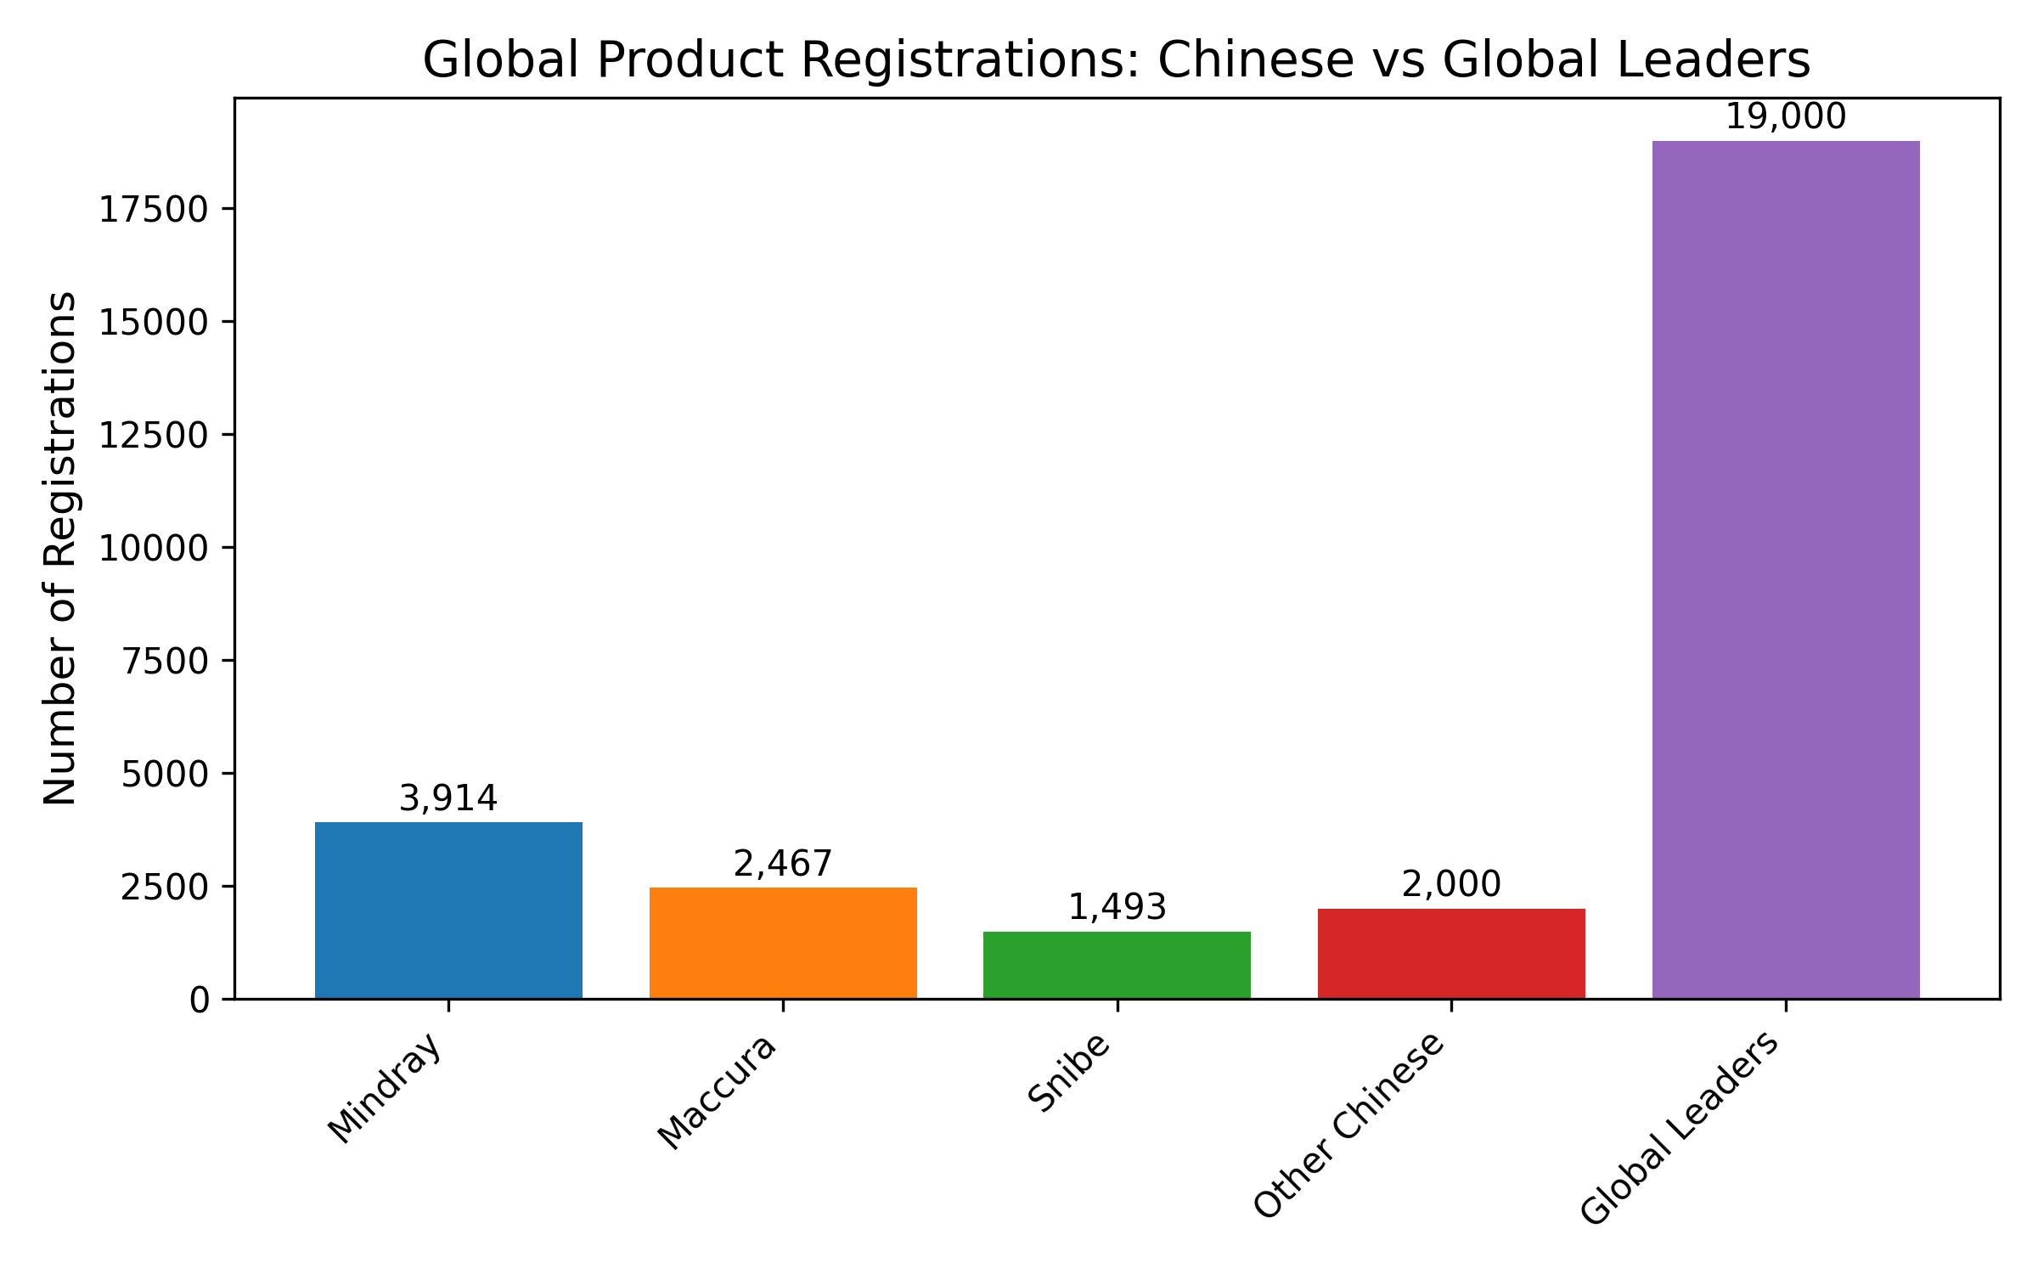
Product Registration Gap: Chinese Suppliers vs Global Leaders
[1] https://en.caclp.com/industry-news/2365.html

Slide 8
Access & Reimbursement: Fragmented European Landscape
Country-Specific Systems
• Germany: EBM catalog for outpatient, DRG-based for inpatient
• France: NABM system with innovative LAHN pathway
• Italy: LEA catalog with defined tariffs
• Spain: Global budget funding, no dedicated reimbursement
• UK: NHS Payment Scheme, Medtech Funding Mandate
Key Challenges
• Fixed prices without inflation adjustment (Germany)
• Manufacturer-triggered reimbursement code creation
• HTA requirements vary by country and region
[1] https://mtrconsult.com/general-market-access-landscape-vitro-diagnostic-tests-europe [2] https://journals.publisso.de/en/journals/gms/volume23/000337

Slide 9
Budget Analysis: Cost Pressures Drive Value Seeking
Country | Funding Mechanism | Cost Pressure Factors
Germany | Global budgets, DRG-based | Fixed prices, efficiency bonus
France | NABM with point values | Innovation funding constraints
Spain | Regional global budgets | No dedicated reimbursement
UK | NHS Payment Scheme | Medtech Funding Mandate limits
• Laboratories operate under severe cost constraints, creating demand for cost-effective solutions
• Chinese suppliers must demonstrate significant cost advantages over incumbents
• Value proposition must align with hospital budget optimization needs
[1] https://mtrconsult.com/general-market-access-landscape-vitro-diagnostic-tests-europe [2] https://journals.publisso.de/en/journals/gms/volume23/000337

Slide 10
Customer Receptivity: Trust Deficit vs Cost Advantage
Adoption Challenges
• Low brand recognition for high-end products in developed markets
• Market dominated by entrenched Western incumbents (Roche, Siemens, Abbott)
• Trust deficit hampers adoption of high-end IVD solutions
Competitive Advantages
• Strong price competitiveness and cost-effectiveness
• Performance-to-cost differentiation strategy
• Successful adoption in price-sensitive segments and emerging markets
[1] https://drive.google.com/file/d/1zt3vNjOlugypsvPkywduyWNRPGTHrsoj/view?usp=drive_link [2] https://en.caclp.com/industry-news/2365.html

Slide 11
Strategic Opportunities: Pathways to Market Success
Market Entry Strategies
• Utilize Eastern European countries (Hungary, Greece) as gateways to EU market
• Leverage German certification for enhanced brand credibility
• Focus on POCT and decentralized testing segments
Strategic Partnerships & Acquisitions
• Acquire European companies for local presence (Mindray-DiaSys model)
• Secure upstream raw materials through acquisitions (HyTest strategy)
• Establish local manufacturing to bypass IPI restrictions
[1] https://drive.google.com/file/d/1zt3vNjOlugypsvPkywduyWNRPGTHrsoj/view?usp=drive_link [2] https://hytest.fi/news/mindray-completes-acquisition-of-hytest

Slide 12
Risks & Challenges: Navigating Complex Barriers
Risk Category | Specific Challenges
Regulatory | IVDR compliance costs, IPI restrictions, REACH environmental rules
Market Access | Country-specific reimbursement systems, HTA requirements
Competitive | Entrenched incumbents, trust deficit in high-end segments
Operational | Supply chain localization requirements, skilled workforce shortages
Geopolitical | Trade tensions, reciprocity requirements, policy changes
[1] https://ec.europa.eu/commission/presscorner/detail/en/ip_25_1569 [2] https://mtrconsult.com/general-market-access-landscape-vitro-diagnostic-tests-europe

Slide 13
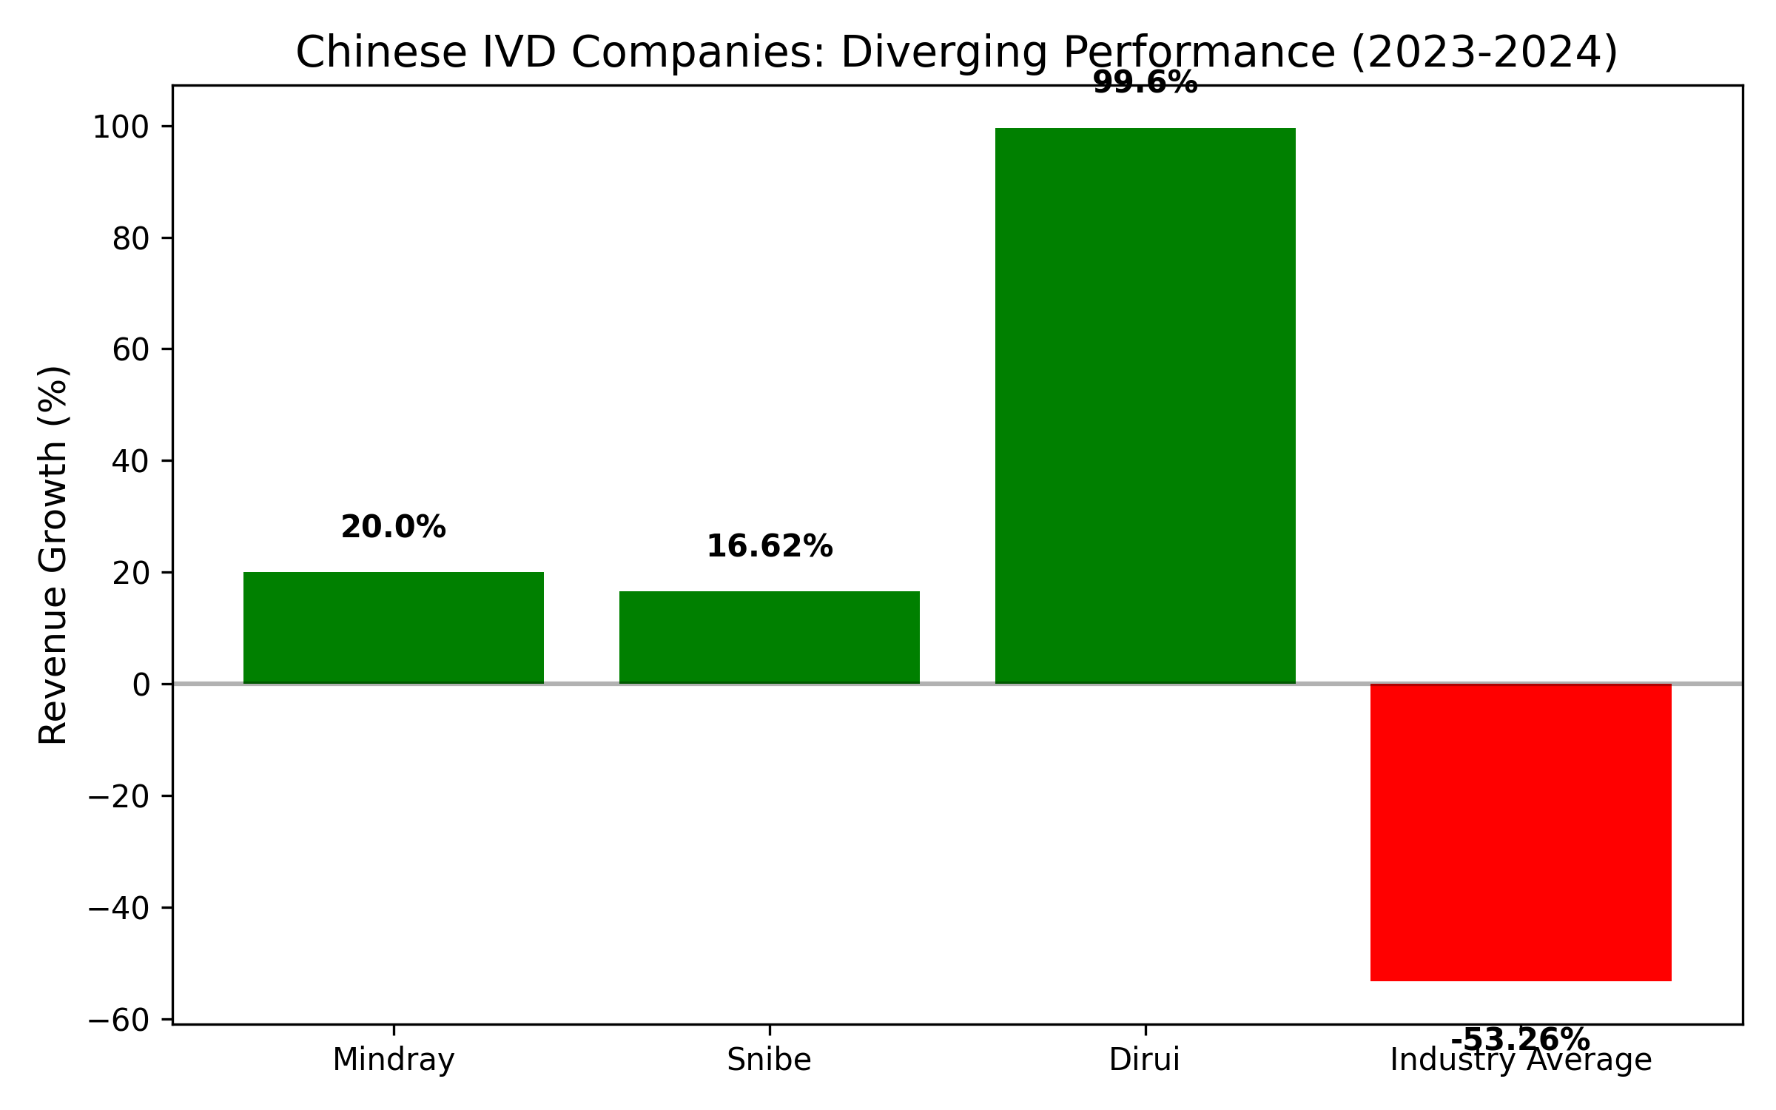
Financial Performance: Export-Focused Companies Outperforming
[1] https://en.caclp.com/industry-news/2808.html [2] https://en.caclp.com/industry-news/2785.html

Slide 14
Strategic Recommendations for Market Entry
Immediate Priorities (0-12 months)
• Establish local EU manufacturing/JVs to bypass IPI restrictions
• Secure full IVDR certification for complete product portfolios
• Develop country-specific HTA and reimbursement dossiers
Medium-Term Strategy (1-3 years)
• Acquire European distributors or establish direct sales force
• Build local service and support capabilities across key markets
• Develop innovative payment models for cost-constrained systems
[1] https://www.ainvest.com/news/frontier-medtech-navigating-china-eu-trade-tensions-investment-gains-2507/ [2] https://mtrconsult.com/general-market-access-landscape-vitro-diagnostic-tests-europe

Slide 15
Conclusion: Strategic Imperatives for European Success
Key Success Factors
• Localization is non-negotiable: manufacturing, service, and compliance
• Focus on cost-advantaged segments while building high-end credibility
• Navigate country-specific reimbursement systems with tailored strategies
Future Outlook
• Chinese suppliers well-positioned for mid-market segments
• Regulatory compliance becoming key differentiator
• Market share gains expected in cost-sensitive segments
[1] https://drive.google.com/file/d/1zt3vNjOlugypsvPkywduyWNRPGTHrsoj/view?usp=drive_link [2] https://www.ainvest.com/news/frontier-medtech-navigating-china-eu-trade-tensions-investment-gains-2507/

