Slide 1
European IVD Market Analysis: Chinese Supplier Expansion
Strategic Research Briefing
2025 Market Intelligence Report

Slide 2
Executive Summary: Chinese IVD Suppliers Face High-Value European Market with Significant Barriers
• European IVD market represents €1.65 trillion healthcare expenditure with €3,685 per capita spending
• Chinese suppliers face new EU procurement restrictions banning participation in tenders >€5M with >50% Chinese inputs
• IVDR transition creates significant regulatory barrier, lengthening certification by 6-12 months and forcing 30% of SMEs out
• Mindray leads Chinese expansion with 3,914 global registrations (3,158 overseas) and acquisition of German DiaSys
• Cost-effectiveness drives adoption in low-mid segments but trust deficit hampers high-end market penetration
[1] https://drive.google.com/file/d/1zt3vNjOlugypsvPkywduyWNRPGTHrsoj/view?usp=drive_link
[2] https://ec.europa.eu/commission/presscorner/detail/en/ip_25_1569
[4] https://en.caclp.com/industry-news/2365.html

Slide 3
Agenda
1. Market Overview & Key Metrics
2. Regulatory Landscape Analysis
3. Competitive Intelligence
4. Market Access & Procurement Barriers
5. Strategic Recommendations

Slide 4
European IVD Market: High-Value Opportunity with Complex Structure
Market Size & Structure
• €1.65 trillion total healthcare expenditure with €3,685 per capita spending
• Government and mandatory insurance funding represents over 60% of budget structure
• Tiered reimbursement system: DRG-based prospective payment at base level, supplementary mechanisms for innovative technologies
Key Market Characteristics
• Not monolithic - collection of government-funded systems with public tender rules
• Cost-control paramount but mechanisms exist for premium reimbursement of proven clinical value
• Price sensitivity toward low-to-mid-end devices in developed European markets
[1] https://drive.google.com/file/d/1zt3vNjOlugypsvPkywduyWNRPGTHrsoj/view?usp=drive_link

Slide 5
Regulatory Landscape: IVDR Creates Significant Barriers for Market Entry
IVDR Transition Impact
• Certification process lengthened by 6-12 months since MDR implementation
• More than 30% of small and medium-sized enterprises forced out of market
• Transition periods extended to 2027-2028 requiring strict compliance throughout product lifecycle
Chinese Company Progress
• Snibe: 211 chemiluminescence + 67 biochemical reagents with IVDR CE certification
• Mindray: First biochemical project IVDR CE certificate (β2-microglobulin) in January 2021
• Wondfo: First IVDR quality management system certificate in POCT field (August 2021)
• Over 40 Chinese companies granted CE for monkeypox virus detection kits (2022)
[1] https://drive.google.com/file/d/1zt3vNjOlugypsvPkywduyWNRPGTHrsoj/view?usp=drive_link
[7] https://en.caclp.com/industry-news/3530.html
[8] https://en.caclp.com/industry-news/1160.html
[10] https://en.caclp.com/industry-news/1480.html

Slide 6
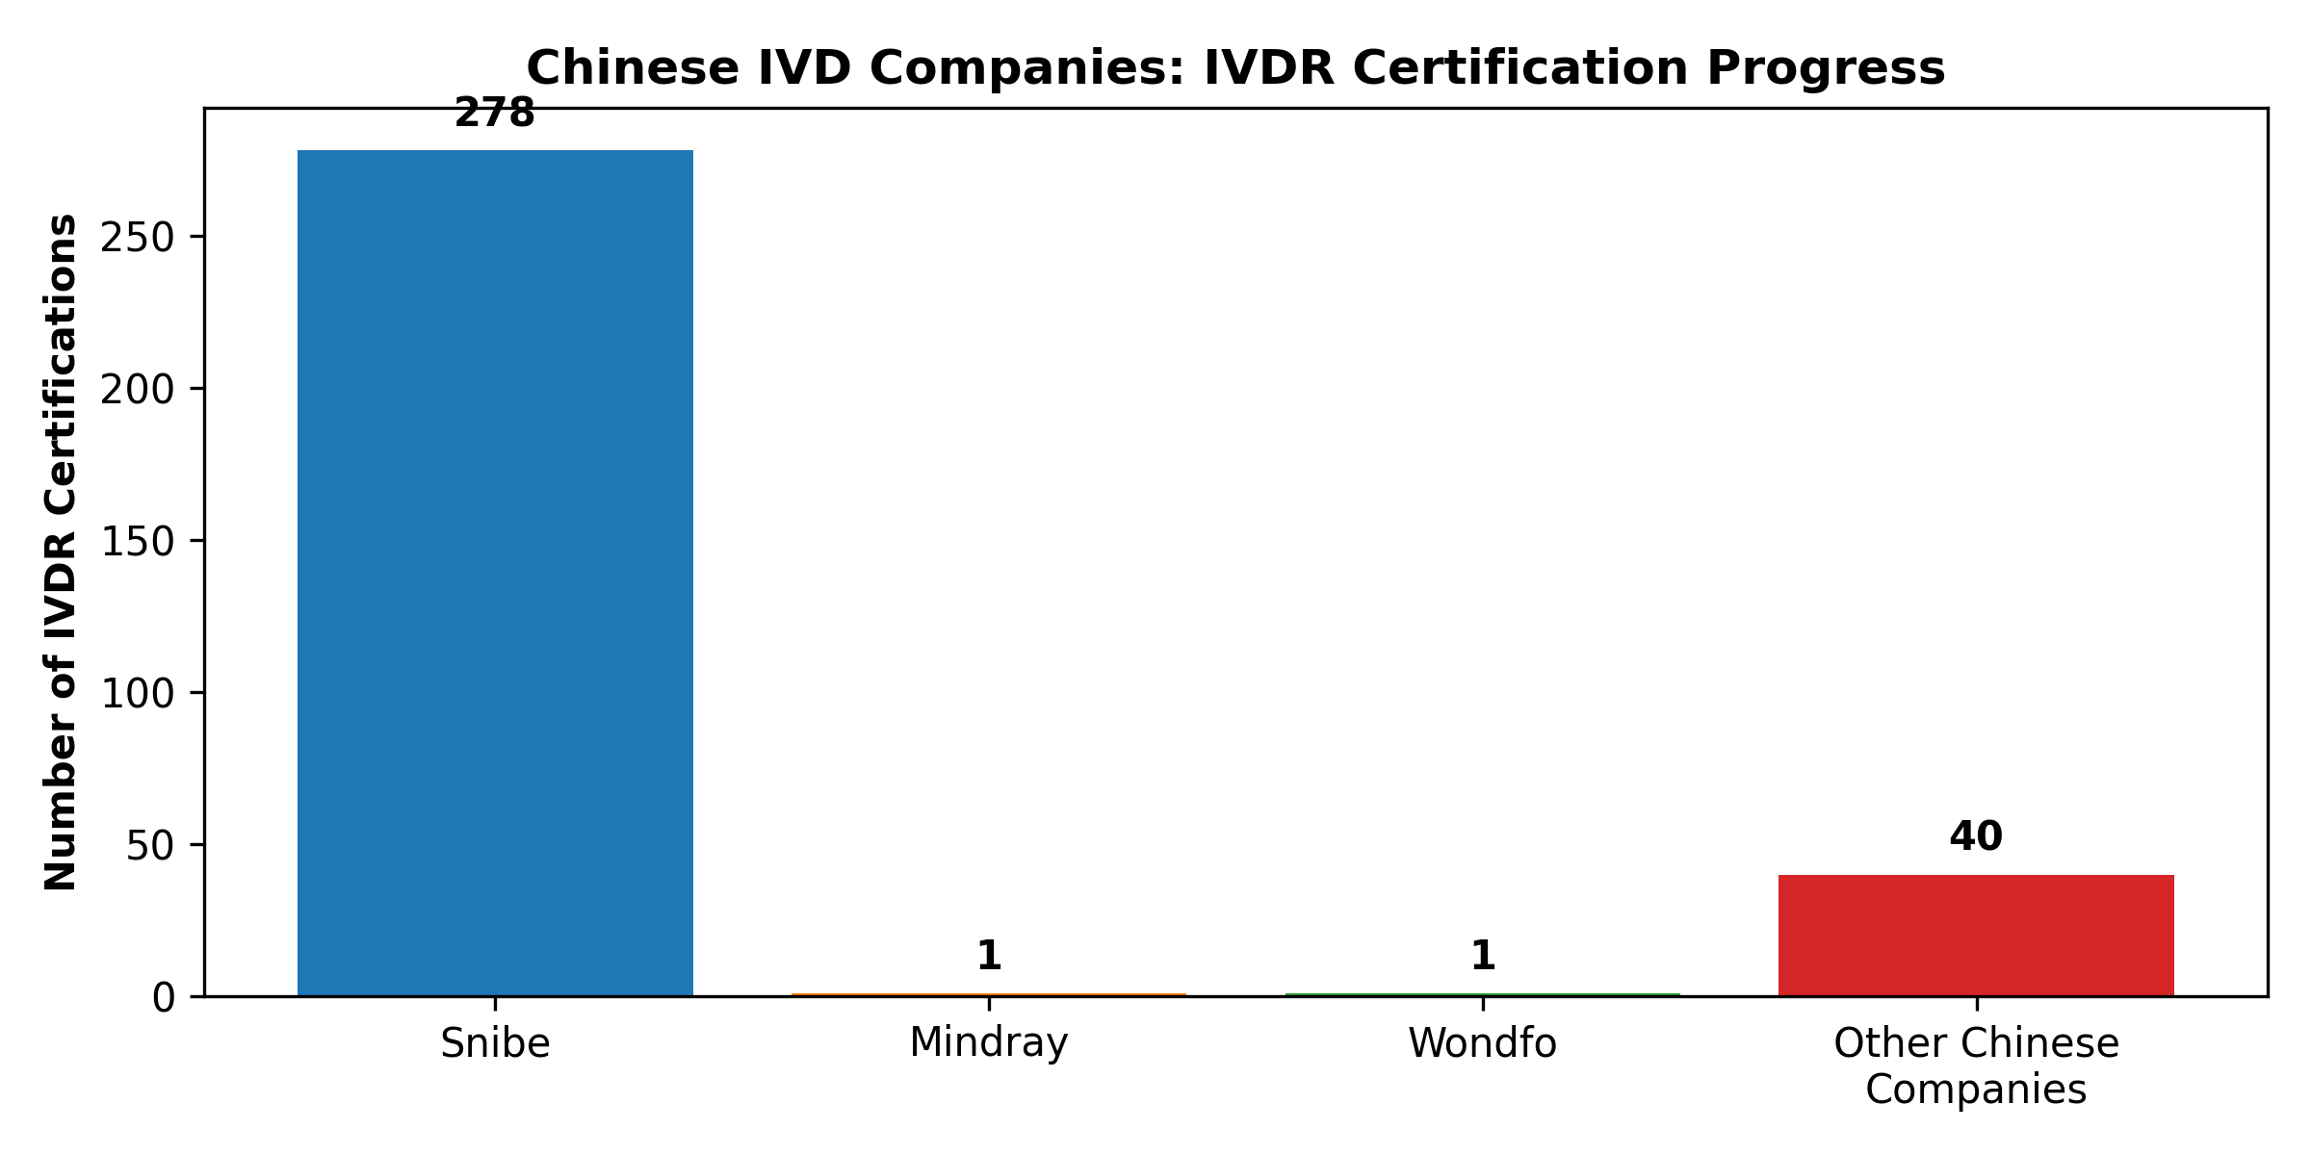
Chinese IVD Suppliers Making Significant Progress on IVDR Compliance
[7] https://en.caclp.com/industry-news/3530.html | [8] https://en.caclp.com/industry-news/1160.html | [10] https://en.caclp.com/industry-news/1480.html

Slide 7
Procurement Restrictions: EU Limits Chinese Participation in High-Value Tenders
EU International Procurement Instrument (IPI) Measures
• Exclusion from public procurement tenders for medical devices >€5 million contract value
• Maximum 50% Chinese inputs allowed for successful bids
• Exceptions only where no alternative suppliers exist
Market Impact Assessment
• Targets high-value public tenders central to IVD lab consolidation deals
• Chinese suppliers limited to smaller, decentralized budget allocations
• Non-Chinese companies may face issues if supply chain relies heavily on Chinese OEM components
• Retaliatory measure against China's 87% exclusion rate of EU medical devices
[2] https://ec.europa.eu/commission/presscorner/detail/en/ip_25_1569

Slide 8
EU Procurement Restrictions: Impact Analysis by Contract Value
Contract Value Threshold | Chinese Participation | Market Impact
Above €5 million | Excluded | Blocked from large-scale lab consolidation tenders
Below €5 million | Permitted | Access to smaller, decentralized purchases
Any value with >50% Chinese inputs | Restricted | Supply chain diversification required
[2] https://ec.europa.eu/commission/presscorner/detail/en/ip_25_1569

Slide 9
Competitive Landscape: Chinese IVD Companies Expanding Global Presence
Market Position & Global Reach
• Mindray: 3,914 global registrations (3,158 overseas) - leader in international expansion
• Snibe: 1,493 global registration certificates with strong overseas instrument sales
• Wondfo: Global service network covering 150+ countries with localized production bases
Strategic Acquisitions & Partnerships
• Mindray acquired Germany's DiaSys (2023) and Finland's HyTest Invest Oy (2021)
• Autobio partnership with Sekisui Medical for biochemical reagents in China
• Wondfo acquired Shenzhen Tisenc Medical to expand chemiluminescence business
[1] https://drive.google.com/file/d/1zt3vNjOlugypsvPkywduyWNRPGTHrsoj/view?usp=drive_link
[3] https://en.caclp.com/industry-news/1161.html
[4] https://en.caclp.com/industry-news/2365.html
[5] https://en.caclp.com/industry-news/2785.html

Slide 10
Chinese IVD Leaders: Global Registration Footprint and Strategic Positioning
Company | Global Registrations | Overseas Registrations | Key Strategic Moves
Mindray | 3,914 | 3,158 | Acquired DiaSys (DE), HyTest (FI); 30% int'l growth
Snibe | 1,493 | N/A | 278 IVDR products; strong chemiluminescence focus
Wondfo | N/A | N/A | 150+ countries; acquired Tisenc; localized production
[1] https://drive.google.com/file/d/1zt3vNjOlugypsvPkywduyWNRPGTHrsoj/view?usp=drive_link | [4] https://en.caclp.com/industry-news/2365.html | [7] https://en.caclp.com/industry-news/3530.html

Slide 11
Financial Performance: Post-COVID Adjustment with Strong Export Growth
Market Contraction & Recovery
• 2023: 53.26% revenue decline to CNY 108.44B from CNY 231.99B in 2022 across 59 IVD companies
• 84.5% net profit decline to CNY 9.14B from CNY 59.12B in 2022
• Only 17 of 59 firms showed year-on-year revenue growth in 2023
Leading Performers & Export Growth
• Mindray: 6 consecutive years of >20% profit growth; 30% international IVD business growth
• Overseas revenue growth: Mindray +21.28%, Autobio +27.6%
• R&D investment: Mindray allocated 10.99% of operating income (RMB 1.030B)
[5] https://en.caclp.com/industry-news/2785.html
[6] https://en.caclp.com/industry-news/2808.html
[9] https://en.caclp.com/industry-news/3349.html

Slide 12
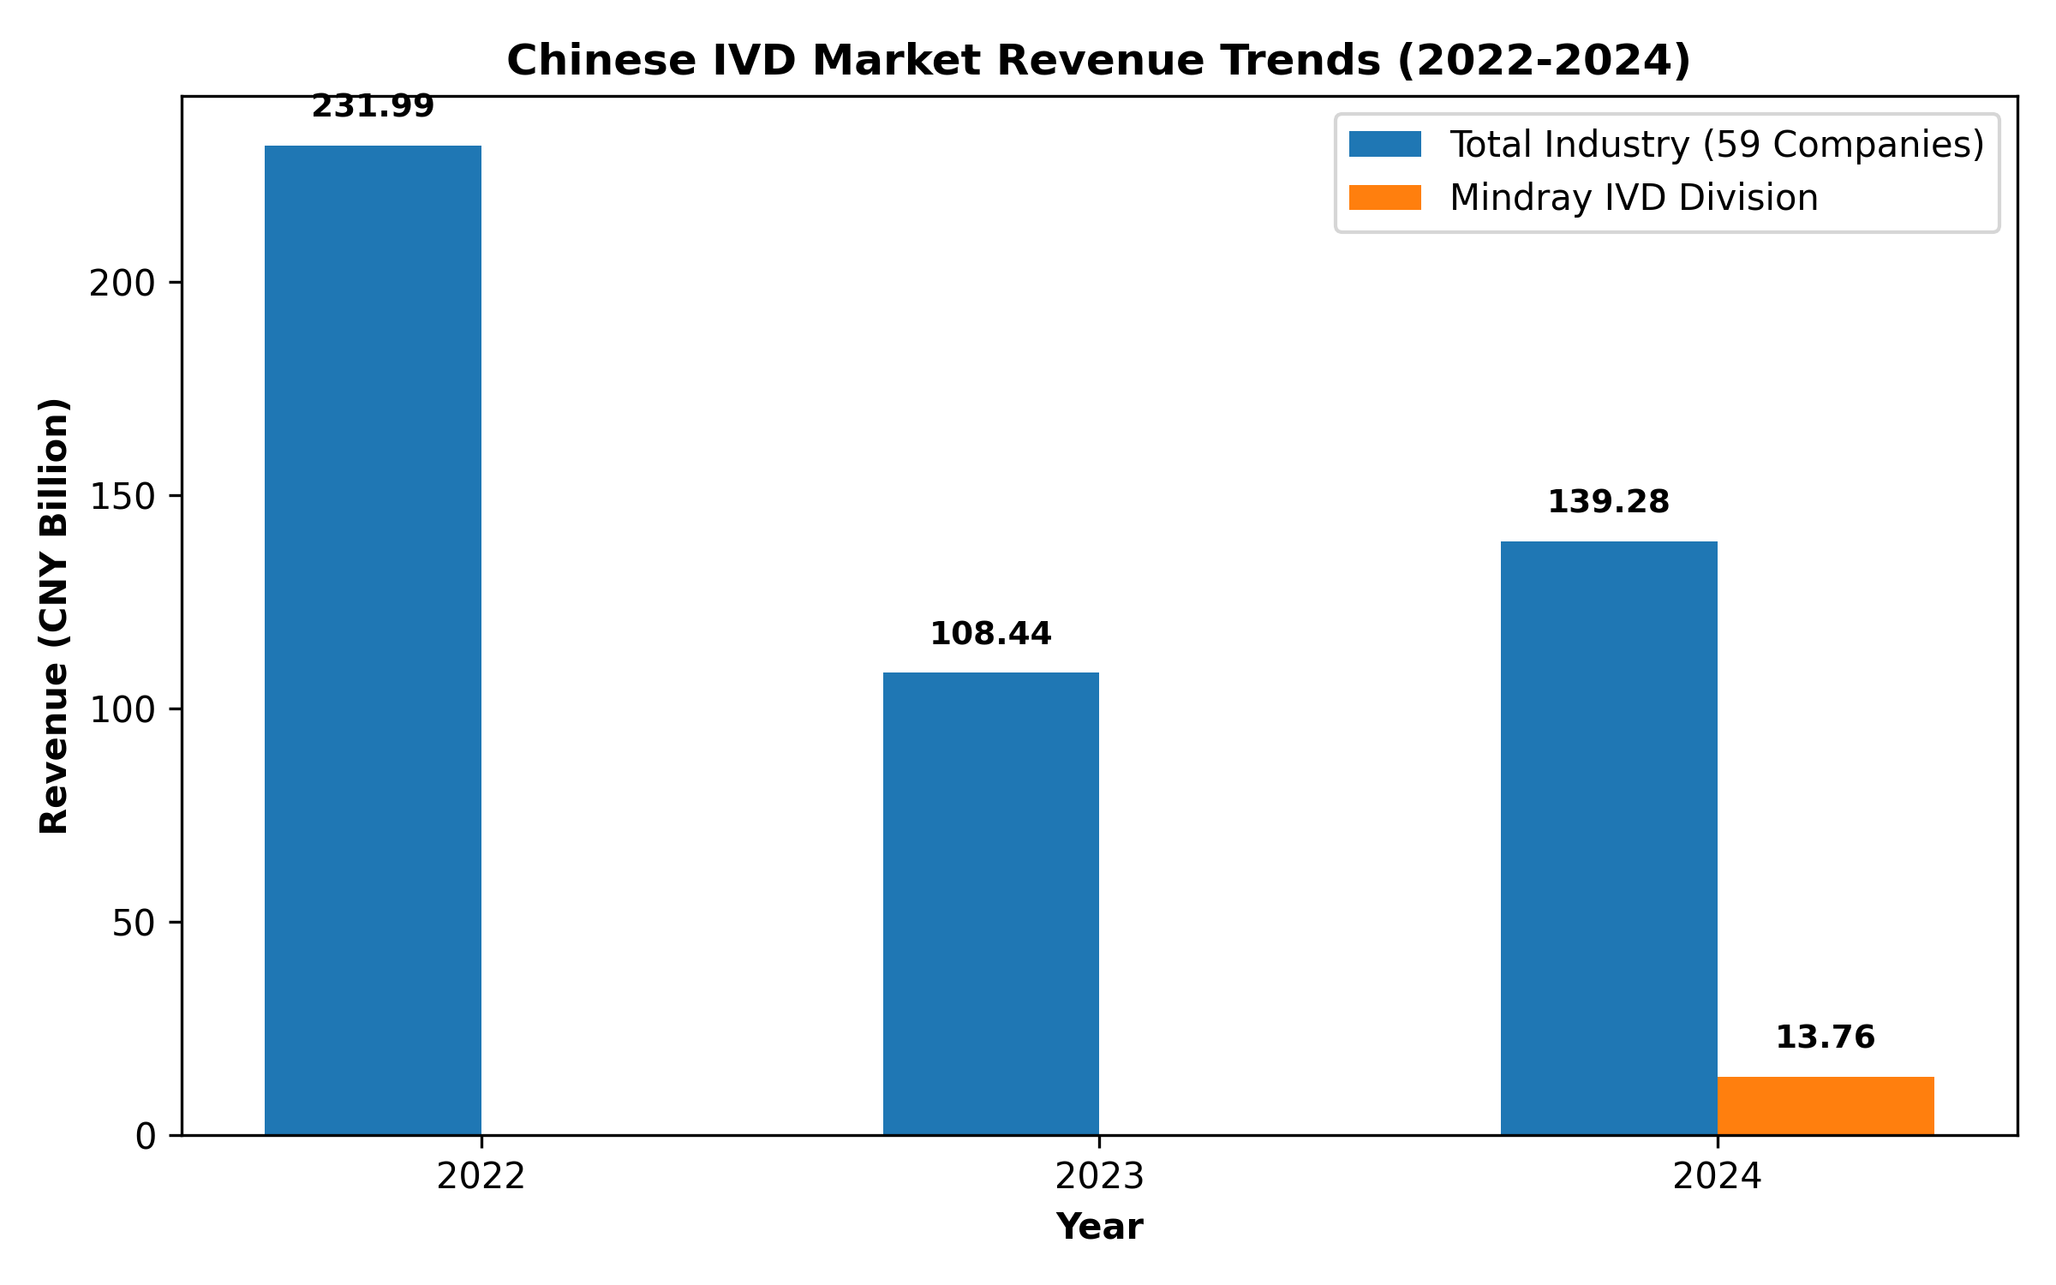
Chinese IVD Market: Post-COVID Revenue Correction with Leading Players Recovering
[6] https://en.caclp.com/industry-news/2808.html | [9] https://en.caclp.com/industry-news/3349.html

Slide 13
Customer Receptivity: Cost-Effectiveness vs. Trust Deficit in High-End Market
Adoption Drivers
• Price competitiveness drives adoption in low-to-mid-tier segments
• Chinese exports to EU more than doubled between 2015-2023 indicating historical receptivity
• Snibe sold 3,637 chemiluminescent instruments abroad vs 1,141 domestically (2022)
Challenges & Barriers
• Low brand recognition in developed European markets
• Trust deficit for high-end products from Chinese manufacturers
• Market dominated by international giants (Roche, J&J) with strong brands and advanced technologies
• Need for local KOL endorsement and price incentives to displace existing workflows
[1] https://drive.google.com/file/d/1zt3vNjOlugypsvPkywduyWNRPGTHrsoj/view?usp=drive_link
[2] https://ec.europa.eu/commission/presscorner/detail/en/ip_25_1569
[4] https://en.caclp.com/industry-news/2365.html

Slide 14
Strategic Approaches: Market Entry Strategies for European Expansion
Market Entry Pathways
• Eastern European gateway countries (Hungary, Greece) for initial EU market access
• German/Dutch certification for enhanced brand credibility despite stricter regulations
• Targeting small laboratories to middle-size diagnostic centers with compact POCT solutions
Localization Strategies
• Acquisition of European entities (Mindray: DiaSys Germany, HyTest Finland)
• Establishing local service networks and production capabilities
• Partnerships with European companies for market access and credibility
Product Segmentation
• Focus on high-margin chemiluminescence sector (20-25% localization rate in China)
• Development of 'world's first' technical specifications for high-end market appeal
• Emergency response kits (monkeypox) as gateway products for market entry
[1] https://drive.google.com/file/d/1zt3vNjOlugypsvPkywduyWNRPGTHrsoj/view?usp=drive_link
[3] https://en.caclp.com/industry-news/1161.html
[10] https://en.caclp.com/industry-news/1480.html

Slide 15
Risks & Challenges: Navigating Complex European Market Dynamics
Regulatory & Compliance Risks
• IVDR transition lengthening certification by 6-12 months with increased costs
• Environmental regulations (REACH) adding compliance complexity for reagents and instruments
• Need for continuous compliance throughout product lifecycle with extended transition to 2027-2028
Market Access Barriers
• EU procurement restrictions blocking participation in tenders >€5M with >50% Chinese inputs
• EU push for supply chain localization increasing uncertainty for pure importers
• Fragmented reimbursement systems across EU member states requiring country-specific strategies
Competitive Challenges
• Trust deficit in high-end segments dominated by Roche, Siemens, Abbott
• Need for significant local KOL endorsement to displace established workflows
• Technical gap compared to global leaders in registration certificate footprint
[1] https://drive.google.com/file/d/1zt3vNjOlugypsvPkywduyWNRPGTHrsoj/view?usp=drive_link
[2] https://ec.europa.eu/commission/presscorner/detail/en/ip_25_1569
[4] https://en.caclp.com/industry-news/2365.html

Slide 16
Strategic Recommendations: Navigating the European IVD Market Landscape
Market Entry Strategy
• Focus on sub-€5M tenders and private sector deals to bypass procurement restrictions
• Utilize Eastern European countries (Hungary, Greece) as gateway markets for EU access
• Pursue German certification for enhanced brand credibility despite regulatory complexity
Operational Approach
• Acquire local European entities for established distribution and service capabilities
• Establish European manufacturing footprint to mitigate supply chain localization policies
• Develop local KOL relationships to build trust and overcome brand recognition deficit
Product & Market Focus
• Target high-margin chemiluminescence and POCT segments with compact solutions
• Leverage emergency response capabilities for rapid market entry during health crises
• Balance cost-effectiveness with innovation to compete beyond price-sensitive segments
[1] https://drive.google.com/file/d/1zt3vNjOlugypsvPkywduyWNRPGTHrsoj/view?usp=drive_link
[2] https://ec.europa.eu/commission/presscorner/detail/en/ip_25_1569
[7] https://en.caclp.com/industry-news/3530.html

Slide 17
Conclusion: Strategic Imperatives for European IVD Market Success
Key Takeaways
• European IVD market offers high-value opportunity but requires navigating complex barriers
• IVDR compliance is table stakes but procurement restrictions create additional hurdles
• Chinese suppliers must transition from export model to localized presence for long-term success
Future Outlook
• Market shifting from simple export economics to deep localization requirements
• Companies with European acquisitions and local capabilities will gain competitive advantage
• Regulatory compliance and procurement restrictions may evolve based on trade reciprocity
• Innovation and quality improvements essential to overcome trust deficit in high-end segments
[1] https://drive.google.com/file/d/1zt3vNjOlugypsvPkywduyWNRPGTHrsoj/view?usp=drive_link
[2] https://ec.europa.eu/commission/presscorner/detail/en/ip_25_1569
[4] https://en.caclp.com/industry-news/2365.html

