Slide 1
European IVD Market Entry Strategy
Strategic Insights for Chinese Diagnostic Companies
Comprehensive Market Analysis & Regulatory Landscape

Slide 2
Executive Summary
• European IVD market presents high-value opportunity with €1.65T healthcare expenditure
• Chinese suppliers face significant regulatory barriers with IVDR transition extending to 2027-2028
• Geopolitical challenges: EU restricts Chinese participation in tenders over €5M
• Strategic acquisitions critical for market entry (e.g., Mindray's DiaSys & HyTest acquisitions)
• Cost-effectiveness drives adoption but trust deficit remains in high-end segments
• Market shifting from export economics to deep localization requirements
References:
[1] https://drive.google.com/file/d/1zt3vNjOlugypsvPkywduyWNRPGTHrsoj/view?usp=drive_link
[2] https://ec.europa.eu/commission/presscorner/detail/en/ip_25_1569

Slide 3
Agenda
Market Overview & Key Metrics
Regulatory Landscape Analysis
Competitive Intelligence
Market Access & Reimbursement
Budget Environment & Spending
Customer Receptivity Trends
Strategic Opportunities
Risk Assessment
Key Recommendations

Slide 4
Market Overview: European IVD Landscape
• Total Healthcare Expenditure: €1.65 trillion (3,685 Euros per capita)
• Government & mandatory insurance funding: >60% of total spending
• Pricing system driven by public health insurance with strategic negotiations
• Tiered reimbursement structure using DRG-based payment system
• Additional mechanisms for innovative technologies at supplementary level
• Public tender rules and long-term cost control priorities
References:
[1] https://drive.google.com/file/d/1zt3vNjOlugypsvPkywduyWNRPGTHrsoj/view?usp=drive_link

Slide 5
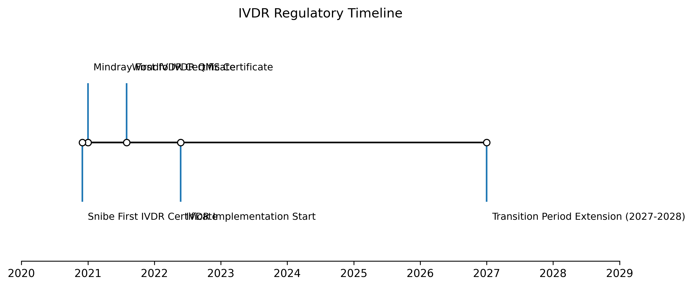
Regulatory Landscape: IVDR Transition
Key Regulatory Challenges
References:
[1] https://drive.google.com/file/d/1zt3vNjOlugypsvPkywduyWNRPGTHrsoj/view?usp=drive_link
[8] https://en.caclp.com/industry-news/1160.html

Slide 6
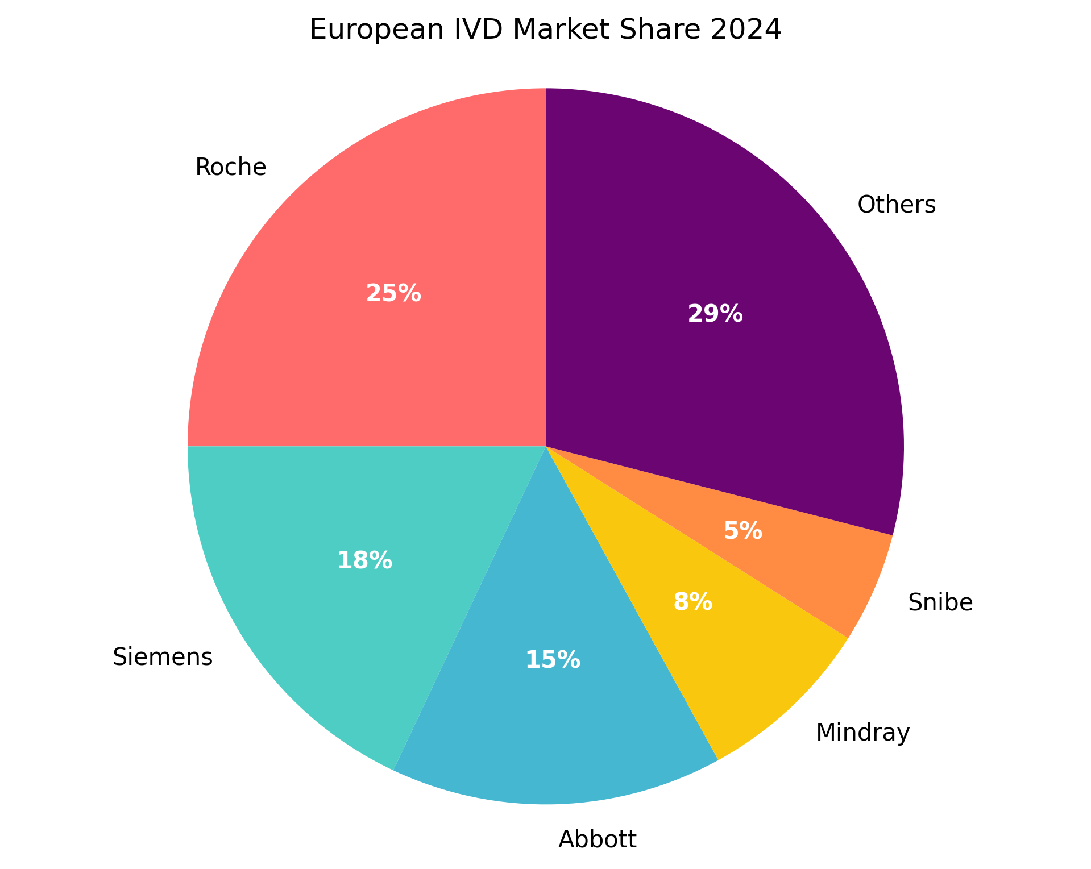
Competitive Landscape Analysis
Market Dominance: Roche, Siemens, Abbott control ~58% of market
Chinese Players: Mindray (8%), Snibe (5%) gaining traction
Mindray: 3,914 global registrations (3,158 overseas)
Snibe: 1,493 global registration certificates
Strategic Acquisitions: Mindray acquired DiaSys (Germany) and HyTest (Finland)
R&D Investment: Mindray allocated 10.99% of revenue to medical R&D
References:
[4] https://en.caclp.com/industry-news/2365.html
[9] https://en.caclp.com/industry-news/3349.html

Slide 7
Market Access & Reimbursement
Factor | Status | Impact
Public Tender Access | Restricted (>€5M) | High Barrier
Input Sourcing Limit | Max 50% Chinese | Supply Chain Risk
Reimbursement System | DRG-Based | Value Demonstration Required
Pricing Negotiations | Government-led | Price Pressure
Innovative Tech | Supplementary Funding | Opportunity for Premium
• EU excludes Chinese companies from government purchases >€5M
• 50% maximum Chinese inputs for successful bids
• Exceptions where no alternative suppliers exist
• Reimbursement requires proving clinical value
• Public health insurance drives pricing systems
References:
[2] https://ec.europa.eu/commission/presscorner/detail/en/ip_25_1569

Slide 8
Budget Environment & Spending Analysis
Healthcare Budget Structure:
• Government funding: Primary source
• Mandatory insurance: Significant contributor
• Private spending: Limited role
Budget Allocation Trends:
• Large-scale tenders: >€5M (restricted)
• Smaller contracts: <€5M (accessible)
• Centralized procurement: Major budget pools
• Decentralized purchasing: Smaller opportunities
Spending Priorities:
• Cost control: Primary focus
• Innovative technologies: Supplementary funding
• Long-term value: Key consideration
References:
[1] https://drive.google.com/file/d/1zt3vNjOlugypsvPkywduyWNRPGTHrsoj/view?usp=drive_link
[2] https://ec.europa.eu/commission/presscorner/detail/en/ip_25_1569

Slide 9
Customer Receptivity & Adoption Trends
Segment | Receptivity | Key Factors | Chinese Position
High-End | Low | Brand Trust, Technology | Challenged
Mid-Tier | Moderate | Price, Performance | Competitive
Low-End | High | Cost-Effectiveness | Strong
POCT | Growing | Convenience, Speed | Emerging
Emerging Tech | Selective | Innovation, Evidence | Developing
• Chinese exports to EU doubled 2015-2023 indicating historical adoption
• Strong price competitiveness in low-to-mid tier segments
• Trust deficit in high-end products versus Western incumbents
• Snibe sold 3,637 units abroad vs 1,141 domestic (2022)
• Local service capabilities critical for customer satisfaction
References:
[1] https://drive.google.com/file/d/1zt3vNjOlugypsvPkywduyWNRPGTHrsoj/view?usp=drive_link
[4] https://en.caclp.com/industry-news/2365.html

Slide 10
Strategic Market Entry Approaches
Acquisition Strategy:
• Mindray: Acquired DiaSys (Germany) for distribution
• Mindray: Acquired HyTest (Finland) for raw materials
• Build local service capabilities and credibility
Regulatory Gateway Approach:
• Eastern Europe: Hungary, Greece as EU entry points
• Strict markets: Germany, Netherlands for credibility
• IVDR certification as market access prerequisite
Product Segmentation:
• Target small-to-mid labs with compact solutions
• Focus on cost-effective segments initially
• Gradually move up value chain with proven quality
References:
[1] https://drive.google.com/file/d/1zt3vNjOlugypsvPkywduyWNRPGTHrsoj/view?usp=drive_link
[9] https://en.caclp.com/industry-news/3349.html

Slide 11
Financial Capability Analysis
Company | 2023 Revenue | YoY Growth | R&D Investment | Overseas Growth
Mindray | CNY 34.93B | 20%+ (6 years) | 10.99% of revenue | 30%+
Snibe | CNY 1.021B | 16.62% | Not specified | Strong
Autobio | Positive | Growth | Not specified | 27.6%
Dirui | CNY 663M | 99.60% | Not specified | Not specified
Key Financial Trends:
• Post-COVID market correction: 53.26% revenue drop industry-wide
• Top players maintained growth despite market challenges
• Strong R&D investment positioning for innovation competition
• Overseas revenue growth outpacing domestic performance
• Financial capacity for strategic acquisitions and expansion
References:
[5] https://en.caclp.com/industry-news/2785.html
[6] https://en.caclp.com/industry-news/2808.html

Slide 12
Risk Assessment Matrix
Risk Category | Impact | Likelihood | Mitigation Strategy
Regulatory Changes | High | High | Early IVDR compliance, local expertise
Geopolitical Tensions | High | Medium | Diversification, local manufacturing
Supply Chain Disruption | Medium | High | Local sourcing, multiple suppliers
Brand Perception | Medium | High | Acquisitions, quality evidence
Price Competition | Medium | High | Differentiation, value demonstration
Currency Fluctuation | Medium | Medium | Hedging, local operations
References:
[1] https://drive.google.com/file/d/1zt3vNjOlugypsvPkywduyWNRPGTHrsoj/view?usp=drive_link
[2] https://ec.europa.eu/commission/presscorner/detail/en/ip_25_1569

Slide 13
Strategic Recommendations
1. Regulatory First Approach:
• Prioritize full IVDR compliance across product portfolio
• Establish European regulatory affairs capability
2. Localization Strategy:
• Consider local manufacturing to overcome input restrictions
• Build local service and support networks
• Acquire European companies for market access
3. Market Segmentation:
• Target smaller contracts (<€5M) initially
• Focus on cost-sensitive segments with proven value
• Gradually build credibility for high-end offerings
4. Partnership Development:
• Collaborate with European distributors
• Establish KOL relationships for credibility
• Partner with local service providers

Slide 14
Implementation Roadmap
Short-Term (0-12 months):
• Complete IVDR certification for key products
• Establish European regulatory compliance team
• Develop distribution partnerships
• Target Eastern European gateway markets
Medium-Term (12-36 months):
• Achieve 50+ IVDR certifications
• Establish local service capabilities
• Develop country-specific reimbursement strategies
• Explore acquisition opportunities
Long-Term (36+ months):
• Establish local manufacturing presence
• Build brand recognition in high-end segments
• Achieve top 5 market position in selected segments
• Develop innovative products for European needs

Slide 15
Conclusion: Path to European Success
• European IVD market offers significant opportunity but requires strategic approach
• Regulatory compliance (IVDR) is non-negotiable foundation for market entry
• Geopolitical constraints necessitate localization and partnership strategies
• Cost-effectiveness provides competitive advantage in value segments
• Acquisition strategy proven effective for rapid market access
• Long-term success requires transition from exporter to local partner
• Companies with strong financials and regulatory readiness best positioned
References:
[1] https://drive.google.com/file/d/1zt3vNjOlugypsvPkywduyWNRPGTHrsoj/view?usp=drive_link
[4] https://en.caclp.com/industry-news/2365.html
[9] https://en.caclp.com/industry-news/3349.html

