Slide 1
Global Expansion of Chinese IVD Companies
European Market Entry Strategy, Regulatory Landscape, and Competitive Dynamics

Slide 2
Executive Summary
High-Value Opportunity: The European market represents a €1.65 trillion healthcare expenditure, offering mature pricing systems and stability compared to domestic Chinese markets [1].
Regulatory Transition: The shift to IVDR is a critical barrier. Leading Chinese firms (Mindray, Snibe, Autobio) are successfully securing IVDR CE certifications to maintain and expand market access [2].
Geopolitical Headwinds: The EU Commission has restricted Chinese participation in public medical device tenders exceeding €5 million, mandating no more than 50% Chinese inputs, fundamentally altering large-scale procurement strategies [3].
Strategic Localization: To overcome a 'trust deficit' in high-end segments and build local service capabilities, Chinese leaders are aggressively pursuing M&A (e.g., Mindray acquiring DiaSys and HyTest) [1, 4].
Financial Resilience: Despite a post-COVID market contraction, top-tier export-focused companies are seeing overseas revenue growth exceeding 20-30%, driven by heavy R&D investment and cost-effectiveness [5].
[1] https://drive.google.com/file/d/1zt3vNjOlugypsvPkywduyWNRPGTHrsoj/view?usp=drive_link
[2] https://en.caclp.com/industry-news/3530.html
[3] https://ec.europa.eu/commission/presscorner/detail/en/ip_25_1569
[4] https://en.caclp.com/industry-news/3349.html
[5] https://en.caclp.com/industry-news/2808.html

Slide 3
Agenda
1. Market Overview & Growth Drivers
2. Financial Performance & Industry Realignment
3. Geographic Focus: The European Opportunity
4. Regulatory Landscape: Navigating IVDR
5. Geopolitical Risks & Procurement Restrictions
6. Access, Reimbursement & Customer Receptivity
7. Competitive Landscape & Key Metrics
8. Strategic M&A and Localization
9. Strategic Recommendations & Conclusion

Slide 4
Market Overview & Growth Drivers
Domestic Push Factors: Intense domestic competition in China, driven by volume-based procurement (VBP) and healthcare reform, is forcing IVD companies to seek higher margins abroad [1].
Global Pull Factors: The vast global market offers mature and stable pricing systems, providing financial stability and support for long-term enterprise development [2].
Cost-Effectiveness: Chinese medical devices hold a core competitive advantage in 'performance-to-cost' ratios, allowing for a substitution effect in international markets [1].
Technological Advancement: The industry is shifting toward high-quality growth, integrating cutting-edge technologies like AI and automation to meet rising technical barriers [3].
Strategic Evolution: Companies are moving beyond the 'in China for China' approach, truly embracing 'in China for the world' through deep localization and global service networks [2].
[1] https://drive.google.com/file/d/1zt3vNjOlugypsvPkywduyWNRPGTHrsoj/view?usp=drive_link
[2] https://en.caclp.com/industry-news/2365.html
[3] https://en.caclp.com/industry-news/3349.html

Slide 5
Financial Performance & Industry Realignment
Post-COVID Contraction: In 2023, the Chinese IVD market quickly fell back to traditional non-COVID business. Total revenue for 59 main IVD listed companies dropped 53.26% year-on-year to CNY 108.44 billion [1].
Profitability Decline: Net profit for these firms fell by approximately 84.5% in 2023 due to lingering cost burdens from pandemic-era expansions and tighter macroeconomic conditions [1, 2].
Resilience of Leaders: Despite the downturn, top players maintained growth. Mindray's net attributable profit has grown by more than 20% for six consecutive years [1].
2024 Recovery via Exports: In 2024, companies with expanding overseas markets saw significant gains. Mindray's international IVD business grew by over 30% year-on-year, and Autobio's overseas revenue rose by 27.6% [2].
[1] https://en.caclp.com/industry-news/2808.html
[2] https://en.caclp.com/industry-news/3349.html

Slide 6
Geographic Focus: The European Opportunity
Massive Market Scale: Europe represents a €1.65 trillion healthcare expenditure market, with a high per capita spend of €3,685, making it a premium target for high-value diagnostics [1].
Stable Pricing Environment: European member states offer mature pricing systems driven by public health insurance, balancing patient affordability with reasonable company profits [1].
Strategic Gateways: Eastern European countries like Hungary and Greece are frequently utilized as initial gateways into the broader EU market [1].
Brand Credibility: For Class III medical devices, Chinese companies prefer certification in strict regulatory environments like Germany and the Netherlands to establish strong brand credibility across the continent [1].
[1] https://drive.google.com/file/d/1zt3vNjOlugypsvPkywduyWNRPGTHrsoj/view?usp=drive_link

Slide 7
Regulatory Landscape: Navigating IVDR
The 'Visa' to Europe: CE certification is the mandatory requirement for product access in the EU market. The transition to the In Vitro Diagnostic Medical Device Regulation (IVDR EU 2017/746) is the primary hurdle [1].
Increased Complexity: The IVDR transition has lengthened the average CE certification process by 6 to 12 months, forcing over 30% of small and medium-sized enterprises out of the market [2].
Early Compliance: Leading Chinese firms have proactively secured IVDR certificates. Snibe has obtained IVDR CE certification for 211 chemiluminescence and 67 biochemical reagent products [3].
Environmental Standards: The EU enforces strict environmental requirements for raw materials (e.g., REACH regulation), requiring adjustments in R&D and green supply chain management [2].
[1] https://en.caclp.com/industry-news/1160.html
[2] https://drive.google.com/file/d/1zt3vNjOlugypsvPkywduyWNRPGTHrsoj/view?usp=drive_link
[3] https://en.caclp.com/industry-news/3530.html

Slide 8
Geopolitical Risks & Procurement Restrictions
International Procurement Instrument (IPI): The European Commission has deployed the IPI to restrict Chinese participation in public procurement tenders for medical devices [1].
The €5 Million Threshold: Chinese companies are excluded from EU government purchases of medical devices where the contract value exceeds €5 million [1].
Supply Chain Mandates: Successful bids for these large public contracts must contain no more than 50% of inputs originating from China, impacting even non-Chinese firms relying on Chinese OEMs [1].
Retaliatory Context: This measure is a direct response to findings that 87% of public procurement contracts for medical devices in China were subject to exclusionary practices against EU suppliers [1].
[1] https://ec.europa.eu/commission/presscorner/detail/en/ip_25_1569

Slide 9
Access, Reimbursement & Customer Receptivity
DRG-Based Systems: EU member states utilize a tiered reimbursement structure, heavily relying on Diagnosis-Related Groups (DRGs) at the base level, demanding strict long-term cost control from suppliers [1].
Public Tender Dominance: Healthcare payments are predominantly government-funded. Success requires navigating complex public tender rules rather than targeting private out-of-pocket spending [1].
The 'Trust Deficit': While Chinese devices win on price in low-to-mid-end segments, there is a distinct lack of brand trust in high-end products among European customers [1].
Incumbent Dominance: The overseas IVD market remains dominated by international giants (Roche, Siemens, Abbott) with strong brands and advanced technologies, making workflow displacement difficult [1, 2].
[1] https://drive.google.com/file/d/1zt3vNjOlugypsvPkywduyWNRPGTHrsoj/view?usp=drive_link
[2] https://en.caclp.com/industry-news/2365.html

Slide 10
Competitive Landscape: Global Registrations
Product registrations serve as a proxy for internationalization capability and regulatory readiness.
Despite rapid growth, top Chinese firms still trail legacy global leaders in total worldwide footprint [1].
Company | Global Registration Certificates | Overseas Certificates
Mindray | 3914 | 3158
Maccura | 2467 | N/A
Snibe | 1493 | N/A
[1] https://en.caclp.com/industry-news/2365.html

Slide 11
Strategic M&A and Localization
Acquiring Local Credibility: Mindray acquired Germany-based DiaSys to strengthen local service capabilities and secure European distribution channels [1, 2].
Securing Upstream Supply: Mindray's 100% equity acquisition of Finland's HyTest filled critical gaps in upstream IVD raw materials, mitigating supply chain risks [1].
Expanding Product Lines: Wondfo acquired Tisenc to expand its high-margin chemiluminescence (CLIA) business, targeting small to mid-size diagnostic centers with POCT analyzers [3].
Global Service Networks: Companies are shifting from pure export models to establishing localized production bases and service networks across over 150 countries [4].
[1] https://drive.google.com/file/d/1zt3vNjOlugypsvPkywduyWNRPGTHrsoj/view?usp=drive_link
[2] https://en.caclp.com/industry-news/3349.html
[3] https://en.caclp.com/industry-news/1161.html
[4] https://en.caclp.com/industry-news/3530.html

Slide 12
Agility in Crisis: Rapid Response Capabilities
Speed to Market: Chinese IVD enterprises possess a significant competitive advantage in rapid R&D and production scaling during global health emergencies [1].
Monkeypox Response: By May 2022, over 40 Chinese IVD companies had successfully obtained EU CE certification for monkeypox virus nucleic acid detection kits [1].
Gateway Strategy: Public health crises serve as an accelerated regulatory gateway, allowing a broad spectrum of Chinese manufacturers to prove technical compliance with European standards [1].
[1] https://en.caclp.com/industry-news/1480.html

Slide 13
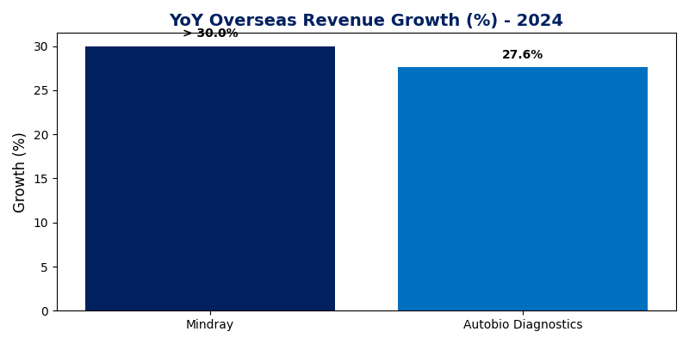
Key Metrics: Overseas Revenue Growth (2024)
Export-focused Chinese IVD companies demonstrated robust international growth in 2024, driven by continuous product innovation and expansion in diagnostic reagent categories [1].
[1] https://en.caclp.com/industry-news/3349.html

Slide 14
Financial Highlights: Top Chinese IVD Companies
Despite broader industry contraction, top players maintain massive revenue bases, providing the capital liquidity required to fund expensive European expansion and M&A campaigns [1, 2].
Company | Reported Revenue (CNY Billion) | Key Insight
Mindray (IVD Division) | 13.76 (2024) | Largest business segment; >30% overseas growth
Dian Diagnostics | 13.41 (2023) | Top revenue generator in 2023
Runda Medical | 9.15 (2023) | Maintained strong top-line scale
KingMed Diagnostics | 8.54 (2023) | Leading domestic diagnostic service provider
[1] https://en.caclp.com/industry-news/2808.html
[2] https://en.caclp.com/industry-news/3349.html

Slide 15
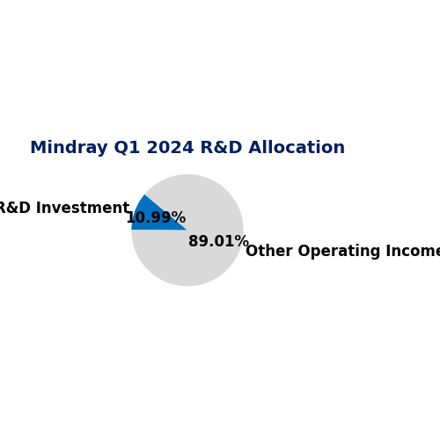
Key Metrics: R&D Investment Intensity
To compete with entrenched European giants and overcome the 'trust deficit', Chinese leaders are heavily allocating capital toward innovation [1].
Mindray reported a medical R&D investment of RMB 1.030 billion in Q1 2024 alone, accounting for 10.99% of its operating income [1].
[1] https://en.caclp.com/industry-news/2785.html

Slide 16
Strategic Opportunities
Decentralized Testing (POCT): High demand exists for compact, rapid testing solutions in small to mid-sized diagnostic centers, avoiding direct competition in centralized high-volume labs [1].
Chemiluminescence (CLIA): This segment offers the largest total market volume and highest profit margins. Chinese firms are rapidly securing IVDR CE marks for CLIA reagents [1, 2].
AI & Automation: Integrating artificial intelligence and automated workflows aligns with European laboratory trends seeking labor-saving and efficiency-driving solutions [3].
Private Sector Focus: With public tenders over €5M restricted, targeting private hospital networks and smaller decentralized lab budgets offers a viable bypass strategy [4].
[1] https://en.caclp.com/industry-news/1161.html
[2] https://en.caclp.com/industry-news/3530.html
[3] https://en.caclp.com/industry-news/3349.html
[4] https://ec.europa.eu/commission/presscorner/detail/en/ip_25_1569

Slide 17
Risks & Challenges
Geopolitical Exclusion: The IPI €5M public tender ban is a severe structural barrier, locking Chinese suppliers out of lucrative centralized lab consolidation deals [1].
Regulatory Bottlenecks: The IVDR transition requires immense capital and time (extra 6-12 months), disproportionately impacting smaller Chinese entrants [2].
Supply Chain Localization: EU policies demanding local supply chains and strict environmental compliance (REACH) increase operational costs and uncertainty for pure exporters [2].
Incumbent Entrenchment: Displacing legacy systems from Roche, Siemens, and Abbott requires overcoming significant workflow inertia and local Key Opinion Leader (KOL) biases [2, 3].
[1] https://ec.europa.eu/commission/presscorner/detail/en/ip_25_1569
[2] https://drive.google.com/file/d/1zt3vNjOlugypsvPkywduyWNRPGTHrsoj/view?usp=drive_link
[3] https://en.caclp.com/industry-news/2365.html

Slide 18
Strategic Recommendations
Accelerate European M&A: Acquire local European entities (distributors, raw material suppliers) to bypass the 50% 'Chinese inputs' restriction and build immediate local service credibility [1, 2].
Pivot to Sub-€5M Tenders: Restructure sales strategies to target decentralized, smaller-scale public tenders or pivot aggressively toward private healthcare networks [2].
Leverage Gateway Geographies: Utilize Eastern European markets (Hungary, Greece) for initial commercial traction while securing strict German/Dutch certifications for brand halo effects [1].
Invest in KOL Networks: Allocate R&D and marketing budgets to fund local European clinical trials and build relationships with Key Opinion Leaders to overcome the high-end trust deficit [1].
[1] https://drive.google.com/file/d/1zt3vNjOlugypsvPkywduyWNRPGTHrsoj/view?usp=drive_link
[2] https://ec.europa.eu/commission/presscorner/detail/en/ip_25_1569

Slide 19
Conclusion
The European IVD market presents a high-value but increasingly high-barrier environment for Chinese suppliers.
The era of simple export economics driven purely by cost-effectiveness is ending, replaced by a demand for deep localization, strict IVDR compliance, and sophisticated geopolitical maneuvering.
Well-capitalized leaders like Mindray, Snibe, and Autobio are successfully transitioning from 'In China for China' to 'In China for the World' through strategic M&A and relentless R&D investment.
Future success in Europe hinges on bypassing public procurement restrictions via private sector engagement and localized supply chains.
[1] https://drive.google.com/file/d/1zt3vNjOlugypsvPkywduyWNRPGTHrsoj/view?usp=drive_link
[2] https://en.caclp.com/industry-news/2365.html

