Slide 1
Strategic Expansion of Chinese IVD Companies in Europe
Market Analysis and Competitive Landscape Focus on Mindray and Snibe
Date: 2025

Slide 2
Executive Summary
Chinese IVD manufacturers demonstrating aggressive global expansion strategy with focus on European markets
Major players like Mindray and Snibe achieving regulatory milestones (IVDR certification) for market access
European market presents high-value opportunity with €1.65T healthcare expenditure but complex barriers
Geopolitical factors creating new challenges through International Procurement Instrument restrictions
Strategic acquisitions (HyTest, DiaSys) enabling technology transfer and local market presence
Cost-competitive positioning vs established players but brand trust remains challenge in high-end segments
References:
https://drive.google.com/file/d/1zt3vNjOlugypsvPkywduyWNRPGTHrsoj/view?usp=drive_link
https://ec.europa.eu/commission/presscorner/detail/en/ip_25_1569

Slide 3
Agenda
Market Overview and Key Metrics
Regulatory Landscape Analysis
Competitive Positioning
Market Access & Reimbursement
Strategic Opportunities & Challenges
Recommendations and Conclusion

Slide 4
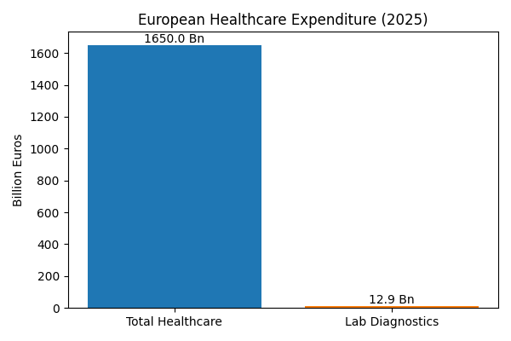
European IVD Market Overview
Total healthcare expenditure: €1.65 trillion (3,685 per capita)
Laboratory diagnostics spending: €12.9B annually in Germany (2.6% of total healthcare)
Market dominated by large commercial laboratory networks (55% share in Germany)
DRG-based reimbursement systems with global budget constraints
Increasing consolidation with decline in hospital-owned laboratory infrastructure
Point-of-Care Testing emerging as growth segment due to staffing constraints
References:
https://drive.google.com/file/d/1zt3vNjOlugypsvPkywduyWNRPGTHrsoj/view?usp=drive_link
https://journals.publisso.de/en/journals/gms/volume23/000337

Slide 5
Regulatory Landscape Analysis
Regulatory Aspect | Status | Impact
IVDR Transition | Extended to 2027-2028 | Increased compliance costs and timelines
CE Certification | 4,001 products certified (2023) | Market access prerequisite
IPI Restrictions | Effective June 2025 | Exclusion from contracts >€5M
Component Sourcing | 50% Chinese content limit | Supply chain restructuring required
Environmental Regulations | REACH compliance | Additional R&D requirements
IVDR certification lengthened by 6-12 months compared to previous directive
30% of SMEs forced out of market due to regulatory complexity
High-risk products require Notified Body certification under IVDR
Environmental regulations (REACH) affecting raw material selection
References:
https://drive.google.com/file/d/1zt3vNjOlugypsvPkywduyWNRPGTHrsoj/view?usp=drive_link
https://ec.europa.eu/commission/presscorner/detail/en/ip_25_1569
https://en.caclp.com/industry-news/1160.html

Slide 6
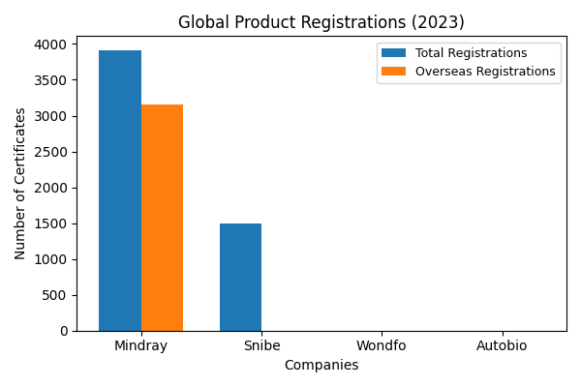
Competitive Landscape Analysis
Company | Global Registrations | Overseas Revenue Growth | Key Strategies
Mindray | 3,914 (3,158 overseas) | 21.28% (2024) | Acquisitions (HyTest, DiaSys)
Snibe | 1,493 global | N/A | IVDR certification for 211 products
Wondfo | N/A | N/A | Global service network in 150+ countries
Autobio | N/A | 27.6% (2024) | Strategic partnerships
Mindray maintains >20% net profit growth for six consecutive years
Chinese companies focusing on chemiluminescence and POCT segments
Vertical integration (instruments + reagents) as competitive advantage
Localization strategies through acquisitions and partnerships
References:
https://en.caclp.com/industry-news/2365.html
https://en.caclp.com/industry-news/3349.html

Slide 7
Market Access & Reimbursement Framework
Complex country-specific reimbursement systems across EU markets
Germany: EBM catalog for outpatient care, DRG-based inpatient payments
France: NABM system with innovative payment schemes (LAHN)
Spain: Global budget funding without dedicated reimbursement system
Italy: LEA catalog defining reimbursable services
HTA requirements mandatory for novel/expensive tests in most countries
Country | Reimbursement System | Key Characteristics
Germany | EBM/DRG | Fixed prices without inflation adjustment
France | NABM | Innovative payment schemes available
Spain | Global Budget | No dedicated IVD reimbursement
Italy | LEA Catalog | Defined tariffs for services
UK | NHS Payment Scheme | Included in basic care payment
References:
https://mtrconsult.com/general-market-access-landscape-vitro-diagnostic-tests-europe
https://journals.publisso.de/en/journals/gms/volume23/000337

Slide 8
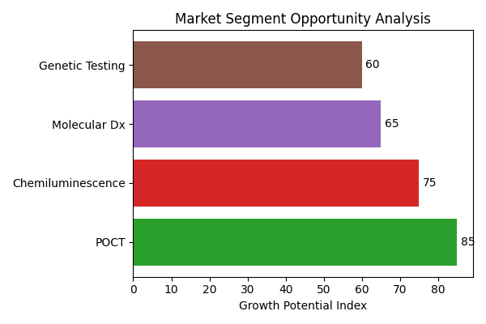
Strategic Opportunities
Point-of-Care Testing growth due to declining hospital lab infrastructure
Cost-effective solutions for budget-constrained healthcare systems
Strategic acquisitions for technology transfer and market access
Partnerships with local distributors across 18+ European countries
Leveraging innovative payment schemes for novel test adoption
Targeting specialized segments (genetic testing, therapeutic monitoring)
References:
https://healthcare-in-europe.com/en/news/snibe-makes-an-entry-at-euromedlab.html
https://mtrconsult.com/general-market-access-landscape-vitro-diagnostic-tests-europe

Slide 9
Key Challenges and Risks
International Procurement Instrument restrictions effective June 2025
Complex regulatory transition to IVDR with increased compliance costs
Brand trust deficit in high-end product segments vs established players
Localization requirements for public tender participation
Price pressure due to fixed reimbursement rates without inflation adjustment
Cultural and regulatory differences across EU member states
Supply chain fragmentation and restructuring requirements
References:
https://www.ainvest.com/news/frontier-medtech-navigating-china-eu-trade-tensions-investment-gains-2507/
https://ec.europa.eu/commission/presscorner/detail/en/ip_25_1569

Slide 10
Financial Performance Analysis
Metric | Mindray | Snibe | Industry Average
2023 Revenue (CNY Bn) | 34.93 | N/A | 108.44 (59 companies)
Revenue Growth | >20% (6 years) | 16.62% (Q1 2024) | -53.26% (2023)
R&D Investment | 10.99% of revenue | N/A | Varying
Overseas Revenue Growth | 21.28% (2024) | N/A | N/A
Net Profit Margin | Positive | Positive | Mixed
Post-COVID market correction with 53.26% revenue decline across industry
Mindray demonstrating consistent financial performance despite market challenges
R&D investment critical for maintaining competitive positioning
Overseas revenue becoming increasingly important for growth
References:
https://en.caclp.com/industry-news/2808.html
https://en.caclp.com/industry-news/3349.html

Slide 11
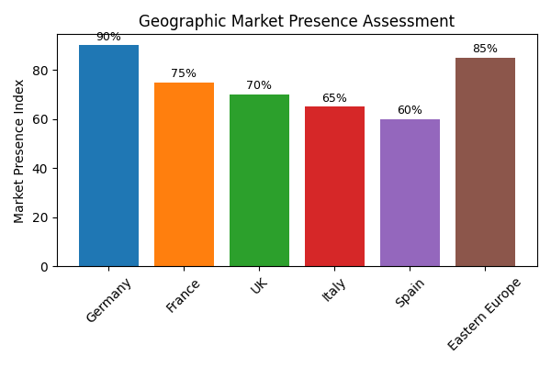
Geographic Expansion Strategies
Initial market entry through Eastern European countries (Hungary, Greece)
Strategic focus on Germany for high-credibility certification
Distribution partnerships across 18+ European countries
Localization through acquisitions (DiaSys in Germany, HyTest in Finland)
Turkey as successful template with 1,300+ medical institutions served
Participation in major European trade shows (EUROMEDLAB 2025)
References:
https://healthcare-in-europe.com/en/news/snibe-makes-an-entry-at-euromedlab.html
https://en.caclp.com/press-release/3381.html

Slide 12
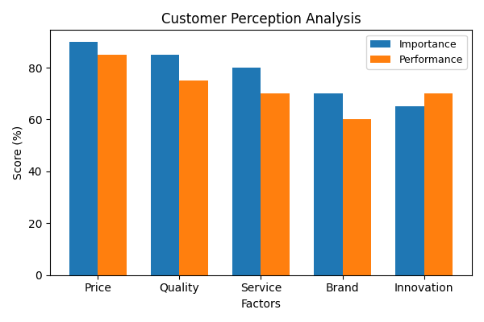
Customer Receptivity Analysis
Price sensitivity driving adoption in low-to-mid tier segments
Brand trust remains challenge for high-end product adoption
Local service capabilities critical for customer satisfaction
90% local workforce in successful markets (Turkey example)
Technical performance and reliability becoming competitive factors
Gradual improvement in perception of Chinese product quality
References:
https://drive.google.com/file/d/1zt3vNjOlugypsvPkywduyWNRPGTHrsoj/view?usp=drive_link
https://healthcare-in-europe.com/en/news/snibe-makes-an-entry-at-euromedlab.html

Slide 13
Strategic Recommendations
Accelerate localization strategies through partnerships and acquisitions
Focus on IVDR compliance and quality certification for market access
Develop country-specific market access strategies for key markets
Leverage cost advantages while investing in brand building
Expand service and support capabilities in target markets
Diversify product portfolio to include high-growth segments (POCT, molecular)
Monitor and adapt to evolving regulatory requirements (IPI, IVDR)
References:
https://www.ainvest.com/news/frontier-medtech-navigating-china-eu-trade-tensions-investment-gains-2507/
https://mtrconsult.com/general-market-access-landscape-vitro-diagnostic-tests-europe

Slide 14
Conclusion
European IVD market presents significant opportunity but requires strategic adaptation
Regulatory compliance (IVDR) and geopolitical factors (IPI) defining market access
Chinese companies demonstrating capability to meet technical requirements
Localization and partnerships critical for long-term success
Cost competitiveness remains key advantage in budget-constrained environment
Brand building and quality perception essential for premium segment penetration
References:
https://drive.google.com/file/d/1zt3vNjOlugypsvPkywduyWNRPGTHrsoj/view?usp=drive_link
https://www.ainvest.com/news/frontier-medtech-navigating-china-eu-trade-tensions-investment-gains-2507/

