Slide 1
European IVD Market Expansion Strategy
Chinese Supplier Landscape Analysis
2025 Market Assessment

Slide 2
Strategic Imperative: Chinese IVD Suppliers Face Regulatory Hurdles and Geopolitical Barriers in European Expansion
• European IVD market valued at €12.9B annually with 2.6% of total healthcare expenditure
• Chinese suppliers face €5M tender restriction under IPI regulations effective June 2025
• IVDR certification achieved by leading players (Mindray, Snibe, Autobio) but market access remains complex
• Customer receptivity remains divided: cost-advantage in mid-tier segments, trust deficit in high-end solutions
• Strategic acquisitions (HyTest, DiaSys) critical for supply chain localization and market credibility
[1] https://docs.google.com/document/d/1KWqiQRt4NvZuv2_3GC2UQWi7agGABNUshk7Pk_lRDTM/edit?tab=t.fxko5jhzd3mf

Slide 3
Agenda: Comprehensive Market Assessment Framework
• Market Overview & Size Assessment
• Regulatory Landscape Analysis
• Competitive Positioning
• Access & Reimbursement Framework
• Budget Allocation Patterns
• Customer Receptivity Mapping
• Strategic Opportunities
• Risk Assessment
• Recommendations

Slide 4
Market Overview: European IVD Represents Significant Opportunity with Structural Complexities
• Total market size: €12.9B annually across European Union
• Per capita expenditure: €150 annually in Germany
• Market concentration: 55% controlled by commercial laboratory chains
• Growth drivers: Aging population, chronic disease prevalence, technological innovation
• Chinese export growth: Doubled between 2015-2023 before IPI restrictions
[1] https://docs.google.com/document/d/1KWqiQRt4NvZuv2_3GC2UQWi7agGABNUshk7Pk_lRDTM/edit?tab=t.fxko5jhzd3mf
[2] https://ec.europa.eu/commission/presscorner/detail/en/ip_25_1569

Slide 5
Regulatory Landscape: IVDR Certification Achieved but IPI Creates New Barriers
• IVDR compliance: Mindray, Snibe, Autobio achieved certification for 4,001+ products
• IPI restrictions: Chinese firms barred from public tenders exceeding €5M effective June 2025
• Component limitation: Maximum 50% Chinese content in successful bids
• Certification timeline: Extended by 6-12 months under IVDR versus previous directive
• Environmental compliance: REACH regulations add additional layer of complexity
Regulatory Framework | Status | Impact
IVDR Certification | Achieved by Leaders | Market Access Prerequisite
IPI Restrictions | Effective June 2025 | €5M Tender Barrier
[1] https://docs.google.com/document/d/1KWqiQRt4NvZuv2_3GC2UQWi7agGABNUshk7Pk_lRDTM/edit?tab=t.0
[2] https://ec.europa.eu/commission/presscorner/detail/en/ip_25_1569

Slide 6
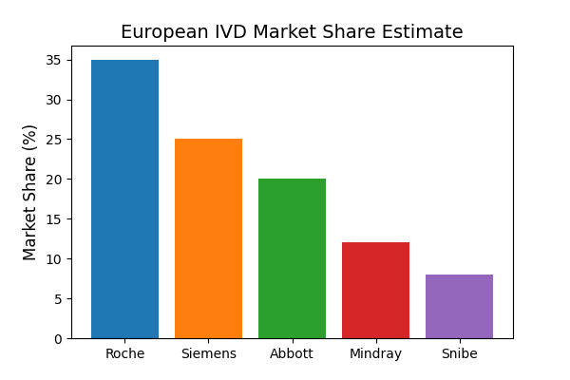
Competitive Landscape: Chinese Suppliers Gaining Traction Against Established Players
• Market leaders: Roche, Siemens, Abbott dominate central laboratory segment
• Chinese presence: Mindray, Snibe, Autobio expanding through acquisitions and partnerships
• Product registrations: 4,001 EU certificates across 23 Chinese companies in 2023
• Market focus: POCT and chemiluminescence segments showing strongest growth
• Localization strategy: Mindray acquired DiaSys (Germany) and HyTest (Finland) for European footprint
[1] https://docs.google.com/document/d/1KWqiQRt4NvZuv2_3GC2UQWi7agGABNUshk7Pk_lRDTM/edit?tab=t.4
[2] https://inf.news/en/economy/05703949a08a4f75f598ad8a52850b03.html

Slide 7
Access & Reimbursement: Fragmented European Systems Require Country-Specific Strategies
• Germany: EBM catalog governs outpatient reimbursement with fixed pricing
• France: NABM system with innovative LAHN pathway for new technologies
• Italy: LEA catalog defines reimbursable services with national tariffs
• Spain: Global budget system without dedicated IVD reimbursement
• UK: NHS Payment Scheme bundles IVD into overall care payments
Country | Reimbursement System | Key Characteristic
Germany | EBM Catalog | Fee-for-service outpatient
France | NABM | Innovation funding available
Italy | LEA Catalog | National tariff system
[1] https://mtrconsult.com/general-market-access-landscape-vitro-diagnostic-tests-europe
[2] https://journals.publisso.de/en/journals/gms/volume23/000337

Slide 8
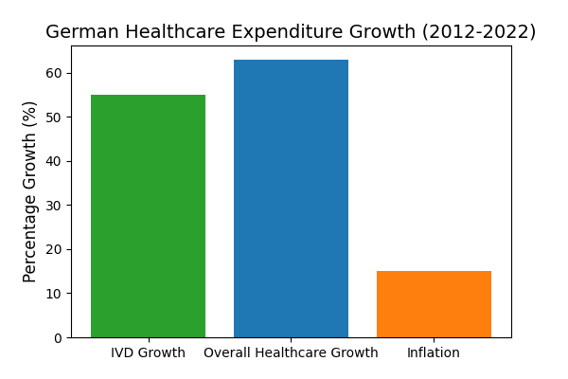
Budget Analysis: Cost Pressure Creates Opportunities for Value Propositions
• Germany: €12.9B annual IVD expenditure with 2.6% of total healthcare budget
• Budget growth: 55% increase (2012-2022) versus 63% overall healthcare growth
• Efficiency measures: €450M efficiency bonus system controls utilization
• Pricing pressure: Fixed technical service prices without inflation adjustment
• Hospital allocation: Approximately 2% of clinic budgets allocated to laboratory services
[1] https://journals.publisso.de/en/journals/gms/volume23/000337

Slide 9
Customer Receptivity: Trust Deficit in High-End Segments Despite Cost Advantages
• Price sensitivity: Strong receptivity for low-to-mid tier products based on cost competitiveness
• Trust barrier: Limited adoption of high-end Chinese IVD solutions due to brand perception
• Segment focus: Success in POCT, emergency departments, and small laboratory settings
• Local presence: Mindray's 90% local workforce in Turkey demonstrates localization success model
• Acquisition strategy: European acquisitions (DiaSys, HyTest) improve credibility and service capability
Market Segment | Receptivity Level | Key Driver
Low-to-Mid Tier | High | Cost competitiveness
High-End Segment | Low | Brand trust deficit
[1] https://docs.google.com/document/d/1KWqiQRt4NvZuv2_3GC2UQWi7agGABNUshk7Pk_lRDTM/edit?tab=t.0
[2] https://healthcare-in-europe.com/en/news/snibe-makes-an-entry-at-euromedlab.html

Slide 10
Strategic Opportunities: Targeted Approaches for Market Penetration
• POCT expansion: Decentralized testing growth driven by laboratory consolidation trends
• Eastern European gateway: Utilize Hungary, Greece for initial EU market entry
• German certification: Leverage strict certification for brand credibility enhancement
• Local manufacturing: Establish EU production facilities to bypass IPI restrictions
• Strategic partnerships: Collaborate with European distributors and laboratory networks
[1] https://docs.google.com/document/d/1KWqiQRt4NvZuv2_3GC2UQWi7agGABNUshk7Pk_lRDTM/edit?tab=t.0
[2] https://docs.google.com/document/d/1KWqiQRt4NvZuv2_3GC2UQWi7agGABNUshk7Pk_lRDTM/edit?tab=t.4

Slide 11
Risk Assessment: Geopolitical and Regulatory Challenges Require Mitigation
• IPI restrictions: €5M tender barrier effective June 2025 limits large contract opportunities
• Component limitations: 50% Chinese content restriction requires supply chain diversification
• Regulatory complexity: IVDR transition adds 6-12 months to certification timelines
• Political scrutiny: Increasing EU focus on supply chain sovereignty and reduced Chinese dependence
• Reimbursement pressure: Fixed pricing systems without inflation adjustment limit margin potential
Risk Category | Impact Level | Mitigation Strategy
Geopolitical | High | Local manufacturing
Regulatory | High | Early IVDR compliance
Competitive | Medium | Niche segmentation
[1] https://ec.europa.eu/commission/presscorner/detail/en/ip_25_1569
[2] https://www.ainvest.com/news/frontier-medtech-navigating-china-eu-trade-tensions-investment-gains-2507/

Slide 12
Strategic Recommendations: Three-Pronged Approach for Market Success
• Accelerate localization: Establish European manufacturing facilities to bypass IPI restrictions
• Focus on strategic segments: Target POCT and mid-tier segments where cost advantage is strongest
• Enhance clinical evidence: Invest in European clinical trials and health economic studies
• Leverage acquisitions: Continue strategic purchases of European companies for market access
• Develop partnership models: Create joint ventures with European distributors and laboratory networks
[1] https://docs.google.com/document/d/1KWqiQRt4NvZuv2_3GC2UQWi7agGABNUshk7Pk_lRDTM/edit?tab=t.0
[2] https://hytest.fi/news/mindray-completes-acquisition-of-hytest

Slide 13
Conclusion: Strategic Transformation Required for Sustainable European Presence
• European IVD market offers significant growth potential but requires sophisticated market entry strategy
• Regulatory compliance (IVDR) is necessary but insufficient without addressing geopolitical barriers
• Local manufacturing presence critical for accessing large public tender opportunities
• Customer acceptance growing in value segments but requires continued investment in quality and clinical evidence
• Strategic acquisitions and partnerships provide fastest path to market credibility and distribution capability
[1] https://docs.google.com/document/d/1KWqiQRt4NvZuv2_3GC2UQWi7agGABNUshk7Pk_lRDTM/edit?tab=t.0
[2] https://www.ainvest.com/news/frontier-medtech-navigating-china-eu-trade-tensions-investment-gains-2507/

