Slide 1
European IVD Market Analysis: Chinese Supplier Expansion
Strategic Research Presentation
Client Confidential

Slide 2
Executive Summary
European IVD market represents high-value opportunity with €1.65T healthcare expenditure
Chinese suppliers face significant regulatory barriers with IVDR transition extending certification by 6-12 months
Geopolitical factors creating new challenges with EU restricting Chinese participation in contracts >€5M
Leading Chinese companies (Mindray, Snibe, Autobio) achieving IVDR certification and showing strong overseas growth
Strategic acquisitions (Mindray/DiaSys, Mindray/HyTest) key to overcoming trust deficit and supply chain risks
Cost-effectiveness drives adoption in low-mid segments, but high-end market remains dominated by Western incumbents
References:
[1] https://drive.google.com/file/d/1zt3vNjOlugypsvPkywduyWNRPGTHrsoj/view?usp=drive_link
[2] https://ec.europa.eu/commission/presscorner/detail/en/ip_25_1569

Slide 3
Agenda
Market Overview & Size
Key Trends & Developments
Competitive Landscape
Regulatory Environment
Access & Reimbursement
Budget & Spend Analysis
Customer Receptivity
Strategic Opportunities
Risks & Challenges
Recommendations

Slide 4
Market Overview
European healthcare expenditure: €1.65 trillion with €3,685 per capita spending
Government and mandatory insurance funding represents over 60% of budget structure
Market transitioning from COVID-era volumes back to traditional non-COVID business
Chinese IVD sector showing contraction with total revenue dropping 53.26% in 2023
Long-term demand drivers: population aging, chronic disease rates, health awareness
References:
[1] https://drive.google.com/file/d/1zt3vNjOlugypsvPkywduyWNRPGTHrsoj/view?usp=drive_link
[2] https://en.caclp.com/industry-news/2808.html

Slide 5
Key Trends & Developments
IVDR transition creating market consolidation with 30% of SMEs forced out
Geopolitical tensions leading to EU restrictions on Chinese participation in large contracts
Strategic acquisitions accelerating (Mindray/DiaSys, Mindray/HyTest, Wondfo/Tisenc)
Localization strategies becoming critical for market access and customer trust
R&D investment increasing with Mindray allocating 10.99% of revenue to medical R&D
Shift toward AI and automation integration in product development
References:
[1] https://drive.google.com/file/d/1zt3vNjOlugypsvPkywduyWNRPGTHrsoj/view?usp=drive_link
[2] https://en.caclp.com/industry-news/2785.html
[3] https://en.caclp.com/industry-news/3349.html

Slide 6
Competitive Landscape
Company | Global Registrations | Overseas Registrations | 2024 Growth | IVDR Progress
Mindray | 3,914 | 3,158 | 30%+ | Multiple certifications
Snibe | 1,493 | N/A | 16.62% | 211 chemiluminescence reagents
Maccura | 2,467 | N/A | N/A | N/A
Autobio | N/A | N/A | 27.6% | IVDR certified
Wondfo | N/A | 140+ countries | N/A | IVDR QMS certified
References:
[1] https://en.caclp.com/industry-news/2365.html
[2] https://en.caclp.com/industry-news/2785.html

Slide 7
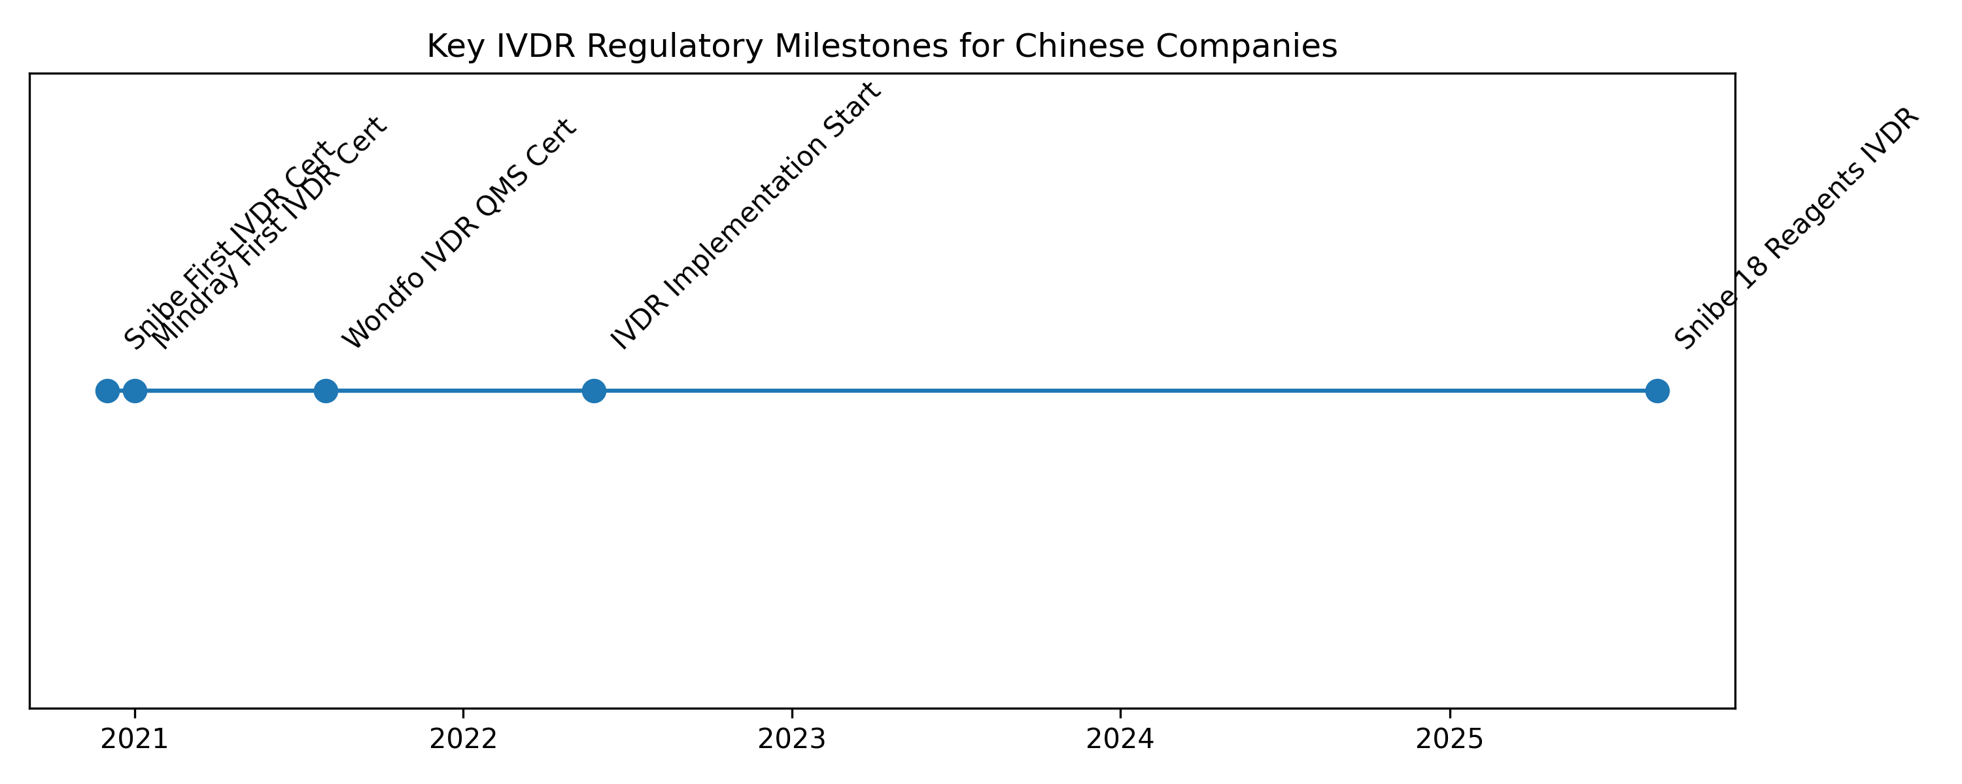
Regulatory Landscape
IVDR (EU 2017/746) implementation began May 26, 2022 with extended transition to 2027-2028
CE certification mandatory for market access, acting as regulatory 'visa'
Chinese companies among first to achieve IVDR certifications across multiple categories
REACH environmental regulations adding compliance complexity for reagents and instruments
High-risk IVD products require Notified Body certification; low-risk can be self-declared
Average certification process lengthened by 6-12 months under IVDR
References:
[1] https://drive.google.com/file/d/1zt3vNjOlugypsvPkywduyWNRPGTHrsoj/view?usp=drive_link
[2] https://en.caclp.com/industry-news/1160.html
[3] https://en.caclp.com/industry-news/3530.html

Slide 8
Access & Reimbursement
EU member states use pricing systems driven by public health insurance
National/regional agencies negotiate with manufacturers balancing affordability, profits, compliance
Tiered reimbursement structure: DRG-based prospective payment system plus supplementary mechanisms
Public tender rules and long-term cost control paramount in government-funded systems
European market fragmentation requires country-specific reimbursement strategies
References:
[1] https://drive.google.com/file/d/1zt3vNjOlugypsvPkywduyWNRPGTHrsoj/view?usp=drive_link

Slide 9
Budget & Spend Analysis
€5M threshold for EU restrictions on Chinese participation in public procurement
Chinese suppliers limited to smaller, decentralized budget allocations
Successful bids must contain no more than 50% Chinese inputs
Exceptions possible where no alternative suppliers exist
Government and mandatory insurance represents majority of funding (>60%)
References:
[1] https://ec.europa.eu/commission/presscorner/detail/en/ip_25_1569
[2] https://drive.google.com/file/d/1zt3vNjOlugypsvPkywduyWNRPGTHrsoj/view?usp=drive_link

Slide 10
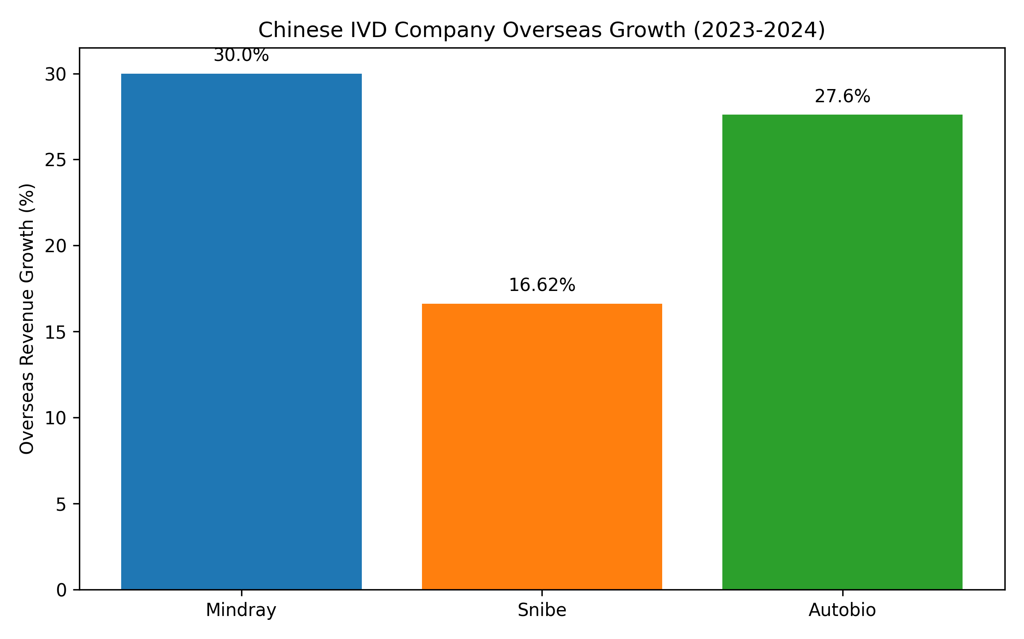
Customer Receptivity
Chinese medical device exports to EU more than doubled between 2015-2023
Price sensitivity in low-to-mid-end devices, brand trust deficit in high-end products
Snibe sold 3,637 units abroad vs 1,141 domestically in first three quarters of 2022
Market dominated by international giants (Roche, J&J, Siemens, Abbott) with strong brands
Chinese companies targeting small to middle size diagnostic centers with compact solutions
Performance-to-cost ratio creating substitution effect in international markets
References:
[1] https://ec.europa.eu/commission/presscorner/detail/en/ip_25_1569
[2] https://drive.google.com/file/d/1zt3vNjOlugypsvPkywduyWNRPGTHrsoj/view?usp=drive_link
[3] https://en.caclp.com/industry-news/2365.html

Slide 11
Strategic Opportunities
Strategic acquisitions of European companies to secure supply chains and credibility
Targeting Eastern European countries (Hungary, Greece) as gateways to EU market
Leveraging German/Dutch certification for enhanced brand credibility
Focus on high-margin chemiluminescence sector with 20-25% localization rate in China
Developing compact POCT solutions for decentralized testing segments
Utilizing cost-effectiveness advantage for price-sensitive market segments
References:
[1] https://drive.google.com/file/d/1zt3vNjOlugypsvPkywduyWNRPGTHrsoj/view?usp=drive_link
[2] https://en.caclp.com/industry-news/1161.html

Slide 12
Risks & Challenges
EU supply chain localization policies increasing uncertainty for Chinese exporters
Complex international regulatory and certification barriers (FDA PMA, EU CE-MDR)
Technology and intellectual property risks in developed markets
Difficulty in localization and building brand trust in high-end segments
Geopolitical tensions affecting market access through IPI restrictions
Market fragmentation requiring country-specific strategies
References:
[1] https://drive.google.com/file/d/1zt3vNjOlugypsvPkywduyWNRPGTHrsoj/view?usp=drive_link
[2] https://ec.europa.eu/commission/presscorner/detail/en/ip_25_1569

Slide 13
Recommendations
Establish local European manufacturing and service capabilities through acquisitions
Develop country-specific market entry strategies accounting for reimbursement variations
Invest in high-level IVDR compliance and environmental regulation (REACH) expertise
Build strategic partnerships with European distributors and service providers
Focus product development on high-margin segments with competitive advantages
Diversify geographic focus to include Eastern European gateway markets
Develop strong clinical evidence and KOL relationships to overcome trust deficit

Slide 14
Conclusion
European IVD market presents significant opportunity but requires sophisticated approach
Regulatory compliance (IVDR) is foundational but insufficient without localization strategy
Geopolitical factors increasingly influencing market access conditions
Leading Chinese companies demonstrating capability to compete through acquisitions and innovation
Success requires balancing cost-effectiveness with quality perception and local presence
Market shifting from export economics to requirement for deep European localization

Slide 15
Sources
Frost & Sullivan: 2025 Blue Book on Global Expansion of Chinese Medical Devices
European Commission: Restrictions on Chinese participation in medical devices procurement
CACLP: Various industry news articles on Chinese IVD company performance
Multiple company announcements and regulatory filings

