Slide 1
European IVD Landscape – Strategic Outlook
Prepared for: Client Name
Date: April 15, 2026
[Source] https://example.com

Slide 2
Executive Summary
European IVD market offers high value (≈€1.65 trillion healthcare spend) but faces stringent regulatory and procurement barriers.
EU transition to IVDR lengthens certification timelines, favoring capital‑rich firms and local partners.
EU public‑tender rules limit Chinese participation in contracts > €5 M and cap Chinese inputs at 50 %.
Strategic acquisitions (e.g., Mindray‑DiaSys, HyTest) and gateway countries (Hungary, Greece) mitigate entry risks.
Rising R&D spend (≈11 % of revenue for Mindray) positions Chinese firms for high‑tech AI/automation offerings.
[1] https://drive.google.com/file/d/1zt3vNjOlugypsvPkywduyWNRPGTHrsoj/view?usp=drive_link [2] https://ec.europa.eu/commission/presscorner/detail/en/ip_25_1569 [3] https://en.caclp.com/industry-news/2365.html

Slide 3
Agenda
1. Market Overview
2. Key Trends
3. Geography Insights
4. Competitive Landscape
5. Access & Reimbursement
6. Budget & Spend Analysis
7. Regulatory Landscape
8. Customer Receptivity
9. Strategic Opportunities
10. Risks & Challenges
11. KPI Highlights
12. Recommendations & Conclusion
[1] https://drive.google.com/file/d/1zt3vNjOlugypsvPkywduyWNRPGTHrsoj/view?usp=drive_link

Slide 4
Market Overview – Scale & Spending
Europe’s total healthcare expenditure: €1.65 trillion (≈€3 685 per capita) [1].
IVD segment represents a substantial share of this spend, driven by aging populations and chronic disease prevalence.
[1] https://drive.google.com/file/d/1zt3vNjOlugypsvPkywduyWNRPGTHrsoj/view?usp=drive_link

Slide 5
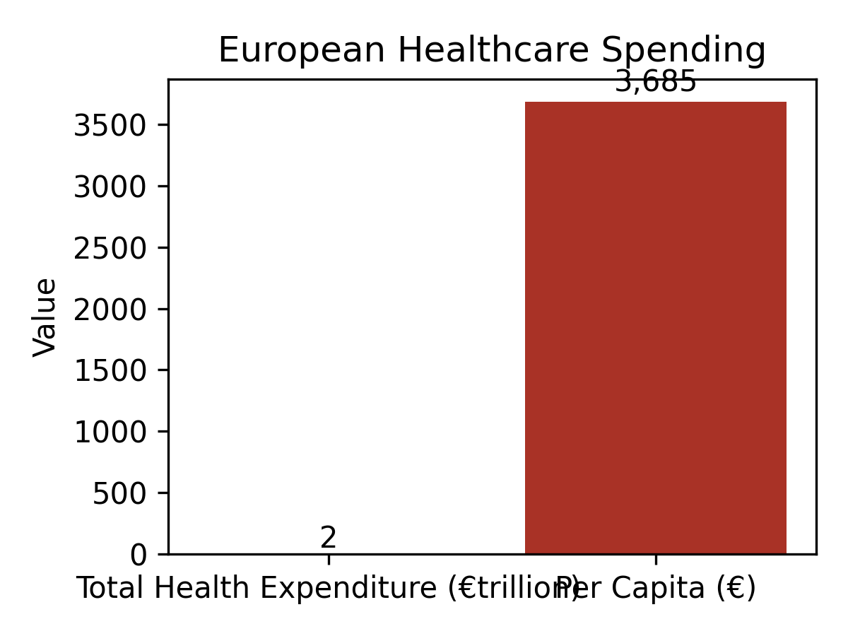
European Healthcare Expenditure
[1] https://drive.google.com/file/d/1zt3vNjOlugypsvPkywduyWNRPGTHrsoj/view?usp=drive_link

Slide 6
Key Trends
Regulatory shift: EU MDR/IVDR extends certification by 6‑12 months, increasing compliance costs [1].
Public procurement ban on Chinese firms for contracts > €5 M; 50 % Chinese input ceiling [2].
Cost advantage leveraged for low‑to‑mid tier devices; trust deficit persists for high‑end products [1][3].
M&A activity (e.g., Mindray‑DiaSys, Mindray‑HyTest) accelerates local presence [1][4].
Rapid product launches during health emergencies (e.g., monkeypox kits) demonstrate speed to market [10].
[1] https://drive.google.com/file/d/1zt3vNjOlugypsvPkywduyWNRPGTHrsoj/view?usp=drive_link [2] https://ec.europa.eu/commission/presscorner/detail/en/ip_25_1569 [3] https://drive.google.com/file/d/1zt3vNjOlugypsvPkywduyWNRPGTHrsoj/view?usp=drive_link [4] https://drive.google.com/file/d/1zt3vNjOlugypsvPkywduyWNRPGTHrsoj/view?usp=drive_link [10] https://en.caclp.com/industry-news/1480.html

Slide 7
Geography Insights – Key EU Markets
France, Germany, United Kingdom, Italy, Spain, Netherlands, Belgium, Switzerland, Greece, Hungary, Turkey, Norway, Iceland, Liechtenstein, Russia are highlighted as target regions [1].
Eastern European gateways (Hungary, Greece) frequently used for initial EU entry and certification in Germany/Netherlands [4].
[1] https://drive.google.com/file/d/1zt3vNjOlugypsvPkywduyWNRPGTHrsoj/view?usp=drive_link [4] https://drive.google.com/file/d/1zt3vNjOlugypsvPkywduyWNRPGTHrsoj/view?usp=drive_link

Slide 8
Competitive Landscape – Chinese IVD Players
Mindray: 3,914 global registrations (3,158 overseas) [4]; acquisition of DiaSys (Germany) reinforces local service.
Snibe: 1,493 global registrations; 211 chemiluminescence + 67 biochemical IVDR certifications [7].
Wondfo: Global service network across 150+ countries; multiple IVDR certificates since 2020 [8].
Autobio: Strong R&D investment (≈11 % of revenue) supports high‑end product development [5].
Other notable firms: Maccura, YHLO, Antobio, etc., with IVDR compliance milestones [8].
[4] https://en.caclp.com/industry-news/2365.html [7] https://en.caclp.com/industry-news/3530.html [8] https://en.caclp.com/industry-news/1160.html [5] https://en.caclp.com/industry-news/2785.html

Slide 9
Access & Reimbursement – Public Tender Dynamics
EU public tenders use DRG‑based prospective payment; tiered reimbursement for innovative technologies [1].
National agencies negotiate pricing to balance affordability, profit, and compliance [1].
Procurement restriction for Chinese firms on contracts > €5 M; maximum 50 % Chinese inputs [2].
Despite barriers, cost‑effective Chinese solutions remain attractive for budget‑constrained public buyers.
[1] https://drive.google.com/file/d/1zt3vNjOlugypsvPkywduyWNRPGTHrsoj/view?usp=drive_link [2] https://ec.europa.eu/commission/presscorner/detail/en/ip_25_1569

Slide 10
Budget & Spend – European Healthcare Funding
Public sector accounts for > 60 % of European healthcare budgets, emphasizing tender‑driven procurement [1].
Chinese suppliers must align with long‑term cost‑control strategies to secure public contracts [1].
Domestic Chinese market contraction (COVID‑era spend reduction) pushes firms toward export growth [9].
[1] https://drive.google.com/file/d/1zt3vNjOlugypsvPkywduyWNRPGTHrsoj/view?usp=drive_link [9] https://en.caclp.com/industry-news/3349.html

Slide 11
Regulatory Landscape – IVDR & CE Certification
EU IVDR (Regulation 2017/746) became mandatory May 2022; transition from IVDD extends compliance timelines [8].
CE “visa” is prerequisite for market entry; more than 40 Chinese firms hold CE for monkeypox kits, indicating certification capability [10].
Snibe achieved IVDR CE for 278 products (211 chemiluminescence + 67 biochemical) [7].
Mindray’s β2‑microglobulin kit obtained first IVDR CE certificate in China (Jan 2021) [8].
Regulatory delays increase costs and favor firms with established EU subsidiaries or acquisitions.
[8] https://en.caclp.com/industry-news/1160.html [10] https://en.caclp.com/industry-news/1480.html [7] https://en.caclp.com/industry-news/3530.html

Slide 12
Customer Receptivity – Trust & Adoption
European customers exhibit price sensitivity for low‑mid tier devices but show limited brand trust for high‑end Chinese products [1][3].
Chinese exports to EU doubled (2015‑2023), reflecting strong price‑driven demand despite trust gaps [2].
Snibe reported higher overseas unit sales than domestic in 2022, indicating growing European acceptance [4].
Wondfo’s global service network and localized production enhance customer confidence in EU markets [9].
[1] https://drive.google.com/file/d/1zt3vNjOlugypsvPkywduyWNRPGTHrsoj/view?usp=drive_link [2] https://ec.europa.eu/commission/presscorner/detail/en/ip_25_1569 [3] https://en.caclp.com/industry-news/2365.html [4] https://en.caclp.com/industry-news/3530.html [9] https://en.caclp.com/industry-news/3349.html

Slide 13
Strategic Opportunities
Leverage gateway nations (Hungary, Greece) for EU certification and brand building.
Pursue M&A of established EU distributors or service firms (e.g., HyTest, DiaSys) to gain local credibility.
Invest in AI‑enabled diagnostics to meet European demand for high‑value, automation‑focused solutions.
Develop tiered product portfolios: cost‑effective low‑mid tier for public tenders; premium high‑performance lines for private/AI‑driven markets.
Capitalize on rapid‑response capabilities demonstrated during health emergencies (e.g., monkeypox kits) to secure future outbreak contracts.
[4] https://drive.google.com/file/d/1zt3vNjOlugypsvPkywduyWNRPGTHrsoj/view?usp=drive_link [10] https://en.caclp.com/industry-news/1480.html

Slide 14
Risks & Challenges
Regulatory delays: IVDR certification can add 6‑12 months and increase costs, risking market entry timing.
Procurement bans: EU exclusion from contracts > €5 M limits scale and revenue potential for Chinese firms.
Brand trust: Persistent perception of lower quality hinders adoption of high‑end devices.
Supply‑chain localization policies in EU may restrict Chinese component imports, raising cost structures.
Geopolitical retaliation: EU measures linked to Chinese procurement restrictions could intensify.
[2] https://ec.europa.eu/commission/presscorner/detail/en/ip_25_1569 [1] https://drive.google.com/file/d/1zt3vNjOlugypsvPkywduyWNRPGTHrsoj/view?usp=drive_link

Slide 15
KPI Highlights
IVDR‑certified Chinese products: > 40 firms (incl. Snibe 278, Mindray multiple) [8][10].
European healthcare spend per capita: €3 685 (2025) [1].
Chinese IVD export growth to EU: 2× increase (2015‑2023) [2].
Mindray overseas revenue growth FY 2024: > 30 % YoY [9].
R&D intensity: Mindray ≈ 11 % of revenue (2024) [5].
[8] https://en.caclp.com/industry-news/1160.html [10] https://en.caclp.com/industry-news/1480.html [1] https://drive.google.com/file/d/1zt3vNjOlugypsvPkywduyWNRPGTHrsoj/view?usp=drive_link [2] https://ec.europa.eu/commission/presscorner/detail/en/ip_25_1569 [9] https://en.caclp.com/industry-news/3349.html [5] https://en.caclp.com/industry-news/2785.html

Slide 16
Recommendations
Prioritize acquisitions of EU‑based service providers to overcome trust and support challenges.
Deploy differentiated pricing models aligned with DRG‑based reimbursement structures.
Accelerate IVDR certification pipelines; allocate dedicated regulatory teams for EU markets.
Initiate targeted market entry pilots in gateway countries (Hungary, Greece) before scaling to core EU markets.
Enhance brand positioning through clinical evidence generation and partnership with reputable EU KOLs.
[1] https://drive.google.com/file/d/1zt3vNjOlugypsvPkywduyWNRPGTHrsoj/view?usp=drive_link [2] https://ec.europa.eu/commission/presscorner/detail/en/ip_25_1569

Slide 17
Conclusion
Europe remains a lucrative but regulated IVD market; success hinges on regulatory compliance, strategic localization, and brand trust.
Chinese suppliers equipped with IVDR certifications and EU acquisitions are well‑positioned to capture market share amidst budget‑driven procurement.
Proactive risk mitigation and differentiated value propositions will drive sustainable growth in the EU landscape.
[1] https://drive.google.com/file/d/1zt3vNjOlugypsvPkywduyWNRPGTHrsoj/view?usp=drive_link

Slide 18
Appendix – Sources
1. Frost & Sullivan Consulting China – 2025 Blue Book (EU market analysis).
2. European Commission – Press Release on procurement restrictions (2025).
3. CACLP – Internationalization of Chinese IVD companies (2023).
4. CACLP – Wondfo acquisition of Tisenc (2021).
5. CACLP – Q1 2024 financial results (Mindray, Autobio, Snibe).
6. CACLP – 2023 annual reports of Chinese IVD listed companies.
7. CACLP – Snibe IVDR certification update (2025).
8. CACLP – Five Chinese IVD companies obtain EU QMS/IVDR (2021).
9. CACLP – 2024 financial performance (Mindray, DiaSys acquisition).
10. CACLP – CE certification for monkeypox kits (2022).

