Slide 1
TAP26 Juniors
Scripting Session
16.10.2026 · Alex Pandi, RO Discipline & Automation Centre Lead
Playwright + TypeScript · Cypress Real World App · TAP26-Junior agents
Warning: contains Playwright, 24 AI agents and puns with 100% test coverage.
1
Notes:
Welcome. Today: one real app, one functional Playwright framework, one agent cohort. Everything you see was built and run on the Cypress Real World App; every number on these slides comes from a real run.

Slide 2









Kick-off
SESSION OUTLINE
Eight stops on today's line
01
02
03
04
05
06
07
08
The app
API & UI layers
Automation suite
Cypress vs Playwright
TAP26-Junior
Agents at work
Hands-on
Homework
RWA tour & architecture
flows, tests, defects
functional Playwright + TS
pros, cons, code side by side
24 agents · 31 skills · memory
production cycle, gaps, bugs
10 exercises · 10 real questions
8 tasks + study kit
Every screenshot, report and number in this deck comes from a real run on our machine — 223 tests, 35 endpoints, 24 agents.
Eight stops, no delays. Mind the gap — we'll even register it properly in chapter 06.
2
Notes:
The session is a journey from the app, through the tests, to the agents that change both. We finish with hands-on work, real-world questions and homework.

Slide 3








Kick-off
SCOPE
What we cover today — and what we politely ignore
In scope
Out of scope
Cypress Real World App running locally (UI :3000 · API :3001)
Production deploys, cloud CI pipelines and real environments
Playwright + TypeScript framework, functional style — API, UI, e2e
Real money, real users, real personal data — synthetic only
Cypress suite as the reference we ported from
Pentesting beyond our local app (security checks stay on localhost)
TAP26-Junior agents, skills and memory inside VS Code
Load testing at scale — we only run a perf smoke
Docs, Swagger UI, mocks, stubs, gap registry, bug reports
Native mobile apps — we test the mobile viewport instead
Scope creep tried to join today's session. We asserted it toBeFalsy().
3
Notes:
In scope: the local app, the functional framework, Cypress as reference, the agents. Out of scope: anything that touches real money, real users or real production.

Slide 4







Kick-off
COMPETENCIES
Eight skills you leave with
TARGET DEPTH BY THE END OF TAP26 (1–5)
TypeScript & FP
API testing
pure functions, types, async
status, body, contract
UI automation
Test data & mocks
locators, web-first asserts
seed, factories, stubs
Debugging & reports
API contracts
trace, UI mode, HTML report
OpenAPI, Swagger, drift
Agentic workflows
Critical review
agents, skills, memory
verify before you trust
By the end you'll be fluent in three languages: TypeScript, HTTP status codes and sarcastic commit messages.
4
Notes:
Radar shows the target depth (1–5) we aim for by the end of the TAP26 programme, not today alone. Verification (critical review) is the skill that makes AI help instead of hurt.

Slide 5
The application
Cypress Real World App — a Venmo-style payments demo
01
Meet the RWA: a payments app where nobody actually gets paid — not even the testers.
IN THIS CHAPTER
Tour
Architecture
API layer
UI layer
Flows
Data model
5
Notes:
Chapter 1: what the app is, how it is built, and how money moves through it.

Slide 6
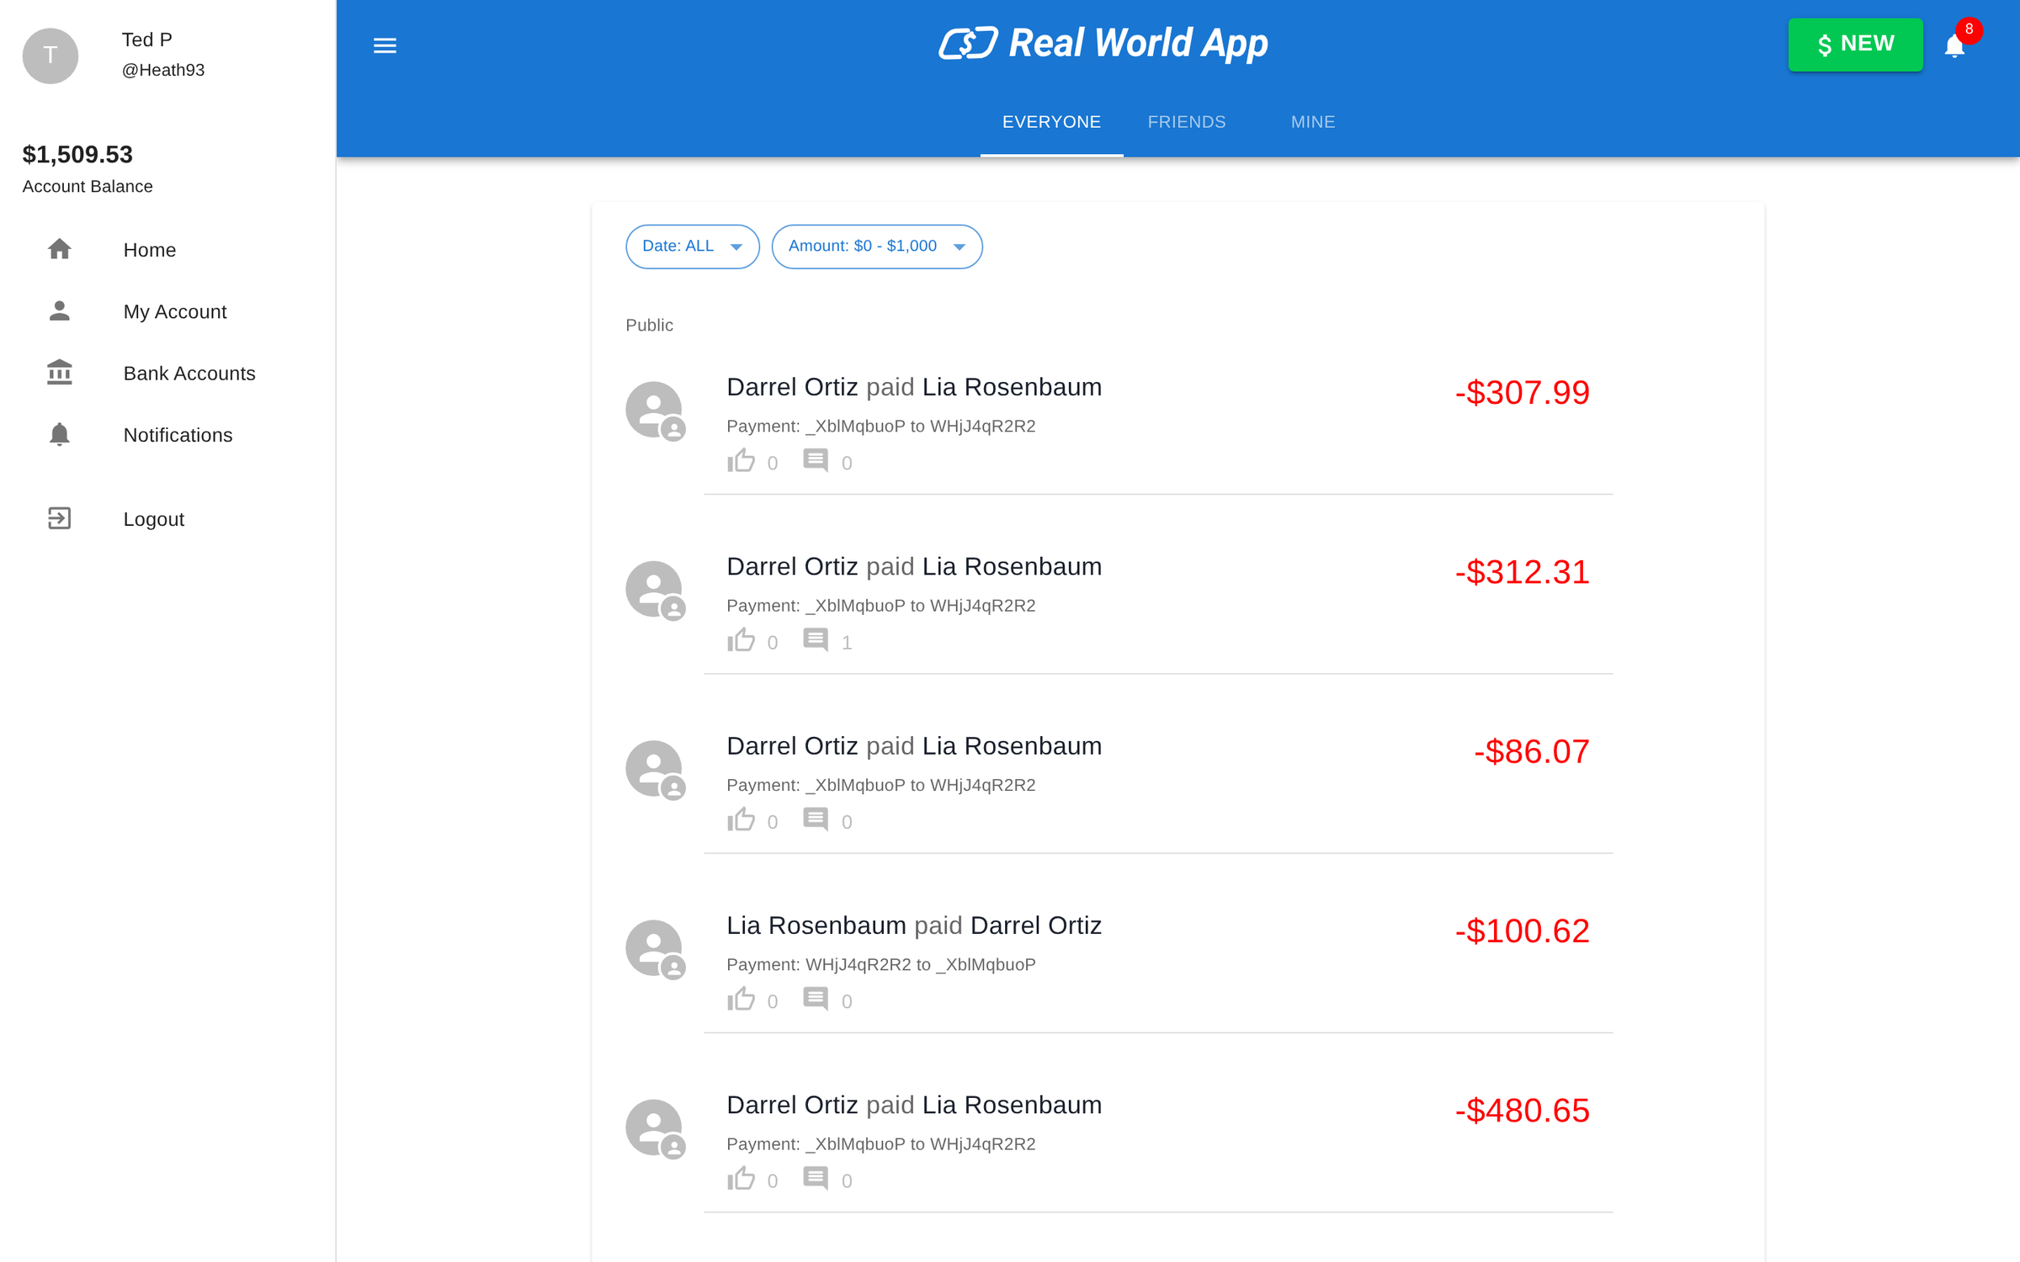




The app
APPLICATION · GENERIC
A Venmo-style app built to be tested
localhost:3000 · signed in as Heath93
5
600
seeded users
transactions
password: s3cret
pay · request · like · comment
35
14
API operations
UI routes
REST + GraphQL
React Router v5
106
14
data-test hooks
XState machines
the selector contract
app logic as states
Every user's password is s3cret. It's the worst-kept secret in QA — and that's the point.
6
Notes:
The Cypress Real World App (MIT, ~5.9k stars) is a full-stack payments demo: React UI, Express API, lowdb JSON database. Seeded with 5 users and 600 transactions. Every user's password is s3cret.

Slide 7
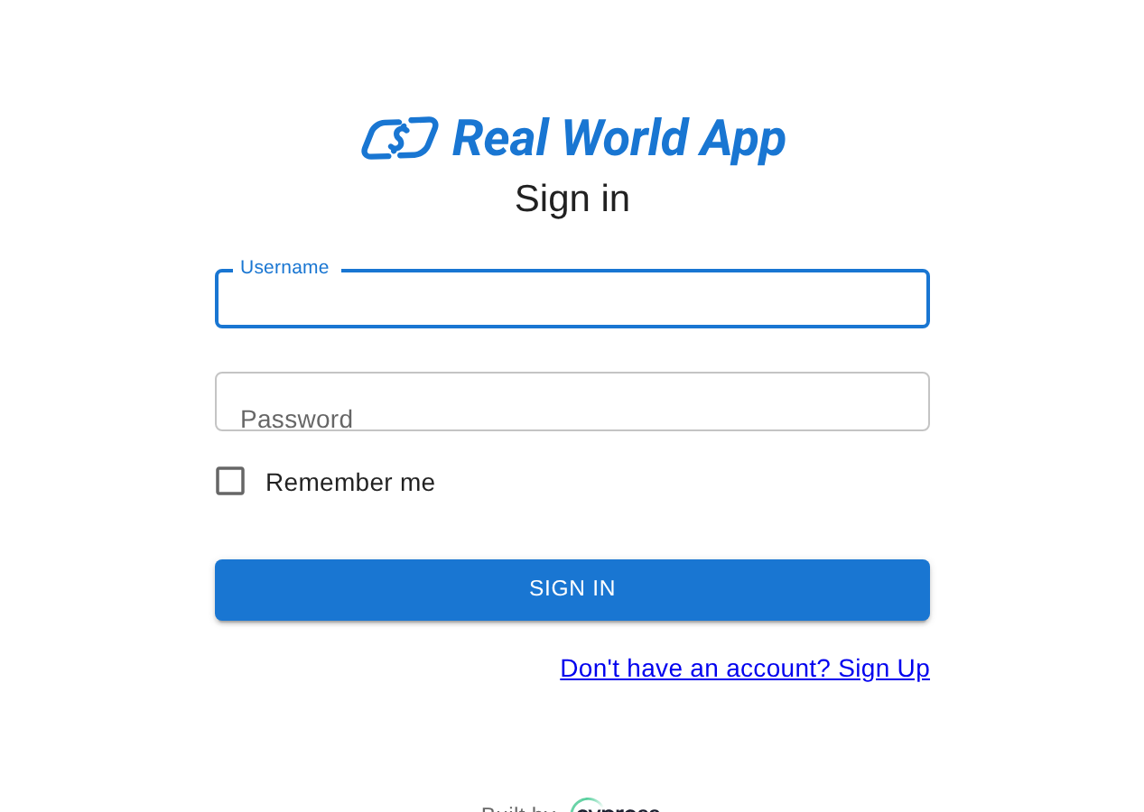
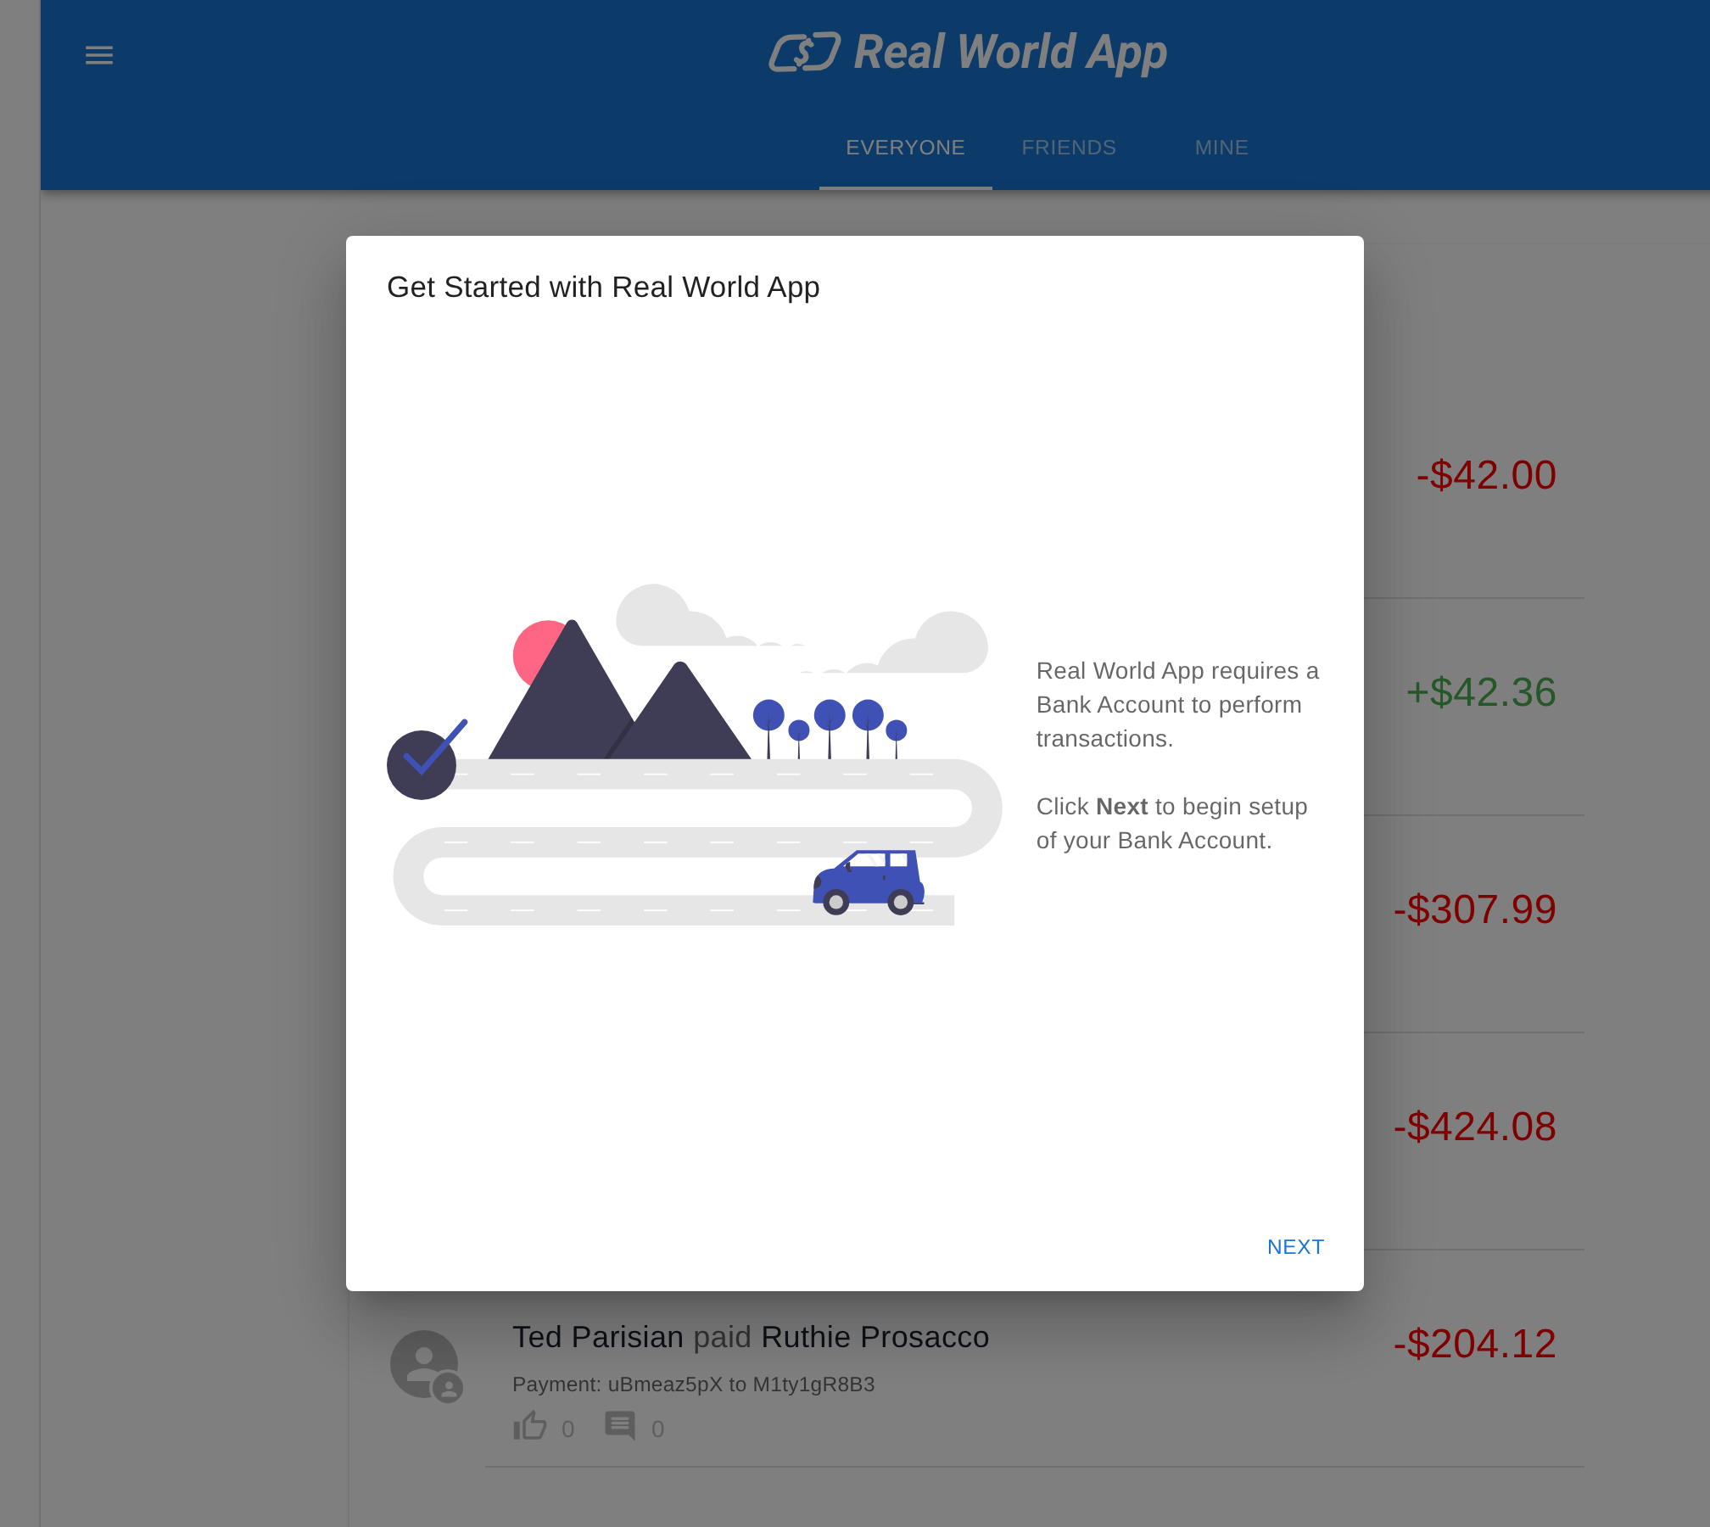
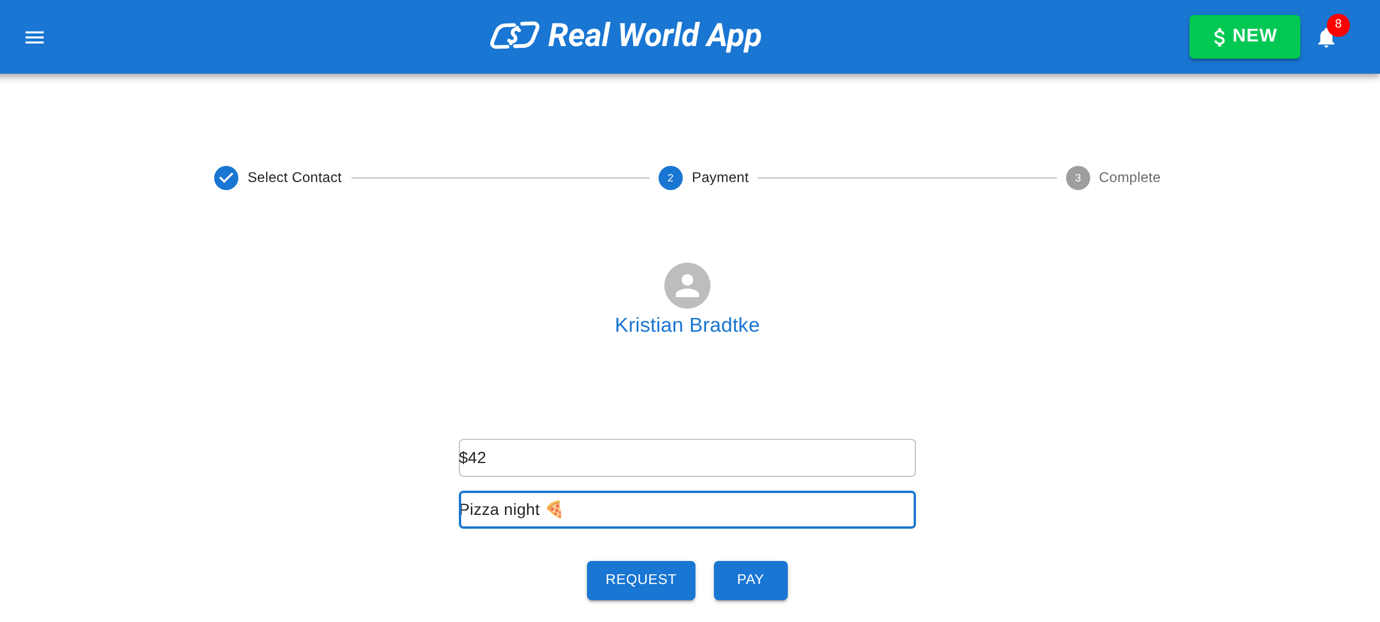
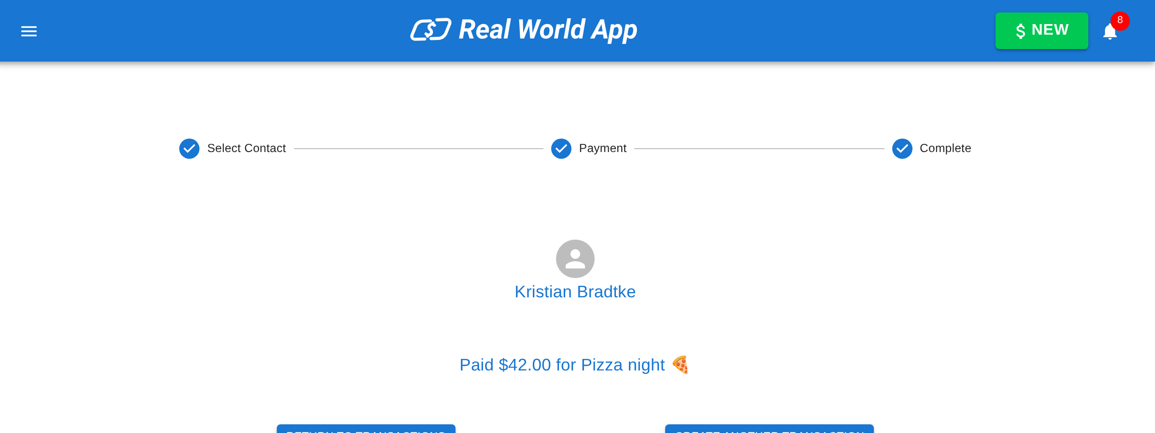
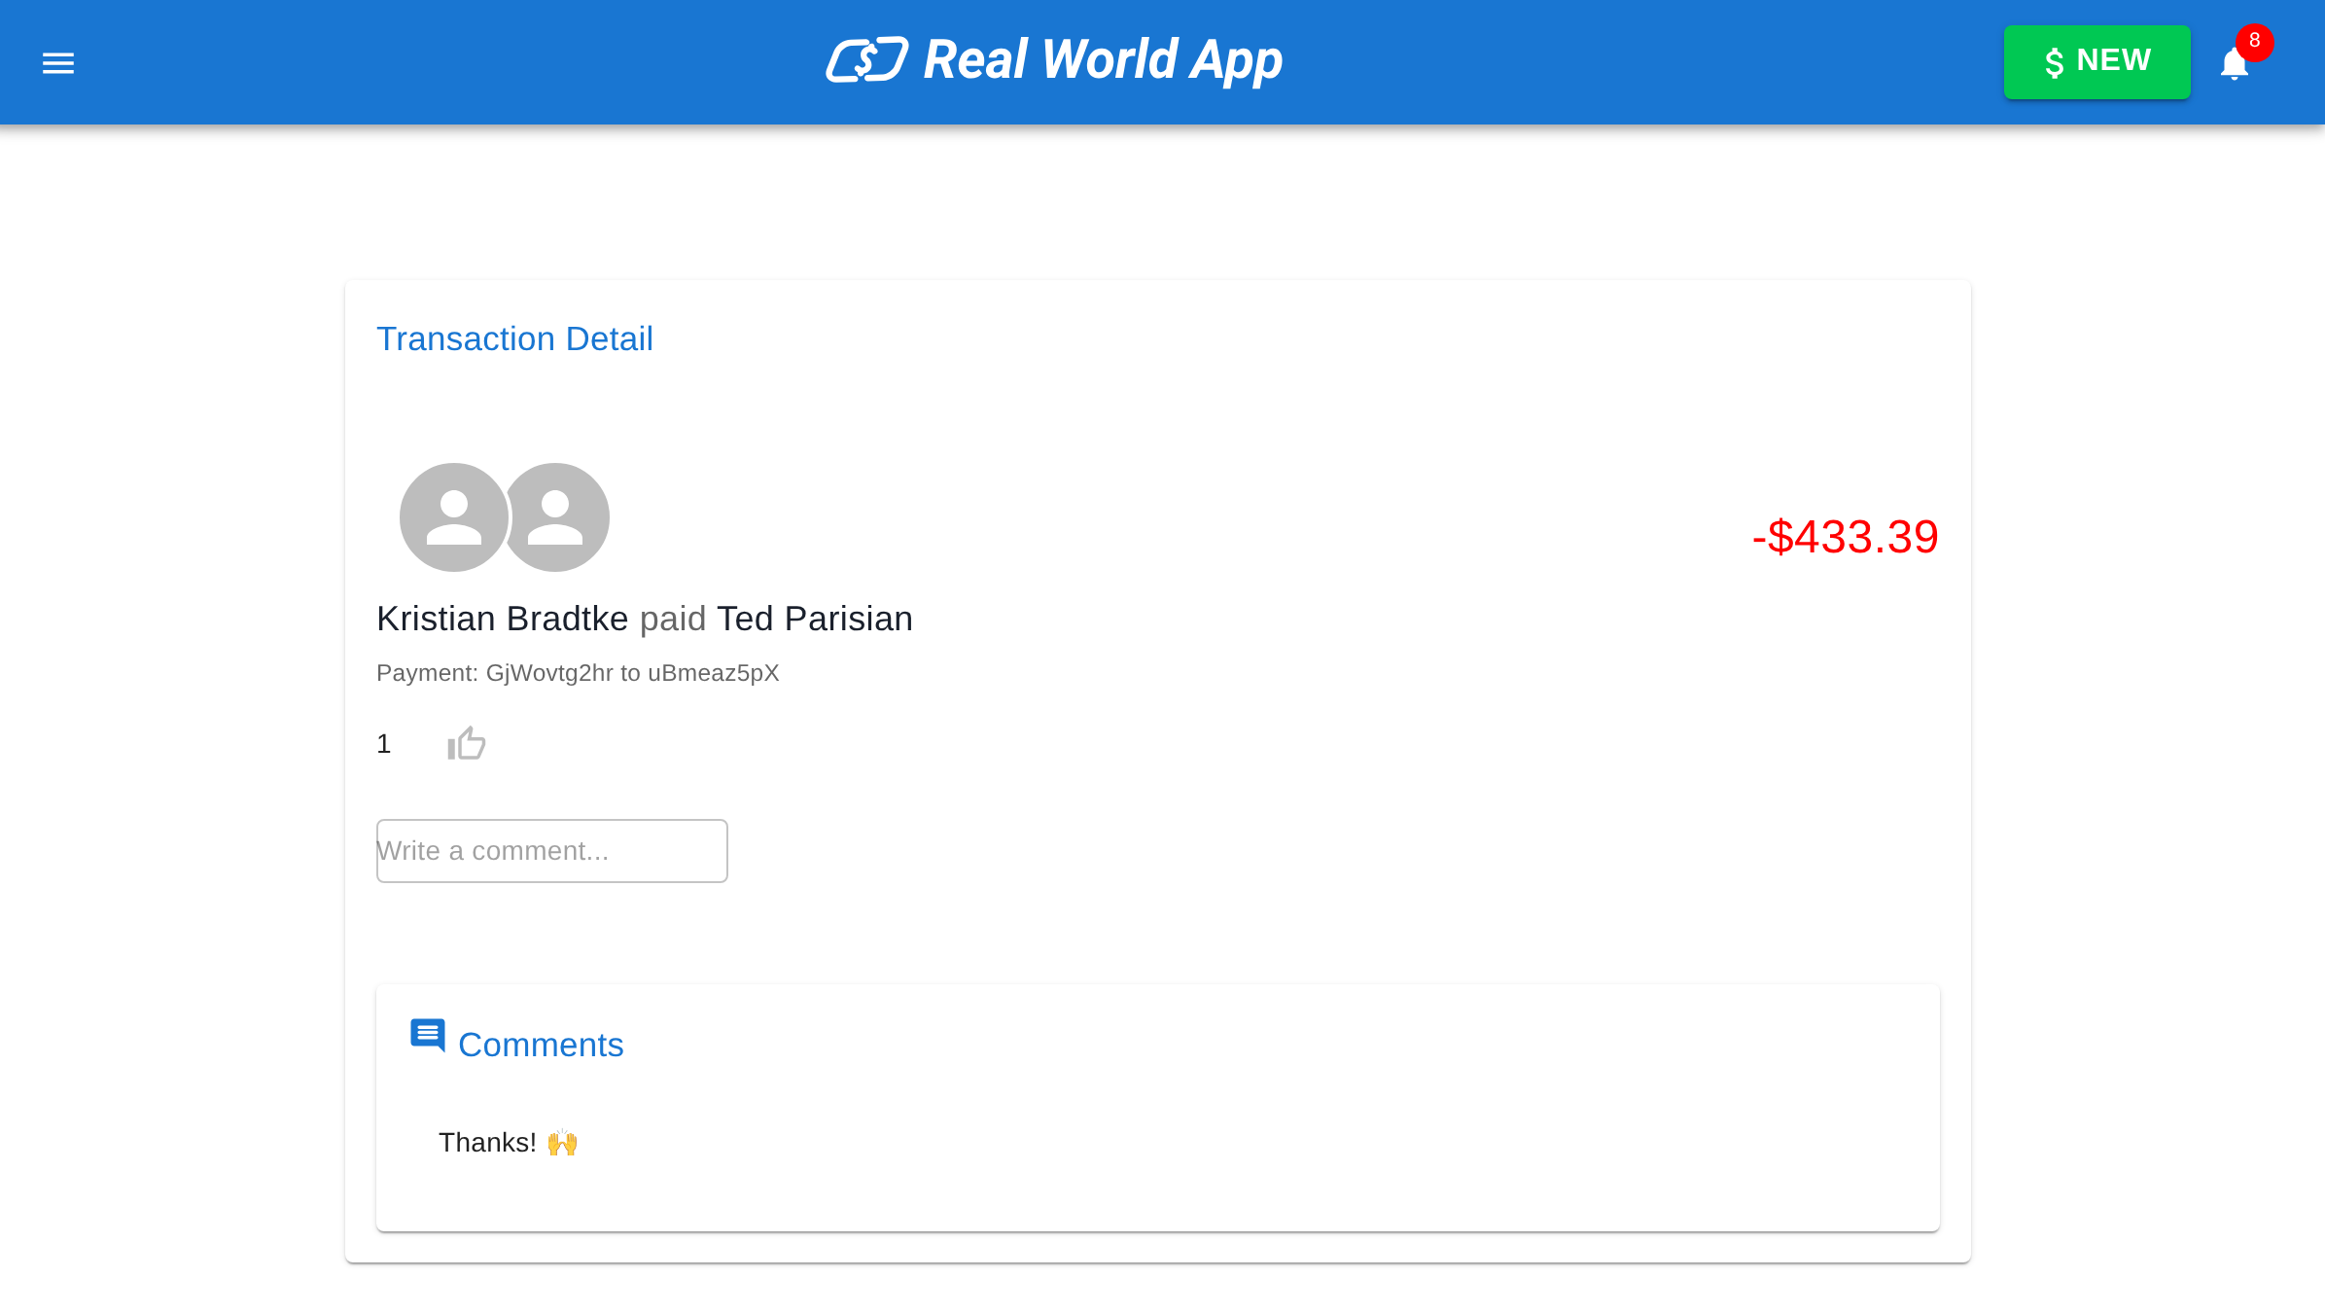
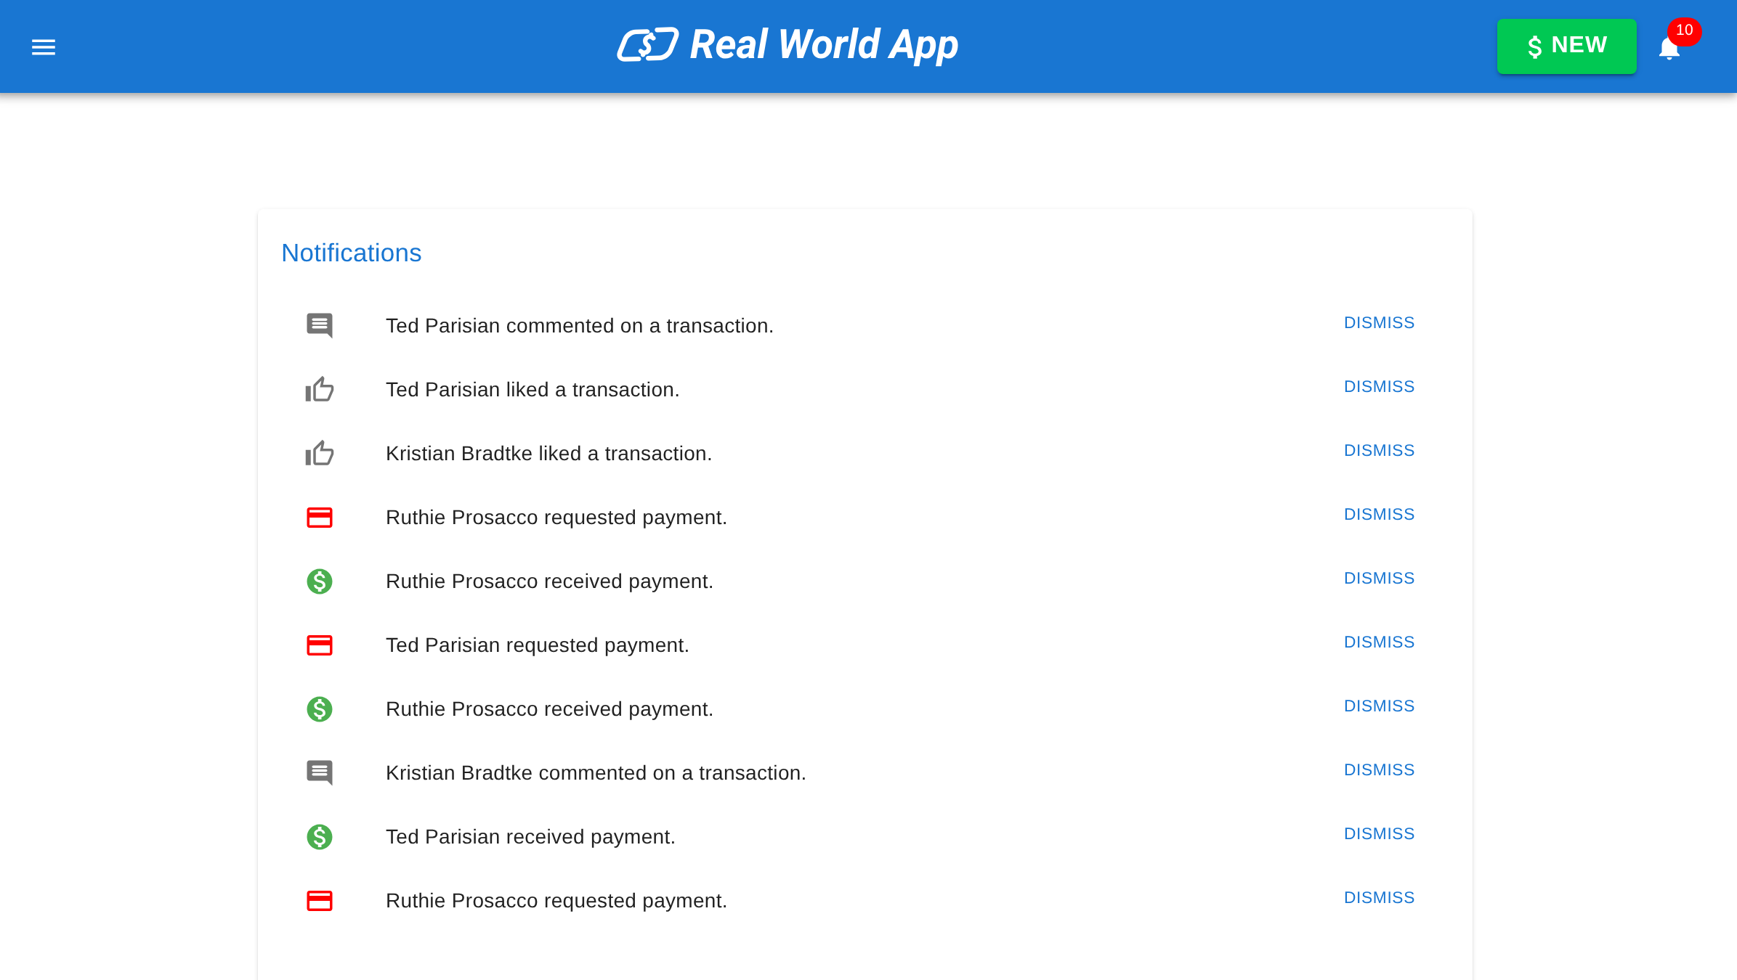
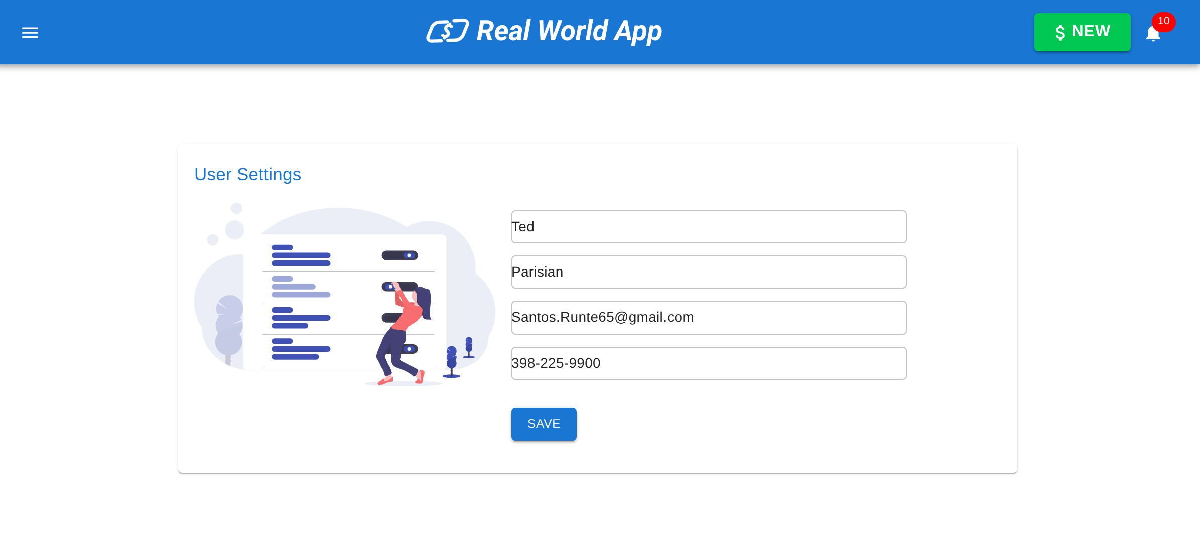
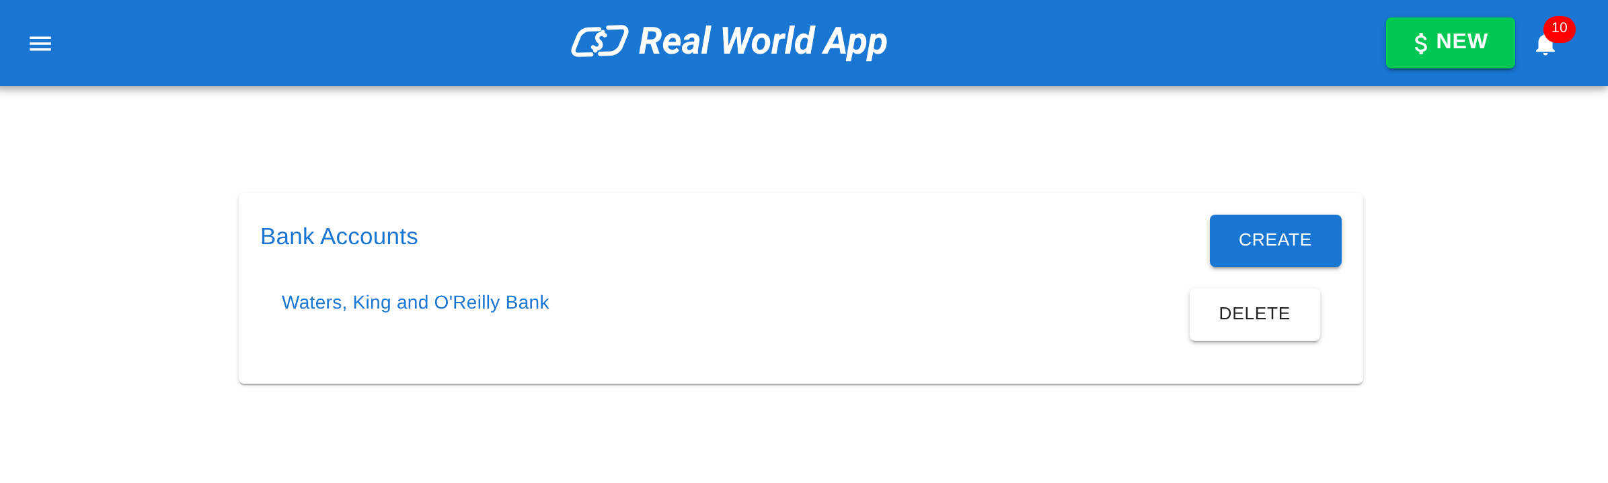
The app
APPLICATION · SCREENS
Eight screens, one happy path (and a few unhappy ones)
01 Sign in
02 Onboarding
03 New payment
04 Payment sent
05 Like & comment
06 Notifications
07 Bank accounts
08 Settings
Every screen here has data-test attributes. Our selectors don't play hide-and-seek.
7
Notes:
Real screenshots from our run: sign in, sign up, onboarding for a new user, new payment, transaction detail with a like and a comment, notifications, bank accounts, settings.

Slide 8





The app
ARCHITECTURE · OVERVIEW
Three tiers, two ports, one JSON file
React UI
:3000
Express API
:3001
lowdb
JSON
● React 18 + Vite
● MUI 5 components
● XState v4 — 14 machines
● Formik + Yup forms
● React Router v5 · 14 routes
● REST routers + GraphQL (graphql-http)
● Passport local + express-session
● express-validator rules
● CORS: origin :3000 only
● 35 operations · nodemon reload
● data/database.json
● seed: database-seed.json
● users · transactions · likes…
● reset: POST /testData/seed
● money stored in cents
HTTP + cookie
connect.sid
read /
write
AROUND IT: OUR TEST & TOOLING LAYER
Playwright api
Playwright ui
Swagger UI :3100
Mock API :3101
APIRequestContext → :3001
Chromium desktop + mobile → :3000
proxies /api → :3001 (cookies work)
OpenAPI examples + scenarios
lowdb: low drama, low latency, and low-key just a JSON file with commitment issues.
8
Notes:
UI on :3000 talks to the API on :3001 with a session cookie (connect.sid). CORS only allows :3000. The API stores everything in lowdb (data/database.json). Our tooling plugs in around it: Playwright, Swagger proxy on :3100, mock API on :3101.

Slide 9
The app
ARCHITECTURE · API LAYER
Every request runs the same gauntlet
Request
CORS :3000
Session + Passport
Auth guard
express-validator
Route handler
lowdb
JSON response
35 OPERATIONS ACROSS 12 RESOURCES
backend/bankaccount-routes.ts · validators.ts
// backend/bankaccount-routes.ts
router.post("/", ensureAuthenticated,
validateMiddleware(isBankAccountValidator),
(req, res) => {
const account = createBankAccountForUser(req.user?.id!, req.body);
res.status(200); // KI-11: 200, not 201
res.json({ account });
});
// backend/validators.ts
export const isBankAccountValidator = [
body("bankName").isString().trim(),
body("accountNumber").isString().trim(), // "123" passes!
body("routingNumber").isString().trim(),
];
Our middleware is like airport security: CORS checks where you're from, Passport checks… your passport.
9
Notes:
Middleware order matters: CORS, session and passport, ensureAuthenticated, express-validator, then the handler that calls database.ts (lowdb). Validation is thin in places — e.g. bank account numbers are only checked to be strings (a /tap-ask be answer we use later).

Slide 10

The app
ARCHITECTURE · UI LAYER
Components draw, machines think, data-test connects
authMachine (simplified)
unauthorized
loading
authorized
Components
XState machines
data-test contract
● src/components/* — view
● src/containers/* — wiring
● MUI 5 + Formik/Yup
● 14 machines (src/machines)
● auth · data · payments
● 5 exposed on window
● 106 declarations · 102 unique
● signin-submit, user-balance…
● 10 never used by tests
LOGIN
SIGNUP
LOGOUT
signup
refreshing
logout
logout → unauthorized · authorized ⇄ refreshing (PATCH user)
playwright · programmatic login
src/components/SignInForm.tsx
// test, not app code: drive the machine directly
await page.evaluate(({ u, p }) =>
window.authService.send("LOGIN",
{ username: u, password: p }),
{ u: "Heath93", p: "s3cret" });
<Button
type="submit" variant="contained"
data-test="signin-submit" // the contract
disabled={!isValid || isSubmitting}>
Sign In
</Button>
XState: because "it depends" is not a valid state.
10
Notes:
React components render; XState machines own the logic (auth, data loading, payments). When window.Cypress is set, 5 services are exposed on window — our Playwright framework sets it too, so tests can log in programmatically.

Slide 11









The app
APPLICATION FLOWS
The user journey, from sign-up to logout
1
2
3
4
5
Sign up
Sign in
Onboarding
Feeds
Pay / request
/signup
/signin
bank account
Everyone · Friends · Mine
/transaction/new
6
7
8
9
Like & comment
Notifications
Settings & banks
Logout
/transaction/:id
/notifications
/user/settings
session ends
Our e2e journey “Alice pays Bob, Bob reacts, Alice is notified” walks steps 2 → 5 → 6 → 7 across UI, API and data in 12.5 s.
Every journey begins with a single sign-up. Ours ends with a logout and a very clean session cookie.
11
Notes:
Nine steps of the main journey. Each step maps to routes, machines and tests; the pay-a-friend e2e test covers steps 2, 5, 6 and 7 in one go.

Slide 12
The app
APPLICATION FLOWS · PAYMENT
What really happens when Alice pays Bob $42
Alice · UI
Express API
lowdb
Bob · UI
POST /transactions { amount: 42 }
save txn · amount 4200 (cents)
Alice −4200 · Bob +4200
notification: “received payment”
200 { transaction } → “Transaction Submitted!”
GET /notifications (after login)
Bob sees $42 and likes it ❤
Alice pays, Bob gets notified, Alice gets a like. Easiest $42 Bob has ever made.
12
Notes:
Sequence from the real e2e journey: the UI posts whole dollars, the API stores cents (x100), updates both balances, creates notifications; Bob's UI reads them later. Our e2e test verifies each arrow: the response, the db balances, the feeds and the notifications.

Slide 13
The app
APPLICATION · DATA MODEL
Eight collections, one seed, zero real people
User
BankAccount
BankTransfer
SEED COUNTS (data/database-seed.json)
id · username · balance
userId · routingNumber
userId · amount · type
Contact
Transaction
Like
userId · contactUserId
senderId · receiverId
amount (cents) · status
userId · transactionId
Notification
Comment
userId · status · isRead
userId · content
600 transactions between 5 people. Someone really needs to stop splitting the pizza bill.
13
Notes:
Seed counts from data/database-seed.json. Amounts are cents everywhere except the POST /transactions body, which takes whole dollars (KI-18).

Slide 14
API & UI layers
Flows, tests, contract, defects — both layers, real results
02
Layers, like an onion: peel carefully. Tests may cause tears — of joy, mostly.
IN THIS CHAPTER
API flows
API tests
Contract
Defects
UI flows
UI tests
Mocks & a11y
14
Notes:
Chapter 2: the two layers we test, the flows through them, and what the tests found.

Slide 15

API & UI
API LAYER · FLOWS
Four business flows, 35 calls, one cookie
Auth
POST /login
GET /checkAuth
PATCH /users/:id
POST /logout
METHOD MIX (OpenAPI)
Pay a friend
GET /users/search
POST /transactions
GET /transactions
GET /notifications
Request money
POST /transactions
PATCH /transactions/:id
balances move
notifications
Social
POST /likes/:txId
POST /comments/:txId
PATCH /notifications/:id
GET /transactions/public
GET 19
POST 11
Bank accounts
POST /graphql list
POST /graphql create
POST /graphql delete
GET /bankTransfers
PATCH 3
DELETE 2
35 operations · 25 paths
REST assured: every endpoint was called. Some even answered with the right status code.
15
Notes:
The API flows the UI uses. Method mix from the OpenAPI spec: 19 GET, 11 POST, 3 PATCH, 2 DELETE.

Slide 16

API & UI
API LAYER · TESTS
73 API tests, zero browsers harmed
73
TESTS PER SPEC FILE
tests/api/users.api.spec.ts
import { test, expect } from "@fixtures/api";
import { users as usersApi, errorsOf } from "@api";
test.describe("Users API", () => {
test("gets a user", async ({ api, me }) => {
const res = await usersApi.getUser(api, me.id);
expect(res.status).toBe(200);
expect(res.body.user).toHaveProperty("firstName");
});
test("errors when invalid userId", async ({ api }) => {
const res = await usersApi.getUser(api, "1234");
expect(res.status).toBe(422);
expect(errorsOf(res)).toHaveLength(1);
});
});
API tests
55 + 18
functional + contract
api project
0.1–0.2 s
$ npx playwright test --project=api
✓ 1 [api] › bankaccounts › list for user (197ms)
✓ 2 [api] › bankaccounts › gets one (163ms)
✓ 3 [api] › bankaccounts › creates (156ms)
… 73/73 api tests green
per API test
Our API tests never throw on a 4xx. They just quietly judge you in the expect.
16
Notes:
api project: 55 functional tests ported from the Cypress API specs plus 18 OpenAPI contract tests. Each test re-seeds the DB via the auto seed fixture. Results from the full regression on 16.10.2026.

Slide 17
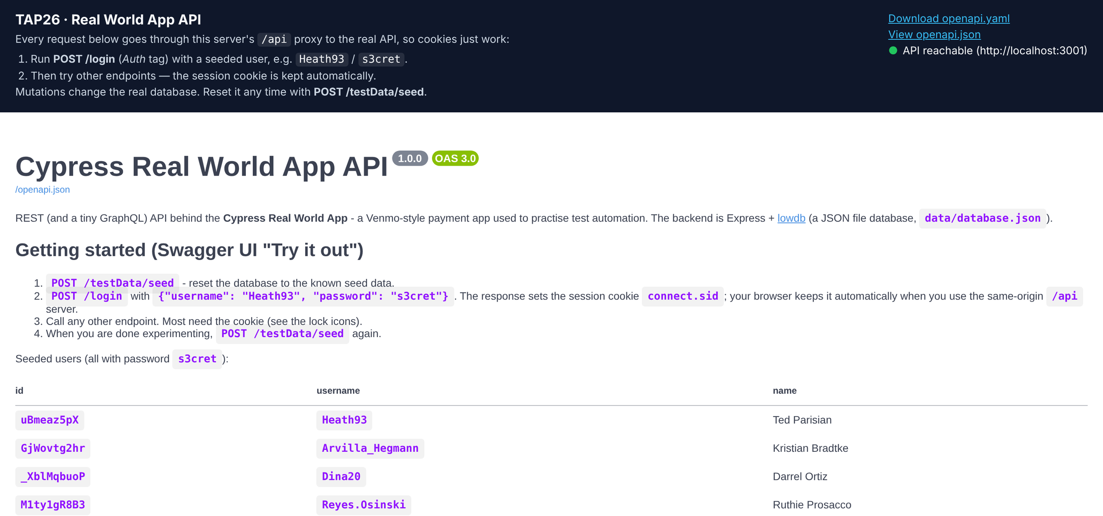
API & UI
API LAYER · CONTRACT
One OpenAPI spec, a working Swagger UI, zero drift
localhost:3100 · TAP26 Swagger UI
spec drift
$ node tap26/scripts/spec-drift.mjs
documented operations: 35 · implemented: 35 · matched: 35
Documented but missing in the API (0) ✔ none
Implemented but undocumented (0) ✔ none
Method mismatches (0) ✔ none
IN SYNC — every documented operation is implemented.
src/api/contract.ts · AJV against OpenAPI
const verdict = validateResponse(
contract, "GET", "/users/{userId}", res.status, res.body);
expect(verdict.errors, verdict.summary).toEqual([]);
// broken body → readable violations:
// "/results/0/balance must be integer"
Try it out
POST /api/login
200 · cookie set
GET /api/checkAuth → 200
Our spec and our API are perfectly in sync — the healthiest relationship in this building.
17
Notes:
tap26/openapi/openapi.yaml documents 25 paths / 35 operations, verified with 135 live checks. Swagger UI runs on :3100 and proxies /api so cookies work (Try it out → real 200). spec-drift compares the spec with the Express routes: IN SYNC.

Slide 18





API & UI
API LAYER · DEFECTS
37 known issues found by testing (we kept receipts)
BY SEVERITY
KI-01
KI-04
DELETE /contacts/<unknown id> deletes every contact
Any user can PATCH any user — incl. balance (IDOR)
37
KI-05
KI-07
Rejecting a request still moves the money
Password hashes returned by /login, /users…
KI-18
KI-29
High 8
Medium 11
Low 18
$12.75 becomes 1200 cents (truncated)
Private transactions visible in friends' feeds
We didn't find bugs. We found features with serious trust issues — and wrote them a test.fail.
18
Notes:
tap26/knowledge/known-issues.md: KI-01…KI-33, A11Y-01…04 — 8 high, 11 medium, 18 low. Per decision D-005 tests assert the CORRECT behaviour and are marked test.fail('KI-xx'), so the suite stays green and flips when a bug is fixed.

Slide 19
API & UI
UI LAYER · FLOWS
14 routes, 106 selectors, one contract
Public
Private
106
data-test declarations
/signin
/ · /public
Everyone feed
/transaction/:id
detail, like, comment
102
unique selectors
/signup
/contacts
Friends feed
/notifications
dismiss
unknown route
→ blank page
(gap G-13)
/personal
Mine
/bankaccounts(/new)
GraphQL CRUD
10
never used by tests
/transaction/new
pay · request
/user/settings
profile form
src/ui/selectors.ts
bySel(page, "signin-submit") // exact: [data-test="signin-submit"]
bySelLike(page, "transaction-item") // prefix: [data-test*="transaction-item"] — Cypress getBySel / getBySelLike
14 routes and not one of them stops to ask for directions. Except the unknown one — it just stares blankly.
19
Notes:
Route map from tap26/knowledge/ui-map.md. Unknown routes while logged in render an empty layout (no 404) — gap G-13. scan-app.mjs found 106 data-test declarations, 102 unique, 10 never referenced by tests.

Slide 20
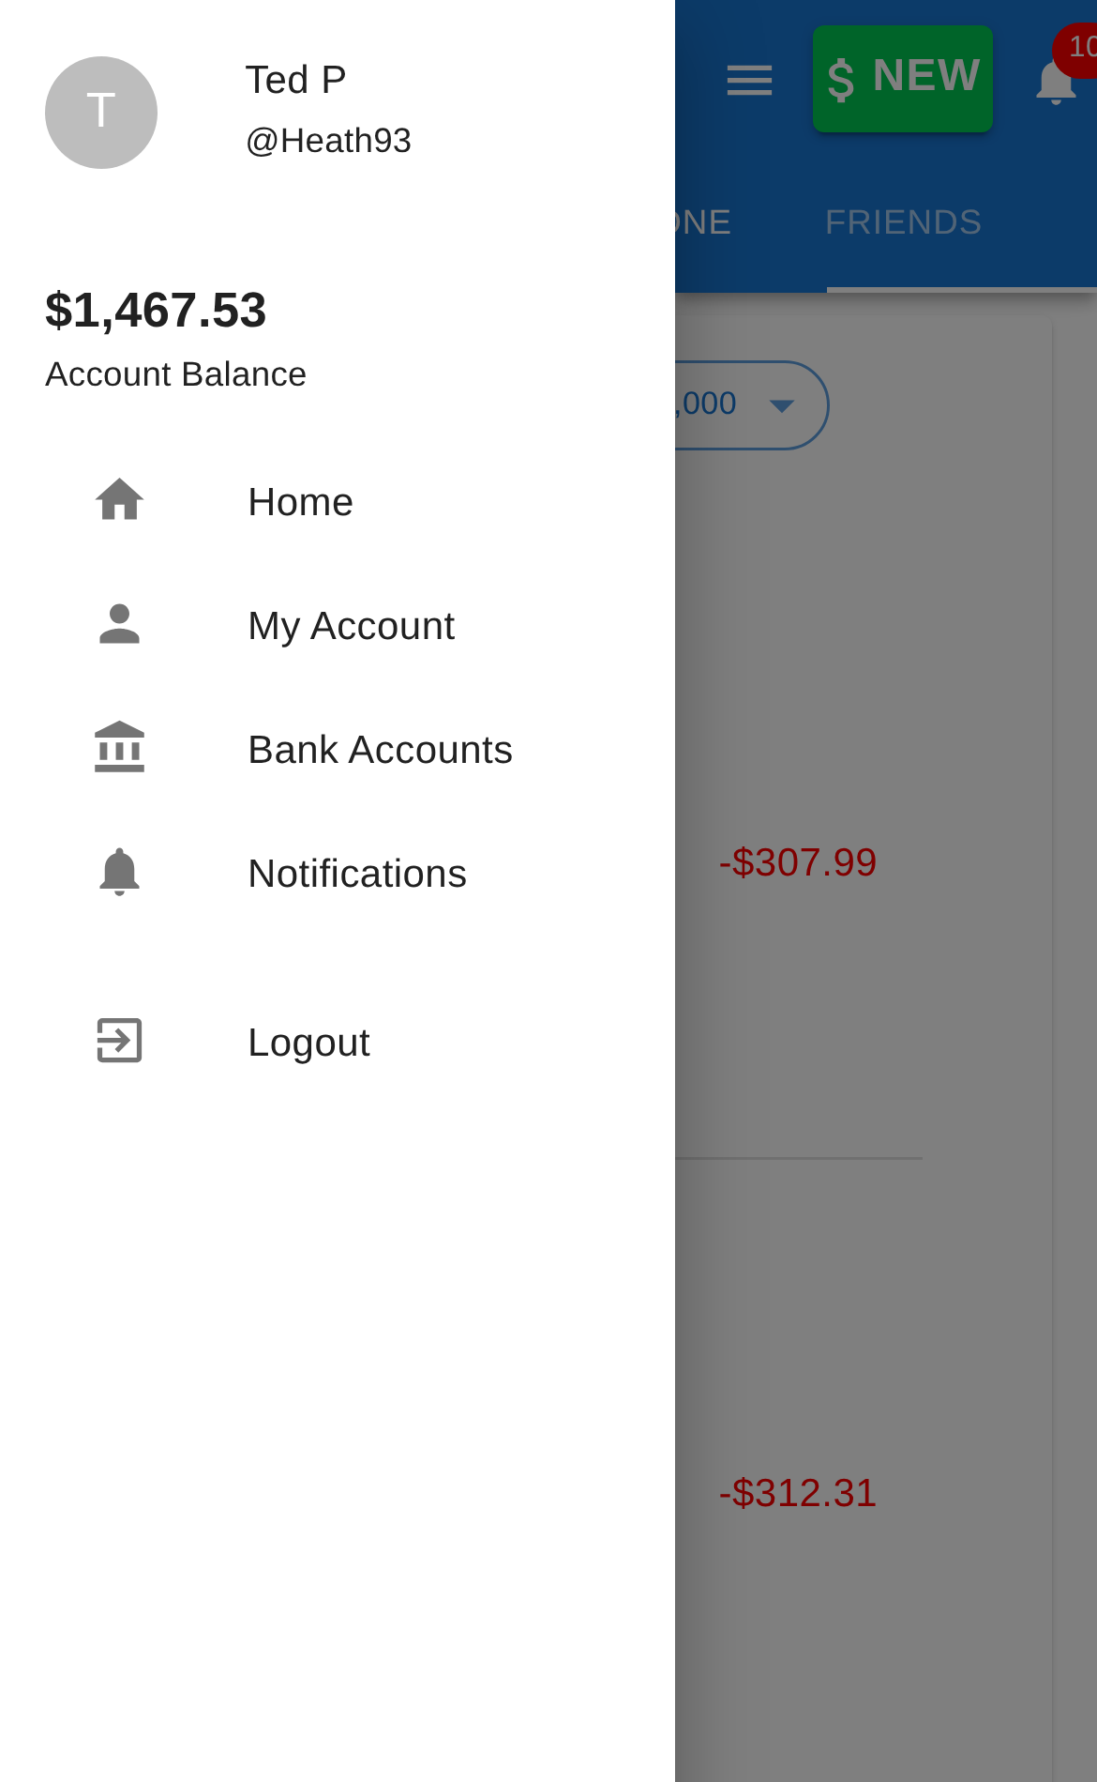
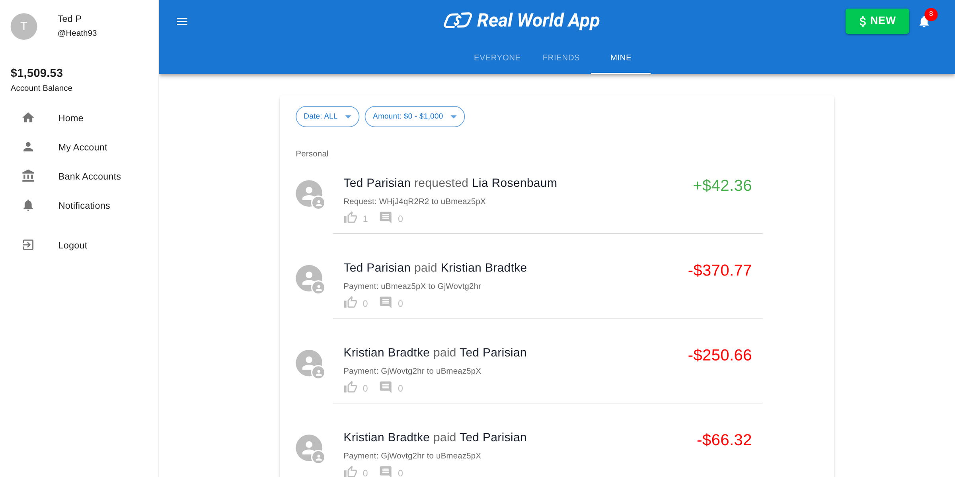
API & UI
UI LAYER · TESTS
75 tests × 2 viewports = one very busy Chromium
ui-desktop · 1280×1000
TESTS PER SPEC (EACH VIEWPORT)
ui-mobile · 375×667
tests/ui/new-transaction.spec.ts
full regression · 16.10.2026
await fillTransactionForm(page, payment.amount, payment.description);
const created = waitForApi(page, createTransaction);
await bySelLike(page, "submit-payment").click();
await created;
await expect(alertBar(page)).toHaveText("Transaction Submitted!");
✓ [ui-desktop] › auth.spec.ts › should redirect to the home page after login (3.4s)
✓ [ui-mobile] › a11y.spec.ts › notifications has no new critical axe violations (5.1s)
223 passed · 1 skipped (12.1m)
Same tests, two viewports. The mobile project fits in your pocket; its bugs, sadly, do too.
20
Notes:
ui-desktop (1280×1000) and ui-mobile (375×667) run the same 75 tests; mobile helpers open and close the drawer. Spec counts per viewport from npx playwright test --list.

Slide 21




API & UI
UI LAYER · MOCKS & ACCESSIBILITY
We broke the server on purpose — politely
tests/ui/mocked-states.spec.ts
AXE-CORE BASELINE · WCAG 2.2 A/AA · 7 SCREENS × 2 VIEWPORTS
test("tells the user when the feed fails (KI-33)", async ({ page, users }) => {
test.fail(true, "KI-33: a 500 renders the empty state");
await stubServerError(page, feedMatcher("public"));
const feed = waitForApi(page, feedMatcher("public"));
await loginByXstate(page, users[0].username);
expect((await feed).status()).toBe(500);
await expect(bySel(page, "alert-bar-error")).toBeVisible();
});
1
critical
aria-required-children (virtualized feed) — allowlisted
3
serious rules
link-name · list/listitem · color-contrast
0
new criticals
the a11y spec fails on any new critical
TAP26 mock API :3101
$ curl -H "x-mock-scenario: empty-notifications" :3101/notifications
{ "results": [] }
$ curl ":3101/transactions/public?__scenario=slow" → 200 in 2.00s
$ curl ":3101/transactions?__scenario=status-500" → 500
57%
found by axe
of WCAG issues on average — the rest needs humans
We sent the app a 500. It reacted like a cat knocking a glass off the table: “nothing happened here.”
21
Notes:
Mocked states: stub the API with page.route to force 500s, latency and empty lists. KI-33: a 500 on the public feed shows the same 'No Transactions' empty state — the test asserts the correct behaviour under test.fail. A11y: axe-core baseline on every screen; one critical (aria-required-children on the virtualized feed) is allowlisted, serious ones are tracked as A11Y-02..04.

Slide 22
The automation suite
Playwright + TypeScript, written as functions — not classes
03
Functional programming: no classes were instantiated in the making of this framework.
IN THIS CHAPTER
Architecture
Folders
FP vs OOP
Concepts
Asserts
Test data
Specs
Debugging
Reporting
22
Notes:
Chapter 3: how the framework is built and why it is functional, then asserts, data, specs, debugging and reporting.

Slide 23




Automation
AUTOMATION SUITE · ARCHITECTURE
Five layers, each one only talks down
Specs
tests/api · 6 specs
tests/ui · 9 specs
tests/e2e · 1 journey
depends
on
what we check
Fixtures
api
seed (auto)
db
page
users · me · ctx
what a test receives
Helpers
src/api/* — users, transactions, social…
src/ui/* — auth, network, navigation, a11y
how we talk to the app
Core
http.ts
contract.ts
fp.ts
money.ts
mocks/
pure building blocks
Runner
4 projects
workers: 1
TZ: UTC
trace on failure
list + html
playwright.config.ts
A layered architecture, like lasagna: every layer talks only to the one beneath it. No spaghetti allowed.
23
Notes:
Specs never call Playwright APIs for HTTP directly: they use fixtures and helpers. Helpers use the core. The runner config defines 4 projects. This keeps specs short and lets one helper fix many tests.

Slide 24



Automation
AUTOMATION SUITE · FOLDERS
A place for everything (and utils is not a junk drawer)
tree playwright -L 2
Path aliases
playwright/
├─ playwright.config.ts # 4 projects
├─ src/
│ ├─ api/ http · contract · users · transactions…
│ ├─ ui/ auth · network · navigation · a11y…
│ ├─ fixtures/ index · api · ui
│ ├─ mocks/ factories · stubs
│ ├─ utils/ fp · money · dates
│ ├─ config/ env.ts
│ └─ types/ models.ts
├─ tests/
│ ├─ api/ 6 × *.api.spec.ts
│ ├─ ui/ 9 × *.spec.ts
│ └─ e2e/ 1 × *.e2e.spec.ts
└─ test-data/ public-transactions.json
@fixtures/api · @ui · @api · @mocks · @config · @models
One concern per file
network.ts waits & stubs, auth.ts logs in, selectors.ts finds
Tests mirror the app
a spec per area: auth, feeds, new transaction, notifications…
Typed end to end
models.ts shared types · npm run typecheck gate
Our folder structure is so tidy, utils/ actually contains utilities. We checked twice.
24
Notes:
Path aliases make imports read like intent: @fixtures/api, @ui, @api, @mocks. Specs mirror app areas; helpers are one concern per file.

Slide 25
Automation
AUTOMATION SUITE · FUNCTIONAL VS OOP
Same login, two philosophies
page-object style
src/ui/auth.ts (ours)
// OOP: Page Object (what we did NOT do)
class LoginPage {
constructor(private page: Page) {}
async login(user: string, pass: string) {
await this.page.fill("#username", user);
await this.page.fill("#password", pass);
await this.page.click("#submit");
}
}
await new LoginPage(page).login("Heath93", "s3cret");
// FP: plain functions, dependency first
export const loginViaForm = async (page: Page, u: string, p: string) => {
await textbox(page, "signin-username").fill(u);
await textbox(page, "signin-password").fill(p);
const login = waitForApi(page, { method: "POST", path: "/login" });
await bySel(page, "signin-submit").click();
return login; // the response, for the test to assert
};
OOP · Page Objects
FP · functions + fixtures
● state hidden in this
● no hidden state — inputs in, values out
● inheritance trees (BasePage…)
● composition: small helpers, pipe
● new instance per page
● fixtures inject ready values
● mocking needs subclasses
● swap a function, stub a route
We didn't object to OOP. We just never instantiated it.
25
Notes:
Page objects bundle state + behaviour in classes; we pass the page as the first argument to small pure-ish functions and compose them. Benefits: no hidden state, trivial reuse across projects, easier for agents to read and change. Trade-off: discipline in naming and folders.

Slide 26





Automation
AUTOMATION SUITE · PROGRAMMING CONCEPTS
Eight ideas doing the heavy lifting
01
02
03
04
Pure functions
Immutability
Higher-order functions
Composition
matches, pick, range in fp.ts
Object.freeze on every API result & factory
matchesRequest(m) returns a predicate
pipe(...fns) · helpers built from helpers
05
06
07
08
async / await
Generics
Dependency injection
Closures
every step awaits — no dangling promises
ApiResult<T> · send<T>() · Builder<T>
fixtures: api, db, page, users
recordApi() keeps seen[] private
src/utils/fp.ts
export const pipe = <T>(...fns: Array<(value: T) => T>) => (value: T): T => fns.reduce((acc, fn) => fn(acc), value);
export const matches = <T extends object>(partial: Partial<T> = {}) => (item: T): boolean =>
Object.entries(partial).every(([key, value]) => (item as Record<string, unknown>)[key] === value);
Pure functions: no side effects, no surprises, and absolutely no “works on my machine.”
26
Notes:
Every concept here is in the framework today. Ask the tutor agent (/tap-explain) to walk through any of them in the code.

Slide 27



Automation
AUTOMATION SUITE · ASSERTS
Assert like you mean it (Playwright retries for you)
Web-first
await expect(alertBar(page)).toHaveText("Transaction Submitted!")
retries until true or 5 s
Value
expect(res.status).toBe(422); expect(errorsOf(res)).toHaveLength(1)
checks once — data is already here
Data layer
expect(aliceAfter.balance).toBe(alice.balance - 4200)
verify state in the DB, not just the UI
Contract
expect(verdict.errors, verdict.summary).toEqual([])
response matches OpenAPI schema
Known defect
test.fail(true, "KI-33: a 500 renders the empty state")
asserts correct behaviour; flips when fixed
Retry block
await expect(async () => { … }).toPass()
for genuinely racy UI (L-002)
Assert yourself — politely, with a 5-second timeout and automatic retries.
27
Notes:
Web-first assertions retry until the timeout; generic assertions check a value once. API tests assert on the frozen result. Contract asserts validate the schema. test.fail marks known defects (D-005). toPass retries a whole block for flaky UI races (L-002).

Slide 28



Automation
AUTOMATION SUITE · TEST DATA MODELLING
Fresh data for every test, no leftovers
seed (auto)
db.find / filter
factories
stubs
Faker
POST /testData/seed
before every test
read real rows:
users, txns, contacts
buildUser({}, 2)
→ id usr00002
stubApi(page, m, body)
500 · slow · empty
unique sign-ups
(never real PII)
src/mocks/factories.ts (abridged)
100%
0
export const buildUser: Builder<User> = (overrides = {}, seq = 1) =>
Object.freeze({
...stamps("usr", seq), // id usr00001, UTC dates
firstName, lastName,
username: `${firstName}${seq}`,
balance: 100_000, // cents!
...overrides, // overrides always win
});
tests start from the same seed
real people in our data
cents
1
stored money unit (KI-18 traps dollars)
worker — the DB is shared
Our test data is 100% synthetic, gluten-free, and has never been anywhere near production.
28
Notes:
The auto seed fixture resets lowdb before every test (like cy.task('db:seed')). db.find/db.filter read real seeded rows; factories build deterministic mock objects for stubs; Faker builds unique sign-up payloads. Lesson L-009: we byte-compared mock responses with the real API.

Slide 29
Automation
AUTOMATION SUITE · SPEC FILES
Anatomy of a spec: the e2e journey
tests/e2e/pay-a-friend.e2e.spec.ts (abridged)
①
Fixtures & helpers via aliases
import { test, expect } from "@fixtures/ui"; // ①
import { loginViaForm, waitForApi, bySelLike } from "@ui";
test.describe("Journey: pay a friend", { tag: ["@e2e"] }, () => { // ②
test("Alice pays Bob, Bob reacts, Alice is notified",
async ({ page, db, users: [alice, bob] }) => { // ③
await test.step("Alice signs in through the form", async () => { // ④
await loginViaForm(page, alice.username, "s3cret");
});
await test.step("Alice sends Bob a payment", async () => {
const created = waitForApi(page, { method: "POST", path: "/transactions" }); // ⑤
await bySelLike(page, "submit-payment").click();
expect((await created).status()).toBe(200); // ⑥
});
await test.step("Balances moved in the data layer", async () => {
const after = await db.find("users", { id: bob.id }); // ⑦
expect(after.balance).toBe(bob.balance + 4200);
});
});
});
②
Tag → run with --grep @e2e
③
Fixtures injected, users destructured
④
One test.step per business step
⑤
Start the wait before the click
⑥
Assert the response
⑦
Verify the data layer too
A good spec reads like a story: a beginning, a middle, and an expect with a twist.
29
Notes:
Imports from fixtures and helpers, a tagged describe, fixtures destructured in the signature, one test.step per business step, waits started before actions, asserts on UI and data.

Slide 30
Automation
AUTOMATION SUITE · NETWORK CONTROL
Wait for it… then stub it, then bend it
waitForApi
stubApi
transformApi
wait for the real response
replace it with your own
let it through, then edit
src/ui/network.ts
src/ui/network.ts
src/ui/network.ts
const res = waitForApi(page,
{ method: "POST", path: "/login" });
await submit.click();
await res;
await stubApi(page,
{ path: "/notifications" },
{ results: [] });
await transformApi(page,
{ path: "/transactions/public" },
(b) => ({ ...b, results: [] }));
CYPRESS EQUIVALENT
CYPRESS EQUIVALENT
CYPRESS EQUIVALENT
cy.intercept().as('x') + cy.wait('@x')
cy.intercept(url, { fixture })
cy.intercept(url, (req) => req.reply(…))
used by feeds, payments, journeys
used by mocked-states (9 tests)
used for edge-case feeds
We intercept so many requests, the API now asks for a lawyer before every response.
30
Notes:
waitForApi = cy.intercept().as() + cy.wait(). stubApi replaces a response (like cy.intercept with a fixture). transformApi lets the real request through and edits the JSON. Lesson L-004: start the wait before the action.

Slide 31
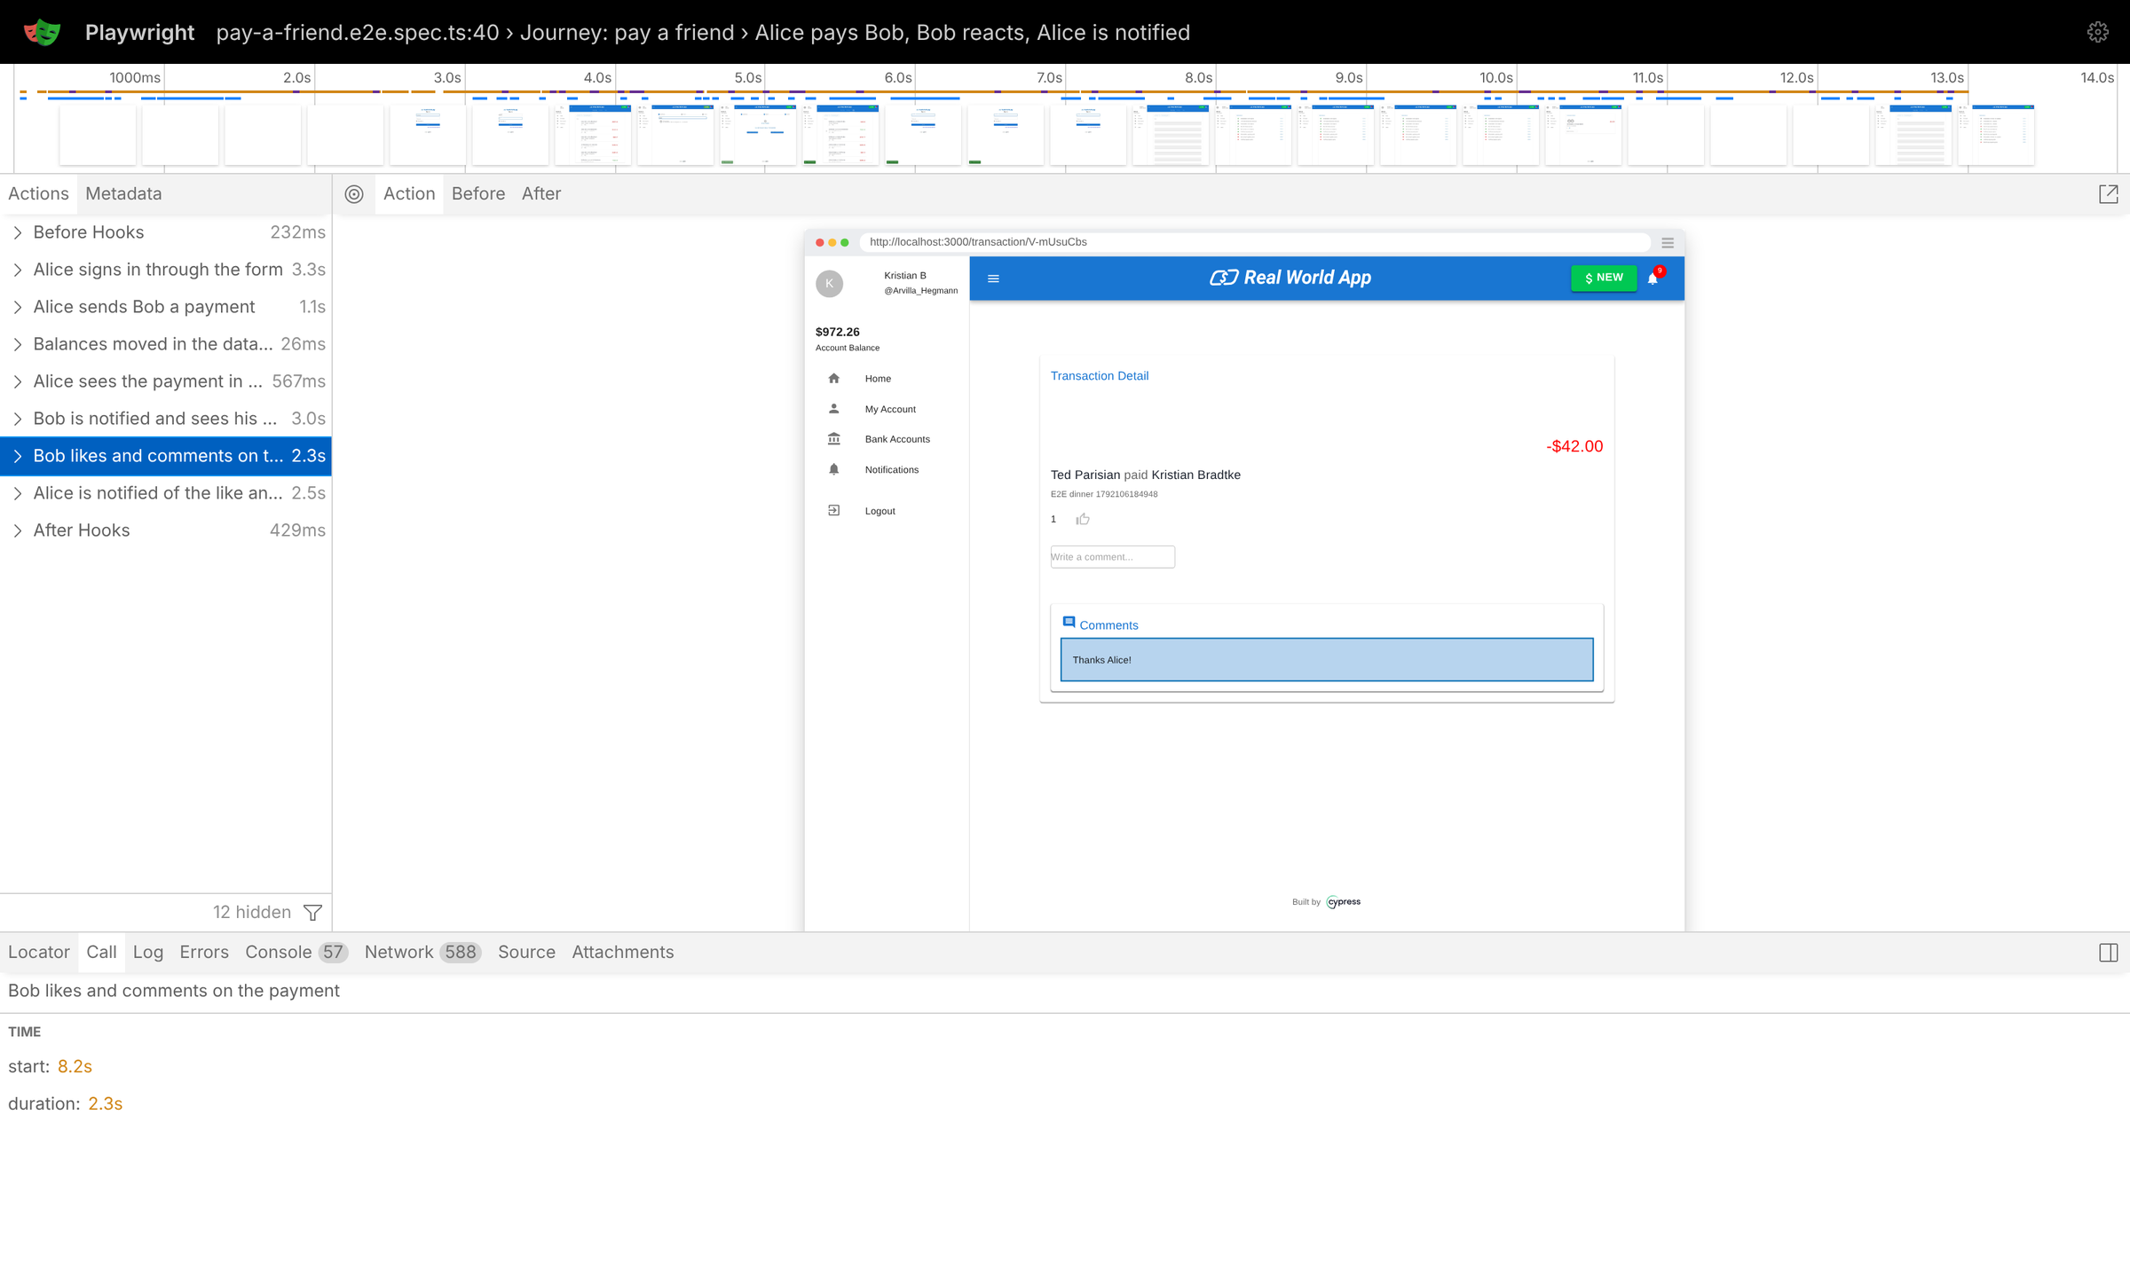


Automation
AUTOMATION SUITE · DEBUGGING
The trace viewer: CCTV for your tests
npx playwright show-trace trace.zip
UI mode
npx playwright test --ui
Step debugger
--debug · VS Code ▶ breakpoints
Trace on failure
trace: "retain-on-failure"
REAL BUGS WE HIT WHILE BUILDING IT
L-002
“Sign Up” click swallowed by blur validation → retry with toPass
L-003
Re-clicking a selected tab doesn't refetch → reload
L-005
pkill -f matched its own shell and killed it
Debugging: being the detective in a crime story where you also wrote the missing await.
31
Notes:
Real trace of the e2e journey (step 'Bob likes and comments'). Tools: UI mode, --debug, trace on failure, VS Code extension. Real lessons from building the suite: L-002 blur swallowed the Sign Up click, L-003 re-clicking a selected tab doesn't refetch, L-005 pkill -f killed its own shell.

Slide 32
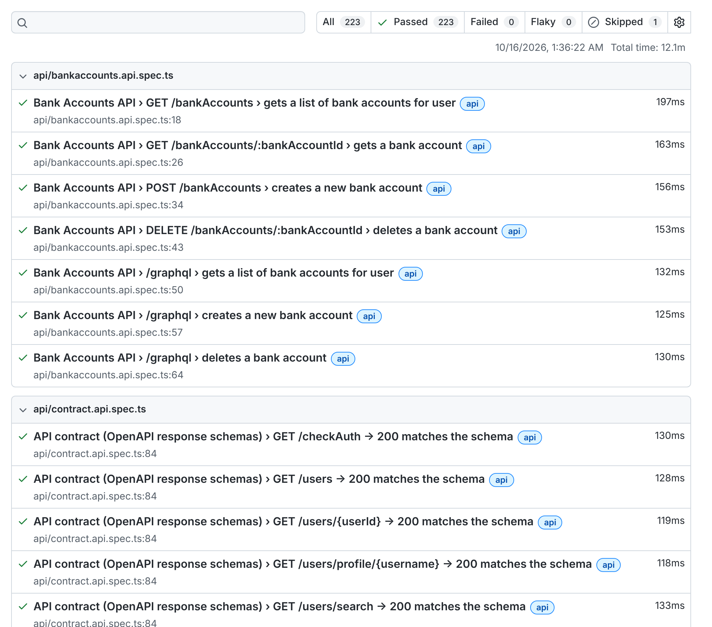
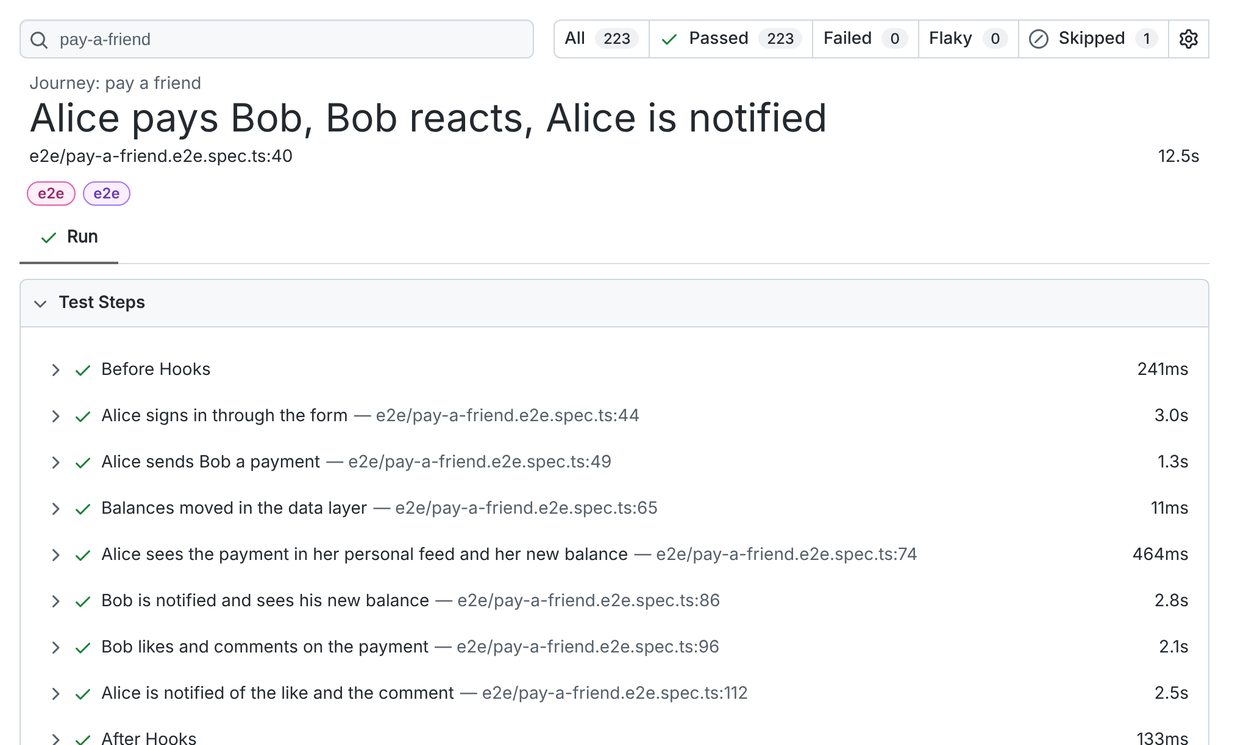
Automation
AUTOMATION SUITE · REPORTING
223 green ticks, framed and hung in the hallway
localhost:9323 · HTML report
journey · test steps
223
passed
0
failed
0
flaky
TESTS PER PROJECT
1
skipped (by design)
12.1 min
1 worker, shared DB
Our report is so green, the HTML file applied for environmental certification.
32
Notes:
HTML report from the full regression on 16.10.2026: 223 passed, 0 failed, 0 flaky, 1 skipped (expected), 12.1 min with workers: 1. The e2e journey report shows each test.step with timings.

Slide 33
Automation
AUTOMATION SUITE · RESULTS
Run history and the health of the whole rig
TESTS IN THE SUITE — HOW IT GREW
API p95 LATENCY (ms) — PERF SMOKE
environment doctor
$ node tap26/scripts/doctor.mjs
✔ Node.js v22.22.0 ✔ Yarn v1.22.22 ✔ @playwright/test 1.56.0 ✔ Port 3000 UI ✔ Port 3001 API ✔ Port 3100 Swagger UI
✔ API reachable GET /testData/users → 200, 5 users (3 ms) ✔ OpenAPI spec 3.0.3, 25 paths / 35 operations
17 ok · 0 warning(s) · 0 error(s)
/users answers in 7 ms. /transactions/public takes 417 ms — it's busy reading everyone's business.
33
Notes:
How the suite grew during the build (real milestones): API port 55, +18 contract tests, UI 59 per viewport, +16 mocked/a11y per viewport, +1 e2e → 223 + 1 skip. Perf smoke (40 req/endpoint, c=5, as Heath93) and doctor output are real.

Slide 34
Cypress vs Playwright
Two great tools, one honest comparison (with a clear favourite)
04
Two frameworks walk into a browser. Only one of them can open a second tab.
IN THIS CHAPTER
At a glance
Architecture
Pros & cons
Features
Adoption
Code side by side
Migration
34
Notes:
Chapter 4: facts validated on 16.10.2026 from official docs, npm and GitHub. Cypress is a great tool — the RWA itself was built by Cypress — but Playwright fits our goals better.

Slide 35


Cy vs PW
CYPRESS VS PLAYWRIGHT · AT A GLANCE
Same goal, different engines
Playwright
Cypress
Made by
Microsoft · Apache-2.0
Made by
Cypress.io · MIT
Latest
1.64.1 (we use 1.56.0)
Latest
16.2.0 (13 Oct 2026)
VS
Runs
in Node, drives browsers remotely
Runs
inside the browser, same run loop
Browsers
Chromium · Firefox · WebKit
Browsers
Chrome family · Edge · Firefox · WebKit (exp.)
Languages
TS/JS · Python · Java · .NET
Languages
JavaScript / TypeScript only
Parallel
built in & free · sharding
Parallel
via Cypress Cloud (--record)
Cypress lives inside your browser. Playwright just remotes in — very work-from-home.
35
Notes:
Versions from the npm registry on 16.10.2026: @playwright/test 1.64.1 (our framework pins 1.56.0), cypress 16.2.0 (13 Oct 2026). Licences: Playwright Apache-2.0, Cypress MIT. Sources: playwright.dev/docs/intro, docs.cypress.io trade-offs and launching-browsers pages.

Slide 36
Cy vs PW
CYPRESS VS PLAYWRIGHT · ARCHITECTURE
Inside the browser vs. remote control
Cypress
Playwright
BROWSER (one at a time)
Node server
screenshots
files
cy.task
Node test
runner
fixtures
workers
shards
Chromium
Your app
(iframe)
Your test
code
context 1 · tabs
context 2 · tabs
Firefox
context 1 · tabs
context 2 · tabs
● same run loop → direct access to window
● command queue + automatic retries
● one superdomain per test (cy.origin)
WebKit
context 1 · tabs
context 2 · tabs
Great developer UX and time-travel snapshots — but one browser, one tab.
Isolated contexts per test, many tabs and origins — Alice and Bob in one test.
Cypress moved into the browser's house. Playwright just has the keys to three of them.
36
Notes:
Cypress: 'Cypress tests run inside of the browser' — direct access to app objects, Node server for privileged tasks; one browser, one superdomain per test (cy.origin for more). Playwright: test code in Node, talks to browsers over a protocol; each test gets a fresh browser context (like a new profile); many pages/contexts per test.

Slide 37


Cy vs PW
CYPRESS VS PLAYWRIGHT · PROS & CONS
Honest scorecard — with a clear winner for us
Playwright · pros
Playwright · cons
● Chromium, Firefox and WebKit — stable, not experimental
● Multi-tab, multi-origin, multi-context in one test
● Parallelism & sharding built in and free
● TS/JS, Python, Java, .NET — skills travel
● Trace Viewer + UI Mode for debugging
● First-class API testing, fixtures, agents (MCP, Healer)
● Patched Firefox/WebKit, not branded Safari
● Forget an await → classic bug
● More concepts up front (fixtures, projects)
Cypress · pros
Cypress · cons
● Friendly runner, time-travel command log
● Direct access to app objects
● Mature component testing
● It built the RWA we test today
● 1 browser · 1 superdomain · JS only
● Parallel needs Cloud (free: 500 results/mo)
Every framework has pros and cons. Playwright's cons list finished early and went parallel.
37
Notes:
Pros/cons from official docs (validated 16.10.2026). Playwright cons are real: patched Firefox/WebKit builds, async/await discipline, more concepts up front. Cypress is excellent for beginners' first steps; Playwright scales better for our goals (multi-user, cross-browser, free parallelism, agents).

Slide 38


Cy vs PW
CYPRESS VS PLAYWRIGHT · FEATURES
Feature matrix: ticks testers actually like
Capability
Playwright
Cypress
green yes · orange partial · red no
Chromium / Chrome
12/12
Firefox
WebKit (Safari engine)
Multiple tabs in a test
Playwright
Multiple origins in a test
Several users / contexts at once
Free parallel runs & sharding
4/12
Languages beyond JS/TS
API testing without a browser
Time-travel debugging
Cypress (+6 partial)
Component testing
Built-in AI test agents / MCP
Checkmarks: the only kind of ticks a tester is happy to find on a Friday afternoon.
38
Notes:
✔ = supported out of the box, ◐ = partial / plugin / paid / experimental, ✘ = not supported. Sources: playwright.dev (intro, browsers, pages, test-parallel, languages, test-agents) and docs.cypress.io (trade-offs, launching-browsers, origin, parallelization, pricing).

Slide 39
Cy vs PW
CYPRESS VS PLAYWRIGHT · ADOPTION
The numbers (dated, sourced, and a bit lopsided)
NPM WEEKLY DOWNLOADS (MILLIONS)
GITHUB STARS (THOUSANDS)
STATE OF JS 2024 · USED AT WORK
≈ 13 : 1
downloads — counts CI installs, not people
≈ 1.9 ×
more GitHub stars
≈ tie
at work in 2024 — the race is close
Playwright 3,674 vs Cypress 3,603 at work — the closest race since tabs vs spaces.
39
Notes:
npm weekly downloads 6–12 Oct 2026 (api.npmjs.org): @playwright/test 76,227,910 vs cypress 5,949,802 (≈13:1; downloads count CI installs, not people). GitHub stars 16.10.2026: microsoft/playwright 96.9k, cypress-io/cypress 51.0k. State of JS 2024 'used at work' counts: Playwright 3,674 vs Cypress 3,603 (of 11,667 answering).

Slide 40
Cy vs PW
APPROACH · EXAMPLE 1
Programmatic login: custom command vs. plain function
Cypress · custom command
Playwright · plain function
// cypress/support/commands.ts
Cypress.Commands.add("loginByXstate", (username, password) => {
cy.intercept("POST", "/login").as("loginUser");
cy.visit("/signin");
cy.window().then((win) =>
win.authService.send("LOGIN", { username, password }));
cy.wait("@loginUser");
return cy.getBySel("list-skeleton").should("not.exist");
});
// in a spec
cy.loginByXstate(ctx.user.username);
// playwright/src/ui/auth.ts
export const loginByXstate = async (page: Page, username: string,
password = env.defaultPassword) => {
await page.goto("/signin");
await waitForService(page, "authService");
const login = waitForApi(page, { method: "POST", path: "/login" });
await sendToService(page, "authService", "LOGIN", { username, password });
expect((await login).status(), `login as ${username}`).toBe(200);
await waitForListLoaded(page);
};
// in a spec
await loginByXstate(page, me.username);
global chain command · implicit queue
typed import · explicit await · asserts status
Same login, two dialects: Cypress chains, Playwright awaits. Patience is a virtue — and a keyword.
40
Notes:
Both use the app's XState auth service; Cypress registers a global command on the cy chain, Playwright exports a typed function you import. Functions are discoverable, typed and composable; no global namespace augmentation.

Slide 41
Cy vs PW
APPROACH · EXAMPLE 2
Waiting for the network
cypress/tests/ui/new-transaction.spec.ts
playwright/tests/e2e/pay-a-friend.e2e.spec.ts
beforeEach(() => {
cy.intercept("POST", "/transactions").as("createTransaction");
});
cy.getBySelLike("submit-payment").click();
cy.wait("@createTransaction")
.its("response.statusCode").should("eq", 200);
const created = waitForApi(page,
{ method: "POST", path: "/transactions" }); // 1. listen
await bySelLike(page, "submit-payment").click(); // 2. act
const response = await created; // 3. await
expect(response.status()).toBe(200);
1
Listen first
2
Act
3
Await & assert
start the wait before the click — otherwise you may miss a fast response
click, type, navigate
a real Promise → Promise.all, status, JSON body
cy.wait('@alias') and await response: both wait. Only one of them knows it's a Promise.
41
Notes:
Cypress: register intercept with alias up front, then cy.wait('@alias'). Playwright: create the waiting promise before the action, then await it (lesson L-004). Same idea, but it's a real Promise you can pass around, combine with Promise.all and assert on.

Slide 42

Cy vs PW
APPROACH · EXAMPLE 3
Two users, one test — Playwright's party trick
two contexts in one test (homework #6 sketch)
Playwright
test("Bob sees Alice's payment live", async ({ browser, users: [alice, bob] }) => {
const aliceCtx = await browser.newContext(); // isolated cookies
const bobCtx = await browser.newContext();
const [a, b] = await Promise.all([aliceCtx.newPage(), bobCtx.newPage()]);
await Promise.all([
loginByXstate(a, alice.username),
loginByXstate(b, bob.username),
]);
await payFriend(a, bob.firstName, 42); // Alice pays…
await b.reload();
await expect(bySelLike(b, "user-balance")) // …Bob sees it
.toContainText("$");
});
2 contexts, 2 sessions, in parallel, one test
Cypress
1 browser = 1 session → logout, login as Bob, continue
Real use: chat apps, payments, admin + customer, approval flows — anything where two people interact.
Two users, two contexts, one test. In Cypress, Bob would have to wait for his own spec.
42
Notes:
Playwright can open two isolated browser contexts in one test (Alice and Bob logged in at the same time). In Cypress you switch users sequentially (logout/login) because one browser = one session. Our e2e journey uses switchUser for parity with Cypress; the two-context version is homework #6.

Slide 43


Cy vs PW
APPROACH · EXAMPLE 4
Test data and setup: tasks & hooks vs fixtures
Cypress · hooks + tasks + shared ctx
Playwright · fixtures
beforeEach(function () {
cy.task("db:seed");
cy.database("filter", "users").then((users: User[]) => {
ctx.user = users[0];
ctx.contact = users[2];
return cy.loginByXstate(ctx.user.username);
});
});
export const test = base.extend<Fixtures>({
seed: [async ({ api }, use) => {
await seedDatabase(api); // before
await use(); // the test runs here
}, { auto: true }],
db: async ({ api, seed }, use) => use(dbFor(api)),
});
// spec: async ({ page, db, users: [alice, bob] }) => …
Lazy
Typed
Self-cleaning
Composable
built only if the test asks for it
users: User[] autocompletes
teardown after use()
db depends on seed + api
Fixtures are like a good butler: the table is set before you arrive and cleared after you leave.
43
Notes:
Cypress seeds with cy.task('db:seed') in beforeEach and reads the DB with cy.database (also a task). Playwright fixtures do setup/teardown around `use`, are lazy (only built when requested), and typed.

Slide 44
Cy vs PW
CYPRESS → PLAYWRIGHT · MIGRATION MAP
102 Cypress tests in, 224 Playwright runs out
cy.intercept(…).as() + cy.wait()
waitForApi(page, matcher)
TESTS: BEFORE → AFTER
cy.task("db:seed")
seed fixture (auto)
cy.database("find", …)
db.find / db.filter
cy.getBySel / getBySelLike
bySel / bySelLike
cy.loginByXstate (command)
loginByXstate(page, user)
21 → 16
×4
reactComponent().invoke(onChange)
setAmountRange — real keyboard
cy.visualSnapshot (Percy)
toHaveScreenshot — gap G-16
spec files
projects
We migrated 102 Cypress tests and ended up with 224 runs. Playwright tests multiply like rabbits — in parallel.
44
Notes:
scan-app.mjs: Cypress e2e 21 specs / 102 tests (+5 component specs / 10 tests). Playwright 16 specs / 104 static tests → 224 runs across 4 projects (desktop + mobile double the UI tests). The react-fiber hack for the amount slider was replaced by real keyboard input.

Slide 45
TAP26-Junior agents
An agent cohort that develops, tests, documents and explains the RWA — from VS Code
05
Meet the team: 24 agents, 31 skills, zero coffee breaks — and nobody steals your lunch from the fridge.
IN THIS CHAPTER
Architecture
Roster
Skills
Memory
Guardrails
Why agents
Agents per role
45
Notes:
Chapter 5: the agentic framework we built for you. Generic architecture first, then why agents, then what each role gets out of it.

Slide 46


TAP26 agents
AGENTIC FRAMEWORK · GENERIC
How TAP26-Junior is put together
You · VS Code + Claude Code
type a request or a /tap-* skill
24
31
Orchestrator
classify → answer or delegate → enforce quality gates
agents
skills
24 specialist agents
dev · test · analysis · docs · ops — each with its own tools & rules
5
5
31 skills
repeatable workflows: /tap-change-api, /tap-new-test, /tap-bug…
hooks
rule files
Hooks & rules
guardrails, change ledger, journal — deterministic, not optional
146
15
Memory & knowledge
facts · decisions · learnings · known issues · inventories
markdown files
guided labs
It's not a one-agent show — it's an ensemble cast with a very strict director and a fully documented script.
46
Notes:
You talk to Claude Code in VS Code. CLAUDE.md makes the main chat the orchestrator; it answers simple questions and delegates real work to 24 specialist subagents (.claude/agents). Skills (/tap-*) are repeatable workflows; hooks enforce guardrails deterministically; shared memory and knowledge make every session start informed.

Slide 47


TAP26 agents
AGENTIC FRAMEWORK · ROSTER
24 agents, six families
Lead & learning
5
Development
5
Test automation
4
tap-orchestrator
qa-lead
be-dev
fe-dev
api-automation
ui-automation
tutor
knowledge-curator
env-ops
debugger
e2e-architect
test-impact-analyst
researcher
code-reviewer
Specialist testing
4
Data & contracts
3
Analysis, UX & docs
3
manual-tester
a11y-auditor
data-tester
mock-smith
business-analyst
ux-designer
perf-tester
security-tester
contract-guardian
doc-writer
24 agents and not one has asked for a raise. HR is deeply suspicious.
47
Notes:
Each agent is a markdown file with frontmatter (name, description, tools, model) and a body of instructions. Only orchestrator, qa-lead and e2e-architect may delegate further (depth ≤ 3, decision D-003). tutor and code-reviewer are read-only by hook.

Slide 48


TAP26 agents
AGENTIC FRAMEWORK · SKILLS
31 slash commands, one per job to be done
Start & environment
6
Test
10
Analyse & fix
4
/tap-start
/tap-setup
/tap-new-test
/tap-e2e
/tap-debug
/tap-bug
/tap-run
/tap-doctor
/tap-run-tests
/tap-test-plan
/tap-review
/tap-research
/tap-status
/tap-scan
/tap-test-cases
/tap-a11y
Learn & document
5
Change the app
4
/tap-perf
/tap-security
/tap-ask
/tap-explain
/tap-change-api
/tap-change-ui
/tap-lab
/tap-docs
/tap-mocks
/tap-data
/tap-feature
/tap-sync-tests
/tap-swagger
Evolve
2
.claude/skills/tap-change-api/SKILL.md (frontmatter) · type /tap- in Claude Code
name: tap-change-api
description: "Implement a change to the RWA API end-to-end: backend code, validators,
OpenAPI + drift check, API tests green twice, docs + memory updated…"
/tap-retro
/tap-evolve
Slash commands: the only place where slashing things counts as productivity.
48
Notes:
Skills live in .claude/skills/<name>/SKILL.md and are invoked as /name. They encode the steps, the agents to use and the quality gates. Full list: tap26/docs/04-skills.md.

Slide 49


TAP26 agents
AGENTIC FRAMEWORK · MEMORY & SELF-LEARNING
Agents that remember — and get better
Work
25
project facts
agents change code & tests
Evolve
Capture
7
decisions (D-001…D-007)
/tap-evolve proposes changes
hooks log journal + change ledger
shared
memory
11
learnings (L-001…L-011)
37
known issues catalogued
Retro
Record
/tap-retro distills what happened
memory.mjs add-fact / learning / decision
memory.mjs (real output)
Digest
$ node tap26/scripts/memory.mjs add-learning "Wait before you click" --lesson "…"
L-012 added to learnings.md
$ node tap26/scripts/memory.mjs search "pkill"
learnings.md:33: ## L-005 `pkill -f <pattern>` can kill the shell that runs it
MEMORY.md → imported by CLAUDE.md
Our agents learn from their mistakes. That already puts them ahead of most printers.
49
Notes:
Shared memory in tap26/memory: facts (25), decisions D-001…D-007, learnings L-001…L-011, change ledger, open questions, glossary, journal. MEMORY.md is a generated digest imported by CLAUDE.md, so every new session starts with it. /tap-retro distills lessons; /tap-evolve proposes improvements to the framework itself.

Slide 50
TAP26 agents
AGENTIC FRAMEWORK · GUARDRAILS
Hooks that say “no” so you don't have to
SessionStart
session-start.mjs
real guardrail output (Claude Code CLI)
health check + memory digest
$ git push --force origin main
PreToolUse:Bash hook error: TAP26 guardrail:
Force-pushing rewrites shared history. Push normally or open a PR.
$ git stash drop
TAP26 guardrail: Dropping or clearing stashes permanently loses the stashed work.
PreToolUse · Bash
guard-bash.mjs
18 risky patterns: 9 deny · 9 ask
PreToolUse · Edit
guard-edit.mjs
seed, .env, lockfiles, CLAUDE.md, agents
PostToolUse · Edit
change-ledger.mjs
.claude/settings.json (excerpt)
logs every app file an agent changes
"PreToolUse": [{ "matcher": "Bash",
"hooks": [{ "type": "command", "command": "node",
"args": ["${CLAUDE_PROJECT_DIR}/.claude/hooks/guard-bash.mjs"] }] }]
Prompt / SubagentStop
journal.mjs
session journal for /tap-retro
Also enforced: quality gates — API change ⇒ OpenAPI + drift clean + tests green · new tests green twice · independent code-reviewer pass · never weaken an assert silently.
Guardrails: because git push --force should require more than enthusiasm and a deadline.
50
Notes:
Hooks are deterministic scripts Claude Code runs at lifecycle points. guard-bash has 18 patterns (9 deny, 9 ask): force-push, rm -rf of roots, stash drop, branch -D… guard-edit asks before touching the seed, .env, lockfiles, CLAUDE.md and TAP26's own definitions; tutor and code-reviewer are read-only. Outputs below are real, captured from the Claude Code CLI.

Slide 51



TAP26 agents
WHY WORK WITH AGENTS
AI is an amplifier — tests decide what it amplifies
90%
>80%
30%
−7.2%
use AI at work
say it boosts productivity
little or no trust in AI code
delivery stability as AI use grew
DORA 2025
DORA 2025
DORA 2025
DORA 2024
METR 2025 RANDOMISED TRIAL · EXPERIENCED OPEN-SOURCE DEVS
Speed on the boring parts
scaffolding, inventories, docs, test boilerplate
Breadth you'd never do by hand
135 contract checks, 37 issues catalogued
But: verify everything
“If you can't verify it, don't ship it.”
And: you stay the engineer
agents amplify skill — they don't replace it
Plug good tests into the amplifier and you get a concert. Plug in chaos and you get feedback — the screechy kind.
51
Notes:
DORA 2025 (≈5,000 respondents): 90% use AI at work, >80% report productivity gains, 30% have little or no trust in AI code; AI 'amplifies an organization's existing strengths and weaknesses'. DORA 2024: with more AI adoption, estimated throughput −1.5% and stability −7.2%. METR 2025 RCT (16 experienced devs, early-2025 tools): expected +24%, felt +20%, measured 19% slower; the 2026 update hints at speed-ups but calls its own data very weak evidence.

Slide 52



TAP26 agents
AGENTS FOR DEVELOPERS
Change the app without breaking the tests
Your agents
TRY ASKING
YOU GET
/tap-change-api add a 9-digit numeric rule to routingNumber
a minimal diff + updated OpenAPI
be-dev
/tap-change-ui show an error when the feed fails (KI-33)
tests updated and green twice
Express routes, validators, lowdb, GraphQL
/tap-debug the API starts on 3002 instead of 3001
impact report: which tests to re-run
fe-dev
React/MUI/XState, keeps data-test
/tap-review my staged changes
change ledger + hand-off report
debugger
reproduce → isolate → root cause
impact of a change (real impact.mjs output)
Changed files: 2 (backend-route 1, frontend-component 1)
Impacted API routes: 2 · selector changes: 2 · machines: 0
Tests to run/review: 17 (6 Playwright, 11 Cypress)
1. Fix selector references: sidenav-user-balance → sidenav-balance — run /tap-sync-tests
code-reviewer
read-only, independent review
Developers get a pair programmer that never says “works on my machine” — it checks the machine.
52
Notes:
be-dev, fe-dev, debugger and code-reviewer. Pipelines in .claude/agents/tap-orchestrator.md enforce: code + spec + tests + docs move together.

Slide 53


TAP26 agents
AGENTS FOR TESTERS
From charter to green pipeline
Your agents
TRY ASKING
YOU GET
/tap-new-test api: rejecting a request must not move money
specs that follow the framework rules
api-automation · ui-automation
/tap-test-cases new transaction — boundary values
test plans and manual test cases
functional Playwright specs
/tap-e2e sign up → onboarding → first payment
BUG-### reports with repro steps
e2e-architect
cross-layer journeys (D-006)
/tap-security IDOR matrix user A vs user B
a11y / perf / security reports
manual-tester
charters, test cases, Gherkin
real test run
✓ [ui-desktop] › auth.spec.ts › should redirect to the home page after login (3.4s)
✓ [ui-mobile] › a11y.spec.ts › notifications has no new critical axe violations (5.1s)
223 passed · 1 skipped (12.1m)
a11y · perf · security
axe, p95 smoke, OWASP lens
Testers get eight new colleagues. None of them argue about whether it's a bug or a feature.
53
Notes:
Test agents write specs in the functional style, start waits before actions, assert correct behaviour (test.fail for known issues), and run new tests twice (flake gate).

Slide 54

TAP26 agents
AGENTS FOR BUSINESS ANALYSTS
Stories, rules and flows — grounded in the real app
Your agents
TRY ASKING
YOU GET
/tap-ask ba what are the privacy rules for the Friends feed?
user stories with Gherkin acceptance criteria
business-analyst
/tap-feature add a note field to bank accounts
Mermaid process flows
INVEST stories, Gherkin ACs, glossary
/tap-ask ux review the empty states on the home feed
traceability: story → tests → code
ux-designer
heuristics review, flows, microcopy
/tap-test-plan for the request-money flow
open questions logged for the team
qa-lead
risk-based plans, traceability
Gherkin draft (business-analyst)
Scenario: private payments stay private
Given Alice paid Bob privately
When Ruthie opens the "Friends" feed
Then she does not see Alice's private payment # today: visible → KI-29
researcher
deep analysis with citations
BAs finally get a colleague who reads the whole spec. Twice. Before the meeting.
54
Notes:
BA output feeds testers directly: Gherkin acceptance criteria become test cases and Playwright specs. Example: KI-29 privacy not enforced — the BA writes the rule, testers assert it.

Slide 55

TAP26 agents
AGENTS FOR DATA ENGINEERS
Seed, inspect, fake — and never touch real data
Your agents
TRY ASKING
YOU GET
/tap-data integrity: every transaction has a valid sender
referential-integrity reports
data-tester
/tap-mocks scenario: 500 on /transactions/public
deterministic factories & stubs
schema, integrity checks, queries
/tap-data how many private txns does Heath93 have?
reset/seed recipes that never leak
mock-smith
factories, stubs, mock scenarios
/tap-swagger regenerate and diff the schemas
schema drift caught early
contract-guardian
OpenAPI schemas = data contract
real mock API checks (:3101)
$ curl -s -H "x-mock-scenario: empty-notifications" localhost:3101/notifications
{ "results": [] }
$ curl -s -o /dev/null -w "%{http_code} %{time_total}s" "localhost:3101/transactions/public?__scenario=slow"
200 2.003631s
perf-tester
latency by data volume
Data engineers love our seed: 600 transactions, 5 users, 0 GDPR incidents.
55
Notes:
Seed: 5 users, 15 contacts, 5 bank accounts, 600 transactions, 10 likes, 10 comments, 40 notifications, 50 bank transfers. Mock API stateful mode was byte-compared with the real API (22/22 identical).

Slide 56



TAP26 agents
AGENTS FOR TECHNICAL WRITERS
Docs that keep up with the code
Your agents
TRY ASKING
YOU GET
/tap-docs summarise this week's changes for release notes
15 docs pages, 15 labs, glossary
doc-writer
/tap-swagger document the new routingNumber rule
Swagger UI that really executes
Diátaxis: tutorial · how-to · ref · explanation
/tap-explain fixtures for a beginner
release notes from the change ledger
contract-guardian
OpenAPI + live Swagger UI
/tap-docs how-to: run only the e2e project
same topic, three levels
knowledge-curator
keeps memory & knowledge fresh
docs index (tap26/docs)
00-index · 01-getting-started-vscode · 02-architecture · 03-agents · 04-skills · 05-memory-and-self-learning
06-workflows · 07-testing-framework · 08-api-contract-and-swagger · 09-mocks-and-stubs · 10-hooks-and-guardrails
11-evolving-tap26 · 12-prompting-guide · 13-troubleshooting · 14-faq · glossary · release-notes
tutor
explains at the student's level
If it isn't documented, it didn't happen. If it's documented wrong, it happened to someone else.
56
Notes:
TAP26 docs follow Diátaxis (diataxis.fr). The change ledger (memory/changes.md) is the source for release notes; spec-drift keeps API docs honest.

Slide 57
Agents at work
A production cycle with agents in every seat — and humans at every gate
06
From idea to incident review, the agents clock in at every stage. Unpaid, but extremely well documented.
IN THIS CHAPTER
Production flow
Benefits
Inquiries
Change tests
Change the app
Document
Gaps
Feature docs
Bugs
Innovation
57
Notes:
Chapter 6: a delivery lifecycle (plan → learn) mapped to TAP26 agents, then the concrete how-tos: inquiries, changing the framework and the app, documenting, gaps, feature docs, bugs and innovation.

Slide 58


Agents at work
PRODUCTION CYCLE WITH AGENTS
Plan to learn: who does what, and who checks
Plan
Require
Design
Build
Test
Review
Release
Operate
Learn
qa-lead
researcher
business-analyst
ux-designer
contract-guardian
e2e-architect
be-dev · fe-dev
env-ops
api/ui-automation
a11y · perf · security
code-reviewer
test-impact-analyst
env-ops
doc-writer
perf-tester
debugger
knowledge-curator
/tap-retro
human gate
human gate
human gate
feedback: metrics, postmortems, every incident becomes a regression test
DORA DELIVERY METRICS
Deployment frequency
Change lead time
Recovery time
Change fail rate
Rework rate
throughput
throughput
throughput
instability
instability
Agents in every seat, humans at every gate — like a self-driving car that still needs you to choose the destination.
58
Notes:
Reference lifecycle from the research pack (DORA, Google SRE postmortems, shift-left). Under each stage: the TAP26 agents that act there. Humans own every gate: approve the plan, review the diff, decide the release. DORA's five delivery metrics close the loop.

Slide 59

Agents at work
PRODUCTION CYCLE · BENEFITS
What it bought us on this very project
223
135
37
tests green, 0 flaky
live checks of the API spec
defects catalogued with repros
full regression, 12.1 min
35/35 operations in sync
KI-01…33 + A11Y-01…04
9
1 + 8
17
builders in parallel
blocker + major review findings
impacted tests found in seconds
framework built in one session
fixed before you ever saw them
from a 2-file change (impact.mjs)
Benefits include faster feedback, fewer surprises, and a framework that documents itself while you sleep.
59
Notes:
All numbers come from building this session's framework with TAP26-style agents: 9 parallel builders, an independent reviewer (1 blocker + 8 major findings, all fixed before delivery), 135 live checks of the OpenAPI spec, impact analysis in one command.

Slide 60

Agents at work
THE INQUIRING PROCESS
Ask a role, get an answer with evidence
You ask
Orchestrator routes
Agent investigates
Answer + evidence
How to test it
Learning saved
/tap-ask be …
role → agent
code · memory · knowledge
file:line, real calls
ready for /tap-new-test
memory.mjs
ROLES:
ux
be
fe
ba
manual
data
api
ui
/tap-ask be · answer (abridged)
$ /tap-ask be "Does POST /bankAccounts validate the account number?"
be-dev: Only as a string. backend/validators.ts → isBankAccountValidator checks bankName, accountNumber and
routingNumber with .isString().trim() — no length or digit rules.
Verified: POST /bankAccounts { accountNumber: "123", routingNumber: "123" } → 200 { account: … }
Suggested rule: body("routingNumber").isLength({ min: 9, max: 9 }).isNumeric()
How to test this: API test posting "123" → expect 422 with one validation message (test.fail today)
There are no stupid questions — only questions without a reproducible example.
60
Notes:
/tap-ask <role> <question>: the orchestrator routes to that role's agent, which reads code, memory and knowledge before answering, cites files, and ends with 'how to test this'. The be answer below was verified live: POST /bankAccounts with accountNumber '123' returns 200.

Slide 61
Agents at work
AGENTS · CHANGE THE PLAYWRIGHT FRAMEWORK
From “the app changed” to “the suite is green again”
1
/tap-scan
2
impact.mjs
3
/tap-sync-tests
4
/tap-new-test
5
run ×2
6
/tap-review
refresh inventories
diff → impacted tests
fix selectors & routes
cover the new behaviour
flake gate
independent reviewer
node tap26/scripts/impact.mjs (real output, abridged)
2
files changed
# Test impact report — working tree vs HEAD
- Changed files: 2 (backend-route 1, frontend-component 1)
- Impacted API routes: 2 · selector changes: 2 · machines: 0
- Tests to run/review: 17 (6 Playwright, 11 Cypress)
| renamed → sidenav-balance | sidenav-user-balance | …pay-a-friend.e2e.spec.ts …
| removed | GET /users/search | users.api.spec.ts, contract.api.spec.ts …
1. Fix selector references → run /tap-sync-tests (ui-automation)
2. Contract: update openapi.yaml, spec-drift must be clean
3. Add API tests for GET /users/find (api-automation)
17
tests flagged
7
recommended actions
Rename one selector and 17 tests panic. Our agents are the calm friend who says “I've made a list.”
61
Notes:
Real impact.mjs report from a synthetic change in a clone: sidenav-user-balance renamed to sidenav-balance and /users/search moved to /users/find. It found 17 tests to run or review and 7 recommended actions. /tap-sync-tests then fixes references and re-runs the impacted specs twice.

Slide 62

Agents at work
AGENTS · CHANGE THE APPLICATION
API, UI and infra — three lanes, same discipline
API
be-dev edits route + validator
contract-guardian updates OpenAPI
spec-drift → IN SYNC
api-automation: tests ×2 green
/tap-change-api
UI
ux-designer sketches the change
fe-dev edits React / XState
data-test contract kept
ui-desktop + ui-mobile green
/tap-change-ui
Infra
ports, scripts, .nvmrc, tasks
doctor.mjs health gate
VS Code tasks & launch configs
CI pipeline proposals
env-ops
Every edit to app code lands in the change ledger automatically (PostToolUse hook) → tap26/memory/changes.md → impact analysis, release notes and the next session's digest.
Change is the only constant. Well — that and s3cret.
62
Notes:
Each lane is a skill with built-in gates. API: code → validator → OpenAPI → spec-drift → API tests ×2. UI: optional UX spec → React/XState → keep data-test → UI tests (desktop + mobile). Infra: env-ops for ports, scripts, VS Code tasks, CI ideas. Every app edit is written to the change ledger by a hook.

Slide 63

Agents at work
AGENTS · DOCUMENT THE CHANGES
One change, five places that must agree
git commit (Conventional Commits 1.0.0)
feat(api): validate routingNumber as 9 digits
- isBankAccountValidator: isLength(9).isNumeric()
- OpenAPI: pattern ^[0-9]{9}$ on BankAccount.routingNumber
- tests: POST /bankAccounts "123" → 422
Refs: tap-ask be answer · BUG-001
OpenAPI + Swagger
the
change
docs page (Diátaxis)
contract-guardian
doc-writer
tap26/docs/release-notes.md (example entry)
release notes
## 2026-10-16 · API
### Changed
- POST /bankAccounts now rejects routing numbers that are
not 9 digits (422). Swagger updated, spec-drift clean.
### Tests
- +2 API tests (bankaccounts.api.spec.ts), green ×2
from the change ledger
commit message
memory & knowledge
Conventional Commits
knowledge-curator
If code and docs disagree, believe the tests. Then fix the docs. Then have a little lie down.
63
Notes:
Docs are part of done (quality gate). The doc-writer reads the change ledger and the diff, updates the right Diátaxis page, release notes and glossary; contract-guardian owns the OpenAPI; knowledge-curator refreshes memory and generated inventories.

Slide 64
Agents at work
AGENTS · IDENTIFY GAPS
The gap registry: what nobody tests (yet)
ID
Gap
Why it matters
Suggested test
Owner
22
G-01
Rejecting a request moves money (KI-05)
money correctness
reject → both balances unchanged
api-automation
coverage gaps G-01…G-22
G-03
Privacy not enforced in Friends feed
privacy
every Friends item is non-private
business-analyst
33
G-04
IDOR: PATCH another user, read their data
security
user A vs user B matrix
security-tester
known defects KI-01…KI-33
G-11
“Transaction Submitted!” even when POST fails
UX errors
stub 500 → expect an error
ui-automation
4
G-14
414–599 px viewports untested
responsive
add a ui-tablet project
e2e-architect
accessibility A11Y-01…04
G-16
No visual regression since Percy
visual
toHaveScreenshot() baselines
ui-automation
2
Find gaps with: /tap-test-plan (risk-based) · /tap-scan (unreferenced routes & selectors) · /tap-security · /tap-a11y · /tap-research — every gap gets evidence, risk, a suggested test and an owner.
test smells TS-01…02
Mind the gap. Then log it, rate it, assign it — and close it before it closes on you.
64
Notes:
Two registries: known issues (tap26/knowledge/known-issues.md — defects in the app: KI, A11Y, TS) and coverage gaps (tap26/knowledge/test-map.md — G-01…G-22: things no test checks). Each gap has evidence, risk and a suggested test, so it can go straight to /tap-new-test. qa-lead and test-impact-analyst maintain them.

Slide 65

Agents at work
AGENTS · FEATURE DOCUMENTATION
A feature doc outline that writes itself (almost)
FEATURE DOC OUTLINE · /tap-feature
1 Summary — what & why (1 paragraph)
Tutorial
How-to
2 User story + Gherkin acceptance criteria
learning-oriented
task-oriented
3 Flows — Mermaid diagram + screens
“Send your first payment”
“Add a bank account via API”
4 API — endpoints, schemas, errors (OpenAPI link)
5 UI — routes, states, data-test selectors
6 Data — entities, seed, migration notes
Reference
Explanation
7 Test coverage — specs, gaps, known issues
information-oriented
understanding-oriented
8 Non-functional — a11y, perf, security notes
OpenAPI · data-test map · errors
why money is stored in cents
9 Rollout & release notes · open questions
Documentation: the love letter you write to your future self — who will absolutely not remember any of this.
65
Notes:
/tap-feature produces a feature slice: BA story with Gherkin, UX notes, API + UI change, tests and docs. The doc follows Diátaxis: tutorial (learn), how-to (do), reference (look up), explanation (understand). Outline below is what /tap-feature assembles (user-story.md template + docs).

Slide 66
Agents at work
AGENTS · BUG REPORTS
A bug report that reproduces on the first try
KI-01
High
data integrity
live repro · 16.10.2026
$ curl -X POST :3001/testData/seed → seed 200
$ curl -c jar -d '{"username":"Heath93",…}' :3001/login → 200
$ curl -b jar :3001/contacts/Heath93 → before 3
$ curl -b jar -X DELETE :3001/contacts/unknownId1 → 200
$ curl -b jar :3001/contacts/Heath93 → after 0
$ curl :3001/testData/contacts → 0 in DB
DELETE /contacts/{id} with an unknown id deletes every contact
Steps
1. POST /testData/seed · 2. login Heath93 · 3. DELETE /contacts/unknownId1
Expected
404 (or 422) — nothing deleted
Actual
200 — Heath93's contacts 3 → 0, all 15 contacts in the DB gone
Root cause
removeContactById passes undefined to lowdb remove() → matches every row
BUG TEMPLATE (tap26/templates/bug-report.md)
title · severity · area
env + seed state
minimal steps
Next
/tap-new-test: assert 404 under test.fail('KI-01'), then fix
expected vs actual
evidence (curl, trace)
failing test link
A good bug report is like a good joke: short, reproducible, and it lands every single time.
66
Notes:
/tap-bug reproduces on a clean seed, minimises steps, captures evidence (requests, responses, screenshots/trace), rates severity and links a failing test. The KI-01 evidence below was re-run live on 16.10.2026: contacts before 3, after 0; all 15 seeded contacts gone.

Slide 67


Agents at work
AGENTS · EXPLORE INNOVATION
Eight experiments for curious juniors
01
02
03
04
Self-healing tests
Explore via MCP
Tests from the spec
Synthetic data
Playwright Healer agent proposes locator fixes — a human reviews the diff
Playwright MCP lets an agent drive the browser by accessibility tree
Schemathesis property-tests our OpenAPI; triage the 500s
Faker factories for users & payments — no real PII, ever
05
06
07
08
a11y on every page
Visual regression
Mutation testing
Chaos & latency
axe after each navigation; agent groups by WCAG rule
toHaveScreenshot baselines + agent-written diff summary
Stryker mutates code — do our tests notice?
page.route / Toxiproxy: slow, 500, timeout matrix
Innovation is when the Healer agent fixes your locator before you've finished blaming the developer.
67
Notes:
All eight are grounded in real, validated tools (sources in the research pack): Playwright test agents (planner/generator/healer), Playwright MCP (microsoft/playwright-mcp), Schemathesis, Faker + UK ICO synthetic-data guidance, axe-core (~57% of WCAG issues), toHaveScreenshot, Stryker mutation testing, Toxiproxy/page.route chaos.

Slide 68
Hands-on
Ten exercises from an empty laptop to agents changing code — then ten real-world questions
07
Theory is over. Time to get your hands dirty — in a sandbox, with a freshly seeded database.
IN THIS CHAPTER
Exercises 1–5
Exercises 6–10
10 real-world questions
68
Notes:
Chapter 7: exercises map to the TAP26 labs (tap26/labs/lab-01…15). Work in pairs; one drives, one navigates — swap every exercise.

Slide 69
Hands-on
PRACTICAL EXERCISES
From zero to a running app
1
Get the code
copy/clone the folder, open it in VS Code
nvm use → Node 22 · Yarn 1
node -v → v22
lab-01
2
Install everything
CYPRESS_INSTALL_BINARY=0 yarn install
cd playwright && npm ci && npx playwright install chromium
no errors
lab-01
3
Run the app
yarn dev → UI :3000 · API :3001
sign in as Heath93 / s3cret
home feed loads
lab-02
4
Install TAP26
node tap26/install/install.mjs
node tap26/scripts/check-framework.mjs --strict
“all checks passed”
lab-01
5
Health check
node tap26/scripts/doctor.mjs
fix anything red before moving on
17 ok · 0 errors
lab-02
Exercise 3 is the first time you'll log in as Heath93. Try not to spend his $1,509.53 all at once.
69
Notes:
Exercises 1–5: setup. Expected results are on each card; if a check fails, run /tap-doctor or ask the tutor agent (/tap-explain).

Slide 70
Hands-on
PRACTICAL EXERCISES
From running app to agents changing code
6
First API run
cd playwright
npx playwright test --project=api
73 passed
lab-05
7
UI mode
npx playwright test --ui --project=ui-desktop
run auth.spec.ts, scrub the timeline
8 tests green
lab-06
8
Report & trace
npx playwright test --project=e2e --trace on
npx playwright show-report → open the trace
find “Bob likes…”
lab-13
9
Meet the agents
Claude Code in VS Code: /tap-start, /tap-status
/tap-ask ba acceptance criteria for requesting money
Health: PASS
lab-04
10
Change + test
/tap-new-test api: routingNumber "123" → 422
run it twice · mark test.fail + KI · /tap-review
green ×2, reviewed
lab-07
Exercise 10: you ask an agent to write a test, then you review it. Trust, but expect.
70
Notes:
Exercises 6–10: tests, debugging and agents. Running Playwright re-seeds the DB — manual data disappears (by design).

Slide 71
Hands-on
REAL-WORLD QUESTIONS
Questions 1 & 2 — straight from the field
Q1
How common are flaky tests?
Q2
Is a bug really “100× more expensive” in production?
16%
1.5%
84%
100×
171
$59.5B
of Google's tests show some flakiness
of all runs report a flaky result
of pass→fail transitions involved a flaky test
chart traced to notes with no data
projects: no “delayed issue effect” found
per year — NIST 2002 cost of poor testing
Very. Bigger tests flake more (large tests ~14% vs small 0.5%). Our cure: isolated contexts, a seed per test, no hard waits, wait for responses.
Treat “100×” as a myth. Late bugs can still be very expensive — just not by a magic constant. Argue with your own evidence.
Sources: testing.googleblog.com · 2016 & 2017
Sources: The Register 2021 · Menzies et al. arXiv:1609.04886 · NIST 2002
The 100× rule is the urban legend of QA — everyone's cousin's manager saw the chart once.
71
Notes:
Sources validated on 16.10.2026 (research pack). Q1: testing.googleblog.com · 2016 & 2017 | Q2: The Register 2021 · Menzies et al. arXiv:1609.04886 · NIST 2002

Slide 72
Hands-on
REAL-WORLD QUESTIONS
Questions 3 & 4 — straight from the field
Q3
Should I automate everything through the UI?
Q4
Will AI replace testers?
80/15/5
27,000
<6 min
84%
46%
39%
unit / integration / e2e at Google
legacy tests retired by one Microsoft team
for 60,000+ unit tests afterwards
of devs use or plan to use AI tools
distrust the accuracy
of core skills change by 2030 (WEF)
No. Push checks down the pyramid: API and unit tests are faster and steadier. Keep a few journeys (like ours) end-to-end.
The job changes rather than disappears. 66% complain of “almost right” answers — someone has to verify. That someone is you.
Sources: SWE at Google ch.11 · martinfowler.com · learn.microsoft.com
Sources: Stack Overflow Survey 2025 · WEF Future of Jobs 2025
Testing everything through the UI is like checking the fridge temperature by eating everything in it.
72
Notes:
Sources validated on 16.10.2026 (research pack). Q3: SWE at Google ch.11 · martinfowler.com · learn.microsoft.com | Q4: Stack Overflow Survey 2025 · WEF Future of Jobs 2025

Slide 73
Hands-on
REAL-WORLD QUESTIONS
Questions 5 & 6 — straight from the field
Q5
How do the big companies test?
Q6
What happens when testing misses something?
billions
S · M · L
2011
21 vs 20
8.5M
$460M
of test cases run at Google every week
tests sized by what they may touch
Netflix Chaos Monkey kills prod instances
fields — CrowdStrike, 19 Jul 2024
Windows devices crashed
lost in 45 min — Knight Capital 2012
Lots of small fast tests, strict size rules, and deliberately breaking production to prove resilience. Beyoncé Rule: if you liked it, put a test on it.
Validators with wildcards, no staged rollout, dead code left on 1 of 8 servers. Small gaps, huge blast radius — hence our gap registry.
Sources: abseil.io SWE book ch.11 · Netflix Tech Blog · principlesofchaos.org
Sources: CrowdStrike RCA 2024 · Microsoft blog · SEC 34-70694
Chaos engineering: breaking things on purpose so they don't break by accident. A fire drill, with more YAML.
73
Notes:
Sources validated on 16.10.2026 (research pack). Q5: abseil.io SWE book ch.11 · Netflix Tech Blog · principlesofchaos.org | Q6: CrowdStrike RCA 2024 · Microsoft blog · SEC 34-70694

Slide 74
Hands-on
REAL-WORLD QUESTIONS
Questions 7 & 8 — straight from the field
Q7
Can I use production data in tests?
Q8
Why bother testing accessibility?
0
2
ICO
95.9%
56.1
57%
real people in a test environment
kinds of synthetic data: partial & full
synthetic ≠ automatically anonymous
of top 1M home pages fail WCAG checks
errors per page on average
of issues found by axe automatically
Avoid it. Use synthetic data (Faker, our factories) — and remember even synthetic data can leak the original if built carelessly.
Because almost everyone gets it wrong — including our app (A11Y-01…04). Automate the 57%, test the rest with keyboard and screen reader.
Sources: UK ICO — privacy-enhancing technologies: synthetic data · fakerjs.dev
Sources: WebAIM Million 2026 · github.com/dequelabs/axe-core
Testing with production data is like rehearsing a magic trick with the audience's real wallets.
74
Notes:
Sources validated on 16.10.2026 (research pack). Q7: UK ICO — privacy-enhancing technologies: synthetic data · fakerjs.dev | Q8: WebAIM Million 2026 · github.com/dequelabs/axe-core

Slide 75
Hands-on
REAL-WORLD QUESTIONS
Questions 9 & 10 — straight from the field
Q9
How do APIs actually get breached?
Q10
Do AI agents make mistakes? Why review?
#1
9.5M
KI-04
+24%
+20%
−19%
OWASP API risk: Broken Object Level Auth
Optus customers' records (alleged)
our own IDOR — found by tests
speed-up developers expected
speed-up they felt
what was measured (METR 2025)
Change an id, get someone else's data. Test every endpoint as user A against user B's objects — exactly our G-04 matrix.
Yes — and we're bad at noticing. Small study, early-2025 tools, but the lesson holds: if you can't verify it, don't ship it.
Sources: OWASP API Security Top 10 2023 · CSO Online (ACMA allegations)
Sources: metr.org 2025 & 2026 update · code.claude.com best practices
AI won't replace testers. Testers who use AI might replace testers who say “it's probably fine.”
75
Notes:
Sources validated on 16.10.2026 (research pack). Q9: OWASP API Security Top 10 2023 · CSO Online (ACMA allegations) | Q10: metr.org 2025 & 2026 update · code.claude.com best practices

Slide 76
Homework & study kit
Eight tasks due Friday 23.10.2026 — plus validated resources
08
Homework: the only deliverable with a deadline AND a pun quota.
IN THIS CHAPTER
8 homework tasks
Study resources
Q&A
76
Notes:
Chapter 8: homework and the curated study list. Every link was validated on 16.10.2026.

Slide 77

Homework
HOMEWORK · DUE FRIDAY 23.10.2026
Eight tasks, one branch each, all green twice
API
01
Bug
02
UI
03
a11y
04
Reject must not move money
Report KI-01 like a pro
Failed payment shows an error
Audit notifications
G-01 · assert both balances unchanged under test.fail('KI-05')
/tap-bug + failing API test for DELETE /contacts/{unknown}
G-11 · stubApi 500 on POST /transactions · test.fail('KI-31')
/tap-a11y → propose a fix for A11Y-02 link-name
Data
05
Multi-user
06
Responsive
07
Agents
08
Empty bank accounts state
Bob sees Alice's payment live
Add a ui-tablet project
Retro + one evolution
factory + stubApi → assert the empty state in both viewports
two browser contexts in one test (the sketch from chapter 04)
G-14 · 500×800 viewport — what breaks? report it
/tap-retro on your week · /tap-evolve propose one improvement
Due next Friday. Yes, “the agent ate my homework” has been tried — the change ledger knows.
77
Notes:
Deliver each task on a branch lab/hw-NN-<name> with a PR description from tap26/templates/pr-description.md. Quality bar: typecheck clean, new tests green twice, known defects as test.fail with the KI id, an independent /tap-review pass. Add five lines of reflection: where did an agent get it wrong, and how did you catch it?

Slide 78


Homework
STUDY RESOURCES
Playwright, Cypress, TypeScript and testing
Playwright
Cypress
TypeScript · FP · testing
Installation / Intro
Why Cypress?
TypeScript Handbook
playwright.dev/docs/intro
docs.cypress.io/app/get-started/why-cypress
typescriptlang.org/docs/handbook
Best Practices — read first
Best practices
Mostly Adequate Guide to FP
playwright.dev/docs/best-practices
docs.cypress.io/app/core-concepts/best-practices
github.com/MostlyAdequate/mostly-adequate-guide
Fixtures
Trade-offs (its own limits)
The Practical Test Pyramid
playwright.dev/docs/test-fixtures
docs.cypress.io/app/references/trade-offs
martinfowler.com/articles/practical-test-pyramid.html
Trace viewer
playwright.dev/docs/trace-viewer
Network requests
Flaky Tests at Google
API testing
docs.cypress.io/app/guides/network-requests
testing.googleblog.com (2016)
playwright.dev/docs/api-testing
Real World App (our app)
ISTQB CTFL v4.0
Codegen
github.com/cypress-io/cypress-realworld-app
istqb.org/certifications
playwright.dev/docs/codegen
VS Code extension
playwright.dev/docs/getting-started-vscode
Playwright on YouTube
youtube.com/@Playwrightdev
Read the docs before you need them. It's like an umbrella — useless to buy in the middle of the storm.
78
Notes:
All links validated (fetched) on 16.10.2026. Text docs, videos, a free book, a course, a paper and standards. Start with Playwright Best Practices and Building Effective Agents.

Slide 79



Homework
STUDY RESOURCES
API, accessibility, docs, agents and delivery
API · a11y · docs
Agents & Claude Code
Research · delivery · Git
OpenAPI Initiative (OAS 3.2.1)
Building effective agents
SWE-bench (Jimenez et al.)
openapis.org
anthropic.com/engineering/building-effective-agents
arxiv.org/abs/2310.06770
Swagger UI installation
Claude Code overview
Playwright test agents
swagger.io/docs/open-source-tools/swagger-ui
code.claude.com/docs/en/overview
playwright.dev/docs/test-agents
OWASP API Security Top 10 2023
Subagents
MCP introduction
owasp.org/API-Security
code.claude.com/docs/en/sub-agents
modelcontextprotocol.io/docs/getting-started/intro
WCAG 2.2 Quick Reference
Skills
SWE at Google · Testing
w3.org/WAI/WCAG22/quickref
code.claude.com/docs/en/skills
abseil.io/resources/swe-book/html/ch11.html
axe-core (Deque)
Hooks
DORA metrics guide
github.com/dequelabs/axe-core
code.claude.com/docs/en/hooks-guide
dora.dev/guides/dora-metrics
Diátaxis documentation
Claude Code in VS Code
Conventional Commits 1.0.0
diataxis.fr
code.claude.com/docs/en/vs-code
conventionalcommits.org
Claude Code 101 (Academy)
Pro Git (free)
academy.claude.com/courses/claude-code-101
git-scm.com/book/en/v2
Study tip: one paper, one video, one doc per day. Like vitamins, but for your pull requests.
79
Notes:
All links validated (fetched) on 16.10.2026. Text docs, videos, a free book, a course, a paper and standards. Start with Playwright Best Practices and Building Effective Agents.

Slide 80
Thank you!
Questions?
TAP26 Juniors · Scripting Session · 16.10.2026 · Alex Pandi
223 tests passed · 35/35 endpoints in sync · 24 agents · 31 skills · 37 known issues · 1 skipped (on purpose)
No questions? Then expect(audience).toHaveUnderstood() passed on the first try. Suspicious.
80
Notes:
Q&A. Remind students: homework due Friday 23.10.2026; labs in tap26/labs; ask the tutor agent anytime (/tap-explain, /tap-lab hint).

