Slide 1

What Is Organizational Behavior?
Copyright © 2011 Pearson Education, Inc. publishing as Prentice Hall
1-<number>
Notes:
(c) 2008 Prentice-Hall, All rights reserved.

Slide 2
The Importance of Interpersonal Skills
Understanding OB helps determine manager effectiveness
  Technical and quantitative skills are important
  But leadership and communication skills are CRITICAL
Organizational benefits of skilled managers
  Lower turnover of quality employees
  Higher quality applications for recruitment
  Better financial performance
Copyright © 2011 Pearson Education, Inc. publishing as Prentice Hall
1-<number>
Notes:
(c) 2008 Prentice-Hall, All rights reserved.

Slide 3
What Managers Do
They get things done through other people.
Management Activities:
  Make decisions
  Allocate resources
  Direct activities of others to attain goals
Work in an organization
  A consciously coordinated social unit composed of two or more people that functions on a relatively continuous basis to achieve a common goal or set of goals.
Copyright © 2011 Pearson Education, Inc. publishing as Prentice Hall
1-<number>
Notes:
(c) 2008 Prentice-Hall, All rights reserved.

Slide 4
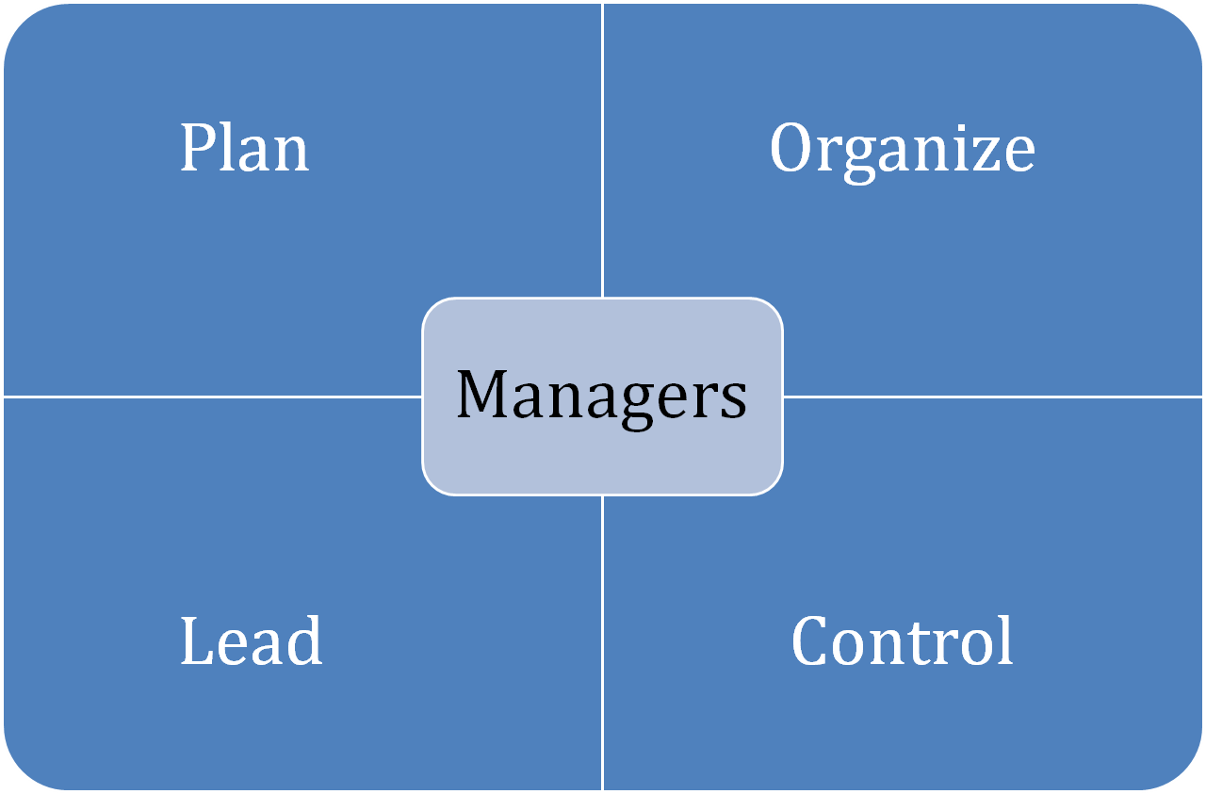
Management Functions
Copyright © 2011 Pearson Education, Inc. publishing as Prentice Hall
1-<number>
Notes:
(c) 2008 Prentice-Hall, All rights reserved.

Slide 5

Mintzberg’s Managerial Roles
Discovered ten managerial roles
Separated into three groups:
  Interpersonal
  Informational
  Decisional
E X H I B I T 1–1
Copyright © 2011 Pearson Education, Inc. publishing as Prentice Hall
1-<number>
Notes:
(c) 2008 Prentice-Hall, All rights reserved.

Slide 6
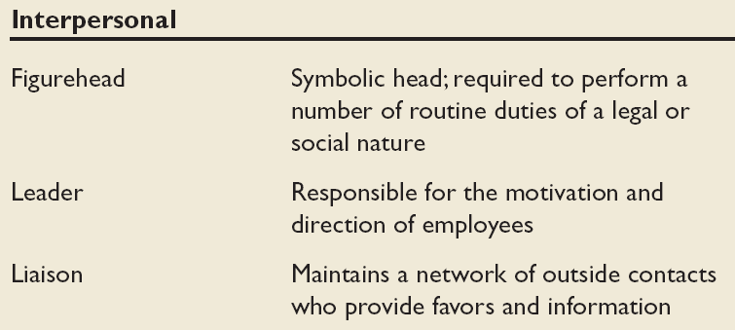
Mintzberg’s Managerial Roles: Interpersonal
Source: Adapted from The Nature of Managerial Work by H. Mintzberg. Copyright © 1973 by H. Mintzberg. Reprinted by permission of Pearson Education.
Copyright © 2011 Pearson Education, Inc. publishing as Prentice Hall
1-<number>
Notes:
(c) 2008 Prentice-Hall, All rights reserved.

Slide 7
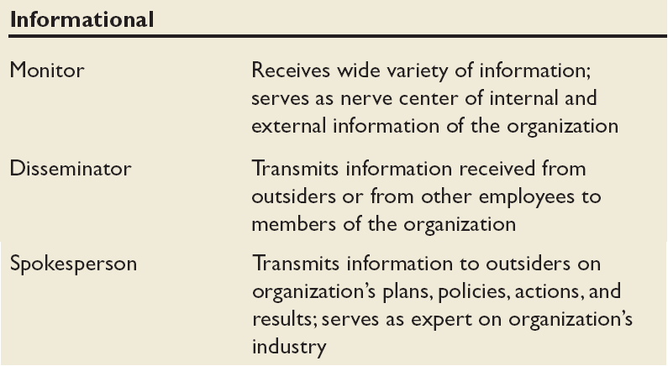
Mintzberg’s Managerial Roles: Informational
Source: Adapted from The Nature of Managerial Work by H. Mintzberg. Copyright © 1973 by H. Mintzberg. Reprinted by permission of Pearson Education.
Copyright © 2011 Pearson Education, Inc. publishing as Prentice Hall
1-<number>
Notes:
(c) 2008 Prentice-Hall, All rights reserved.

Slide 8
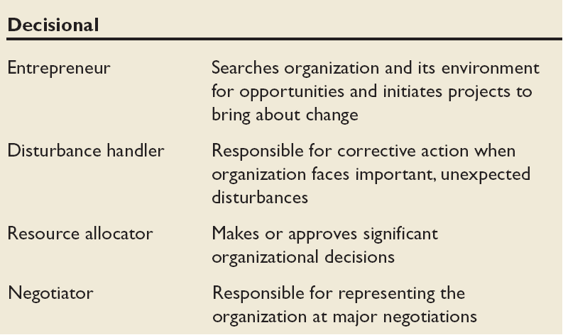
Mintzberg’s Managerial Roles: Decisional
Source: Adapted from The Nature of Managerial Work by H. Mintzberg. Copyright © 1973 by H. Mintzberg. Reprinted by permission of Pearson Education.
Copyright © 2011 Pearson Education, Inc. publishing as Prentice Hall
1-<number>
Notes:
(c) 2008 Prentice-Hall, All rights reserved.

Slide 9

Essential Management Skills
Technical Skills
  The ability to apply specialized knowledge or expertise
Human Skills
  The ability to work with, understand, and motivate other people, both individually and in groups
Conceptual Skills
  The mental ability to analyze and diagnose complex situations
Copyright © 2011 Pearson Education, Inc. publishing as Prentice Hall
1-<number>
Notes:
(c) 2008 Prentice-Hall, All rights reserved.

Slide 10
Luthans’ Study of Managerial Activities
Four types of managerial activity:
  Traditional Management
    Decision making, planning, and controlling
  Communication
    Exchanging routine information and processing paperwork
  Human Resource Management
    Motivating, disciplining, managing conflict, staffing and training
  Networking
    Socializing, politicking, and interacting with others
Copyright © 2011 Pearson Education, Inc. publishing as Prentice Hall
1-<number>
Notes:
(c) 2008 Prentice-Hall, All rights reserved.

Slide 11
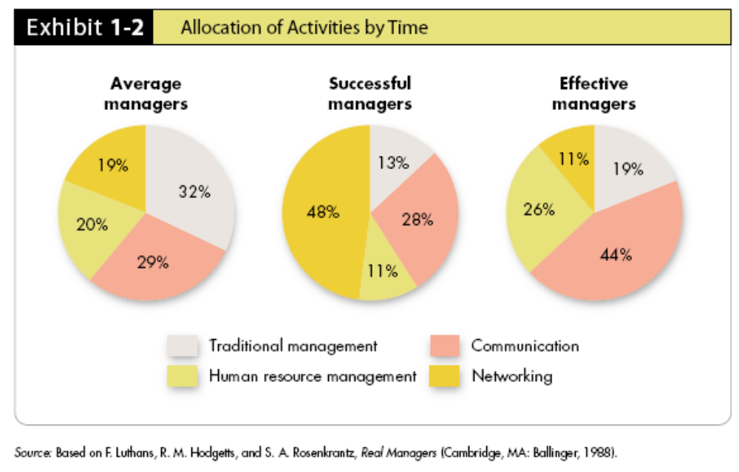
Successful vs. Effective Allocation by Time
Managers who promoted faster (were successful) did different things than did effective managers (those who did their jobs well)
E X H I B I T 1–2
Copyright © 2011 Pearson Education, Inc. publishing as Prentice Hall
1-<number>
Notes:
(c) 2008 Prentice-Hall, All rights reserved.

Slide 12

Organizational Behavior
A field of study that investigates the impact that individuals, groups, and structure have on behavior within organizations, for the purpose of applying such knowledge toward improving an organization’s effectiveness.
Copyright © 2011 Pearson Education, Inc. publishing as Prentice Hall
1-<number>
Notes:
(c) 2008 Prentice-Hall, All rights reserved.

Slide 13
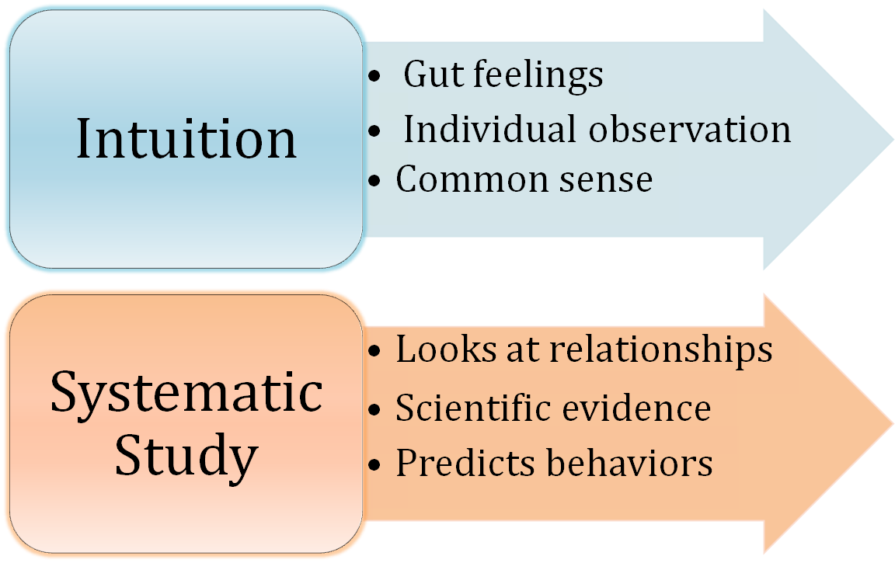
Intuition and Systematic Study
The two are complementary means of predicting behavior.
Copyright © 2011 Pearson Education, Inc. publishing as Prentice Hall
1-<number>
Notes:
(c) 2008 Prentice-Hall, All rights reserved.

Slide 14
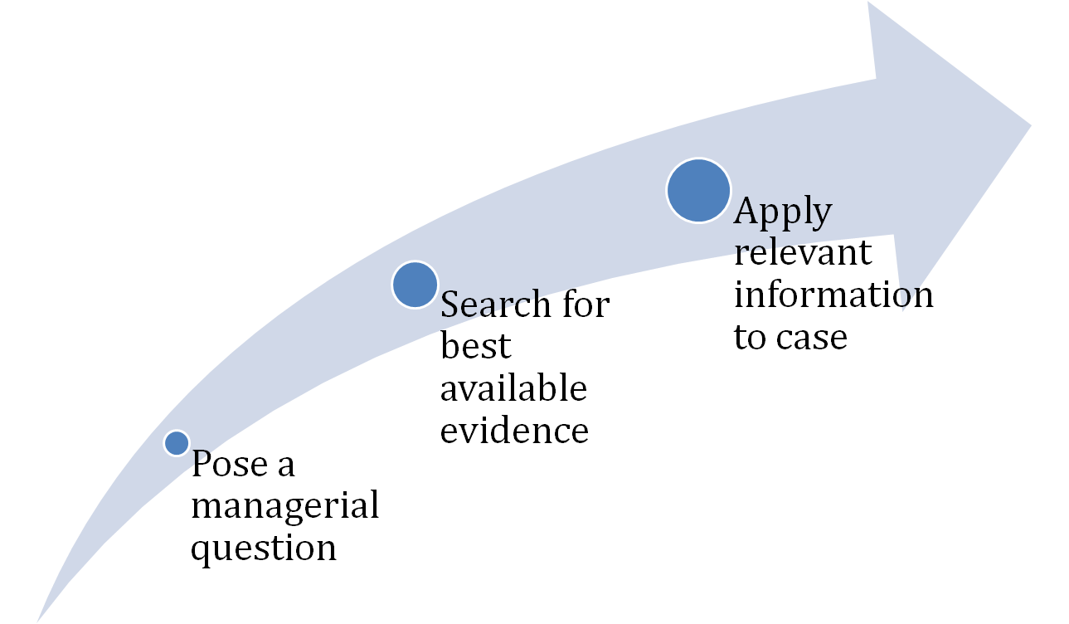
An Outgrowth of Systematic Study…
Evidence-Based Management (EBM)
Basing managerial decisions on the best available scientific evidence
Must think like scientists:
Copyright © 2011 Pearson Education, Inc. publishing as Prentice Hall
1-<number>
Notes:
(c) 2008 Prentice-Hall, All rights reserved.

Slide 15
Managers Should Use All Three Approaches
The trick is to know when to go with your gut.
– Jack Welsh
Intuition is often based on inaccurate information
Faddism is prevalent in management
Systematic study can be time consuming
Use evidence as much as possible to inform your intuition and experience. That is the promise of OB.
Copyright © 2011 Pearson Education, Inc. publishing as Prentice Hall
1-<number>
Notes:
(c) 2008 Prentice-Hall, All rights reserved.

Slide 16
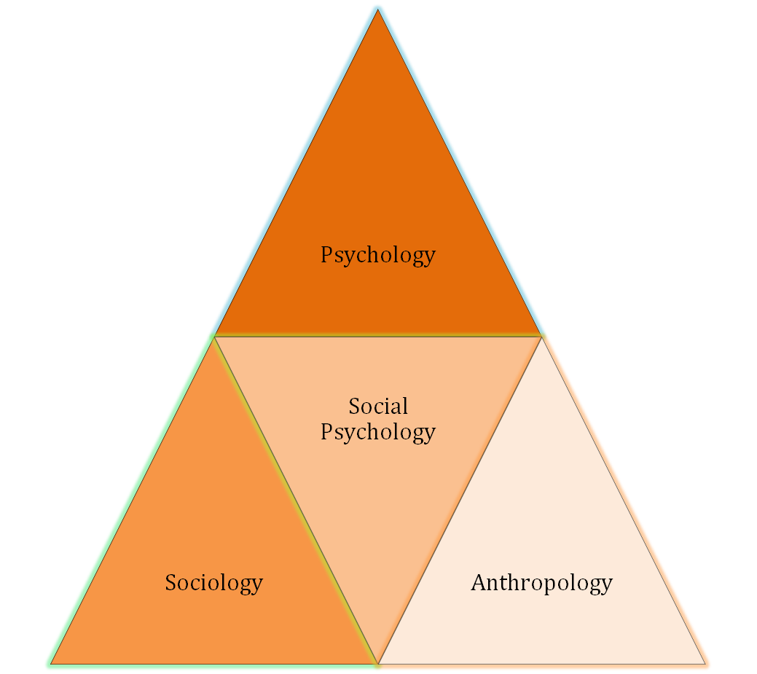
Contributing Disciplines
Many behavioral sciences
have contributed to the
development of
Organizational
Behavior
See E X H I B I T 1–3 for details
Copyright © 2011 Pearson Education, Inc. publishing as Prentice Hall
1-<number>
Notes:
(c) 2008 Prentice-Hall, All rights reserved.

Slide 17
Psychology
The science that seeks to measure, explain, and sometimes change the behavior of humans and other animals.
Unit of Analysis:
  Individual
Contributions to OB:
  Learning, motivation, personality, emotions, perception
  Training, leadership effectiveness, job satisfaction
  Individual decision making, performance appraisal attitude measurement
  Employee selection, work design, and work stress
Copyright © 2011 Pearson Education, Inc. publishing as Prentice Hall
1-<number>
Notes:
(c) 2008 Prentice-Hall, All rights reserved.

Slide 18

Social Psychology
An area within psychology that blends concepts from psychology and sociology and that focuses on the influence of people on one another.
Unit of Analysis:
  Group
Contributions to OB:
  Behavioral change
  Attitude change
  Communication
  Group processes
  Group decision making
Copyright © 2011 Pearson Education, Inc. publishing as Prentice Hall
1-<number>
Notes:
(c) 2008 Prentice-Hall, All rights reserved.

Slide 19
Sociology
The study of people in relation to their fellow human beings.
Unit of Analysis:
  -- Organizational System
  -- Group
Contributions to OB:
  Group dynamics
  Work teams
  Communication
  Power
  Conflict
  Intergroup behavior
  Formal organization theory
  Organizational technology
  Organizational change
  Organizational culture
Copyright © 2011 Pearson Education, Inc. publishing as Prentice Hall
1-<number>
Notes:
(c) 2008 Prentice-Hall, All rights reserved.

Slide 20

Anthropology
The study of societies to learn about human beings and their activities.
Unit of Analysis:
  -- Organizational System
  -- Group
Contributions to OB:
  Organizational culture
  Organizational environment
  Comparative values
  Comparative attitudes
  Cross-cultural analysis
Copyright © 2011 Pearson Education, Inc. publishing as Prentice Hall
1-<number>
Notes:
(c) 2008 Prentice-Hall, All rights reserved.

Slide 21
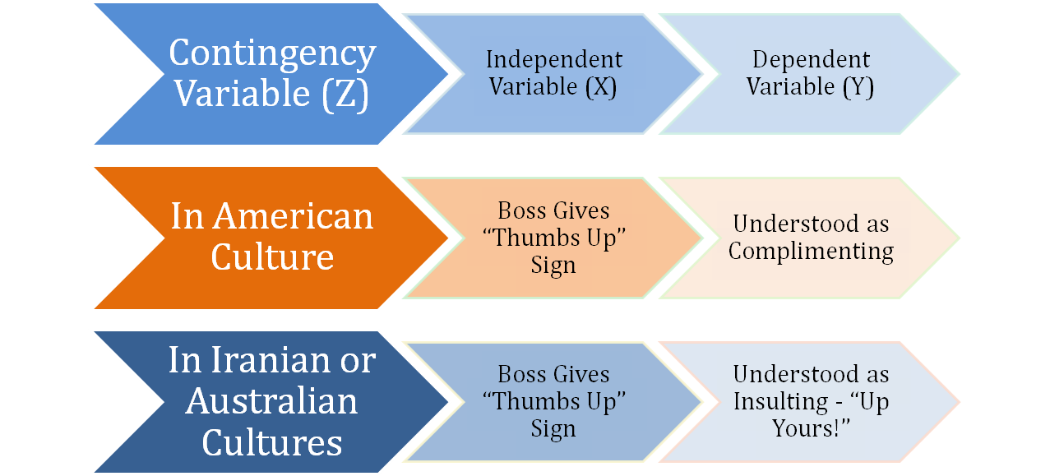
Few Absolutes in OB
Situational factors that make the main relationship between two variables change—e.g., the relationship may hold for one condition but not another.
Copyright © 2011 Pearson Education, Inc. publishing as Prentice Hall
1-<number>
Notes:
(c) 2008 Prentice-Hall, All rights reserved.

Slide 22

Challenges and Opportunities for OB
Responding to Economic Pressures
Responding to Globalization
Managing Workforce Diversity
Improving Quality and Productivity
Improving Customer Service
Improving People Skills
Stimulating Innovation and Change
Coping with “Temporariness”
Working in Networked Organizations
Helping Employees Balance Work-Life Conflicts
Creating a Positive Work Environment
Improving Ethical Behavior
Copyright © 2011 Pearson Education, Inc. publishing as Prentice Hall
1-<number>
Notes:
(c) 2008 Prentice-Hall, All rights reserved.

Slide 23

Responding to Economic Pressures
What do you do during difficult economic times?
  Effective management is critical during hard economic times.
  Managers need to handle difficult activities such as firing employees, motivating employees to do more with less and working through the stress employees feel when they are worrying about their future.
  OB focuses on issues such as stress, decision making, and coping during difficult times.
Copyright © 2011 Pearson Education, Inc. publishing as Prentice Hall
1-<number>
Notes:
(c) 2008 Prentice-Hall, All rights reserved.

Slide 24

Responding to Globalization
Increased foreign assignments
Working with people from different cultures
Overseeing movement of jobs to countries with low-cost labor
Copyright © 2011 Pearson Education, Inc. publishing as Prentice Hall
1-<number>
Notes:
(c) 2008 Prentice-Hall, All rights reserved.

Slide 25
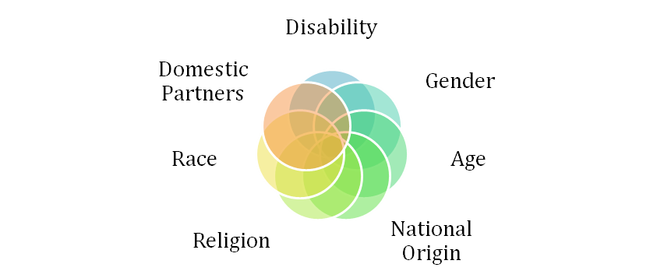
Managing Workforce Diversity
The people in organizations are becoming more heterogeneous demographically
  Embracing diversity
  Changing U.S. demographics
  Changing management philosophy
  Recognizing and responding to differences
See E X H I B I T 1–4
Copyright © 2011 Pearson Education, Inc. publishing as Prentice Hall
1-<number>
Notes:
(c) 2008 Prentice-Hall, All rights reserved.

Slide 26
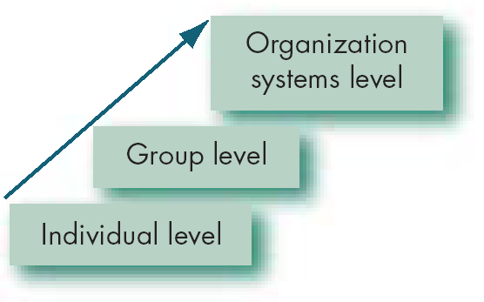
Developing an OB Model
A model is an abstraction of reality – a simplified representation of some real-world phenomenon.
Our OB model has three levels of analysis
  Each level is constructed on the prior level
E X H I B I T 1-4
Copyright © 2011 Pearson Education, Inc. publishing as Prentice Hall
1-<number>
Notes:
(c) 2008 Prentice-Hall, All rights reserved.

Slide 27
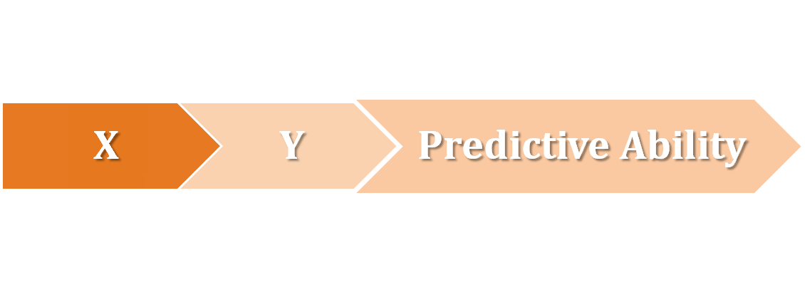
Types of Study Variables
Independent (X)
Dependent (Y)
  The presumed cause of the change in the dependent variable (Y).
  This is the variable that OB researchers manipulate to observe the changes in Y.
  This is the response to X (the independent variable).
  It is what the OB researchers want to predict or explain.
  The interesting variable!
Copyright © 2011 Pearson Education, Inc. publishing as Prentice Hall
1-<number>
Notes:
(c) 2008 Prentice-Hall, All rights reserved.

Slide 28
Interesting OB Dependent Variables
Productivity
  Transforming inputs to outputs at lowest cost. Includes the concepts of effectiveness (achievement of goals) and efficiency (meeting goals at a low cost).
Absenteeism
  Failure to report to work – a huge cost to employers.
Turnover
  Voluntary and involuntary permanent withdrawal from an organization.
Deviant Workplace Behavior
  Voluntary behavior that violates significant organizational norms and thereby threatens the well-being of the organization and/or any of its members.
Copyright © 2011 Pearson Education, Inc. publishing as Prentice Hall
1-<number>
Notes:
(c) 2008 Prentice-Hall, All rights reserved.

Slide 29

More Interesting OB Dependent Variables
Organizational Citizenship Behavior (OCB)
  Discretionary behavior that is not part of an employee’s formal job requirements, but that nevertheless promotes the effective functioning of the organization.
Job Satisfaction
  A general attitude (not a behavior) toward one’s job; a positive feeling of one's job resulting from an evaluation of its characteristics.
Copyright © 2011 Pearson Education, Inc. publishing as Prentice Hall
1-<number>
Notes:
(c) 2008 Prentice-Hall, All rights reserved.

Slide 30
The Independent Variables
The independent variable (X) can be at any of these three levels in this model:
Individual
  Biographical characteristics, personality and emotions, values and attitudes, ability, perception, motivation, individual learning, and individual decision making
Group
  Communication, group decision making, leadership and trust, group structure, conflict, power and politics, and work teams
Organization System
  Organizational culture, human resource policies and practices, and organizational structure and design
Copyright © 2011 Pearson Education, Inc. publishing as Prentice Hall
1-<number>
Notes:
(c) 2008 Prentice-Hall, All rights reserved.

Slide 31
Summary and Managerial Implications
Managers need to develop their interpersonal skills to be effective.
OB focuses on how to improve factors that make organizations more effective.
The best predictions of behavior are made from a combination of systematic study and intuition.
Situational variables moderate cause-and-effect relationships, which is why OB theories are contingent.
There are many OB challenges and opportunities for managers today.
The textbook is based on the contingent OB model.
Copyright © 2011 Pearson Education, Inc. publishing as Prentice Hall
1-<number>
Notes:
(c) 2008 Prentice-Hall, All rights reserved.

