Slide 1

Diversity in Organizations
Copyright © 2011 Pearson Education, Inc. publishing as Prentice Hall
2-<number>
Notes:
(c) 2008 Prentice-Hall, All rights reserved.

Slide 2
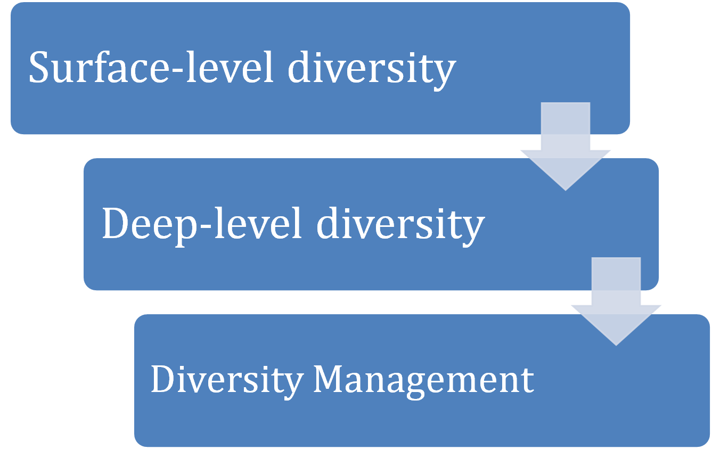
Diversity
Copyright © 2011 Pearson Education, Inc. publishing as Prentice Hall
2-<number>
Notes:
(c) 2008 Prentice-Hall, All rights reserved.

Slide 3
Biographical Characteristics
Objective and easily obtained personal characteristics.
Age
  Older workers bring experience, judgment, a strong work ethic, and commitment to quality.
Gender
  Few differences between men and women that affect job performance.
Copyright © 2011 Pearson Education, Inc. publishing as Prentice Hall
2-<number>
Notes:
(c) 2008 Prentice-Hall, All rights reserved.

Slide 4
Biographical Characteristics (Continued)
Race & Ethnicity
  Contentious issue: differences exist, but could be more culture based than race based.
Tenure
  People with job tenure (seniority at a job) are more productive, absent less frequently, have lower turnover, and are more satisfied.
Copyright © 2011 Pearson Education, Inc. publishing as Prentice Hall
2-<number>
Notes:
(c) 2008 Prentice-Hall, All rights reserved.

Slide 5
Other Biographical Characteristics
Religion
  May impact the workplace in areas of dress, grooming and scheduling
Sexual Orientation
  Federal law does not protect against discrimination (but state or local laws may).
  Domestic partner benefits are important considerations.
Gender Identity
  Relatively new issue – transgendered employees.
Copyright © 2011 Pearson Education, Inc. publishing as Prentice Hall
2-<number>
Notes:
(c) 2008 Prentice-Hall, All rights reserved.

Slide 6


Ability
An individual’s capacity to perform the various tasks in a job.
Intellectual and Physical Abilities
Copyright © 2011 Pearson Education, Inc. publishing as Prentice Hall
2-<number>
Notes:
(c) 2008 Prentice-Hall, All rights reserved.

Slide 7
Ability
Made up of two sets of factors:
  Intellectual Abilities
    The abilities needed to perform mental activities.
    General Mental Ability (GMA) is a measure of overall intelligence.
    Wonderlic Personnel Test: a quick measure of intelligence for recruitment screening.
    No correlation between intelligence and job satisfaction.
  Physical Abilities
    The capacity to do tasks demanding stamina, dexterity, strength, and similar characteristics.
Copyright © 2011 Pearson Education, Inc. publishing as Prentice Hall
2-<number>
Notes:
(c) 2008 Prentice-Hall, All rights reserved.

Slide 8
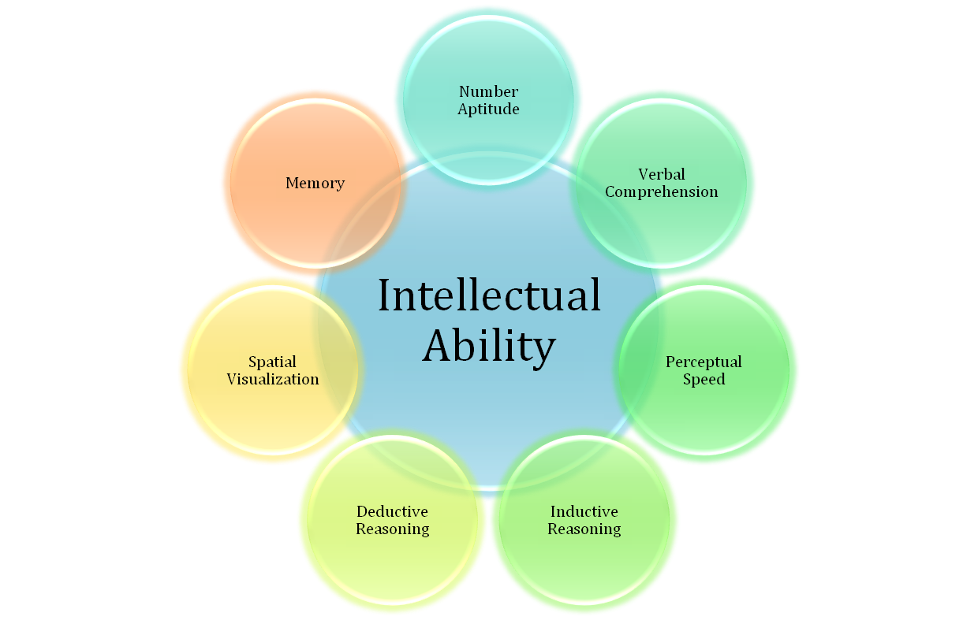
Dimensions of Intellectual Ability
E X H I B I T 2–1
Copyright © 2011 Pearson Education, Inc. publishing as Prentice Hall
2-<number>
Notes:
(c) 2008 Prentice-Hall, All rights reserved.

Slide 9
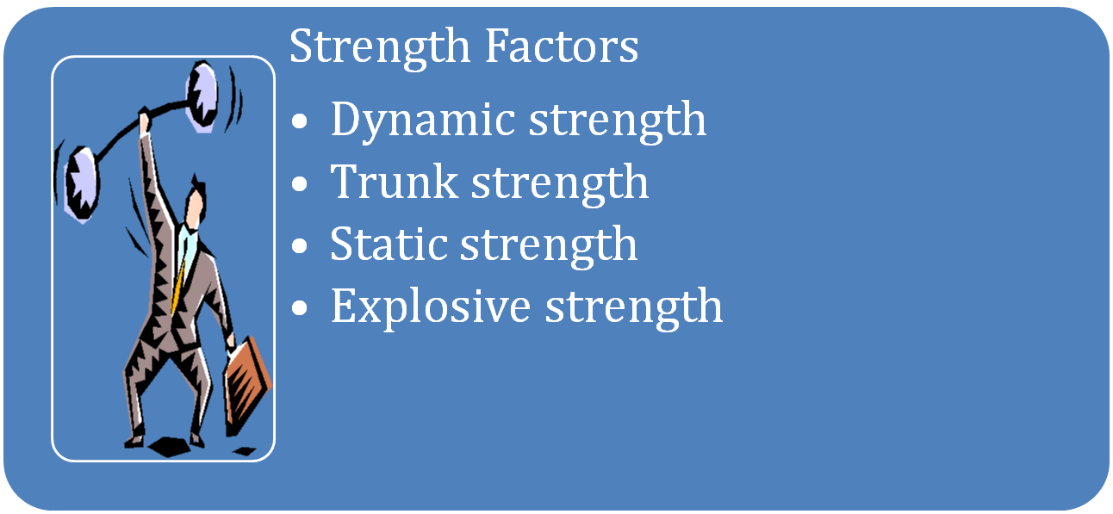
Basic Physical Abilities
Copyright © 2011 Pearson Education, Inc. publishing as Prentice Hall
2-<number>
Notes:
(c) 2008 Prentice-Hall, All rights reserved.

Slide 10
Role of Disabilities
When focusing on ability, it can create problems when attempting to develop workplace policies that recognize diversity in terms of disabilities.
It is important to recognize diversity and strive for it in the hiring process.
An organization needs to be careful to avoid discriminatory practices by making generalizations about people with disabilities.
Copyright © 2011 Pearson Education, Inc. publishing as Prentice Hall
2-<number>
Notes:
(c) 2008 Prentice-Hall, All rights reserved.

Slide 11
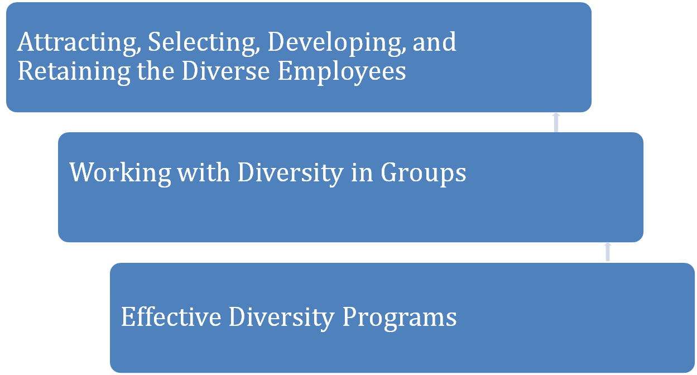
Implementing Diversity Management Strategies
Making everybody more aware and sensitive to the needs of others.
Copyright © 2011 Pearson Education, Inc. publishing as Prentice Hall
2-<number>
Notes:
(c) 2008 Prentice-Hall, All rights reserved.

Slide 12


Global Implications
Biographical Characteristics
  Not much evidence on the global relevance of the relationships described in this chapter.
  Countries do vary dramatically on their biographical composition.
Copyright © 2011 Pearson Education, Inc. publishing as Prentice Hall
2-<number>
Notes:
(c) 2008 Prentice-Hall, All rights reserved.

Slide 13
Additional Global Implications
Intellectual Abilities
  Structures and measures of intelligence generalize across cultures.
Diversity Management
  Diversity management is important across the globe. However, different cultures will use different frameworks for handling diversity.
Copyright © 2011 Pearson Education, Inc. publishing as Prentice Hall
2-<number>
Notes:
(c) 2008 Prentice-Hall, All rights reserved.

Slide 14
Summary and Managerial Implications
Summary:
  Ability
    Directly influences employee’s level of performance.
    Managers need to focus on ability in selection, promotion, and transfer.
    Fine-tune job to fit incumbent’s abilities.
  Biographical Characteristics
    Should not be used in management decisions: possible source of bias.
Copyright © 2011 Pearson Education, Inc. publishing as Prentice Hall
2-<number>
Notes:
(c) 2008 Prentice-Hall, All rights reserved.

Slide 15
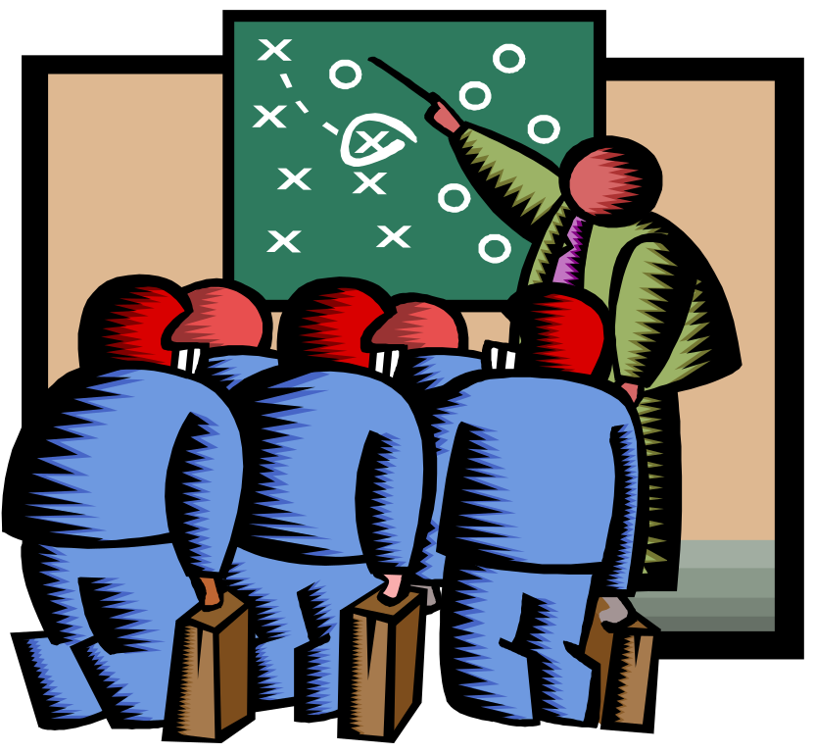
Summary and Managerial Implications
  Diversity Management
    Must be an ongoing commitment at all levels of the organization.
    Policies must include multiple perspectives and be long term in their orientation to be effective.
Copyright © 2011 Pearson Education, Inc. publishing as Prentice Hall
2-<number>
Notes:
(c) 2008 Prentice-Hall, All rights reserved.

