Slide 1
Part IV: Software

Slide 2
Why Software?
Why is software as important to security as crypto, access control, protocols?
Virtually all information security features are implemented in software
If your software is subject to attack, your security can be broken
Regardless of strength of crypto, access control, or protocols
Software is a poor foundation for security

Slide 3
Chapter 11: Software Flaws and Malware
If automobiles had followed the same development cycle as the computer,
a Rolls-Royce would today cost $100, get a million miles per gallon,
and explode once a year, killing everyone inside.
⎯ Robert X. Cringely
My software never has bugs. It just develops random features.
⎯ Anonymous

Slide 4
Bad Software is Ubiquitous
NASA Mars Lander (cost $165 million)
Crashed into Mars due to…
…error in converting English and metric units of measure
Believe it or not
Denver airport
Baggage handling system ⎯ very buggy software
Delayed airport opening by 11 months
Cost of delay exceeded $1 million/day
What happened to person responsible for this fiasco?
MV-22 Osprey
Advanced military aircraft
Faulty software can be fatal

Slide 5
Software Issues
Alice and Bob
Find bugs and flaws by accident
Hate bad software…
…but they learn to live with it
Must make bad software work
Trudy
Actively looks for bugs and flaws
Likes bad software…
…and tries to make it misbehave
Attacks systems via bad software

Slide 6
Complexity
“Complexity is the enemy of security”, Paul Kocher, Cryptography Research, Inc.
System | Lines of Code (LOC)
Netscape | 17 million
Space Shuttle | 10 million
Linux kernel 2.6.0 | 5 million
Windows XP | 40 million
Mac OS X 10.4 | 86 million
Boeing 777 | 7 million
A new car contains more LOC than was required to land the Apollo astronauts on the moon

Slide 7
Lines of Code and Bugs
Conservative estimate: 5 bugs/10,000 LOC
Do the math
Typical computer: 3k exe’s of 100k LOC each
Conservative estimate: 50 bugs/exe
Implies about 150k bugs per computer
So, 30,000-node network has 4.5 billion bugs
Maybe only 10% of bugs security-critical and only 10% of those remotely exploitable
Then “only” 45 million critical security flaws!

Slide 8
Software Security Topics
Program flaws (unintentional)
Buffer overflow
Incomplete mediation
Race conditions
Malicious software (intentional)
Viruses
Worms
Other breeds of malware

Slide 9
Program Flaws
An error is a programming mistake
To err is human
An error may lead to incorrect state: fault
A fault is internal to the program
A fault may lead to a failure, where a system departs from its expected behavior
A failure is externally observable
error
fault
failure

Slide 10
Example
char array[10];
for(i = 0; i < 10; ++i)
array[i] = `A`;
array[10] = `B`;
This program has an error
This error might cause a fault
Incorrect internal state
If a fault occurs, it might lead to a failure
Program behaves incorrectly (external)
We use the term flaw for all of the above

Slide 11
Secure Software
In software engineering, try to ensure that a program does what is intended
Secure software engineering requires that software does what is intended…
…and nothing more
Absolutely secure software? Dream on…
Absolute security anywhere is impossible
How can we manage software risks?

Slide 12
Program Flaws
Program flaws are unintentional
But can still create security risks
We’ll consider 3 types of flaws
Buffer overflow (smashing the stack)
Incomplete mediation
Race conditions
These are the most common flaws

Slide 13
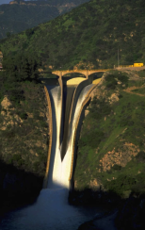
Buffer Overflow

Slide 14
Attack Scenario
Users enter data into a Web form
Web form is sent to server
Server writes data to array called buffer, without checking length of input data
Data “overflows” buffer
Such overflow might enable an attack
If so, attack could be carried out by anyone with Internet access

Slide 15
Buffer Overflow
int main(){
int buffer[10];
buffer[20] = 37;}
Q: What happens when code is executed?
A: Depending on what resides in memory at location “buffer[20]”
Might overwrite user data or code
Might overwrite system data or code
Or program could work just fine

Slide 16

Simple Buffer Overflow
Consider boolean flag for authentication
Buffer overflow could overwrite flag allowing anyone to authenticate
Boolean flag
buffer
F
O
U
R
S
C
…
T
F
In some cases, Trudy need not be so lucky as in this example

Slide 17
Memory Organization
Text ⎯ code
Data ⎯ static variables
Heap ⎯ dynamic data
Stack ⎯ “scratch paper”
Dynamic local variables
Parameters to functions
Return address
low
address
text
data
heap
↓
↑
stack
pointer (SP)
stack
high
address

Slide 18
Simplified Stack Example
low →
void func(int a, int b){
char buffer[10];
}
void main(){
func(1,2);
}
:
:
SP
buffer
SP
ret
return
address
a
SP
high →
b
SP

Slide 19
Smashing the Stack
low →
What happens if buffer overflows?
???
:
:
Program “returns” to wrong location
buffer
SP
overflow
SP
A crash is likely
ret
ret…
NOT!
overflow
a
SP
high →
b
SP

Slide 20
Smashing the Stack
low →
Trudy has a better idea…
:
:
Code injection
Trudy can run code of her choosing…
…on your machine
SP
evil code
ret
ret
SP
a
SP
high →
b
SP

Slide 21
Smashing the Stack
:
:
Trudy may not know…
Address of evil code
Location of ret on stack
Solutions
Precede evil code with NOP “landing pad”
Insert ret many times
NOP
:
NOP
evil code
ret
ret
ret
:
ret
:
:

Slide 22
Stack Smashing Summary
A buffer overflow must exist in the code
Not all buffer overflows are exploitable
Things must align properly
If exploitable, attacker can inject code
Trial and error is likely required
Fear not, lots of help is available online
Smashing the Stack for Fun and Profit, Aleph One
Stack smashing is “attack of the decade”…
…for many recent decades
Also heap & integer overflows, format strings, etc.

Slide 23
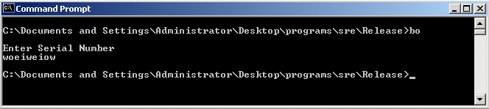
Stack Smashing Example
Suppose program asks for a serial number that Trudy does not know
Also, Trudy does not have source code
Trudy only has the executable (exe)
Program quits on incorrect serial number

Slide 24
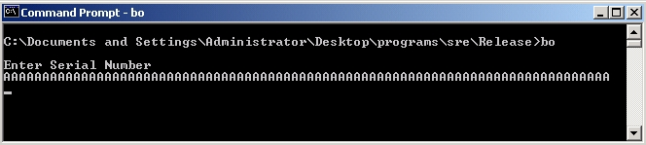
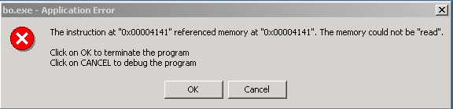
Buffer Overflow Present?
By trial and error, Trudy discovers apparent buffer overflow
Note that 0x41 is ASCII for “A”
Looks like ret overwritten by 2 bytes!

Slide 25
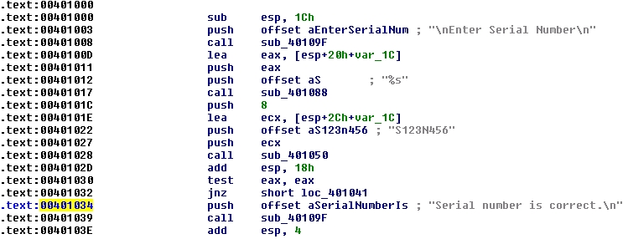
Disassemble Code
Next, disassemble bo.exe to find
The goal is to exploit buffer overflow to jump to address 0x401034

Slide 26
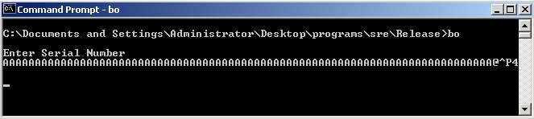
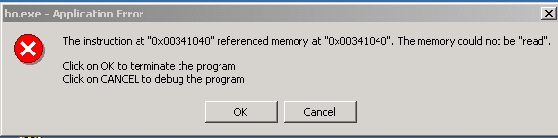
Buffer Overflow Attack
Find that, in ASCII, 0x401034 is “@^P4”
Byte order is reversed? What the …
X86 processors are “little-endian”

Slide 27
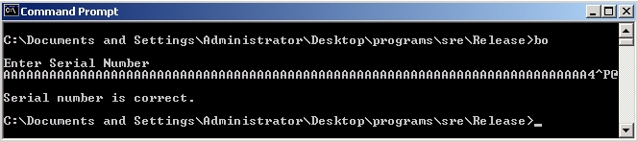
Overflow Attack, Take 2
Reverse the byte order to “4^P@” and…
Success! We’ve bypassed serial number check by exploiting a buffer overflow
What just happened?
Overwrote return address on the stack

Slide 28
Buffer Overflow
Trudy did not require access to the source code
Only tool used was a disassembler to determine address to jump to
Find desired address by trial and error?
Necessary if attacker does not have exe
For example, a remote attack

Slide 29
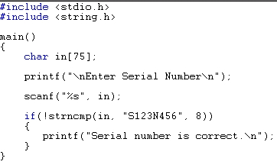
Source Code
Source code for buffer overflow example
Flaw easily exploited by attacker…
…without access to source code!

Slide 30
Stack Smashing Defenses
Employ non-executable stack
“No execute” NX bit (if available)
Seems like the logical thing to do, but some real code executes on the stack (Java, for example)
Use a canary
Address space layout randomization (ASLR)
Use safe languages (Java, C#)
Use safer C functions
For unsafe functions, safer versions exist
For example, strncpy instead of strcpy

Slide 31

Stack Smashing Defenses
low →
Canary
Run-time stack check
Push canary onto stack
Canary value:
Constant 0x000aff0d
Or, may depends on ret
:
:
buffer
overflow
canary
overflow
ret
a
high →
b

Slide 32
Microsoft’s Canary
Microsoft added buffer security check feature to C++ with /GS compiler flag
Based on canary (or “security cookie”)
Q: What to do when canary dies?
A: Check for user-supplied “handler”
Handler shown to be subject to attack
Claimed that attacker can specify handler code
If so, formerly “safe” buffer overflows become exploitable when /GS is used!

Slide 33
ASLR
Address Space Layout Randomization
Randomize place where code loaded in memory
Makes most buffer overflow attacks probabilistic
Windows Vista uses 256 random layouts
So about 1/256 chance buffer overflow works
Similar thing in Mac OS X and other OSs
Attacks against Microsoft’s ASLR do exist
Possible to “de-randomize”

Slide 34
Buffer Overflow
A major security threat yesterday, today, and tomorrow
The good news?
It is possible to reduce overflow attacks (safe languages, NX bit, ASLR, education, etc.)
The bad news?
Buffer overflows will exist for a long time
Why? Legacy code, bad development practices, clever attacks, etc.

Slide 35
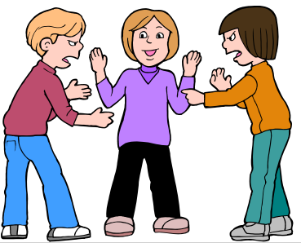
Incomplete Mediation
Notes:
Richter, Gerhard
Mediation
1986
Oil on canvas
320 x 400 cm (126 x 157 1/2 in.)
Musee des beaux-arts de Montrea

Slide 36
Input Validation
Consider: strcpy(buffer, argv[1])
A buffer overflow occurs if
len(buffer) < len(argv[1])
Software must validate the input by checking the length of argv[1]
Failure to do so is an example of a more general problem: incomplete mediation

Slide 37
Input Validation
Consider web form data
Suppose input is validated on client
For example, the following is valid
http://www.things.com/orders/final&custID=112&num=55A&qty=20&price=10&shipping=5&total=205
Suppose input is not checked on server
Why bother since input checked on client?
Then attacker could send http message
http://www.things.com/orders/final&custID=112&num=55A&qty=20&price=10&shipping=5&total=25

Slide 38
Incomplete Mediation
Linux kernel
Research revealed many buffer overflows
Lots of these due to incomplete mediation
Linux kernel is “good” software since
Open-source
Kernel ⎯ written by coding gurus
Tools exist to help find such problems
But incomplete mediation errors can be subtle
And tools useful for attackers too!

Slide 39
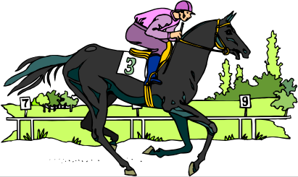
Race Conditions

Slide 40
Race Condition
Security processes should be atomic
Occur “all at once”
Race conditions can arise when security-critical process occurs in stages
Attacker makes change between stages
Often, between stage that gives authorization, but before stage that transfers ownership
Example: Unix mkdir

Slide 41
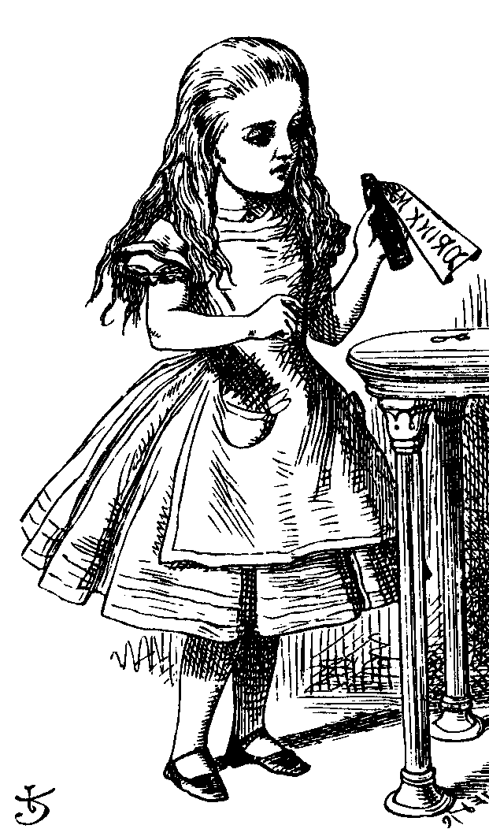
mkdir Race Condition
mkdir creates new directory
How mkdir is supposed to work
mkdir
1. Allocate
space
2. Transfer
ownership

Slide 42
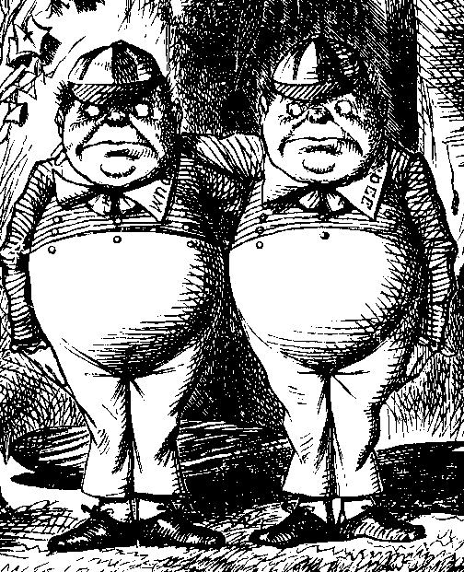
mkdir Attack
The mkdir race condition
mkdir
1. Allocate
space
3. Transfer
ownership
2. Create link to
password file
Not really a “race”
But attacker’s timing is critical

Slide 43
Race Conditions
Race conditions are common
Race conditions may be more prevalent than buffer overflows
But race conditions harder to exploit
Buffer overflow is “low hanging fruit” today
To prevent race conditions, make security-critical processes atomic
Occur all at once, not in stages
Not always easy to accomplish in practice

Slide 44
Malware

Slide 45
Malicious Software
Malware is not new…
Fred Cohen’s initial virus work in 1980’s
Cohen used viruses to break MLS systems
Types of malware (no standard definition)
Virus ⎯ passive propagation
Worm ⎯ active propagation
Trojan horse ⎯ unexpected functionality
Trapdoor/backdoor ⎯ unauthorized access
Rabbit ⎯ exhaust system resources
Spyware ⎯ steals info, such as passwords

Slide 46
Where do Viruses Live?
They live just about anywhere, such as…
Boot sector
Take control before anything else
Memory resident
Stays in memory
Applications, macros, data, etc.
Library routines
Compilers, debuggers, virus checker, etc.
These would be particularly nasty!

Slide 47
Malware Examples
Brain virus (1986)
Morris worm (1988)
Code Red (2001)
SQL Slammer (2004)
Stuxnet (2010)
Botnets (currently fashionable malware)
Future of malware?

Slide 48
Brain
First appeared in 1986
More annoying than harmful
A prototype for later viruses
Not much reaction by users
What it did
Placed itself in boot sector (and other places)
Screened disk calls to avoid detection
Each disk read, checked boot sector to see if boot sector infected; if not, goto 1
Brain did nothing really malicious

Slide 49
Morris Worm
First appeared in 1988
What it tried to do
Determine where it could spread, then…
…spread its infection and…
…remain undiscovered
Morris claimed his worm had a bug!
It tried to re-infect infected systems
Led to resource exhaustion
Effect was like a so-called rabbit

Slide 50
How Morris Worm Spread
Obtained access to machines by…
User account password guessing
Exploit buffer overflow in fingerd
Exploit trapdoor in sendmail
Flaws in fingerd and sendmail were well-known, but not widely patched

Slide 51
Bootstrap Loader
Once Morris worm got access…
“Bootstrap loader” sent to victim
99 lines of C code
Victim compiled and executed code
Bootstrap loader fetched the worm
Victim authenticated sender
Don’t want user to get a bad worm…

Slide 52
How to Remain Undetected?
If transmission interrupted, all code deleted
Code encrypted when downloaded
Code deleted after decrypt/compile
When running, worm regularly changed name and process identifier (PID)

Slide 53
Morris Worm: Bottom Line
Shock to the Internet community of 1988
Internet of 1988 much different than today
Internet designed to survive nuclear war
Yet, brought down by one graduate student!
At the time, Morris’ father worked at NSA…
Could have been much worse
Result? CERT, more security awareness
But should have been a wakeup call

Slide 54
Code Red Worm
Appeared in July 2001
Infected more than 250,000 systems in about 15 hours
Eventually infected 750,000 out of about 6,000,000 vulnerable systems
Exploited buffer overflow in Microsoft IIS server software
Then monitor traffic on port 80, looking for other susceptible servers

Slide 55
Code Red: What it Did
Day 1 to 19 of month: spread its infection
Day 20 to 27: distributed denial of service attack (DDoS) on www.whitehouse.gov
Later version (several variants)
Included trapdoor for remote access
Rebooted to flush worm, leaving only trapdoor
Some said it was “beta test for info warfare”
But, no evidence to support this

Slide 56
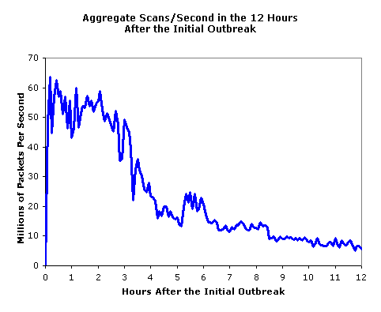
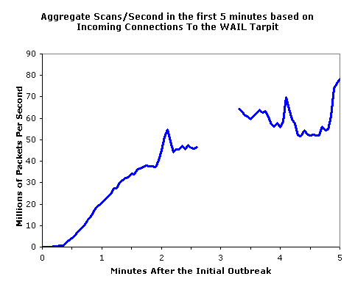
SQL Slammer
Infected 75,000 systems in 10 minutes!
At its peak, infections doubled every 8.5 seconds
Spread “too fast”…
…so it “burned out” available bandwidth

Slide 57
Why was Slammer Successful?
Worm size: one 376-byte UDP packet
Firewalls often let one packet thru
Then monitor ongoing “connections”
Expectation was that much more data required for an attack
So no need to worry about 1 small packet
Slammer defied “experts”

Slide 58
Stuxnet
Malware for information warfare…
Discovered in 2010
Origins go back to 2008, or earlier
Apparently, targeted Iranian nuclear processing facility
Reprogrammed specific type of PLC
Changed speed of centrifuges, causing damage to about 1000 of them

Slide 59
Stuxnet
Many advanced features including…
Infect system via removable drives ⎯ able to get behind “airgap” firewalls
Used 4 unpatched MS vulnerabilities
Updates via P2P over a LAN
Contact C&C server for code/updates
Includes a Windows rootkit for stealth
Significant exfiltration/recon capability
Used a compromised private key

Slide 60
Malware Related to Stuxnet
Duqu (2011)
Likely that developers had access to Stuxnet source code
Apparently, used mostly for info stealing
Flame (2012)
May be “most complex” malware ever
Very sophisticated spyware mechanisms
Notes:
According to one source, Flame is “20 times” more complex than Stuxnet

Slide 61

Trojan Horse Example
Trojan: unexpected functionality
Prototype trojan for the Mac
File icon for freeMusic.mp3:
For a real mp3, double click on icon
iTunes opens
Music in mp3 file plays
But for freeMusic.mp3, unexpected results…

Slide 62
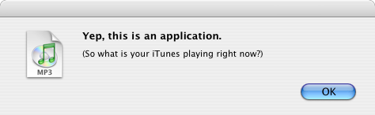
Mac Trojan
Double click on freeMusic.mp3
iTunes opens (expected)
“Wild Laugh” (not expected)
Message box (not expected)

Slide 63
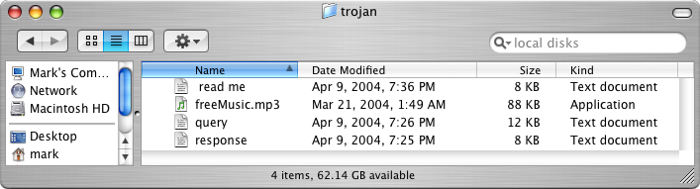
Trojan Example
How does freeMusic.mp3 trojan work?
This “mp3” is an application, not data
This trojan is harmless, but…
…could have done anything user could do
Delete files, download files, launch apps, etc.

Slide 64
Malware Detection
Three common detection methods
Signature detection
Change detection
Anomaly detection
We briefly discuss each of these
And consider advantages…
…and disadvantages

Slide 65
Signature Detection
A signature may be a string of bits in exe
Might also use wildcards, hash values, etc.
For example, W32/Beast virus has signature
83EB 0274 EB0E 740A 81EB 0301 0000
That is, this string of bits appears in virus
We can search for this signature in all files
If string found, have we found W32/Beast?
Not necessarily ⎯ string could be in normal code
At random, chance is only 1/2¹¹²
But software is not random…

Slide 66
Signature Detection
Advantages
Effective on “ordinary” malware
Minimal burden for users/administrators
Disadvantages
Signature file can be large (10s of thousands)…
…making scanning slow
Signature files must be kept up to date
Cannot detect unknown viruses
Cannot detect some advanced types of malware
The most popular detection method

Slide 67
Change Detection
Viruses must live somewhere
If you detect a file has changed, it might have been infected
How to detect changes?
Hash files and (securely) store hash values
Periodically re-compute hashes and compare
If hash changes, file might be infected

Slide 68
Change Detection
Advantages
Virtually no false negatives
Can even detect previously unknown malware
Disadvantages
Many files change ⎯ and often
Many false alarms (false positives)
Heavy burden on users/administrators
If suspicious change detected, then what? Might fall back on signature detection

Slide 69
Anomaly Detection
Monitor system for anything “unusual” or “virus-like” or “potentially malicious” or …
Examples of anomalous things
Files change in some unexpected way
System misbehaves in some way
Unexpected network activity
Unexpected file access, etc., etc., etc., etc.
But, we must first define “normal”
And normal can (and must) change over time

Slide 70
Anomaly Detection
Advantages
Chance of detecting unknown malware
Disadvantages
No proven track record
Trudy can make abnormal look normal (go slow)
Must be combined with another method (e.g., signature detection)
Also popular in intrusion detection (IDS)
Difficult unsolved (unsolvable?) problem
Reminds me of AI…

Slide 71
Future of Malware
Recent trends
Encrypted, polymorphic, metamorphic malware
Fast replication/Warhol worms
Flash worms, slow worms
Botnets
The future is bright for malware
Good news for the bad guys…
…bad news for the good guys
Future of malware detection?

Slide 72
Encrypted Viruses
Virus writers know signature detection used
So, how to evade signature detection?
Encrypting the virus is a good approach
Ciphertext looks like random bits
Different key, then different “random” bits
So, different copies have no common signature
Encryption often used in viruses today

Slide 73
Encrypted Viruses
How to detect encrypted viruses?
Scan for the decryptor code
More-or-less standard signature detection
But may be more false alarms
Why not encrypt the decryptor code?
Then encrypt the decryptor of the decryptor (and so on…)
Encryption of limited value to virus writers

Slide 74
Polymorphic Malware
Polymorphic worm
Body of worm is encrypted
Decryptor code is “mutated” (or “morphed”)
Trying to hide decryptor signature
Like an encrypted worm on steroids…
Q: How to detect?
A: Emulation ⎯ let the code decrypt itself
Slow, and anti-emulation is possible

Slide 75
Metamorphic Malware
A metamorphic worm mutates before infecting a new system
Sometimes called “body polymorphic”
Such a worm can, in principle, evade signature-based detection
Mutated worm must function the same
And be “different enough” to avoid detection
Detection is a difficult research problem

Slide 76
Metamorphic Worm
One approach to metamorphic replication…
The worm is disassembled
Worm then stripped to a base form
Random variations inserted into code (permute the code, insert dead code, etc., etc.)
Assemble the resulting code
Result is a worm with same functionality as original, but different signature

Slide 77
Warhol Worm
“In the future everybody will be world-famous for 15 minutes” ⎯ Andy Warhol
Warhol Worm is designed to infect the entire Internet in 15 minutes
Slammer infected 250,000 in 10 minutes
“Burned out” bandwidth
Could not have infected entire Internet in 15 minutes ⎯ too bandwidth intensive
Can rapid worm do “better” than Slammer?

Slide 78
A Possible Warhol Worm
Seed worm with an initial hit list containing a set of vulnerable IP addresses
Depends on the particular exploit
Tools exist for identifying vulnerable systems
Each successful initial infection would attack selected part of IP address space
Could infect entire Internet in 15 minutes!
No worm this sophisticated has yet been seen in the wild (as of 2011)
Slammer generated random IP addresses

Slide 79
Flash Worm
Can we do “better” than Warhol worm?
Infect entire Internet in less than 15 minutes?
Searching for vulnerable IP addresses is the slow part of any worm attack
Searching might be bandwidth limited
Like Slammer
Flash worm designed to infect entire Internet almost instantly

Slide 80
Flash Worm
Predetermine all vulnerable IP addresses
Depends on details of the attack
Embed these addresses in worm(s)
Results in huge worm(s)
But, the worm replicates, it splits
No wasted time or bandwidth!
Original worm(s)
1st generation
2nd generation

Slide 81
Flash Worm
Estimated that ideal flash worm could infect the entire Internet in 15 seconds!
Some debate as to actual time it would take
Estimates range from 2 seconds to 2 minutes
In any case…
…much faster than humans could respond
So, any defense must be fully automated
How to defend against such attacks?

Slide 82
Rapid Malware Defenses
Master IDS watches over network
“Infection” proceeds on part of network
Determines whether an attack or not
If so, IDS saves most of the network
If not, only a slight delay
Beneficial worm
Disinfect faster than the worm infects
Other approaches?

Slide 83
Push vs Pull Malware
Viruses/worms examples of “push”
Recently, a lot of “pull” malware
Scenario
A compromised web server
Visit a website at compromised server
Malware loaded on you machine
Good paper: Ghost in the Browser

Slide 84
Botnet
Botnet: a “network” of infected machines
Infected machines are “bots”
Victim is unaware of infection (stealthy)
Botmaster controls botnet
Generally, using IRC
P2P botnet architectures exist
Botnets used for…
Spam, DoS attacks, keylogging, ID theft, etc.

Slide 85
Botnet Examples
XtremBot
Similar bots: Agobot, Forbot, Phatbot
Highly modular, easily modified
Source code readily available (GPL license)
UrXbot
Similar bots: SDBot, UrBot, Rbot
Less sophisticated than XtremBot type
GT-Bots and mIRC-based bots
mIRC is common IRC client for Windows

Slide 86
More Botnet Examples
Mariposa
Used to steal credit card info
Creator arrested in July 2010
Conficker
Estimated 10M infected hosts (2009)
Kraken
Largest as of 2008 (400,000 infections)
Srizbi
For spam, one of largest as of 2008

Slide 87
Computer Infections
Analogies are made between computer viruses/worms and biological diseases
There are differences
Computer infections are much quicker
Ability to intervene in computer outbreak is more limited (vaccination?)
Bio disease models often not applicable
“Distance” almost meaningless on Internet
But there are some similarities…

Slide 88
Computer Infections
Cyber “diseases” vs biological diseases
One similarity
In nature, too few susceptible individuals and disease will die out
In the Internet, too few susceptible systems and worm might fail to take hold
One difference
In nature, diseases attack more-or-less at random
Cyber attackers select most “desirable” targets
Cyber attacks are more focused and damaging
Mobile devices an interesting hybrid case

Slide 89
Future Malware Detection?
Malware today far outnumbers “goodware”
Metamorphic copies of existing malware
Many virus toolkits available
Trudy can recycle old viruses, new signatures
So, may be better to “detect” good code
If code not on approved list, assume it’s bad
That is, use whitelist instead of blacklist

Slide 90
Miscellaneous Software-Based Attacks

Slide 91
Miscellaneous Attacks
Numerous attacks involve software
We’ll discuss a few issues that do not fit into previous categories
Salami attack
Linearization attack
Time bomb
Can you ever trust software?

Slide 92
Salami Attack
What is Salami attack?
Programmer “slices off” small amounts of money
Slices are hard for victim to detect
Example
Bank calculates interest on accounts
Programmer “slices off” any fraction of a cent and puts it in his own account
No customer notices missing partial cent
Bank may not notice any problem
Over time, programmer makes lots of money!

Slide 93
Salami Attack
Such attacks are possible for insiders
Do salami attacks actually occur?
Or is it just Office Space folklore?
Programmer added a few cents to every employee payroll tax withholding
But money credited to programmer’s tax
Programmer got a big tax refund!
Rent-a-car franchise in Florida inflated gas tank capacity to overcharge customers

Slide 94
Salami Attacks
Employee reprogrammed Taco Bell cash register: $2.99 item registered as $0.01
Employee pocketed $2.98 on each such item
A large “slice” of salami!
In LA, four men installed computer chip that overstated amount of gas pumped
Customers complained when they had to pay for more gas than tank could hold
Hard to detect since chip programmed to give correct amount when 5 or 10 gallons purchased
Inspector usually asked for 5 or 10 gallons

Slide 95
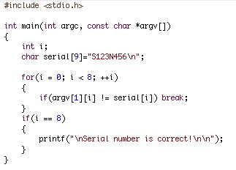
Linearization Attack
Program checks for serial number S123N456
For efficiency, check made one character at a time
Can attacker take advantage of this?

Slide 96
Linearization Attack
Correct number takes longer than incorrect
Trudy tries all 1st characters
Find that S takes longest
Then she guesses all 2nd characters: S∗
Finds S1 takes longest
And so on…
Trudy can recover one character at a time!
Same principle as used in lock picking

Slide 97
Linearization Attack
What is the advantage to attacking serial number one character at a time?
Suppose serial number is 8 characters and each has 128 possible values
Then 128⁸ = 2⁵⁶ possible serial numbers
Attacker would guess the serial number in about 2⁵⁵ tries ⎯ a lot of work!
Using the linearization attack, the work is about 8 ∗ (128/2) = 2⁹ which is easy

Slide 98
Linearization Attack
A real-world linearization attack
TENEX (an ancient timeshare system)
Passwords checked one character at a time
Careful timing was not necessary, instead…
…could arrange for a “page fault” when next unknown character guessed correctly
Page fault register was user accessible
Attack was very easy in practice

Slide 99
Time Bomb
In 1986 Donald Gene Burleson told employer to stop withholding taxes from his paycheck
His company refused
He planned to sue his company
He used company time to prepare legal docs
Company found out and fired him
Burleson had been working on malware…
After being fired, his software “time bomb” deleted important company data

Slide 100
Time Bomb
Company was reluctant to pursue the case
So Burleson sued company for back pay!
Then company finally sued Burleson
In 1988 Burleson fined $11,800
Case took years to prosecute…
Cost company thousands of dollars…
Resulted in a slap on the wrist for attacker
One of the first computer crime cases
Many cases since follow a similar pattern
Companies reluctant to prosecute

Slide 101
Trusting Software
Can you ever trust software?
See Reflections on Trusting Trust
Consider the following thought experiment
Suppose C compiler has a virus
When compiling login program, virus creates backdoor (account with known password)
When recompiling the C compiler, virus incorporates itself into new C compiler
Difficult to get rid of this virus!

Slide 102
Trusting Software
Suppose you notice something is wrong
So you start over from scratch
First, you recompile the C compiler
Then you recompile the OS
Including login program…
You have not gotten rid of the problem!
In the real world
Attackers try to hide viruses in virus scanner
Imagine damage that would be done by attack on virus signature updates

Slide 103
Chapter 12: Insecurity in Software
Every time I write about the impossibility of effectively protecting digital files
on a general-purpose computer, I get responses from people decrying the
death of copyright. “How will authors and artists get paid for their work?”
they ask me. Truth be told, I don’t know. I feel rather like the physicist
who just explained relativity to a group of would-be interstellar travelers,
only to be asked: “How do you expect us to get to the stars, then?”
I’m sorry, but I don't know that, either.
⎯ Bruce Schneier
So much time and so little to do! Strike that. Reverse it. Thank you.
⎯ Willy Wonka

Slide 104

Software Reverse Engineering (SRE)

Slide 105
SRE
Software Reverse Engineering
Also known as Reverse Code Engineering (RCE)
Or simply “reversing”
Can be used for good...
Understand malware
Understand legacy code
…or not-so-good
Remove usage restrictions from software
Find and exploit flaws in software
Cheat at games, etc.

Slide 106
SRE
We assume…
Reverse engineer is an attacker
Attacker only has exe (no source code)
No bytecode (i.e., not Java, .Net, etc.)
Attacker might want to
Understand the software
Modify (“patch”) the software
SRE usually focused on Windows
So we focus on Windows

Slide 107
SRE Tools
Disassembler
Converts exe to assembly (as best it can)
Cannot always disassemble 100% correctly
In general, not possible to re-assemble disassembly into working executable
Debugger
Must step thru code to completely understand it
Labor intensive ⎯ lack of useful tools
Hex Editor
To patch (modify) exe file
Process Monitor, VMware, etc.

Slide 108
SRE Tools
IDA Pro ⎯ good disassembler/debugger
Costs a few hundred dollars (free version exists)
Converts binary to assembly (as best it can)
OllyDbg ⎯ high-quality shareware debugger
Includes a good disassembler
Hex editor ⎯ to view/modify bits of exe
UltraEdit is good ⎯ freeware
HIEW ⎯ useful for patching exe
Process Monitor ⎯ freeware

Slide 109
Why is Debugger Needed?
Disassembly gives static results
Good overview of program logic
User must “mentally execute” program
Difficult to jump to specific place in the code
Debugging is dynamic
Can set break points
Can treat complex code as “black box”
And code not always disassembled correctly
Disassembly and debugging both required for any serious SRE task

Slide 110
SRE Necessary Skills
Working knowledge of target assembly code
Experience with the tools
IDA Pro ⎯ sophisticated and complex
OllyDbg ⎯ good choice for this class
Knowledge of Windows Portable Executable (PE) file format
Boundless patience and optimism
SRE is a tedious, labor-intensive process!

Slide 111
SRE Example
We consider a simple example
This example only requires disassembly (IDA Pro used here) and hex editor
Trudy disassembles to understand code
Trudy also wants to patch (modify) the code
For most real-world code, would also need a debugger (e.g., OllyDbg)

Slide 112
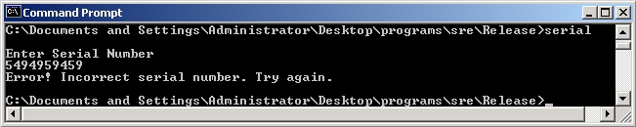
SRE Example
Program requires serial number
But Trudy doesn’t know the serial number…
Can Trudy get serial number from exe?

Slide 113
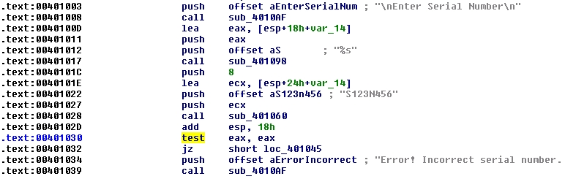
SRE Example
IDA Pro disassembly
Looks like serial number is S123N456

Slide 114
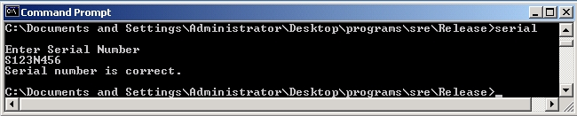
SRE Example
Try the serial number S123N456
It works!
Can Trudy do “better”?

Slide 115

SRE Example
Again, IDA Pro disassembly
And hex view…

Slide 116
SRE Example
“test eax,eax” is AND of eax with itself
So, zero flag set only if eax is 0
If test yields 0, then jz is true
Trudy wants jz to always be true
Can Trudy patch exe so jz always holds?

Slide 117
SRE Example
Can Trudy patch exe so that jz always true?
xor
← jz always true!!!
Assembly Hex
test eax,eax 85 C0 …
xor eax,eax 33 C0 …

Slide 118


SRE Example
Can edit serial.exe with hex editor
serial.exe
serialPatch.exe
Save as serialPatch.exe

Slide 119
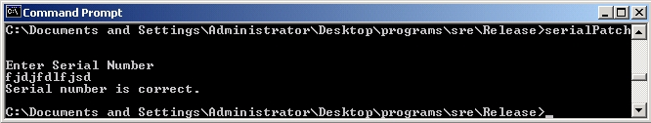
SRE Example
Any “serial number” now works!
Very convenient for Trudy

Slide 120
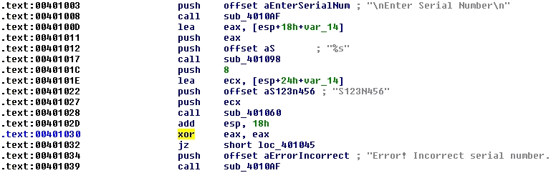
SRE Example
Back to IDA Pro disassembly…
serial.exe
serialPatch.exe

Slide 121
SRE Attack Mitigation
Impossible to prevent SRE on open system
Can we make such attacks more difficult?
Anti-disassembly techniques
To confuse static view of code
Anti-debugging techniques
To confuse dynamic view of code
Tamper-resistance
Code checks itself to detect tampering
Code obfuscation
Make code more difficult to understand

Slide 122
Anti-disassembly
Anti-disassembly methods include
Encrypted or “packed” object code
False disassembly
Self-modifying code
Many other techniques
Encryption prevents disassembly
But need plaintext decryptor to decrypt code!
Same problem as with polymorphic viruses

Slide 123
Anti-disassembly Example
Suppose actual code instructions are
inst 1
jmp
junk
inst 3
inst 4
…
What a “dumb” disassembler sees
inst 1
inst 2
inst 3
inst 4
inst 5
inst 6
…
This is example of “false disassembly”
Persistent attacker will figure it out

Slide 124
Anti-debugging
IsDebuggerPresent()
Can also monitor for
Use of debug registers
Inserted breakpoints
Debuggers don’t handle threads well
Interacting threads may confuse debugger…
…and therefore, confuse attacker
Many other debugger-unfriendly tricks
See next slide for one example

Slide 125
Anti-debugger Example
inst 1
inst 2
inst 3
inst 4
inst 5
inst 6
…
Suppose when program gets inst 1, it pre-fetches inst 2, inst 3, and inst 4
This is done to increase efficiency
Suppose when debugger executes inst 1, it does not pre-fetch instructions
Can we use this difference to confuse the debugger?

Slide 126
Anti-debugger Example
inst 2
inst 3
inst 4
…
inst 1
junk
inst 5
inst 6
Suppose inst 1 overwrites inst 4 in memory
Then program (without debugger) will be OK since it fetched inst 4 at same time as inst 1
Debugger will be confused when it reaches junk where inst 4 is supposed to be
Problem if this segment of code executed more than once!
Also, self-modifying code is platform-dependent
Again, clever attacker can figure this out

Slide 127
Tamper-resistance
Goal is to make patching more difficult
Code can hash parts of itself
If tampering occurs, hash check fails
Research has shown, can get good coverage of code with small performance penalty
But don’t want all checks to look similar
Or else easy for attacker to remove checks
This approach sometimes called “guards”

Slide 128
Code Obfuscation
Goal is to make code hard to understand
Opposite of good software engineering
Spaghetti code is a good example
Much research into more robust obfuscation
Example: opaque predicate
int x,y
:
if((x−y)∗(x−y) > (x∗x−2∗x∗y+y∗y)){…}
The if() conditional is always false
Attacker wastes time analyzing dead code

Slide 129
Code Obfuscation
Code obfuscation sometimes promoted as a powerful security technique
Diffie and Hellman’s original idea for public key crypto was based on code obfuscation
But public key crypto didn’t work out that way
It has been shown that obfuscation probably cannot provide strong, crypto-like security
On the (im)possibility of obfuscating programs
Obfuscation might still have practical uses
Even if it can never be as strong as crypto

Slide 130
Authentication Example
Software used to determine authentication
Ultimately, authentication is 1-bit decision
Regardless of method used (pwd, biometric, …)
Somewhere in authentication software, a single bit determines success/failure
If Trudy can find this bit, she can force authentication to always succeed
Obfuscation makes it more difficult for attacker to find this all-important bit

Slide 131
Obfuscation
Obfuscation forces attacker to analyze larger amounts of code
Method could be combined with
Anti-disassembly techniques
Anti-debugging techniques
Code tamper-checking
All of these increase work/pain for attacker
But a persistent attacker can ultimately win

Slide 132
Software Cloning
Suppose we write a piece of software
We then distribute an identical copy (or clone) to each customers
If an attack is found on one copy, the same attack works on all copies
This approach has no resistance to “break once, break everywhere” (BOBE)
This is the usual situation in software development

Slide 133
Metamorphic Software
Metamorphism sometimes used in malware
Can metamorphism also be used for good?
Suppose we write a piece of software
Each copy we distribute is different
This is an example of metamorphic software
Two levels of metamorphism are possible
All instances are functionally distinct (only possible in certain application)
All instances are functionally identical but differ internally (always possible)
We consider the latter case

Slide 134
Metamorphic Software
If we distribute N copies of cloned software
One successful attack breaks all N
If we distribute N metamorphic copies, where each of N instances is functionally identical, but they differ internally…
An attack on one instance does not necessarily work against other instances
In the best case, N times as much work is required to break all N instances

Slide 135
Metamorphic Software
We cannot prevent SRE attacks
The best we can hope for is BOBE resistance
Metamorphism can improve BOBE resistance
Consider the analogy to genetic diversity
If all plants in a field are genetically identical, one disease can rapidly kill all of the plants
If the plants in a field are genetically diverse, one disease can only kill some of the plants

Slide 136
Cloning vs Metamorphism
Spse our software has a buffer overflow
Cloned software
Same buffer overflow attack will work against all cloned copies of the software
Metamorphic software
Unique instances ⎯ all are functionally the same, but they differ in internal structure
Buffer overflow likely exists in all instances
But a specific buffer overflow attack will only work against some instances
Buffer overflow attacks are delicate!

Slide 137
Metamorphic Software
Metamorphic software is intriguing concept
But raises concerns regarding…
Software development, upgrades, etc.
Metamorphism does not prevent SRE, but could make it infeasible on a large scale
Metamorphism might be a practical tool for increasing BOBE resistance
Metamorphism currently used in malware
So, metamorphism is not just for evil!

Slide 138
Digital Rights Management

Slide 139
Digital Rights Management
DRM is a good example of limitations of doing security in software
We’ll discuss
What is DRM?
A PDF document protection system
DRM for streaming media
DRM in P2P application
DRM within an enterprise

Slide 140
What is DRM?
“Remote control” problem
Distribute digital content
Retain some control on its use, after delivery
Digital book example
Digital book sold online could have huge market
But might only sell 1 copy!
Trivial to make perfect digital copies
A fundamental change from pre-digital era
Similar comments for digital music, video, etc.

Slide 141
Persistent Protection
“Persistent protection” is the fundamental problem in DRM
How to enforce restrictions on use of content after delivery?
Examples of such restrictions
No copying
Limited number of reads/plays
Time limits
No forwarding, etc.

Slide 142
What Can be Done?
The honor system?
Example: Stephen King’s, The Plant
Give up?
Internet sales? Regulatory compliance? etc.
Lame software-based DRM?
The standard DRM system today
Better software-based DRM?
MediaSnap’s goal
Tamper-resistant hardware?
Closed systems: Game Cube, etc.
Open systems: TCG/NGSCB for PCs

Slide 143
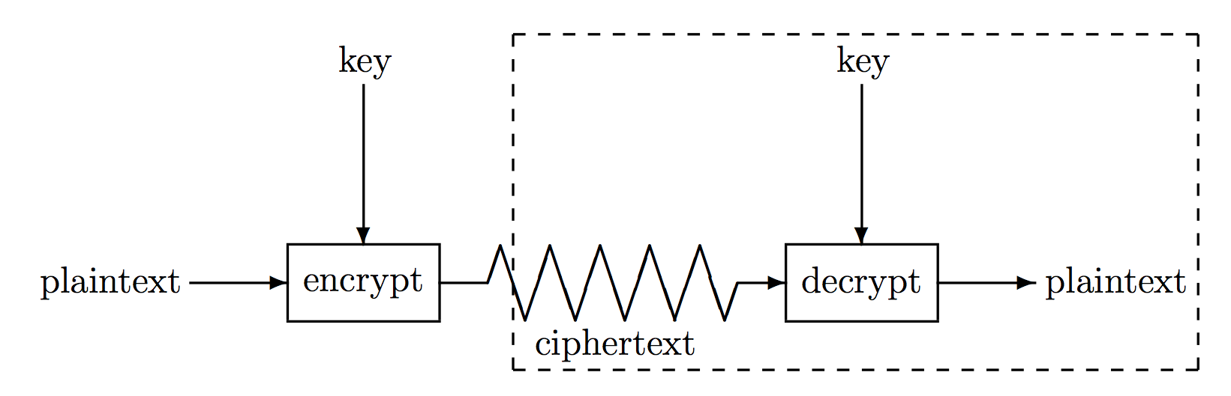
Is Crypto the Answer?
Attacker’s goal is to recover the key
In standard crypto scenario, attacker has
Ciphertext, some plaintext, side-channel info, etc.
In DRM scenario, attacker has
Everything in the box (at least)
Crypto was not designed for this problem!

Slide 144
Is Crypto the Answer?
But crypto is necessary
To securely deliver the bits
To prevent trivial attacks
Then attacker will not try to directly attack crypto
Attacker will try to find keys in software
DRM is “hide and seek” with keys in software!

Slide 145
Current State of DRM
At best, security by obscurity
A derogatory term in security
Secret designs
In violation of Kerckhoffs Principle
Over-reliance on crypto
“Whoever thinks his problem can be solved using cryptography, doesn’t understand his problem and doesn’t understand cryptography.” ⎯ Attributed by Roger Needham and Butler Lampson to each other

Slide 146
DRM Limitations
The analog hole
When content is rendered, it can be captured in analog form
DRM cannot prevent such an attack
Human nature matters
Absolute DRM security is impossible
Want something that “works” in practice
What works depends on context
DRM is not strictly a technical problem!

Slide 147
Software-based DRM
Strong software-based DRM is impossible
Why?
We can’t really hide a secret in software
We cannot prevent SRE
User with full admin privilege can eventually break any anti-SRE protection
Bottom line: The killer attack on software-based DRM is SRE

Slide 148
DRM for PDF Documents
Based on design of MediaSnap, Inc., a small Silicon Valley startup company
Developed a DRM system
Designed to protect PDF documents
Two parts to the system
Server ⎯ Secure Document Server (SDS)
Client ⎯ PDF Reader “plugin” software

Slide 149
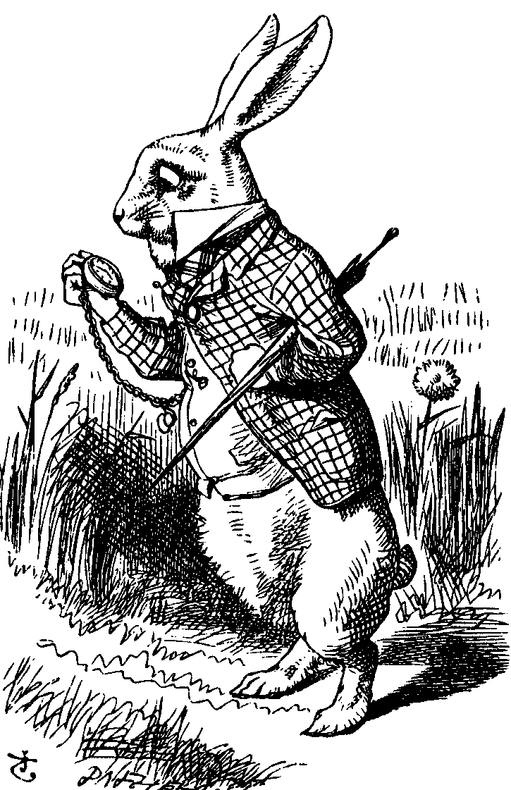
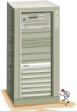
Protecting a Document
encrypt
persistent
protection
Alice
SDS
Bob
Alice creates PDF document
Document encrypted and sent to SDS
SDS applies desired “persistent protection”
Document sent to Bob

Slide 150
Accessing a Document
Request key
key
Alice
SDS
Bob
Bob authenticates to SDS
Bob requests key from SDS
Bob can then access document, but only thru special DRM software

Slide 151
Security Issues
Server side (SDS)
Protect keys, authentication data, etc.
Apply persistent protection
Client side (PDF plugin)
Protect keys, authenticate user, etc.
Enforce persistent protection
Remaining discussion concerns client

Slide 152
Security Overview
Tamper-resistance
Obfuscation
A tamper-resistant outer layer
Software obfuscation applied within

Slide 153
Tamper-Resistance
Anti-debugger
Encrypted code
Encrypted code will prevent static analysis of PDF plugin software
Anti-debugging to prevent dynamic analysis of PDF plugin software
These two designed to protect each other
But the persistent attacker will get thru!

Slide 154
Obfuscation
Obfuscation can be used for
Key management
Authentication
Caching (keys and authentication info)
Encryption and “scrambling”
Key parts (data and/or code)
Multiple keys/key parts
Obfuscation can only slow the attacker
The persistent attacker still wins!

Slide 155
Other Security Features
Code tamper checking (hashing)
To validate all code executing on system
Anti-screen capture
To prevent obvious attack on digital documents
Watermarking
In theory, can trace stolen content
In practice, of limited value
Metamorphism (or individualization)
For BOBE-resistance

Slide 156
Security Not Implemented
More general code obfuscation
Code “fragilization”
Code that hash checks itself
Tampering should cause code to break
OS cannot be trusted
How to protect against “bad” OS?
Not an easy problem!

Slide 157
DRM for Streaming Media
Stream digital content over Internet
Usually audio or video
Viewed in real time
Want to charge money for the content
Can we protect content from capture?
So content can’t be redistributed
We want to make money!

Slide 158
Attacks on Streaming Media
Spoof the stream between endpoints
Man in the middle
Replay and/or redistribute data
Capture the plaintext
This is the threat we are concerned with
Must prevent malicious software from capturing plaintext stream at client end

Slide 159
Design Features
Scrambling algorithms
Encryption-like algorithms
Many distinct algorithms available
A strong form of metamorphism!
Negotiation of scrambling algorithm
Server and client must both know the algorithm
Decryption at receiver end
To remove the strong encryption
De-scrambling in device driver
De-scramble just prior to rendering

Slide 160
Scrambling Algorithms
Server has a large set of scrambling algorithms
Suppose N of these numbered 1 thru N
Each client has a subset of algorithms
For example: LIST = {12,45,2,37,23,31}
The LIST is stored on client, encrypted with server’s key: E(LIST,K_{server})

Slide 161
Server-side Scrambling
On server side
scrambled
data
encrypted
scrambled data
data
Server must scramble data with an algorithm the client supports
Client must send server list of algorithms it supports
Server must securely communicate algorithm choice to client

Slide 162
Select Scrambling Algorithm
E(LIST, K_{server})
E(m,K)
scramble (encrypted) data
using Alice’s m-th algorithm
Alice
(client)
Bob
(server)
The key K is a session key
The LIST is unreadable by client
Reminiscent of Kerberos TGT

Slide 163
Client-side De-scrambling
On client side
encrypted
scrambled data
scrambled
data
data
Try to keep plaintext away from potential attacker
“Proprietary” device driver
Scrambling algorithms “baked in”
Able to de-scramble at last moment

Slide 164
Why Scrambling?
Metamorphism deeply embedded in system
If a scrambling algorithm is known to be broken, server will not choose it
If client has too many broken algorithms, server can force software upgrade
Proprietary algorithm harder for SRE
We cannot trust crypto strength of proprietary algorithms, so we also encrypt

Slide 165
Why Metamorphism?
The most serious threat is SRE
Attacker does not need to reverse engineer any standard crypto algorithm
Attacker only needs to find the key
Reverse engineering a scrambling algorithm may be difficult
This is just security by obscurity
But appears to help with BOBE-resistance

Slide 166
DRM for a P2P Application
Today, much digital content is delivered via peer-to-peer (P2P) networks
P2P networks contain lots of pirated music
Is it possible to get people to pay for digital content on such P2P networks?
How can this possibly work?
A peer offering service (POS) is one idea

Slide 167

P2P File Sharing: Query
Suppose Alice requests “Hey Jude”
Black arrows: query flooding
Red arrows: positive responses
Frank
Alice
Dean
Bob
Marilyn
Carol
Pat
Ted
Carol
Pat
Fred
Alice can select from: Carol, Pat

Slide 168
P2P File Sharing with POS
Suppose Alice requests “Hey Jude”
Black arrow: query
Red arrow: positive response
Bill
Ben
Joe
POS
Alice
Dean
Bob
Marilyn
Carol
Pat
Ted
Carol
Pat
Fred
Alice selects from: Bill, Ben, Carol, Joe, Pat
Bill, Ben, and Joe have legal content!

Slide 169
POS
Bill, Ben and Joe must appear normal to Alice
If “victim” (Alice) clicks POS response
DRM protected (legal) content downloaded
Then small payment required to play
Alice can choose not to pay
But then she must download again
Is it worth the hassle to avoid paying small fee?
POS content can also offer extras

Slide 170
POS Conclusions
A very clever idea!
Piggybacking on existing P2P networks
Weak DRM works very well here
Pirated content already exists
DRM only needs to be more hassle to break than the hassle of clicking and waiting
Current state of POS?
Very little interest from the music industry
Considerable interest from the “adult” industry

Slide 171
DRM in the Enterprise
Why enterpise DRM?
Health Insurance Portability and Accountability Act (HIPAA)
Medical records must be protected
Fines of up to $10,000 “per incident”
Sarbanes-Oxley Act (SOA)
Must preserve documents of interest to SEC
DRM-like protections needed by corporations for regulatory compliance

Slide 172
What’s Different in Enterprise DRM?
Technically, similar to e-commerce
But motivation for DRM is different
Regulatory compliance
To satisfy a legal requirement
Not to make money ⎯ to avoid losing money!
Human dimension is completely different
Legal threats are far more plausible
Legally, corporation is OK provided an active attack on DRM is required

Slide 173
Enterprise DRM
Moderate DRM security is sufficient
Policy management issues
Easy to set policies for groups, roles, etc.
Yet policies must be flexible
Authentication issues
Must interface with existing system
Must prevent network authentication spoofing (authenticate the authentication server)
Enterprise DRM is a solvable problem!

Slide 174
DRM Failures
Many examples of DRM failures
One system defeated by a felt-tip pen
One defeated my holding down shift key
Secure Digital Music Initiative (SDMI) completely broken before it was finished
Adobe eBooks
Microsoft MS-DRM (version 2)
Many, many others!

Slide 175
DRM Conclusions
DRM nicely illustrates limitations of doing security in software
Software in a hostile environment is extremely vulnerable to attack
Protection options are very limited
Attacker has enormous advantage
Tamper-resistant hardware and a trusted OS can make a difference
We’ll discuss this more later: TCG/NGSCB

Slide 176
Secure Software Development

Slide 177
Penetrate and Patch
Usual approach to software development
Develop product as quickly as possible
Release it without adequate testing
Patch the code as flaws are discovered
In security, this is “penetrate and patch”
A bad approach to software development
An even worse approach to secure software!

Slide 178
Why Penetrate and Patch?
First to market advantage
First to market likely to become market leader
Market leader has huge advantage in software
Users find it safer to “follow the leader”
Boss won’t complain if your system has a flaw, as long as everybody else has same flaw…
User can ask more people for support, etc.
Sometimes called “network economics”

Slide 179
Why Penetrate and Patch?
Secure software development is hard
Costly and time consuming development
Costly and time consuming testing
Cheaper to let customers do the work!
No serious economic disincentive
Even if software flaw causes major losses, the software vendor is not liable
Is any other product sold this way?
Would it matter if vendors were legally liable?

Slide 180
Penetrate and Patch Fallacy
Fallacy: If you keep patching software, eventually it will be secure
Why is this a fallacy?
Empirical evidence to the contrary
Patches often add new flaws
Software is a moving target: new versions, features, changing environment, new uses,…

Slide 181
Open vs Closed Source
Open source software
The source code is available to user
For example, Linux
Closed source
The source code is not available to user
For example, Windows
What are the security implications?

Slide 182
Open Source Security
Claimed advantages of open source is
More eyeballs: more people looking at the code should imply fewer flaws
A variant on Kerchoffs Principle
Is this valid?
How many “eyeballs” looking for security flaws?
How many “eyeballs” focused on boring parts?
How many “eyeballs” belong to security experts?
Attackers can also look for flaws!
Evil coder might be able to insert a flaw

Slide 183
Open Source Security
Open source example: wu-ftp
About 8,000 lines of code
A security-critical application
Was deployed and widely used
After 10 years, serious security flaws discovered!
More generally, open source software has done little to reduce security flaws
Why?
Open source follows penetrate and patch model!

Slide 184
Closed Source Security
Claimed advantage of closed source
Security flaws not as visible to attacker
This is a form of “security by obscurity”
Is this valid?
Many exploits do not require source code
Possible to analyze closed source code…
…though it is a lot of work!
Is “security by obscurity” real security?

Slide 185
Open vs Closed Source
Advocates of open source often cite the Microsoft fallacy which states
Microsoft makes bad software
Microsoft software is closed source
Therefore all closed source software is bad
Why is this a fallacy?
Not logically correct
More relevant is the fact that Microsoft follows the penetrate and patch model

Slide 186
Open vs Closed Source
No obvious security advantage to either open or closed source
More significant than open vs closed source is software development practices
Both open and closed source follow the “penetrate and patch” model

Slide 187
Open vs Closed Source
If there is no security difference, why is Microsoft software attacked so often?
Microsoft is a big target!
Attacker wants most “bang for the buck”
Few exploits against Mac OS X
Not because OS X is inherently more secure
An OS X attack would do less damage
Would bring less “glory” to attacker
Next, we consider the theoretical differences
See this paper

Slide 188
Security and Testing
Can be shown that probability of a security failure after t units of testing is about
E = K/t where K is a constant
This approximation holds over large range of t
Then the “mean time between failures” is
MTBF = t/K
The good news: security improves with testing
The bad news: security only improves linearly with testing!

Slide 189
Security and Testing
The “mean time between failures” is approximately
MTBF = t/K
To have 1,000,000 hours between security failures, must test 1,000,000 hours!
Suppose open source project has MTBF = t/K
If flaws in closed source are twice as hard to find, do we then have MTBF = 2t/K ?
No! Testing not as effective MTBF = 2(t/2)/K = t/K
The same result for open and closed source!

Slide 190
Security and Testing
Closed source advocates might argue
Closed source has “open source” alpha testing, where flaws found at (higher) open source rate
Followed by closed source beta testing and use, giving attackers the (lower) closed source rate
Does this give closed source an advantage?
Alpha testing is minor part of total testing
Recall, first to market advantage
Products rushed to market
Probably no real advantage for closed source

Slide 191
Security and Testing
No security difference between open and closed source?
Provided that flaws are found “linearly”
Is this valid?
Empirical results show security improves linearly with testing
Conventional wisdom is that this is the case for large and complex software systems

Slide 192
Security and Testing
The fundamental problem
Good guys must find (almost) all flaws
Bad guy only needs 1 (exploitable) flaw
Software reliability far more difficult in security than elsewhere
How much more difficult?
See the next slide…

Slide 193
Security Testing: Do the Math
Recall that MTBF = t/K
Suppose 10⁶ security flaws in some software
Say, Windows XP
Suppose each bug has MTBF of 10⁹ hours
Expect to find 1 bug for every 10³ hours testing
Good guys spend 10⁷ hours testing: find 10⁴ bugs
Good guys have found 1% of all the bugs
Trudy spends 10³ hours of testing: finds 1 bug
Chance good guys found Trudy’s bug is only 1% !!!

Slide 194

Software Development
General software development model
Specify
Design
Implement
Test
Review
Document
Manage
Maintain

Slide 195
Secure Software Development
Goal: move away from “penetrate and patch”
Penetrate and patch will always exist
But if more care taken in development, then fewer and less severe flaws to patch
Secure software development not easy
Much more time and effort required thru entire development process
Today, little economic incentive for this!

Slide 196
Secure Software Development
We briefly discuss the following
Design
Hazard analysis
Peer review
Testing
Configuration management
Postmortem for mistakes

Slide 197
Design
Careful initial design
Try to avoid high-level errors
Such errors may be impossible to correct later
Certainly costly to correct these errors later
Verify assumptions, protocols, etc.
Usually informal approach is used
Formal methods
Possible to rigorously prove design is correct
In practice, only works in simple cases

Slide 198
Hazard Analysis
Hazard analysis (or threat modeling)
Develop hazard list
List of what ifs
Schneier’s “attack tree”
Many formal approaches
Hazard and operability studies (HAZOP)
Failure modes and effective analysis (FMEA)
Fault tree analysis (FTA)

Slide 199
Peer Review
Three levels of peer review
Review (informal)
Walk-through (semi-formal)
Inspection (formal)
Each level of review is important
Much evidence that peer review is effective
Although programmers might not like it!

Slide 200
Levels of Testing
Module testing ⎯ test each small section of code
Component testing ⎯ test combinations of a few modules
Unit testing ⎯ combine several components for testing
Integration testing ⎯ put everything together and test

Slide 201
Types of Testing
Function testing ⎯ verify that system functions as it is supposed to
Performance testing ⎯ other requirements such as speed, resource use, etc.
Acceptance testing ⎯ customer involved
Installation testing ⎯ test at install time
Regression testing ⎯ test after any change

Slide 202
Other Testing Issues
Active fault detection
Don’t wait for system to fail
Actively try to make it fail ⎯ attackers will!
Fault injection
Insert faults into the process
Even if no obvious way for such a fault to occur
Bug injection
Insert bugs into code
See how many of injected bugs are found
Can use this to estimate number of bugs
Assumes injected bugs similar to unknown bugs

Slide 203
Testing Case History
In one system with 184,000 lines of code
Flaws found
17.3% inspecting system design
19.1% inspecting component design
15.1% code inspection
29.4% integration testing
16.6% system and regression testing
Conclusion: must do many kinds of testing
Overlapping testing is necessary
Provides a form of “defense in depth”

Slide 204
Security Testing: The Bottom Line
Security testing is far more demanding than non-security testing
Non-security testing ⎯ does system do what it is supposed to?
Security testing ⎯ does system do what it is supposed to and nothing more?
Usually impossible to do exhaustive testing
How much testing is enough?

Slide 205
Security Testing: The Bottom Line
How much testing is enough?
Recall MTBF = t/K
Seems to imply testing is nearly hopeless!
But there is some hope…
If we eliminate an entire class of flaws then statistical model breaks down
For example, if a single test (or a few tests) find all buffer overflows

Slide 206
Configuration Issues
Types of changes
Minor changes ⎯ maintain daily functioning
Adaptive changes ⎯ modifications
Perfective changes ⎯ improvements
Preventive changes ⎯ no loss of performance
Any change can introduce new flaws!

Slide 207
Postmortem
After fixing any security flaw…
Carefully analyze the flaw
To learn from a mistake
Mistake must be analyzed and understood
Must make effort to avoid repeating mistake
In security, always learn more when things go wrong than when they go right
Postmortem may be the most under-used tool in all of security engineering!

Slide 208
Software Security
First to market advantage
Also known as “network economics”
Security suffers as a result
Little economic incentive for secure software!
Penetrate and patch
Fix code as security flaws are found
Fix can result in worse problems
Mostly done after code delivered
Proper development can reduce flaws
But costly and time-consuming

Slide 209
Software and Security
Even with best development practices, security flaws will still exist
Absolute security is (almost) never possible
So, it is not surprising that absolute software security is impossible
The goal is to minimize and manage risks of software flaws
Do not expect dramatic improvements in consumer software security anytime soon!

Slide 210
Chapter 13: Operating Systems and Security
UNIX is basically a simple operating system,
but you have to be a genius to understand the simplicity.
Dennis Ritchie
And it is a mark of prudence never to trust wholly
in those things which have once deceived us.
⎯ Rene Descartes

Slide 211
OS and Security
OSs are large, complex programs
Many bugs in any such program
We have seen that bugs can be security threats
Here we are concerned with security provided by OS
Not concerned with threat of bad OS software
Concerned with OS as security enforcer
In this section we only scratch the surface

Slide 212
OS Security Challenges
Modern OS is multi-user and multi-tasking
OS must deal with
Memory
I/O devices (disk, printer, etc.)
Programs, threads
Network issues
Data, etc.
OS must protect processes from other processes and users from other users
Whether accidental or malicious

Slide 213
OS Security Functions
Memory protection
Protect memory from users/processes
File protection
Protect user and system resources
Authentication
Determines and enforce authentication results
Authorization
Determine and enforces access control

Slide 214
Memory Protection
Fundamental problem
How to keep users/processes separate?
Separation
Physical separation ⎯ separate devices
Temporal separation ⎯ one at a time
Logical separation ⎯ sandboxing, etc.
Cryptographic separation ⎯ make information unintelligible to outsider
Or any combination of the above

Slide 215
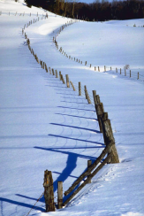
Memory Protection
Fence ⎯ users cannot cross a specified address
Static fence ⎯ fixed size OS
Dynamic fence ⎯ fence register
Base/bounds register ⎯ lower and upper address limit
Assumes contiguous space

Slide 216
Memory Protection
Tagging ⎯ specify protection of each address
+ Extremely fine-grained protection
- High overhead ⎯ can be reduced by tagging sections instead of individual addresses
- Compatibility
More common is segmentation and/or paging
Protection is not as flexible
But much more efficient

Slide 217
Segmentation
Divide memory into logical units, such as
Single procedure
Data in one array, etc.
Can enforce different access restrictions on different segments
Any segment can be placed in any memory location (if location is large enough)
OS keeps track of actual locations

Slide 218
Segmentation
memory
program

Slide 219
Segmentation
OS can place segments anywhere
OS keeps track of segment locations as <segment,offset>
Segments can be moved in memory
Segments can move out of memory
All address references go thru OS

Slide 220
Segmentation Advantages
Every address reference can be checked
Possible to achieve complete mediation
Different protection can be applied to different segments
Users can share access to segments
Specific users can be restricted to specific segments

Slide 221
Segmentation Disadvantages
How to reference <segment,offset> ?
OS must know segment size to verify access is within segment
But some segments can grow during execution (for example, dynamic memory allocation)
OS must keep track of variable segment sizes
Memory fragmentation is also a problem
Compacting memory changes tables
A lot of work for the OS
More complex ⇒ more chance for mistakes

Slide 222
Paging
Like segmentation, but fixed-size segments
Access via <page,offset>
Plusses and minuses
+ Avoids fragmentation, improved efficiency
+ OS need not keep track of variable segment sizes
- No logical unity to pages
- What protection to apply to a given page?

Slide 223
Paging
memory
program
Page 1
Page 0
Page 2
Page 1
Page 0
Page 2
Page 3
Page 4
Page 4
Page 3

Slide 224
Other OS Security Functions
OS must enforce access control
Authentication
Passwords, biometrics
Single sign-on, etc.
Authorization
ACL
Capabilities
These topics discussed previously
OS is an attractive target for attack!

Slide 225
Trusted Operating System

Slide 226
Trusted Operating System
An OS is trusted if we rely on it for
Memory protection
File protection
Authentication
Authorization
Every OS does these things
But if a trusted OS fails to provide these, our security fails

Slide 227
Trust vs Security
Trust implies reliance
Trust is binary
Ideally, only trust secure systems
All trust relationships should be explicit
Security is a judgment of effectiveness
Judge based on specified policy
Security depends on trust relationships
Note: Some authors use different terminology!

Slide 228
Trusted Systems
Trust implies reliance
A trusted system is relied on for security
An untrusted system is not relied on for security
If all untrusted systems are compromised, your security is unaffected
Ironically, only a trusted system can break your security!

Slide 229
Trusted OS
OS mediates interactions between subjects (users) and objects (resources)
Trusted OS must decide
Which objects to protect and how
Which subjects are allowed to do what

Slide 230
General Security Principles
Least privilege ⎯ like “low watermark”
Simplicity
Open design (Kerchoffs Principle)
Complete mediation
White listing (preferable to black listing)
Separation
Ease of use
But commercial OSs emphasize features
Results in complexity and poor security

Slide 231
OS Security
Any OS must provide some degree of
Authentication
Authorization (users, devices and data)
Memory protection
Sharing
Fairness
Inter-process communication/synchronization
OS protection

Slide 232




OS Services
users
Synchronization
Concurrency
Deadlock
Communication
Audit trail, etc.
User interface
services
Operating system
Resource
Data, programs,
CPU, memory,
I/O devices, etc.
allocation

Slide 233
Trusted OS
A trusted OS also provides some or all of
User authentication/authorization
Mandatory access control (MAC)
Discretionary access control (DAC)
Object reuse protection
Complete mediation ⎯ access control
Trusted path
Audit/logs

Slide 234
Trusted OS Services
users
Synchronization
Concurrency
Deadlock
Communication
Audit trail, etc.
User interface
Access control
Authentication
services
Resource
allocation
Operating system
Data, programs,
CPU, memory,
I/O devices, etc.
Access control

Slide 235
MAC and DAC
Mandatory Access Control (MAC)
Access not controlled by owner of object
Example: User does not decide who holds a TOP SECRET clearance
Discretionary Access Control (DAC)
Owner of object determines access
Example: UNIX/Windows file protection
If DAC and MAC both apply, MAC wins

Slide 236
Object Reuse Protection
OS must prevent leaking of info
Example
User creates a file
Space allocated on disk
But same space previously used
“Leftover” bits could leak information
Magnetic remanence is a related issue

Slide 237
Trusted Path
Suppose you type in your password
What happens to the password?
Depends on the software!
How can you be sure software is not evil?
Trusted path problem:
“I don't know how to to be confident even of a digital signature I make on my own PC, and I've worked in security for over fifteen years. Checking all of the software in the critical path between the display and the signature software is way beyond my patience. ”
⎯ Ross Anderson

Slide 238
Audit
System should log security-related events
Necessary for postmortem
What to log?
Everything? Who (or what) will look at it?
Don’t want to overwhelm administrator
Needle in haystack problem
Should we log incorrect passwords?
“Almost” passwords in log file?
Logging is not a trivial matter

Slide 239
Security Kernel
Kernel is the lowest-level part of the OS
Kernel is responsible for
Synchronization
Inter-process communication
Message passing
Interrupt handling
The security kernel is the part of the kernel that deals with security
Security kernel contained within the kernel

Slide 240
Security Kernel
Why have a security kernel?
All accesses go thru kernel
Ideal place for access control
Security-critical functions in one location
Easier to analyze and test
Easier to modify
More difficult for attacker to get in “below” security functions

Slide 241
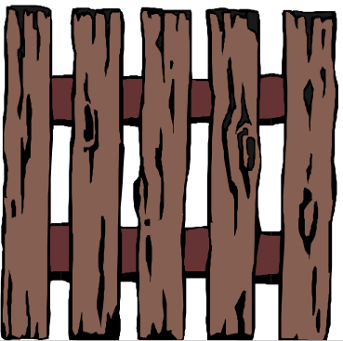
Reference Monitor
The part of the security kernel that deals with access control
Mediates access of subjects to objects
Tamper-resistant
Analyzable (small, simple, etc.)
Objects
Subjects
Reference monitor

Slide 242
Trusted Computing Base
TCB ⎯ everything in the OS that we rely on to enforce security
If everything outside TCB is subverted, trusted OS would still be trusted
TCB protects users from each other
Context switching between users
Shared processes
Memory protection for users
I/O operations, etc.

Slide 243
TCB Implementation
Security may occur many places within OS
Ideally, design security kernel first, and build the OS around it
Reality is usually the other way around
Example of a trusted OS: SCOMP
Developed by Honeywell
Less than 10,000 LOC in SCOMP security kernel
Win XP has 40,000,000 lines of code!

Slide 244
Poor TCB Design
Hardware
OS kernel
Operating system
User space
Security critical activities
Problem: No clear security layer

Slide 245
Better TCB Design
Hardware
Security kernel
Operating system
User space
Security kernel is the security layer

Slide 246
Trusted OS Summary
Trust implies reliance
TCB (trusted computing base) is everything in OS we rely on for security
If everything outside TCB is subverted, we still have trusted system
If TCB subverted, security is broken
OS
OS Kernel
Security Kernel

Slide 247
NGSCB

Slide 248
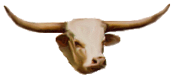

Next Generation Secure Computing Base
NGSCB pronounced “n-scub” (the G is silent)
Was supposed to be part of Vista OS
Vista was once known as Longhorn…
TCG (Trusted Computing Group)
Led by Intel, TCG makes special hardware
NGSCB is the part of Windows that will interface with TCG hardware
TCG/NGSCB formerly TCPA/Palladium
Why the name changes?

Slide 249
NGSCB
The original motivation for TCPA/Palladium was digital rights management (DRM)
Today, TCG/NGSCB is promoted as general security-enhancing technology
DRM just one of many potential applications
Depending on who you ask, TCG/NGSCB is
Trusted computing
Treacherous computing

Slide 250
Motivation for TCG/NGSCB
Closed systems: Game consoles, etc.
Good at protecting secrets (tamper resistant)
Good at forcing people to pay for software
Limited flexibility
Open systems: PCs
Incredible flexibility
Poor at protecting secrets
Very poor at defending their own software
TCG: closed system security on open platform
“virtual set-top box inside your PC” ⎯ Rivest

Slide 251
TCG/NGSCB
TCG provides tamper-resistant hardware
Secure place to store cryptographic key
Key secure from a user with admin privileges!
TCG hardware is in addition to ordinary hardware, not in place of it
PC has two OSs ⎯ regular OS and special trusted OS to deal with TCG hardware
NGSCB is Microsoft’s trusted OS

Slide 252
NGSCB Design Goals
Provide high assurance
High confidence that system behaves correctly
Correct behavior even if system is under attack
Provide authenticated operation
Authenticate “things” (software, devices, etc.)
Protection against hardware tampering is concern of TCG, not NGSCB

Slide 253
NGSCB Disclaimer
Specific details are sketchy
Based on available info, Microsoft may not have resolved all of the details
Maybe un-resolvable?
What follows: author’s best guesses
This should all become much clearer in the not-too-distant future
At least I thought so a couple of years ago…

Slide 254
NGSCB Architecture
Left-hand side (LHS)
Right-hand side (RHS)
u
n
t
r
u
s
t
e
d
Application
NCA
NCA
t
r
u
s
t
e
d
Application
User space
Kernel
Regular OS
Nexus
Drivers
Nexus is the Trusted Computing Base in NGSCB
The NCA (Nexus Computing Agents) talk to Nexus and LHS

Slide 255
NGSCB
NGSCB has 4 “feature groups”
Strong process isolation
Processes do not interfere with each other
Sealed storage
Data protected (tamper resistant hardware)
Secure path
Data to and from I/O protected
Attestation
“Things” securely authenticated
Allows TCB to be extended via NCAs
All are aimed at malicious code
4. also provides (secure) extensibility

Slide 256
NGSCB Process Isolation
Curtained memory
Process isolation and the OS
Protect trusted OS (Nexus) from untrusted OS
Isolate trusted OS from untrusted stuff
Process isolation and NCAs
NCAs isolated from software they do not trust
Trust determined by users, to an extent…
User can disable a trusted NCA
User cannot enable an untrusted NCA

Slide 257
NGSCB Sealed Storage
Sealed storage contains secret data
If code X wants access to secret, a hash of X must be verified (integrity check of X)
Implemented via symmetric key cryptography
Confidentiality of secret is protected since only accessed by trusted software
Integrity of secret is assured since it’s in sealed storage

Slide 258
NGSCB Secure Path
Secure path for input
From keyboard to Nexus
From mouse to Nexus
From any input device to Nexus
Secure path for output
From Nexus to the screen
Uses crypto (digital signatures)

Slide 259
NGSCB Attestation (1)
Secure authentication of things
Authenticate devices, services, code, etc.
Separate from user authentication
Public key cryptography used
Certified key pair required
Private key not user-accessible
Sign and send result to remote system
TCB extended via attestation of NCAs
This is a major feature!

Slide 260
NGSCB Attestation (2)
Public key used for attestation
However, public key reveals the user identity
Using public keys, anonymity would be lost
Trusted third party (TTP) can be used
TTP verifies signature
Then TTP vouches for signature
Anonymity preserved (except to TTP)
Support for zero knowledge proofs
Verify knowledge of a secret without revealing it
Anonymity “preserved unconditionally”

Slide 261
NGSCB Compelling Apps (1)
Type your Word document in Windows
I.e., the untrusted LHS
Move document to trusted RHS
Read document carefully
Digitally sign the document
Assured that “what you see is what you sign”
Practically impossible to get this on your PC

Slide 262
NGSCB Compelling Apps (2)
Digital Rights Management (DRM)
Many DRM problems solved by NGSCB
Protect secret ⎯ sealed storage
Impossible without something like NGSCB
Scraping data ⎯ secure path
Cannot prevent without something like NGSCB
Positively ID users
Higher assurance with NGSCB

Slide 263
NGSCB According to MS
All of Windows works on untrusted LHS
User is in charge of…
Which Nexus(es) will run on system
Which NCAs will run on system
Which NCAs allowed to identify system, etc.
No external process enables Nexus or NCA
Nexus can’t block, delete, censor data
NCA does, but NCAs authorized by user
Nexus is open source

Slide 264
NGSCB Critics
Many critics ⎯ we consider two
Ross Anderson
Perhaps the most influential critic
Also one of the harshest critics
Clark Thomborson
Lesser-known critic
Criticism strikes at heart of NGSCB

Slide 265
Anderson’s NGSCB Criticism (1)
Digital object controlled by its creator, not user of machine where it resides: Why?
Creator can specify the NCA
If user does not accept NCA, access is denied
Aside: This is critical for, say, MLS applications
If Microsoft Word encrypts all documents with key only available to Microsoft products
Then difficult to stop using Microsoft products

Slide 266
Anderson’s NGSCB Criticism (2)
Files from a compromised machine could be blacklisted to, e.g., prevent music piracy
Suppose everyone at SJSU uses same pirated copy of Microsoft Word
If you stop this copy from working on all NGSCB machines, SJSU users will not use NGSCB
Instead, make all NGSCB machines refuse to open documents created with this copy of Word…
…so SJSU user can’t share docs with NGSCB user…

Slide 267
Anderson’s NGSCB Criticism (3)
Going off the deep end…
“The Soviet Union tried to register and control all typewriters. NGSCB attempts to register and control all computers.”
“In 2010 President Clinton may have two red buttons on her desk ⎯ one that sends missiles to China and another that turns off all of the PCs in China…”

Slide 268
Thomborson’s NGSCB Criticism
NGSCB acts like a security guard
By passive observation, NGSCB “security guard” can see sensitive info
Former student worked as security guard at apartment complex
By passive observations…
…he learned about people who lived there

Slide 269
Thomborson’s NGSCB Criticism
Can NGSCB spy on you?
According to Microsoft
Nexus software is public
NCAs can be debugged (for development)
NGSCB is strictly “opt in”
Loophole?
Release version of NCA can’t be debugged and debug and release versions differ

Slide 270
NGSCB Bottom Line (1)
NGCSB: trusted OS on an open platform
Without something similar, PC may lose out
Particularly in entertainment-related areas
Copyright holders will not trust PC
Already lost? (iPod, Kindle, iPad, etc., etc.)
With NGSCB, will users lose some control of their PCs?
But NGSCB users must choose to “opt in”
If user does not opt in, what has been lost?

Slide 271
NGSCB Bottom Line (2)
NGSCB is a trusted system
Only trusted system can break security
By definition, an untrusted system is not trusted with security critical tasks
Also by definition, a trusted system is trusted with security critical tasks
If untrusted system is compromised, security is not at risk
If a trusted system is compromised (or simply malfunctions), security is at risk

Slide 272
Software Summary
Software flaws
Buffer overflow
Race conditions
Incomplete mediation
Malware
Viruses, worms, etc.
Other software-based attacks

Slide 273
Software Summary
Software Reverse Engineering (SRE)
Digital Rights Management (DRM)
Secure software development
Penetrate and patch
Open vs closed source
Testing

Slide 274
Software Summary
Operating systems and security
How does OS enforce security?
Trusted OS design principles
Microsoft’s NGSCB
A trusted OS for DRM

Slide 275
Course Summary
Crypto
Symmetric key, public key, hash functions, cryptanalysis
Access Control
Authentication, authorization
Protocols
Simple auth., SSL, IPSec, Kerberos, GSM
Software
Flaws, malware, SRE, Software development, trusted OS

