Slide 2



Slide 3
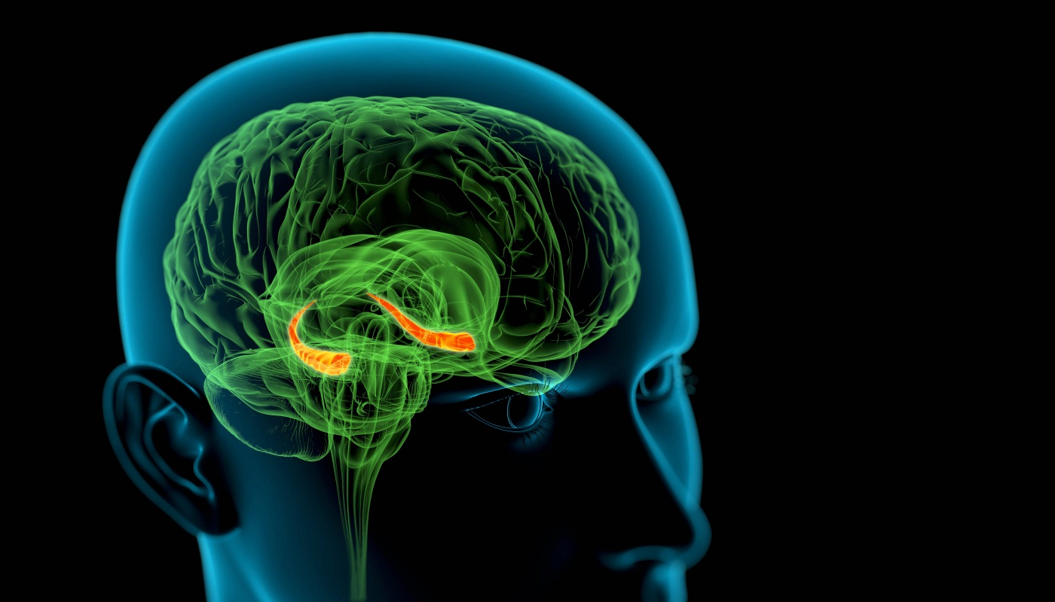
Roger Harris/Science Photo Library | Andersen, P. ed., 2007. The hippocampus book. Oxford university press.

