Slide 1
Updates
Marium Yousuf
FA25

Slide 2
Agenda
Last time: spike graph on N=3
Scalability profile
N=3 to N=10 (chain) and N=3 to N=9 (cycle)
N=3, 4, and 5 (multiple graphs)
Application to NEURON data

Slide 3
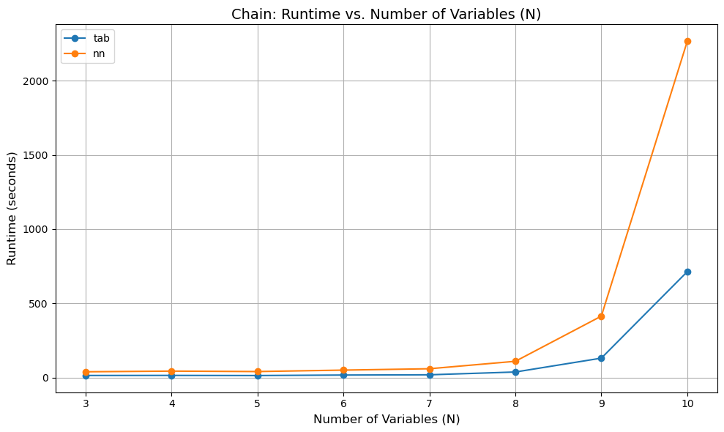
Runtime (Chain)

Slide 4
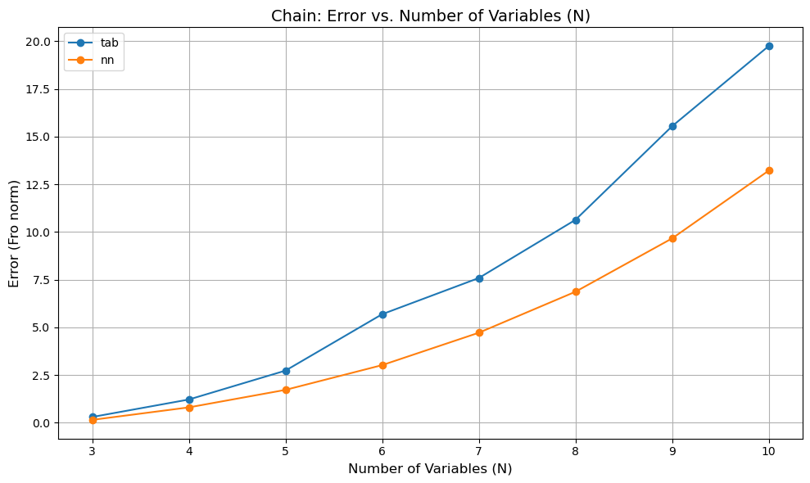
Error (Chain)

Slide 5
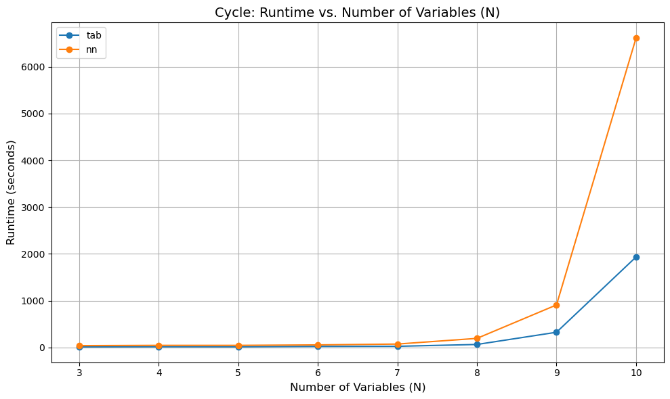
Runtime (Cycle)

Slide 6
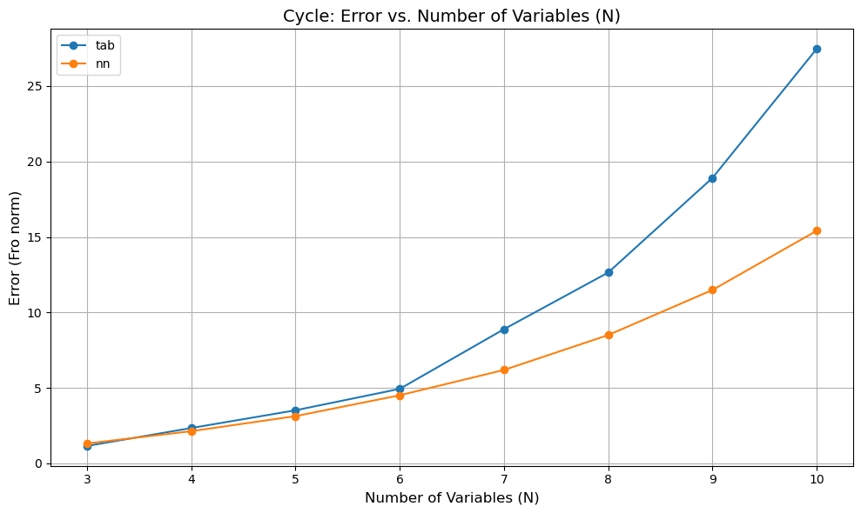
Error (Cycle)

Slide 7
Other graphs (N=3)
Graph | Runtime in s (tab/nn) | Error (tab/nn)
Chain T=20, K=1000 | 14.5911 / 39.5192 | 0.3031 / 0.1523
Inward fork T=20, K=1000 | 13.0337 / 40.8725 | 0.3395 / 0.1439
Single edge T=20, K=1000 | 13.4979 / 42.6146 | 0.2687 / 0.1327
Outward form T=20, K=1000 | 13.8945 / 41.9764 | 0.2827 / 0.0597
Empty T=20, K=1000 | 13.8677 / 42.0798 | 0.2211 / 0.0819
DAG T=20, K=1000 | 13.5603 / 41.7291 | 0.3294 / 0.1785
Cycle T=20, K=1000 | 13.7027 / 41.6537 | 2.0364 / 2.2047
Cycle T=40, K=10K | 12.7265 / 37.4910 | 1.1493 / 1.5794
Cycle T=60, K=10K | 12.3985 / 38.1734 | 1.1546 / 1.3173
Cycle T=100, K=100K | 13.3274 / 40.1913 | 1.2039 / 1.1157

Slide 8
Other graphs (N=4)
Graph | Runtime in s (tab/nn) | Error (tab/nn)
Chain T=20, K=1000 | 15.0796 / 44.0042 | 1.2197 / 0.8074
Inward fork T=20, K=1000 | 14.3675 / 43.6284 | 1.2883 / 0.3793
Single edge T=20, K=1000 | 14.1792 / 43.1564 | 0.7299 / 0.1775
Outward fork T=20, K=1000 | 14.4912 / 43.3753 | 0.5895 / 0.2184
Empty T=20, K=1000 | 14.5122 / 41.9608 | 0.5301 / 0.1210
DAG T=20, K=1000 | 13.6298 / 41.1224 | 1.1491 / 0.7875
Cycle T=60, K=10K | 14.5563 / 44.1851 | 2.3419 / 2.1324
Cycle+chord α=10 | 13.7148 / 41.1705 | 2.5925 / 2.1212

Slide 9
Other graphs (N=5)
Graph | Runtime in s (tab/nn) | Error (tab/nn)
Chain T=20, K=1000 | 14.2143 / 41.0399 | 2.7347 / 1.7248
Empty T=20, K=1000 | 13.4176 / 41.3769 | 1.3170 / 0.2188
Cycle T=60, K=10K | 13.8833 / 44.1778 | 3.5173 / 3.1297
Cycle+chord T=60, K=10K | 14.9570 / 43.2242 | 4.5665 / 3.4765
Cycle+chord α=10 | 13.4370 / 40.7904 | 4.5722 / 3.0948
Cycle+2chords α=10 | 13.5383 / 42.3660 | 4.9336 / 3.2946
Cycle+IF+Chain | 14.3309 / 43.2873 | 2.8437 / 2.3743
Two cycles T=20, K=1000 | 14.2317 / 43.5965 | 4.3631 / 3.3442

Slide 10
Application to NEURON data
Currently not getting output close to the ground truth
Only tried tabular
Choice of parameters
T (trajectory length), K (number of trajectories), α (nll coeff)
Errors:
VL: long-range effects
NLL: short-term transitions
Frequency of paths observed in the data
Transition probability matrix
First column dominant
Transition matrix to influence matrix

Slide 11
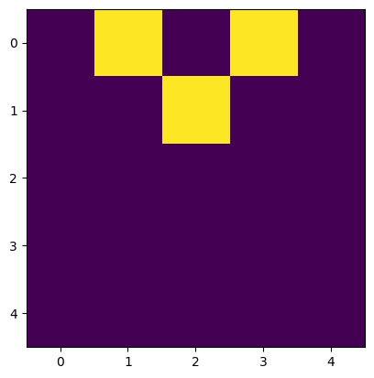
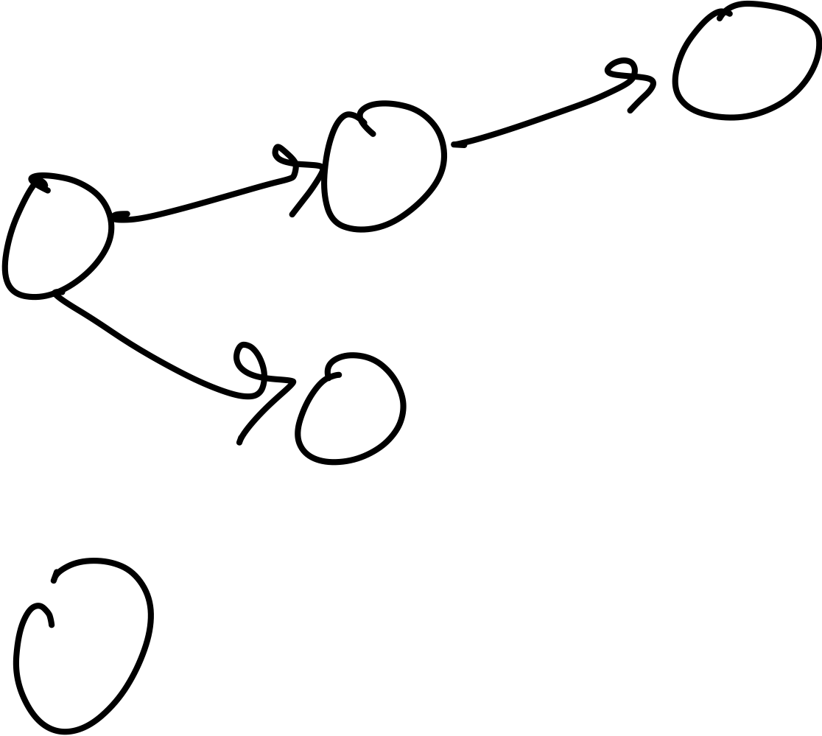
Frequency of observed paths
Frequency of paths informative?
For example, in a DAG:
(1, 1, 0, 0, 0): 24,
(0, 1, 1, 0, 0): 12,
(1, 0, 0, 1, 0): 18,
Counts of these state indices should be high
2^(i-1), i \in {1, …, N} is also high

Slide 12
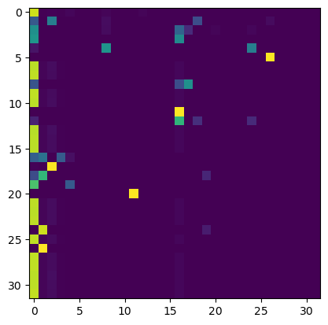
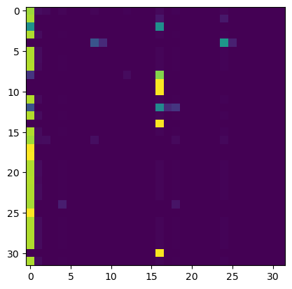
Transition probability matrix
First column dominant
State (0, 0, 0, 0, 0): 0 is prevalent
Model learning it as the default next state
Is drop-first relevant here?
Contains cycle
DAG

