Slide 1

Training Database
Creators:
Tugui Ioan
Nastasa Marius Alexandru
Nechita-Drob Sebastian

Slide 2
Motivation:
Our motivation for creating this trainings database is to help Human Resource employees to
have a easier way to keep track of the available learning resources and
too see the status of all the available trainings in the company.
Instead of having to collect from every individual employee or Team Leader, the status of their learning path through their period of employment , they will simply access our web page and life will be easy.

Slide 3
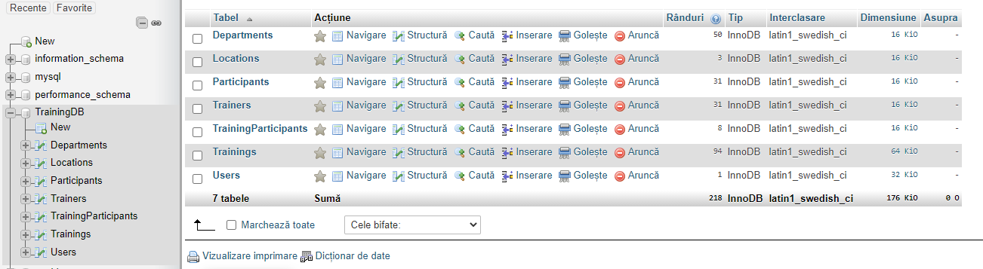
Our database in phpMyAdmin:

Slide 4
As you saw earlier, the database is named “TrainingDB”. It is composed from the following tables : Departments, Location, Participants, Trainers, TrainingParticipants, Trainings, Users.
Departments are formed from : Software, Testing, Research and Development, Human Resources and Hardware. Every department has its own specific trainings.
Locations only has an Online option and two Off-site options to participate at trainings.
Obviously Participants table contains the employees who are enrolled .
Same case with the Trainers table. It contains all the trainers that present a course.
TrainingParticipants table is a intermediary table to help with the many-to-many relationship.
Table Trainings contains all the learning coursers presented by the company.
And Users table contains all the username and password(in hash) pair of the “admins”. Meaning the only the HRs can view it’s content and modify the Trainings table.

Slide 5
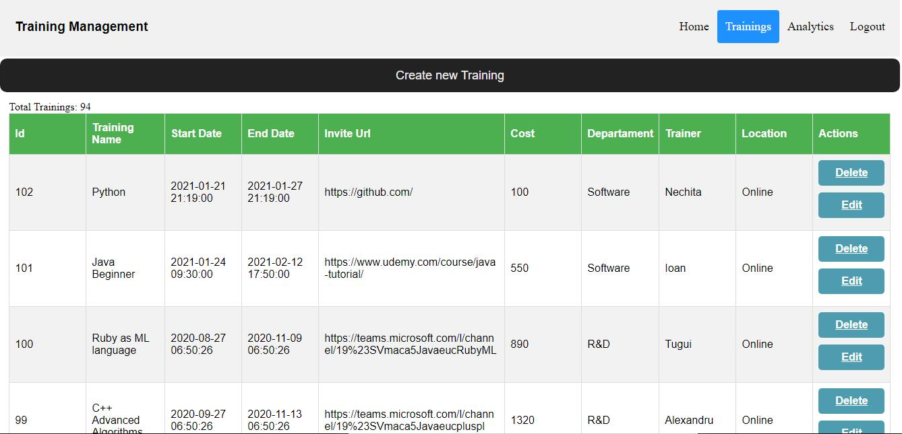
The Webpage:
This is the Trainings page

Slide 6
As you can see, our idea was to create a easy to read Webpage. Not agglomerating the pages with unnecessary buttons and strident colors , it will not stress your eyes even after 1 hour of continuous watching the screen monitor.
There are simple buttons. For creating new trainings or to delete/edit a training which is already created.
We also added a Login/Logout button and only the users that are added in the database cand access it. You cannot access the other pages until you’ve logged in in your account. If you try to access other pages, it will not matter because you’ll be pushed to the login page.
As a short mention is that the passwords are hashed for improved security.

Slide 7
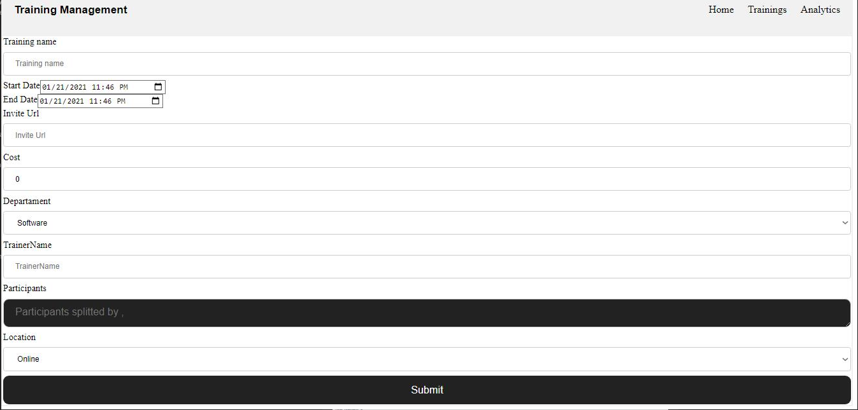
The “Create new Training” button:

Slide 8
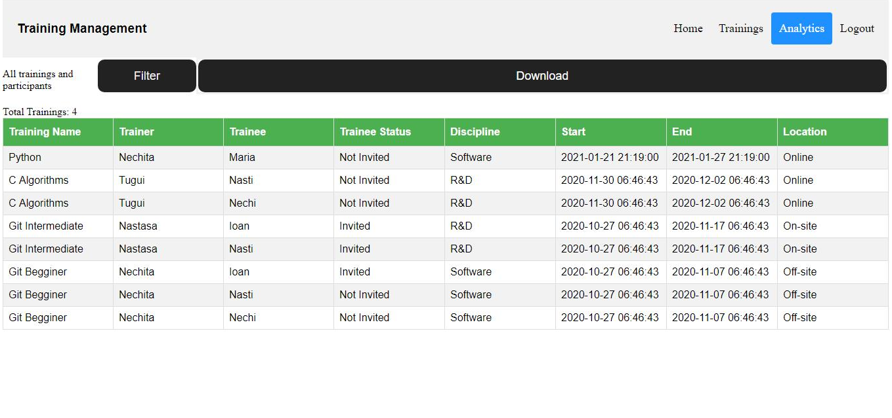
The Analytics page:

Slide 9
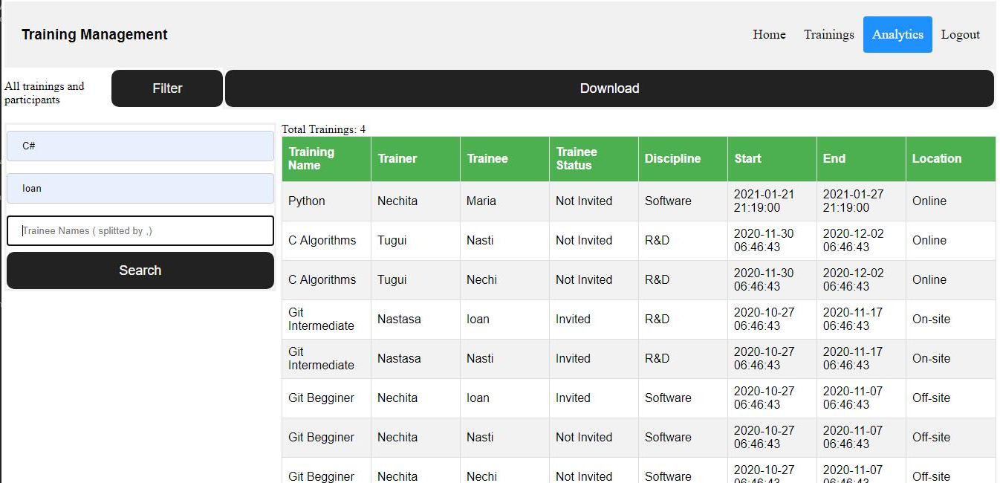
The Analytics page has 2 functions. One for filtering through the trainings and the other one to download the report of the filter search. As you can see the filtering can be on multiple criteria. By training names, by trainers name and by trainee names. Multiple names cand be added for a more exact search.

Slide 10
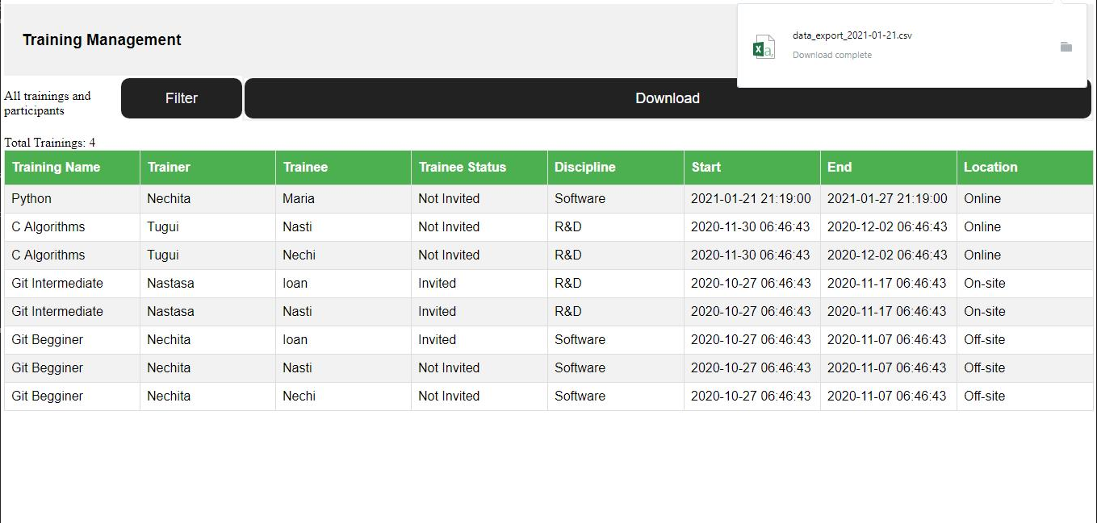
Here the Download function it is not yet fully developed and tested. It is still in work but we want to finish it as soon as possible. The idea is to have it exported as a csv file an after that you’ll be able to show the report to other people.

Slide 11
Thank you for the attention !!
You can find our work on GitHub on the link to our repository:
https://github.com/mariusalexandrunastasa/trainingsDB

