Slide 1

CASCON Community Hackathon 2011
Team 12:
      Marius-Gabriel Butuc,
      Dickson Chau,
      Qiao Chu,
      Jin Lee

Slide 2
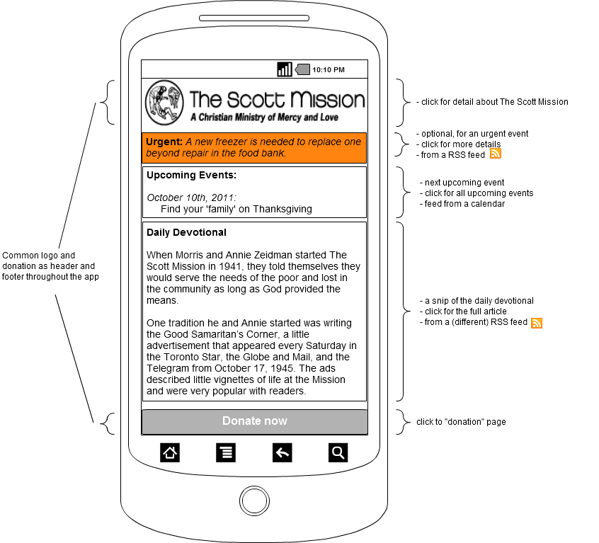
Landing Page

Slide 3
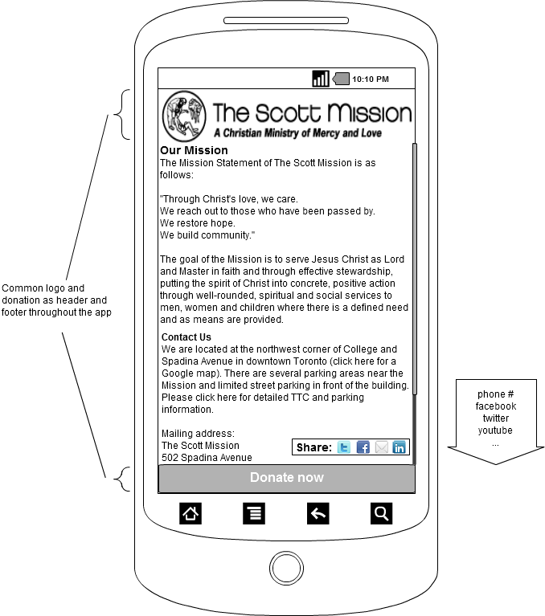
About Us

Slide 4
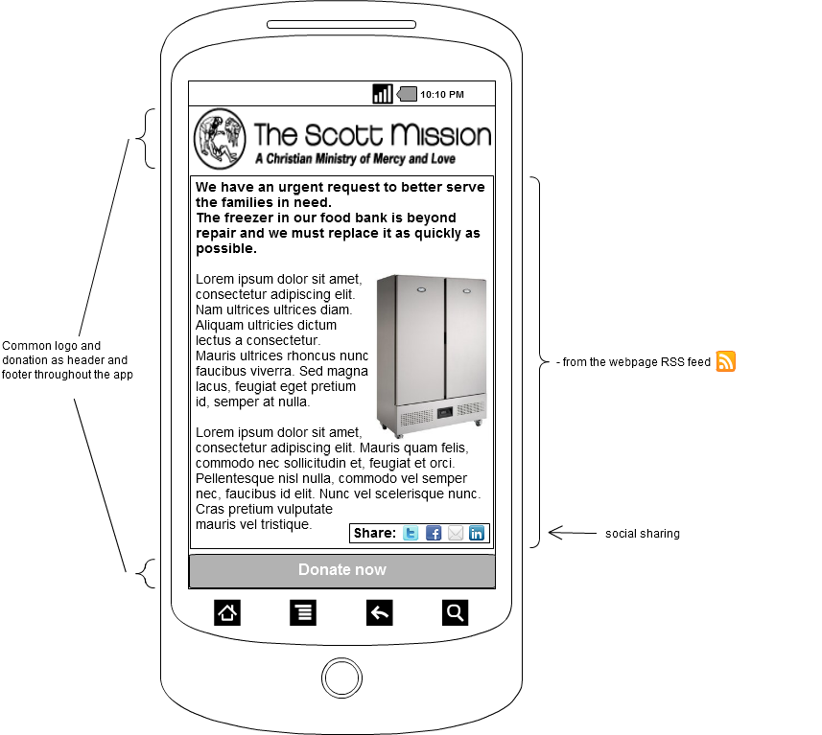
Urgent Event

Slide 5
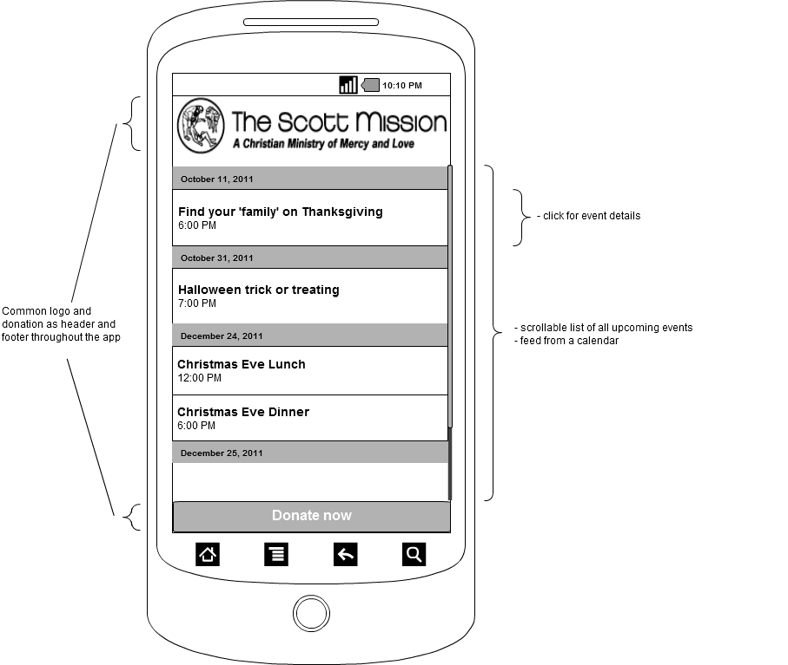
Calendar

Slide 6
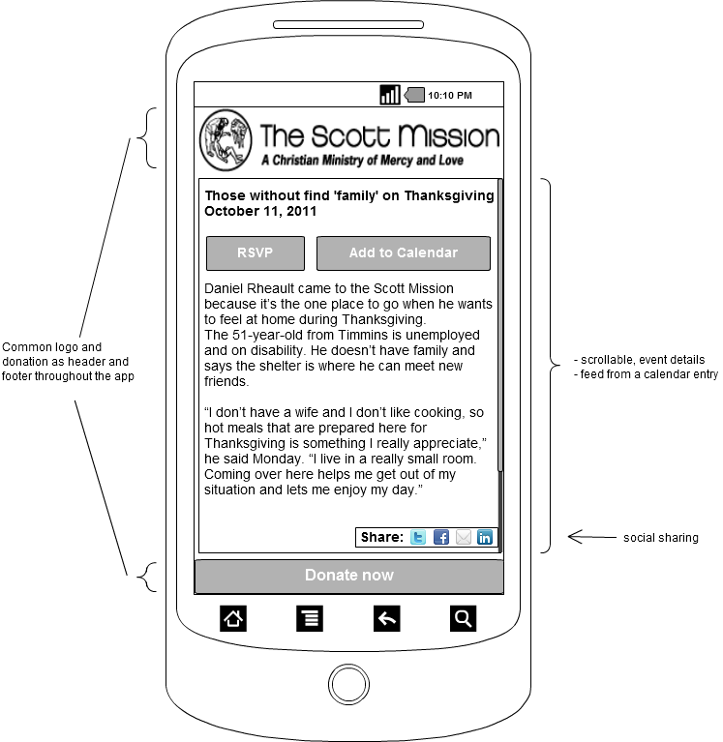
Calendar
» Event details

Slide 7
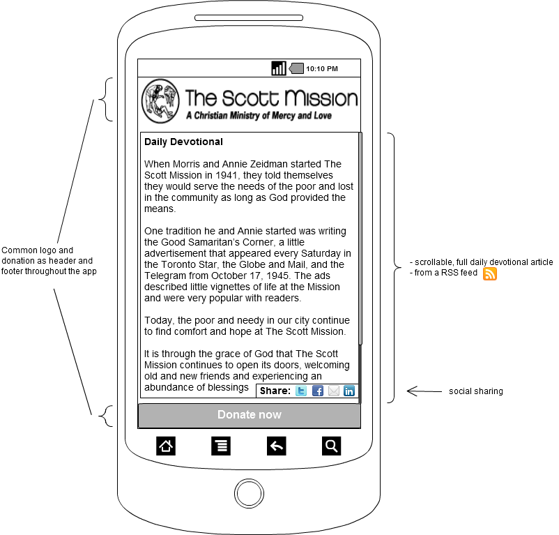
Daily Devotional

Slide 8
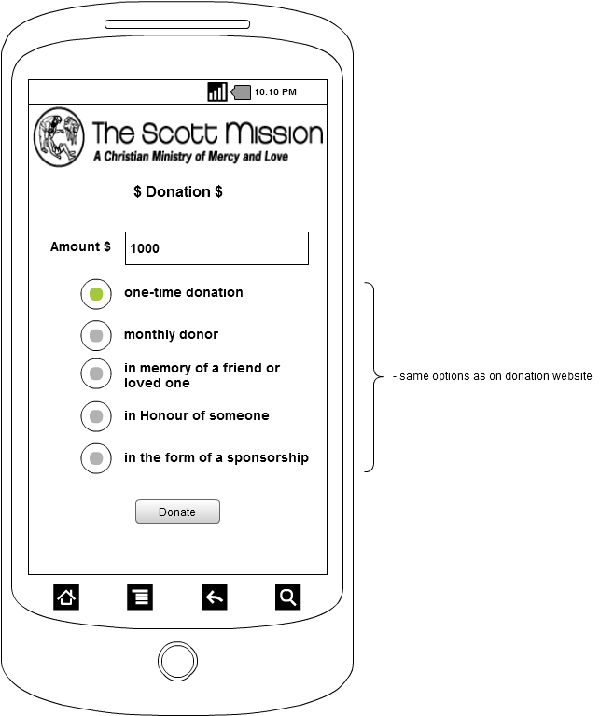
Donate

Slide 9
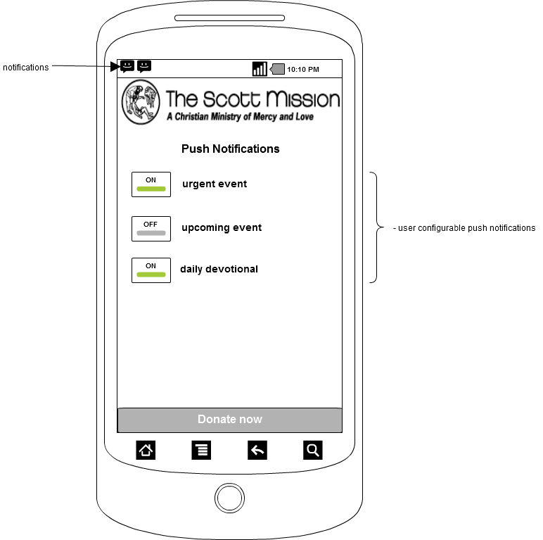
Setup

Slide 10
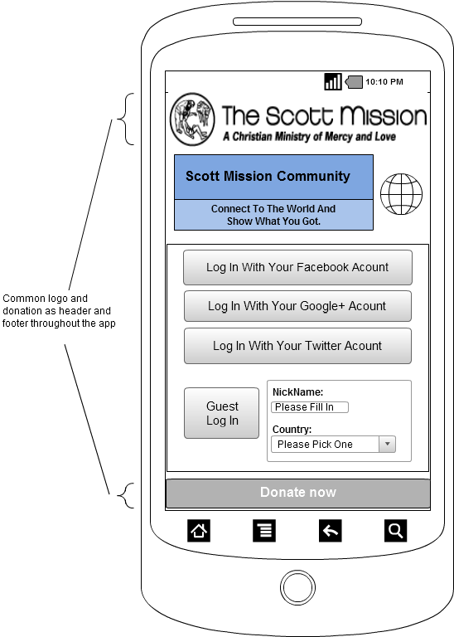
User Interaction
» Login

Slide 11
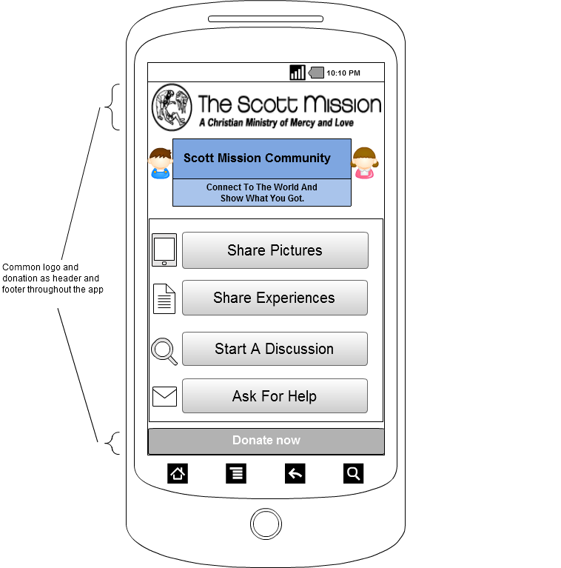
User Community

