Slide 1
Android Development
Android Development
November 13, 2011

Slide 2
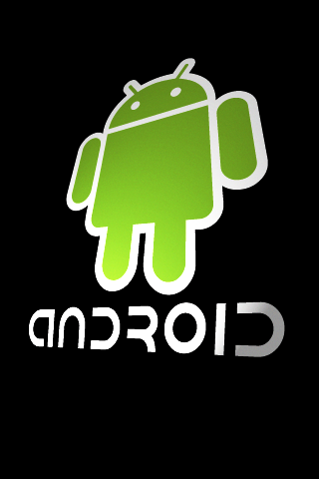

IBM Hackday
Project: RTC Android Application
  Connect to RTC via REST protocol
  Find work items based on id or keyword
  View work item information
Demo:

Slide 3
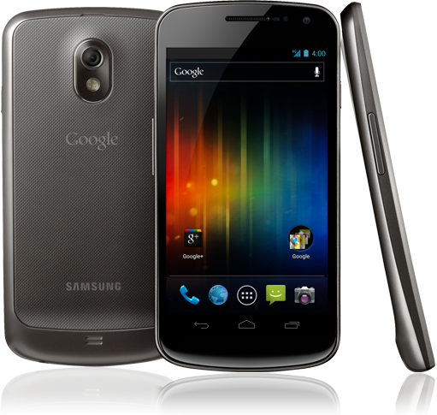
Android Platform
Background
  Open Source Operating System for Smartphones
  Over 190 million android devices in the market
  Approximately 300k applications available

Slide 4
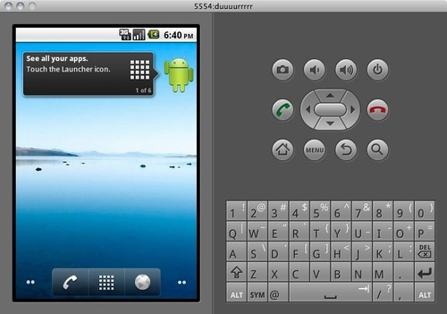
Android Application Development
Background
  Technologies:
    Logic: Java and C/C++ (through JNI)
    UI: XML
    Development: Eclipse + ADT plugin
    Testing: Android Emulator

Slide 5

Android Application Development

Slide 6
Android Application Development
Android Applications:
Activities
  An application that has a visible UI is implemented with an activity. When a user selects an application from the home screen or application launcher, an activity is started.
Services
  A service should be used for any application that needs to persist for a long time, such as a battery monitor or update-checking application.
Content providers
  You can think of content providers as a database server. A content provider's job is to manage access to persisted data, such as a SQLite database. If your application is very simple, you might not necessarily create a content provider. If you're building a larger application, or one that makes data available to multiple activities or applications, a content provider is the means of accessing your data.
Broadcast receivers
  An Android application may be launched to process a element of data or respond to an event, such as the receipt of a text message.

Slide 7
Hello World in Android
Activity Code: (HelloWorld.java)
package com.example.helloworld;
import android.app.Activity;
import android.os.Bundle;
public class HelloWorld extends Activity {
/** Called when the activity is first created. */
@Override
public void onCreate(Bundle savedInstanceState) {
super.onCreate(savedInstanceState);
setContentView(R.layout.main);
}
}
UI: (main.xml)
<?xml version="1.0" encoding="utf-8"?>
<TextView xmlns:android="http://schemas.android.com/apk/res/android"
android:id="@+id/textview"
android:layout_width="fill_parent"
android:layout_height="fill_parent"
android:text=“Hello World"/>

Slide 8
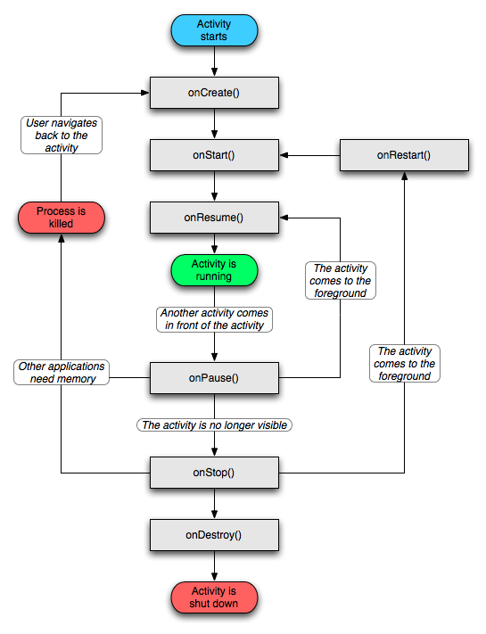
Activity Lifecycle

Slide 9
Android Manifest
AndroidManifest.xml:
<?xml version="1.0" encoding="utf-8"?>
<manifest xmlns:android="http://schemas.android.com/apk/res/android"
package="com.ibm.rational.jazz.android" android:versionCode="1"
android:versionName="1.0">
<uses-sdk android:minSdkVersion="7" />
<application android:icon="@drawable/icon" android:label=“Hello World Application">
<activity android:label=“Hello World Activity"
android:name="com.example.helloworld">
<intent-filter>
<action android:name="android.intent.action.MAIN" />
<category android:name="android.intent.category.LAUNCHER" />
</intent-filter>
</activity>
</application>
</manifest>

Slide 10
Multiplatform Mobile Development
PhoneGap
UI: HTML
Logic: Javascript
Supported Platforms: iOS, Android, Blackberry, WebOS, Symbian
URL: http://phonegap.com/start/#android

