Slide 1
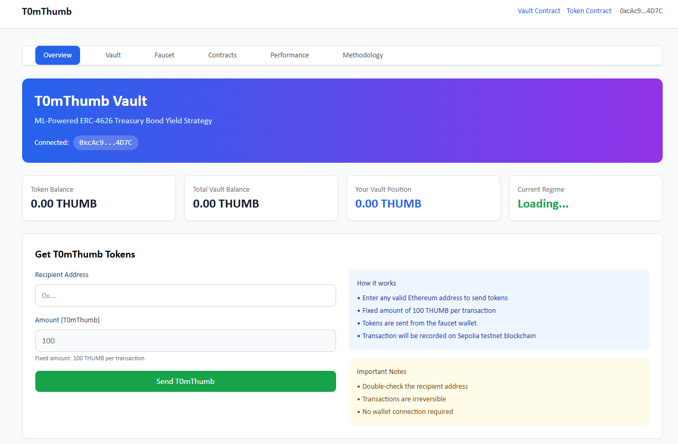
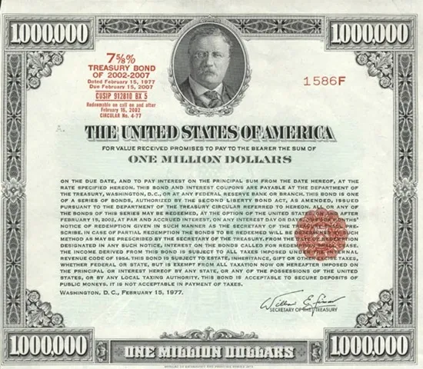

Demonstration for yield bearing token (ERC4626) of US treasury bonds
http://t0mthumb.projectcafe.kr:3000/
US treasury bonds
Deposit Asset
tokenize
Investors
Withdraw Asset
Deposit Earn
Owner
AI value distributor :
Tokens across different bonds

