Slide 1
Probabilistic Information Retrieval
Chris Manning, Pandu Nayak and
Prabhakar Raghavan

Slide 2



Who are these people?
Karen Spärck Jones
Stephen Robertson
Keith van Rijsbergen

Slide 3
Summary – vector space ranking
Represent the query as a weighted tf-idf vector
Represent each document as a weighted tf-idf vector
Compute the cosine similarity score for the query vector and each document vector
Rank documents with respect to the query by score
Return the top K (e.g., K = 10) to the user

Slide 4
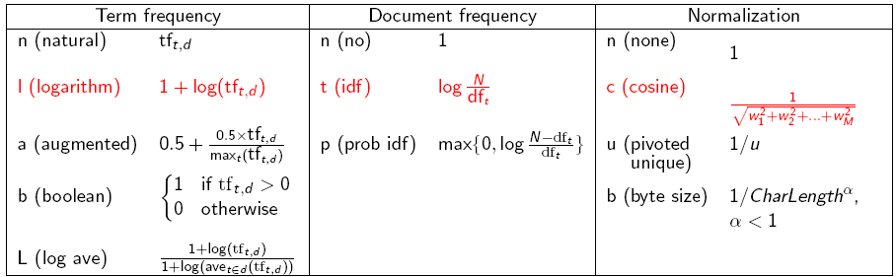
tf-idf weighting has many variants
Sec. 6.4
Notes:
n default is just term frequency
ltc is best known form of weighting

Slide 5
Why probabilities in IR?
User
Information Need
Query
Representation
Understanding
of user need is
uncertain
How to match?
Document
Representation
Uncertain guess of
whether document has relevant content
Documents
In traditional IR systems, matching between each document and
query is attempted in a semantically imprecise space of index terms.
Probabilities provide a principled foundation for uncertain reasoning.
Can we use probabilities to quantify our uncertainties?

Slide 6
Probabilistic IR topics
Classical probabilistic retrieval model
Probability ranking principle, etc.
Binary independence model (≈ Naïve Bayes text cat)
(Okapi) BM25
Bayesian networks for text retrieval
Language model approach to IR
An important emphasis in recent work
Probabilistic methods are one of the oldest but also one of the currently hottest topics in IR.
Traditionally: neat ideas, but didn’t win on performance
It may be different now.

Slide 7
The document ranking problem
We have a collection of documents
User issues a query
A list of documents needs to be returned
Ranking method is the core of an IR system:
In what order do we present documents to the user?
We want the “best” document to be first, second best second, etc….
Idea: Rank by probability of relevance of the document w.r.t. information need
P(R=1|document_{i}, query)

Slide 8
Recall a few probability basics
For events A and B:
Bayes’ Rule
Odds:
Prior
Posterior

Slide 9
The Probability Ranking Principle
“If a reference retrieval system’s response to each request is a ranking of the documents in the collection in order of decreasing probability of relevance to the user who submitted the request, where the probabilities are estimated as accurately as possible on the basis of whatever data have been made available to the system for this purpose, the overall effectiveness of the system to its user will be the best that is obtainable on the basis of those data.”
[1960s/1970s] S. Robertson, W.S. Cooper, M.E. Maron; van Rijsbergen (1979:113); Manning & Schütze (1999:538)

Slide 10
Probability Ranking Principle
Let x represent a document in the collection.
Let R represent relevance of a document w.r.t. given (fixed)
query and let R=1 represent relevant and R=0 not relevant.
Need to find p(R=1|x) - probability that a document x is relevant.
p(R=1),p(R=0) - prior probability
of retrieving a relevant or non-relevant
document
p(x|R=1), p(x|R=0) - probability that if a relevant (not relevant) document is retrieved, it is x.

Slide 11
Probability Ranking Principle (PRP)
Simple case: no selection costs or other utility concerns that would differentially weight errors
PRP in action: Rank all documents by p(R=1|x)
Theorem: Using the PRP is optimal, in that it minimizes the loss (Bayes risk) under 1/0 loss
Provable if all probabilities correct, etc. [e.g., Ripley 1996]

Slide 12
Probability Ranking Principle
More complex case: retrieval costs.
Let d be a document
C – cost of not retrieving a relevant document
C’ – cost of retrieving a non-relevant document
Probability Ranking Principle: if
for all d’ not yet retrieved, then d is the next document to be retrieved
We won’t further consider cost/utility from now on

Slide 13
Probability Ranking Principle
How do we compute all those probabilities?
Do not know exact probabilities, have to use estimates
Binary Independence Model (BIM) – which we discuss next – is the simplest model
Questionable assumptions
“Relevance” of each document is independent of relevance of other documents.
Really, it’s bad to keep on returning duplicates
Boolean model of relevance
That one has a single step information need
Seeing a range of results might let user refine query

Slide 14
Probabilistic Retrieval Strategy
Estimate how terms contribute to relevance
How do things like tf, df, and document length influence your judgments about document relevance?
A more nuanced answer is the Okapi formulae
Spärck Jones / Robertson
Combine to find document relevance probability
Order documents by decreasing probability
Notes:
In addition to the “document independence assumption” on previous slide, we have a “term independence assumption”: terms’ contributions to relevance are treated as independent events.
Okapi is one particular way of estimating probability given tf, df, and length.

Slide 15
Probabilistic Ranking
Basic concept:
“For a given query, if we know some documents that are relevant, terms that occur in those documents should be given greater weighting in searching for other relevant documents.
By making assumptions about the distribution of terms and applying Bayes Theorem, it is possible to derive weights theoretically.”
Van Rijsbergen

Slide 16
Binary Independence Model
Traditionally used in conjunction with PRP
“Binary” = Boolean: documents are represented as binary incidence vectors of terms (cf. IIR Chapter 1):
iff term i is present in document x.
“Independence”: terms occur in documents independently
Different documents can be modeled as the same vector

Slide 17
Binary Independence Model
Queries: binary term incidence vectors
Given query q,
for each document d need to compute p(R|q,d).
replace with computing p(R|q,x) where x is binary term incidence vector representing d.
Interested only in ranking
Will use odds and Bayes’ Rule:

Slide 18
Binary Independence Model
Constant for a given query
Needs estimation
Using Independence Assumption:

Slide 19
Binary Independence Model
Since x_{i} is either 0 or 1:
Let
Assume, for all terms not occurring in the query (q_{i}=0)

Slide 20
 | document | relevant (R=1) | not relevant (R=0)
term present | x_{i} = 1 | p_{i} | r_{i}
term absent | x_{i} = 0 | (1 – p_{i}) | (1 – r_{i})

Slide 21
Binary Independence Model
All matching terms
Non-matching query terms
All matching terms
All query terms
Notes:
Put all terms in query into right product and then divide through by them in left product.

Slide 22
Binary Independence Model
Constant for
each query
Only quantity to be estimated
for rankings
Retrieval Status Value:

Slide 23
Binary Independence Model
All boils down to computing RSV.
The c_{i} are log odds ratios
They function as the term weights in this model
So, how do we compute c_{i}’s from our data ?
Notes:
Used to say: Linear Discriminant Function, because it is a linear function in terms of log probabilities, but maybe that’s too far afield for here, and is better discussed later

Slide 24
Binary Independence Model
Estimating RSV coefficients in theory
For each term i look at this table of document counts:
Estimates:
For now,
assume no
zero terms.
See later
lecture.
Notes:
Prabhakar wanted the add 0.5 explained. Here or elsewhere?
Log odds ratio. Add 0.5 to every expression

Slide 25
Estimation – key challenge
If non-relevant documents are approximated by the whole collection, then r_{i} (prob. of occurrence in non-relevant documents for query) is n/N and

Slide 26
Estimation – key challenge
p_{i} (probability of occurrence in relevant documents) cannot be approximated as easily
p_{i} can be estimated in various ways:
from relevant documents if know some
Relevance weighting can be used in a feedback loop
constant (Croft and Harper combination match) – then just get idf weighting of terms (with p_{i}=0.5)
proportional to prob. of occurrence in collection
Greiff (SIGIR 1998) argues for 1/3 + 2/3 df_{i}/N

Slide 27
Probabilistic Relevance Feedback
Guess a preliminary probabilistic description of R=1 documents and use it to retrieve a first set of documents
Interact with the user to refine the description: learn some definite members with R=1 and R=0
Reestimate p_{i} and r_{i} on the basis of these
Or can combine new information with original guess (use Bayesian prior):
Repeat, thus generating a succession of approximations to relevant documents
κ is
prior
weight
Notes:
explicit Bayesian smoothing with a prior

Slide 28
Iteratively estimating p_{i} and r_{i} (= Pseudo-relevance feedback)
Assume that p_{i} is constant over all x_{i} in query and r_{i} as before
p_{i} = 0.5 (even odds) for any given doc
Determine guess of relevant document set:
V is fixed size set of highest ranked documents on this model
We need to improve our guesses for p_{i} and r_{i}, so
Use distribution of x_{i} in docs in V. Let V_{i} be set of documents containing x_{i}
p_{i} = |V_{i}| / |V|
Assume if not retrieved then not relevant
r_{i} = (n_{i} – |V_{i}|) / (N – |V|)
Go to 2. until converges then return ranking

Slide 29
PRP and BIM
Getting reasonable approximations of probabilities is possible.
Requires restrictive assumptions:
Term independence
Terms not in query don’t affect the outcome
Boolean representation of documents/queries/relevance
Document relevance values are independent
Some of these assumptions can be removed
Problem: either require partial relevance information or only can derive somewhat inferior term weights

Slide 30
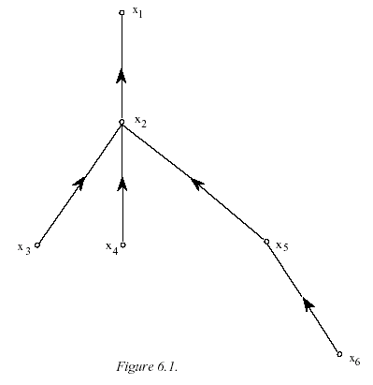
Removing term independence
In general, index terms aren’t independent
Dependencies can be complex
van Rijsbergen (1979) proposed model of simple tree dependencies
Exactly Friedman and Goldszmidt’s Tree Augmented Naive Bayes (AAAI 13, 1996)
Each term dependent on one other
In 1970s, estimation problems held back success of this model

Slide 31
Resources
S. E. Robertson and K. Spärck Jones. 1976. Relevance Weighting of Search Terms. Journal of the American Society for Information Sciences 27(3): 129–146.
C. J. van Rijsbergen. 1979. Information Retrieval. 2nd ed. London: Butterworths, chapter 6. [Most details of math] http://www.dcs.gla.ac.uk/Keith/Preface.html
N. Fuhr. 1992. Probabilistic Models in Information Retrieval. The Computer Journal, 35(3),243–255. [Easiest read, with BNs]
F. Crestani, M. Lalmas, C. J. van Rijsbergen, and I. Campbell. 1998. Is This Document Relevant? ... Probably: A Survey of Probabilistic Models in Information Retrieval. ACM Computing Surveys 30(4): 528–552.
http://www.acm.org/pubs/citations/journals/surveys/1998-30-4/p528-crestani/
[Adds very little material that isn’t in van Rijsbergen or Fuhr ]

