Slide 1
Hinrich Schütze and Christina Lioma
Lecture 14: Vector Space Classification

Slide 2
Overview
Recap
Feature selection
Intro vector space classification
Rocchio
kNN
Linear classifiers
> two classes

Slide 3
Outline
Recap
Feature selection
Intro vector space classification
Rocchio
kNN
Linear classifiers
> two classes

Slide 4
Relevance feedback: Basic idea
The user issues a (short, simple) query.
The search engine returns a set of documents.
User marks some docs as relevant, some as nonrelevant.
Search engine computes a new representation of the information need – should be better than the initial query.
Search engine runs new query and returns new results.
New results have (hopefully) better recall.
4

Slide 5
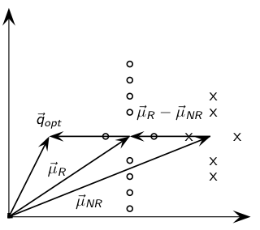
Rocchio illustrated
5

Slide 6
Take-away today
Feature selection for text classification: How to select a subset of available dimensions
Vector space classification: Basic idea of doing textclassification for documents that are represented as vectors
Rocchio classifier: Rocchio relevance feedback idea applied to text classification
k nearest neighbor classification
Linear classifiers
More than two classes
6

Slide 7
Outline
Recap
Feature selection
Intro vector space classification
Rocchio
kNN
Linear classifiers
> two classes

Slide 8
Feature selection
In text classification, we usually represent documents in a high-dimensional space, with each dimension corresponding to a term.
In this lecture: axis = dimension = word = term = feature
Many dimensions correspond to rare words.
Rare words can mislead the classifier.
Rare misleading features are called noise features.
Eliminating noise features from the representation increases efficiency and effectiveness of text classification.
Eliminating features is called feature selection.
8

Slide 9
Example for a noise feature
Let’s say we’re doing text classification for the class China.
Suppose a rare term, say ARACHNOCENTRIC, has no information about China . . .
. . . but all instances of ARACHNOCENTRIC happen to occur in
China documents in our training set.
Then we may learn a classifier that incorrectly interprets ARACHNOCENTRIC as evidence for the class China.
Such an incorrect generalization from an accidental property of the training set is called overfitting.
Feature selection reduces overfitting and improves the
accuracy of the classifier.
9

Slide 10
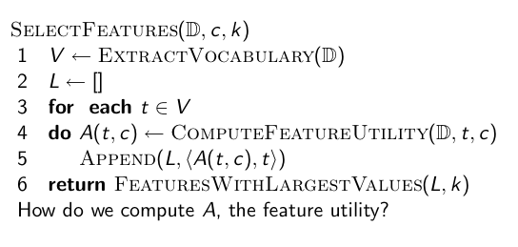
Basic feature selection algorithm
10

Slide 11
Different feature selection methods
A feature selection method is mainly defined by the feature utility measure it employs
Feature utility measures:
Frequency – select the most frequent terms
Mutual information – select the terms with the highest mutual information
Mutual information is also called information gain in this context.
Chi-square (see book)
11

Slide 12

Mutual information
Compute the feature utility A(t, c) as the expected mutual information (MI) of term t and class c.
MI tells us “how much information” the term contains about the class and vice versa.
For example, if a term’s occurrence is independent of the class (same proportion of docs within/without class contain the term), then MI is 0.
Definition:
12

Slide 13
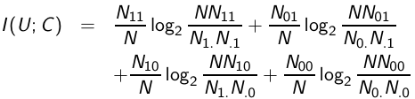
How to compute MI values
Based on maximum likelihood estimates, the formula we actually use is:
N10: number of documents that contain t (et = 1) and are
not in c (ec = 0); N11: number of documents that contain t
(et = 1) and are in c (ec = 1); N01: number of documents
that do not contain t (et = 1) and are in c (ec = 1); N00:
number of documents that do not contain t (et = 1) and are
not in c (ec = 1); N = N00 + N01 + N10 + N11.
13

Slide 14
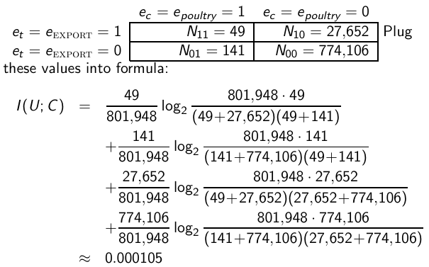
MI example for poultry/EXPORT in Reuters
14

Slide 15
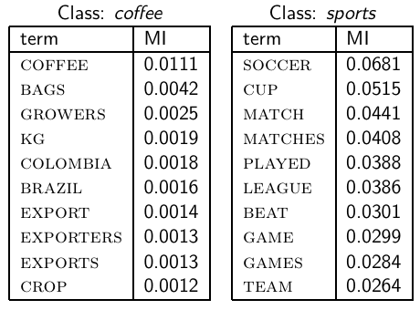
MI feature selection on Reuters
15

Slide 16
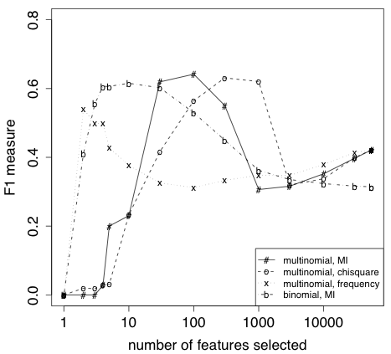
Naive Bayes: Effect of feature selection
(multinomial = multinomial Naive Bayes, binomial
= Bernoulli Naive Bayes)
16

Slide 17
Feature selection for Naive Bayes
In general, feature selection is necessary for Naive Bayes to get decent performance.
Also true for most other learning methods in text classification: you need feature selection for optimal performance.
17

Slide 18
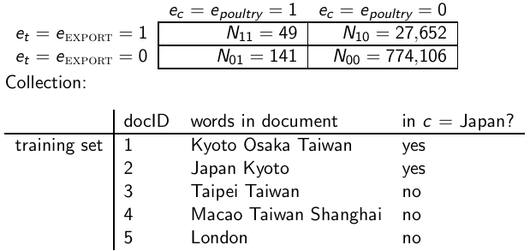
Exercise
(i) Compute the “export”/POULTRY contingency table for the
“Kyoto”/JAPAN in the collection given below. (ii) Make up a
contingency table for which MI is 0 – that is, term and class are
independent of each other. “export”/POULTRY table:
18

Slide 19
Outline
Recap
Feature selection
Intro vector space classification
Rocchio
kNN
Linear classifiers
> two classes

Slide 20
Recall vector space representation
Each document is a vector, one component for each term.
Terms are axes.
High dimensionality: 100,000s of dimensions
Normalize vectors (documents) to unit length
How can we do classification in this space?
20

Slide 21
Vector space classification
As before, the training set is a set of documents, each labeled with its class.
In vector space classification, this set corresponds to a labeled set of points or vectors in the vector space.
Premise 1: Documents in the same class form a contiguous region.
Premise 2: Documents from different classes don’t overlap.
We define lines, surfaces, hypersurfaces to divide regions.
21

Slide 22
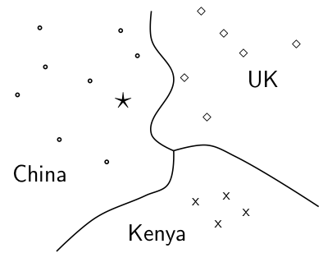
Classes in the vector space
Should the document ⋆ be assigned to China, UK or Kenya? Find
separators between the classes Based on these separators: ⋆ should
be assigned to China How do we find separators that do a good job
at classifying new documents like ⋆? – Main topic of today
22

Slide 23
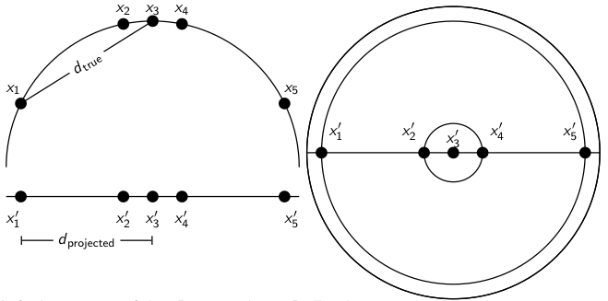
Aside: 2D/3D graphs can be misleading
Left: A projection of the 2D semicircle to 1D. For the points
x₁, x₂, x₃, x₄, x₅ at x coordinates −0.9,−0.2, 0, 0.2, 0.9 the distance
|x₂x₃| ≈ 0.201 only differs by 0.5% from |x′₂x′₃| = 0.2; but
|x₁x₃|/|x′₁x′₃| = d_{true}/d_{projected} ≈ 1.06/0.9 ≈ 1.18 is an example of
a large distortion (18%) when projecting a large area. Right: The
corresponding projection of the 3D hemisphere to 2D.
23

Slide 24
Outline
Recap
Feature selection
Intro vector space classification
Rocchio
kNN
Linear classifiers
> two classes

Slide 25
Relevance feedback
In relevance feedback, the user marks documents as relevant/nonrelevant.
Relevant/nonrelevant can be viewed as classes or categories.
For each document, the user decides which of these two classes is correct.
The IR system then uses these class assignments to build a better query (“model”) of the information need . . .
. . . and returns better documents.
Relevance feedback is a form of text classification.
25

Slide 26
Using Rocchio for vector space classification
The principal difference between relevance feedback and text classification:
The training set is given as part of the input in text classification.
It is interactively created in relevance feedback.
26

Slide 27
Rocchio classification: Basic idea
Compute a centroid for each class
The centroid is the average of all documents in the class.
Assign each test document to the class of its closest centroid.
27

Slide 28

Recall definition of centroid
where Dc is the set of all documents that belong to class c and
is the vector space representation of d.
28

Slide 29
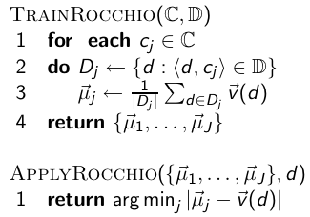
Rocchio algorithm
29

Slide 30
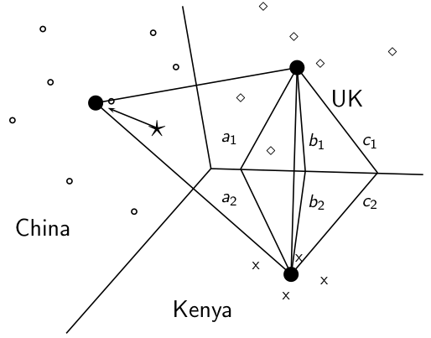
Rocchio illustrated : a1 = a2, b1 = b2, c1 = c2
30

Slide 31
Rocchio properties
Rocchio forms a simple representation for each class: the centroid
We can interpret the centroid as the prototype of the class.
Classification is based on similarity to / distance from centroid/prototype.
Does not guarantee that classifications are consistent with the training data!
31

Slide 32

Time complexity of Rocchio
32

Slide 33
Rocchio vs. Naive Bayes
In many cases, Rocchio performs worse than Naive Bayes.
One reason: Rocchio does not handle nonconvex, multimodal classes correctly.
33

Slide 34
Rocchio cannot handle nonconvex, multimodal classes
Exercise: Why is Rocchio
not expected to do well for
the classification task a vs.
b here?
A is centroid of the a’s, B is centroid of the b’s.
The point o is closer to A than to B.
But o is a better fit for the b class.
A is a multimodal class with two prototypes.
But in Rocchio we only have one prototype.
a
a
a
a
a
a
a
a
a
a
a
A
a
X
a
X
a
a
a
a
a
a
a
a
a
a
O
a
b
b
b
b
b
b
B
b
b
b
b
b
b
b
b
34

Slide 35
Outline
Recap
Feature selection
Intro vector space classification
Rocchio
kNN
Linear classifiers
> two classes

Slide 36
kNN classification
kNN classification is another vector space classification method.
It also is very simple and easy to implement.
kNN is more accurate (in most cases) than Naive Bayes and Rocchio.
If you need to get a pretty accurate classifier up and running in a short time . . .
. . . and you don’t care about efficiency that much . . .
. . . use kNN.
36

Slide 37
kNN classification
kNN = k nearest neighbors
kNN classification rule for k = 1 (1NN): Assign each test document to the class of its nearest neighbor in the training set.
1NN is not very robust – one document can be mislabeled or atypical.
kNN classification rule for k > 1 (kNN): Assign each test document to the majority class of its k nearest neighbors in the training set.
Rationale of kNN: contiguity hypothesis
We expect a test document d to have the same label as the training documents located in the local region surrounding d.
37

Slide 38
Probabilistic kNN
Probabilistic version of kNN: P(c|d) = fraction of k neighbors of d that are in c
kNN classification rule for probabilistic kNN: Assign d to class c with highest P(c|d)
38

Slide 39
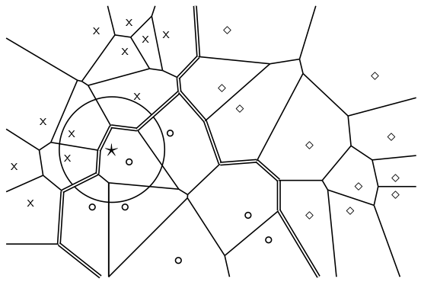
Probabilistic kNN
1NN, 3NN
classification
decision
for star?
39

Slide 40
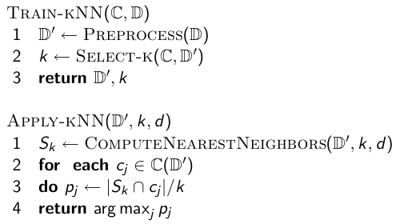
kNN algorithm
40

Slide 41
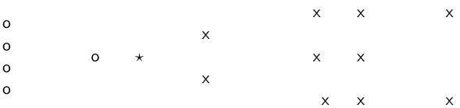
Exercise
How is star classified by:
(i) 1-NN (ii) 3-NN (iii) 9-NN (iv) 15-NN (v) Rocchio?
41

Slide 42
Time complexity of kNN
kNN with preprocessing of training set
training
testing
kNN test time proportional to the size of the training set!
The larger the training set, the longer it takes to classify a test document.
kNN is inefficient for very large training sets.
42

Slide 43
kNN: Discussion
No training necessary
But linear preprocessing of documents is as expensive as training Naive Bayes.
We always preprocess the training set, so in reality training time of kNN is linear.
kNN is very accurate if training set is large.
Optimality result: asymptotically zero error if Bayes rate is zero.
But kNN can be very inaccurate if training set is small.
43

Slide 44
Outline
Recap
Feature selection
Intro vector space classification
Rocchio
kNN
Linear classifiers
> two classes

Slide 45
Linear classifiers
Definition:
A linear classifier computes a linear combination or weighted sum of the feature values.
Classification decision:
. . .where (the threshold) is a parameter.
(First, we only consider binary classifiers.)
Geometrically, this corresponds to a line (2D), a plane (3D) or a hyperplane (higher dimensionalities), the separator.
We find this separator based on training set.
Methods for finding separator: Perceptron, Rocchio, Naïve Bayes – as we will explain on the next slides
Assumption: The classes are linearly separable.
45

Slide 46

A linear classifier in 1D
A linear classifier in 1D is a point described by the equation w₁d₁ = θ
The point at θ/w₁
Points (d₁) with w₁d₁ ≥ are in the class c.
Points (d₁) with w₁d₁ < θ are in the complement class
46

Slide 47
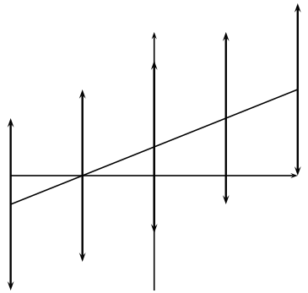
A linear classifier in 2D
A linear classifier in 2D is a line described by the equation w₁d₁ +w₂d₂ = θ
Example for a 2D linear classifier
Points (d₁ d₂) with w₁d₁ + w₂d₂ ≥ θ are in the class c.
Points (d₁ d₂) with w₁d₁ + w₂d₂ < θ are in the complement class
47

Slide 48
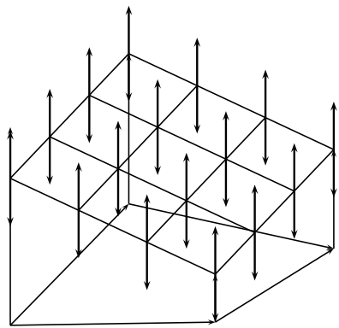
A linear classifier in 2D
A linear classifier in 3D is a plane described by the equation w1d1 + w2d2 + w3d3 = θ
Example for a 3D linear classifier
Points (d1 d2 d3) with w1d1 + w2d2 + w3d3 ≥ θ are in the class c.
Points (d1 d2 d3) with w1d1 + w2d2 + w3d3 < θ are in the complement class
48

Slide 49

Rocchio as a linear classifier
Rocchio is a linear classifier defined by:
where is the normal vector and
49

Slide 50

Naive Bayes as a linear classifier
Multinomial Naive Bayes is a linear classifier (in log space) defined
by:
where , d_{i} = number of occurrences of t_{i}
in d, and . Here, the index i , 1 ≤ i ≤ M,
refers to terms of the vocabulary (not to positions in d as k did in
our original definition of Naive Bayes)
50

Slide 51
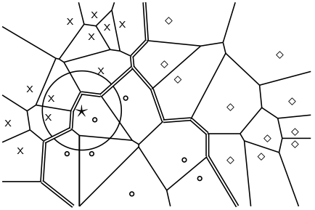
kNN is not a linear classifier
Classification decision based on majority of k nearest neighbors.
The decision boundaries between classes are piecewise linear . . .
. . . but they are in general not linear classifiers that can be described as
51

Slide 52
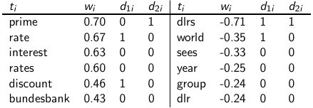
Example of a linear two-class classifier
This is for the class interest in Reuters-21578.
For simplicity: assume a simple 0/1 vector representation
d₁: “rate discount dlrs world”
d₂: “prime dlrs”
θ = 0
Exercise: Which class is d₁ assigned to? Which class is d₂ assigned to?
We assign document “rate discount dlrs world” to interest since
= 0.67 · 1 + 0.46 · 1 + (−0.71) · 1 + (−0.35) · 1 = 0.07 > 0 = θ.
We assign “prime dlrs” to the complement class (not in interest) since
= −0.01 ≤ θ.
52

Slide 53
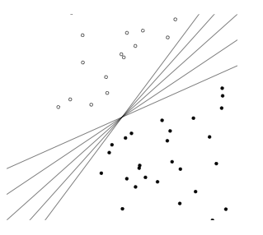
Which hyperplane?
53

Slide 54
Learning algorithms for vector space classification
In terms of actual computation, there are two types of learning algorithms.
(i) Simple learning algorithms that estimate the parameters of the classifier directly from the training data, often in one linear pass.
Naive Bayes, Rocchio, kNN are all examples of this.
(ii) Iterative algorithms
Support vector machines
Perceptron (example available as PDF on website: http://ifnlp.org/ir/pdf/p.pdf)
The best performing learning algorithms usually require iterative learning.
54

Slide 55
Which hyperplane?
55

Slide 56
Which hyperplane?
For linearly separable training sets: there are infinitely many separating hyperplanes.
They all separate the training set perfectly . . .
. . . but they behave differently on test data.
Error rates on new data are low for some, high for others.
How do we find a low-error separator?
Perceptron: generally bad; Naive Bayes, Rocchio: ok; linear SVM: good
56

Slide 57
Linear classifiers: Discussion
Many common text classifiers are linear classifiers: Naive Bayes, Rocchio, logistic regression, linear support vector machines etc.
Each method has a different way of selecting the separating hyperplane
Huge differences in performance on test documents
Can we get better performance with more powerful nonlinear classifiers?
Not in general: A given amount of training data may suffice for estimating a linear boundary, but not for estimating a more complex nonlinear boundary.
57

Slide 58
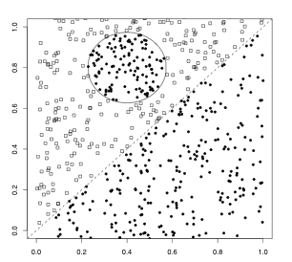
A nonlinear problem
Linear classifier like Rocchio does badly on this task.
kNN will do well (assuming enough training data)
58

Slide 59
Which classifier do I use for a given TC problem?
Is there a learning method that is optimal for all text classification problems?
No, because there is a tradeoff between bias and variance.
Factors to take into account:
How much training data is available?
How simple/complex is the problem? (linear vs. nonlinear decision boundary)
How noisy is the problem?
How stable is the problem over time?
For an unstable problem, it’s better to use a simple and robust classifier.
59

Slide 60
Outline
Recap
Feature selection
Intro vector space classification
Rocchio
kNN
Linear classifiers
> two classes

Slide 61
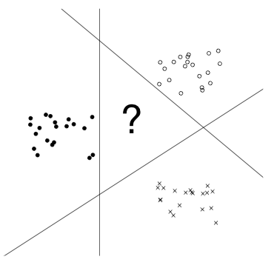
How to combine hyperplanes for > 2 classes?
61

Slide 62
One-of problems
One-of or multiclass classification
Classes are mutually exclusive.
Each document belongs to exactly one class.
Example: language of a document (assumption: no document
contains multiple languages)
62

Slide 63
One-of classification with linear classifiers
Combine two-class linear classifiers as follows for one-of classification:
Run each classifier separately
Rank classifiers (e.g., according to score)
Pick the class with the highest score
63

Slide 64
Any-of problems
Any-of or multilabel classification
A document can be a member of 0, 1, or many classes.
A decision on one class leaves decisions open on all other classes.
A type of “independence” (but not statistical independence)
Example: topic classification
Usually: make decisions on the region, on the subject area, on the industry and so on “independently”
64

Slide 65
Any-of classification with linear classifiers
Combine two-class linear classifiers as follows for any-of classification:
Simply run each two-class classifier separately on the test document and assign document accordingly
65

Slide 66
Take-away today
Feature selection for text classification: How to select a subset of available dimensions
Vector space classification: Basic idea of doing text classification for documents that are represented as vectors
Rocchio classifier: Rocchio relevance feedback idea applied to text classification
k nearest neighbor classification
Linear classifiers
More than two classes
66

Slide 67
Resources
Chapter 13 of IIR (feature selection)
Chapter 14 of IIR
Resources at http://ifnlp.org/ir
Perceptron example
General overview of text classification: Sebastiani (2002)
Text classification chapter on decision tress and perceptrons: Manning & Schütze (1999)
One of the best machine learning textbooks: Hastie, Tibshirani & Friedman (2003)
67

