Slide 1

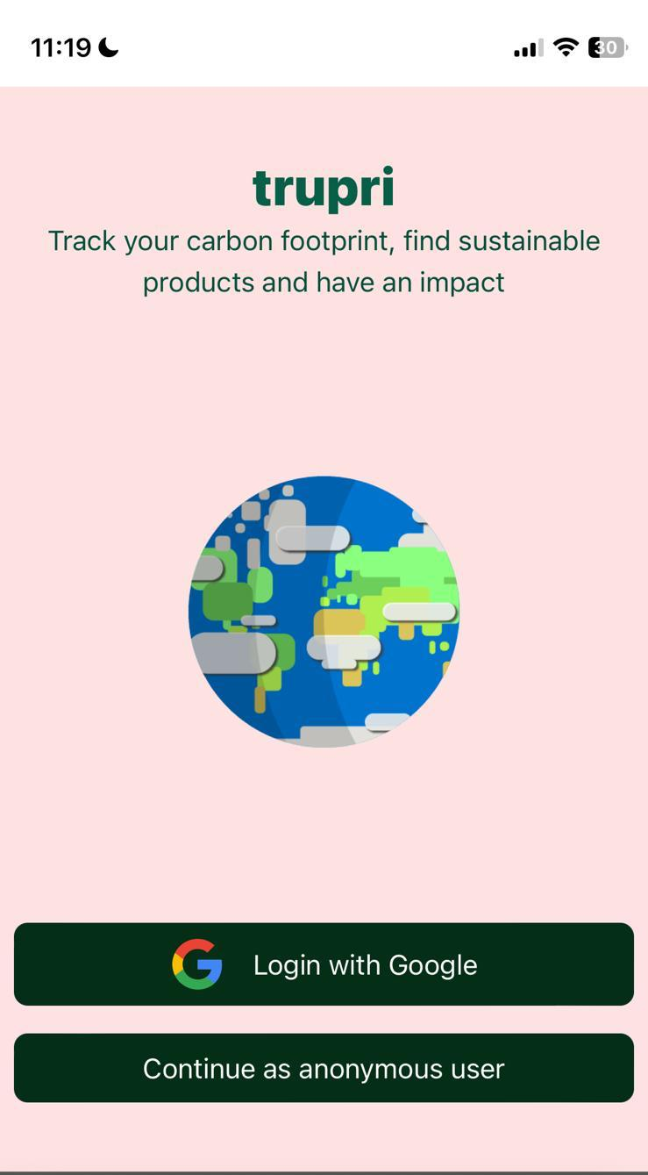
trupri
The mobile tracker of your carbon
footprint
Debug Demons:
Marius Gebert
Dmitrji Kraus
Erik Salzsieder
Egon Uhlmann
Nadine Weißflog

Slide 2




Future vision for trupri
Break into new markets
Waste Disposal
API integration
Support of more goods like clothes and household items
Expansion of database using crowdsourcing
App recommends how to properly dispose packaging
Analyze regional patterns
Coorperation with existing calorie tracker apps
Avoids double scanning of barcodes

Slide 3
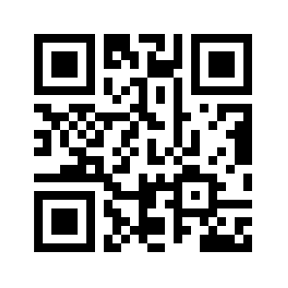
Just try it yourself

