Slide 1
Recurrent neural networks

Slide 2
Why use RNNs?
Introduces the dimension of time to neural networks
Performs well in all time series data:
  Prediction: weather, gameresults, etc.
  Classification: handwritten digits (as sequence), earthquake risk, etc.
  Generation: sine wave, music, poems

Slide 3
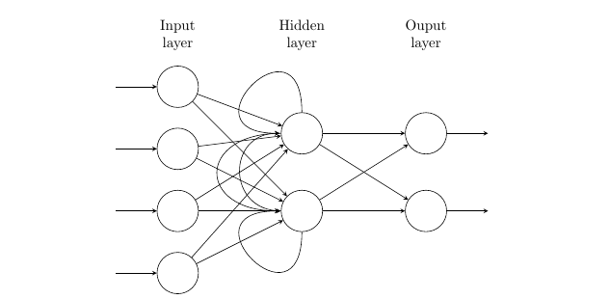
How does it work?

Slide 4
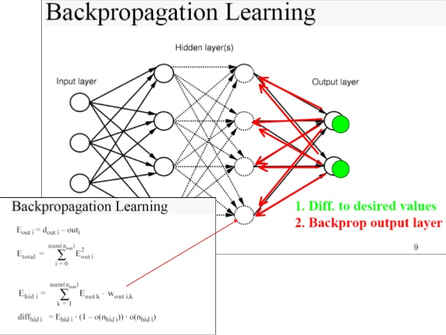
Backpropagation

Slide 5
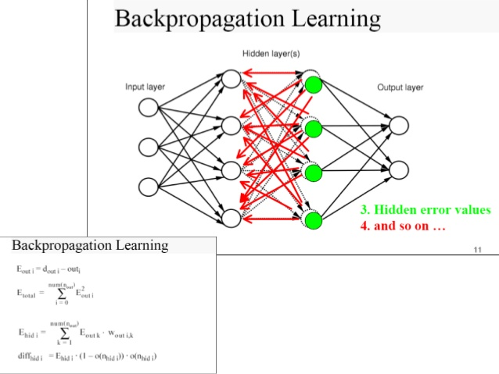

Slide 6
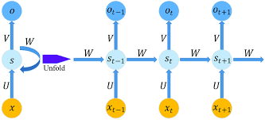
Unfold RNN

Slide 7
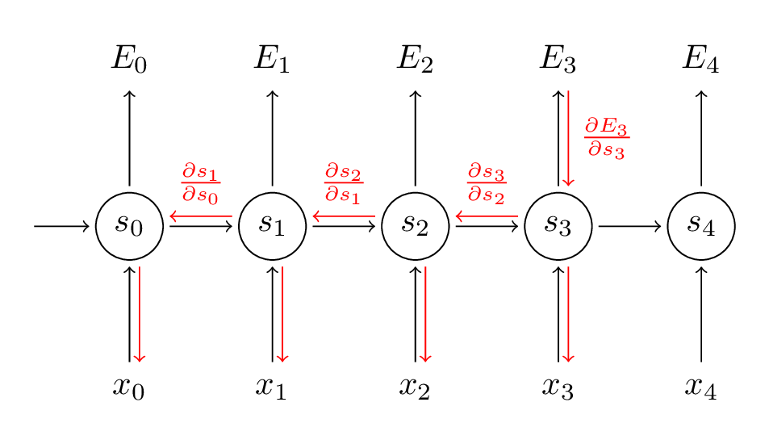
Backpropagation through time

Slide 8
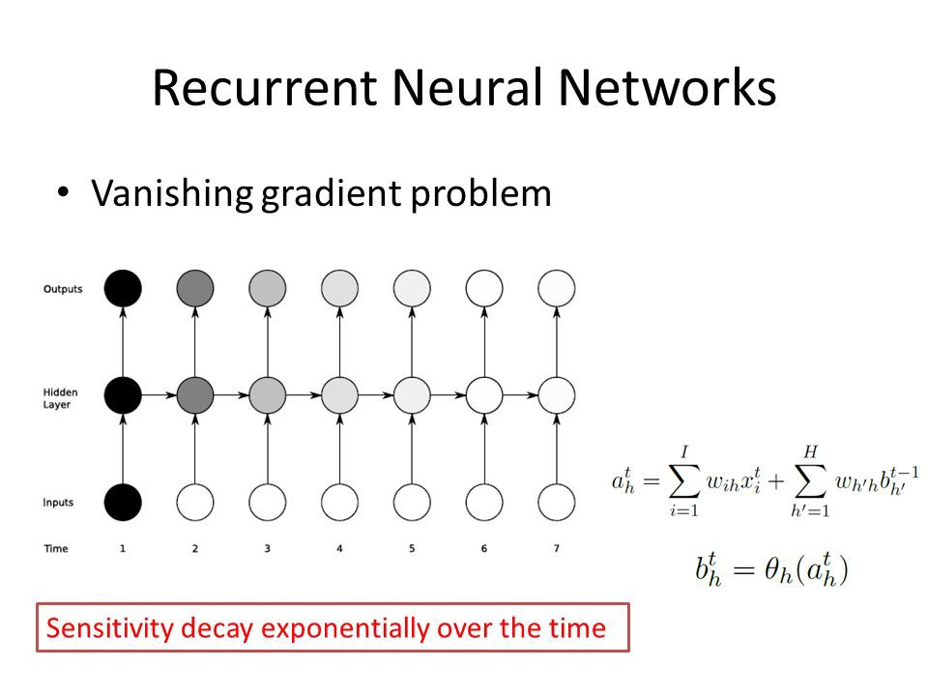

Slide 9
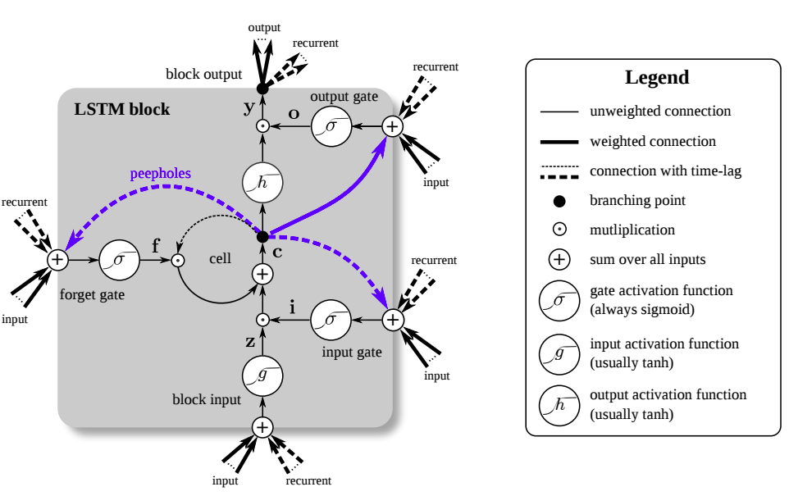
Long Short-Term Memory (LSTM)

Slide 10
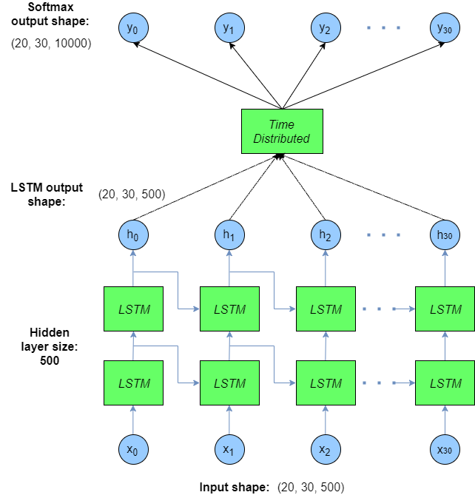
Full LSTM network

Slide 11
Live presentation

