Slide 1
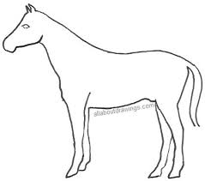


VS
#training samples child << #training samples CNN
Conceptual learning child > Conceptual learning CNN

