Slide 1




object relational mapper for .NET
© voidsoft 2004-2005

Slide 2
_
what is DataBlock ?
what it can do for you ?
features.
working with DataBlock. API samples
questions

Slide 3
What is DataBlock ?
powerful, high performance data persistence framework
object/relational mapping tool for .NET 2.0

Slide 4
What it can do for you ?
no need to write data access code
no SQL, no stored procedures
concentrate on business logic
improves developer productivity
write independent database code
think objects not SQL.
no ADO.NET code

Slide 5
Features
supports Access, SqlServer and MySql
object oriented query language
visual tool (DataBlock Modeler) for mapping which supports code generation in both VB.NET and C#
simple and straightforward API

Slide 6
Features
works both in connected and disconnected mode for maximum performance
supports caching to improve performance
generic database provider. Allows swapping of multiple providers for the same database server.

Slide 7
Features
reads data in multiple formats : DataSets, mapping objects and IList / IDictionary.
no mocking around with xml files. Everything compiles into an assembly
support for ADO.NET transactions.

Slide 8
Features
leverage/Interops with already written ADO.NET code
supports for all types of relations.
VERY extensible. Use stored procedures instead of parametrized queries if you want. You have runtime access to generated sql queries.

Slide 9
Features
allows you to create long running transactionable operations.
the developer is always in control. Work with data the way YOU want.
small footprint. DataBlock is a 100 kilobytes library.
support for hierarchical database operations

Slide 10
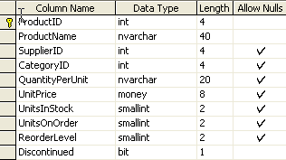
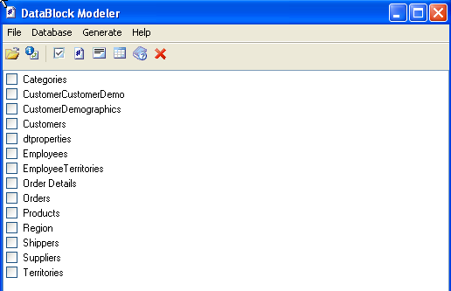
Working with.
Start with the database schema
Create the schema of your database. Let’s take as an
example the “Products” table of the Northwind database.
With DataBlock Modeler we generate the mapping files
Start DataBlock Modeler, connect to the database and generate
the mapping files for your entities. The tool can generate
both C# and VB.NET code.

Slide 11

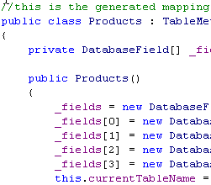

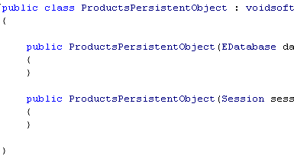
Working with. API samples
Generated Mapping objects. Workflow
Products.cs
Product
Product
Product
PersistentProduct
ProductsPersistentObject.cs
Database

Slide 12
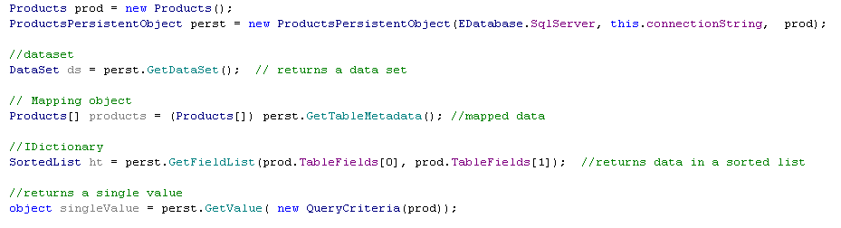
Working with. API samples
Read data. A single line of code.

Slide 13

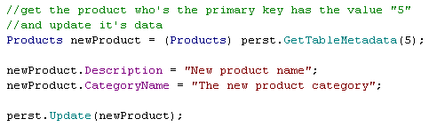

Working with. API samples
Create
Update
Delete

Slide 14

Working with. API samples
QueryCriteria – Object Oriented way to write criteria queries.
Becomes
SELECT Products.ProductID, Products.ProductName, Products.SupplierId, Products.
CategoryId, Products.QuantityPerUnit, Products.UnitPrice, Products.UnitsInStock,
Products.UnitsOnOrder, Products.ReorderLevel, Products.Discontinued
FROM Products
WHERE
Products.ProductId < 36 AND
Products.SupplierId > 50 AND
Products.ProductName LIKE ‘Chai%’

Slide 15

About
visit us at www.voidsoft.ro
Contact us at gmarius@gmail.com

